Slide 1
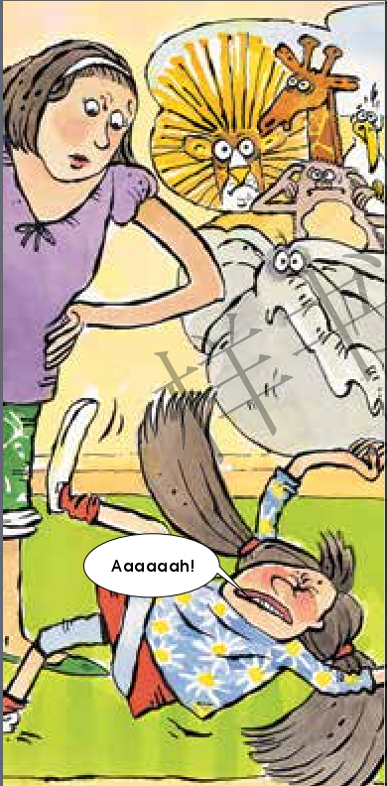
Tilly’s
Tantrum
爱发脾气的蒂莉
选自
《多维阅读第8级》

Slide 2
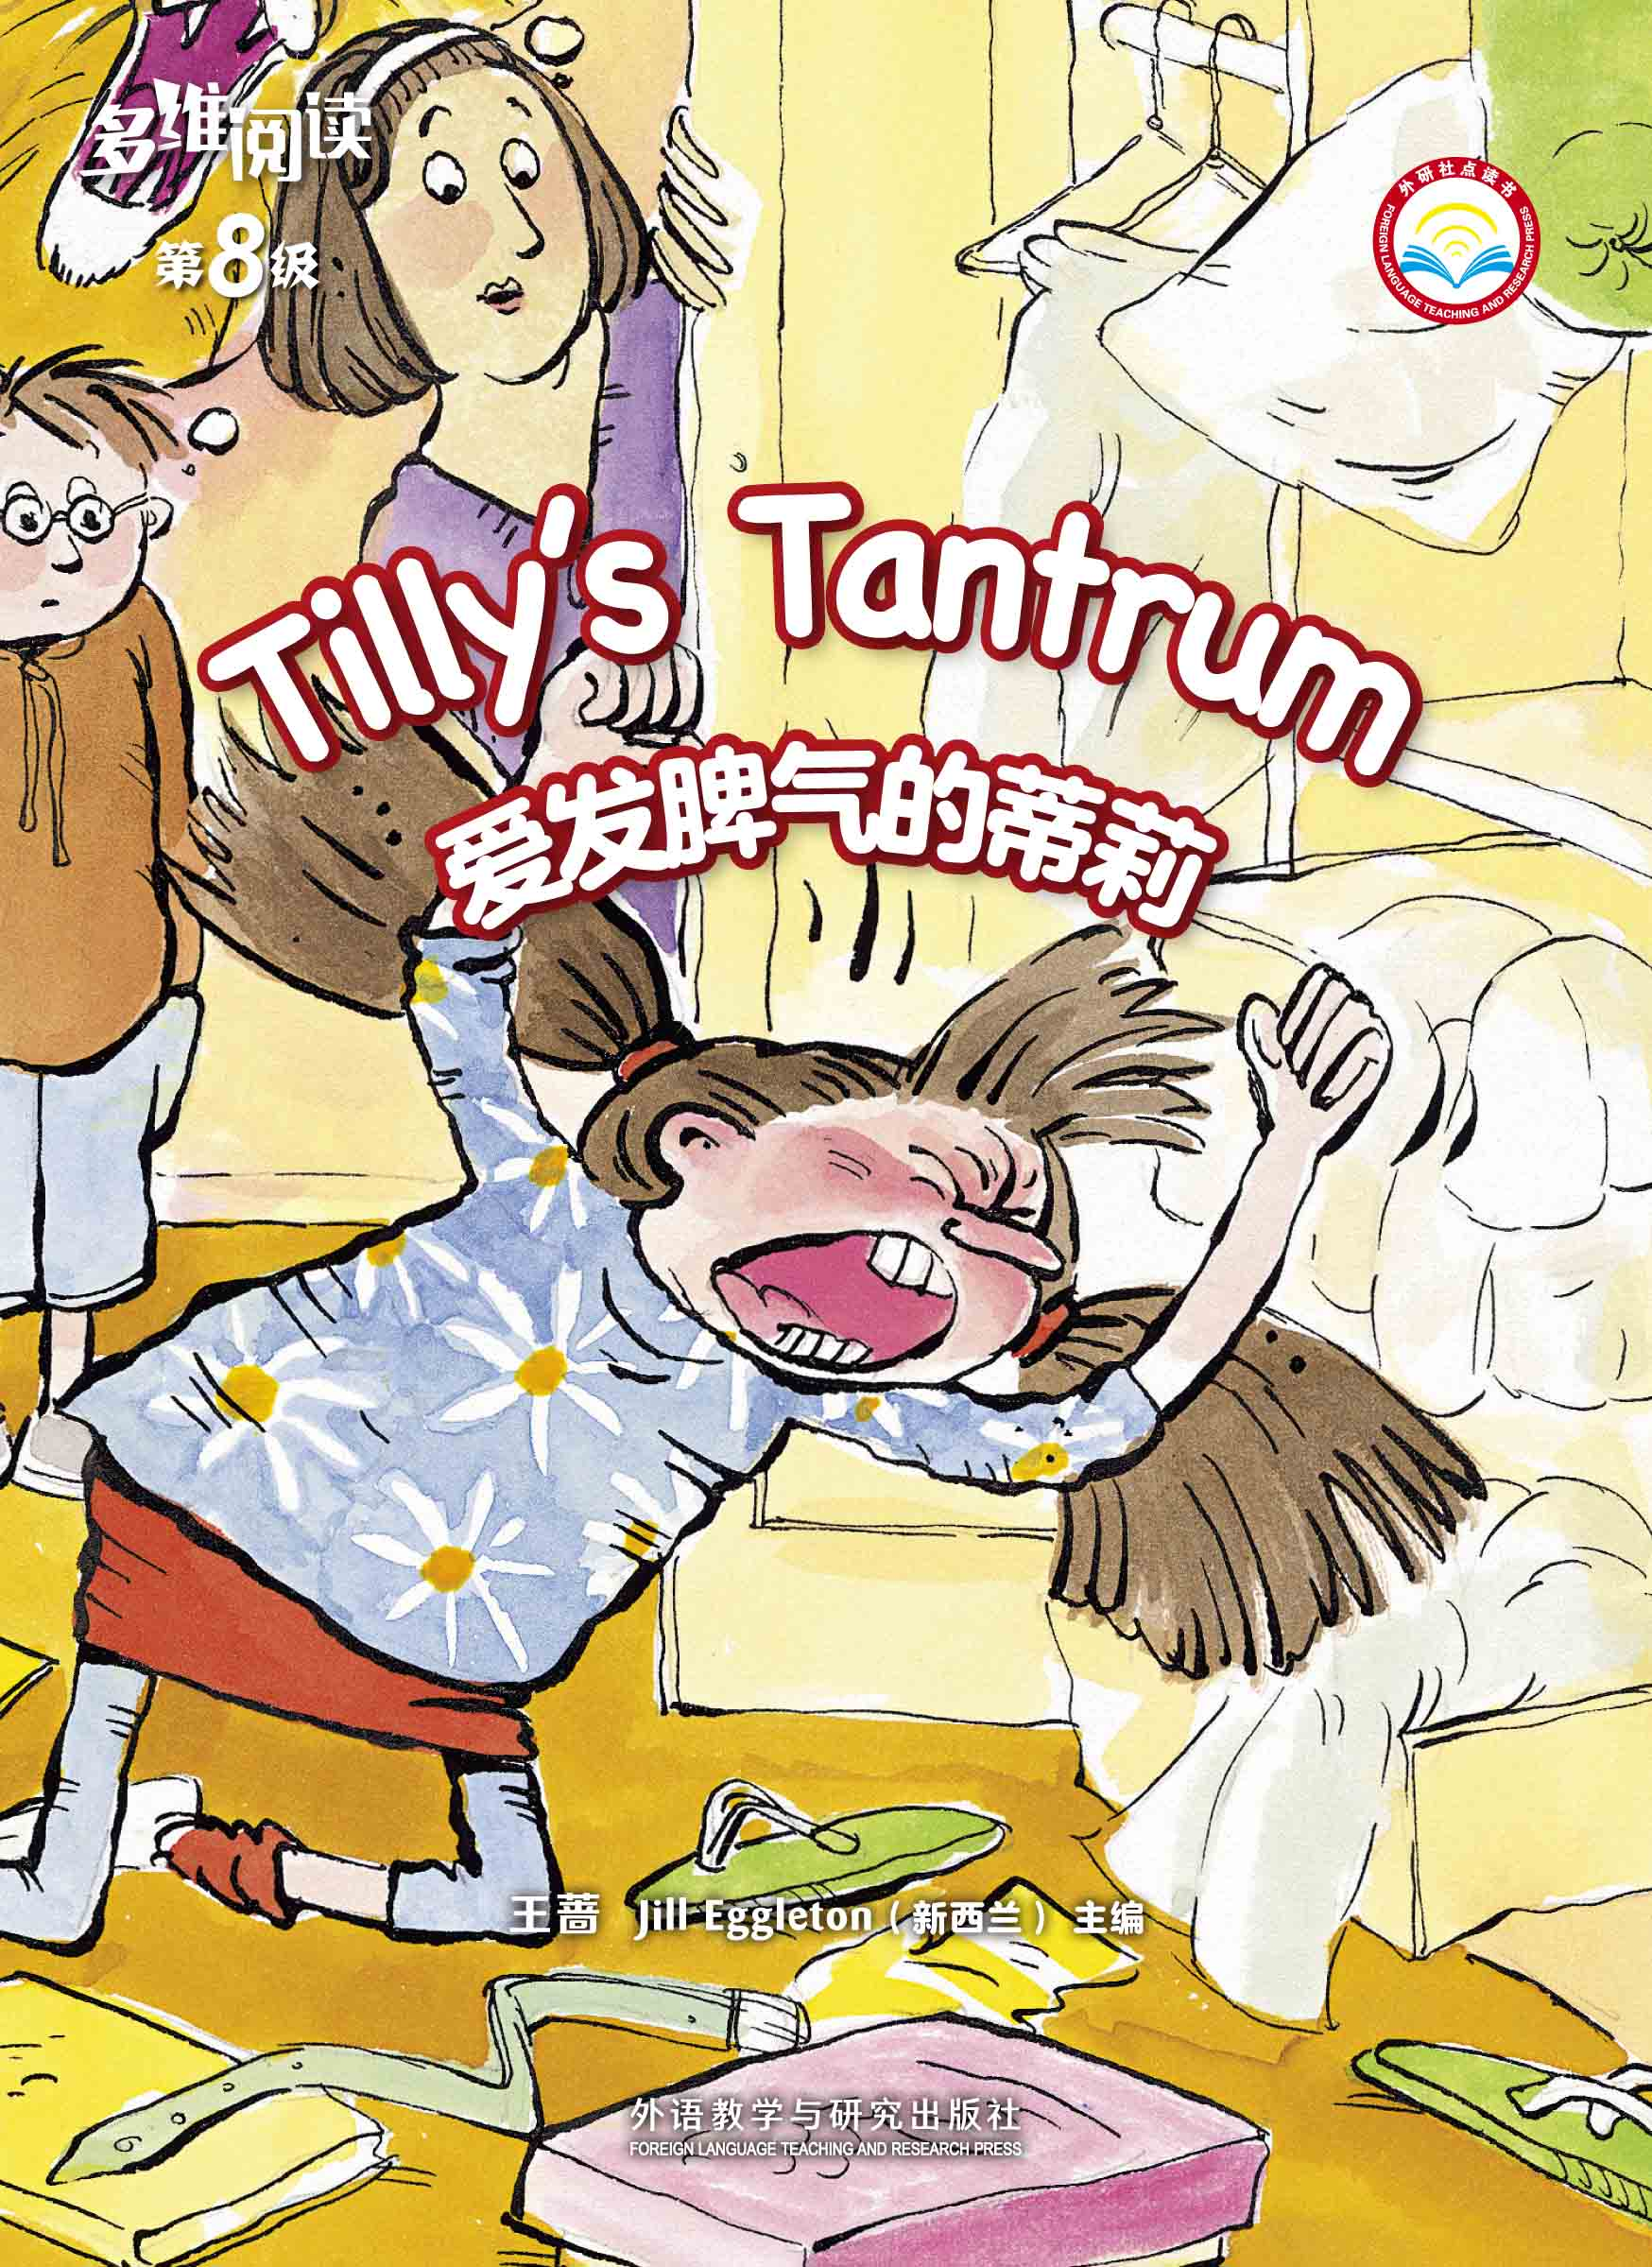
What do you know from the cover?
Title
Author

Slide 3
What do you think the meaning of the title is?
Tilly
very angry
When do you often have a tantrum?

Slide 4
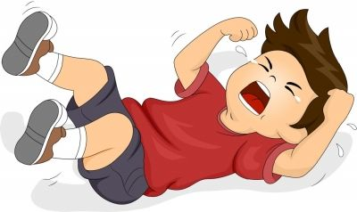
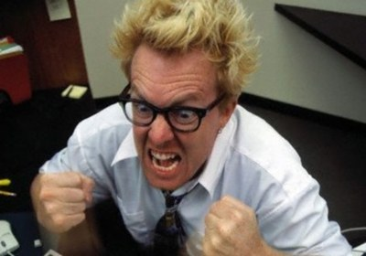
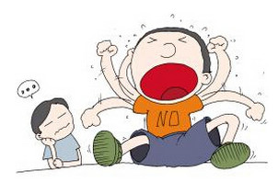
have a tantrum

Slide 5
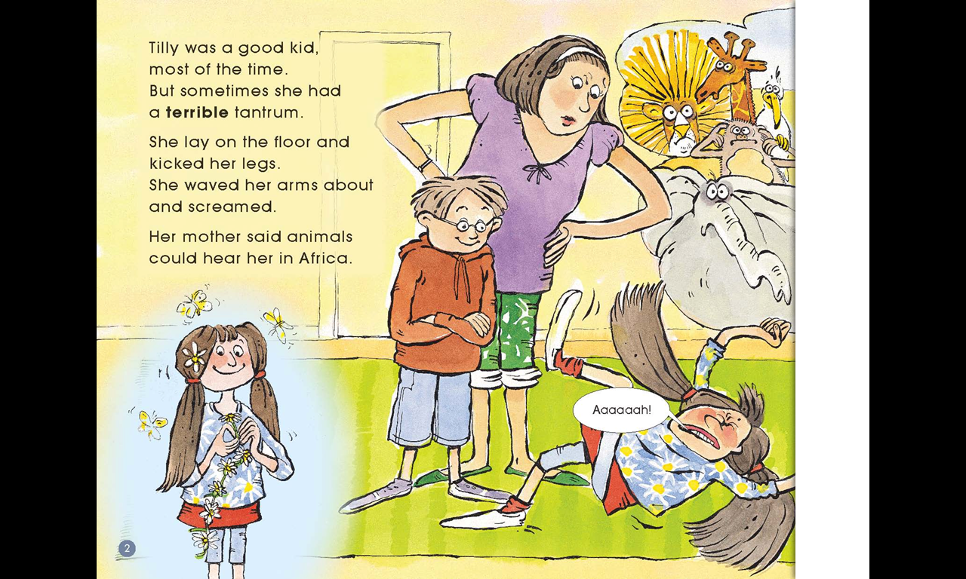
What did Tilly do when she had a tantrum?
What did her mom and brother do with her?
lay
kicked
waved
screamed
a good kid
had a terrible tantrum

Slide 6
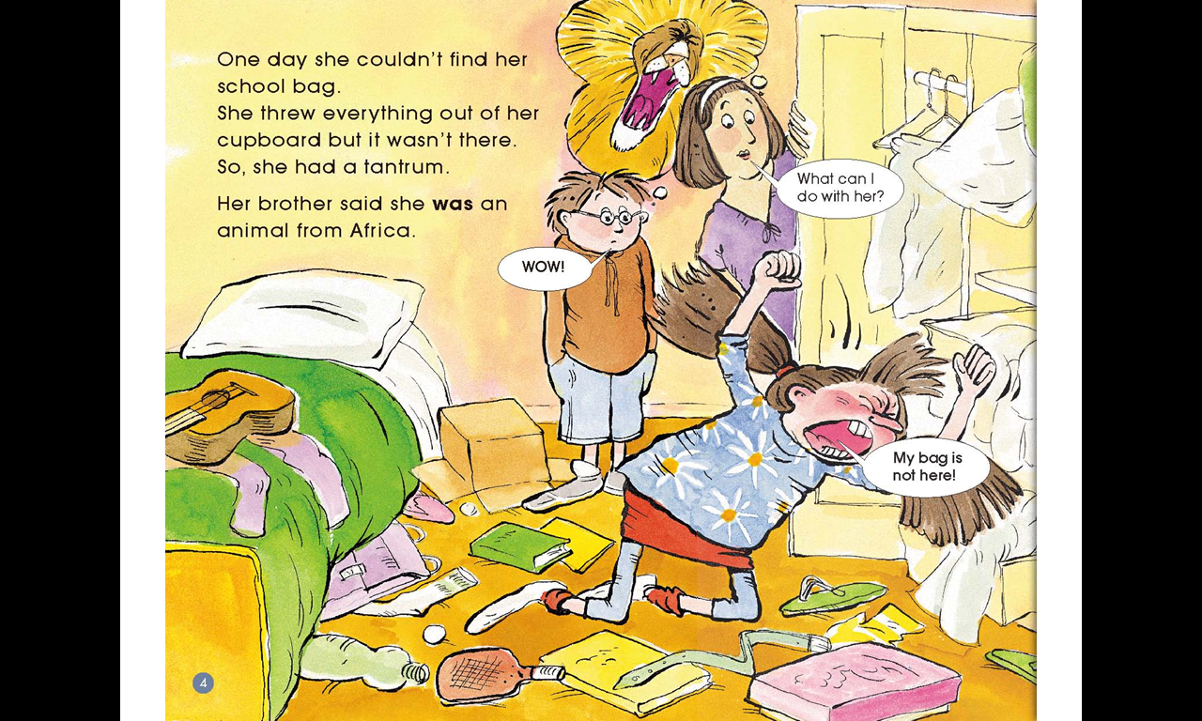
Why did Tilly have a tantrum?
What did she do?
What did her brother think of her?

Slide 7
Read and say in groups
Tilly sometimes had a tantrum.
Tilly was a good kid, most of the time.
But sometimes she had a terrible tantrum.
…
One day, …

Slide 8
Read and discuss
in groups
1. Read pages 6-13 by yourself
2. Answer the questions in groups
(1) Who came to their home?
(2) What games did they play?
(3) What happened to Ben?
(4) What did Tilly think of Ben’s tantrum?

Slide 9
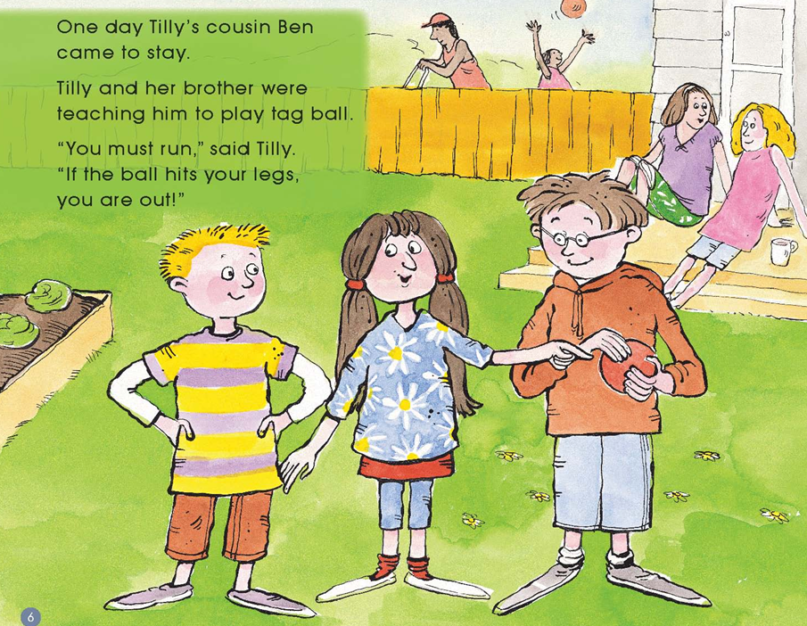
What’s the rule of the game?
tag ball

Slide 10
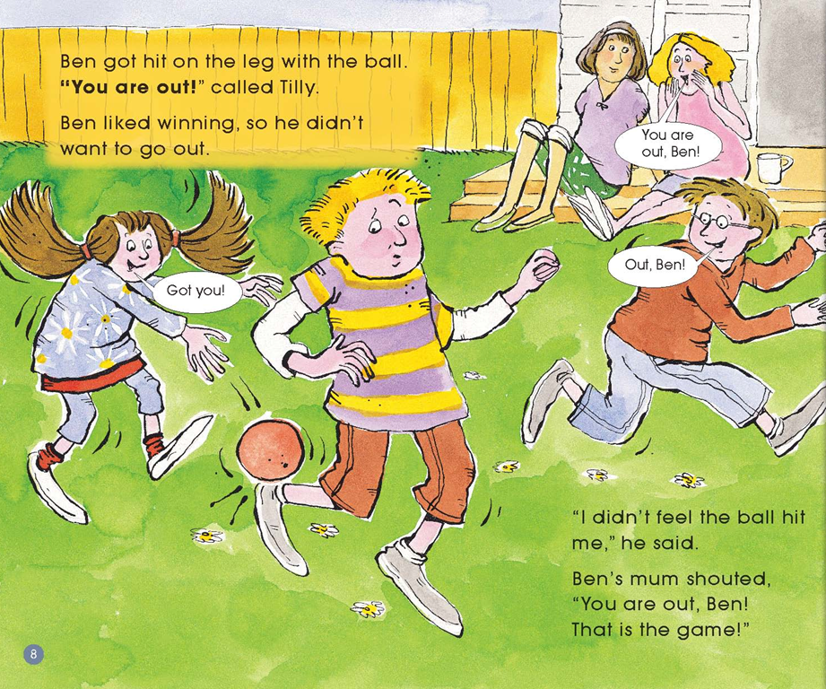
got hit on the leg

Slide 11
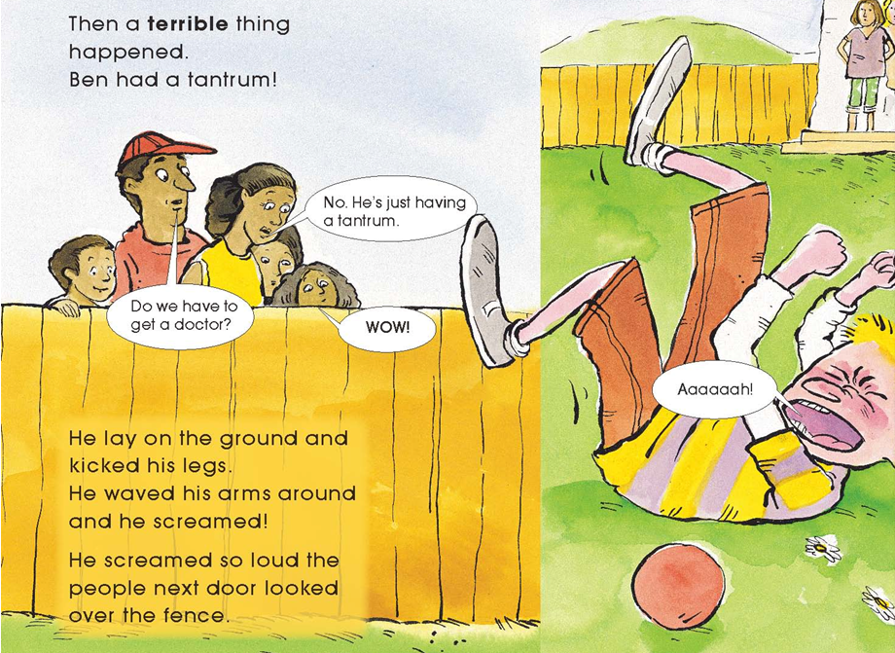
What do you think of Ben?

Slide 12
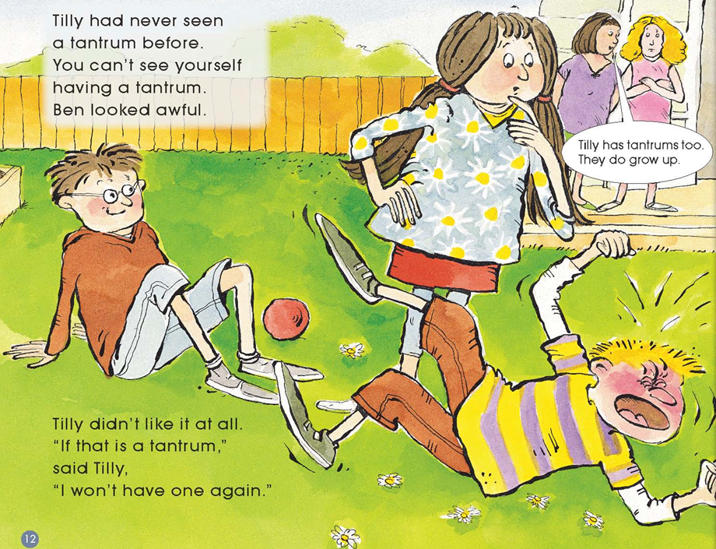
Had Tilly seen a tantrum before?
looked awful

Slide 13
Read and say in groups
Tilly disliked Ben’s tantrum.
One day Tilly’s cousin Ben came to stay.
...
Tilly disliked Ben’s tantrum.

Slide 14
Think and predict
Predict:
What’s the end of the story?

Slide 15
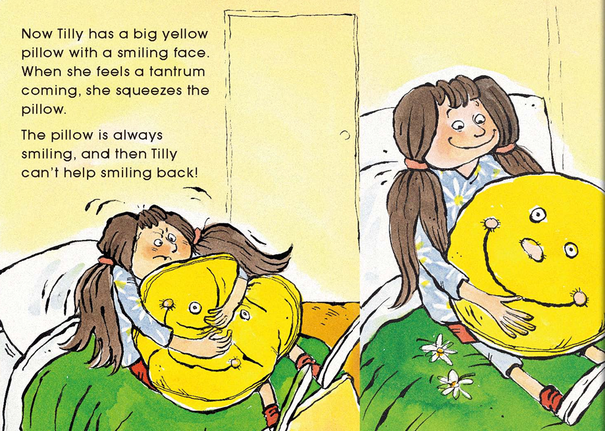
What does Tilly do when she feels a tantrum coming?
What is the pillow like?
squeeze the pillow

Slide 16
Read and say in groups
Tilly controlled her tantrum.
Now Tilly …
When she feels…
The pillow is always …

Slide 17
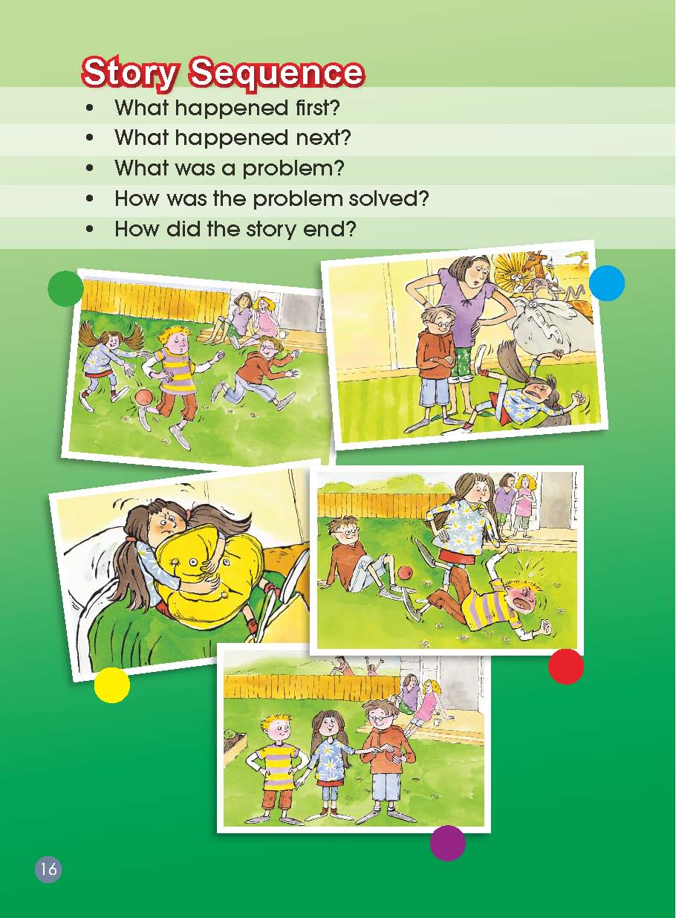
Story Sequence
What happened first? What happened next? What was a problem? How was the problem solved? How did the story end?

Slide 18
Reading Circles
Word master:
Write the words and expressions about a
tantrum in the box.
Summarizer :
Retell the story according to the story map.

Slide 19
Reading Circles
Cultural connector:
If you have a tantrum, will your family do like Tilly’s family ?
What did Tilly’s mom and brother do when Tilly had a tantrum?
If you were Tilly, what would your mom and brother do?
Creative connector:
If you were Tilly, what will you do when your tantrum is coming?
Please share your experiences:
When my tantrum is coming, I will stay in my room and stay alone.
When my tantrum is coming, I will shout at the trees.
…

Slide 20
Act and discuss
Act in groups:
Tilly had two different attitudes in the story when her tantrum
was coming.
Discuss in groups:
List the right way to deal with the terrible tantrum.
When I feel mad, I could …
When my tantrum is coming, I could …

Slide 21
Homework
1. Act or retell the story.
2. Make a list: How to control your tantrum.

