Slide 1
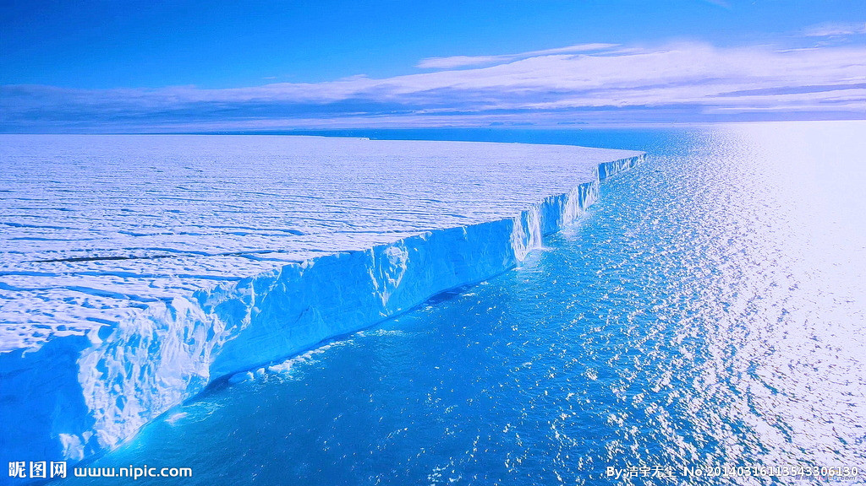
Knut
A Pet or Not?
北极熊克努特
选自《多维阅读第8级》

Slide 2
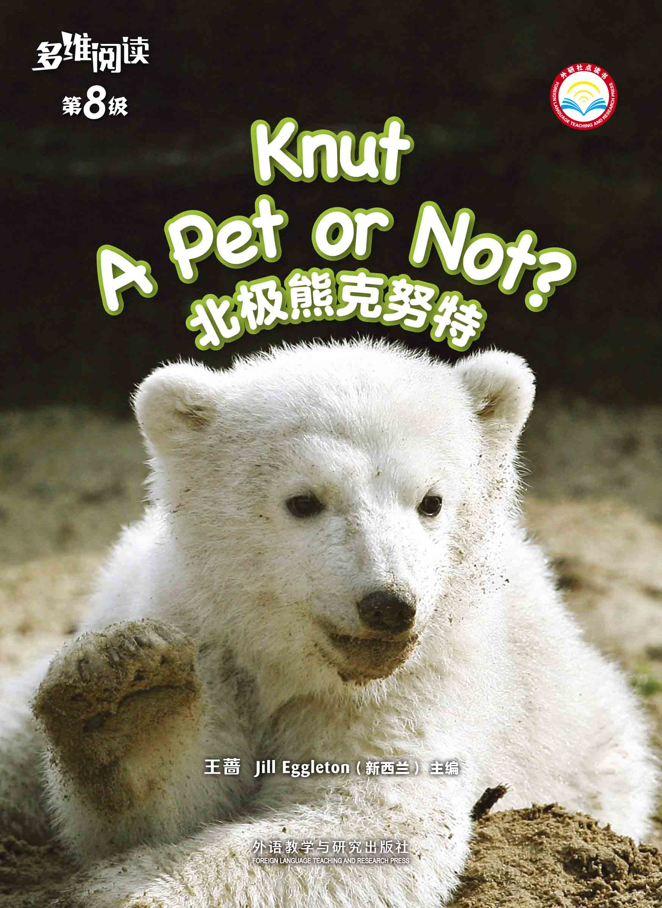
What do you know from the cover?
Title
Author

Slide 3
What do you know about polar bears?
Who is Knut?
What’s this?

Slide 4
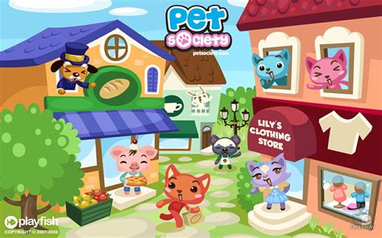
What is a pet?
Do you keep a pet?
What is a pet like?
Is Knut a pet or not?
What happened to Knut?

Slide 5
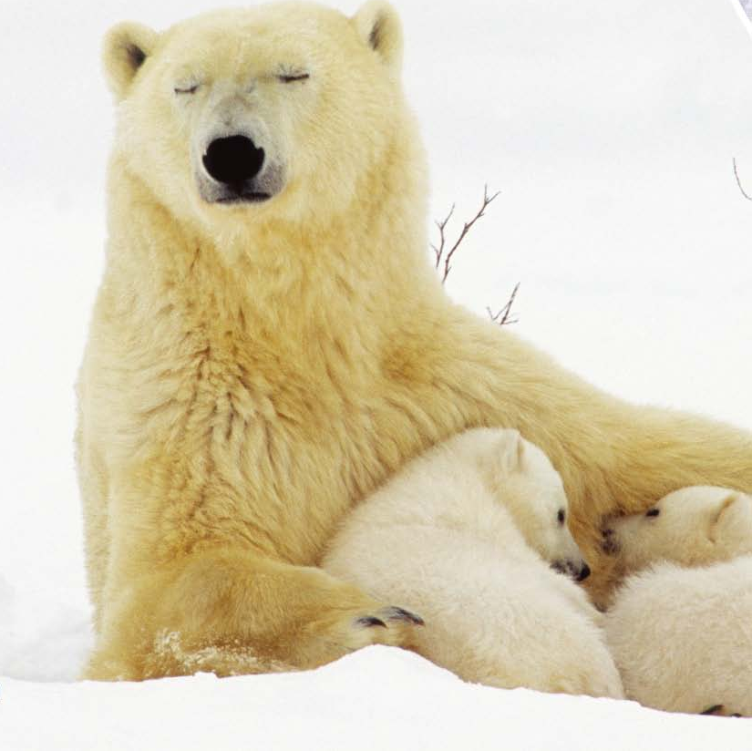
Read Pages 2 - 3
What are the babies called?
Where are they born?
Do you think the cubs
need a mother? Why?
If you saw one in the wild,
would you go up to it and pet it? Why or why not?

Slide 6
Read Pages 4-5
Most polar bears…
a den
mother
But Knut…
a zoo
mother

Slide 7
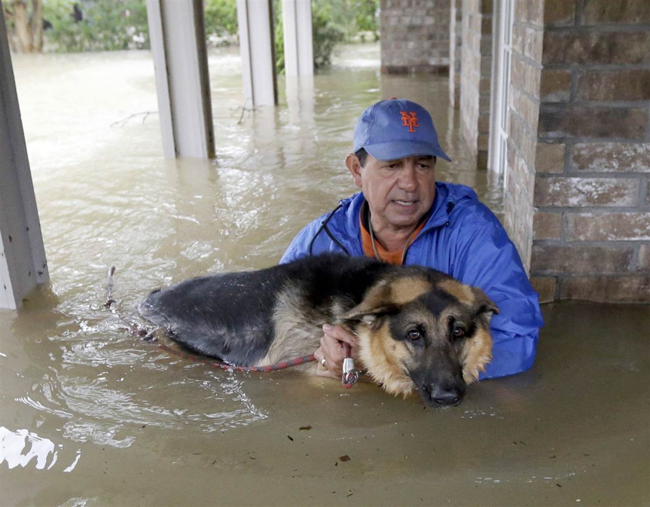
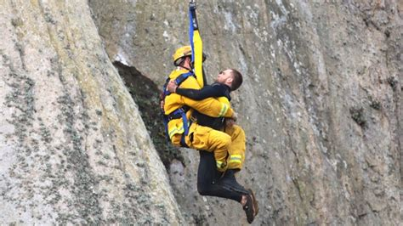
Read Pages 6-7
How could Knut be rescued?
Who is rescued?
The dog is rescued.

Slide 8
Read Pages 8-9
How could Knut be rescued?
Is it hard work?
Who’s he?
What did he have to do for Knut?
What do you think is happening?

Slide 9
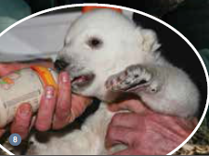
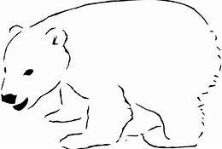
born in
fed by
looked after by
play with
feeling
How do Knut and wild polar bear cubs grow up?

Slide 10
Read Pages 10-11
What were all the people doing?
What made Knut a superstar?
How do you know Knut likes Thomas?

Slide 11
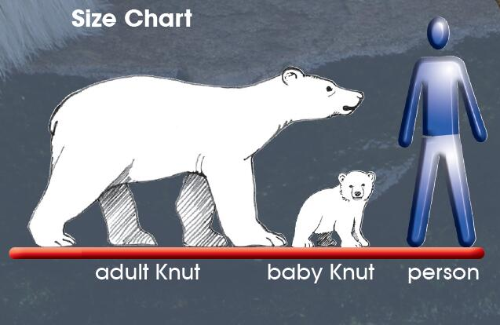
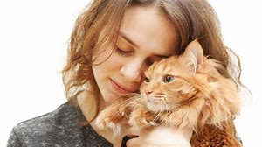
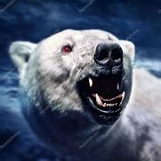
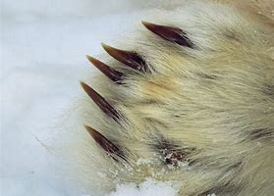
Read Pages 14-15
What do you know
from this chart?
Do you think
he was a pet?

Slide 12
Do you agree with these people?
Why? / Why not?
In the wild or at the zoo

Slide 13
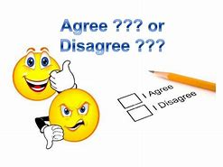
Is it okay to have a different idea about something to someone else?
Are you always right?

Slide 14
Why is the book titled…?
What can we do
to protect
wild animals?
Why does the author write the book?

Slide 15
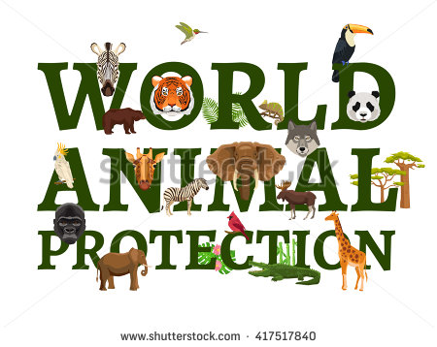
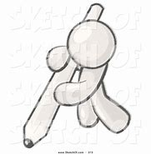
Homework
Make a poster
2. Draw and write one reason for having Knut looked after in the zoo and one reason that is against it.

