Slide 1
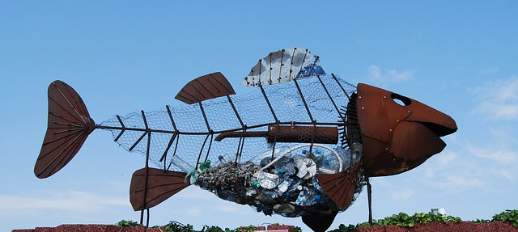
The Junk Raft Journey
海上的垃圾船
选自《多维阅读第8级》

Slide 2
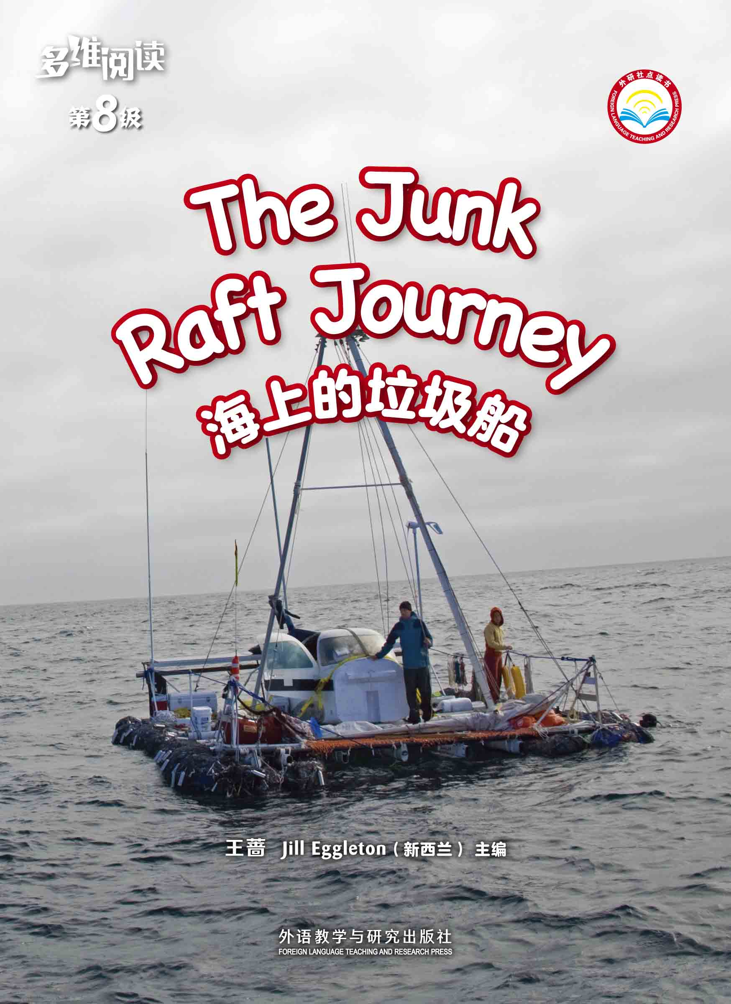
What do you know from the cover?

Slide 3
Read Pages 2-3
What does “a junk dump in the sea” mean?

Slide 4
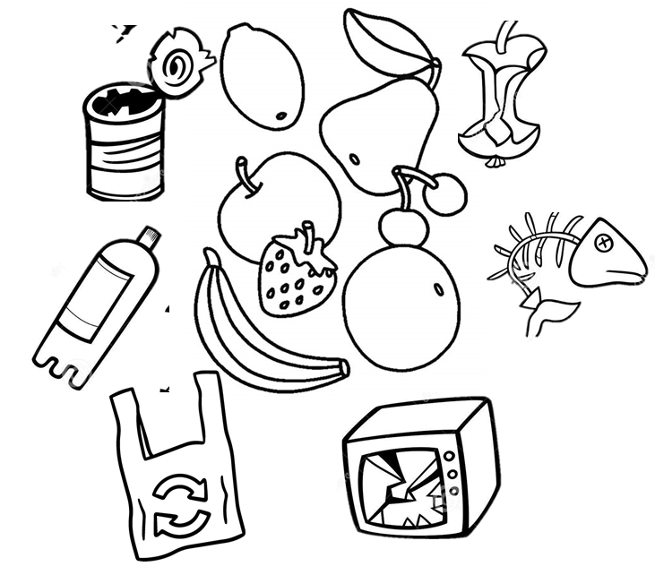
Circle the junk from the pictures below.

Slide 5
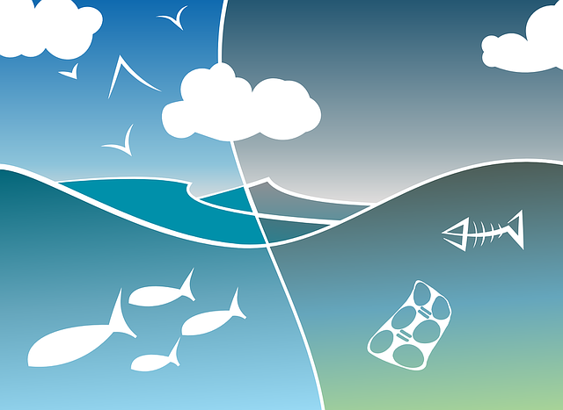
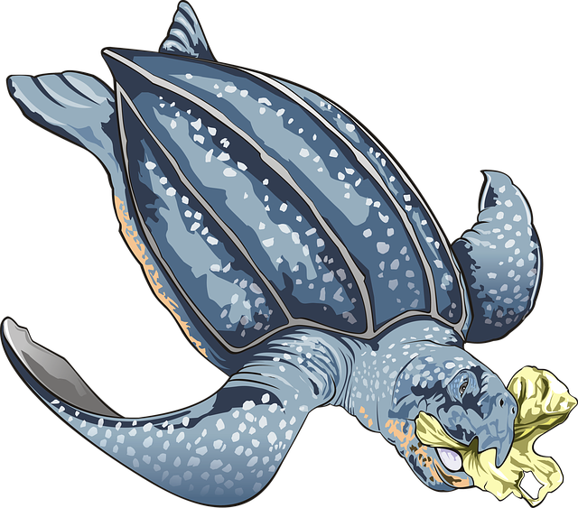
Why do you think people shouldn’t throw junk in the ocean?

Slide 6
What do you want to know about this journey in a raft made of junk?

Slide 7
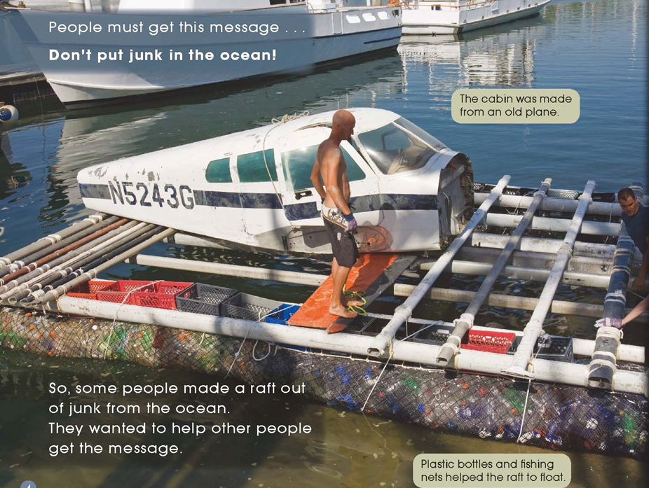
Read Pages 4-5
What junk can you see on this raft?

Slide 8
Read Pages 6-7
What problem or danger might happen to the raft?

Slide 9
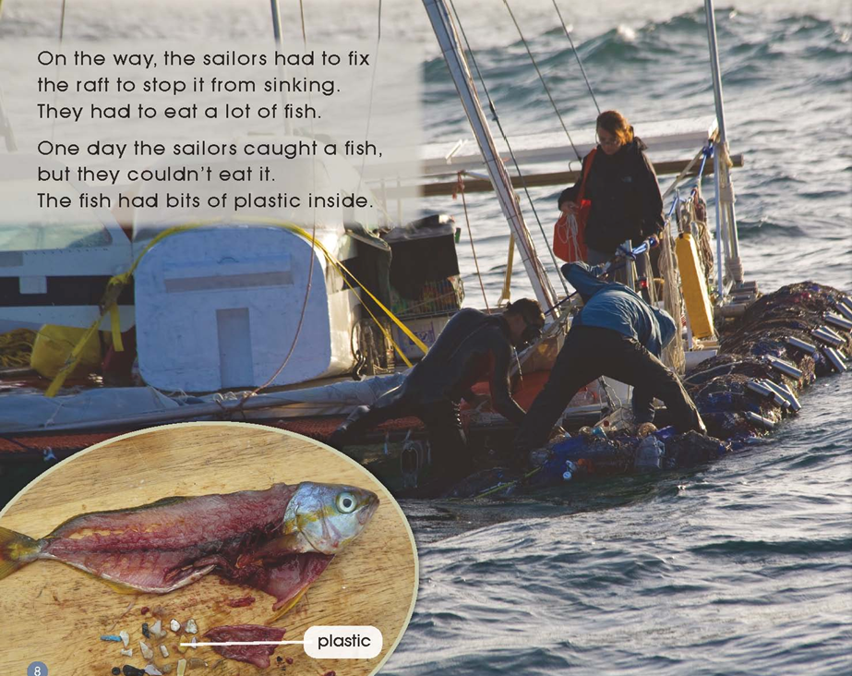
Read Pages 8-9
Was the journey an easy one for the sailors?
Why do you think so?

Slide 10
Read Pages 10-11
Why did the sailors put water in a jar?
How would people feel when they saw the water?

Slide 11
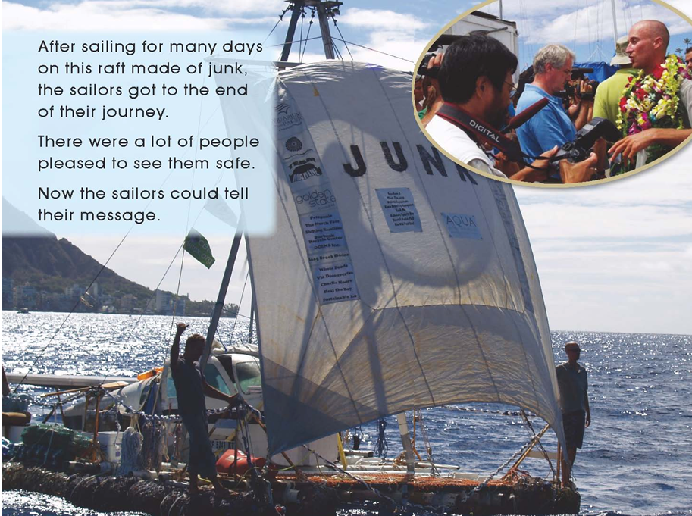
Read Pages 12-13
What do you see happening here?
How do you know this was a long journey?

Slide 12
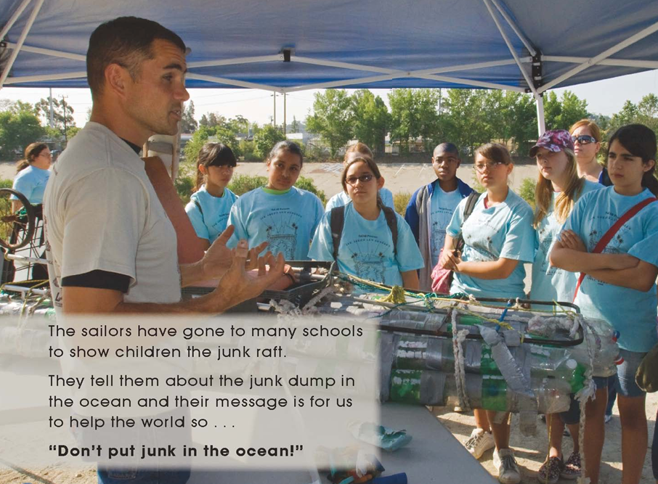
Read Pages 14-15
Why do the sailors want to send out this message?

Slide 13
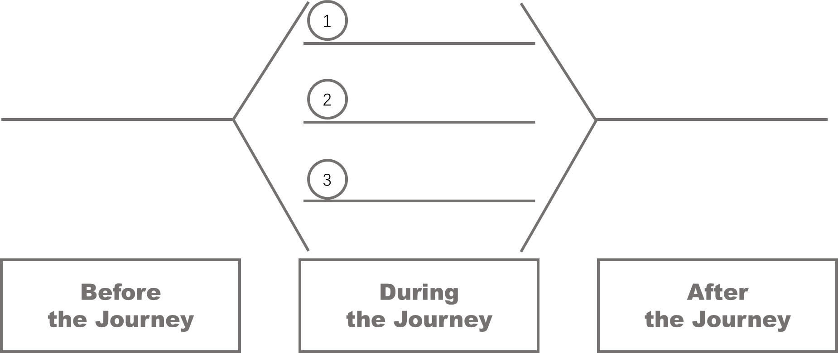
Finish the graphic organizer below.

Slide 14
Do you think this is a good way
to protect the environment of the ocean?

Slide 15
Homework
1. Made a poster to tell people how important it is to protect the environment.
2. Find more activities to protect the environment on the Internet with your friends.

