Slide 1
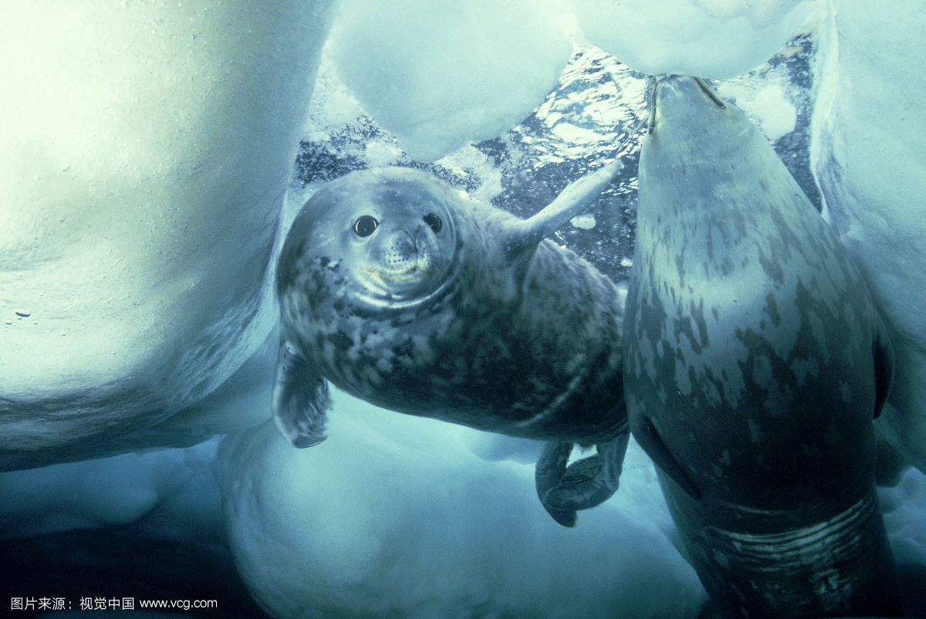
The Battle to Breathe
呼吸孔争夺战
选自《多维阅读第8级》

Slide 2
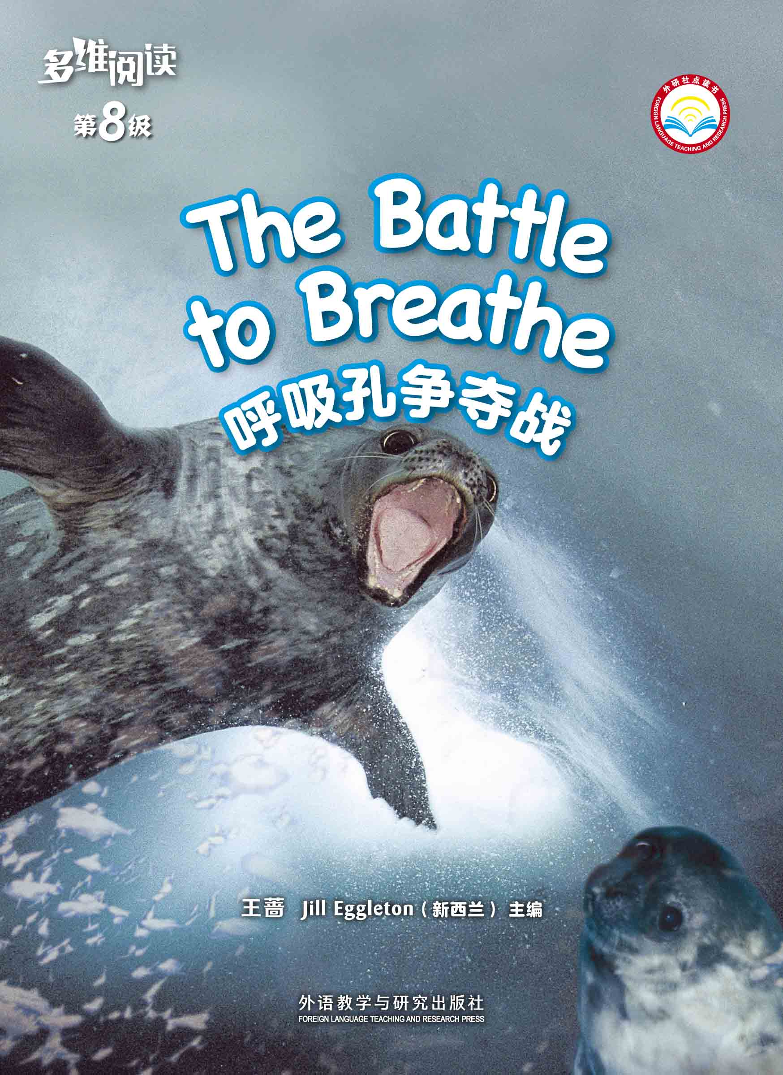
What’s this in the picture?
What do you know from the cover?

Slide 3
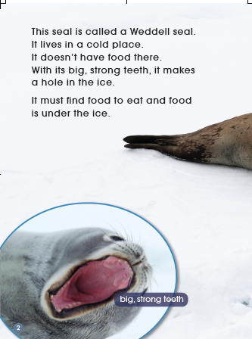
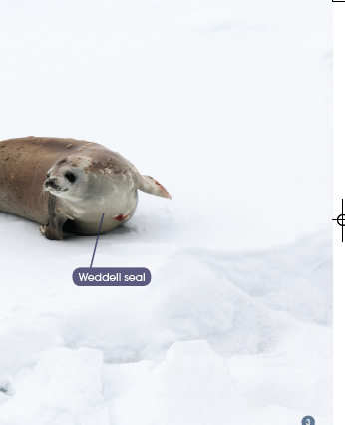
Read Pages 2-7

Slide 4
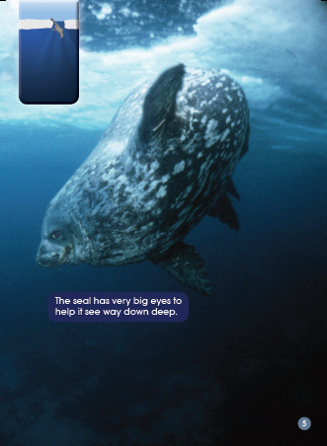
Read Pages 2-7

Slide 5
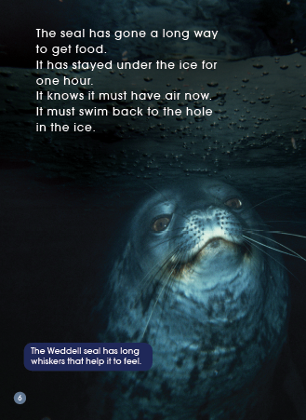
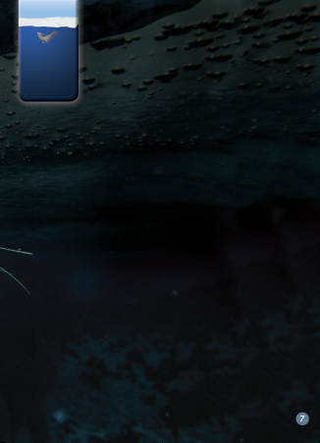
Read Pages 2-7

Slide 6
Read Pages 2-7
Draw a body part map of a Weddell seal and write words to describe it.
Draw a picture here.

Slide 7
Read Pages 2-7
Answer the questions
1. How could a Weddell seal make a hole
through the ice?
2. How does a Weddell seal find food?
What does it eat?
3. How long has the Weddell seal stayed under the ice?

Slide 8
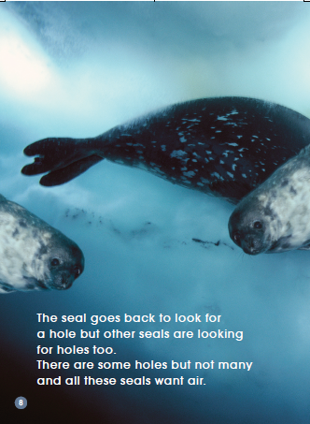
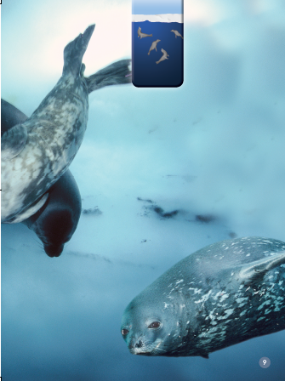
Read Pages 8-13
What is the problem?

Slide 9
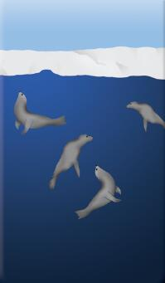
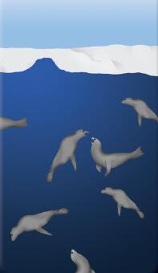
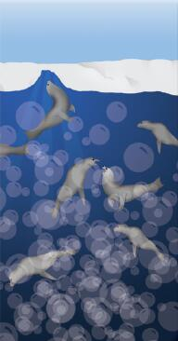
Read Pages 8-13
What information can you get
from these diagrams ?

Slide 10
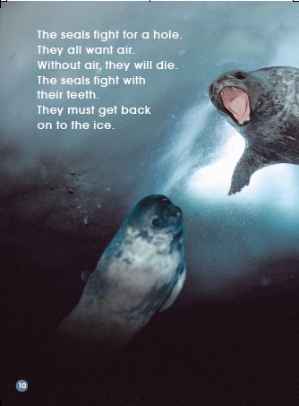
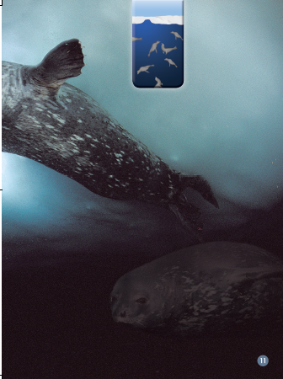
Read Pages 8-13
How do the seals fight?

Slide 11
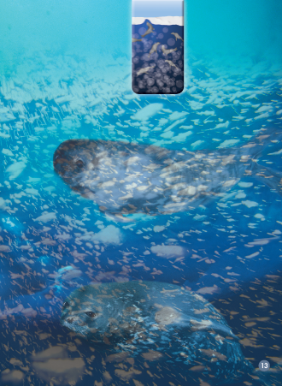
Read Pages 8-13
Do you think the bubbles could be a problem
for the seals? Why or why not?

Slide 12
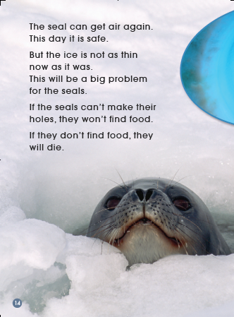
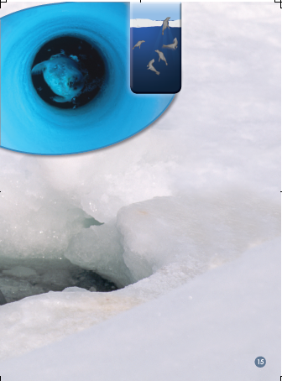
Read Pages 14-15
What’s the new problem for
the Weddell seal?

Slide 13
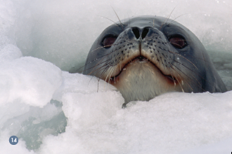
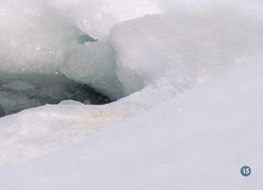
Additional information
The ice is not so thin now because all the extra ice from a big iceberg has joined on to the part of Antarctica where the seals live.

Slide 14
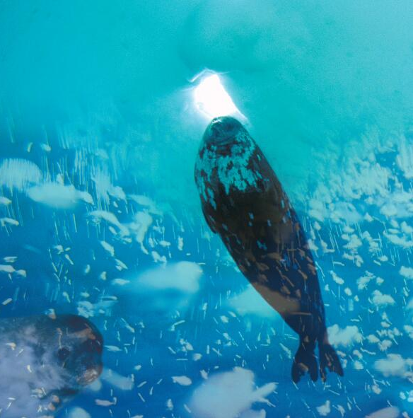
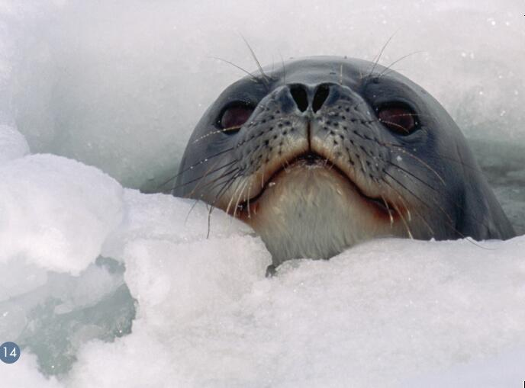
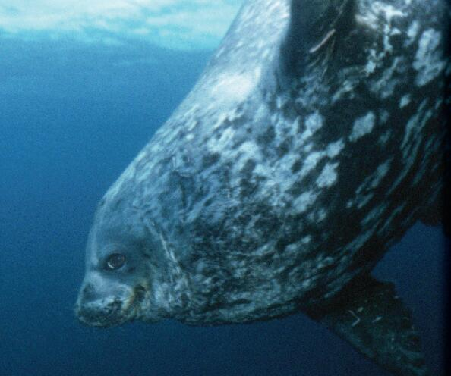
Reorder the pictures according to the book.
Use key words to describe the pictures.
3
4
1
2

Slide 15
Retell the story of the Weddell seals
big, strong teeth
very big eyes
long whiskers
lived in Antarctica
makes a hole in the ice with its teeth
goes down for food
must swim back after one hour
looks for the hole
fights for the hole
Life becomes
much harder.
gets air again
is safe
goes up to
the little hole

Slide 16
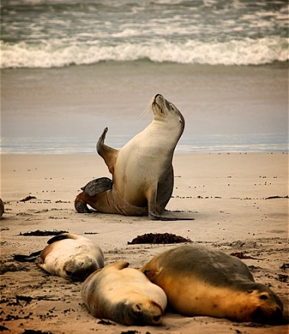
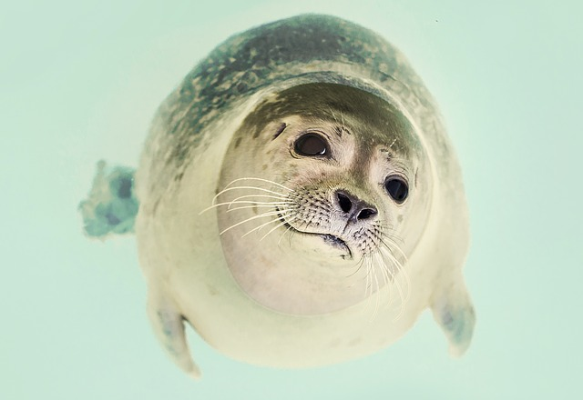
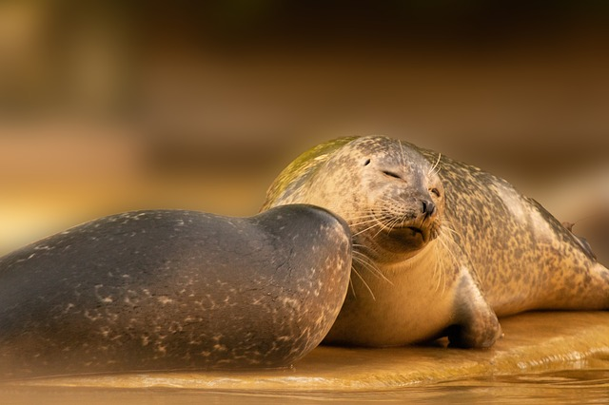
Let’s discuss
Do you like Weddell seals?
Why or why not?
Why does the author write this book?
Weddell seals struggle to live.
What do you need to live?
How do you get it?

Slide 17
Homework
Listen and read.
Make a poster about Weddell seals.

