Slide 1
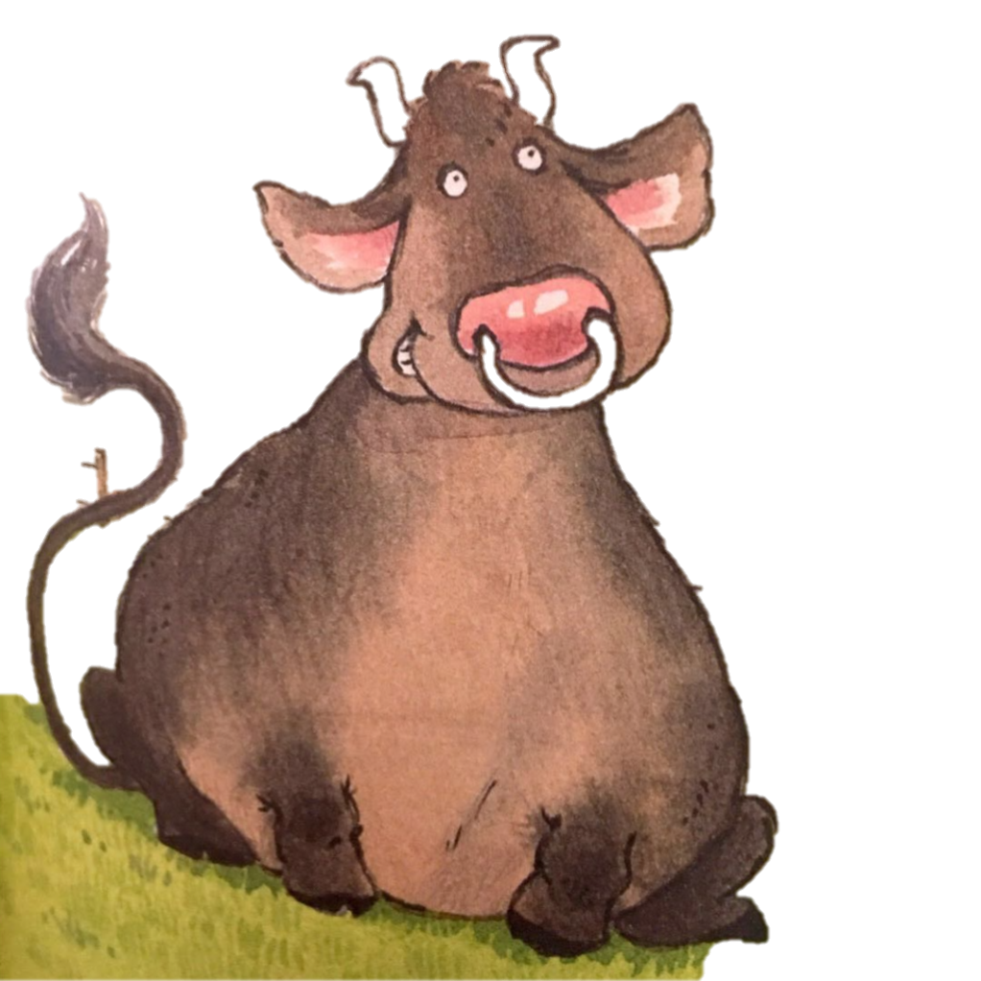
Big Bull Gets Bored
选自《多维阅读第7级》

Slide 2
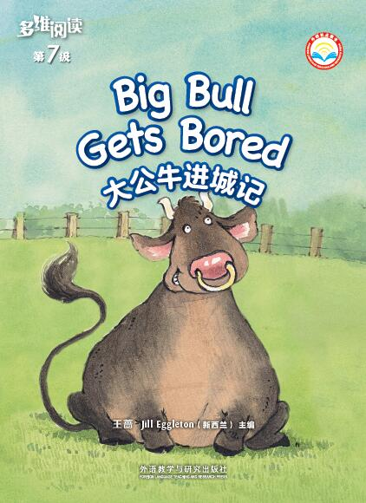
Title
Author

Slide 3
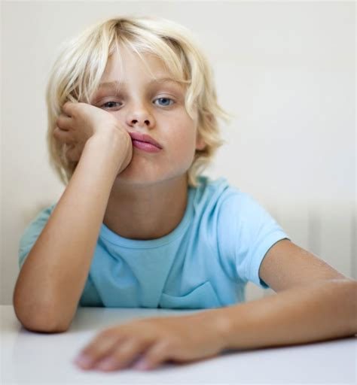
bored

Slide 4
bored

Slide 5
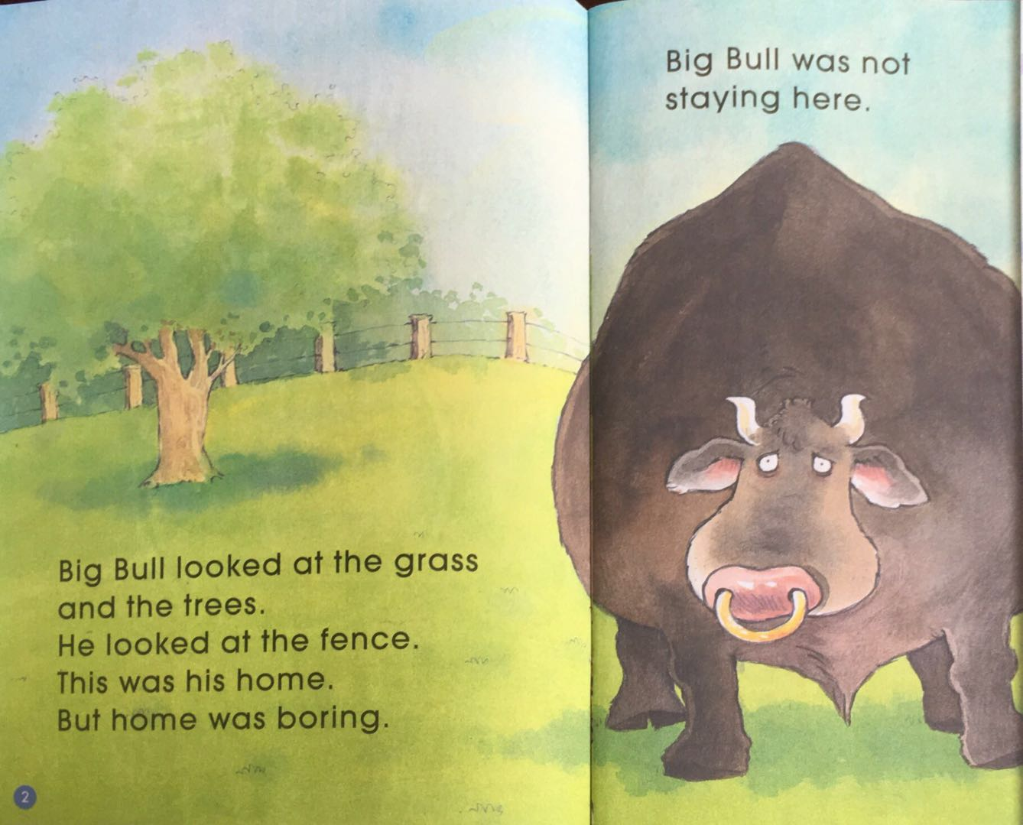
Where does the beginning of the story take place?

Slide 6
What do you think Big Bull is thinking?

Slide 7
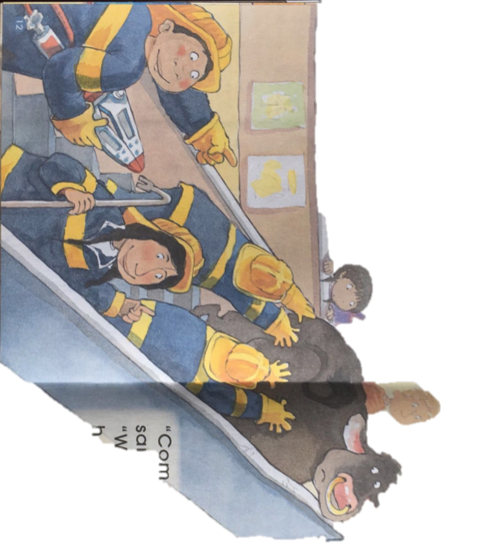
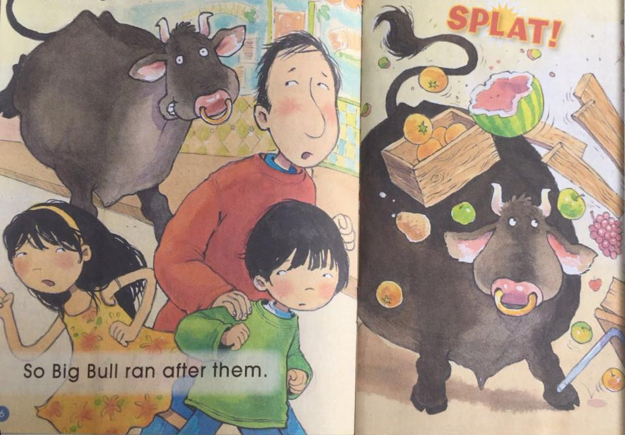
Put the pictures in order.

Slide 8
What is Big Bull doing?

Slide 9
What do you think the man is saying?

Slide 10
What words would you use to describe how the man might be feeling?

Slide 12
Where does the story take place now?

Slide 13
Why do you think the people are running?
What do they feel?

Slide 14
run after

Slide 15
What problem can you see now?
Where did the people run to?

Slide 16
What happened to Big Bull?

Slide 17
What words could you use to describe how Big Bull might be feeling?
What are the people doing?

Slide 18
st
stamp

Slide 19
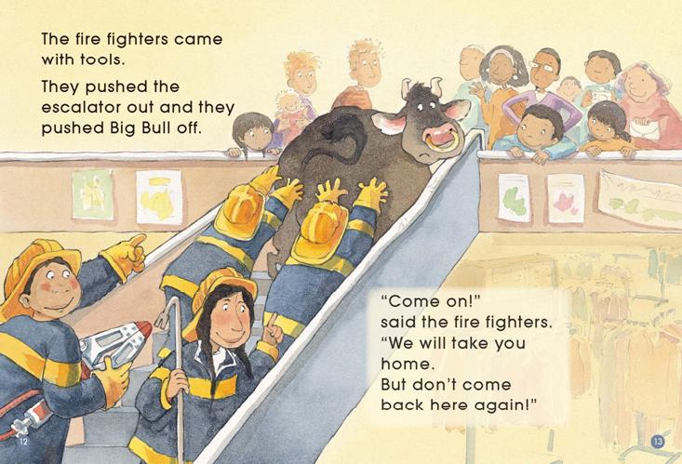
Do you think the fire fighters are able to get Big Bull off the escalator?
Why?

Slide 20
escalator

Slide 21
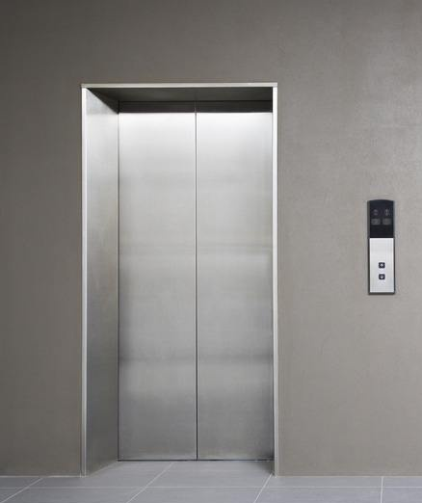
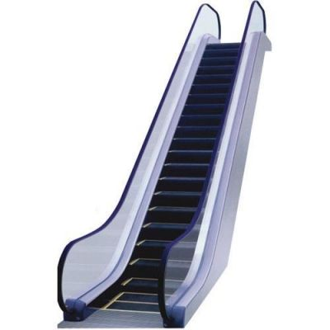

Slide 22
escalator

Slide 23
escalator
What warning did the fire fighters give Big Bull?

Slide 24
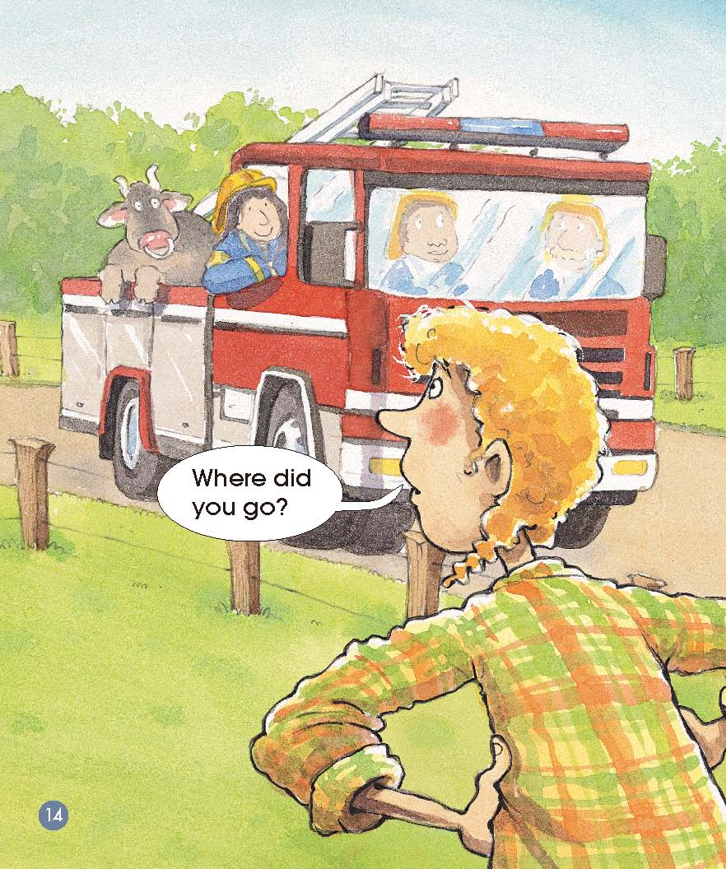
What new character is in the story?
How might the farmer be feeling?

Slide 25
What does Big Bull feel about home now?

Slide 26
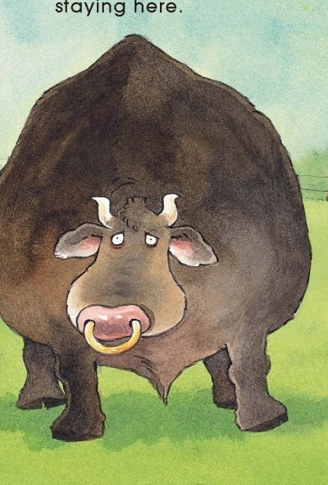
excited
angry
bored
happy

Slide 27
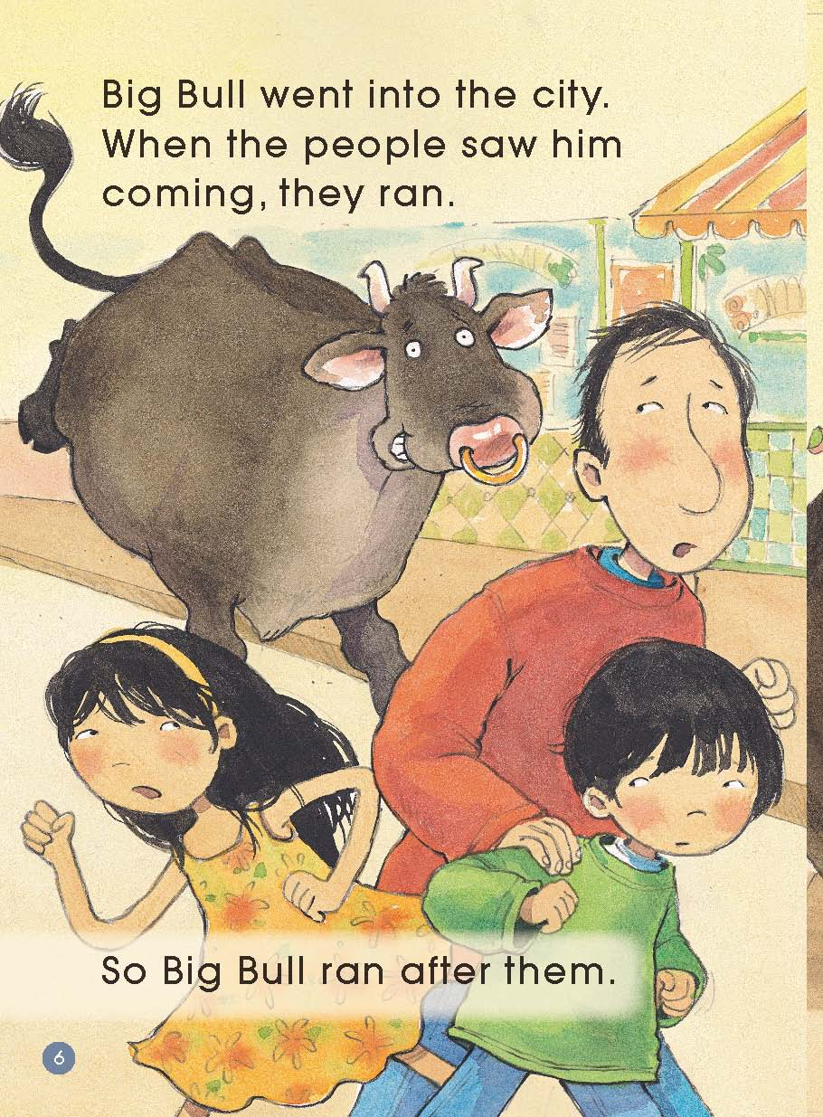
Can you retell the story?

Slide 28
Reading Circle

Slide 29
Let’s Write!

