Slide 1
Lazy Lily
莉莉“生病”了
选自
《多维阅读第7级》

Slide 2
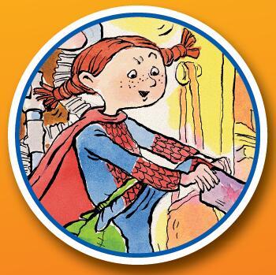
Lazy Lily
What is the story about?
Can you guess?

Slide 3
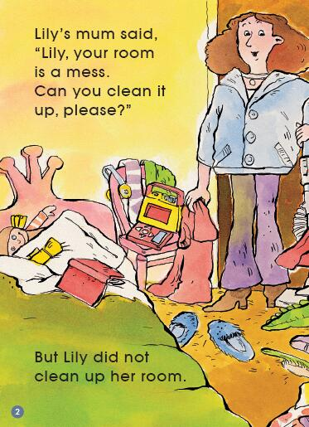
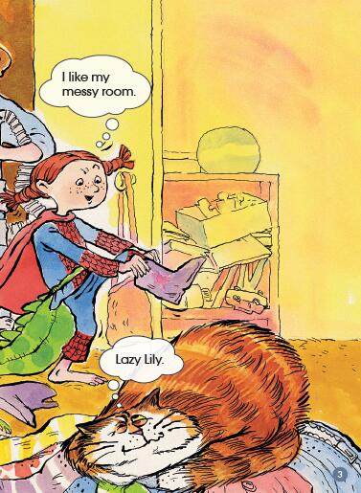
Preview
What might Lily say? Can you guess?

Slide 4
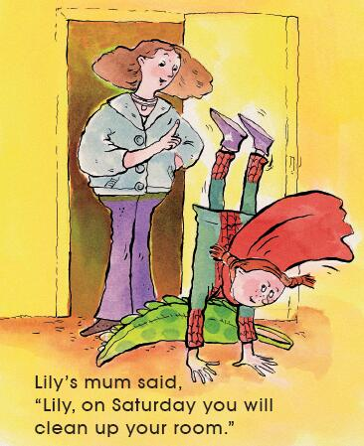
Will Lily clean up her room on Saturday?

Slide 5
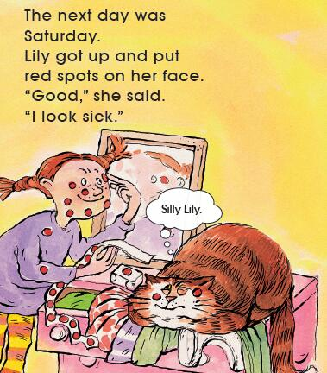
Why does she do that?

Slide 6
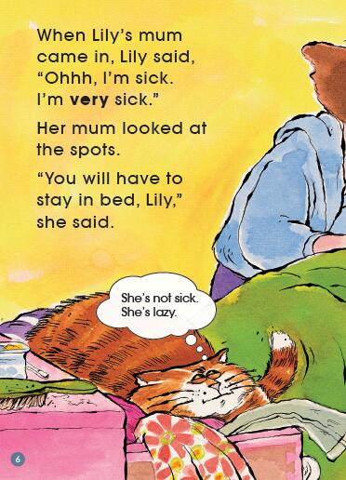
How does Lily feel?
Do you think Lily has tricked her mum?

Slide 7
How does Lily feel after several days?
What will she do?
Please read and answer.

Slide 8
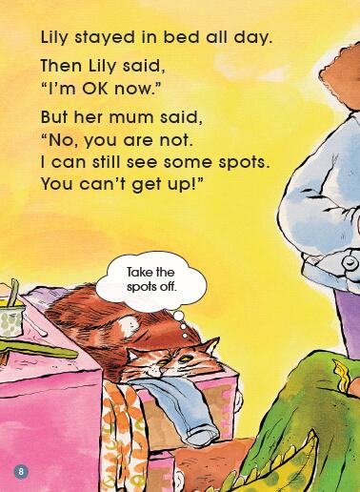
How does Lily feel?

Slide 9
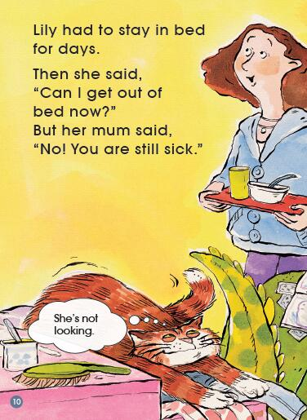
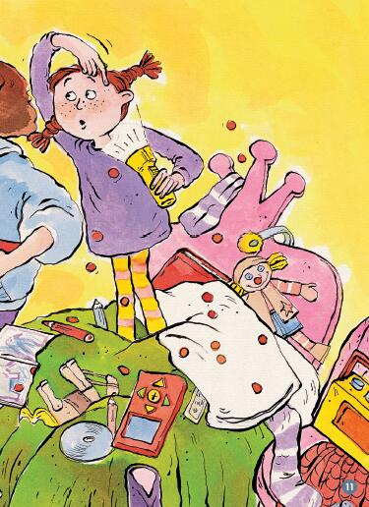
Why do you think Lily has taken the spots off?

Slide 10
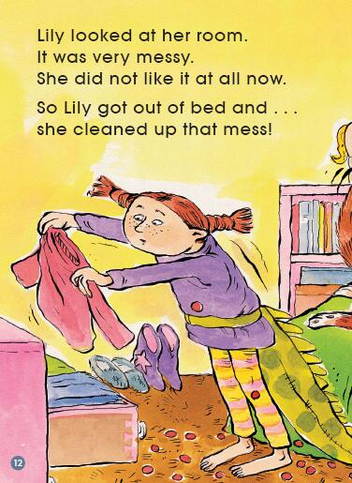
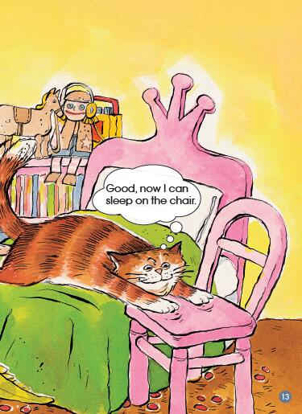
Why do you think Lily is doing this?

Slide 11
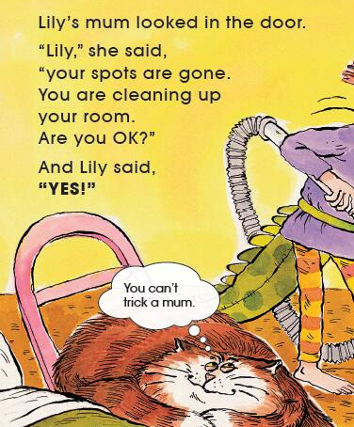
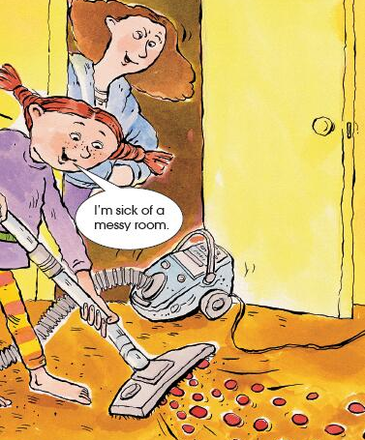
How do you think Lily’s mum feels?
What is the cat thinking about?

Slide 12
view
Let’s talk about the story.

Slide 13
Lily’s room was
a mess
Lily’s room was clean
asked... to stay in bed
asked... to clean up
was happy
put red spots on her face
try to trick
her mum
wanted to get up
wanted to get out of bed very much
didn’t clean up
cleaned up

Slide 14
C
B
A
E
D

Slide 15
What does the cat think of Lily?
If you were the cat,
what do you think of Lily?
Why?

Slide 19
Reading Theatre
Role play in groups.

Slide 20
Review
Reading Circles
Word Master
Character’s Captain
Summarizer
Creative Connector

Slide 21
If you were Lily, would you do like that?
What would you do?

Slide 22
Have you ever tried to trick someone? Who?
Was it good to do that?
Why or why not?

Slide 23
Lazy Lily

Slide 24
Listen and read the story.
Tell the story to your parents.
Make a list of housework you can do at home.

