Slide 1

Tricera’s Lesson
淘气包的教训
选自《多维阅读第7级》

Slide 2
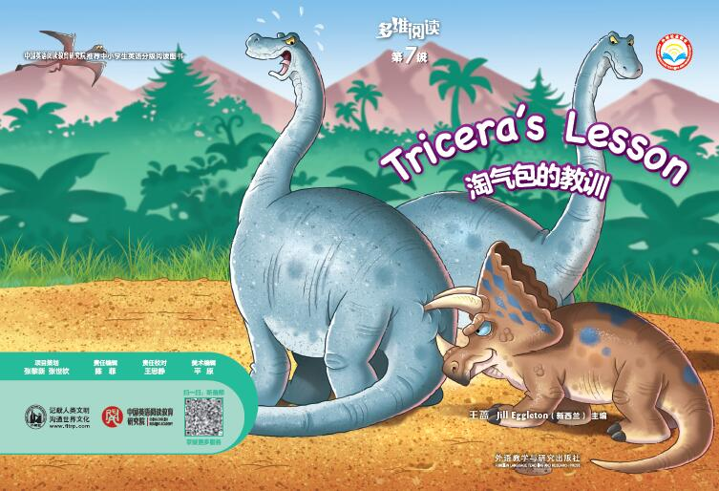
title
characters
What do you know from the cover?

Slide 3
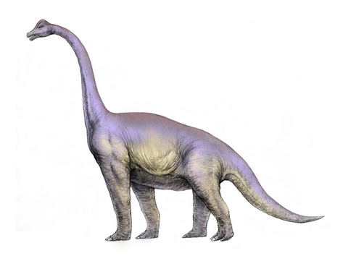
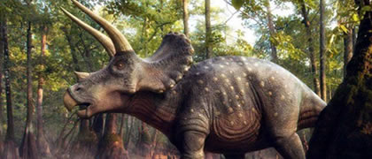
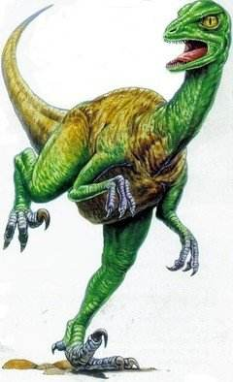
What do you know about dinosaurs?

Slide 4
Read all the pictures of this book and find out:
How many parts are there in the story?
Tricera always bullied others.
Tricera was in trouble, Little Dinosaur helped him.
Tricera was kind to all the dinosaurs and he had friends.
Tricera was a little dinosaur who likes to bully others. One day, … no one helped him…

Slide 5
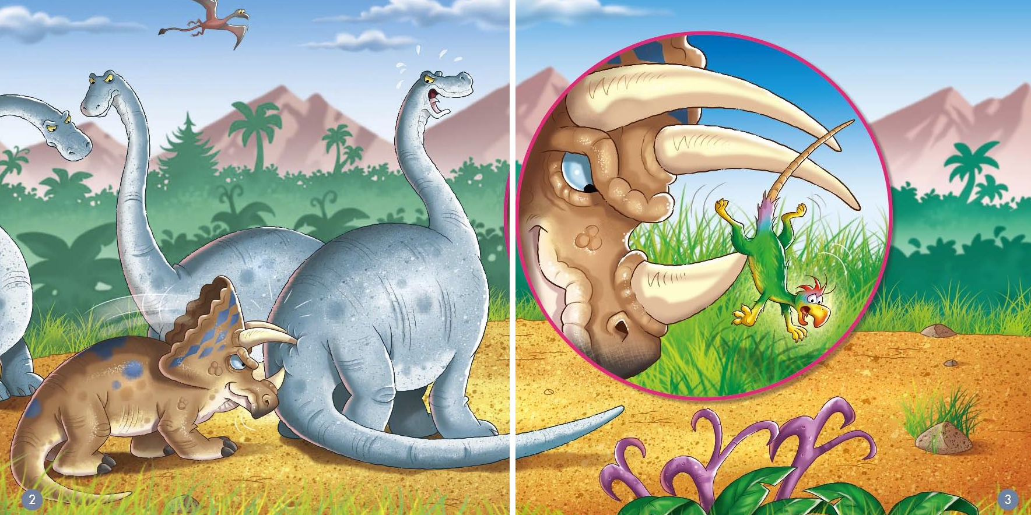
Read pages 2-3
What word(s) would you use to describe Tricera?
mean
nasty
bully

Slide 6
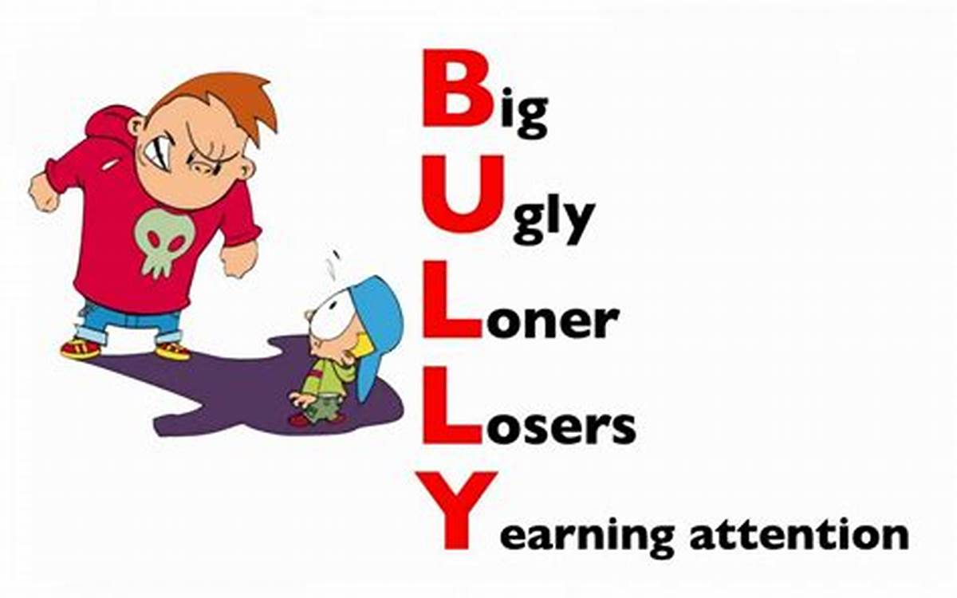
bully
Have you ever seen someone bully
others before?

Slide 7
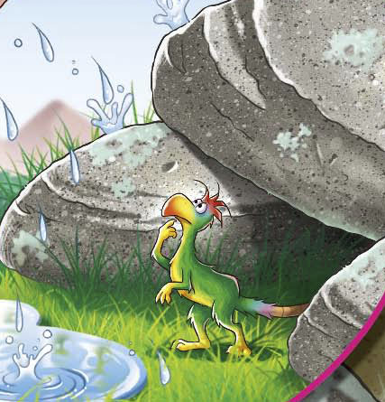
Read pages 4-15
Who has the greatest influence on the change of Tricera?
①Tricera roared and roared. No dinosaur came to help him. ② I will have to help him. ③ Little Dinosaur was shaking all over!
Little Dinosaur

Slide 8
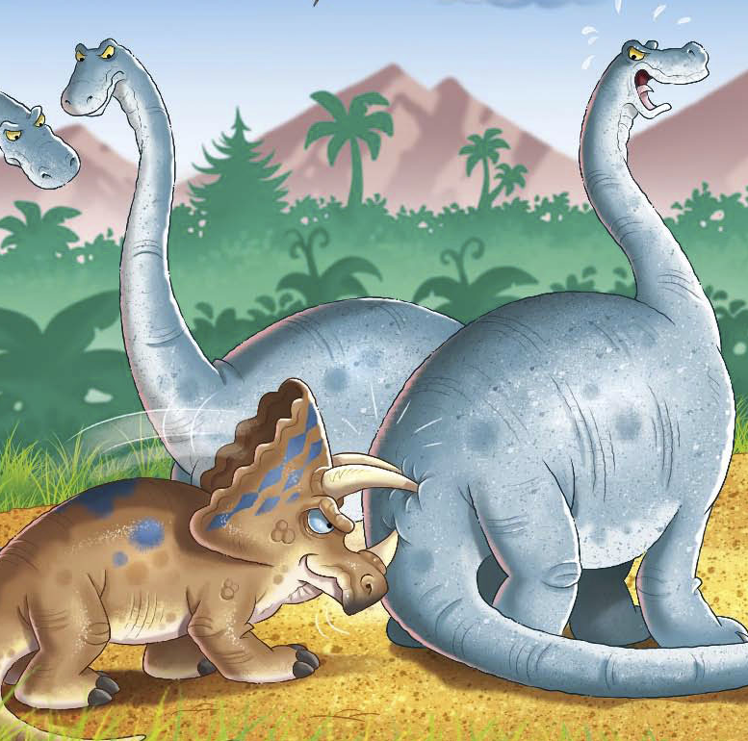
Read pages 4-15
Who has the greatest influence on the change of Tricera?
① The big dinosaurs did not look at him. He was a bully. They were not going to help him. ② Tricera sat down. He was a bully and now he had no friends.
Other animals

Slide 9
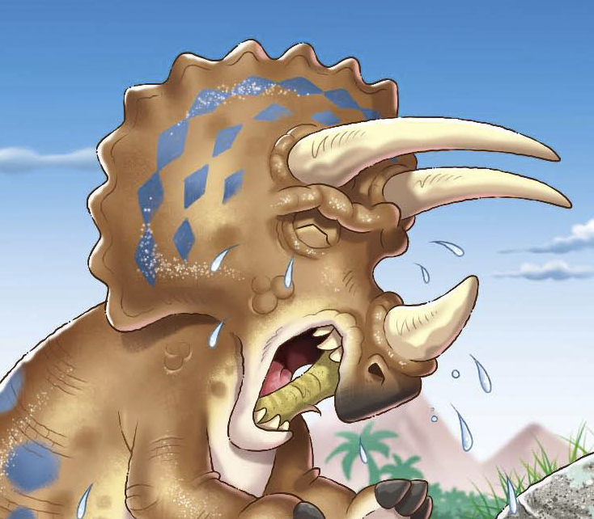
Read pages 4-15
Who has the greatest influence on the change of Tricera?
①Tricera stamped his feet and roared! ②But Tricera put Little Dinosaur on to the grass and he licked him.
Tricera

Slide 10
What did Little Dinosaur do with Tricera?

Slide 11
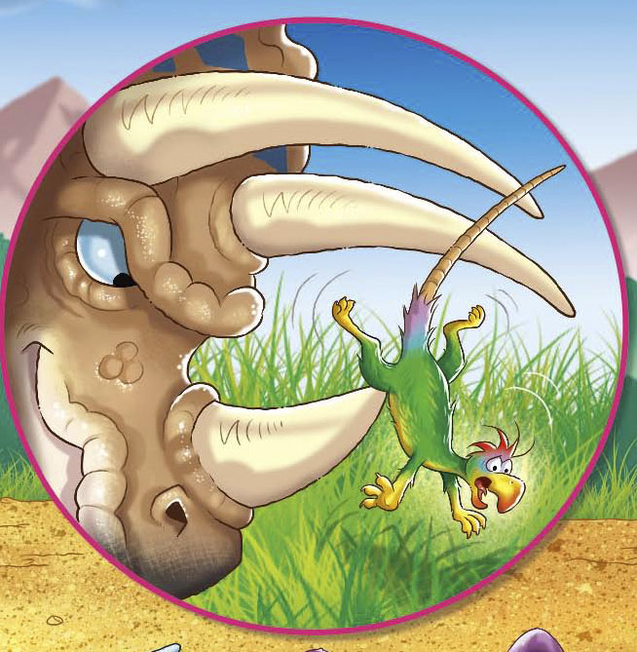
He is so mean! I would never be his friend!
When Tricera bullied（欺负） him …

Slide 12
I will have to help him.
When he saw Tricera was in trouble（有麻烦）…

Slide 13
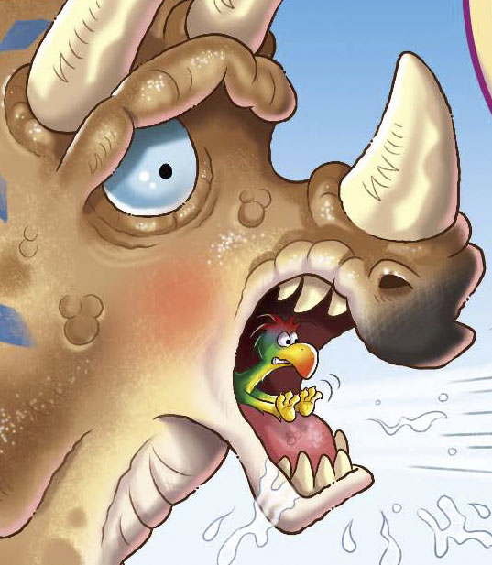
I must help him!
When he pushed the stick out of Tricera's mouth …

Slide 14
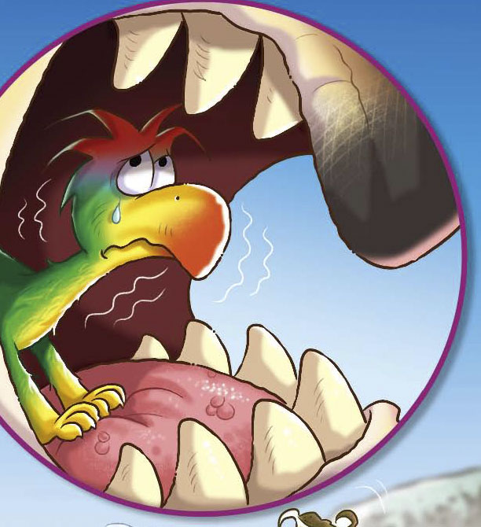
Is he going to eat me?
How can I get out of his mouth?
When he was shaking in Tricera's mouth …

Slide 15
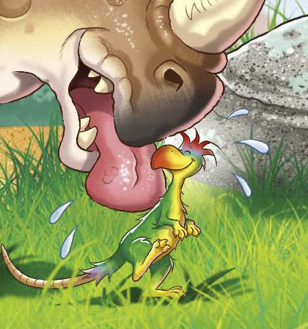
He licked me. He must like me. He is not that bad.
When Tricera put little Dinosaur on to the grass and licked him …

Slide 16
What should you do if someone is being a bully to you?
1. Try to be nice to him/her.
2. Try to protect yourself. Stay in a safe place.
3. Don’t be afraid to let the teachers and parents know about it.
…

Slide 17
