Slide 1
A Handy Horse 导盲马
选自《多维阅读第7级》

Slide 2
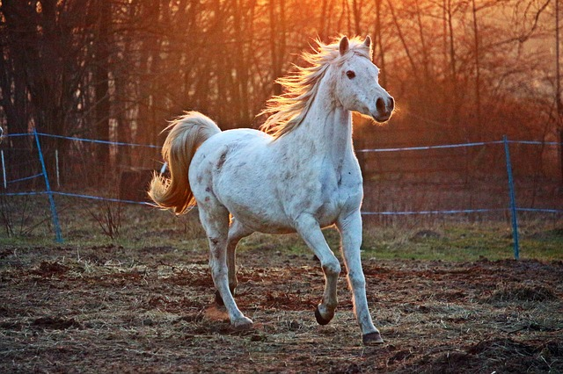
A horse
Notes:
1. What’s that? Where could you see horses?
2. What do you know about horses? For example: How tall is a horse? ...
3. Do you like horses? Why or why not?

Slide 4
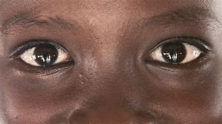
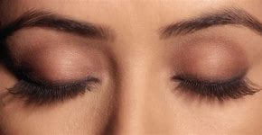
Game time
1. Come to the front of the classroom.
2. Get a cup of water which is on the table.
3. Go back with the cup.
Easy!
Difficult !
Notes:
Let’s play a game. Please finish a task, then you can get a present.
Task: Come to the front of the class and get a cup from the table. After that, go back to your seat with the cup.
Close your eyes to do the task again.
1. Which part did you find very difficult just now?
2. Do you know anyone who is blind? How can they go somewhere? (stick)
3. How can you help them in our life?

Slide 5
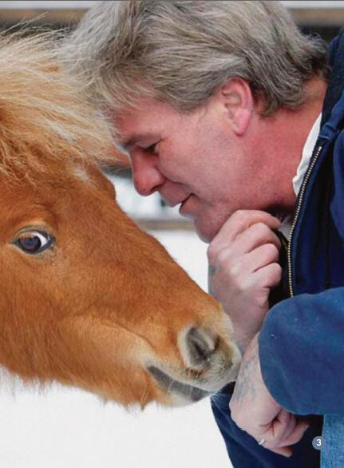
Dan and Cuddles
blind
Notes:
What do you think this photograph might be about? This man is Dan Shaw. He is the first blind person to use a horse as a guide. This horse is a pygmy horse.

Slide 6
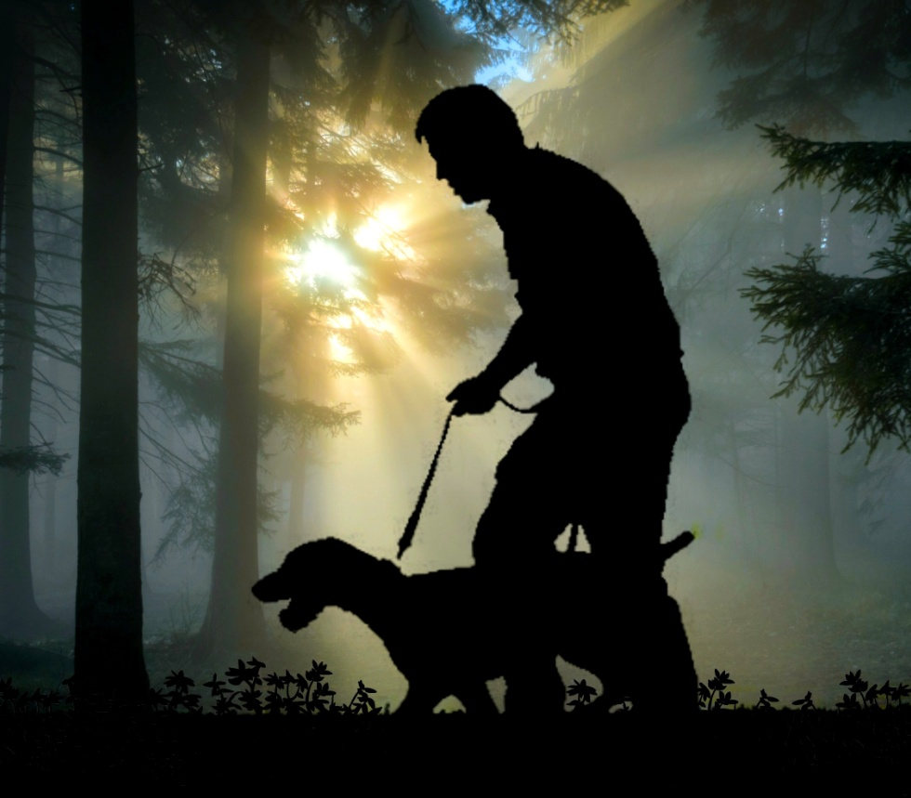
Blind people go out with…

Slide 7
Why?
How?
Notes:
What do you think this photograph might be about? This man is Dan Shaw. He is the first blind person to use a horse as a guide. This horse is a pygmy horse.

Slide 8
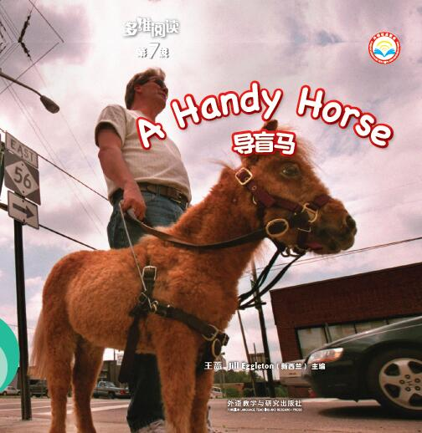
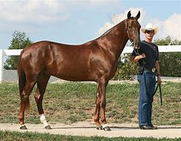
Why is this horse called a handy horse?
Notes:
1.Read the title and the cover, what do you think this book might be about?
2.Why do you think so? Why is this horse called a handy horse?

Slide 9
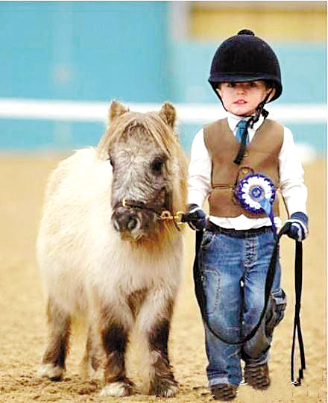
It is called a pygmy horse.

Slide 10
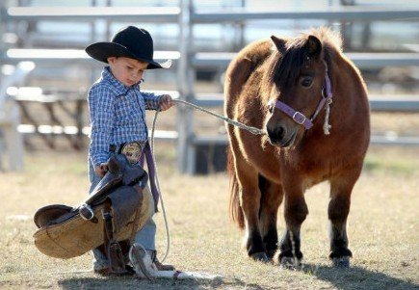
pygmy horse
a handy horse

Slide 11
Cuddles can help Dan.
Can this horse help Dan?
Why?

Slide 12
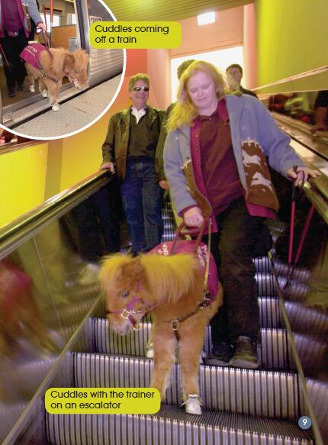
trainer
Notes:
1.The woman with Cuddles is the trainer. The trainer has to train Cuddles and also teach Dan. What amazing things can you see Cuddles doing in these photographs?
2. Do you think horses are usually on planes? Why or Why not? What other animals might go on planes?
3.How do you know where to go at airports? Why would it be very difficult for someone like Dan in a big airport?

Slide 13
The trainer trains Cuddles and teaches Dan.
Notes:
Which word says trainer? How do you know? Read the pages. Write trainer on your paper. Put a circle around the base word. What is the suffix? What other words can you make with the base word?

Slide 14
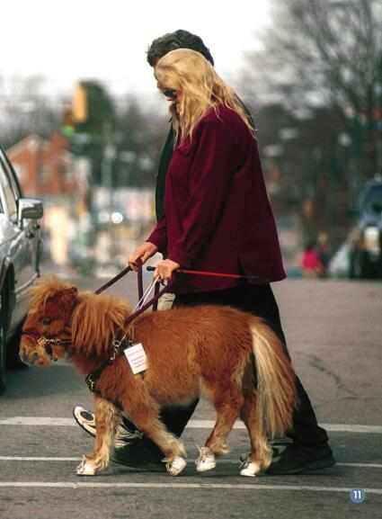
Do you think Cuddles could always be trusted ?
Why? Why not?
Notes:
1. What do you think the trainer is doing now? Read the page. What is something very important that Cuddles has learnt?
2. Do you think Cuddles could always be trusted? Why? Why not?
3. Is this story written as though it has happened or is happening? How do you know?

Slide 15
Notes:
Find the words that have a /t/ sound on these pages. Write them on the paper. Beginning: teacher, to. Inside: stopped, stay. End: not.

Slide 16
Cuddles can take Dan to…
big airport
big shopping mall
cross the road
…

Slide 17
Why?
How?

Slide 18
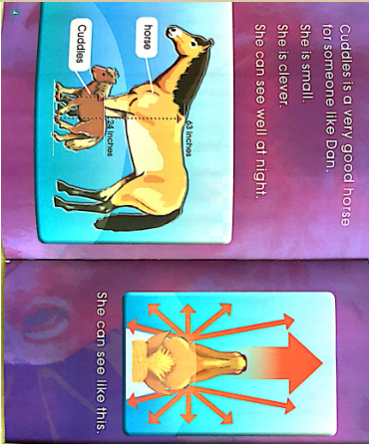
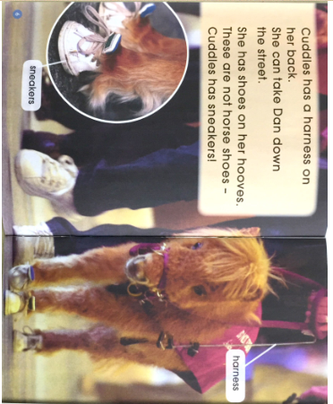
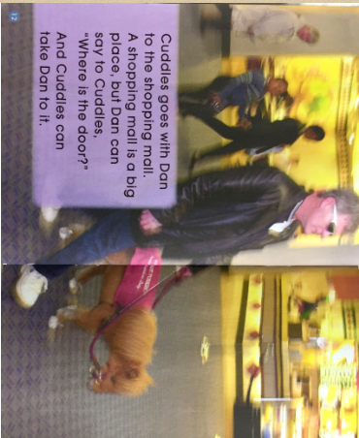
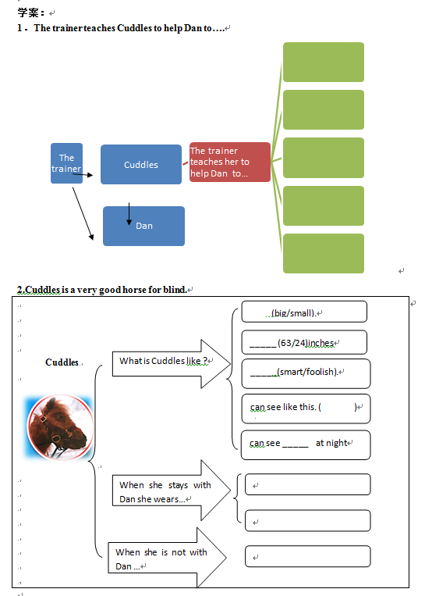
Read pages 4-7 & pages 12-13.
Finish the tasks. Time :10’

Slide 19
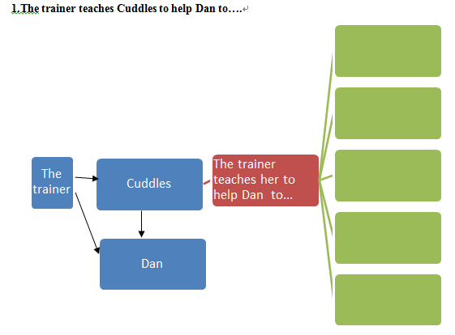
Discuss in groups. Time: 5’

Slide 20
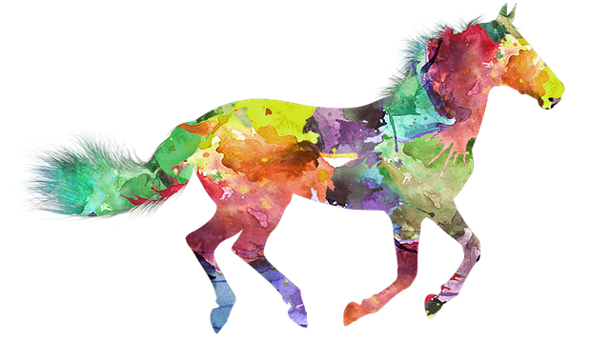
Share in class

Slide 21
Discuss in groups.
1. How does Dan feel about having Cuddles with him?
2. What do you notice about Cuddles in the photograph on the left?
3. What can Cuddles do when she is not with Dan?
4. Can Cuddles run when she is with Dan ? Why?
Notes:
How does this photograph show you what Dan feels about Cuddles?
What do you notice about Cuddles in the other photograph?
What can Cuddles do when she is not with Dan?
Can Cuddles run when she is with Dan? Why?

Slide 22
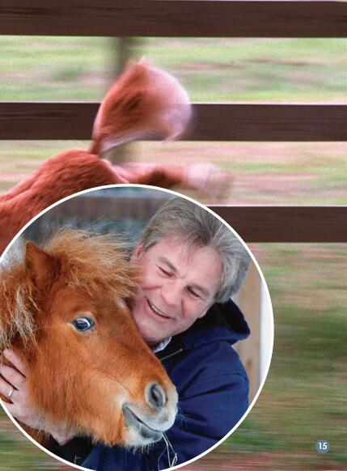
What do you think the last sentence means?
Notes:
Cuddles is a great helper to Dan. Life could be difficult for blind people like Dan. How can we help to make life easier for people like Dan?

Slide 23
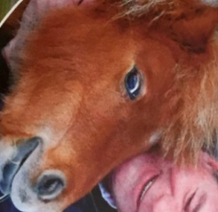
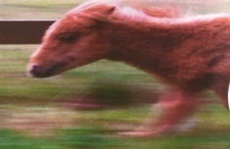
A Handy Horse
small clever
can see well at night
She has shoes on her hooves.
harness back.
airport
shopping mall
Cuddles’ job
… can take... to
cross the roads
Cuddles
teaches
says to
When she is not with Dan.
…
helps
The trainer
run and jump
A horse is a horse.
Dan

Slide 24
A Handy Horse

Slide 25
Be kind to disabled people!
Try to help disabled people!

Slide 27
Homework:
Write a very thin book to introduce a kind of animal that you like.
(3-10 pages with photographs.)

