Slide 1
Moving Seeds
种子的旅行
选自《多维阅读第7级》

Slide 2
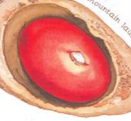
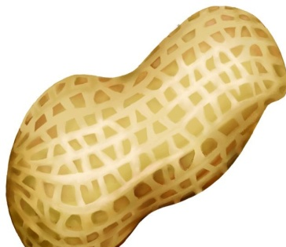
Guess a riddle
It has no feet but it can walk.
It has no wings but it can fly.
It can grow into a plant.
What’s it?
A seed

Slide 3
Title
dandelion
Author

Slide 4
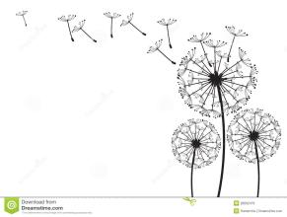
Listen and read
Answer the questions:
What’s it about?
What kind of seeds do you know
from this book?

Slide 5
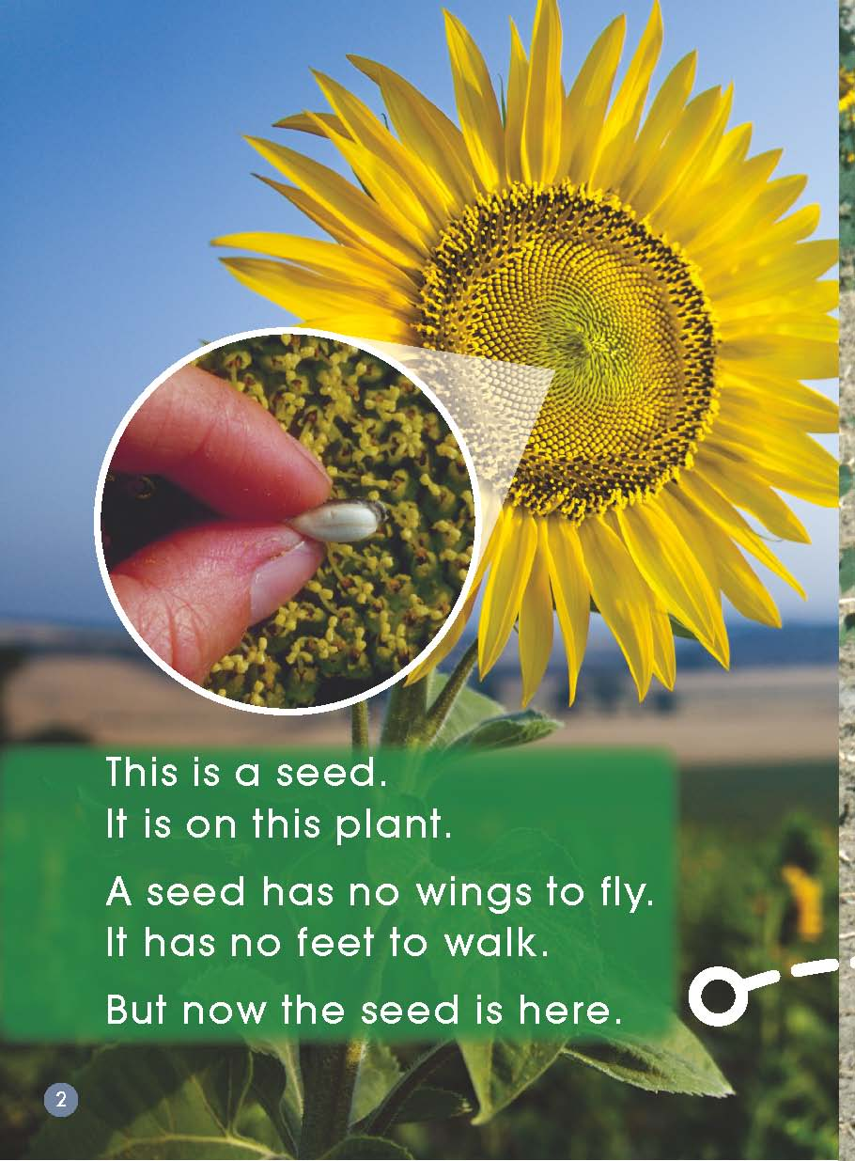
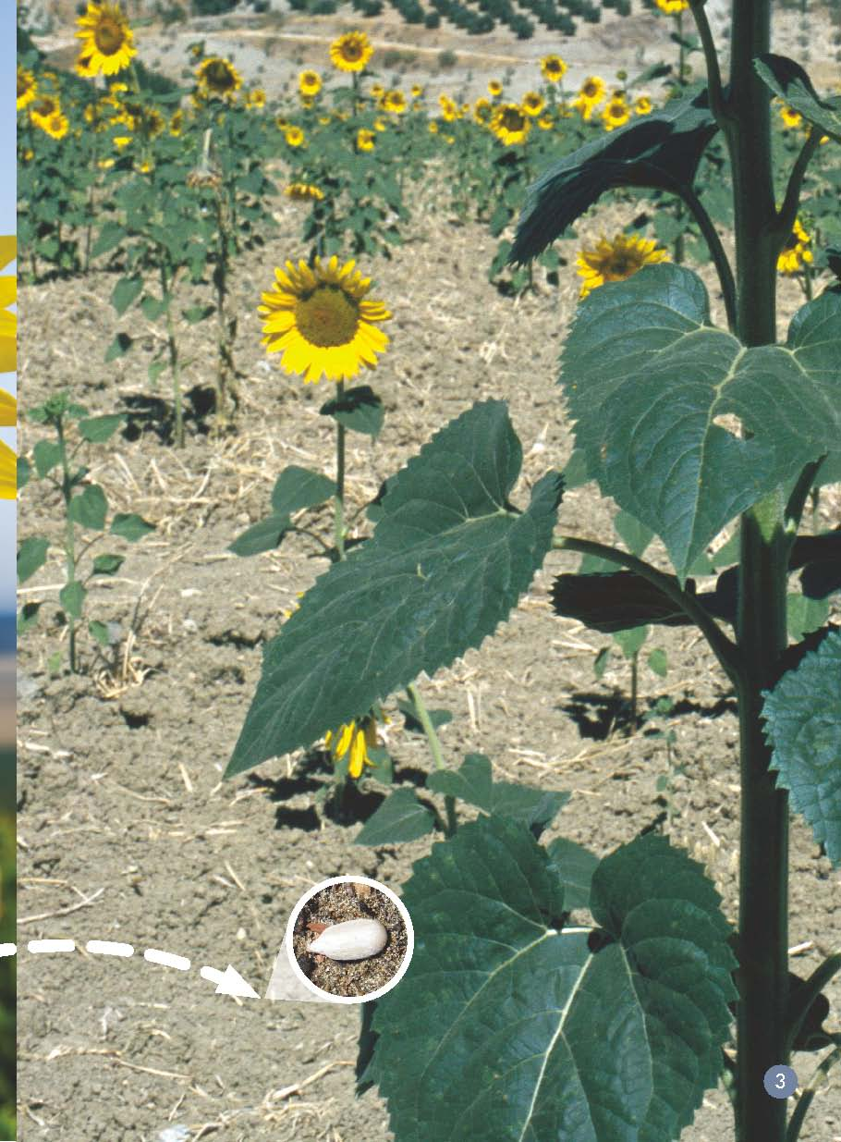
What does this seed look like?
How does the seed move here?

Slide 6
Read and finish the form
Read from pages 4-13.
Fill in the form in groups.

Slide 7
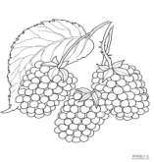
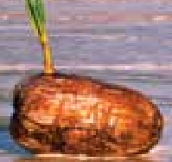
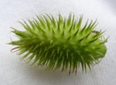
Name of seeds | Dandelion seeds | Berry seeds | Bean seeds | Coconut seeds | Siberian cocklebur seeds
How to move
The wind blows on the seeds and the seeds fly.
A bird eats the berries and off it goes.
The sun makes these pods hot. Then…
pop! pop! pop!
Out come the seeds.
A coconut falls into the water and floats on the water to this island.
This boy has seeds on his boots. He will take these seeds home with him.

Slide 8
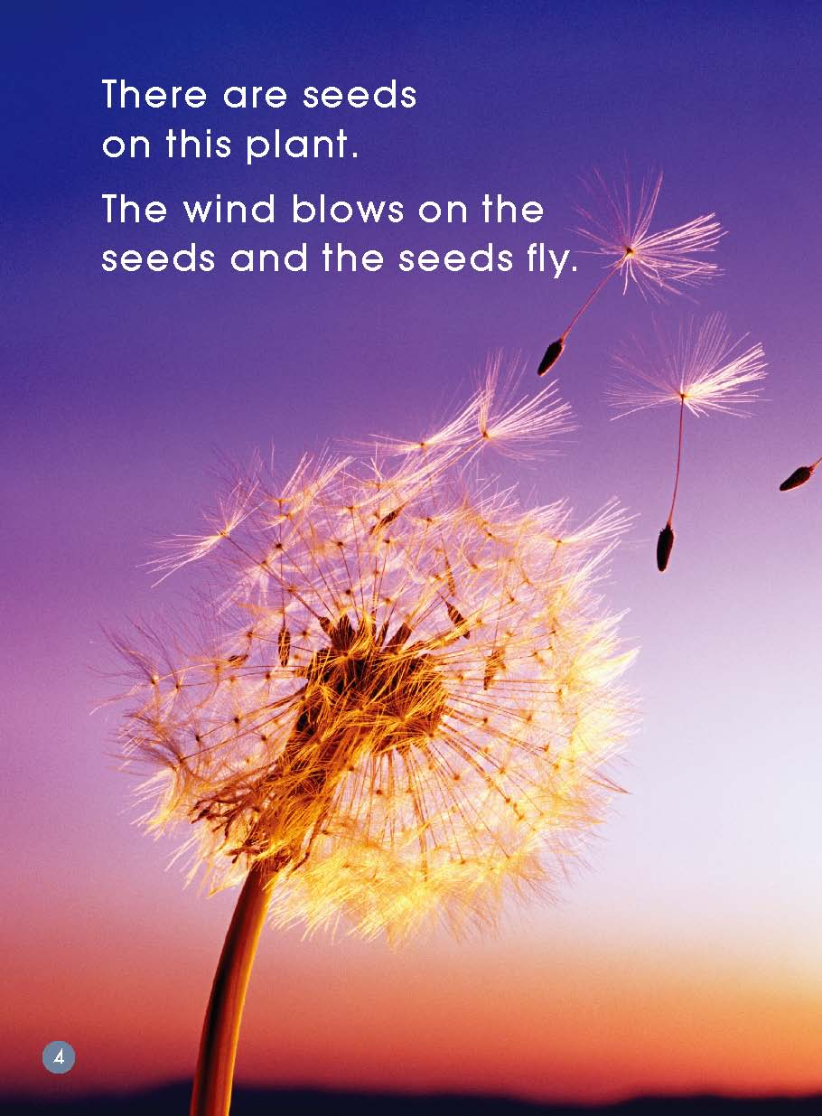
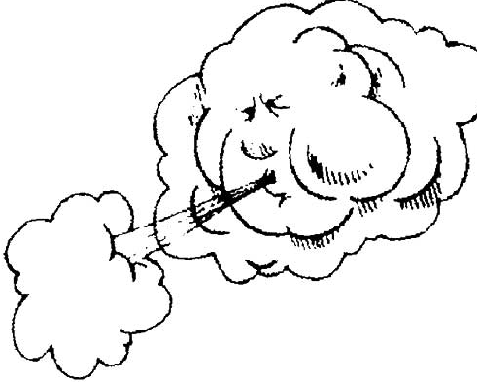
blows
grow into

Slide 9
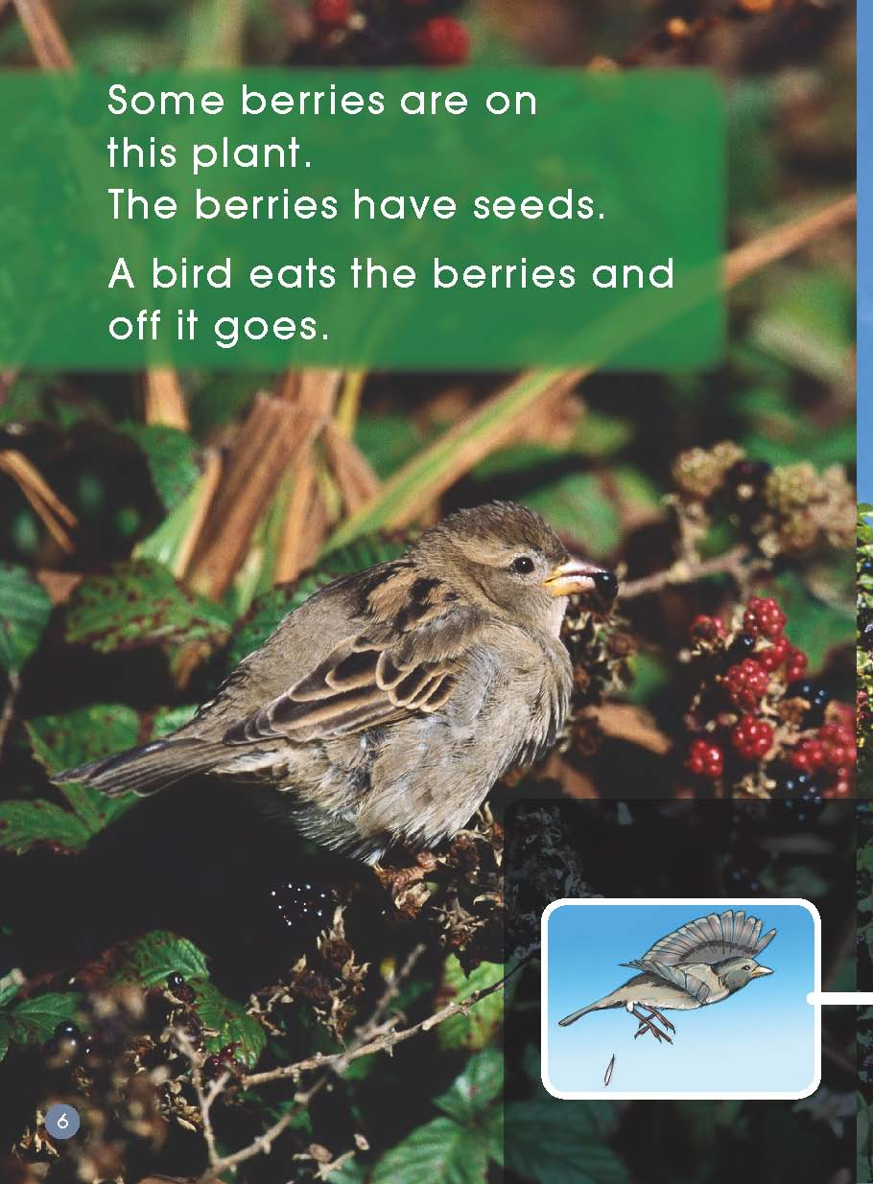
berries

Slide 10
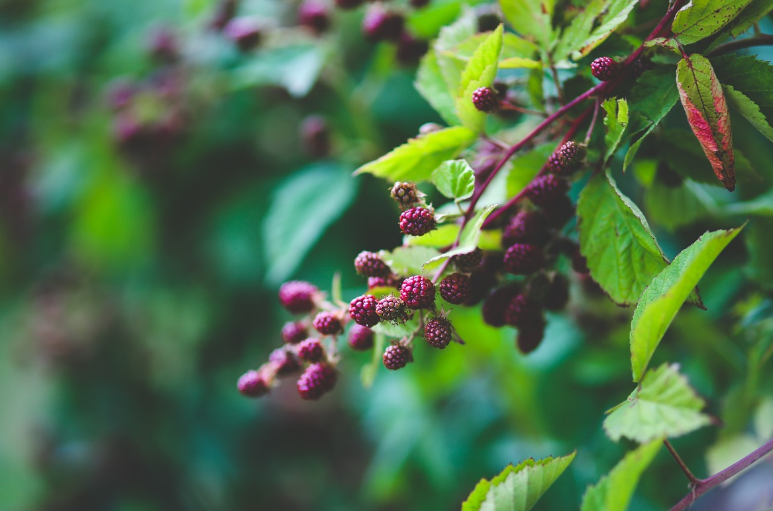
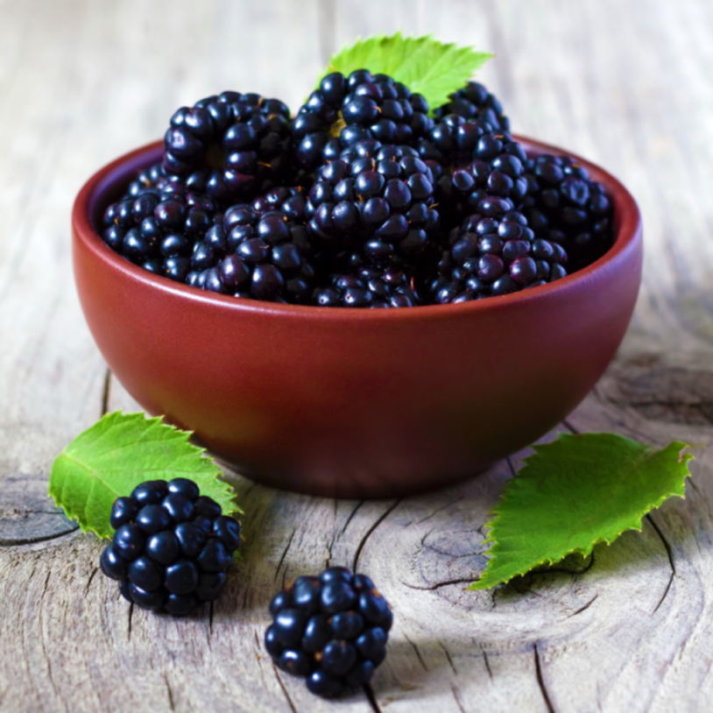
blackberry bush
blackberries

Slide 11
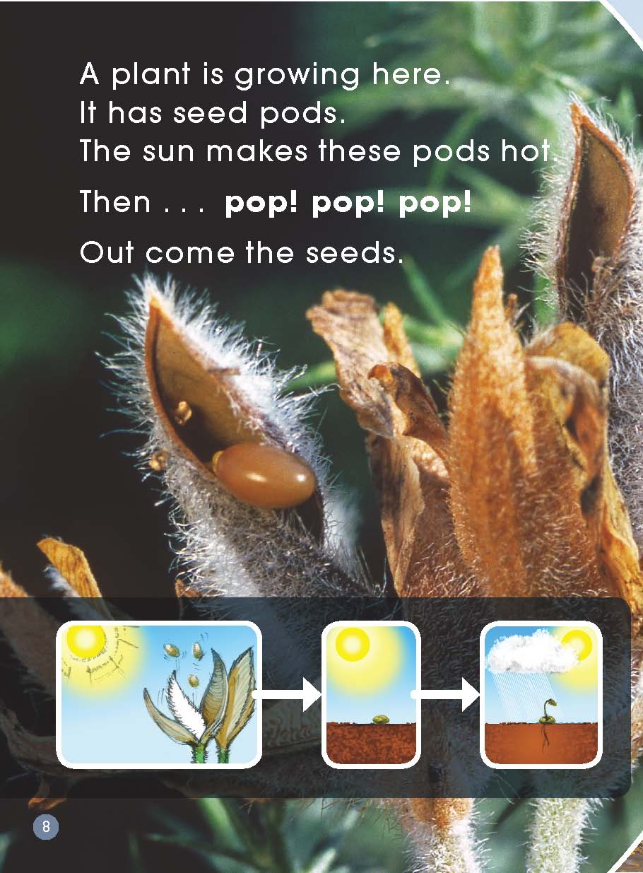
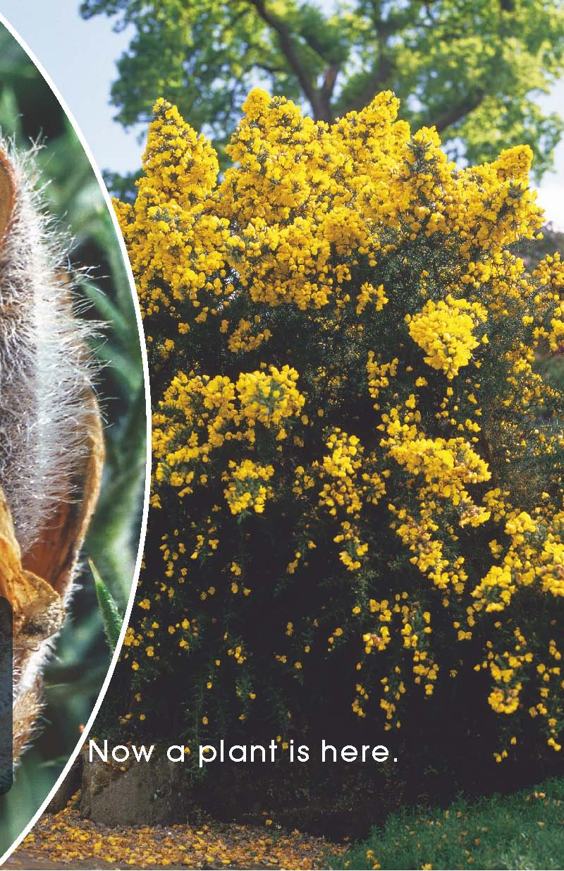
pop
pod

Slide 12
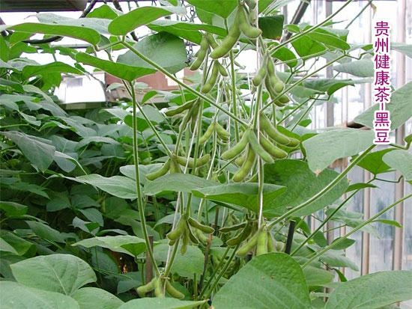
The sun makes these pods hot.
pop
explode
seeds pod

Slide 13
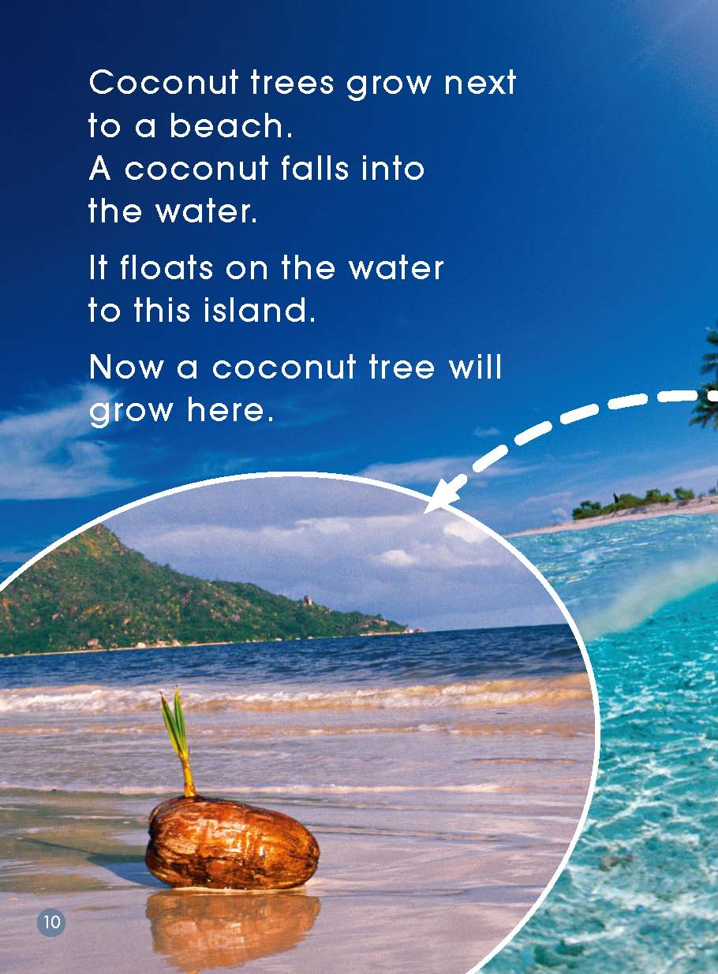
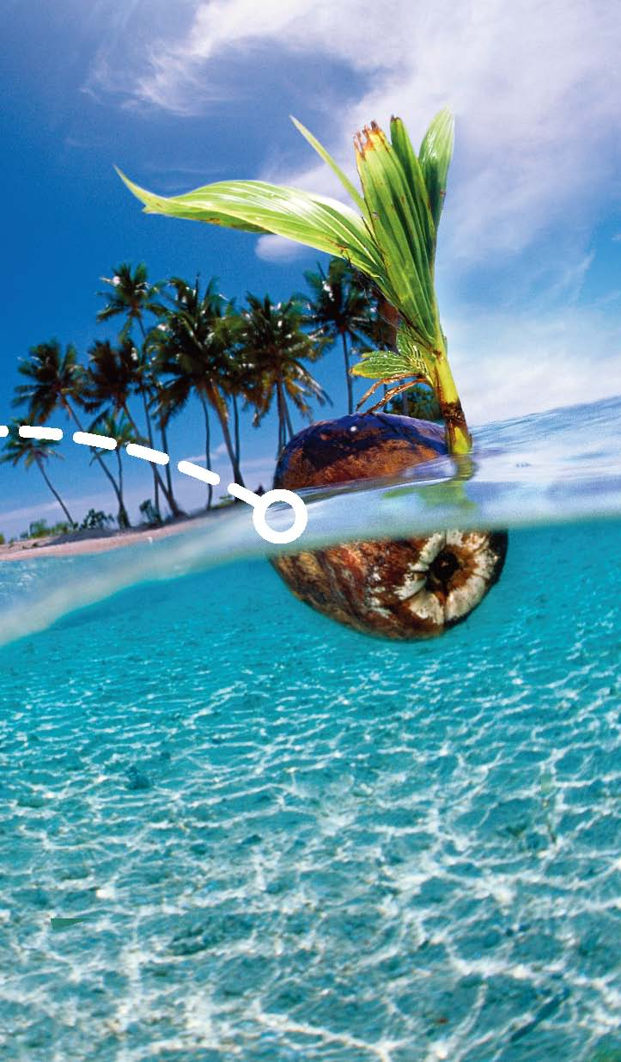
island
float

Slide 14
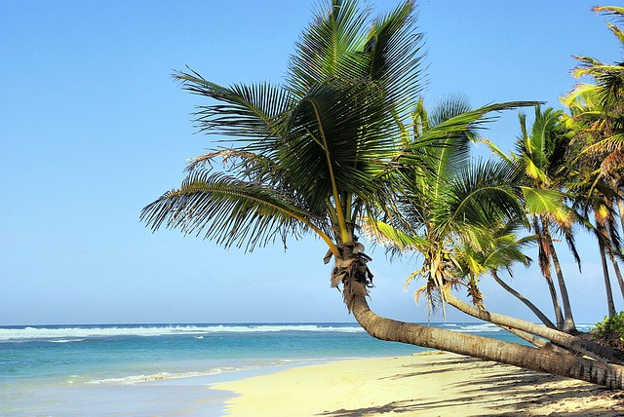
coconuts

Slide 15
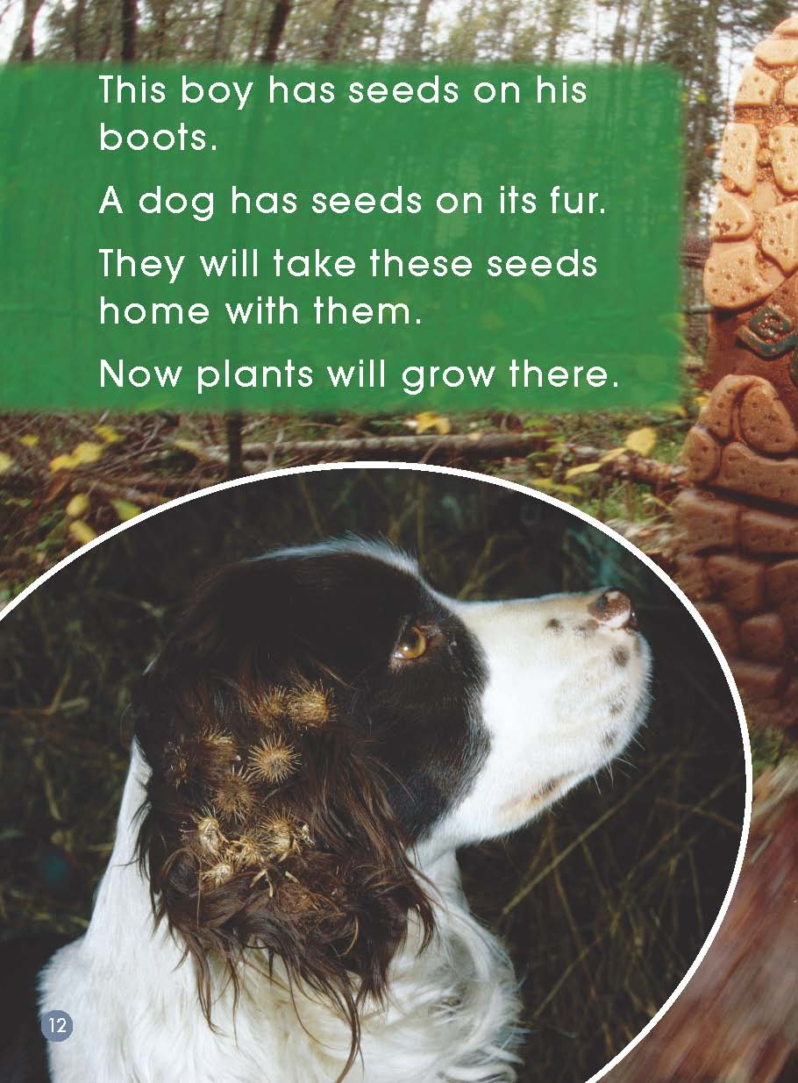
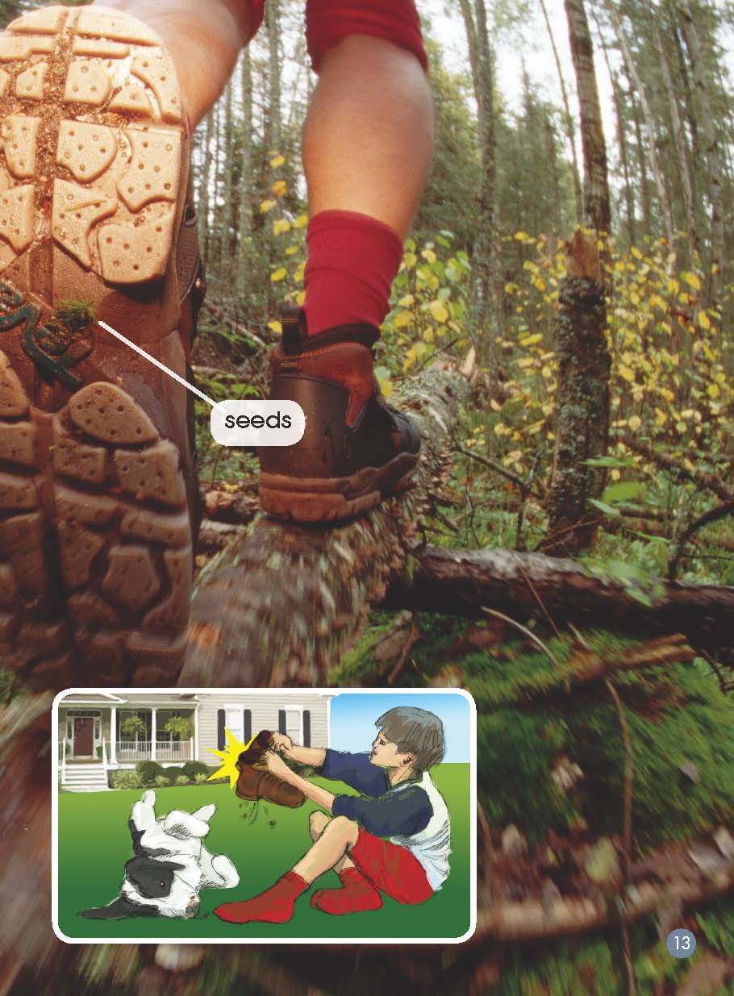
seeds
seeds on its fur

Slide 16
Read and finish the form
Read from page 14.
Fill in the form in groups.

Slide 17
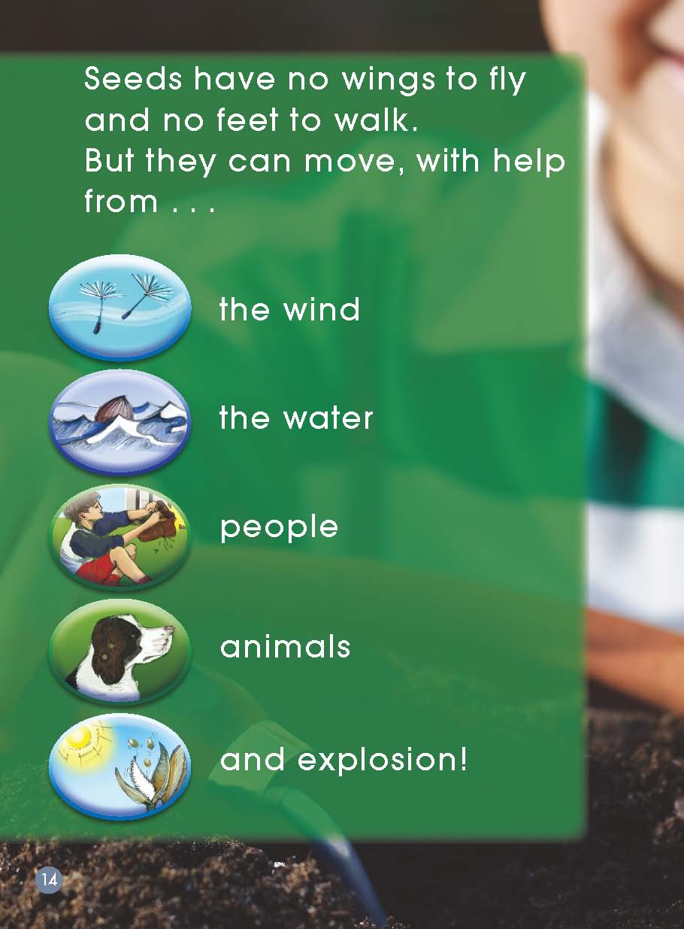
move
with the help from…

Slide 18
move
with the help from…

Slide 19
Name of seeds | Dandelion seeds | Berry seeds | Bean seeds | Coconut seeds | Siberian cocklebur seeds
Move with help from… | the wind | animals | explosion | the water | people

Slide 20
Name of seeds | Dandelion seeds | Berry seeds | Bean seeds | Coconut seeds | Siberian cocklebur seeds
How to move
Move with help from… | the wind | animals | explosion | the water | people
The wind blows on the seeds and the seeds fly.
A bird eats the berries and off it goes.
The sun makes these pods hot. Then…
pop! pop! pop!
Out come the seeds.
A coconut falls into the water and floats on the water to this island.
This boy has seeds on his boots. He will take these seeds home with them.

Slide 21
Reading Circles
Summarizer:
introduce the moving seeds
Post-maker:
make a post to introduce the seeds
Discussant:
talk about seeds
Creative connector:
learn from the seeds

Slide 22
Homework
1. Find more seeds and talk about their moving.
2. Make a poster to introduce the seeds
growing into a new plant.

