Slide 1
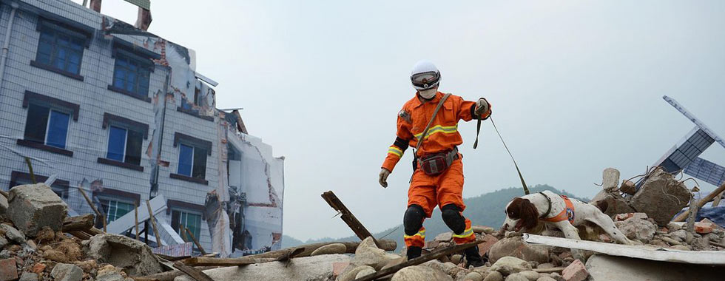
A Big Earthquake
大地震
选自
《多维阅读第7级》

Slide 2
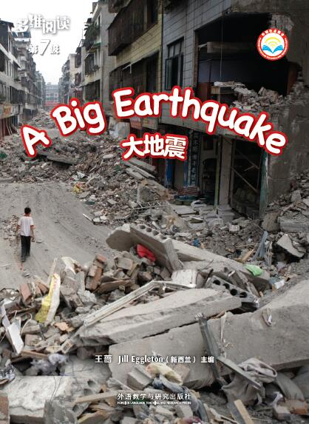
Title
Author
What do you know about an earthquake?

Slide 3
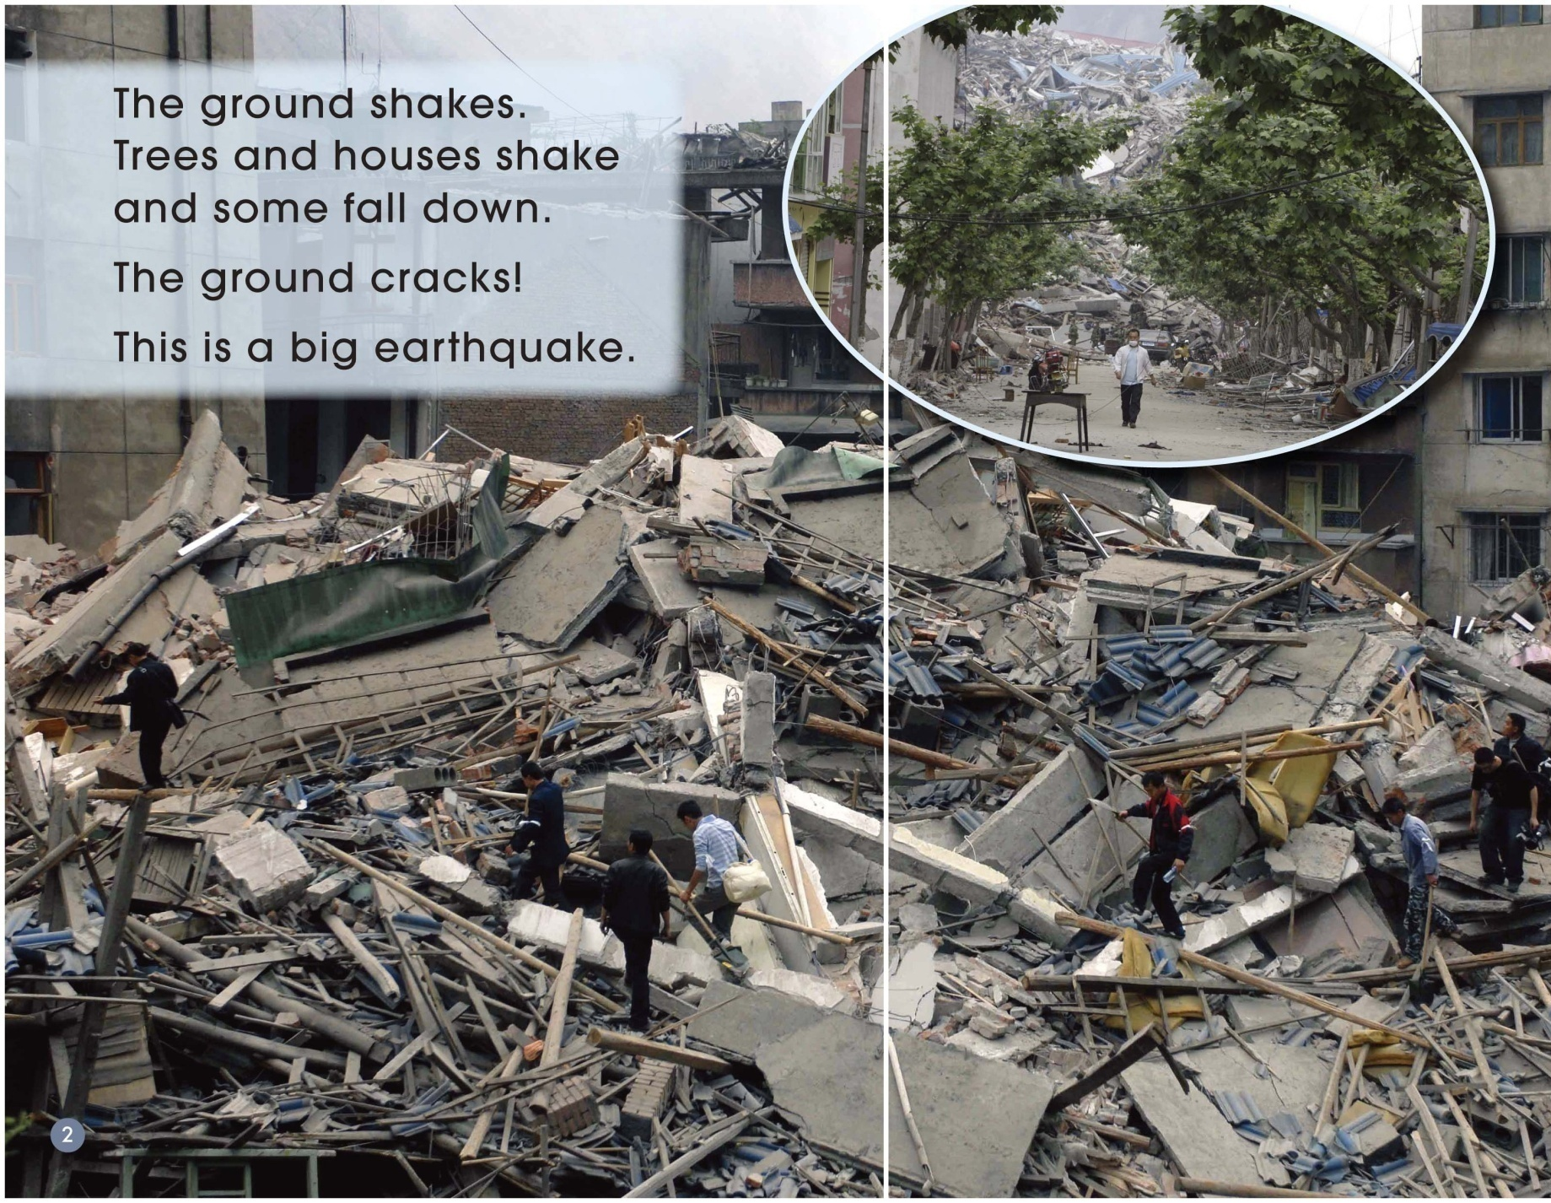
What happened?
What can you see that has happened in the photograph here?

Slide 4
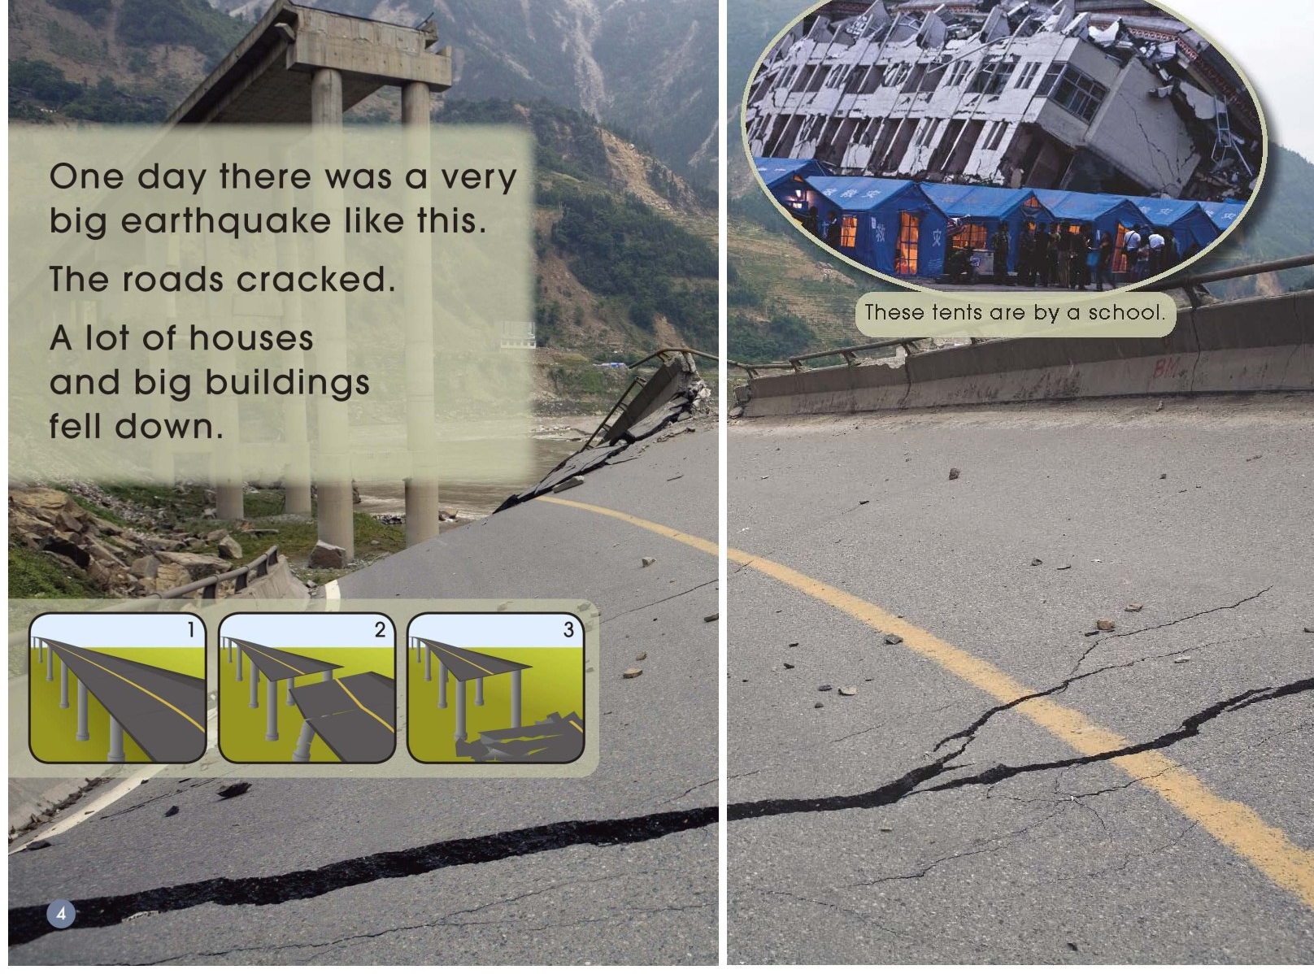
What do you notice about the road?
What happened next?

Slide 5
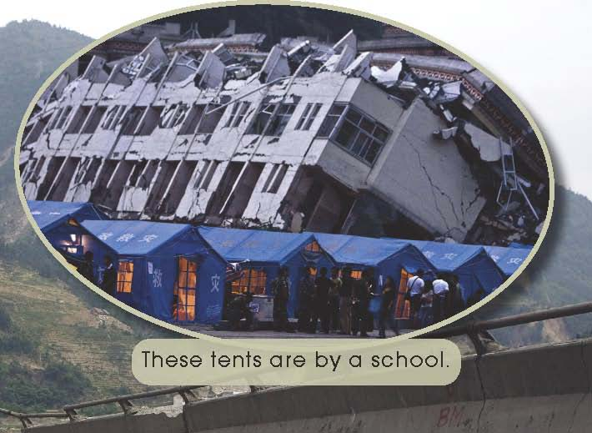
Why do you think
there are tents by the school?

Slide 6
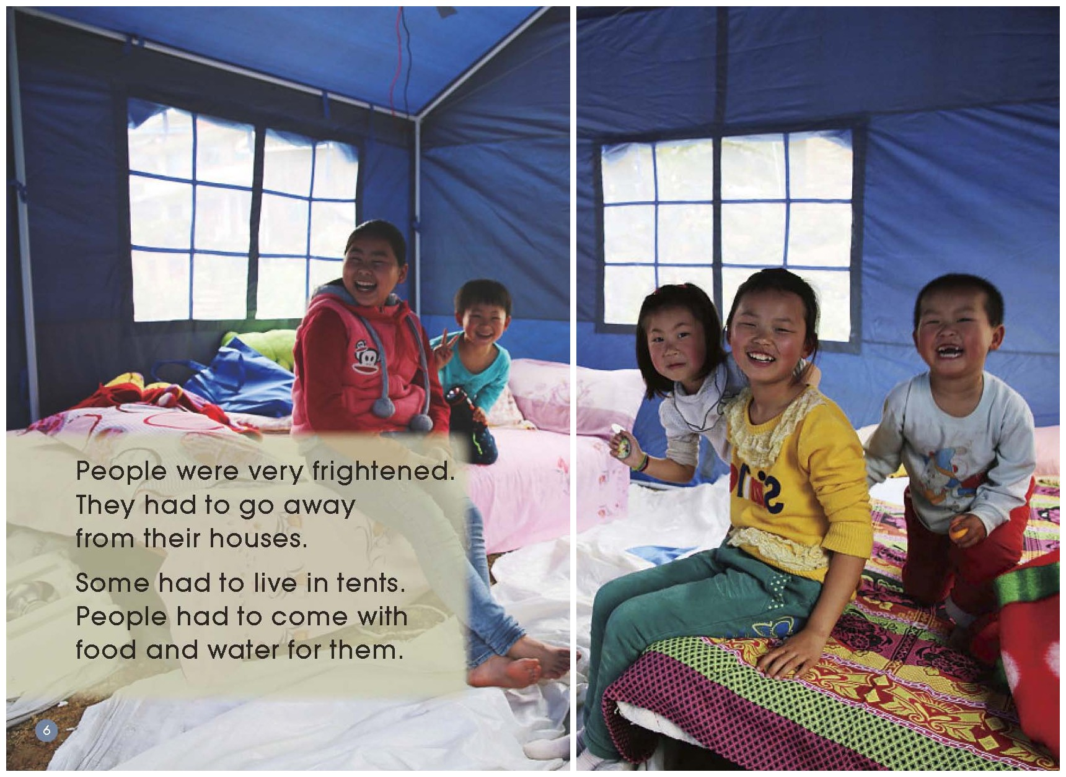
Where did the people live and how did they get food and water?

Slide 7
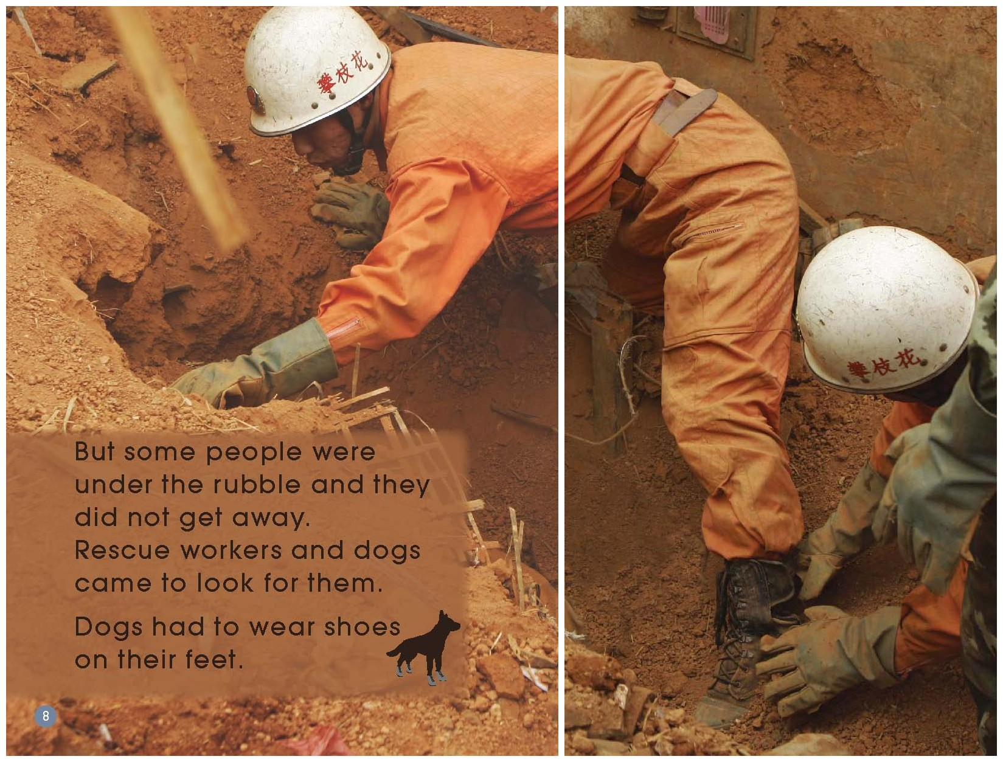
What do you think the man is doing in this photograph?

Slide 8
Why do you think the rescue workers here are wearing hard hats?

Slide 9
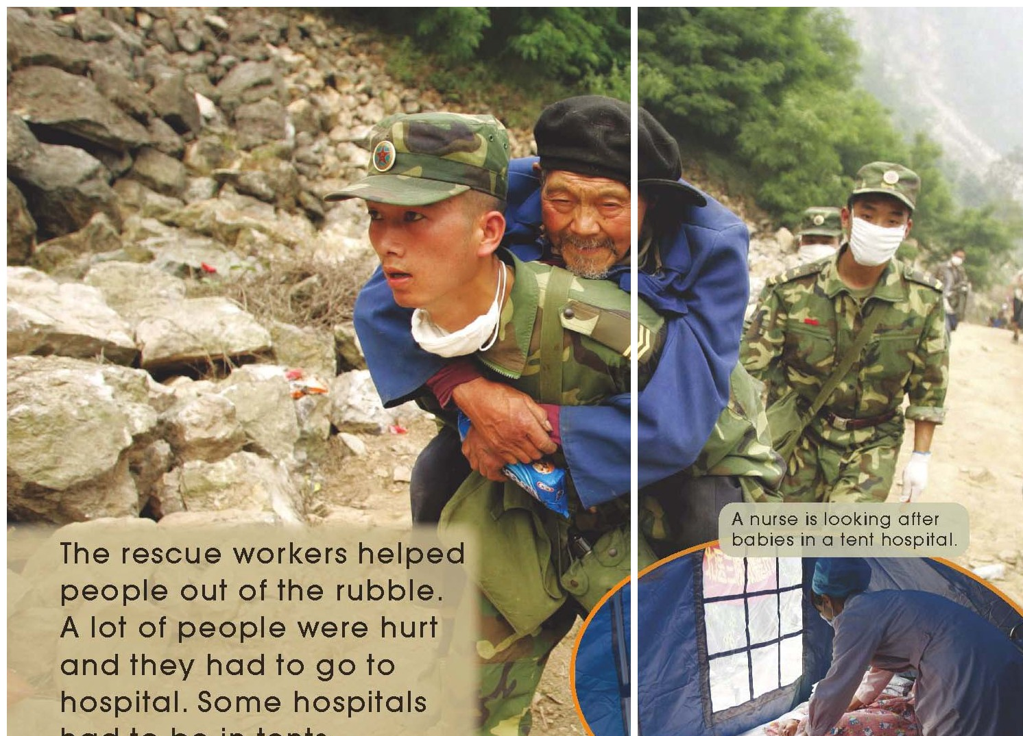
Why do you think this man is being carried?
What other help might be offered to him?

Slide 10
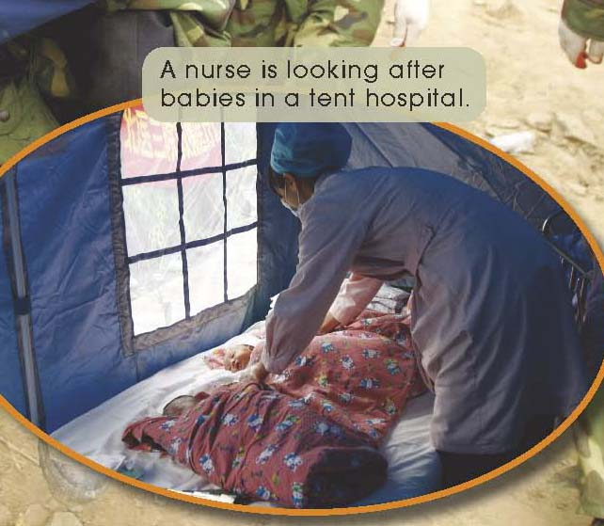
Why did some hospitals have to be in tents?

Slide 11
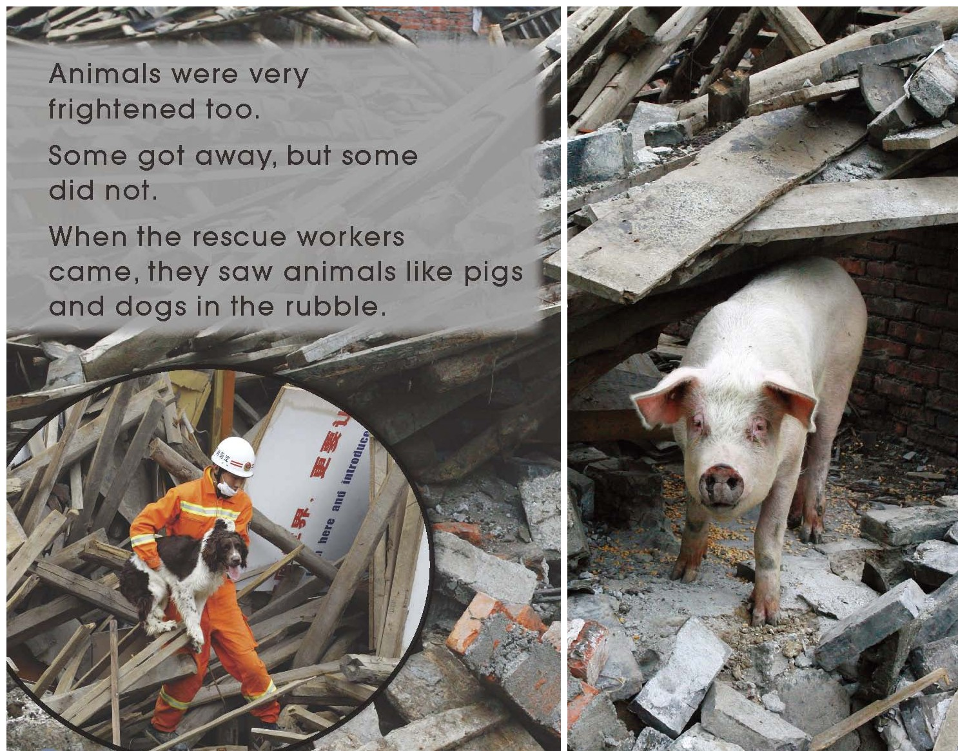
What happened to the animals in this earthquake?

Slide 12
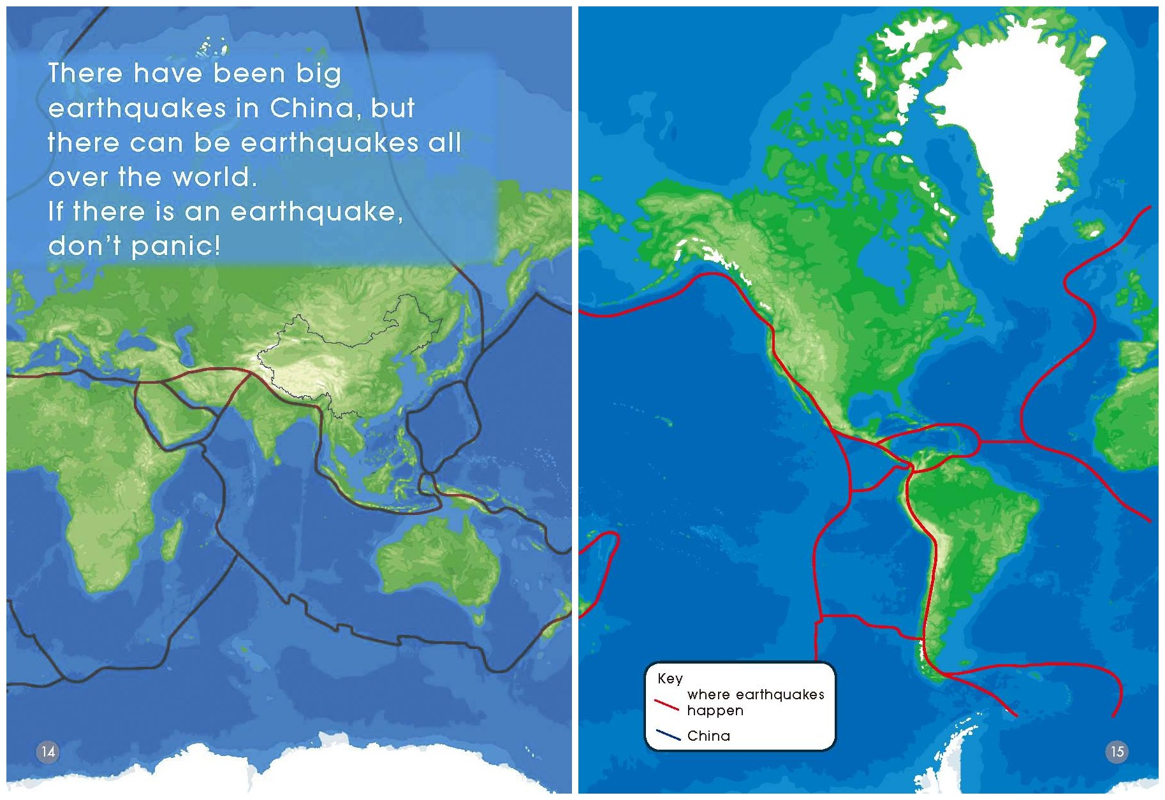
Do earthquakes happen only in China?
Where else may have earthquakes too?

Slide 13
What do these red lines tell you?

Slide 14
= feel scared
panic
Have you ever panicked?

Slide 15
Find out!
panic
shake
rubble
tent
rescue
……

Slide 16
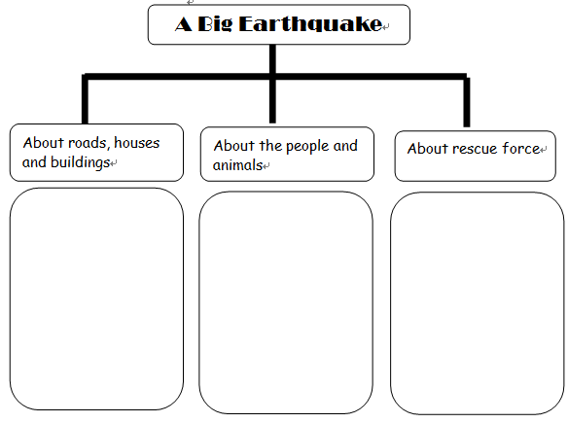
Jig Saw Reading

Slide 17

Discussion
What does the author write the book?

Slide 18
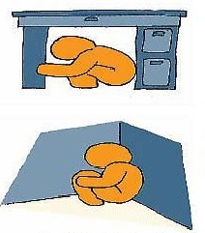
Discussion
What can we do when there is an earthquake?
We can…

