Slide 1
谁把家里弄乱了
A Possum in the House
选自
《多维阅读第7级》

Slide 2
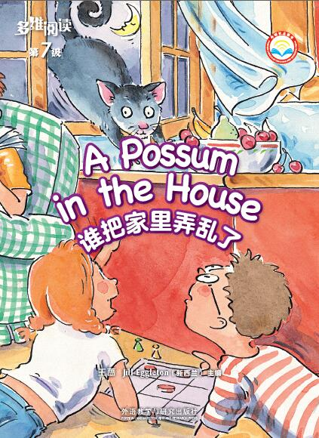
What do you know from the cover?
Title
Author

Slide 3
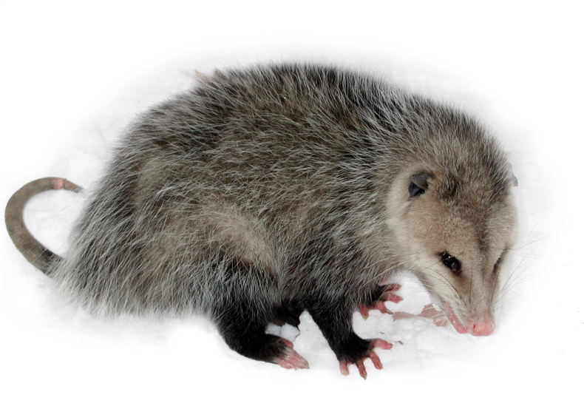
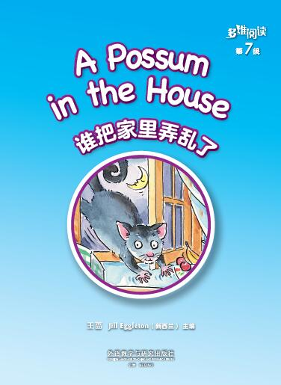
What do you know about possums?
What’s this?
Where is the story
taking place?

Slide 4
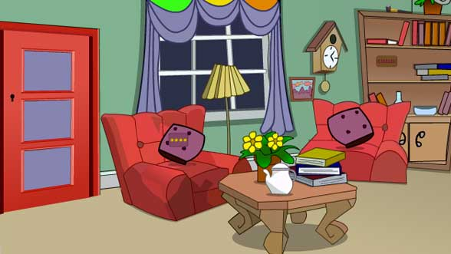
What will you do if there is a possum
in your house?

Slide 5
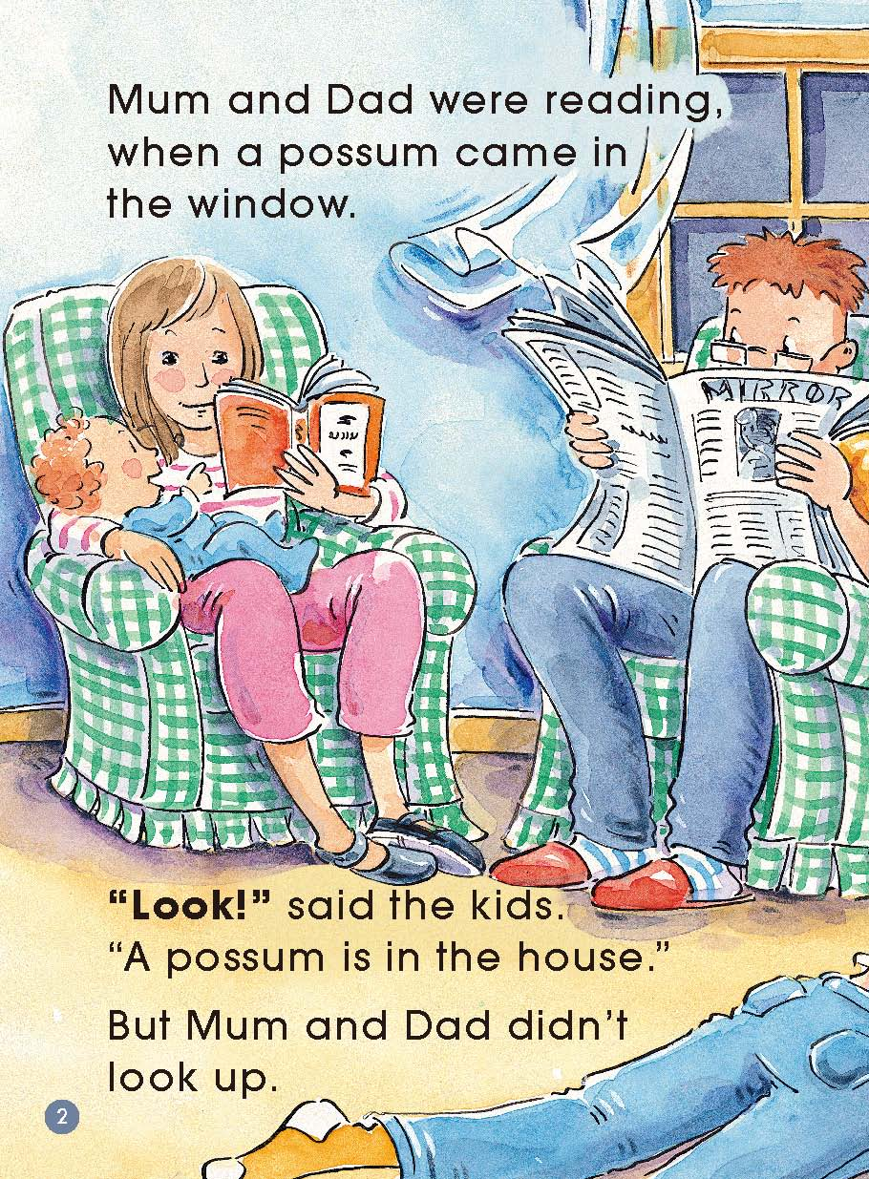
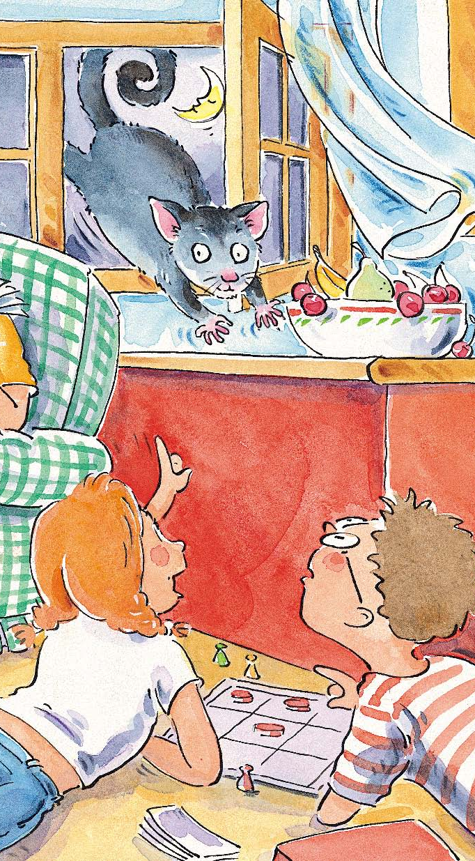
Pages 2 - 3
What can you see?
Where are they?
What are they doing?
Did Mum and Dad see the possum?
Who saw the possum?
What will happen?

Slide 6
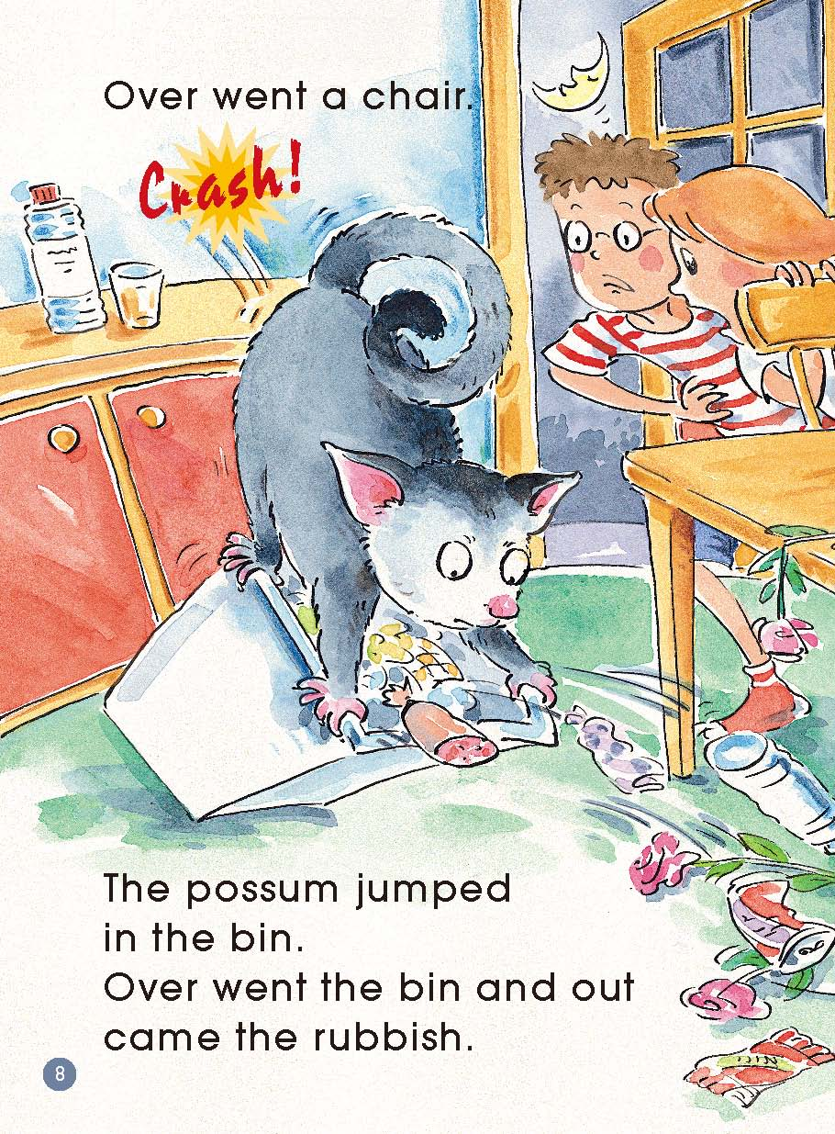
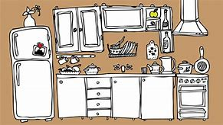
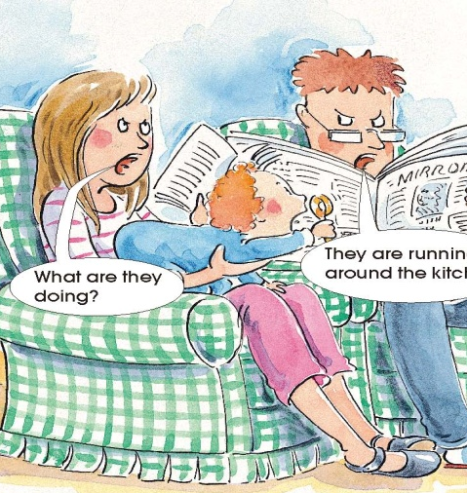
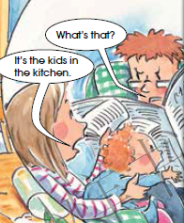
Pages 4 - 9
chase
vase
rubbish
bin
In the
kitchen
In the
sitting room

Slide 7
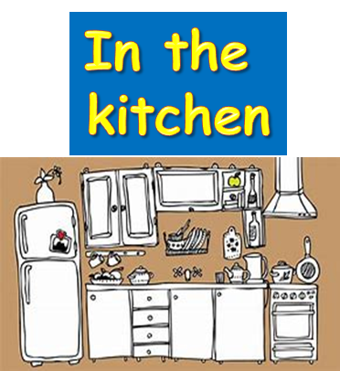
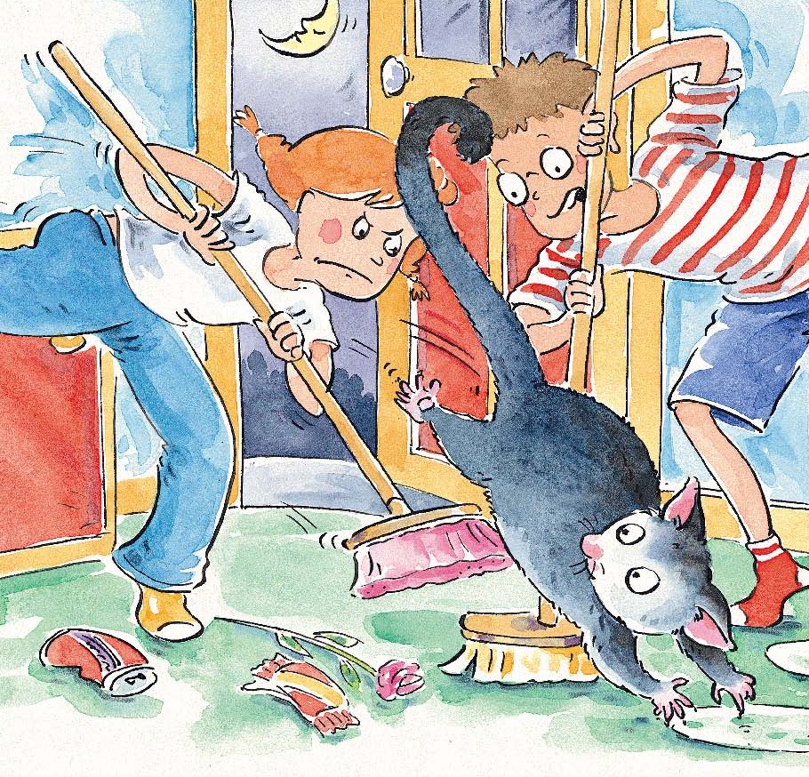
Pages 10 - 11
broom
banged

Slide 8
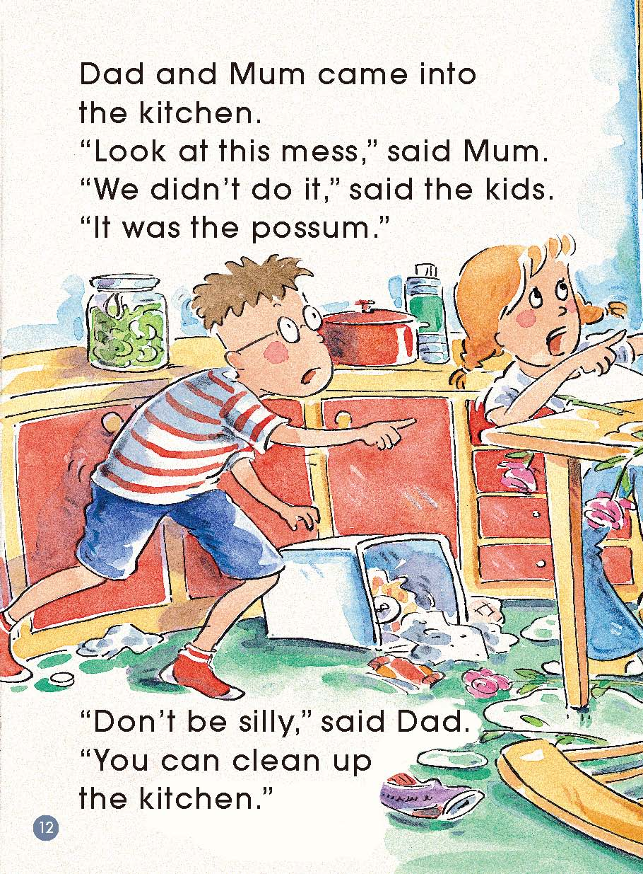
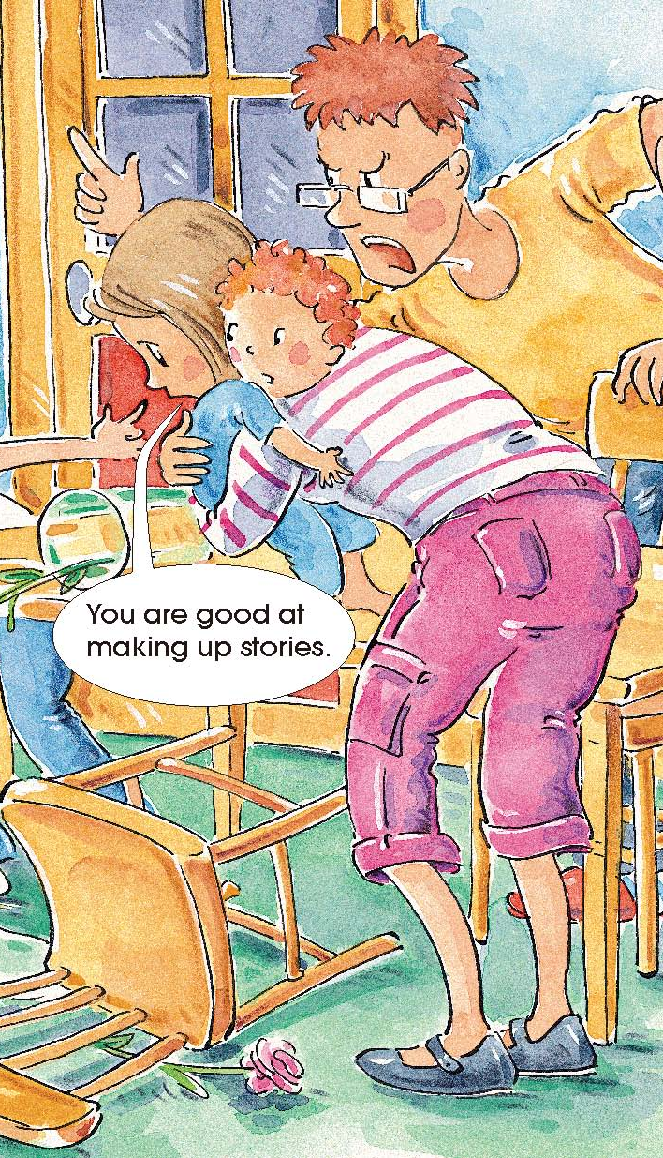
Pages 12 - 13
Were Mum and Dad happy?
Why or why not?
Do you think the kids should clean up the kitchen?
Why or why not?

Slide 9
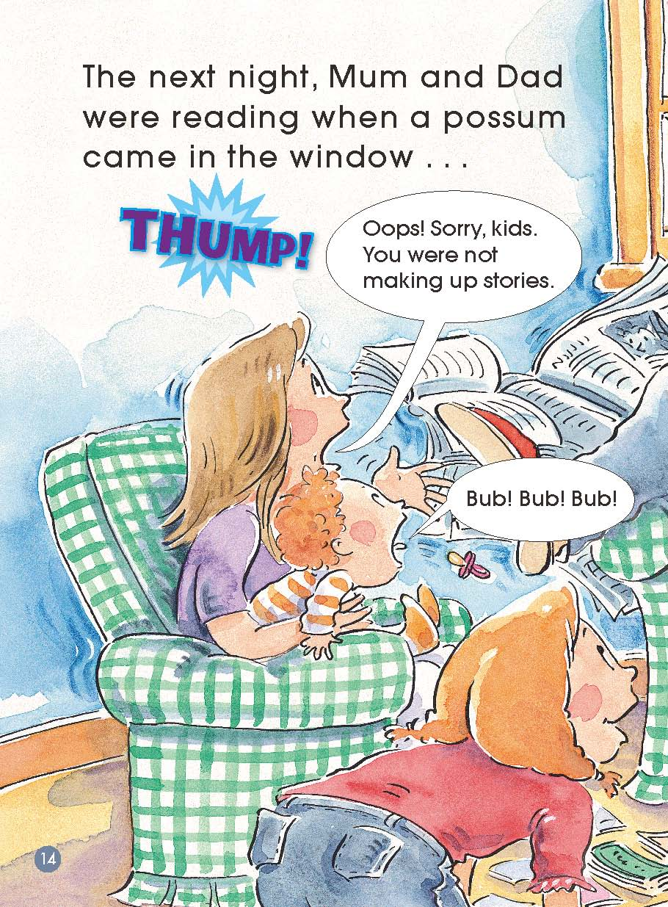
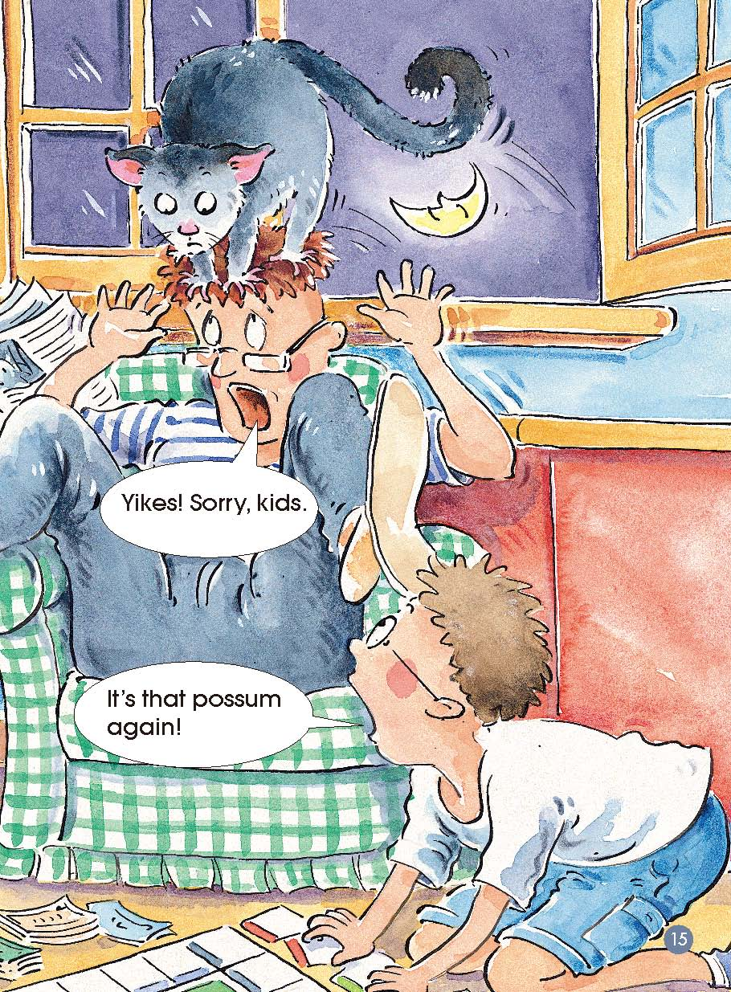
Pages 14 - 15
In the
sitting room
What did Mum and Dad say to the kids?
What happened?
When?
Where?

Slide 10
Put the pictures in order.
2
5
4
3
1

Slide 11
Reading Circles
Word
Master
Summarizer
Creative
Connector
Questioner

Slide 12
Word Master
I choose_____
From this word,
I know_______.
Page__
I choose_____
Page__
From this word,
I know_______.
I choose_____
Page__
From this word,
I know_______.
Page__
I choose_____
From this word,
I know_______.

Slide 13
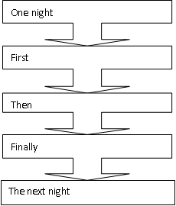
Summarizer

Slide 14
Questioner
Question 3__________________
My answer__________________
Question 1________________
My answer__________________
Question 2_________________
My answer_________________

Slide 15
Creative Connector
1. Have you ever felt something wasn’t fair?
2. Have you ever had someone not believing what you said or listening to you?
3. What was it?
4. How did you feel?
5. What did you do?

Slide 16
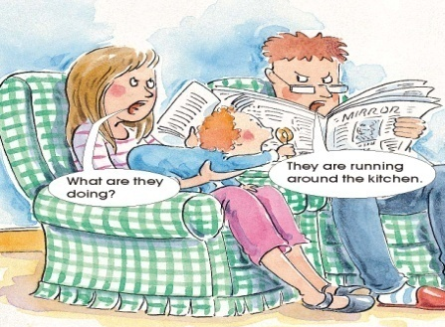
Make a new story and act it.
1
2
3
Two kids try
to make their parents know what happens and deal with the problem together with their parents.
Hearing the noise in the kitchen, Mum and Dad go
to the kitchen and see what happened.
If you were
the two kids, what would you do when your parents asked you to clean up the kitchen as a punishment?

Slide 17
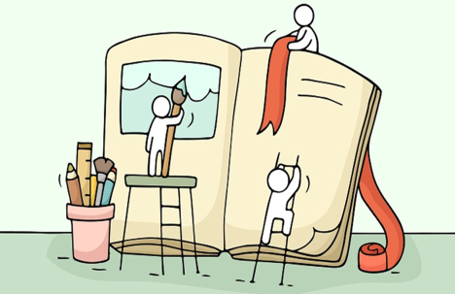
Homework
Write the story：The next night, Mum and Dad were reading when a possum came in the window...
2. Draw and write of a time when
you felt something wasn’t fair
for you.

