Slide 1
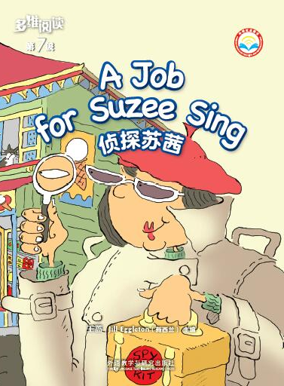
What can you see from the cover?
What’s the title and what do you think the meaning of the title is?
What is Suzee Sing's job?
选自
《多维阅读第7级》

Slide 2
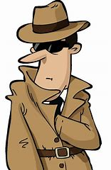
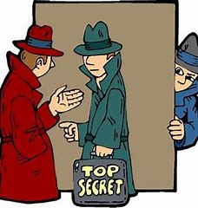
spy

Slide 3
Read pages 2-5
Where do you think Suzee Sing the spy might be going?
Why do you think Suzee Sing put on her spy clothes?

Slide 4
Read pages 2-5
What do you think this shop sells? How do you know?
What was Ravi's problem? Find the words that tell you.

Slide 5
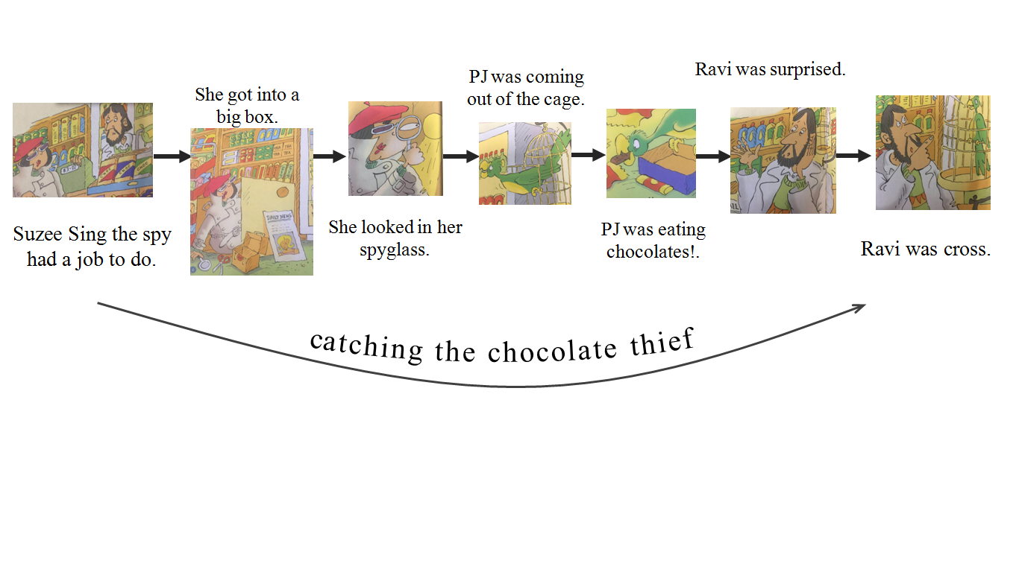
Read the whole story
and finish the mind map

Slide 6
Reading Circles
Summarizer
Word
Master
Creative
Connector
Cultural
Connector

Slide 7
Word Master
put on her spy clothes
worried
said “come in”
hired a spy
had a box in his break
got into a big box
got the thief
was eating chocolates
looked in her spyglass
got angry
…
…
…

Slide 8
Summarizer

Slide 9
Cultural Connector
If you were Suzee Sing
What did you wear and bring for the new job?
What did you do for the job at Ravi's shop?
Are you happy with your job? Why or why not?

Slide 10
If you were Ravi
What did you do with the chocolate thief in the past?
What would you do with the chocolate thief, PJ?
What should you do if the same thing happened next time?

Slide 11
If you were PJ the parrot
What did you do every night in the shop?
Is it good to do so?
What punishment do you think you would get from Ravi?

Slide 12
Creative Connector
Have you ever had a problem you couldn’t fix yourself?
What was it and who did you get to help you?

Slide 13
Let’s act
Tips:
1. Group work.
2. Act with full emotion.
3. Do some actions.

Slide 14
Homework
Try to retell the story in your own words.
What job would you like to do when you grow up? Draw and write about it.

