Slide 1
Let’s read
第6级

Slide 2
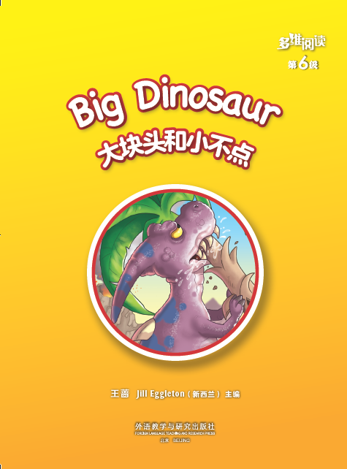
Series name
Level
Title
Where is he?
Authors
Publisher

Slide 3
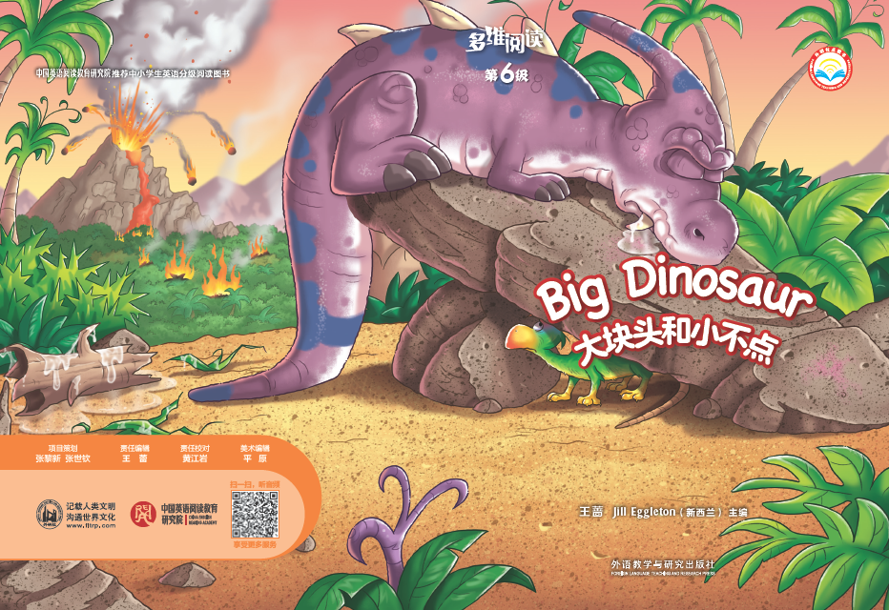
What happened in the forest?
What would happen to them?

Slide 4
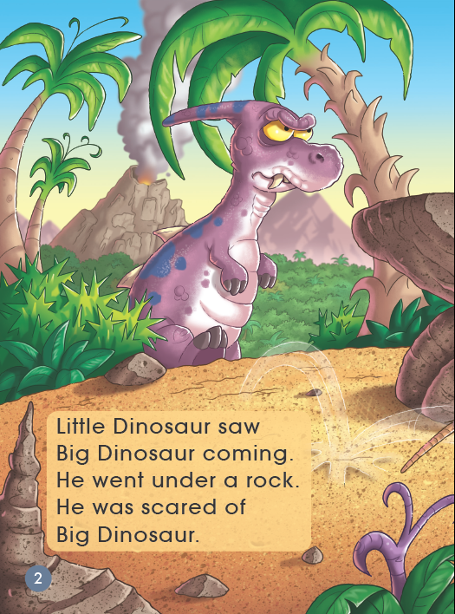
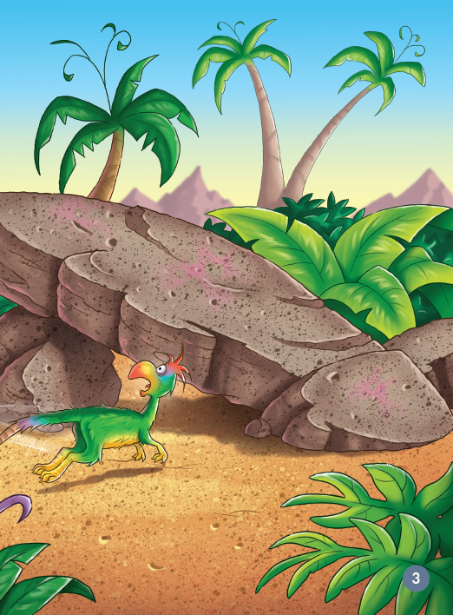
Why is Little Dinosaur looking so scared?
How did Little Dinosaur feel?

Slide 5
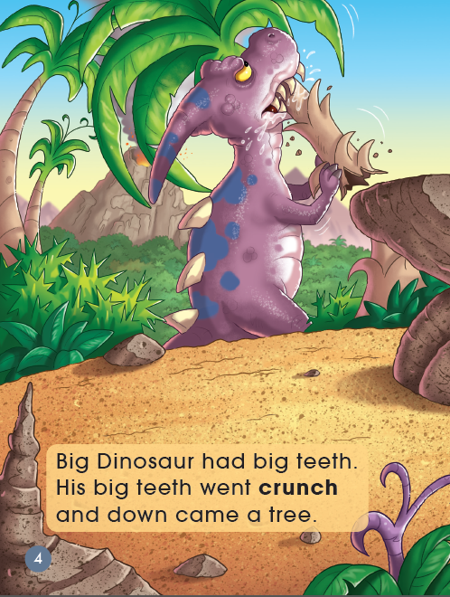
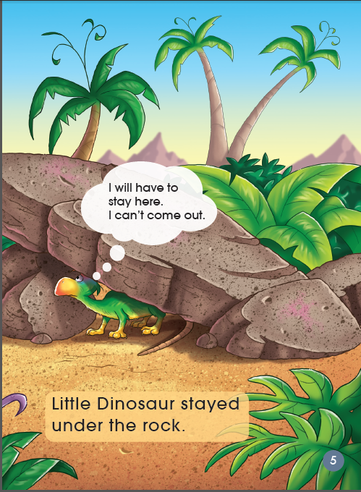
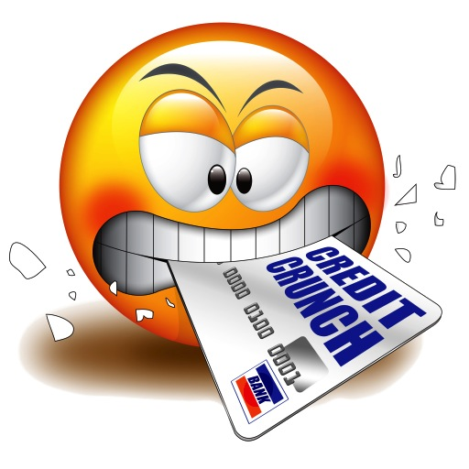
What did Big Dinosaur do?
What did Little Dinosaur do?

Slide 6
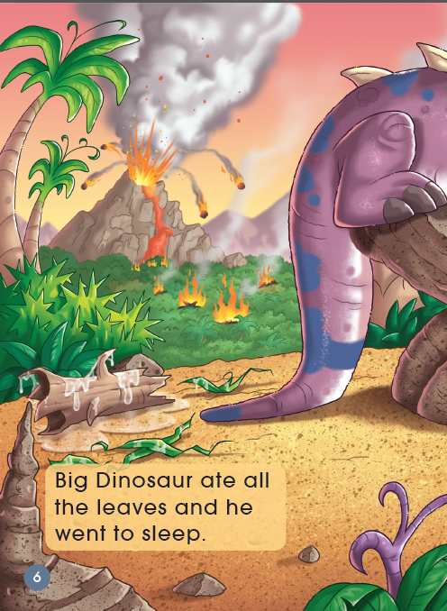
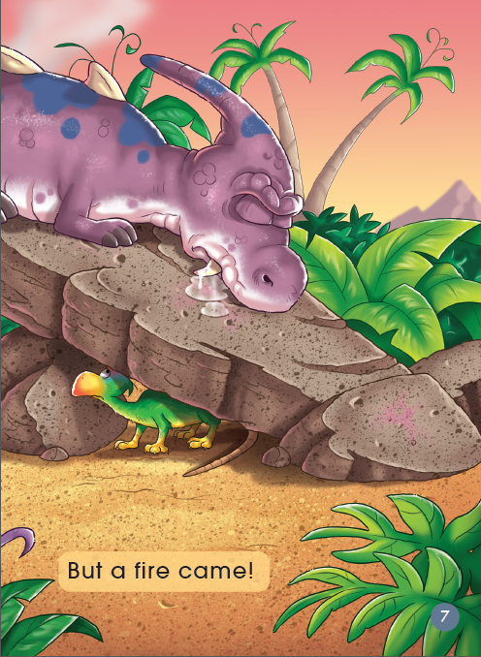
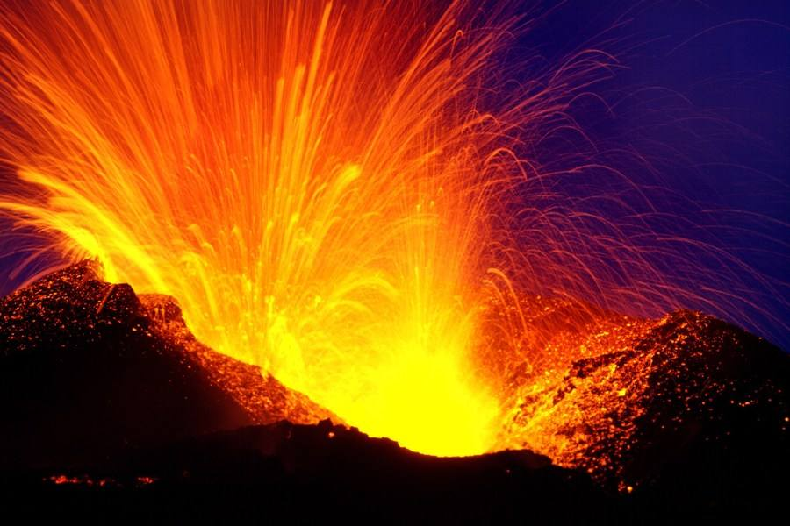
the volcano erupted
What happened in the forest?
图片来源
https://image.baidu.com/search/detail?ct=503316480&z=0&ipn=d&word=%E7%81%AB%E5%B1%B1%E7%88%86%E5%8F%91&step_word=&hs=0&pn=558&spn=0&di=138134223040&pi=0&rn=1&tn=baiduimagedetail&is=0%2C0&istype=2&ie=utf-8&oe=utf-8&in=&cl=2&lm=-1&st=-1&cs=79381698%2C1077253468&os=3340490680%2C486918765&simid=0%2C0&adpicid=0&lpn=0&ln=1822&fr=&fmq=1540186900930_R&fm=&ic=0&s=undefined&se=&sme=&tab=0&width=&height=&face=undefined&ist=&jit=&cg=&bdtype=0&oriquery=&objurl=http%3A%2F%2Fg0.hexunimg.cn%2F2015-09-11%2F179039494.jpg&fromurl=ippr_z2C%24qAzdH3FAzdH3Fgjof_z%26e3Bijx7g_z%26e3Bv54AzdH3Fda8c-al-88AzdH3F80lanl9bb_c_z%26e3Bip4s&gsm=1fe&rpstart=0&rpnum=0&islist=&querylist=

Slide 7
What was Big Dinosaur doing?
a fire came
图片来源
https://image.baidu.com/search/detail?ct=503316480&z=0&ipn=d&word=%E7%81%AB%E5%B1%B1%E7%88%86%E5%8F%91&step_word=&hs=0&pn=558&spn=0&di=138134223040&pi=0&rn=1&tn=baiduimagedetail&is=0%2C0&istype=2&ie=utf-8&oe=utf-8&in=&cl=2&lm=-1&st=-1&cs=79381698%2C1077253468&os=3340490680%2C486918765&simid=0%2C0&adpicid=0&lpn=0&ln=1822&fr=&fmq=1540186900930_R&fm=&ic=0&s=undefined&se=&sme=&tab=0&width=&height=&face=undefined&ist=&jit=&cg=&bdtype=0&oriquery=&objurl=http%3A%2F%2Fg0.hexunimg.cn%2F2015-09-11%2F179039494.jpg&fromurl=ippr_z2C%24qAzdH3FAzdH3Fgjof_z%26e3Bijx7g_z%26e3Bv54AzdH3Fda8c-al-88AzdH3F80lanl9bb_c_z%26e3Bip4s&gsm=1fe&rpstart=0&rpnum=0&islist=&querylist=

Slide 8
Read PP 6-11 by yourself and anwser the questions
1. What did Little Dinosaur do?
2. What did Big Dinosaur do?

Slide 9
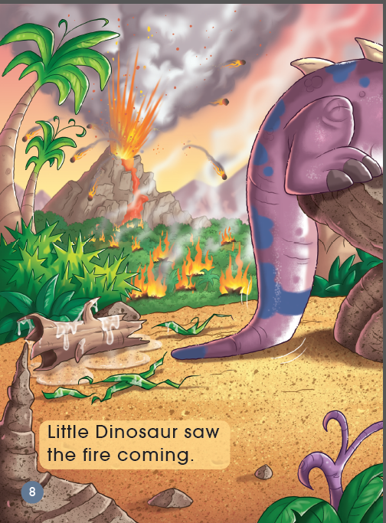
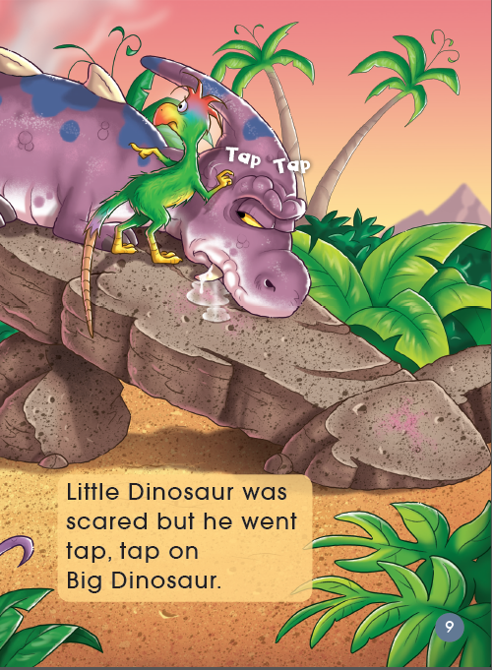
Why did Little Dinosaur choose to tap?

Slide 10
Notes:
图片来源 http://image.baidu.com/search/detail?ct=503316480&z=0&ipn=d&word=%E8%BD%BB%E8%BD%BB%E7%9A%84%E6%95%B2%E6%89%93&step_word=&hs=0&pn=42&spn=0&di=17114362451&pi=0&rn=1&tn=baiduimagedetail&is=0%2C0&istype=0&ie=utf-8&oe=utf-8&in=&cl=2&lm=-1&st=undefined&cs=1322794402%2C2665986216&os=336427588%2C1738428964&simid=1961658747%2C884976890&adpicid=0&lpn=0&ln=1155&fr=&fmq=1535161356450_R&fm=&ic=undefined&s=undefined&se=&sme=&tab=0&width=undefined&height=undefined&face=undefined&ist=&jit=&cg=&bdtype=13&oriquery=&objurl=http%3A%2F%2Fimgsrc.baidu.com%2Fimage%2Fc0%3Dpixel_huitu%2C0%2C0%2C294%2C40%2Fsign%3D7fff31c370cb0a46912f8379021b9348%2F11385343fbf2b211e01f5677c18065380cd78ed2.jpg&fromurl=ippr_z2C%24qAzdH3FAzdH3Fooo_z%26e3Bi7tp7_z%26e3Bv54AzdH3Fri5p5AzdH3Ffi5oAzdH3Fda8mabnaAzdH3Fa99nnbl8a9aa_z%26e3Bip4s&gsm=0&rpstart=0&rpnum=0&islist=&querylist=
http://image.baidu.com/search/detail?ct=503316480&z=0&ipn=d&word=%E8%BD%BB%E8%BD%BB%E7%9A%84%E6%95%B2%E6%89%93&step_word=&hs=0&pn=102&spn=0&di=28441040101&pi=0&rn=1&tn=baiduimagedetail&is=0%2C0&istype=0&ie=utf-8&oe=utf-8&in=&cl=2&lm=-1&st=undefined&cs=2058367920%2C3751308024&os=2977864697%2C272561730&simid=4178784154%2C693787068&adpicid=0&lpn=0&ln=1155&fr=&fmq=1535161356450_R&fm=&ic=undefined&s=undefined&se=&sme=&tab=0&width=undefined&height=undefined&face=undefined&ist=&jit=&cg=&bdtype=0&oriquery=&objurl=http%3A%2F%2Fthumbs.dreamstime.com%2Fx%2F%E6%95%B2%E6%89%93%E9%94%A4%E5%AD%90-10249259.jpg&fromurl=ippr_z2C%24qAzdH3FAzdH3Fvg_z%26e3B16jw4fpt4j_z%26e3Bv54AzdH3F%25Ec%25bc%25bD%25E0%25bl%25bb%25E0%25Ab%25bE%25Ec%25BA%25ln%25Ec%25AD%25lb%25Ec%25lB%25BE%25E0%25bl%25b0-%25Em%25lc%25Bd%25Em%25bl%25ln%25El%25l9%25A9%25Ec%25AD%25la-t4w2j8ad9ldcl&gsm=3c&rpstart=0&rpnum=0&islist=&querylist=

Slide 11
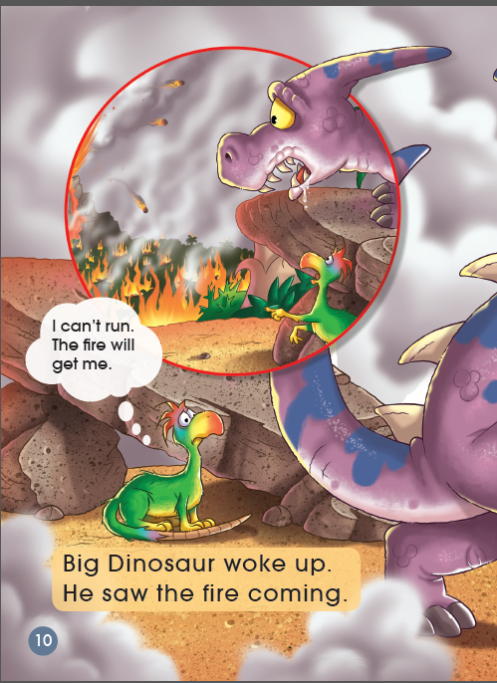
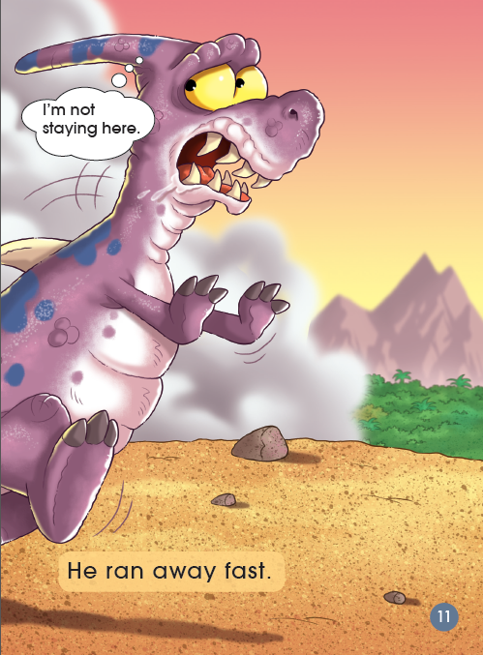
Little Dinosaur was surprised

Slide 12
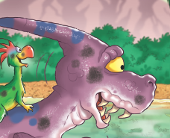
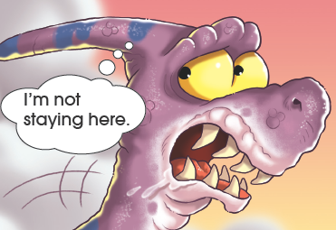
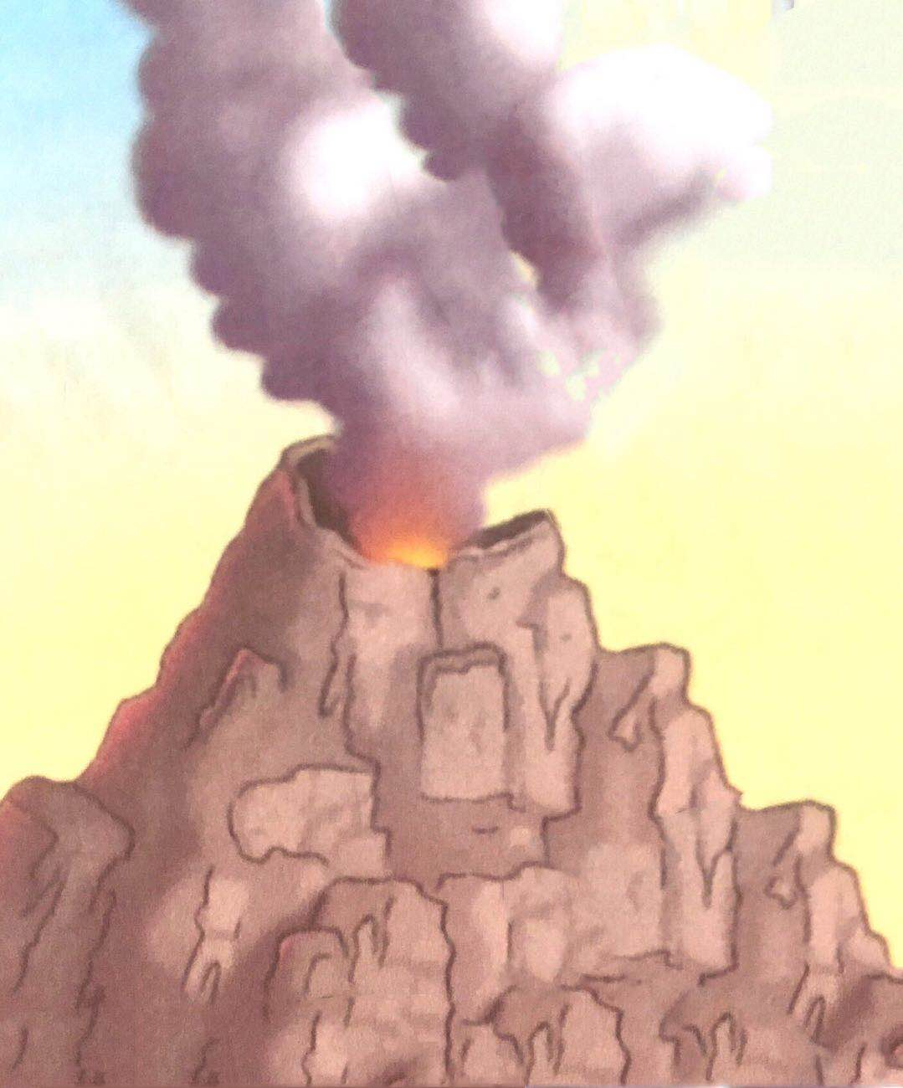
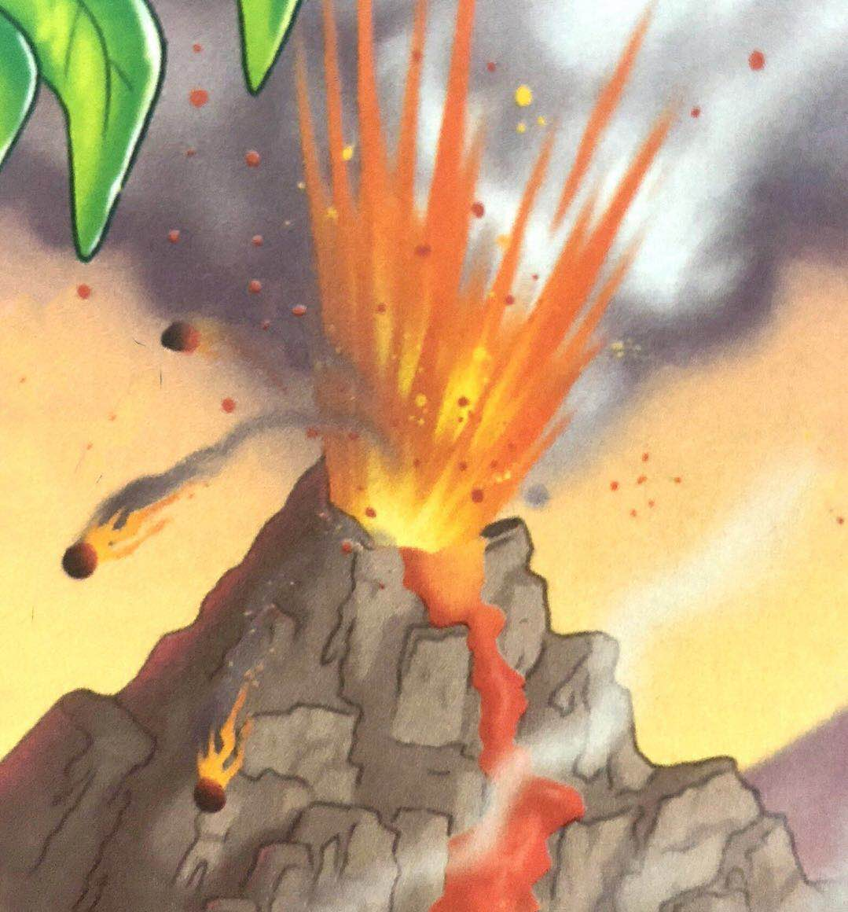
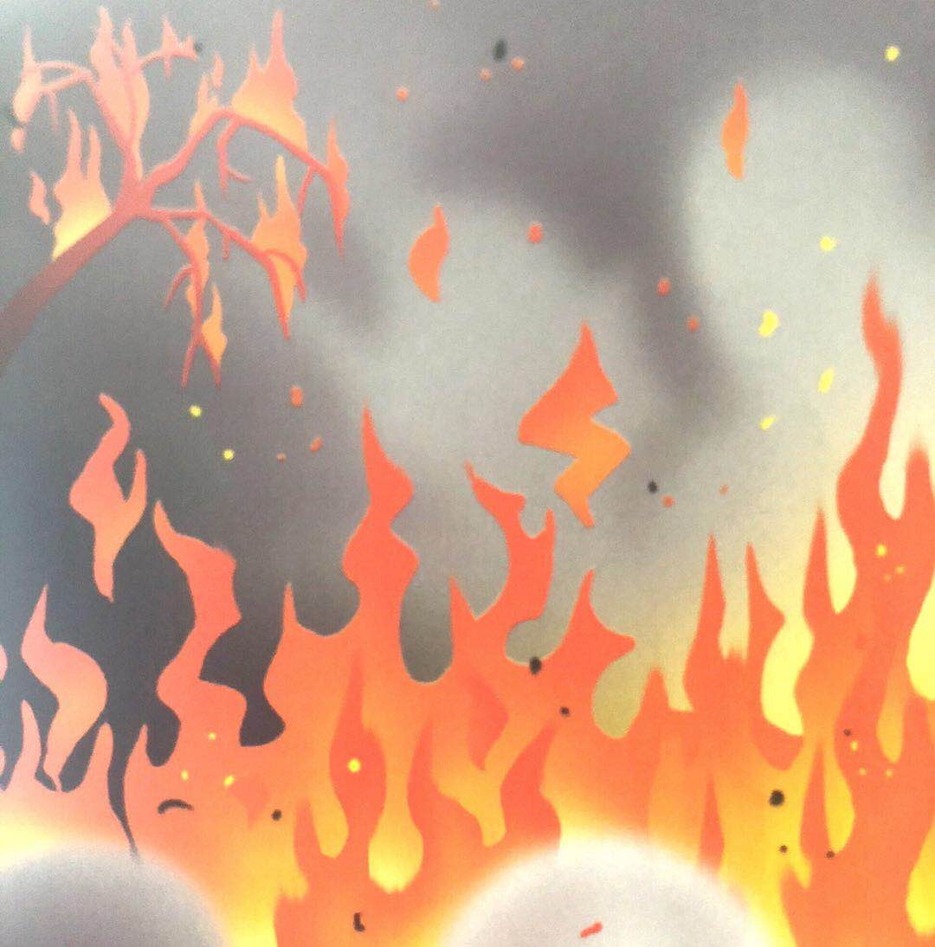
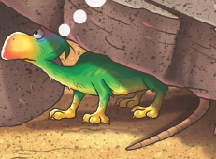
1. Read PP 6-11 by yourself 2. Finish Worksheet 1
went crunch and down came a tree
came to help
ran away fast
stayed under the rock
stayed under the rock
was scared but went tap, tap

Slide 13
went crunch and down came a tree
came to help
ran away fast
stayed under the rock
stayed under the rock
was scared but went tap, tap

Slide 14
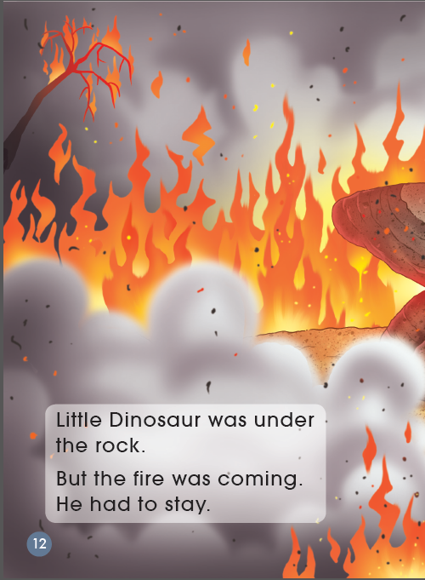
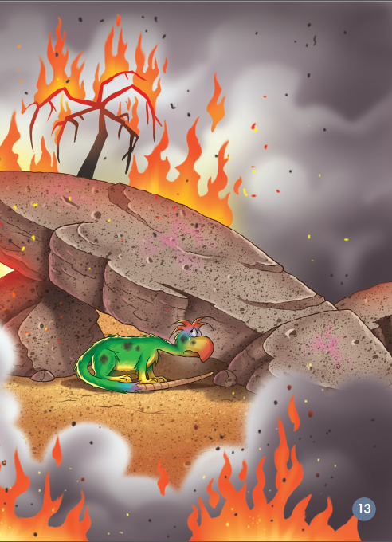
What was Little Dinosaur doing?
How did he feel?

Slide 15
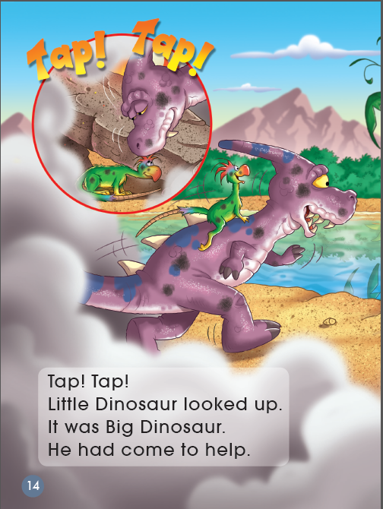
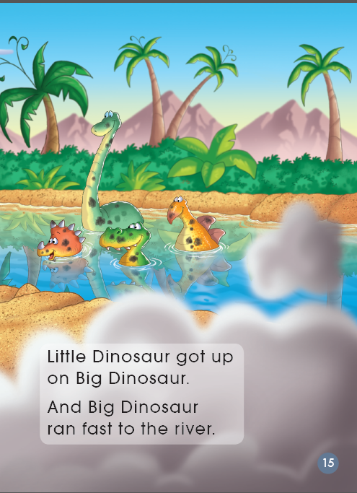
How did Big Dinosaur help him?
What do you think of him?

Slide 16
Listen and repeat
Tips:
1. Listen carefully.
2. Follow to read.
3. Point with fingers.

Slide 17
1. Finish Worksheet 2
2. Talk about it with your partner
Cause
Problem
The volcano erupted.
A _______ came.
Solution
Tap Tap/ran away by yourself/help others

Slide 18
Talk about the story
Help each other.
Q1: If Big Dinosaur didn't help Little Dinosaur, what would happen?
Q2: If Big Dinosaur were nice to others in the beginning, what would happen?

Slide 19
Homework
Read the story again.
Tell a story that happened between you and your friends.

