Slide 1
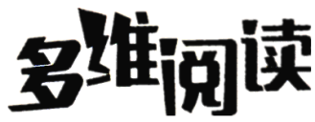
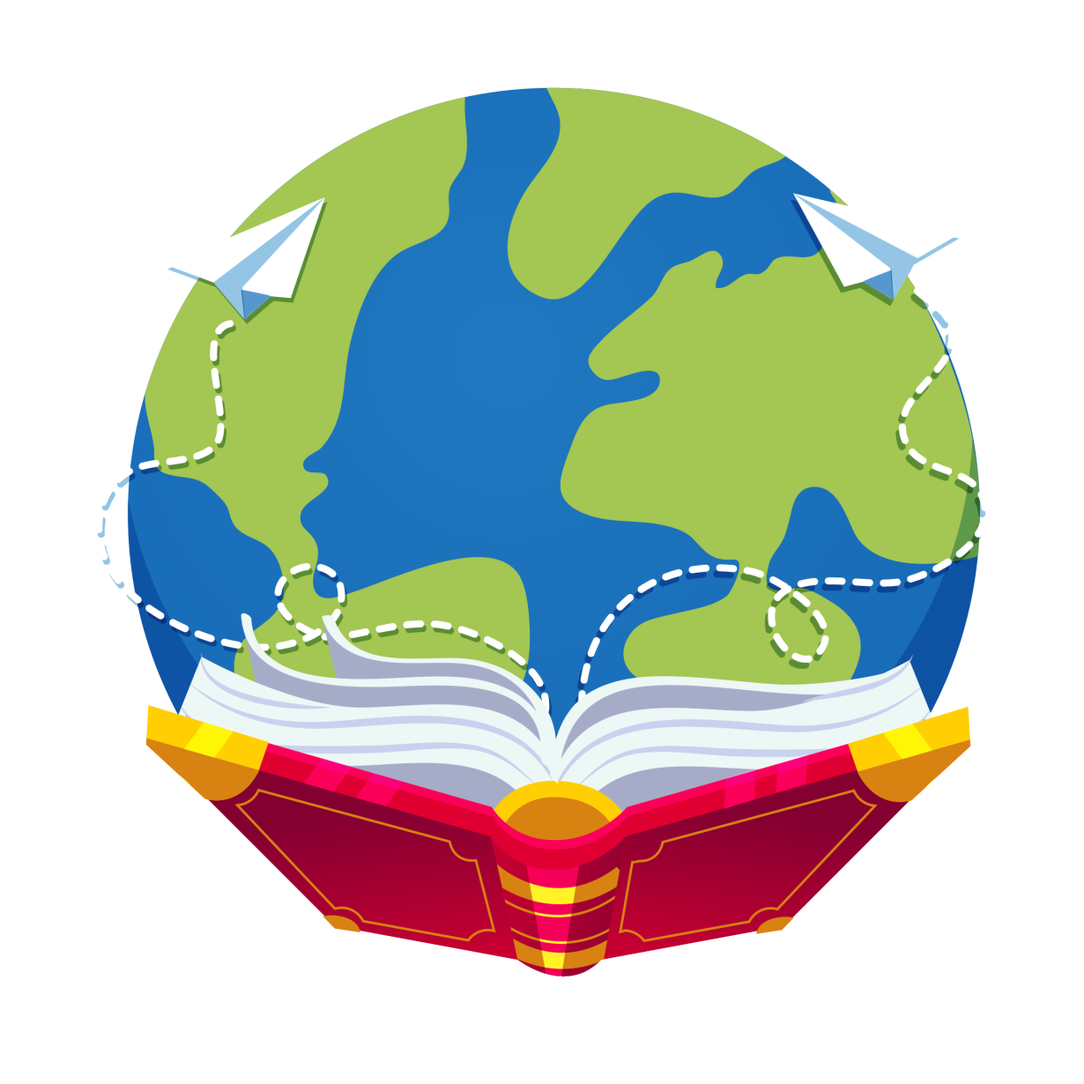
Let’s read
第6级

Slide 2
Let’s guess
Q: Who is he?
His work is dangerous.
He can swim.
He works under the water.

Slide 3
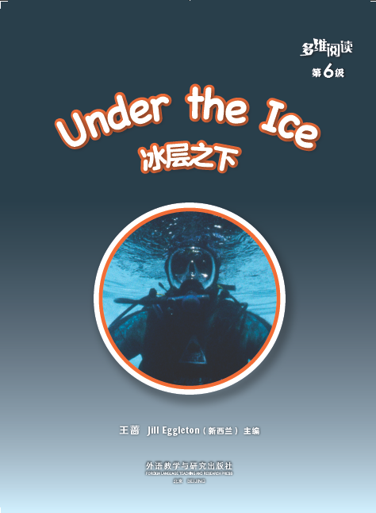
Q: What do you want to know about the diver?
Series name
Level
Diver
Title
Where is this diver?
Authors
I think he is …
Publisher

Slide 4
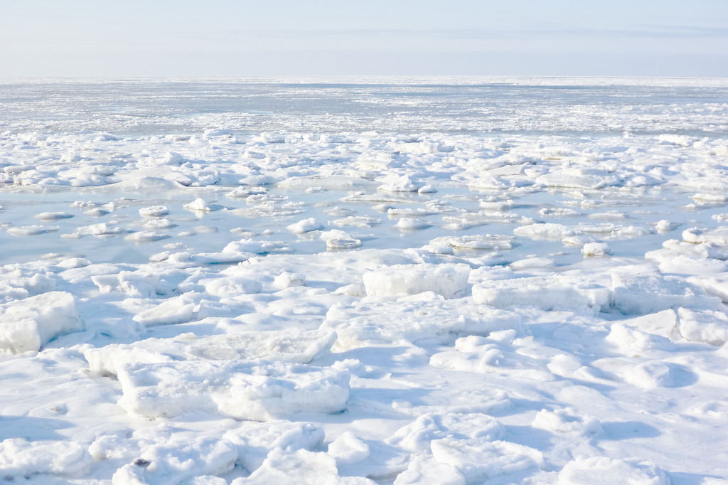

Slide 5
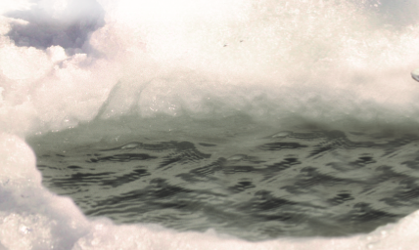
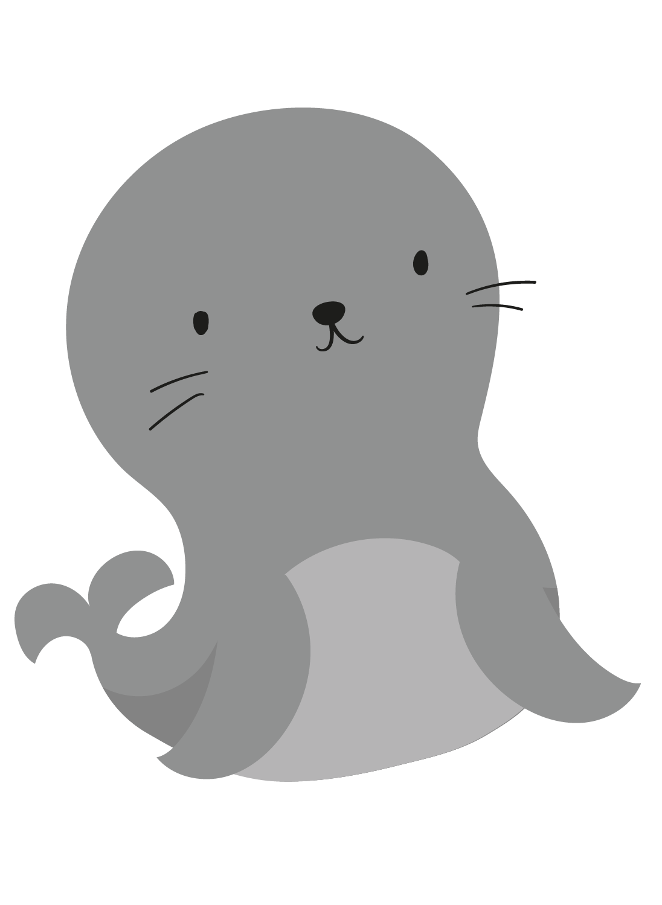
How has the seal made it?
Who has made the hole?
a hole in the ice

Slide 6
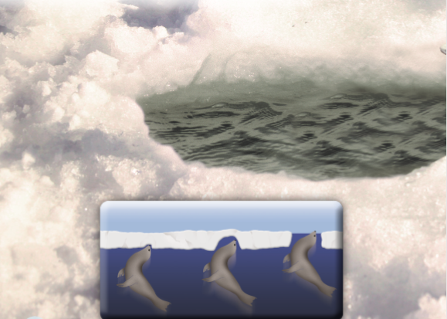
push the ice with its head

Slide 7
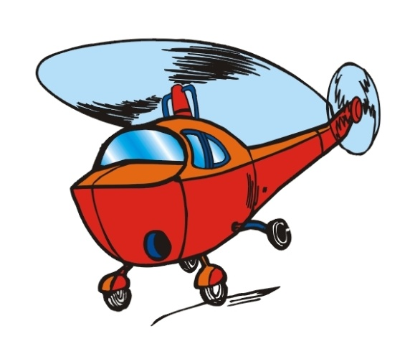
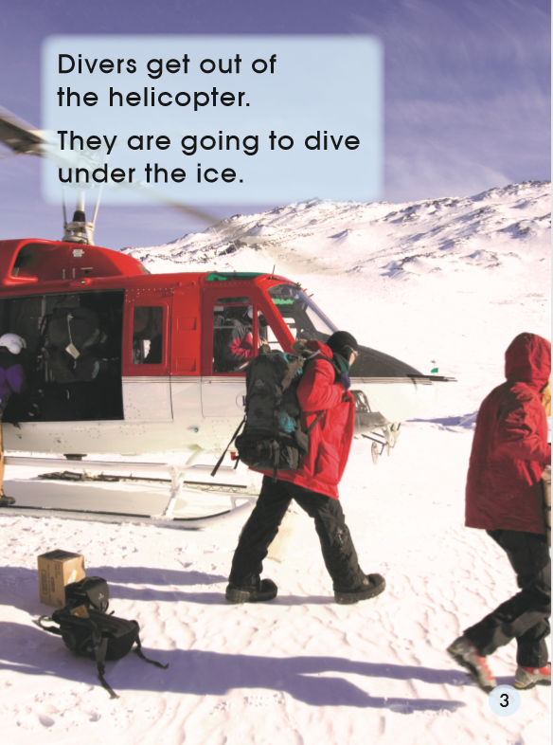
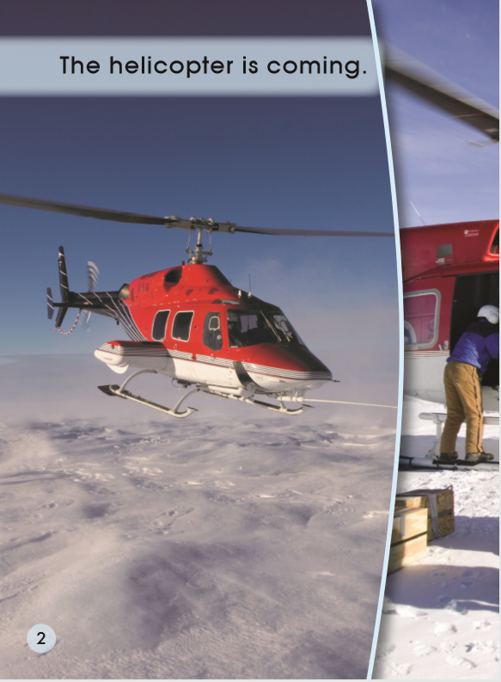
helicopter

Slide 8
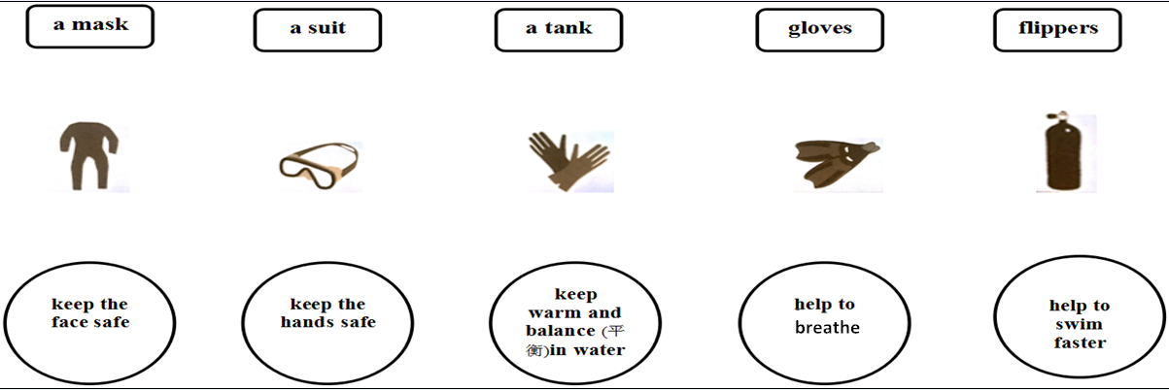
Q: What do the divers put on? Why?
Tips:
1. Read page 6. Match the names with the pictures.
2. Match the pictures with their functions(功能).
3. Talk in groups.

Slide 9
Q: What do the divers put on? Why?
They put on … It/They can …

Slide 10
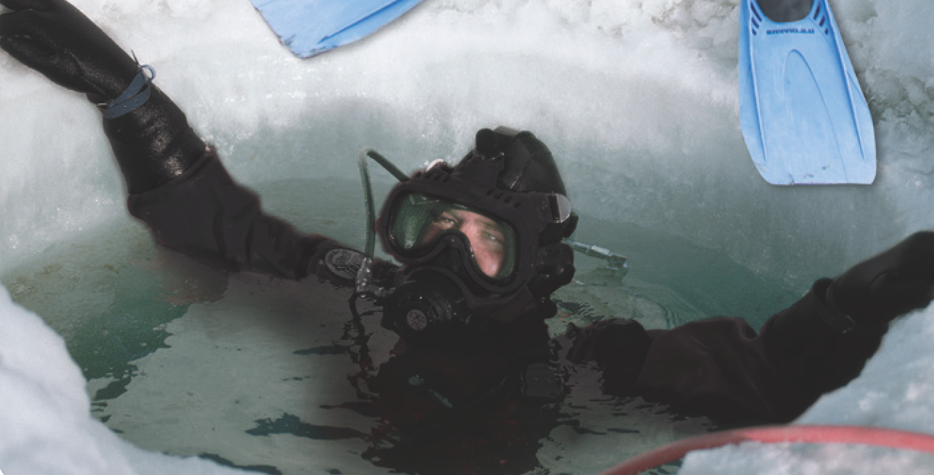

Slide 11
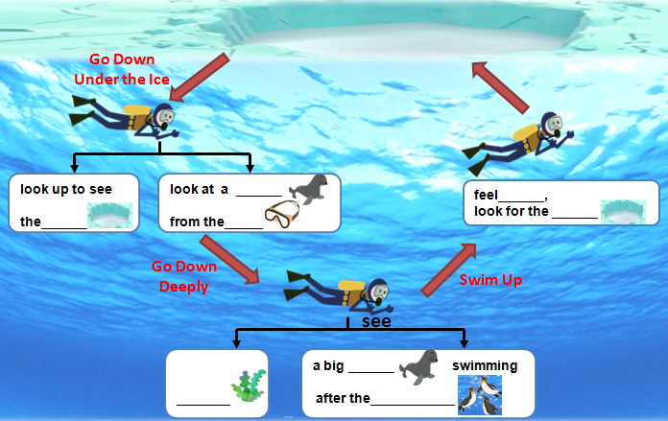
Tips:
1. Read PP 8-15.
2. Finish the worksheet.
3. Discuss in groups.
Q: What do the divers do under the ice?

Slide 12
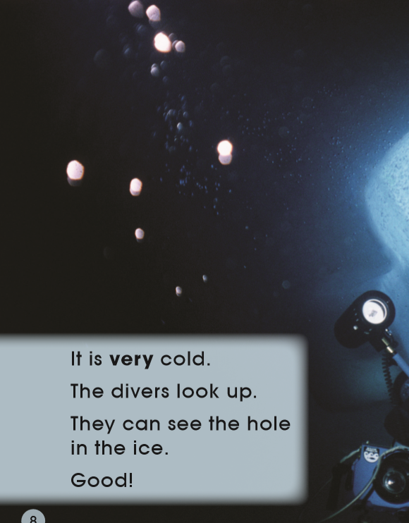
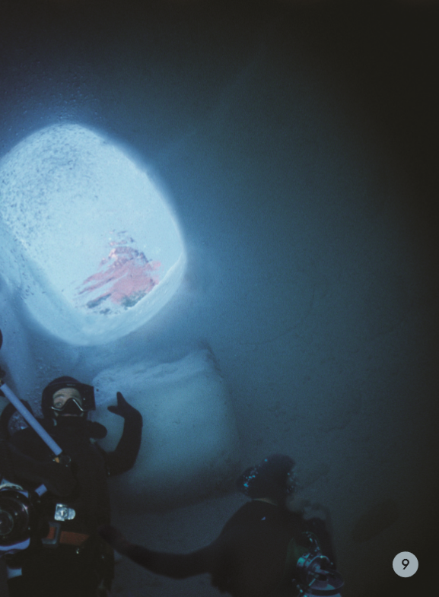
Go down at first
hole
Why?
Swim back!

Slide 13
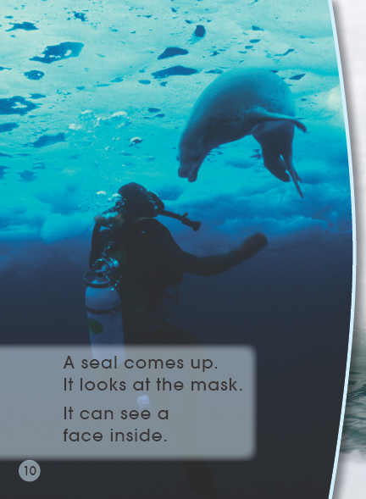
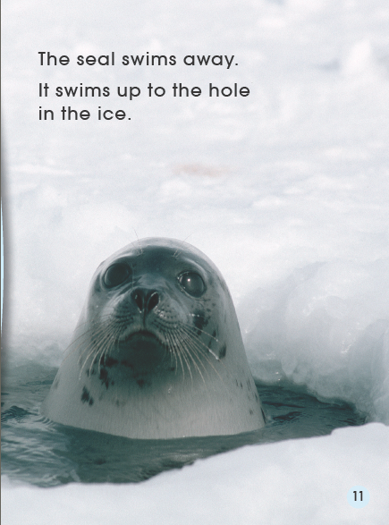
seal

Slide 14
Go down deep
What can they see?
Divers see…

Slide 15
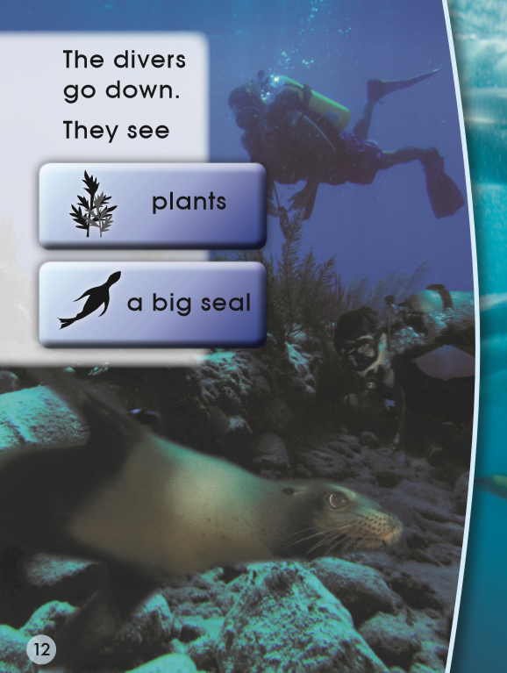
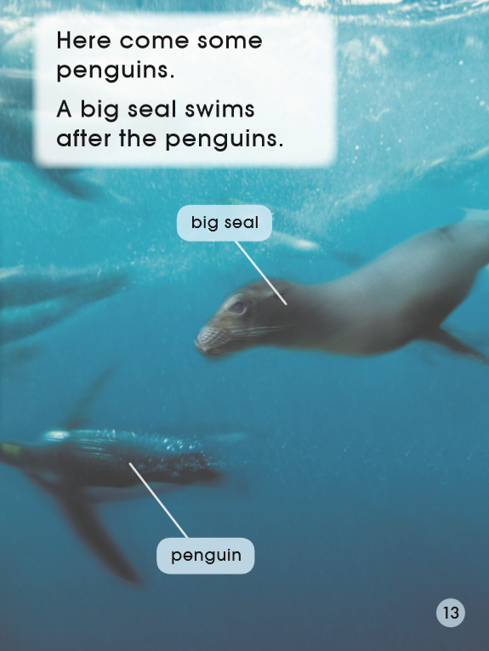
Go down deep
safe?
Why?

Slide 16
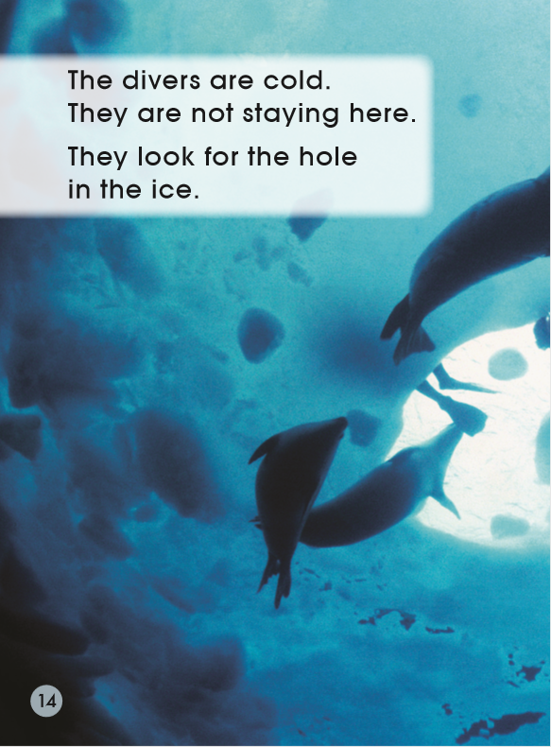
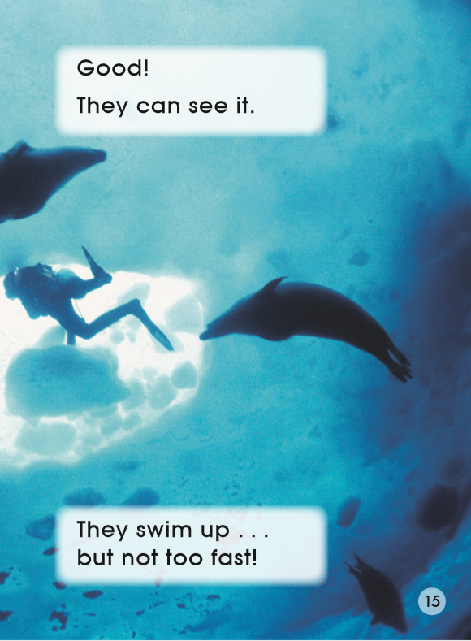
Swim up
Divers feel …
They look for …
Why do they swim slowly?

Slide 17
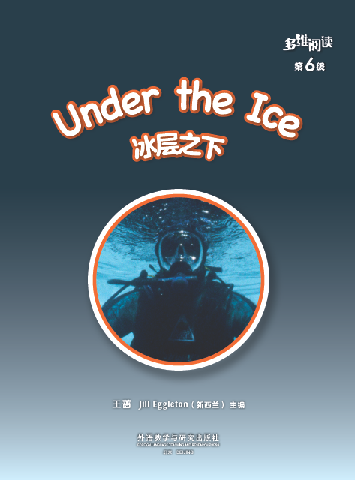
Listen and repeat
Tips:
1. Listen carefully.
2. Follow to read.
3. Point with fingers.

Slide 18
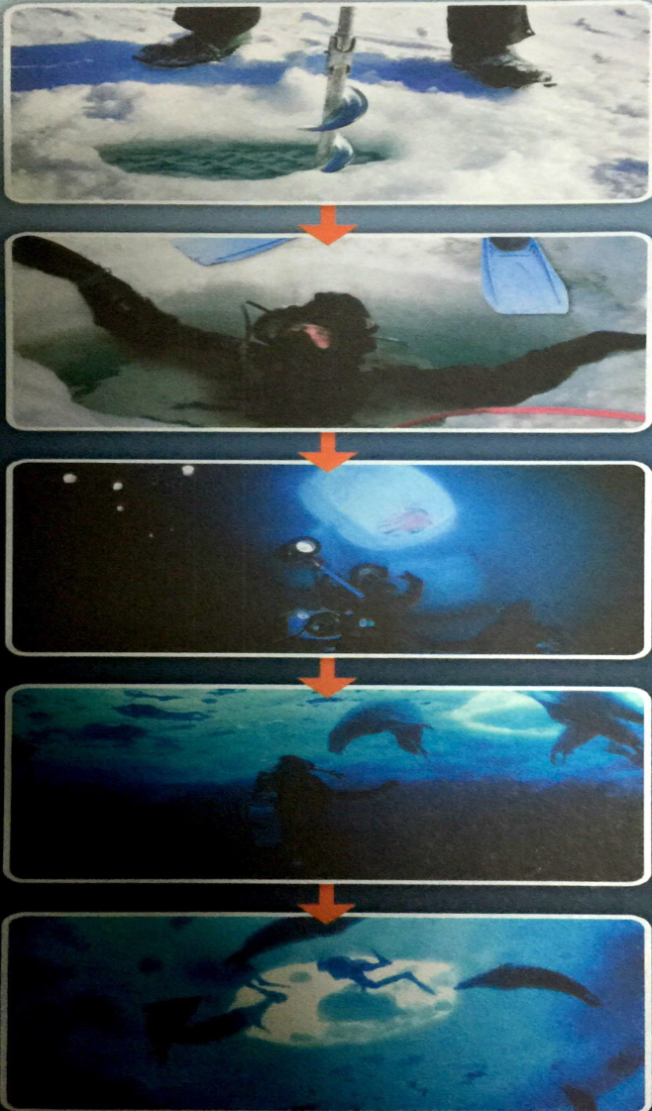
Tell the story
S1: One day, the divers find a … and make it … They go down, under the ice.
S2: Divers look up. They can see the … It’s good.
S3: They see a … coming. They see penguins and ... deep under the ice.
S4: Divers feel …
They look for the … and swim up.

Slide 19
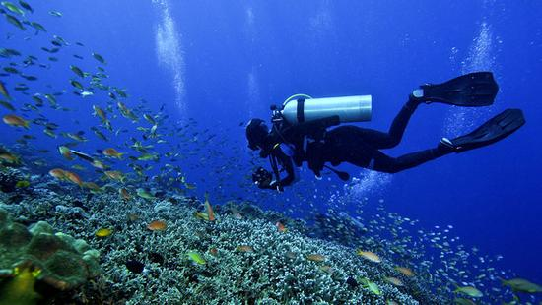
Q: Why do divers go down under the ice?
Tips:
1. Talk in pairs.
2. Share it in the class.
Useful structure:
I think divers want to …

Slide 20
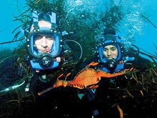
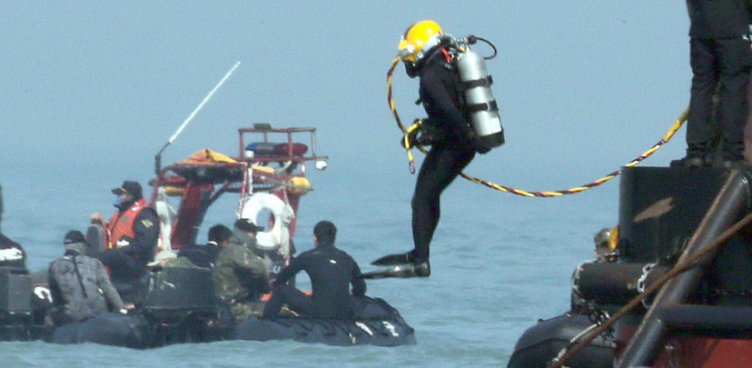
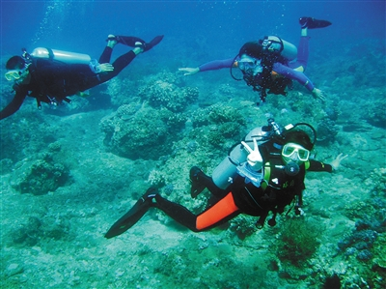

Slide 21
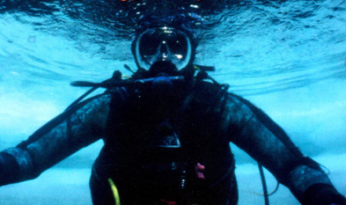
Q: What do you think of the divers?
Tips:
1. Comment on divers.
2. Share it in the class.
Useful structures:
I think divers are/have …
Please look at page …, it says …
cool great brave strong tough(坚强)
good teamwork

Slide 22
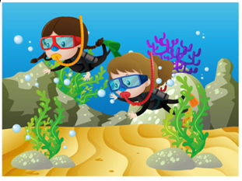
Homework
1. Listen and read the book.
2. Write down your experience under the water.
I have been under the water in … (city/country name)
I see …
I feel …
…

