Slide 1
Let’s read
第6级

Slide 2
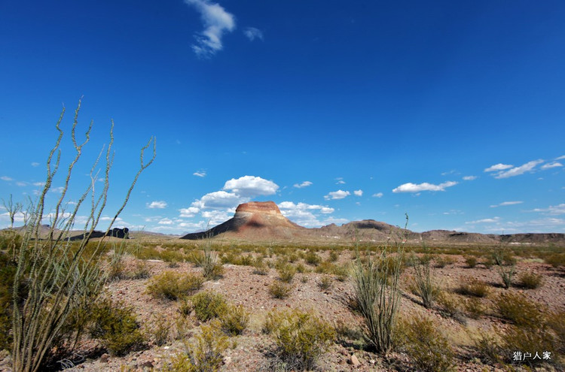
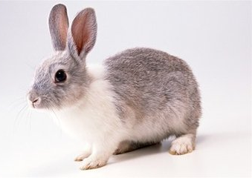
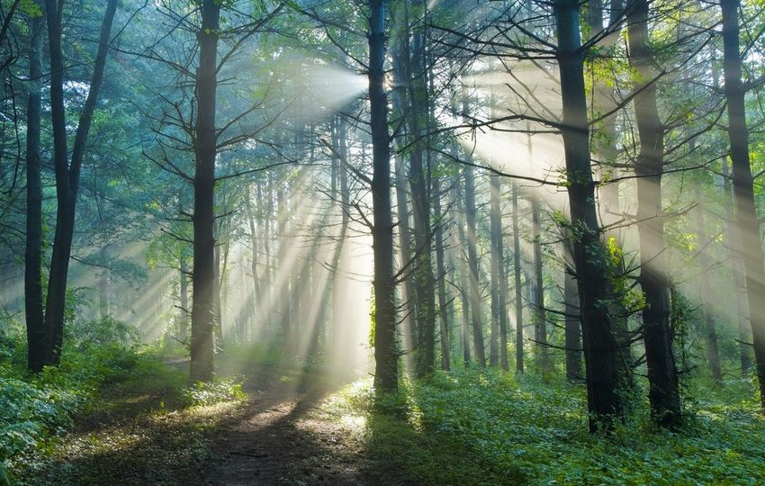
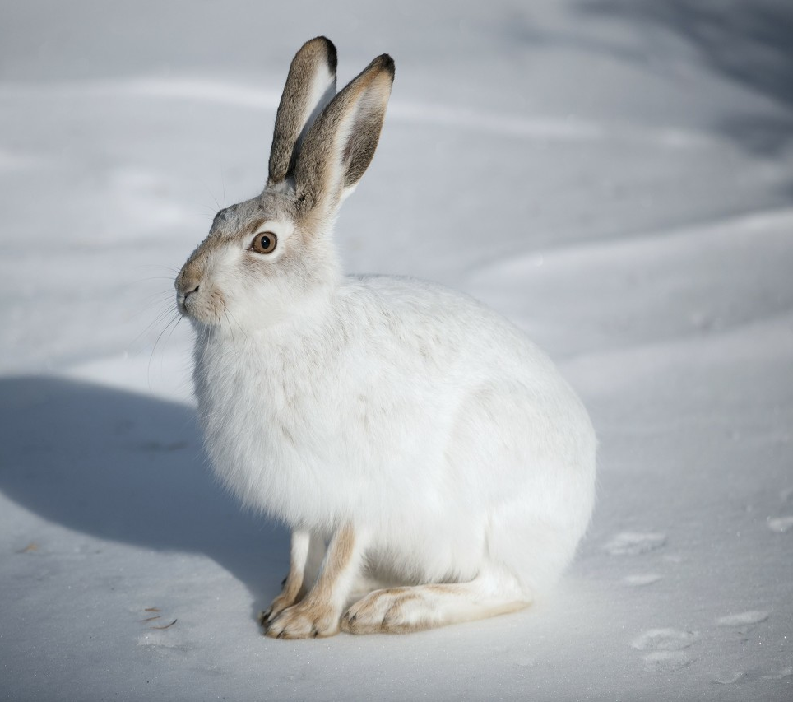
Rabbit
longer ears
Hare
bigger, stronger feet

Slide 3
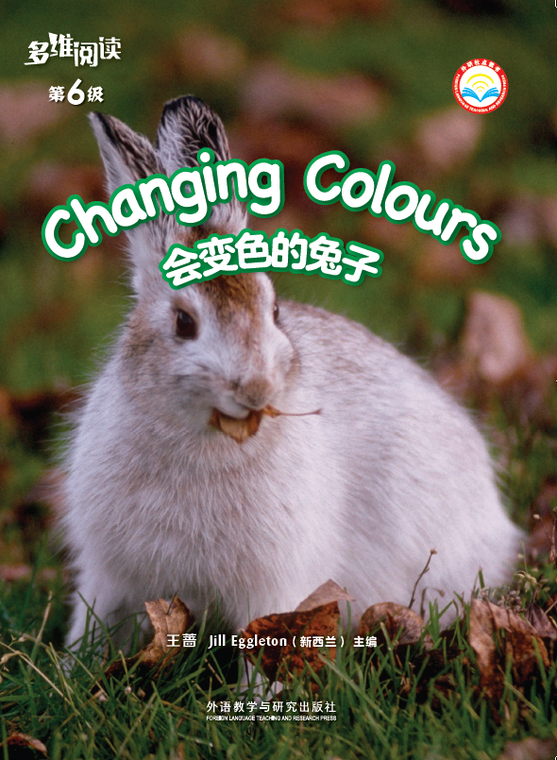
Series name
Level
Title
Authors
Publisher

Slide 4
What do you want to know about the hare?
What?
Where?
When?
Why?
How?

Slide 5
When does the snowshoe hare hide in the log?
What colour is the snowshoe hare in summer?
in the day
brown
Where does the snowshoe hare live or hide?
inside the log

Slide 6
What time is it?
night
What is the snowshoe hare doing?
fox
looking for food
Who is coming?

Slide 7
Can the fox catch the rabbit? Why?
big feet
Why is the snowshoe hare faster than the fox?
I think ... can/can't ..., because ...

Slide 8
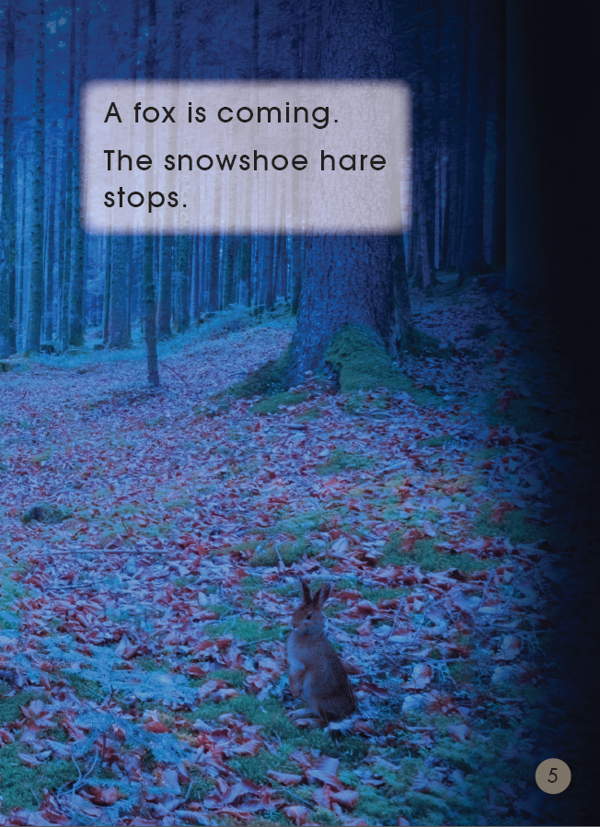
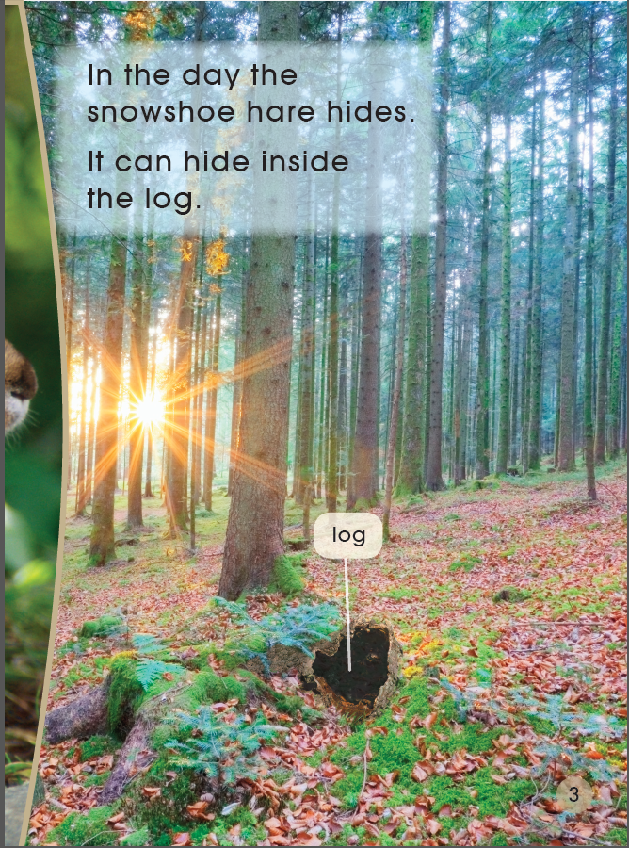
Living Style
hides inside the log in the day
looks for food at night

Slide 9
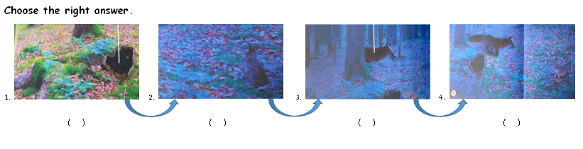
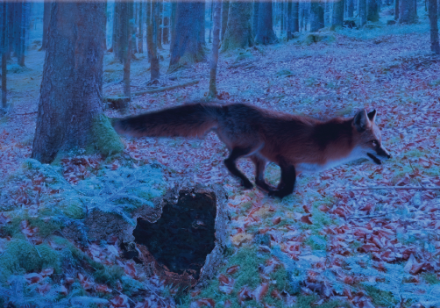
Tips:
1. Read PP 2-7.
2. Finish the worksheet.
3. Check and read in groups.
Q: What do you know about snowshoe hare?
At night, the snowshoe hare looks for food.
The snowshoe hare is too fast for the fox. Because it has big feet.
A fox is coming. The snowshoe hare runs away.
In the day, the snowshoe hare hides inside the log.

Slide 10
D.
A.
C.
B.
In the day, the snowshoe hare hides inside the log.
At night, the snowshoe hare looks for food.
A fox is coming. The snowshoe hare runs away.
The snowshoe hare is too fast for the fox. Because it has big feet.
At night, the snowshoe hare looks for food.
The snowshoe hare is too fast for the fox. Because it has big feet.
A fox is coming. The snowshoe hare runs away.
In the day, the snowshoe hare hides inside the log.

Slide 11
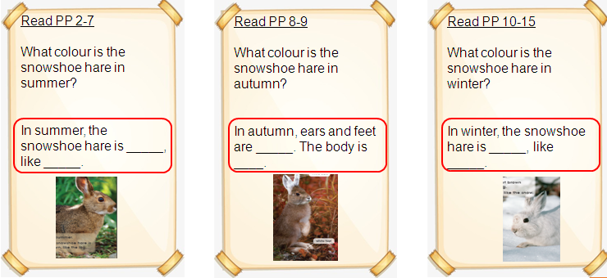
Jigsaw Reading
Q: What colours are the snowshoe hare in different seasons?
Tips:
1. Read PP 2-15.
2. Finish the worksheet.
3. Share in expert group.
4. Share in basic group.

Slide 12
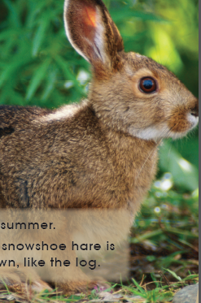
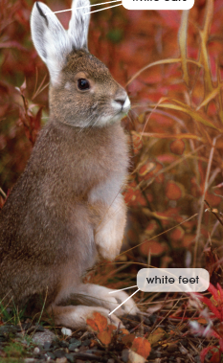
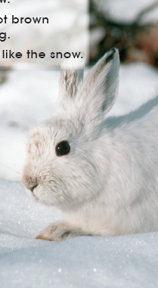
Jigsaw Reading
Read PP 2-7
What colour is the snowshoe hare in summer?
In summer, the snowshoe hare is _____, like _____.
Read PP 8-9
What colour is the snowshoe hare in autumn?
In autumn, ears and feet are _____. The body is ____.
Read PP 10-15
What colour is the snowshoe hare in winter?
In winter, the snowshoe hare is _____, like _____.

Slide 13
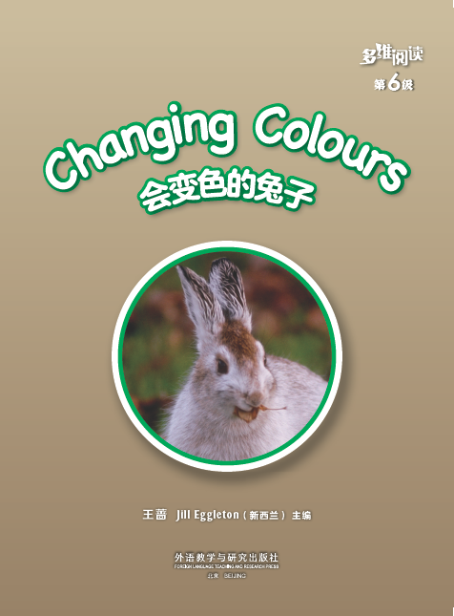
Listen and repeat
Tips:
1. Listen carefully.
2. Follow to read.

Slide 14
Tell the story
Tips:
1. Tell the story in groups.
2. Share it in class.
Useful structures:
in summer, brown, in the day, hides, at night, looks for,
in autumn, ears are ..., feet are ...
in winter, white.

Slide 15
What colour is the snowshoe hare in spring?
?
Useful structures:
I think it is ..., because in ...

Slide 16
Why is the hare called snowshoe hare?

Slide 17
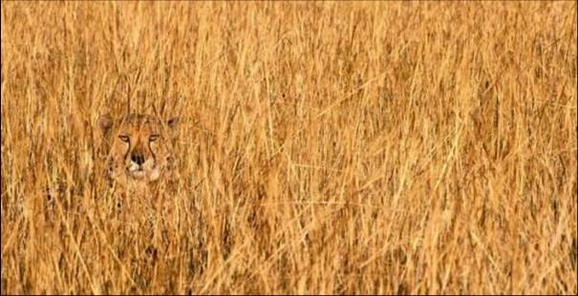
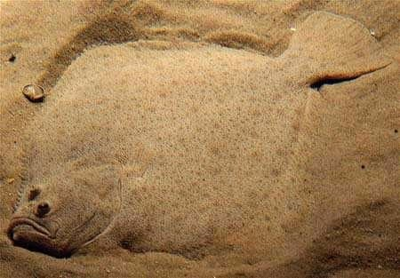
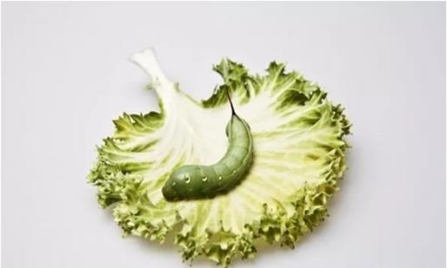
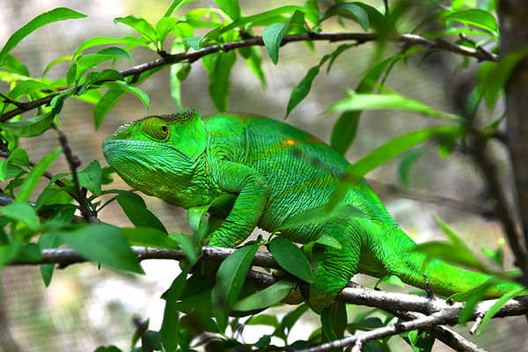
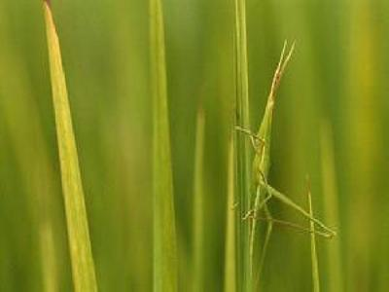
Colour protection of different kinds of animals

Slide 18
Homework
1. Draw a story map about the snowshoe hare.
2. Find more information about colour protection of other animals.

