Slide 1
Let’s read
第6级

Slide 2
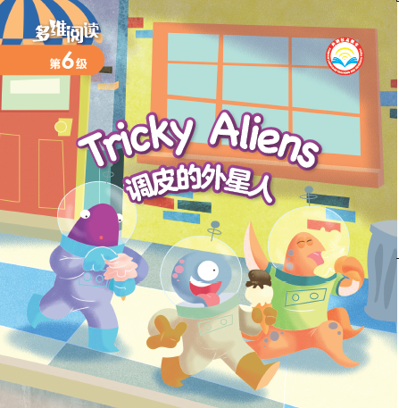
aliens
Where were they? How did they feel?
What do they look like?
Who are they?

Slide 3
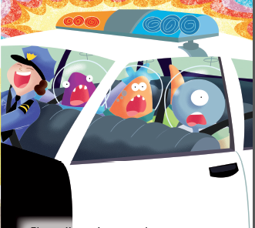
Where were they? How did they feel?
What happened?

Slide 4
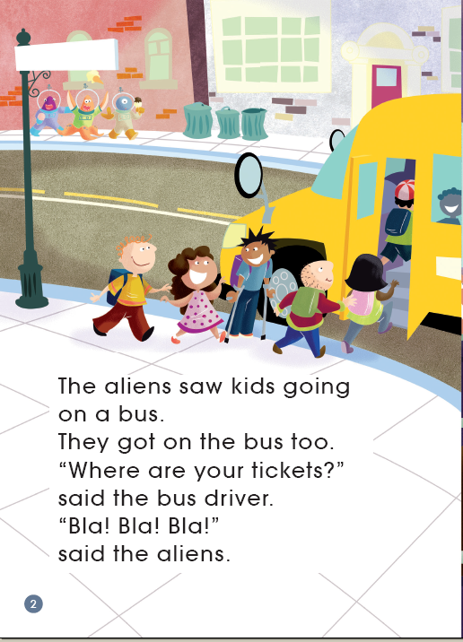
school bus

Slide 5
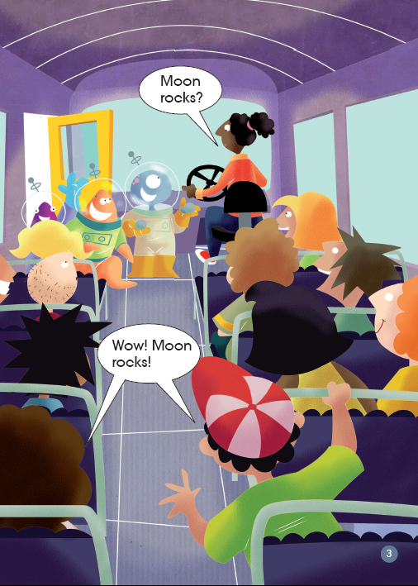
What does it mean?
Bla! Bla! Bla!
What did they have?

Slide 6
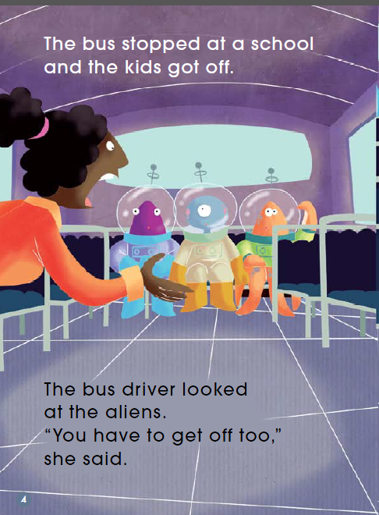
Why didn’t they get off?

Slide 7
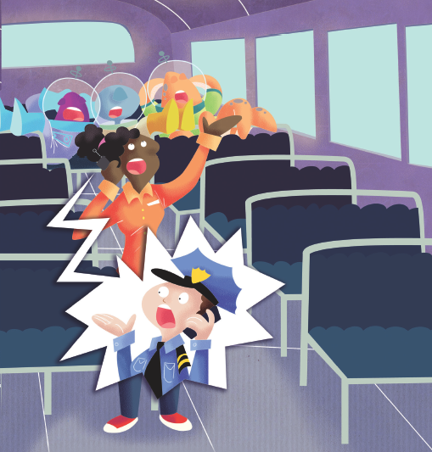
What were they doing?
put their feet up and went to sleep
If you were the bus driver, what would you do?

Slide 8
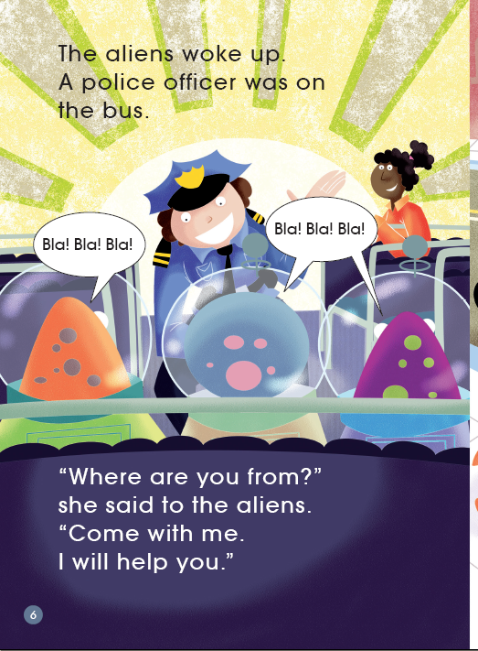
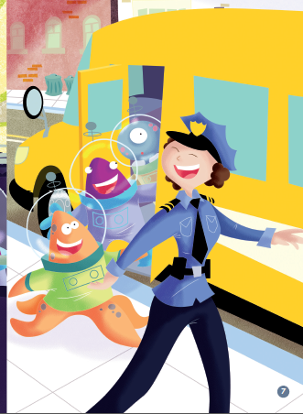
What was the police officer going to do?
What does it mean?

Slide 9
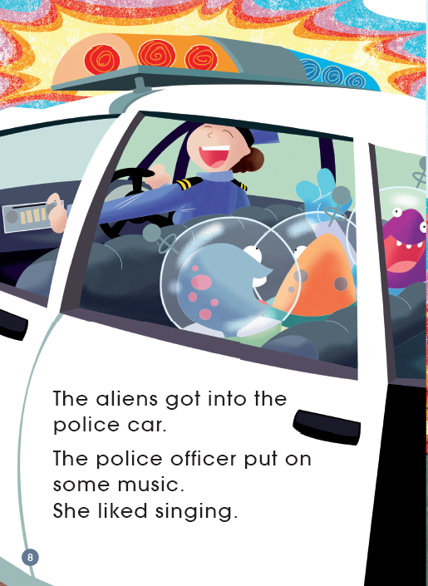
What might happen next?

Slide 10
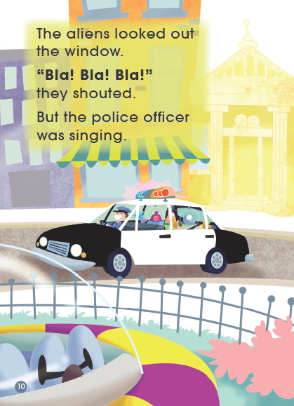
Could the police officer hear them?
Why (not)?
What did the aliens see outside the window?
Bla! Bla! Bla!
How could they get off?
space ship

Slide 11
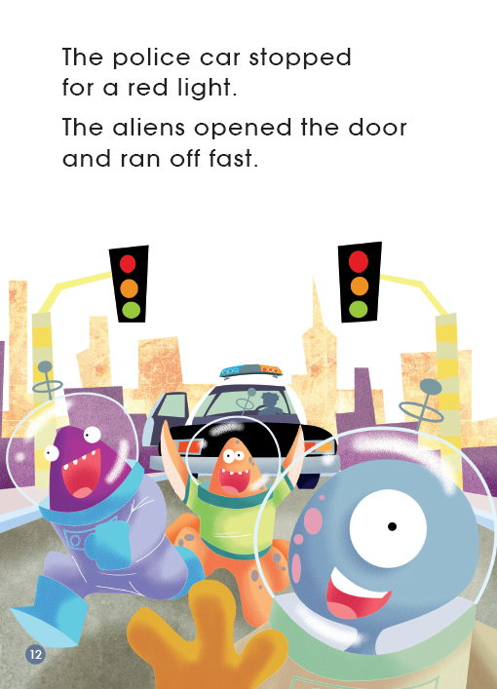
red light

Slide 12
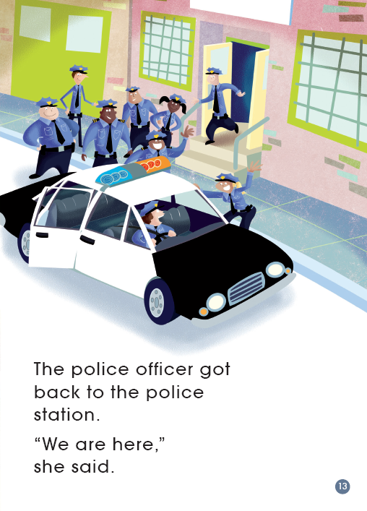
Did the police officer know they were not there? How do you think that?
We are here.

Slide 13
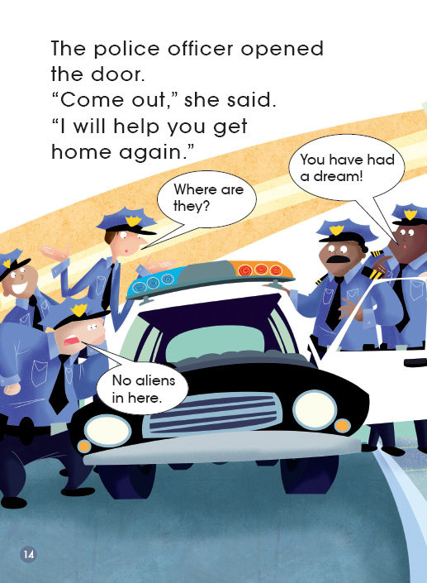
confused

Slide 14
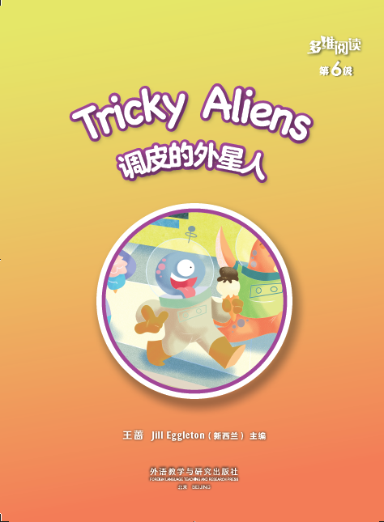
Could you give a new a title to this story?
Series name
Level
Title
Authors
Publisher

Slide 15
Listen and repeat
Tips:
1. Listen carefully.
2. Listen and repeat.
3. Point with fingers.

Slide 16
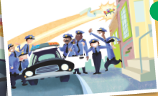
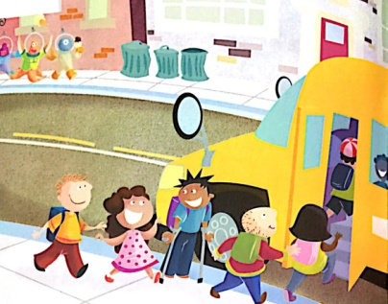
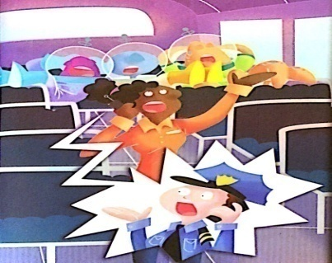
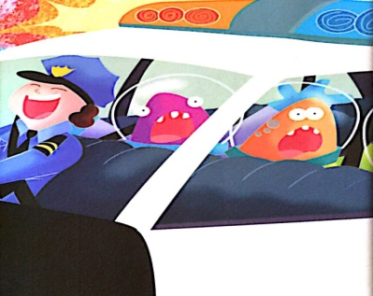
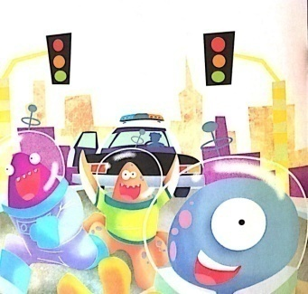
Match the pictures with each part of the story.
2. The aliens got on the bus.
3. The aliens got on the police car.
4. The car stopped for a red light.
5. The police officer opened the door.
1. A bus was coming.

Slide 17
Tell one part of the story in your group.
1. A bus was coming.
2. The aliens got on the bus.
3. The aliens got on the police car.
4. The car stopped for a red light.
5. The police officer opened the door.
...
Useful structure:
I’m the alien/bus driver/kid/police officer …

Slide 18
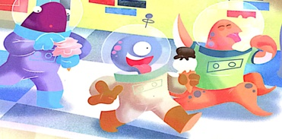
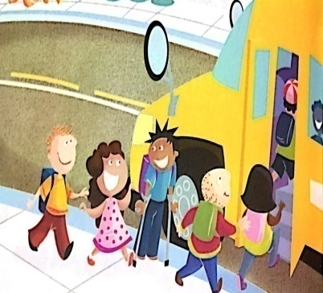
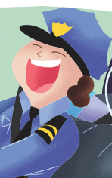
What do you think of them?
Useful structures:
My character is ... I (don’t) like him/her/them.
He/She/They look(s) ... /has(have) ...
I think ... is/are ..., because he/she/they (said) ...
Useful words:
kind, cute, tricky, clever, strange, enthusiastic(热情的), careless(粗心的), tolerate(宽容的), curious(好奇的), outgoing(开朗的).

Slide 19
Write a letter to the friends on Earth.
Dear ________,
We are the aliens. We are back to our planet now. Thank you for helping us ___________________. You are very ___________.
Best wishes to you!
Yours,
_______

Slide 20
Homework
1. Retell the story.
2. Draw and write about a part of the story which you think is funny.

