Slide 1


Let’s read
第6级

Slide 2

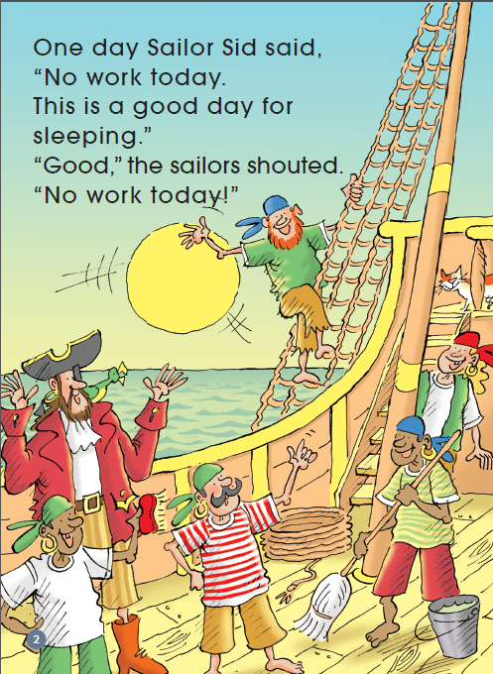
Q: What characters can you see here？
Do you remember the story with these characters?

Slide 3
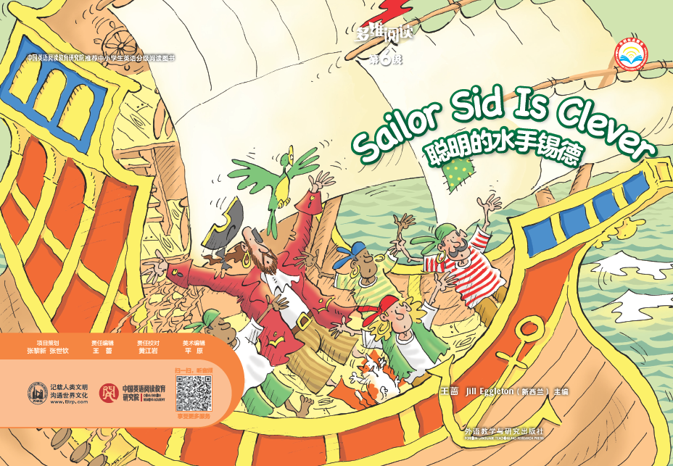

Q: What do you think of Sailor Sid?

Slide 4
Q: What do you know from the first picture？

Slide 5
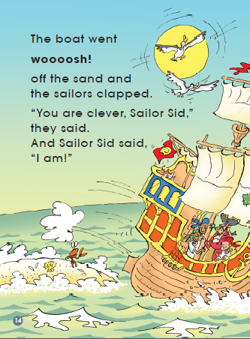
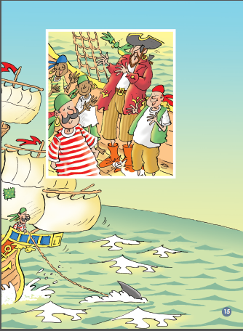
Q: What has happened？
Why was a shark pulling their boat?

Slide 6
第6级
Q: What happened to them?

Slide 7
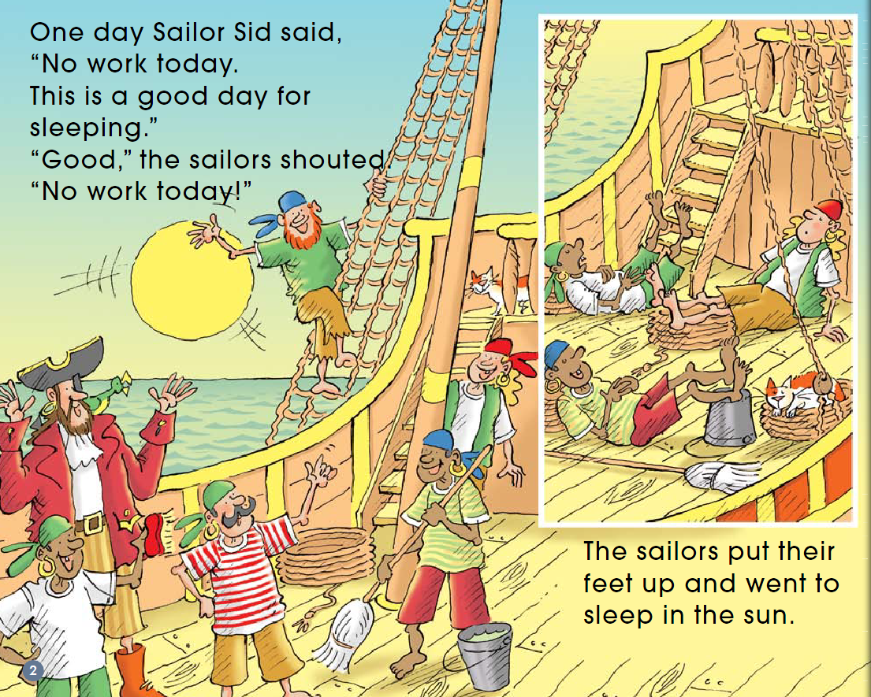
What does “put their feet up” mean ?

Slide 8
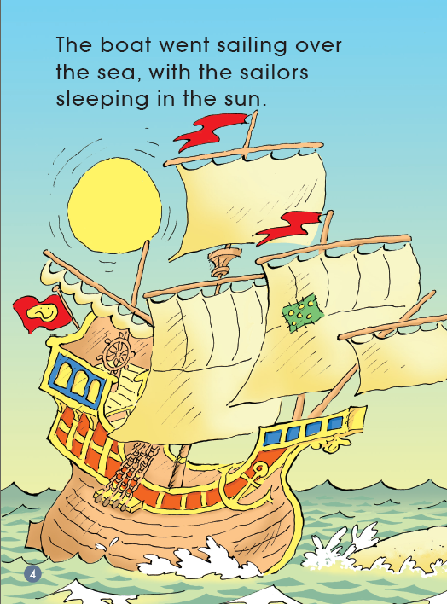
What was the problem?
What had caused the problem?

Slide 9
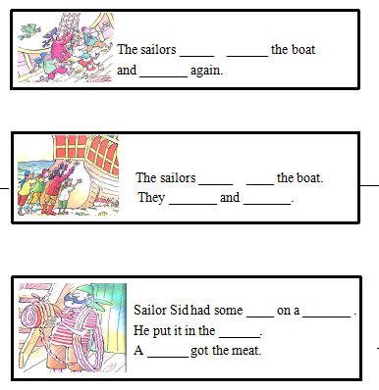

Q: How did the sailors try to get the boat off the sand?
Tips:
1. Please read PP 5-13.
2. Finish the worksheet.

Slide 10
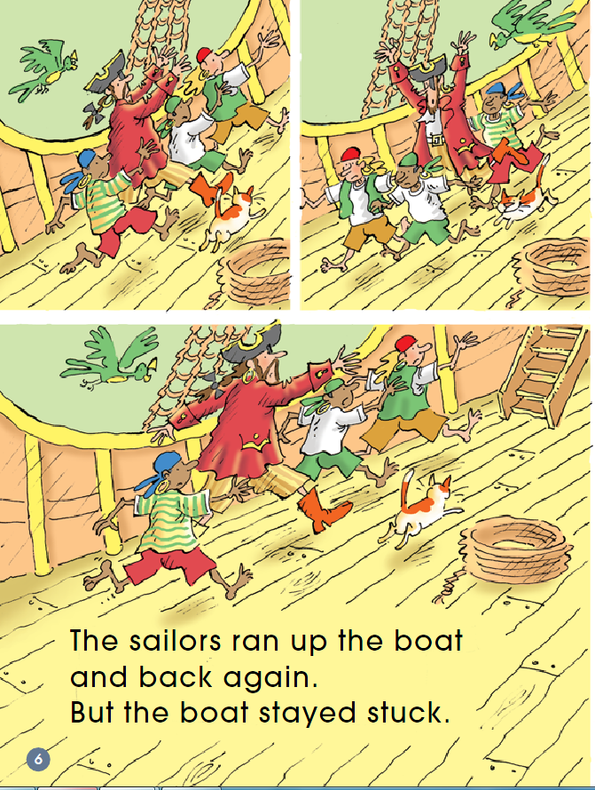



The first method
The sailors _____ ______ the boat and _______ again.

Slide 11
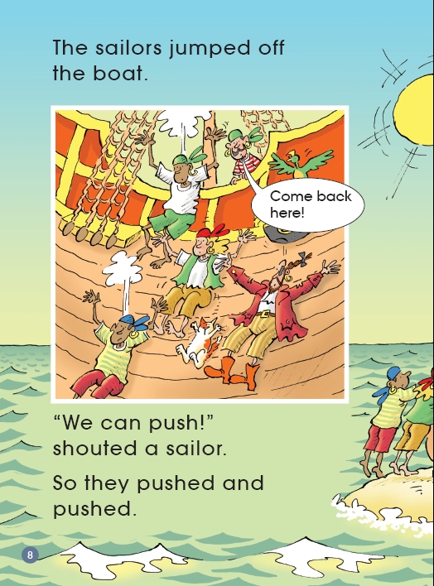
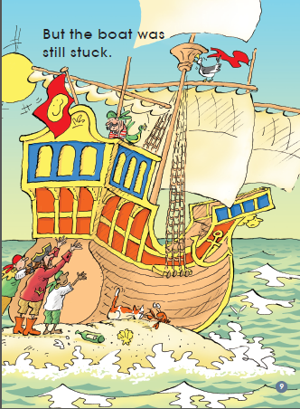

The second method
What would you do?
The sailors _____ ____ the boat.
They _______ and _______.

Slide 12
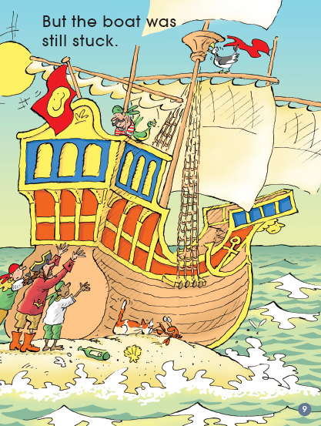
Q: What do you think he might be going to do?
Q: Which sailor is not helping? Why?

Slide 13
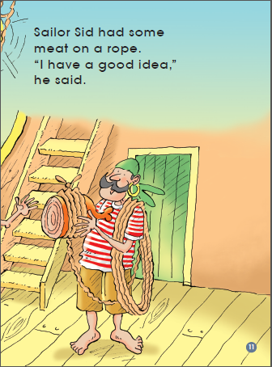
Q: What do you think he might be going to do?

Slide 14
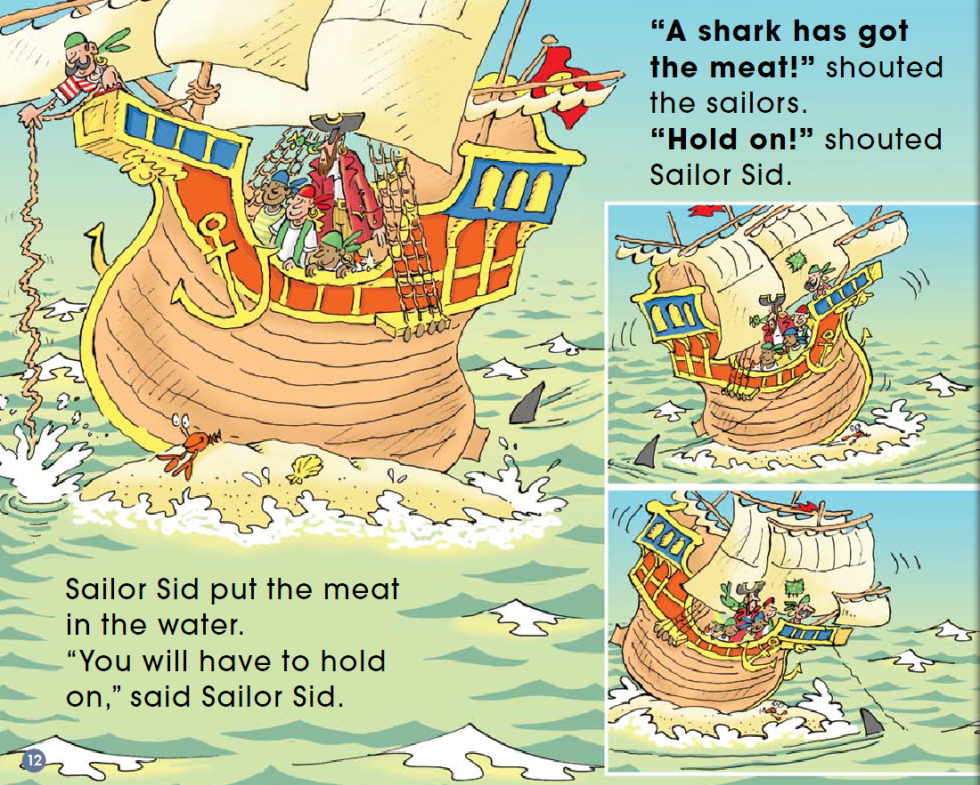

Slide 15
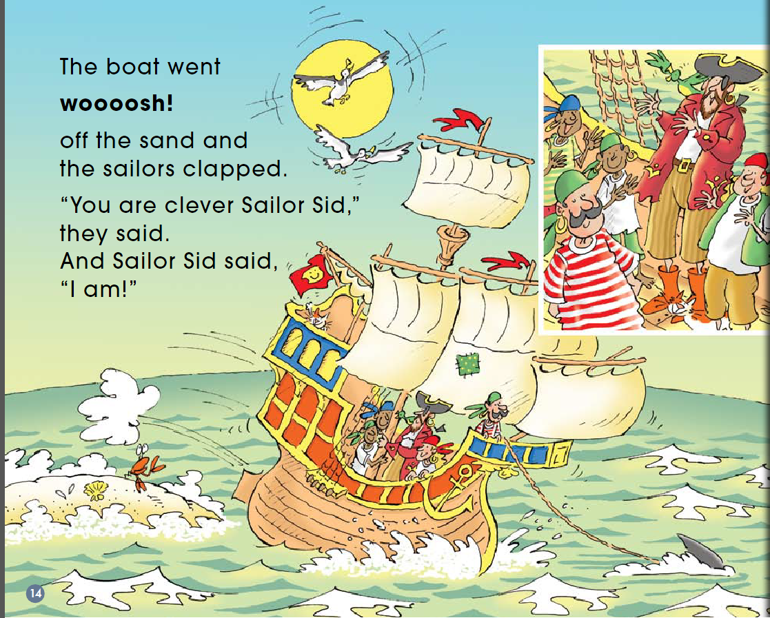
What words could you use to describe how the sailors might feel?

Slide 16
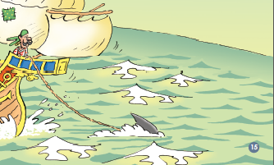
What do you think about Sid’s idea? Why?
The Result
The boat _____ ____the sand.

Slide 17

Listen and repeat
Tips:
1. Listen carefully.
2. Follow to read.

Slide 18
Let’s act
Tips:
1. Act in groups.
2. Add some actions.

Slide 19
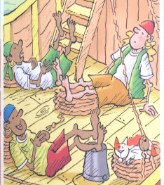
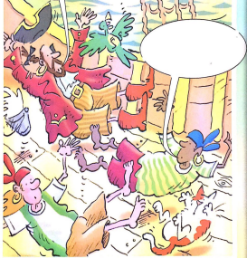
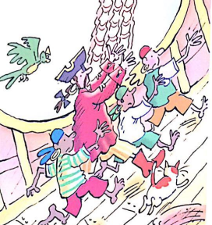
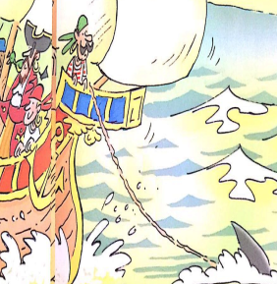
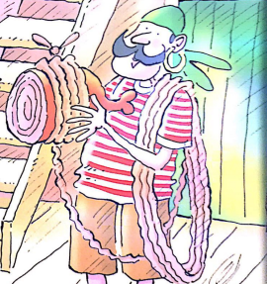
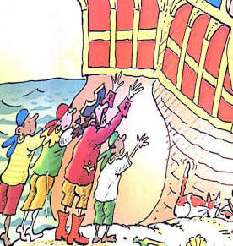
Please retell the story according to the pictures.

Slide 20
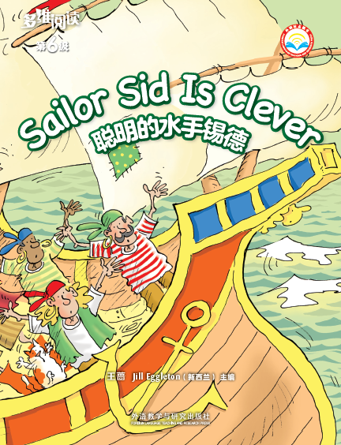
Series name
Why?
Level
Title
Authors
Publisher

Slide 21
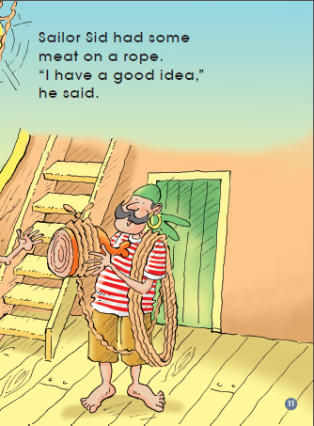
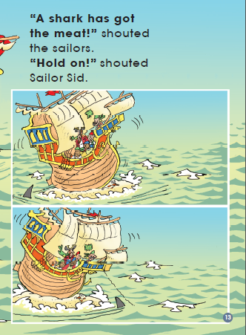
What do you think of Sid?

Slide 22
Can you give a new title to this story?
Have you or someone you know had a problem because of not doing what you should have done?

Slide 23
Homework
1. Draw the sailors’ problem and describe your picture to your partner.
2. Write about the sailors’ problem and the solution.

