Slide 1
Let’s read
第6级

Slide 2
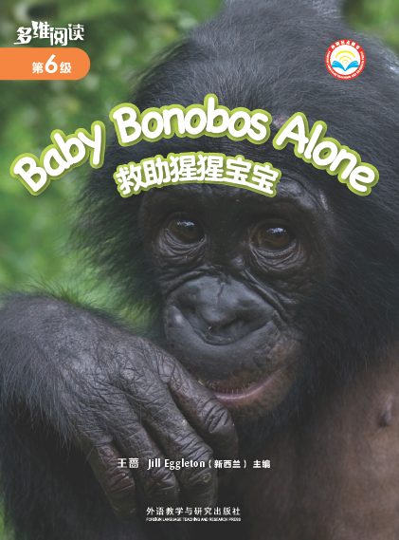
Series name
Level
Title
Authors
Publisher

Slide 3
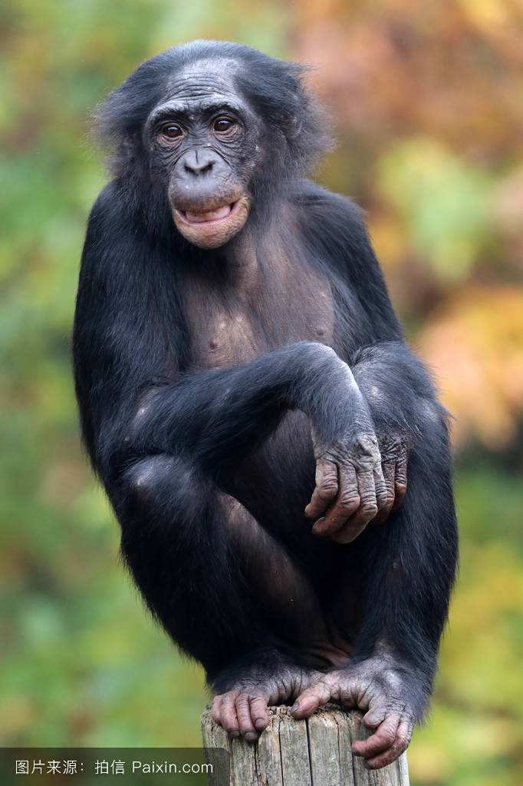
gorilla
Q: What are the differences between them?
bonobo

Slide 4
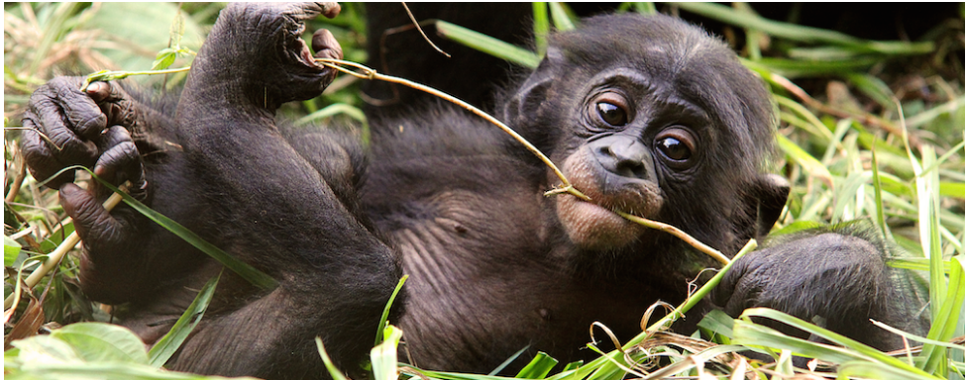
rain forest
bonobo
Pan paniscus
倭黑猩猩
highly endangered
高度濒危

Slide 5
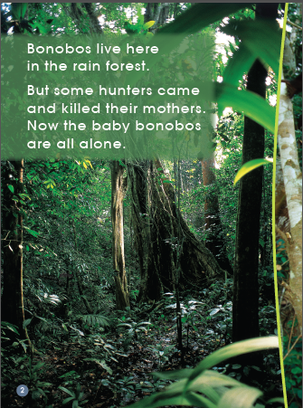
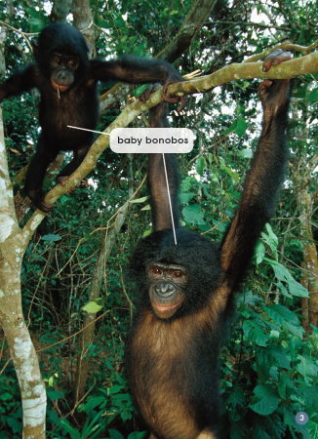
rain forest

Slide 6
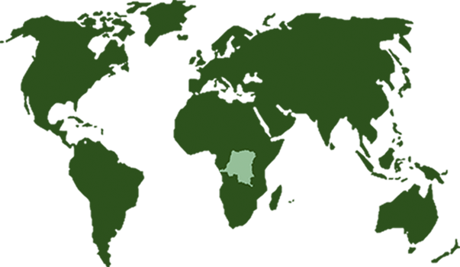
Bonobos live only in one country.
Congo

Slide 7
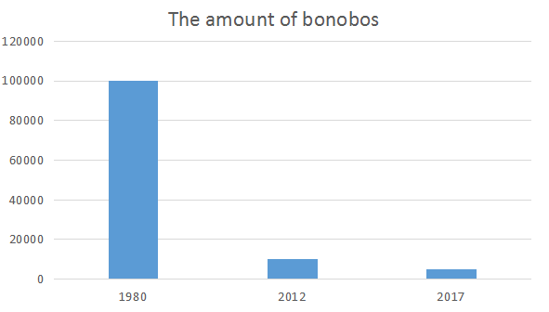
（数量）
100000
Q: What is the reason?
10000
5000

Slide 8
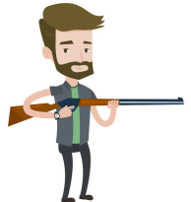
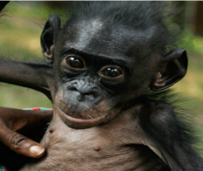
rain forest
Dangerous!
Hunters killed bonobos’ mothers.
People cut down trees.
Baby bonobos are alone.

Slide 9
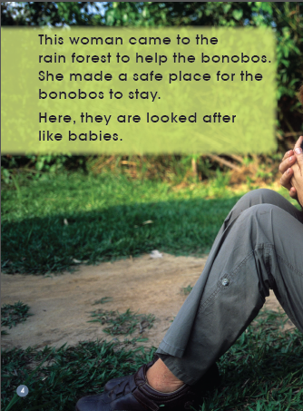
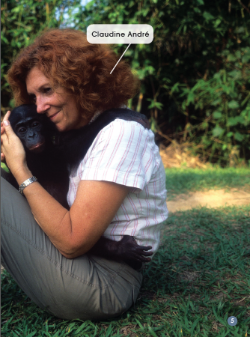
What is this woman doing?
Claudine Andre

Slide 10
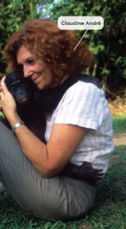
rain forest
safe place
Dangerous!
Hunters killed bonobos’ mothers.
Q: How do people look after baby bonobos here?
Claudine Andre
People cut down trees.
Baby bonobos are alone.

Slide 11
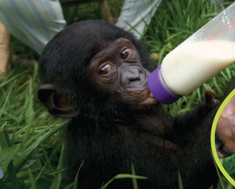
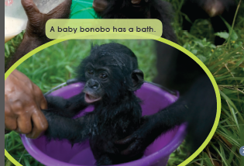
｛
Q: How would they get cleaned there?
Q: How would they get fed in Lolaya Bonobo?
They are looked after like babies.
get milk from the bottle
have a bath

Slide 12
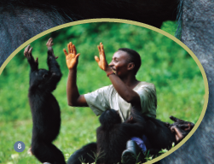
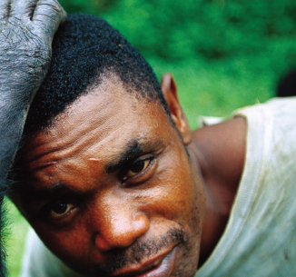
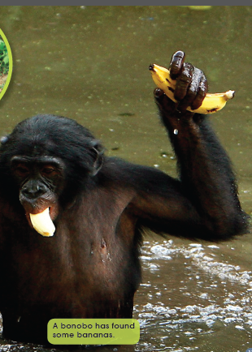
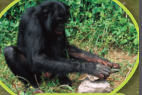
Q: What is something important that bonobos have to learn?
People teach bonobos to be like bonobos.
They learn to ... .
open nuts with rocks
look after hair
play like bonobos
look for food/banana

Slide 13
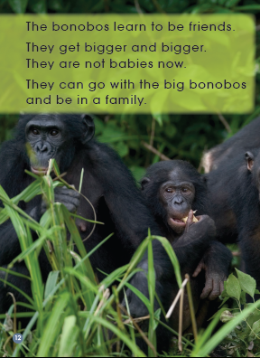
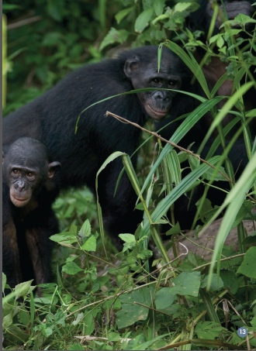

Slide 14
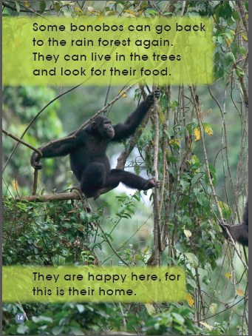
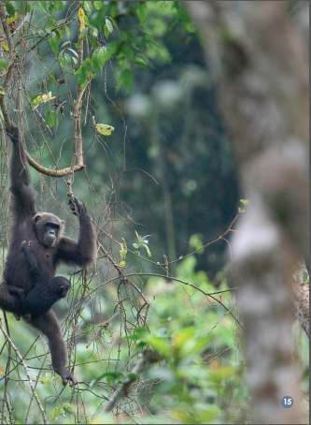
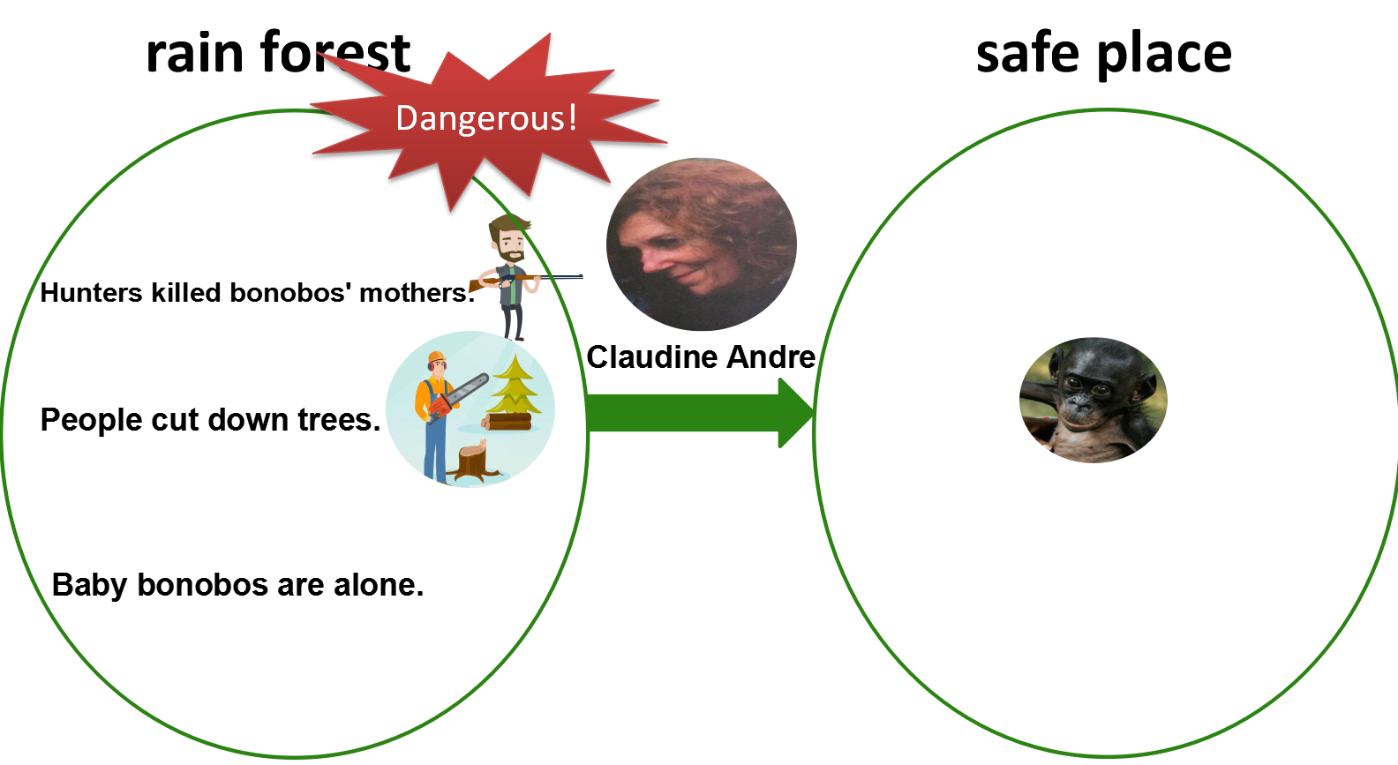
Do you think it was a good idea to take them to the safe place? Why? Why not?
How do you think they are feeling? Why?

Slide 15
rain forest
Problem
_______killed their mothers.
Baby bonobos are ________.

Slide 16
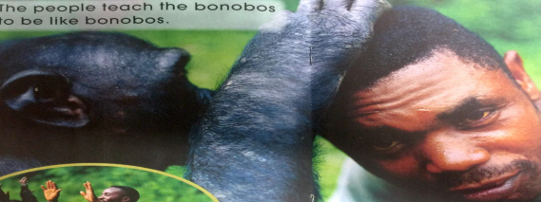
safe place
Solution
___________
Bonobos
___________
｛
___________
___________
Bonobos learn to
___________
___________

Slide 17
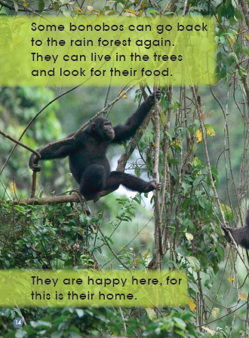
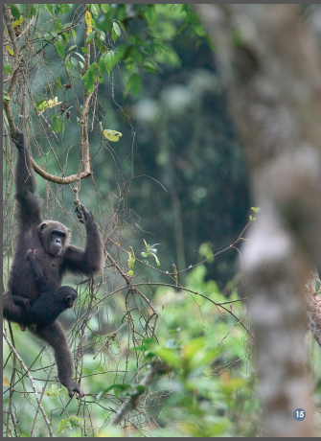
rain forest
_______killed their mothers.
Baby bonobos are ________.
Bonobos can ___________ and look for food.
Result
They are ________ here, for this is their _________.

Slide 18
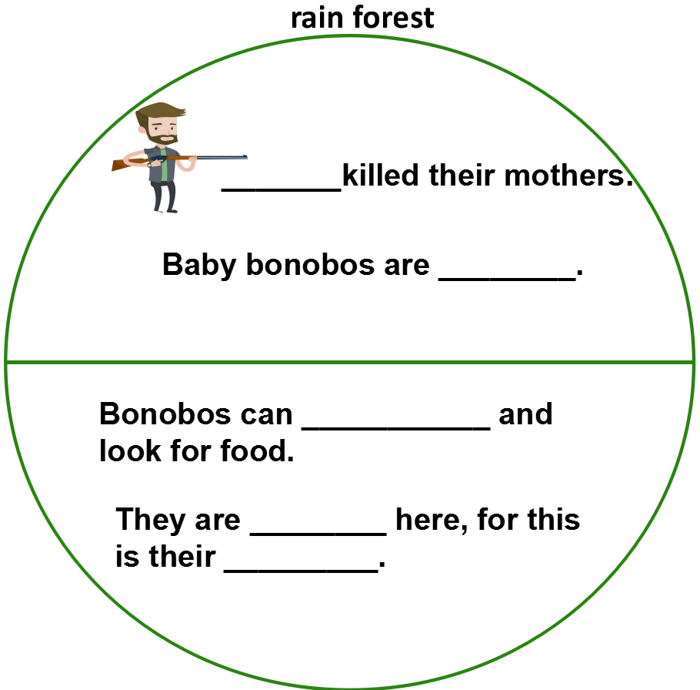
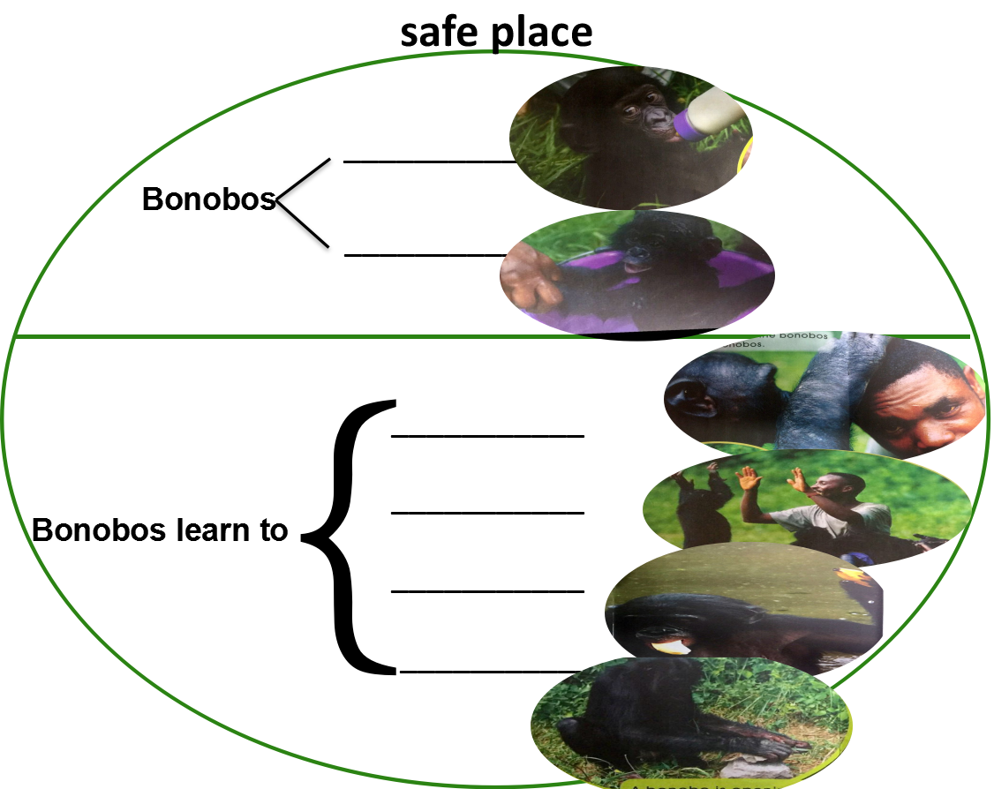
Claudine Andre made a
They go back to

Slide 19
safe place
What do you think of this job?
___________
Bonobos
___________
｛
___________
___________
Bonobos learn to
look for food
___________
___________

Slide 20
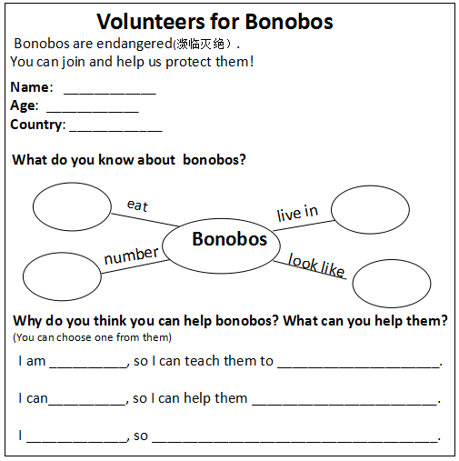
Lola Ya Bonobo
What can you do to help bonobos?
Word Bank:
loving(有爱心的） cook
patient（有耐心的） feed
helpful(乐于助人的） play
responsible(有责任心的） teach
warmhearted(热心的） look after
animal protector(动物保护者） share
... ... advertise(宣传)
donate money（捐钱）

Slide 21
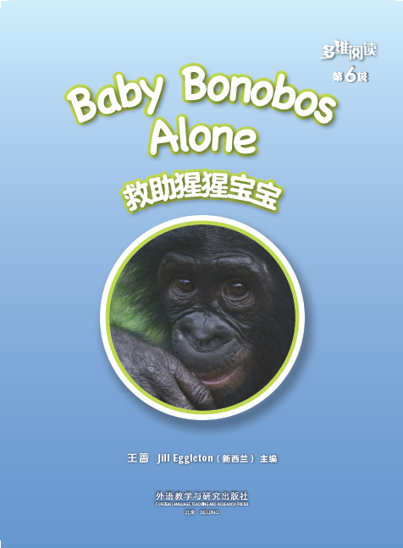
What other reasons cause this problem?
What do you think of the relationship between human beings and animals?
What can we do to protect animals?

Slide 22
Homework
1. Draw and write about something that the bonobos had to be taught to do.
2. Draw a picture and write about someone who looks after you and teaches you.

