Slide 1


Let’s read
第5级

Slide 2


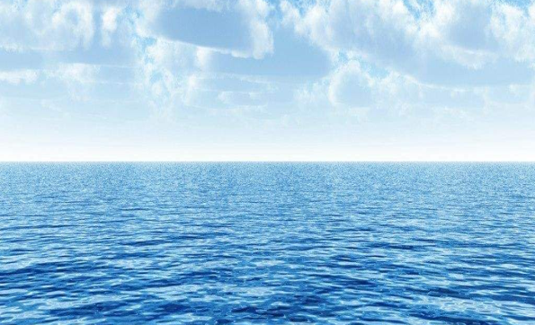
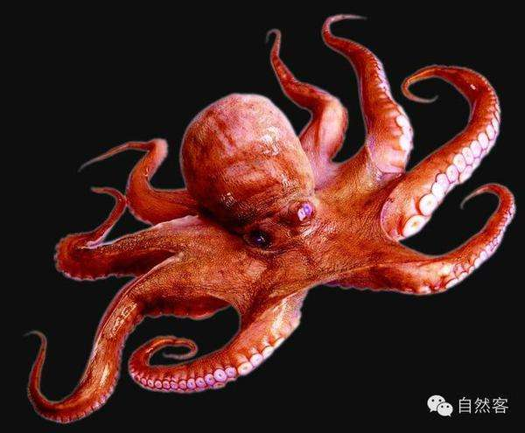
Guessing game
I live in the ocean.
I like to eat crabs.
I can change colors.
My eight legs are called
tentacles(触角).
Who am I?
Notes:
问号图片素材：https://image.baidu.com/search/detail
大海图片素材：https://image.baidu.com/search/detail
章鱼图片素材：https://image.baidu.com/search/detail

Slide 3
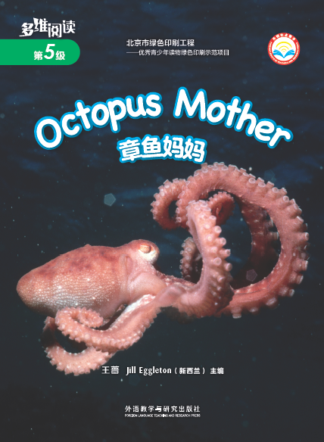

Series
Level
Title
Authors
Publisher

Slide 4
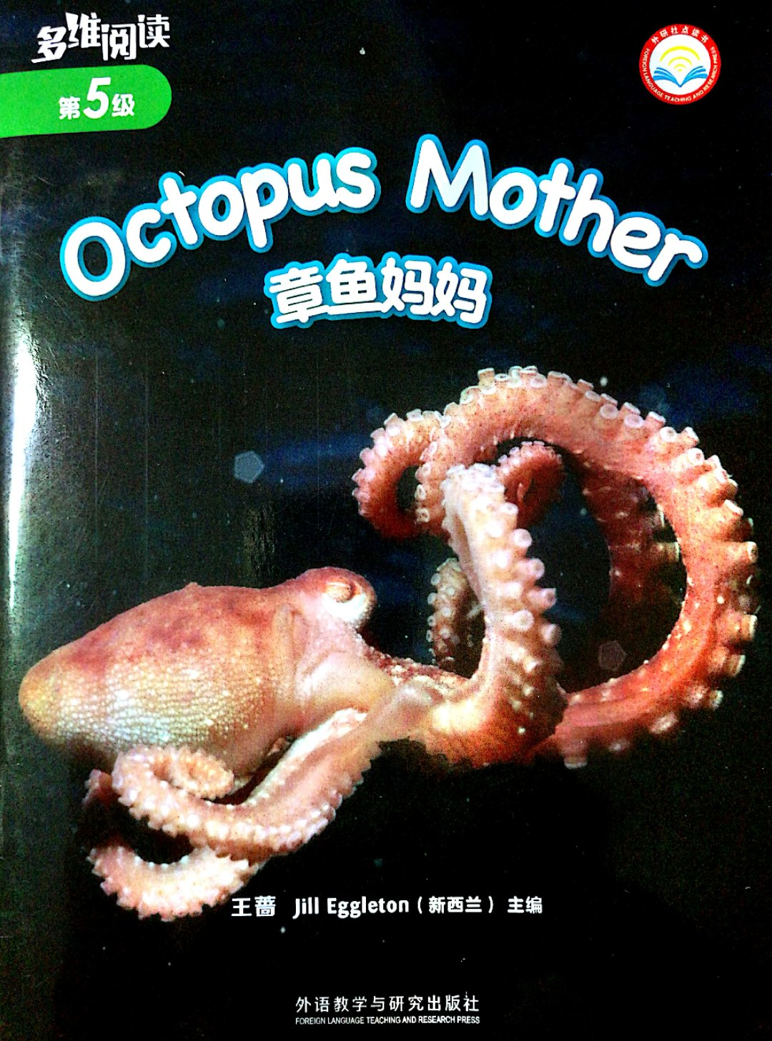
What can we know from the title?
Where can octopus mother have eggs?

Slide 5
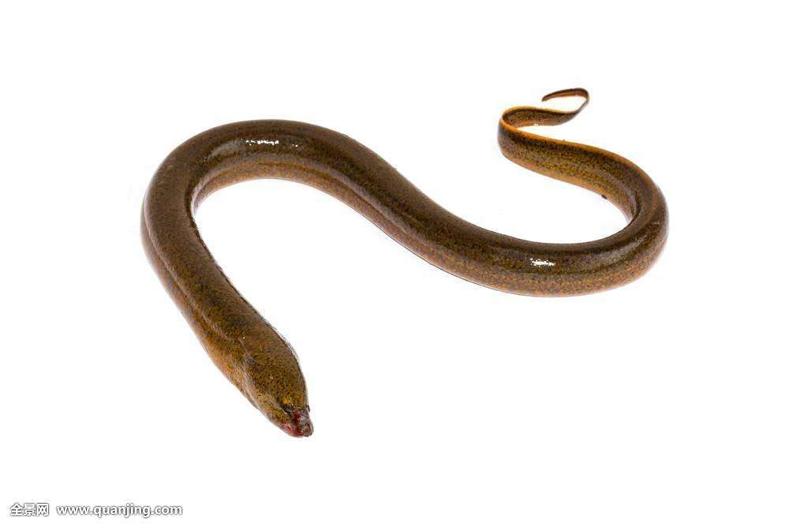
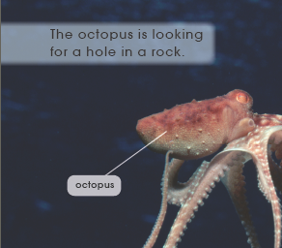
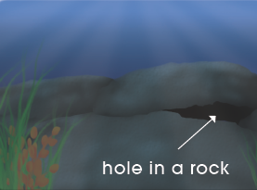
Watch pictures and find
Where can octopus mother have eggs?
Why does octopus mother choose this place?
Is it a good place?
Something is coming.
Notes:
鳗鱼图片素材：https://image.baidu.com/search/detail?ct=503316480&z=0&ipn=d&word=%E9%B3%97%E9%B1%BC&step

Slide 6
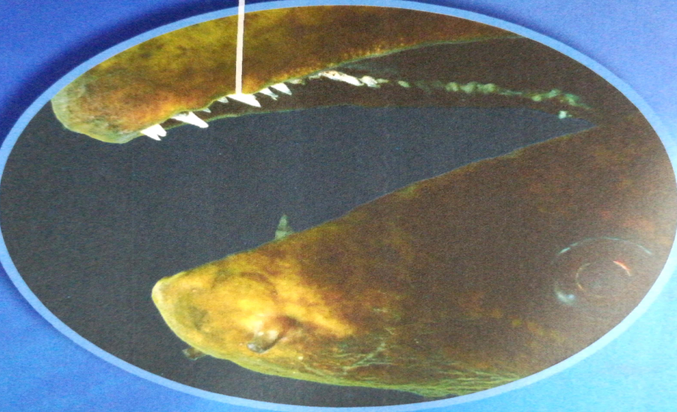
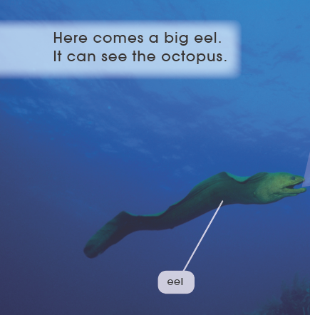
Read PP.4-5 and find
It has sharp teeth.
Who is coming?
What is it like?
What will the eel do?

Slide 7
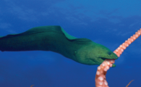
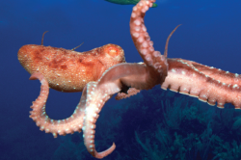
Read PP.6-7 and find
What will the eel do to octopus mother?
The eel has got the octopus.
The eel has got a tentacle.
Crunch!
No!
What can octopus mother do?
How will octopus mother feel?

Slide 8
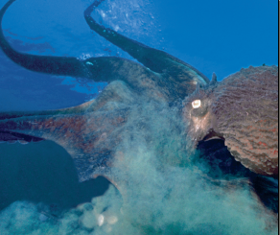
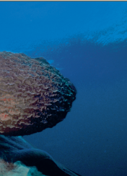
Watch and find
Is octopus mother safe now?
What does octopus mother do?
Why?
squirt out ink
is brown

Slide 9

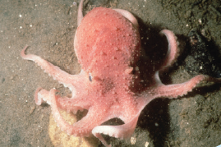
Finish Task 1
Name
Features (特点)
Tips:
Discuss in pairs.
Fill in the table.
eel
octopus
big
squirt out ink
sharp teeth
be brown

Slide 10
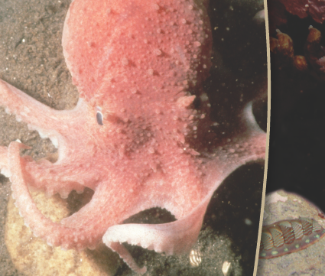
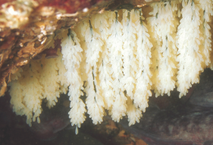
Read PP.10-15 and find
What do you think of octopus mother?
Where is octopus mother now?
Why is she in the hole?
What has she done in the hole?
She has eggs up on the rock.
She looks after the eggs.
She will stay and won’t go away.

Slide 11

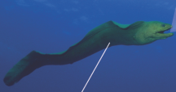

Complete the map
beginning
problem
solution
ending
Tips:
Think by yourselves.
Complete the map.
eggs
have __________ up on the rock
eggs
look after the ___________
stay in the _________ in the rock
hole
The love of octopus mother is _________ !

Slide 12

Silent reading
Tips:
1. Read by yourselves.
2. Read silently.

Slide 13
Listen and repeat
Tips:
1. Listen carefully.
2. Follow to read.
3. Point with finger.

Slide 14
I am a host of Natural legend
Tips:
Work in groups of 4 students.
Introduce octopus mother.
S1: Hello, everyone! Welcome to the Natural Legend.
Today we are going to talk about the great octopus mother.
S2: The octopus is looking for a hole. She can…
S3: She can go in a hole. She has…
S4: She will stay in a hole. She will…
Notes:
主持人图片来源：http://image.so.com/v?q=%E5%84%BF%E7%AB%A5%E6%BC%94%E8%AE%B2&src=srp&correct=%E5%84%BF%E7%AB%A5%E6%BC%94%E8%AE%B2&cmsid=4cd59aa884c5eb725e9b0a0212c92c49&cmran=0&cmras=6&cn=0&gn=0&kn=0#multiple=0&gsrc=1&dataindex=35&id=f465e62e7a32d7a9e963cb88b2888d5d&currsn=0&jdx=35&fsn=60

Slide 15
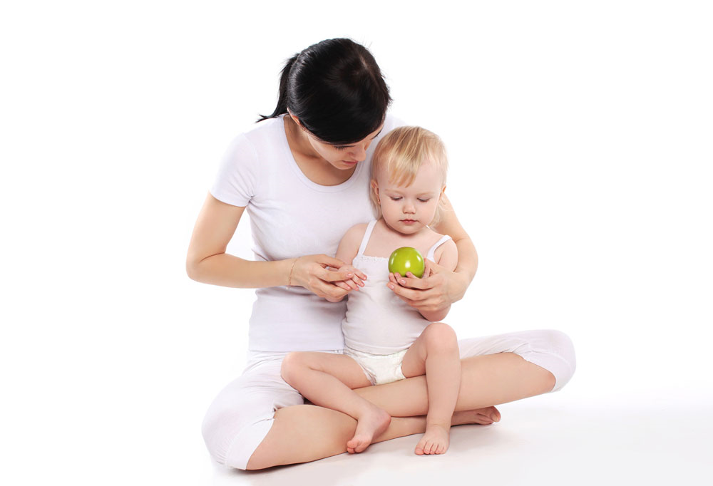
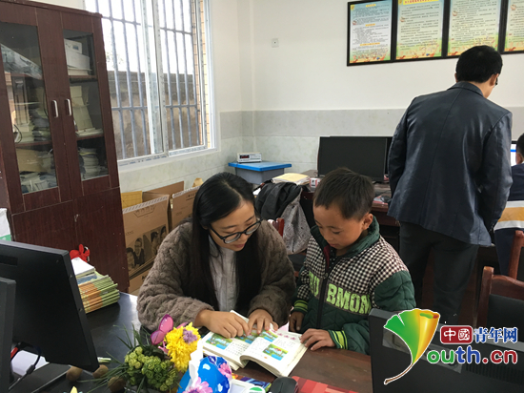
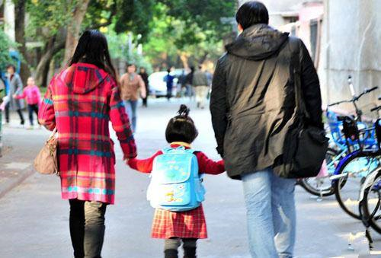
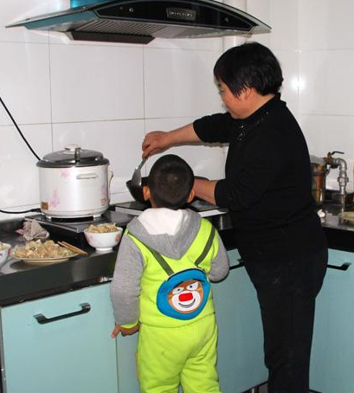
Group work and discussion
Tips : 1. Work in groups of 4 students.
2. Discuss in groups.
3. Share one thing that your mum has done for you.
4. Discuss what you can do for your mum.
Notes:
照片来源：http://image.so.com/v?q=%E5%A6%88%E5%A6%88+%E6%8E%A5%E9%80%81+%E5%AD%A9%E5%AD%90&src=srp&correct=%E5%A6%88%E5%A6%88+%E6%8E%A5%E9%80%81+%E5%AD%A9%E5%AD%90&cmsid=93c16d47be08521f8bf14f35a37a1c09&cmran=0&cmras=6&cn=0&gn=0&kn=0#multiple=0&gsrc=1&dataindex=35&id=089c4c59d4d2e5c89bd619592dfb483f&currsn=0&jdx=35&fsn=60
http://image.so.com/v?q=%E5%A6%88%E5%A6%88%E7%BB%99%E5%AD%A9%E5%AD%90%E5%81%9A%E9%A5%AD&src=srp&correct=%E5%A6%88%E5%A6%88%E7%BB%99%E5%AD%A9%E5%AD%90%E5%81%9A%E9%A5%AD&cmsid=f45121bf9ce0448b47c1b1042affedfb&cmran=0&cmras=0&cn=0&gn=0&kn=0#multiple=0&gsrc=1&dataindex=14&id=92fb81837def38865a65ae5878335985&currsn=0&jdx=14&fsn=60
http://image.so.com/v?q=%E5%A6%88%E5%A6%88++%E5%AD%A9%E5%AD%90&src=srp&correct=%E5%A6%88%E5%A6%88++%E5%AD%A9%E5%AD%90&cmsid=36e37c208a1b330da0044f6e4b21ffdf&cmran=0&cmras=6&cn=0&gn=0&kn=0#multiple=0&gsrc=1&dataindex=9&id=62a8bbc898235f1decca0cf8ea01b96f&currsn=0&jdx=9&fsn=60
http://image.so.com/v?q=%E5%A6%88%E5%A6%88+%E6%8E%A5%E9%80%81+%E5%AD%A9%E5%AD%90&src=srp&correct=%E5%A6%88%E5%A6%88+%E6%8E%A5%E9%80%81+%E5%AD%A9%E5%AD%90&cmsid=93c16d47be08521f8bf14f35a37a1c09&cmran=0&cmras=6&cn=0&gn=0&kn=0#multiple=0&gsrc=1&dataindex=35&id=089c4c59d4d2e5c89bd619592dfb483f&currsn=0&jdx=35&fsn=60

Slide 16
Homework
1. Read the book fluently.
2. Do one thing for your mother to express
your love.

