Slide 1
Let’s read
第5级

Slide 2
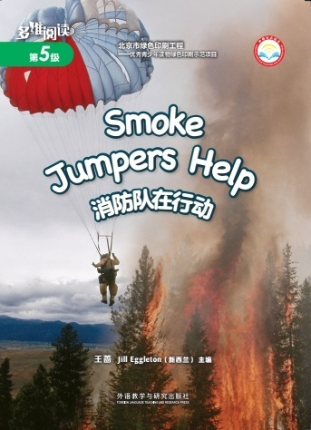
Series
Level
Title
Authors
Publisher

Slide 3
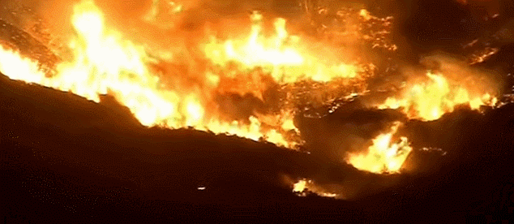
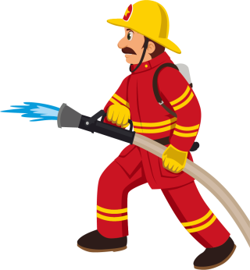
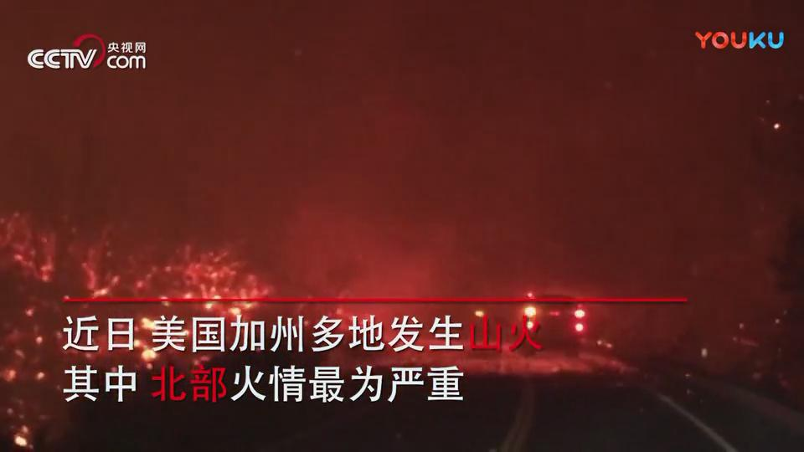
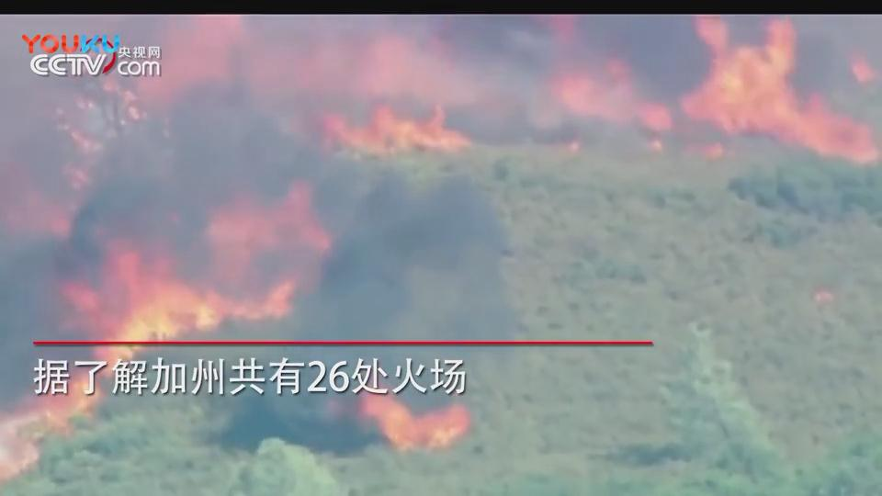
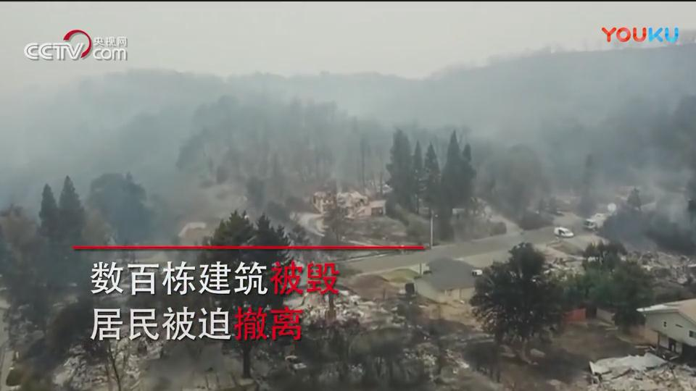
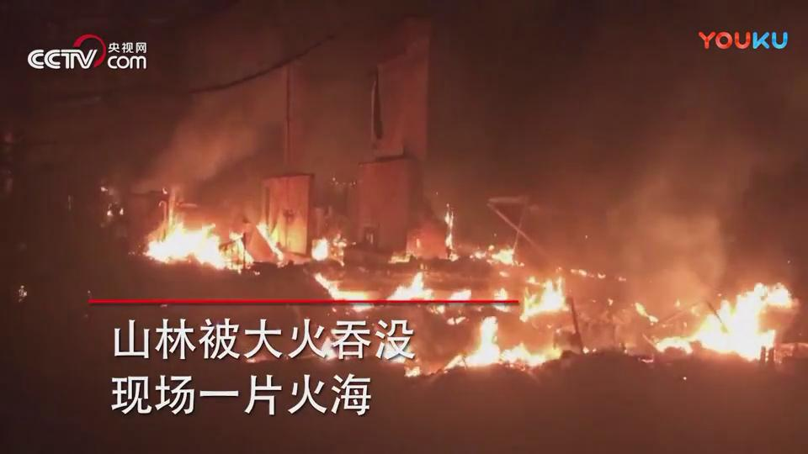
Q: Who can help to put out the fire?
Big fire
in the mountain
forest has been destroyed
someone died
lose home

Slide 4
Series name
Q: How can the smoke jumpers put out the fire?
Level
They can …
Title
Author
Publisher

Slide 5
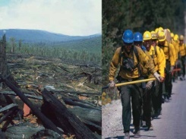
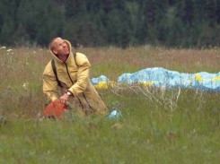
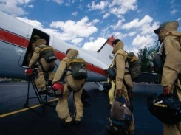
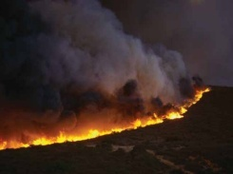
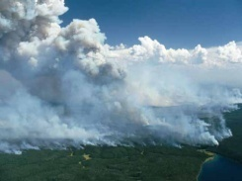
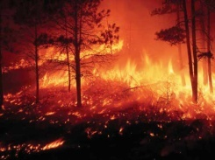
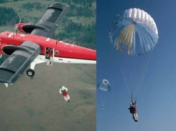
Q: How can the smoke jumpers put out the fire?
Tips:
1. Read the book.
2. Match the right pictures in group.
Get to the fire
Smoke Jumpers
Notice the fire
Put out the fire
The fire is out

Slide 6
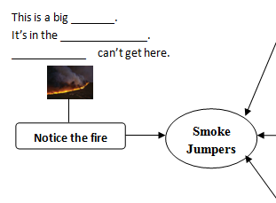
Q: How is the fire?
Tips:
1. Read PP. 2-3.
2. Finish the mind map.

Slide 7
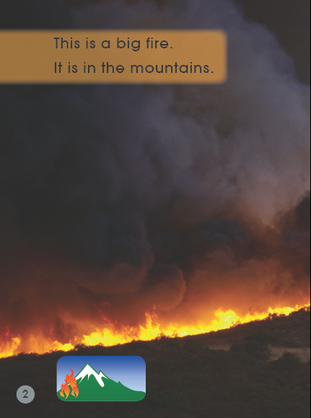
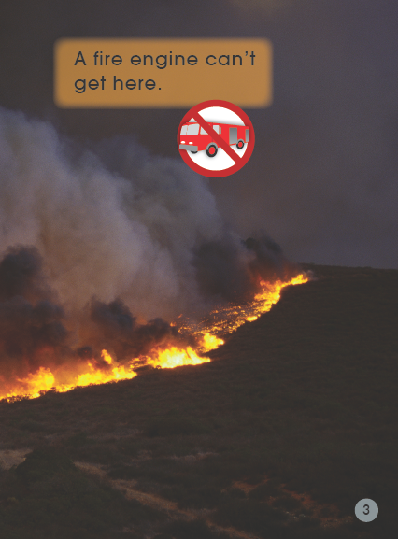
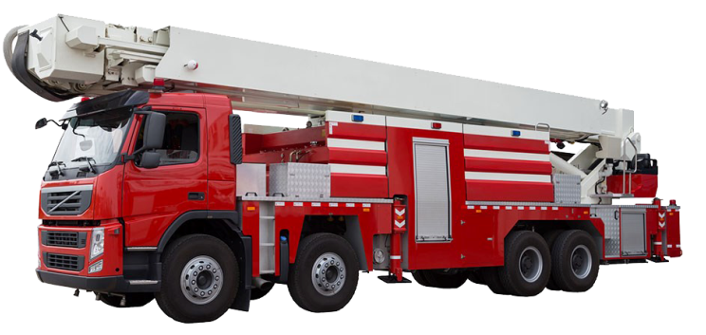

Slide 8
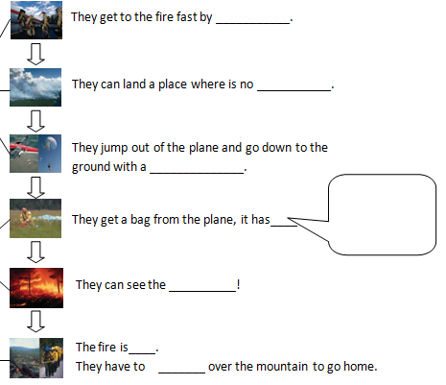
Q: How do the smoke jumpers work?
Tips:
1. Read PP. 4-15.
2. Finish the mind map.
3. Discuss in group.

Slide 9
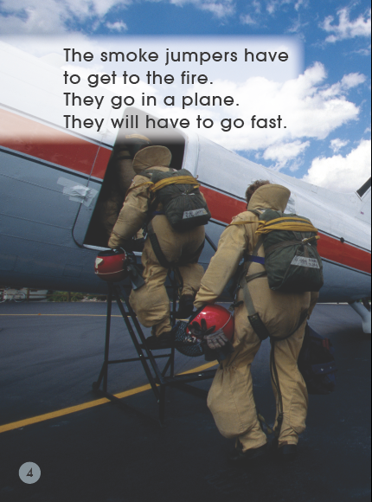
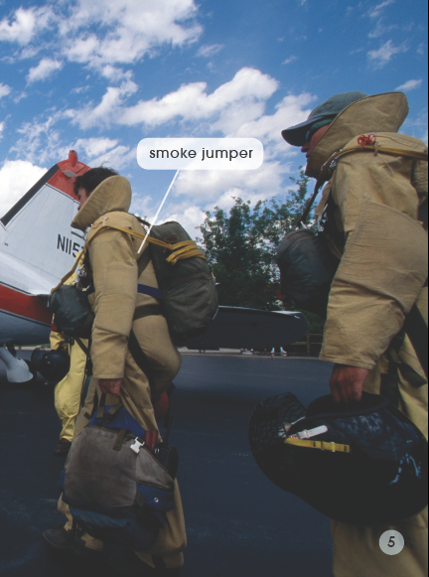
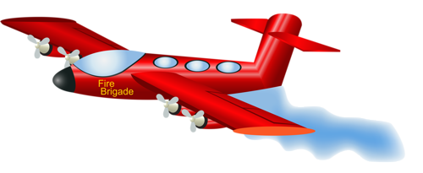
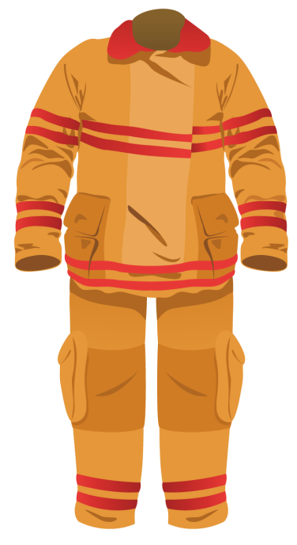
What do they get in their backpacks?
What are they wearing?
Why do they wear this kind of cloth?

Slide 10
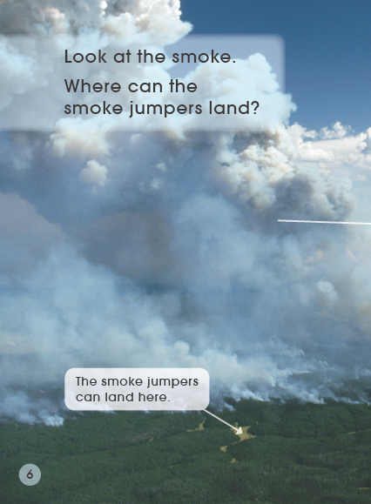
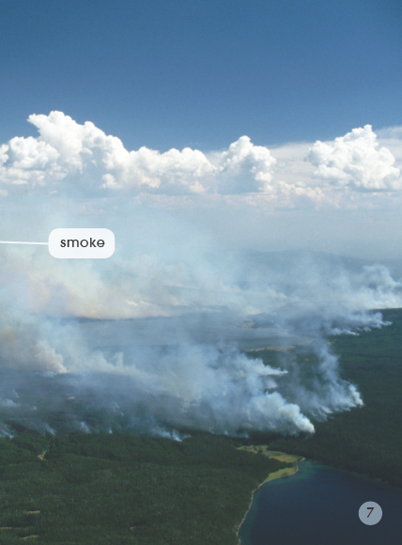
Why can they land here?

Slide 11
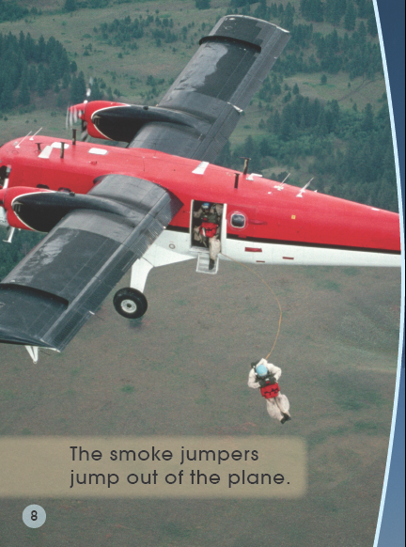
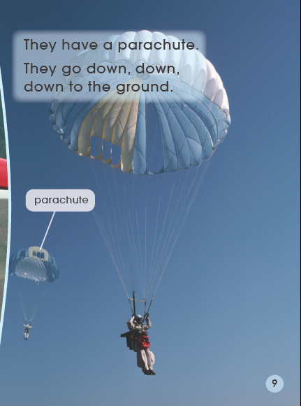
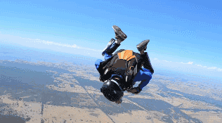

Slide 12
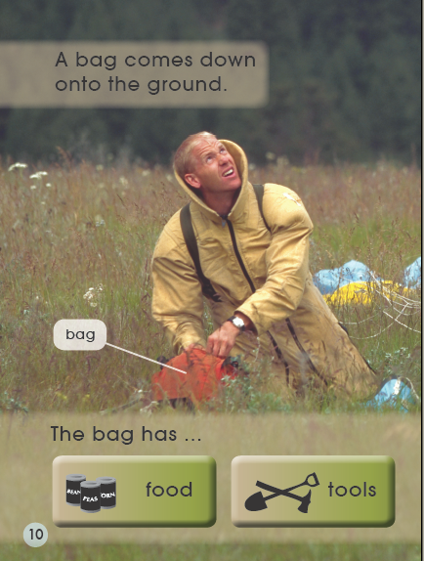
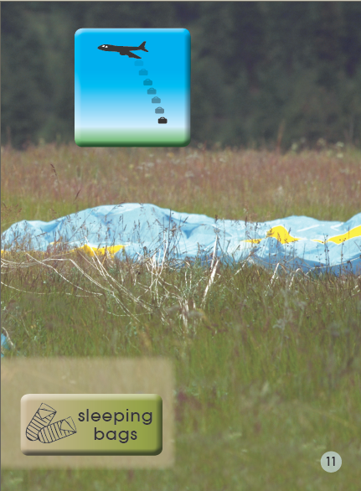
Why do they have these things in the bag?

Slide 13
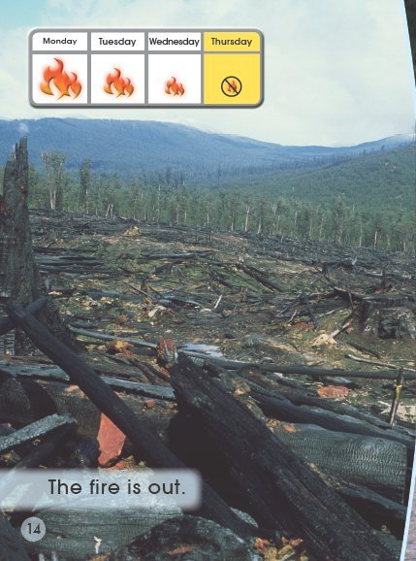
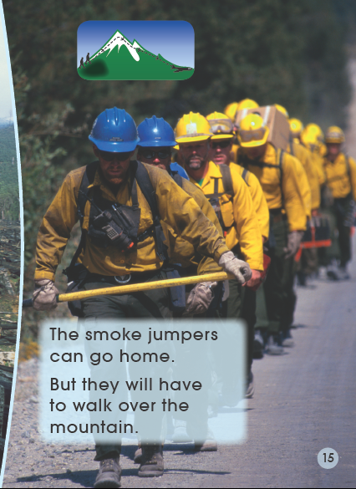
How many days does it take to put out the fire?
Why do they have to walk home?

Slide 14
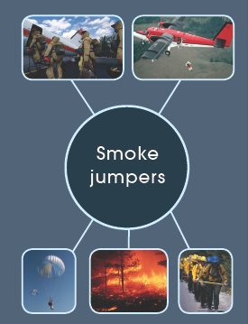
Q: Do you think it’s a very difficult and dangerous job?
Tips:
Talk in pairs.
Useful structures:
I think it’s difficult/dangerous.
Please look at page…, it says…

Slide 15
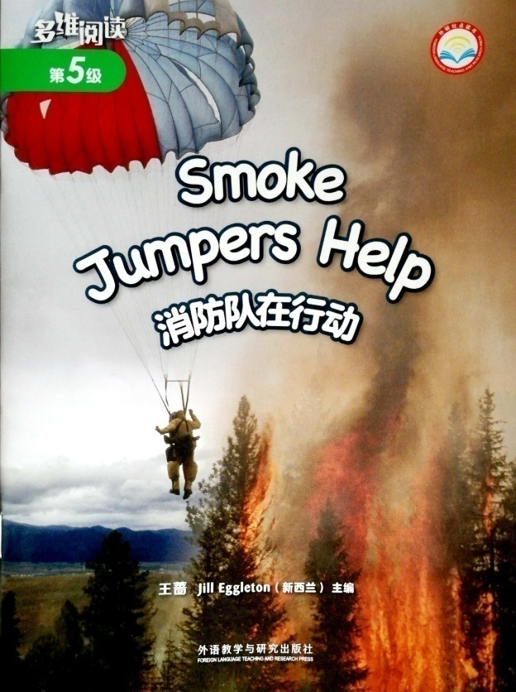
Listen and repeat
Tips:
Listen carefully.
Follow to read.
Point with finger.

Slide 16
Hot News
Tips:
Finish the news report in groups.
Useful structures:
S1: Hello, everyone. This is Hot News. Here is a big fire…
S2: The smoke jumpers have to…
S3: Look at the flames…
S4: The fire is out…

Slide 17
HOT NEWS
Sep. 5th
Wednesday
Smoke Jumpers Help

Slide 18
Q: How much do you know about the smoke jumpers?
Tips:
1. Match the pictures and words.
2. Give the right order.

Slide 19
⑤ ② ③ ① ④

Slide 20
Q1: Why is it called “Smoke Jumpers Help”?
Q2: What do you think of the smoke jumpers?
Tips:
1. Comment on the smoke jumpers.
2. Share in the class.
Useful structures:
I think smoke jumpers are very… because they are …
brave(勇敢的), dedicated(有奉献精神的), dutiful(尽职的), responsible(负责的), hard-working(勤劳的), persistent (坚持不懈的), strong-willed(意志坚强的), efficient(有效率的)…

Slide 21
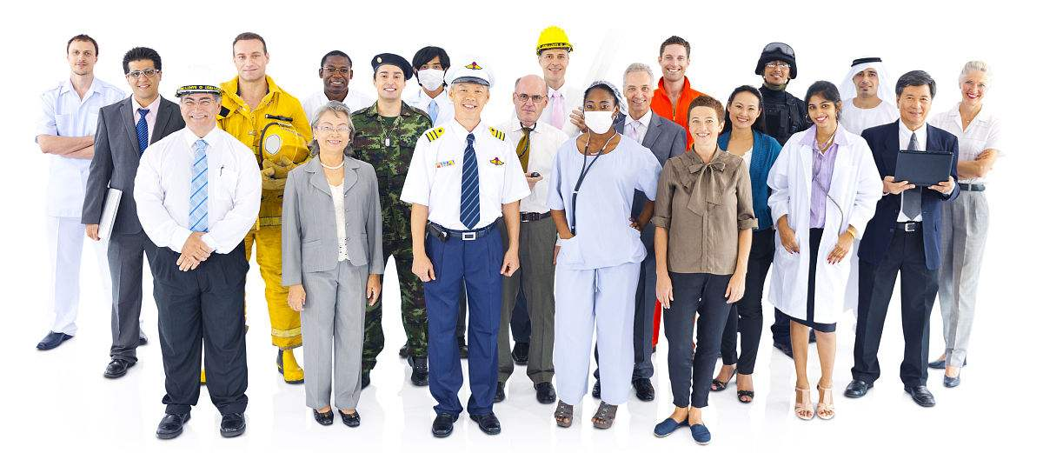
Q: Do you know any other difficult and dangerous jobs?
I think … is difficult/dangerous, because …

Slide 22
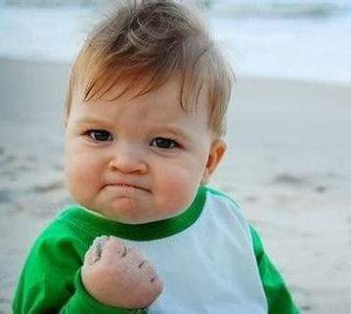
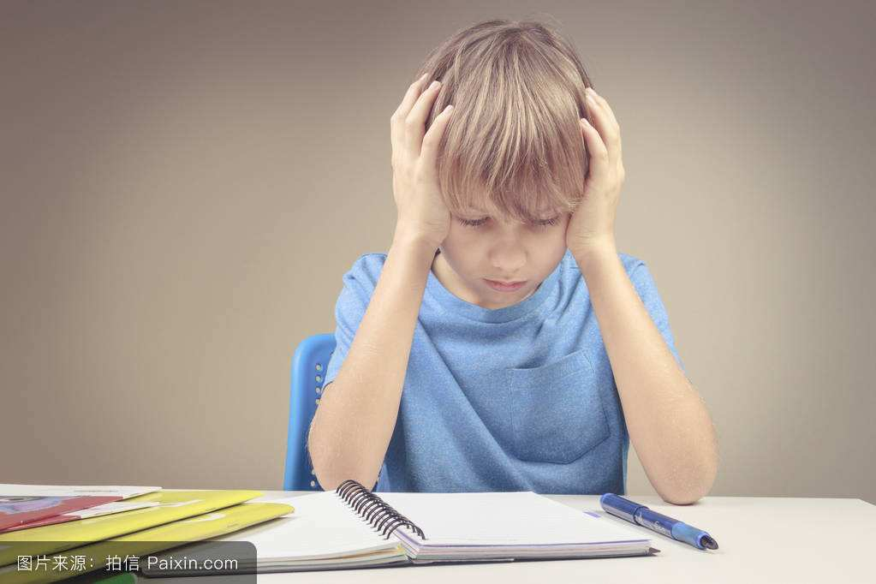
Q: What do you do when you have some difficulties(困难)?

Slide 23
Homework
1. Read the book fluently.
2. Make a mind map about another difficult or dangerous job.

