Slide 1
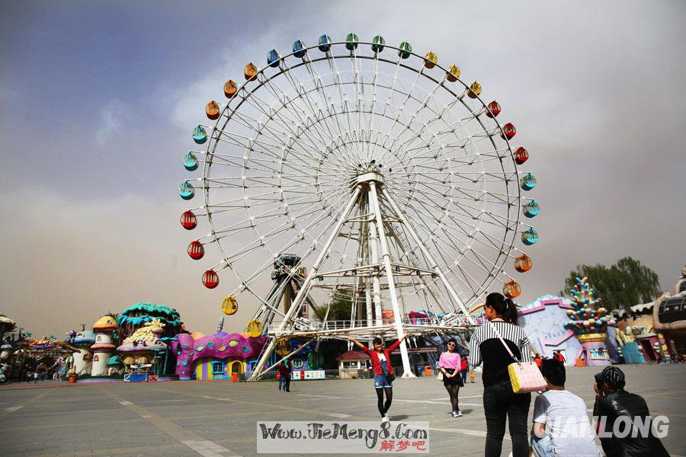
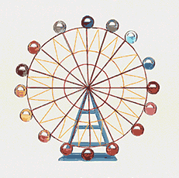
Ferris Wheel

Slide 2
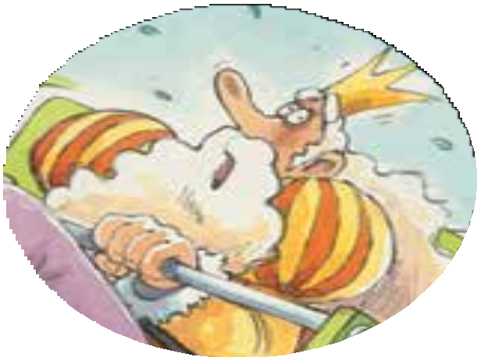
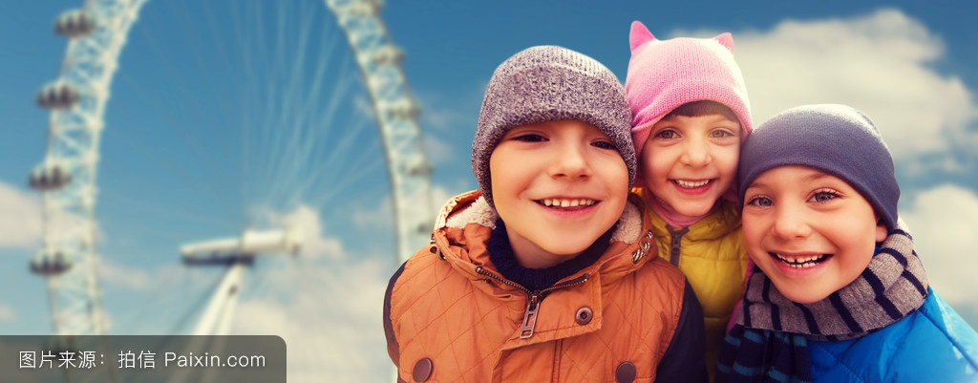
Q: How do you feel?
A: I feel…
Ferris Wheel

Slide 3
scared
Who
What
When
Where
Why
How
What do you want to know
about the story?

Slide 4


Let’s read
第5级

Slide 5

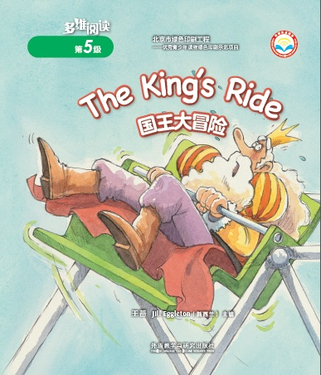
Series
Level
Title
Authors
Publisher

Slide 6
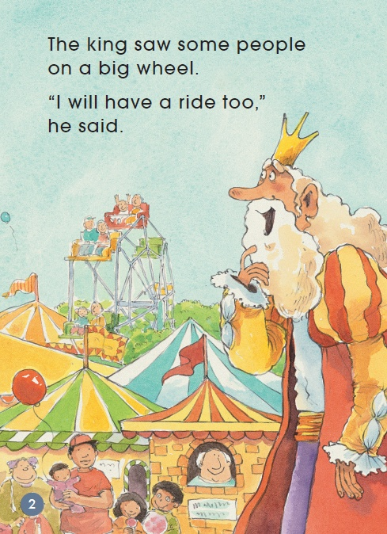
1. What did the king see?
He saw…
2. What did the king want to do?
He wanted to…

Slide 7
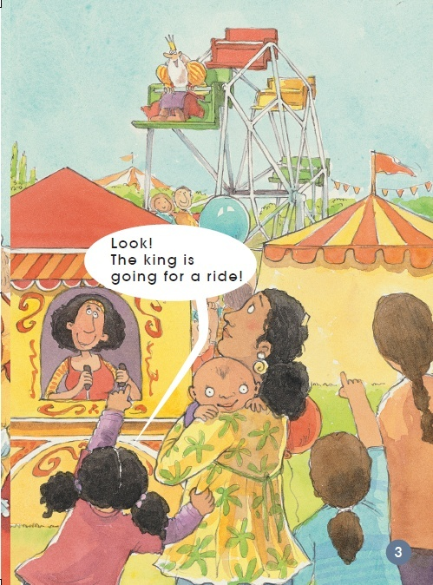
Look!
The king is
going for a ride!

Slide 8
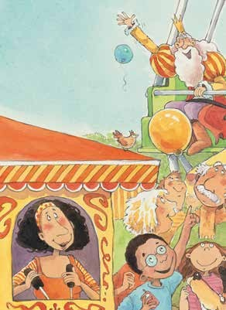
The wheel went
up and over,
up and over.
“This is good. I like it!”
shouted the king.
1. How did the king feel?
He was…
2. What did people think?

Slide 9
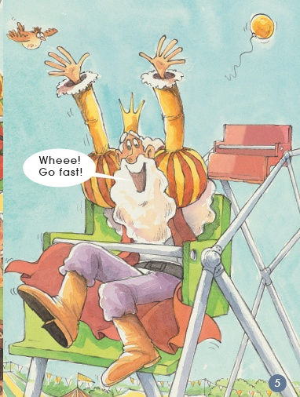
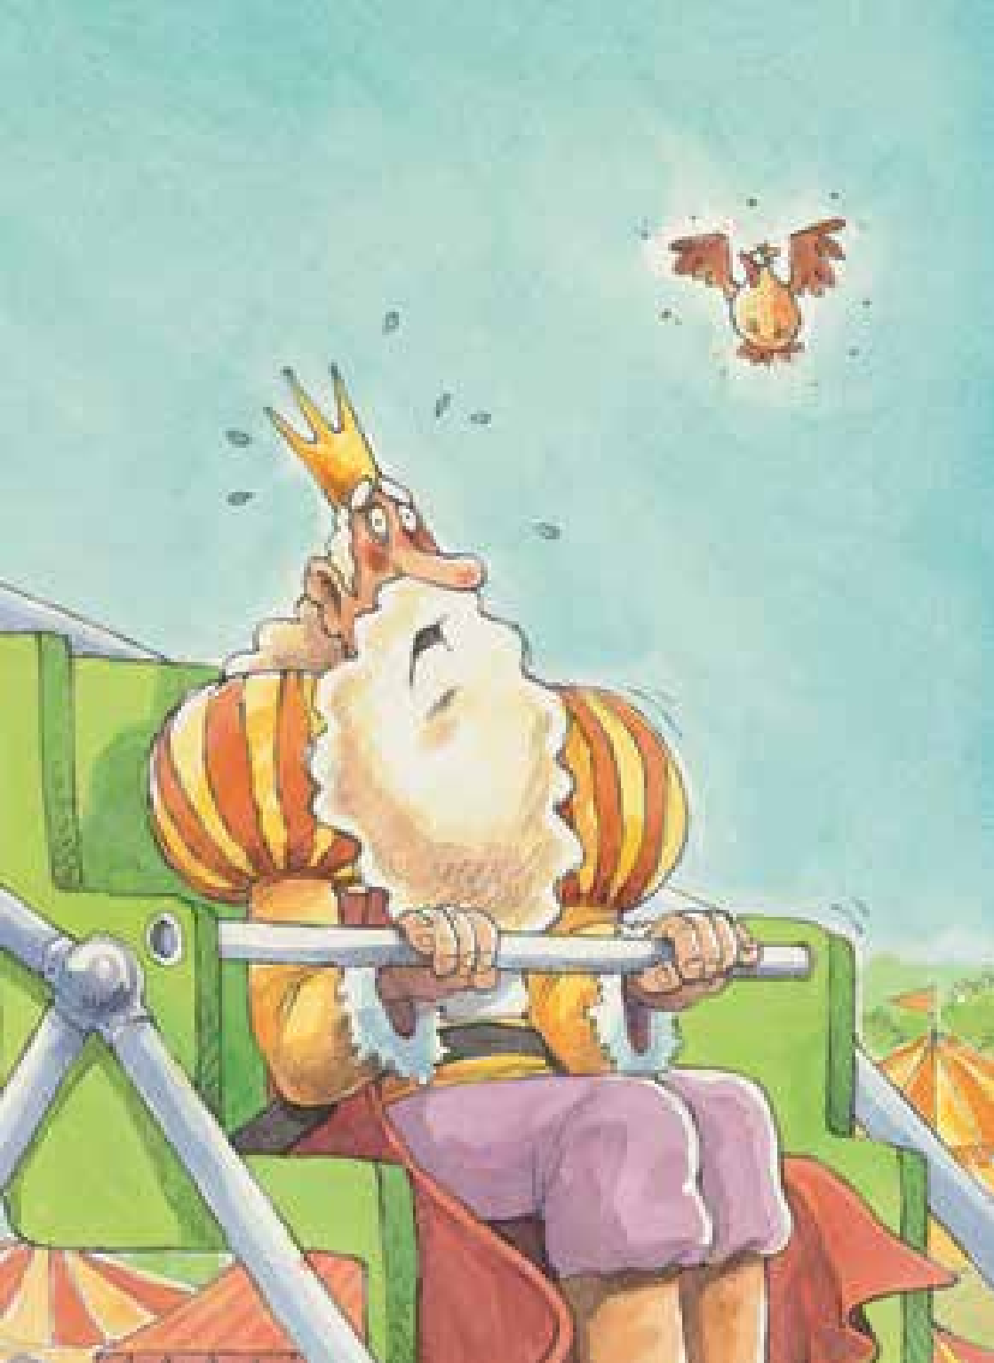
?

Slide 10
But the wheel stopped and the king was at the top.

Slide 11
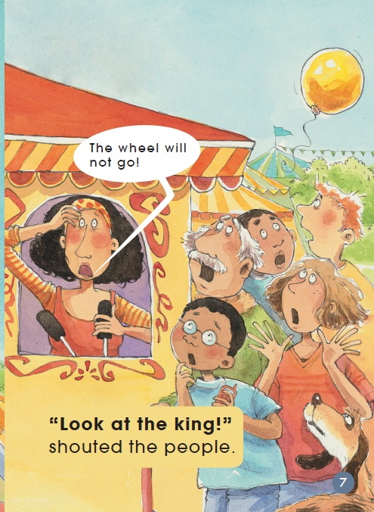
The wheel will not go!
“Look at the king!”
shouted the people.

Slide 12
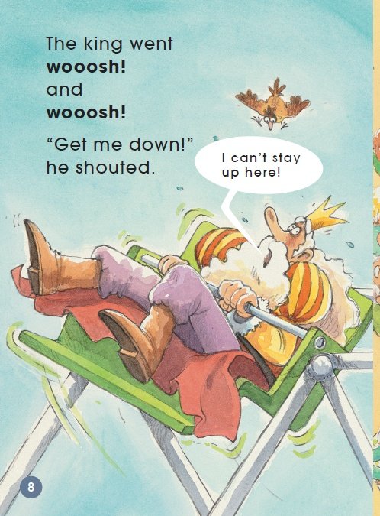
The king went
wooosh!
and
wooosh!
“Get me down!”
he shouted.
I can’ t stay
up here!

Slide 13
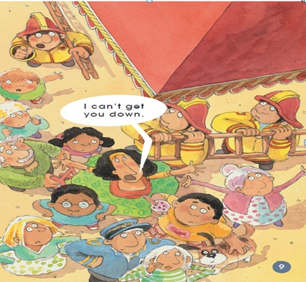
I can’ t get you down.

Slide 14
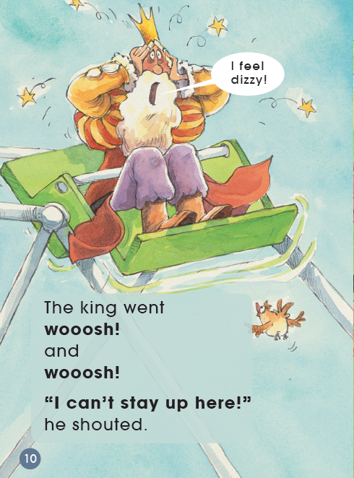

The king went
wooosh!
and
wooosh!
“I can’t stay up here!”
he shouted.

Slide 15
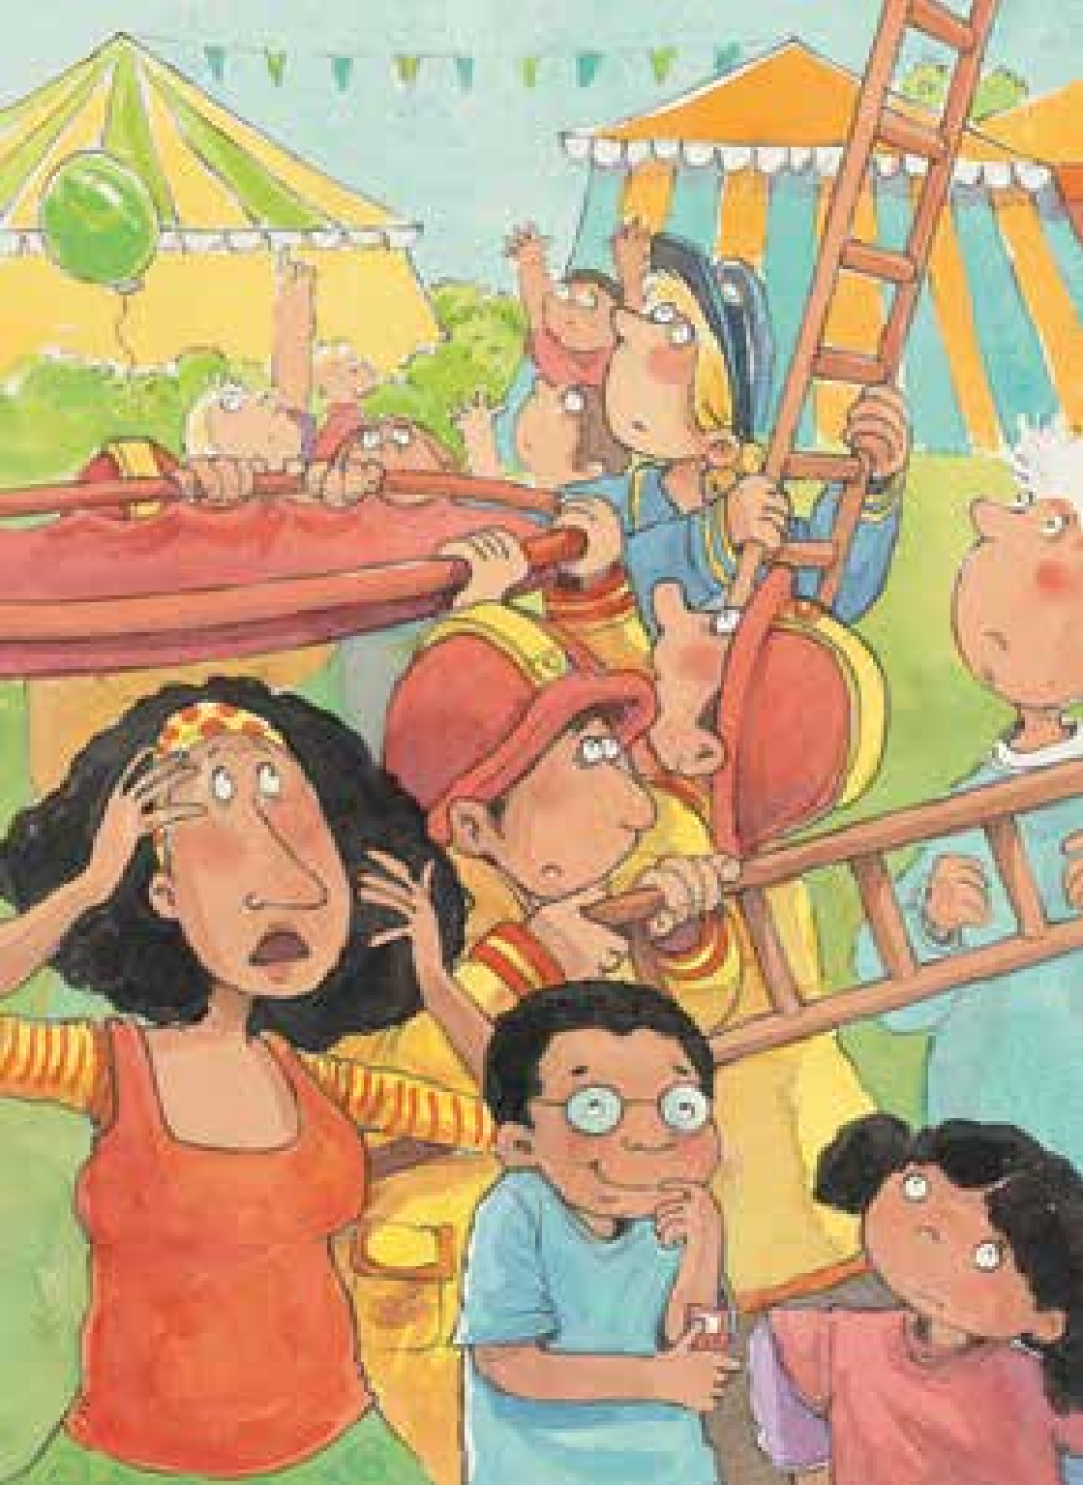

Slide 16
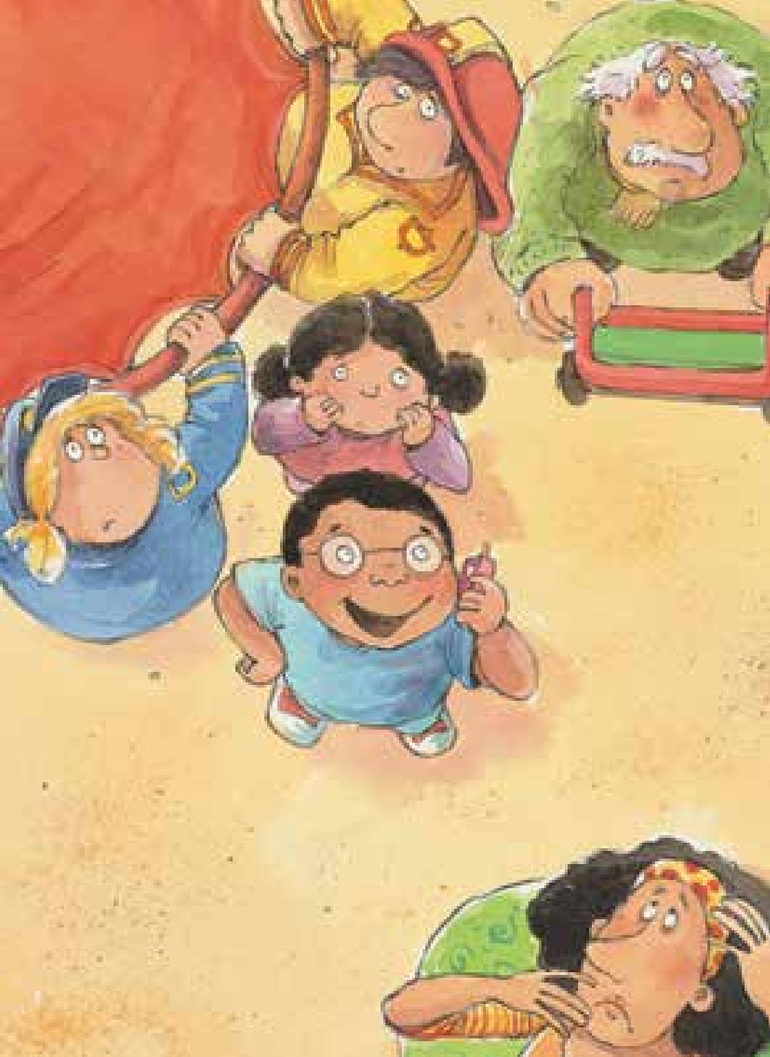
Come and
get the king.
What did the boy do?
Helicopter
coming!
A boy got out
his cellphone.
“Come and get the
king,” he said.

Slide 17
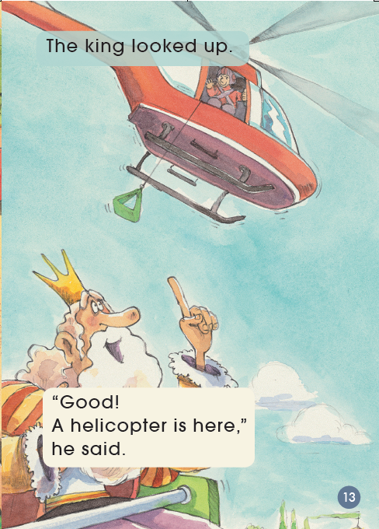
How did the king feel?
How do you know?
The king looked up.
“Good!
A helicopter is here,” he said.

Slide 18
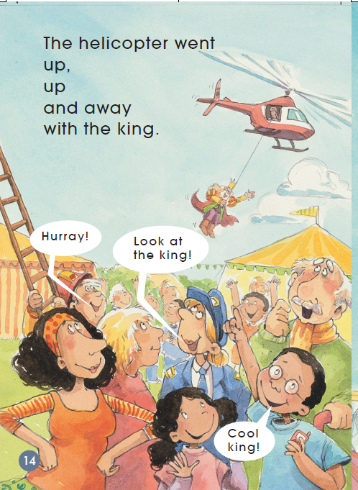
The helicopter went up,
up and away
with the king.
How did people feel?
How do you know?
What else could they say?
Hurray!
Look at
the king!
Cool
king!

Slide 19
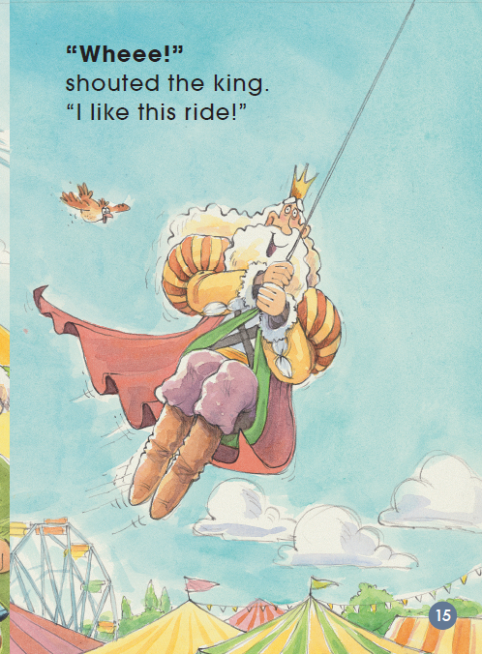
What do you
think of the king?
I think he is…

Slide 20


Read
Tips:
Read with full emotion.

Slide 21
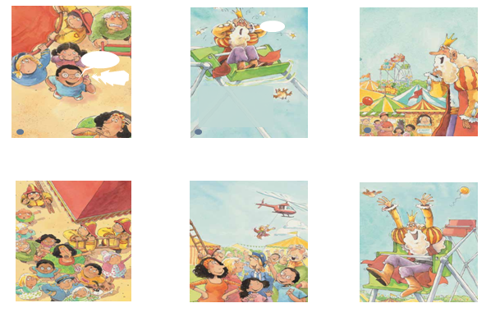
Q: How much do you know about the story?
Tips:
Order the pictures.

Slide 22
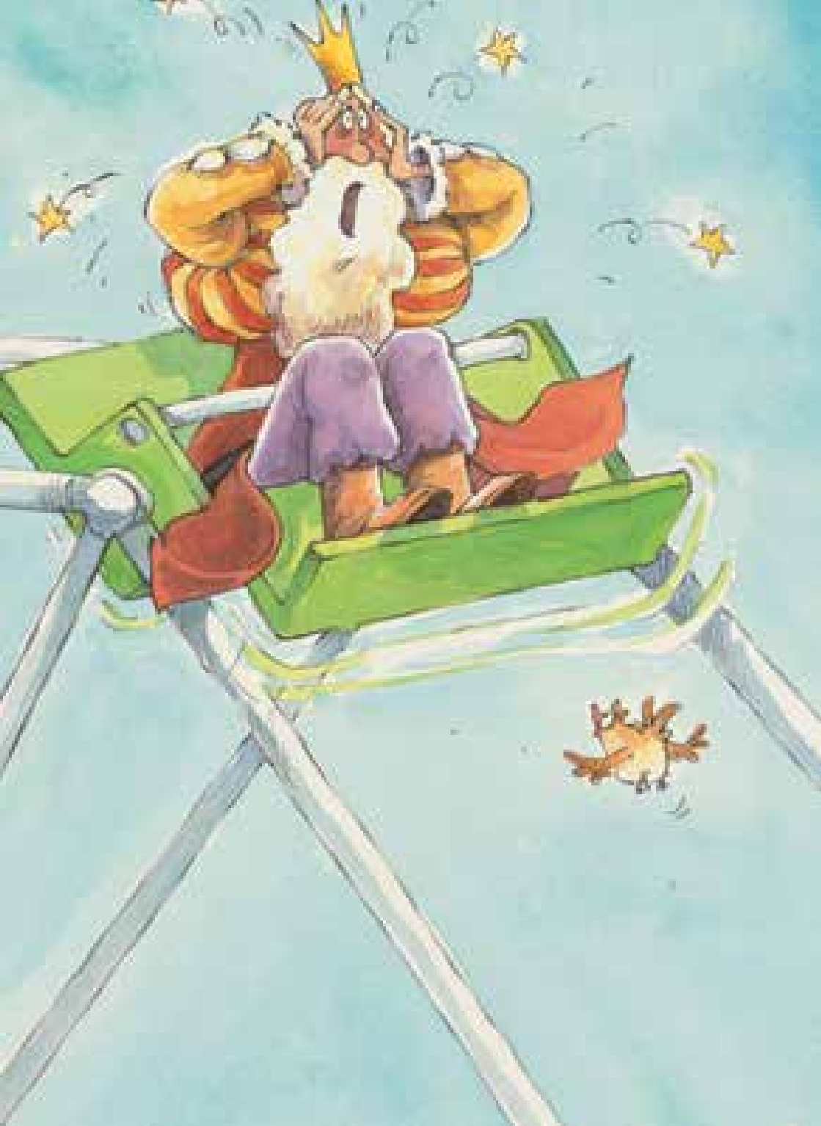
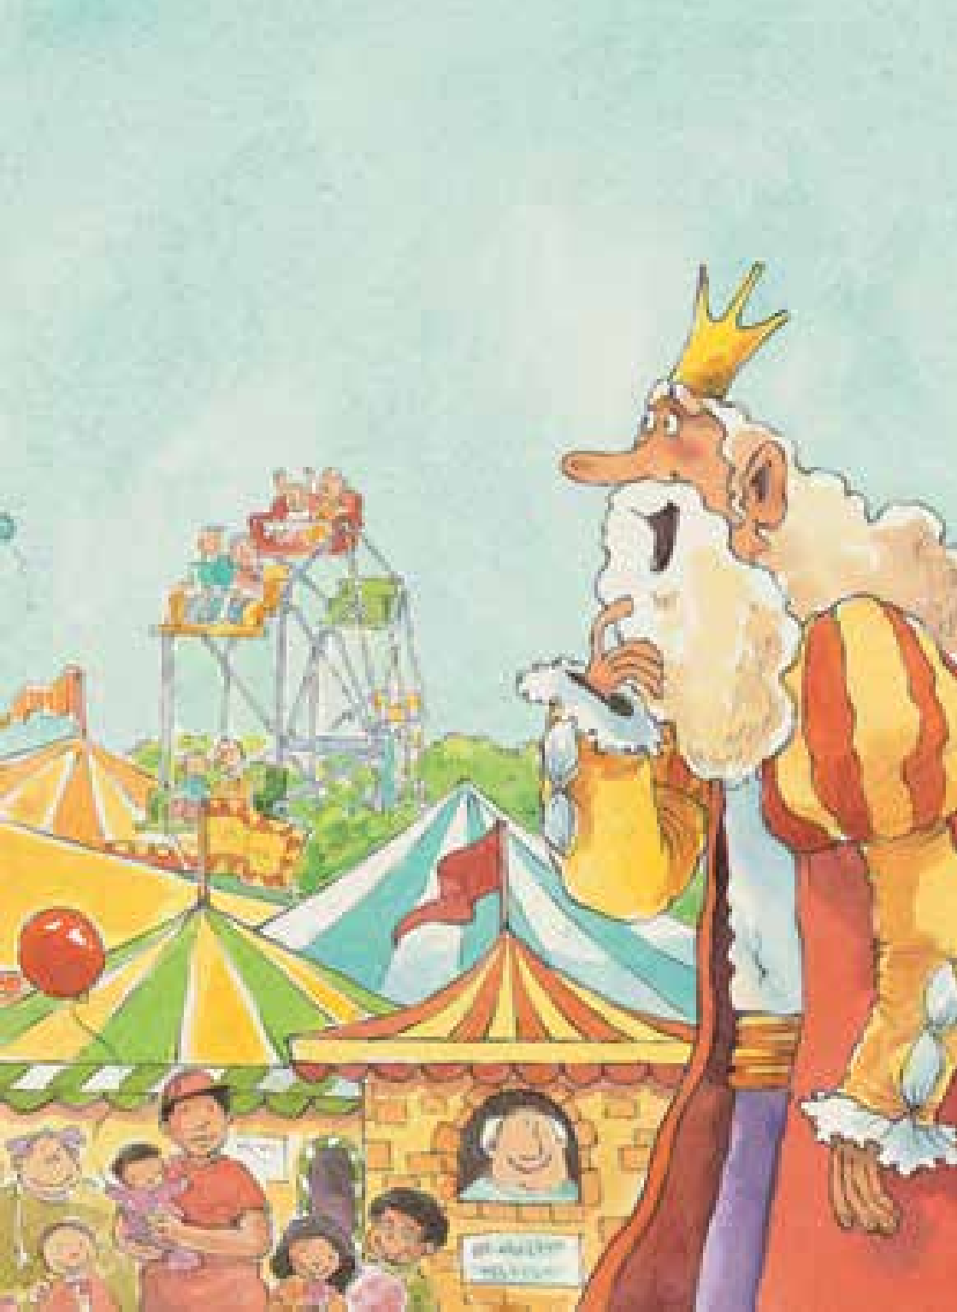
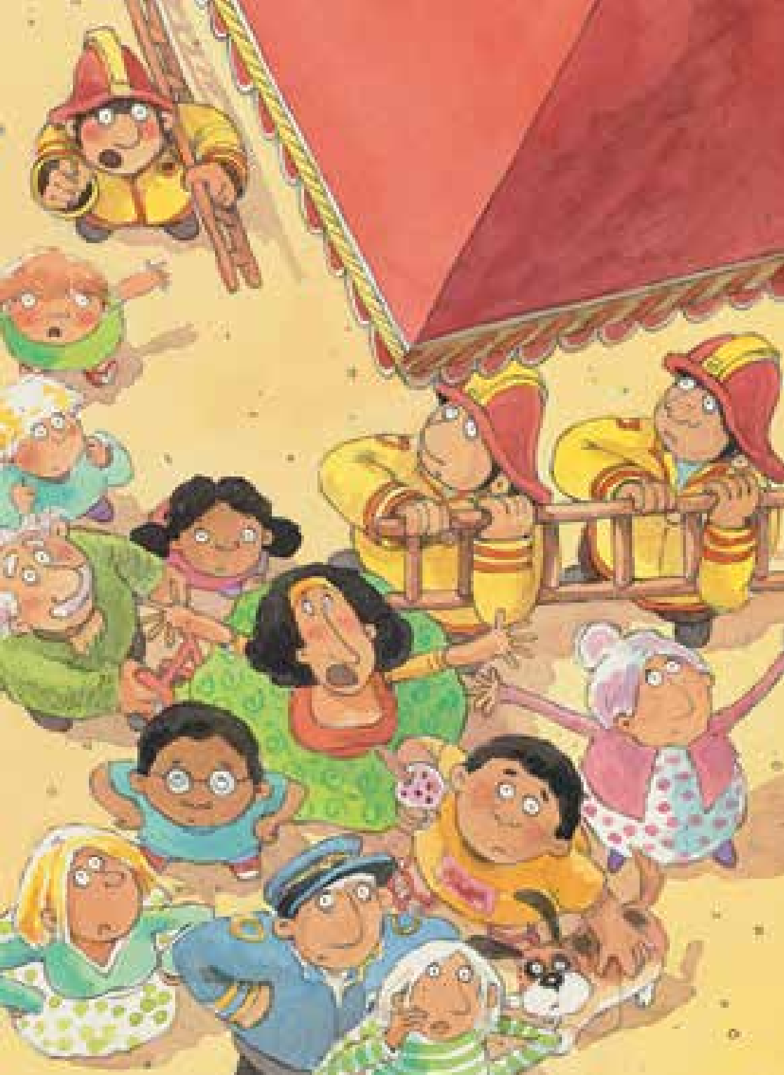
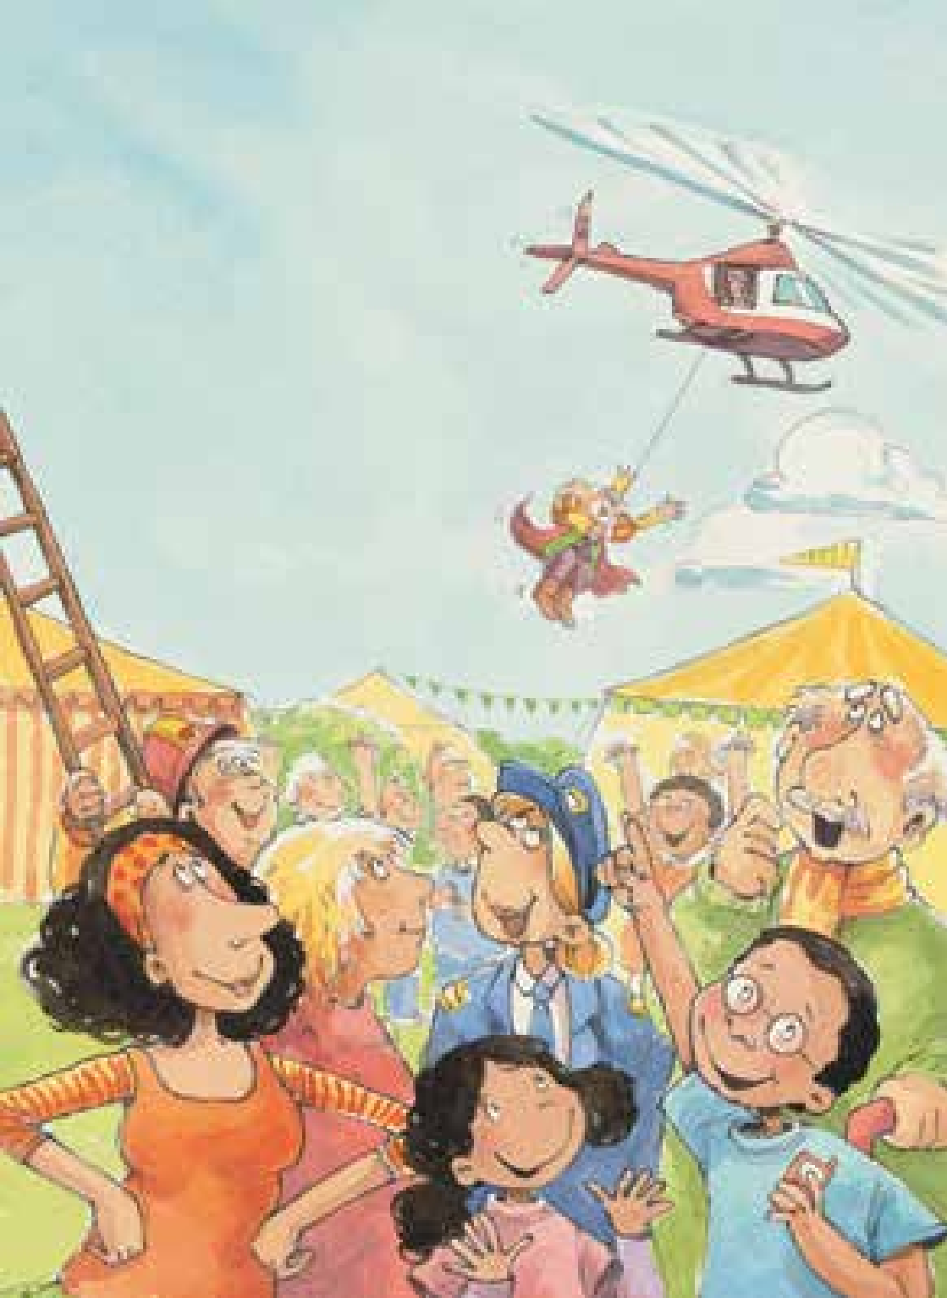
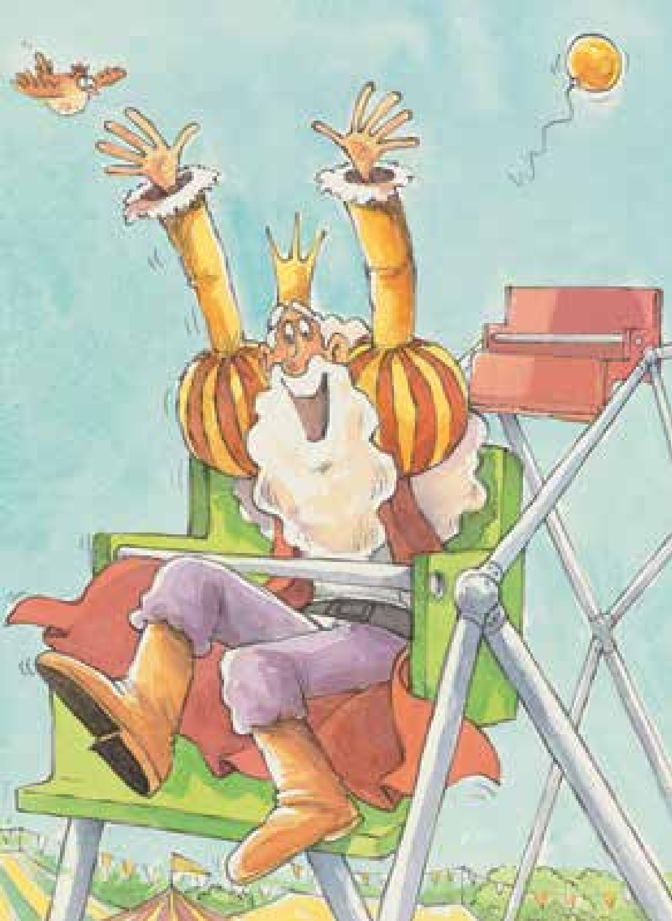
⑤
③
①
A boy called
the helicopter.
The wheel stopped.
The king wanted to have a ride.
④
⑥
②
People wanted to help the king.
The king went up with the helicopter.
The king went up with the wheel.

Slide 23
Reading theater
Tips:
Finish the worksheet in groups.

Slide 24
Title | Today, we learned a story. The title of the story is ________________ .
Authors | It was written by _____________ and ______________.
Who? When? Where? | Here is the story. One day, _________went to the play park.
Beginning | Narrator | Reading theater
 | The king wanted to _________________. Then, the king went up with the wheel. He was very __________. | And he said “_______________.” He shouted “_______________.”
Middle | But the wheel ____________________. The king was at _______________. He was very __________. | He shouted “_______________.” People shouted “_____________.”
End | At last, a boy called _______________. The king went up with the _______________. The king was very __________. | The boy said “_______________.” And king shouted “___________.” People shouted “_____________.”

Slide 25
Q: Do you think it’s a good idea
to rescue the king with a helicopter?
I think it’s a good idea, because…
I don’t think it’s a good idea, because…

Slide 26
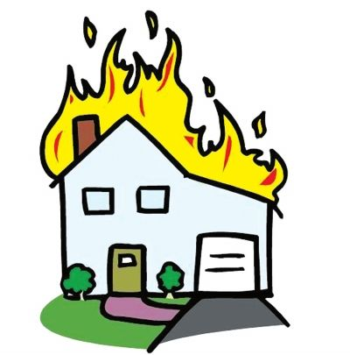

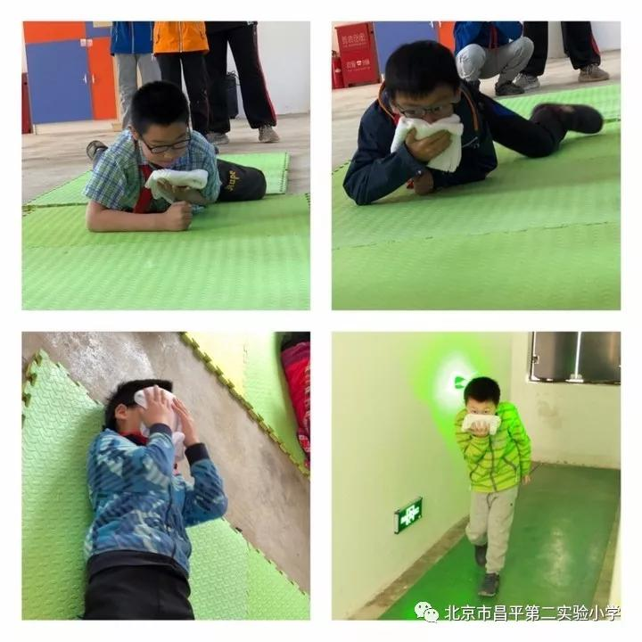
Q: What do you do when you have some difficulties?
Problems | Solutions—Drawing out or writing down your answers
 | What should you do? | What shouldn’t you do?
On fire | Lower your body, Cover your mouth and nose, Use the fire extinguisher, Use the fire hydrant, etc. | Don’t take the elevator, Don’t jump out of the window, Don’t push others, Don’t rush to the door, etc.

Slide 27
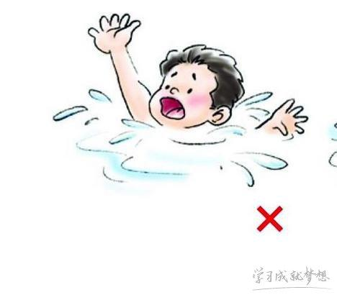
Q: What do you do when you have some difficulties?
Problems | Solutions—Drawing out or writing down your answers
 | What should you do？ | What shouldn’t you do？
Drowning | Go to safe beaches or pools, Always be careful. | Don’t go to dangerous area, Don’t be far away from your parents.

Slide 28
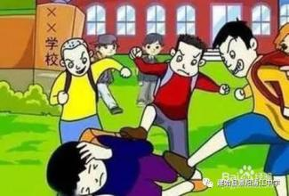
Q: What do you do when you have some difficulties?
Problems | Solutions—Drawing out or writing down your answers
 | What should you do？ | What shouldn’t you do？
Bullied by classmates | Seek help from parents and teachers. | Don’t keep it as a secret and do nothing.

Slide 29
Homework
1. Listen and read the book.
2. Draw a picture of how to solve the problems in your life.

