Slide 1
Let’s read
第5级

Slide 2
Series
Level
Title
Authors
Publisher

Slide 3
Q: How did they feel?
They were…

Slide 4
Q: How did they feel?
They were…
Q: What happened?
Maybe…

Slide 5
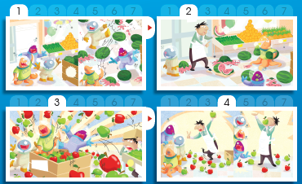
Read PP 2-9
Q1: What did the shopkeeper say and do?
Q2: What did the aliens say and do?

Slide 6
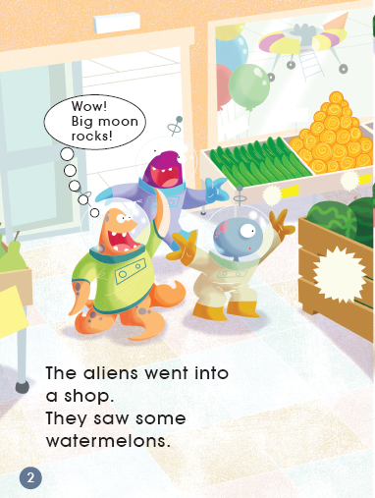
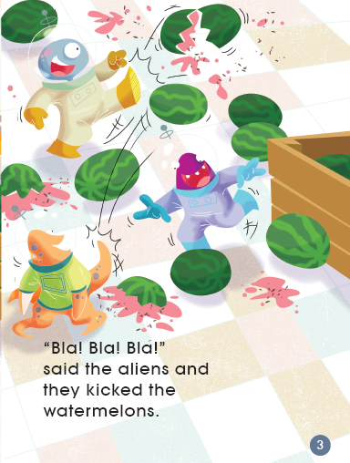

Slide 7
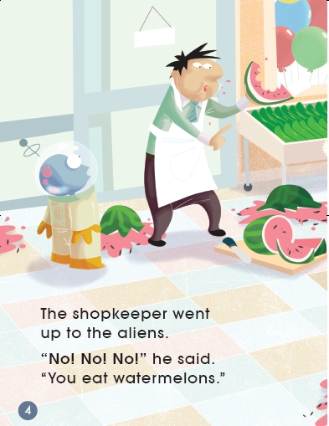
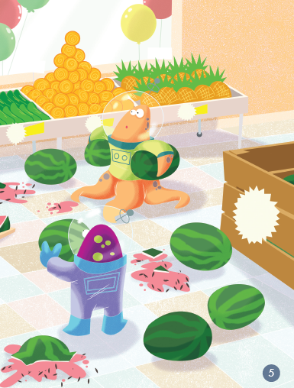

Slide 8
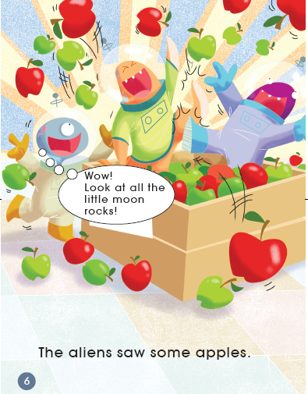
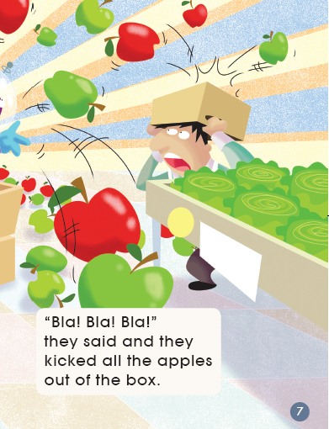

Slide 9
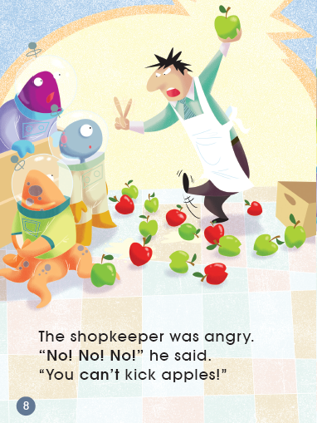
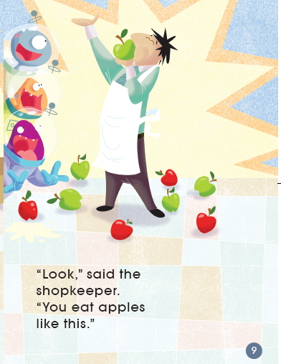

Slide 10
Read PP 2-9
Q1: What did the shopkeeper say and do?
Q2: What did the aliens say and do?

Slide 11
Role play PP 2-9
Tips:
1. Facial expression.
2. Body language.

Slide 12
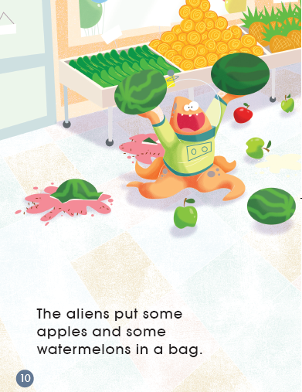
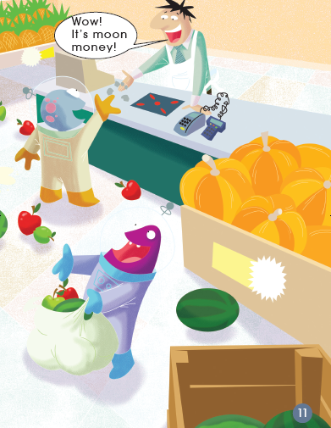
Q: How did they feel?
Q: What did they learn?

Slide 13
Role play PP 10-11
Tips:
1. Facial expression.
2. Body language.

Slide 14
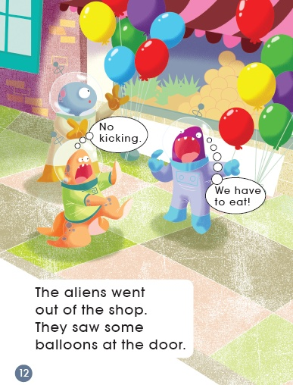
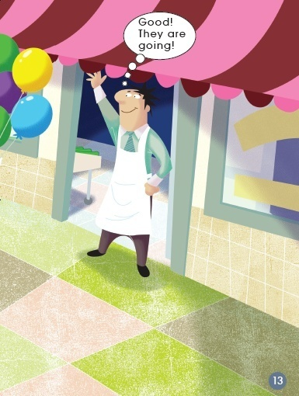
Q: What would they do?
Q: How did he feel?

Slide 15
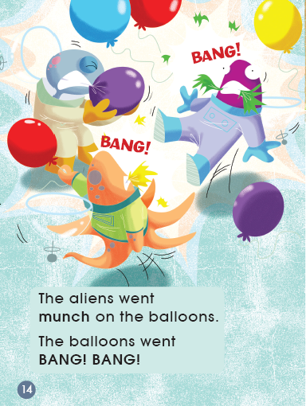
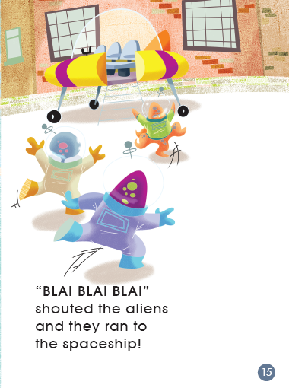
Q: How did they feel?

Slide 16
Let’s read
Tips:
1. Read with full emotion.
2. Point with fingers.

Slide 17
Hot news
Tips:
Finish the interview in groups.
A: Reporter 1
B: Reporter 2
C: Shopkeeper
D: Aliens

Slide 18
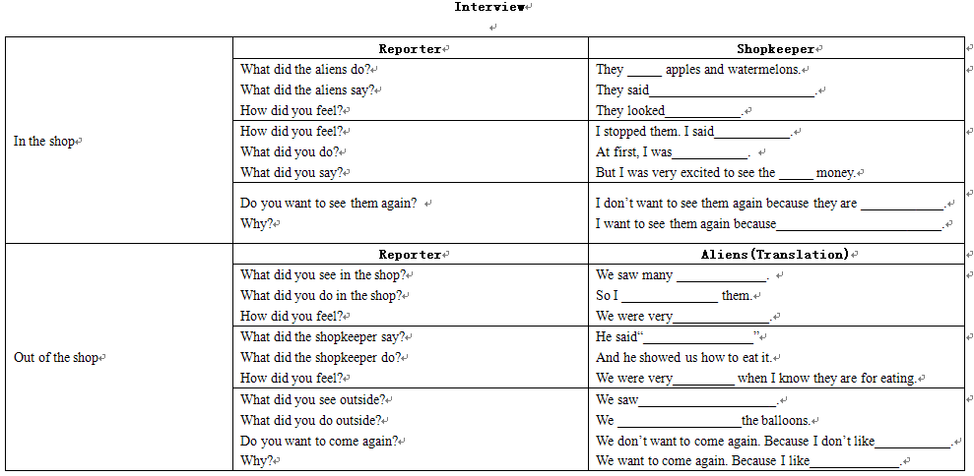
Hot news
Tips:
Finish the interview in groups

Slide 19
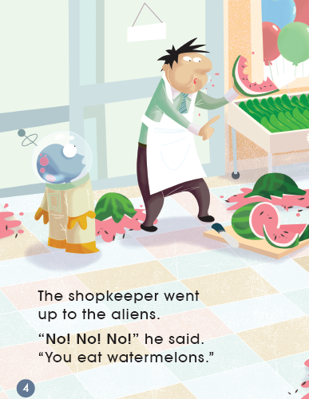
Q: What do you think of the shopkeeper in the shop?
Tips:
1. What did he do?
2. What did he say?
Useful structures:
I think…
Please look at Page…

Slide 20
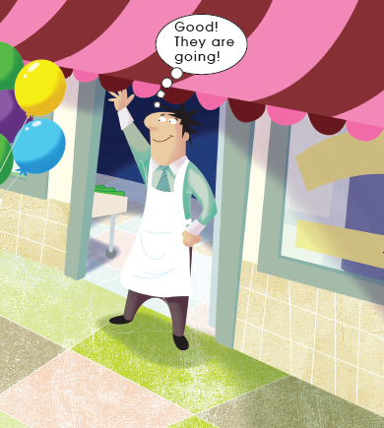
Q: What do you think of the shopkeeper out of the shop?
Tips:
1. What did he do?
2. What did he say?
Useful structures:
I think…
Please look at Page…

Slide 21
Q: What could he do and say to help the aliens?
Tips:
1. What would happen next?
2. Will the aliens run away?

Slide 22
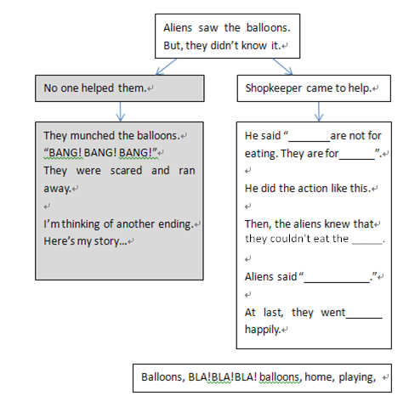
Q: What could he do and say to help the aliens?

Slide 23
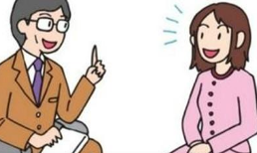
Q: What are the most important things in communication?
Body language
Facial expression
Language
Win-win

Slide 24
Homework
1. Listen and read the book.
2. Choose a topic, draw a picture:
If you were the alien, what would you do and say in the shop?
OR
If you were the shopkeeper, what would you do and say to the aliens?

