Slide 1
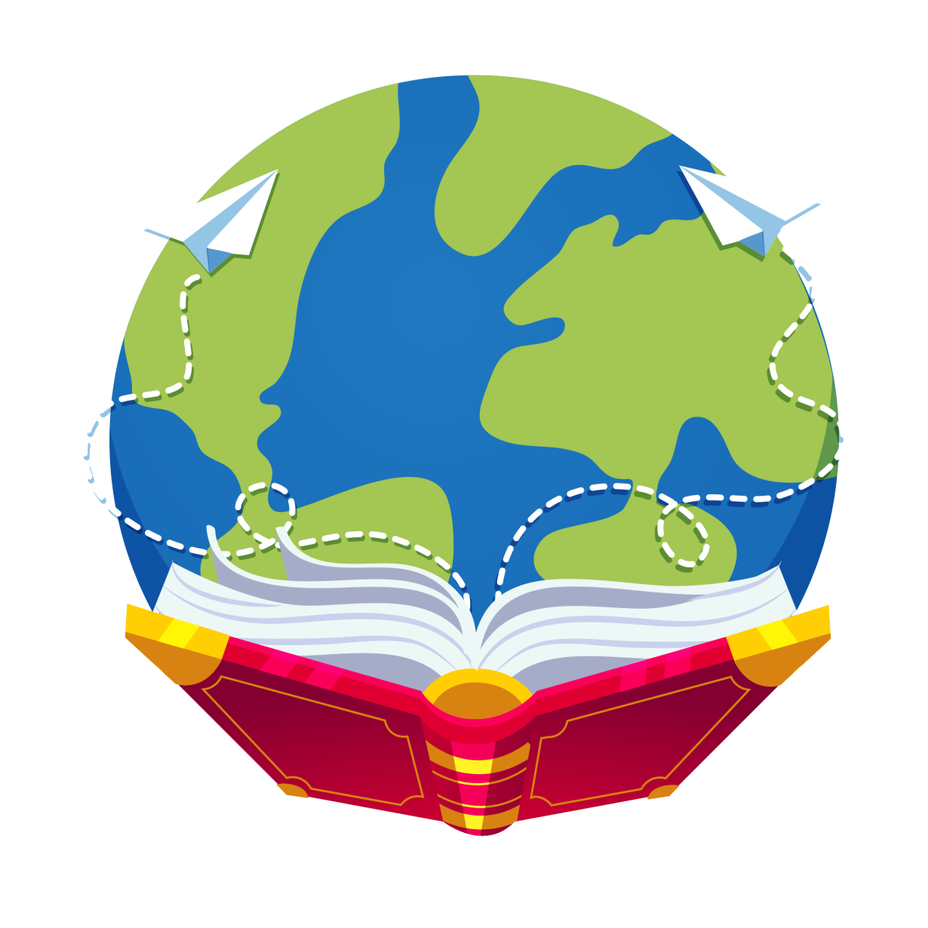
Let’s read
第5级

Slide 2
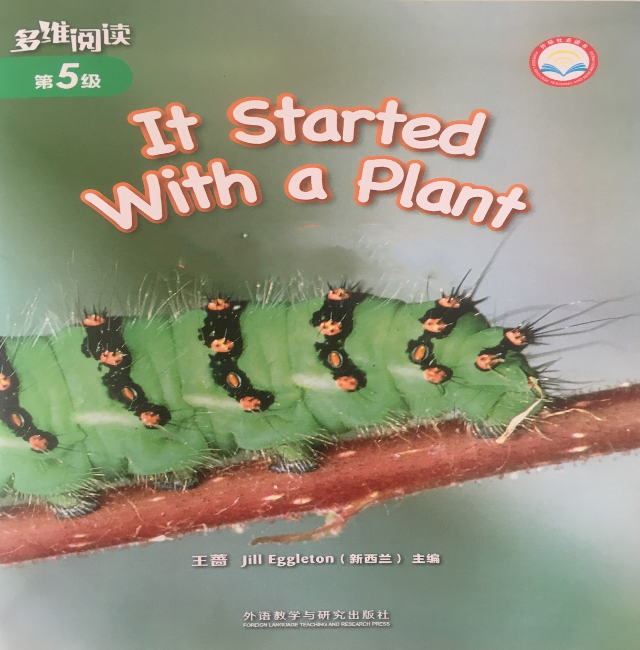
Series
Level
Title
What?
Authors
Publisher

Slide 3
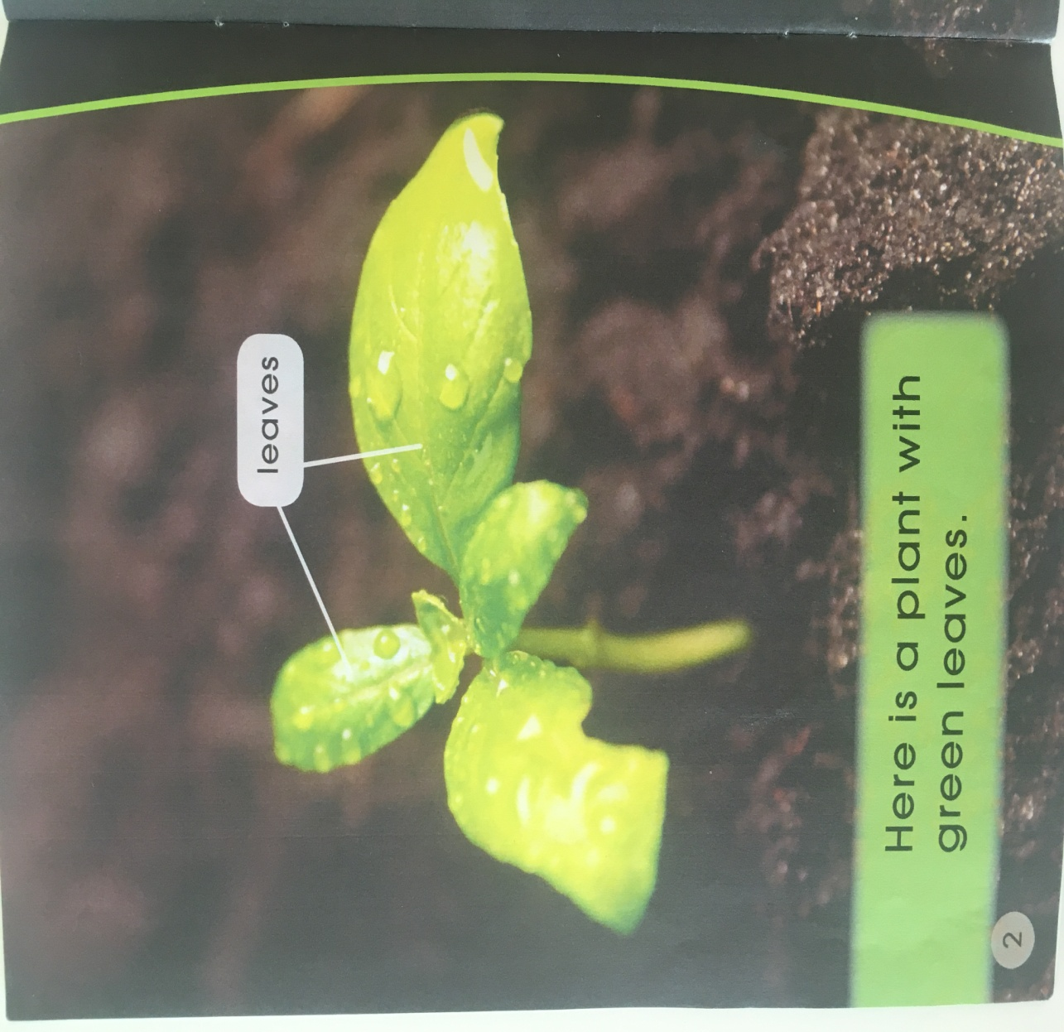
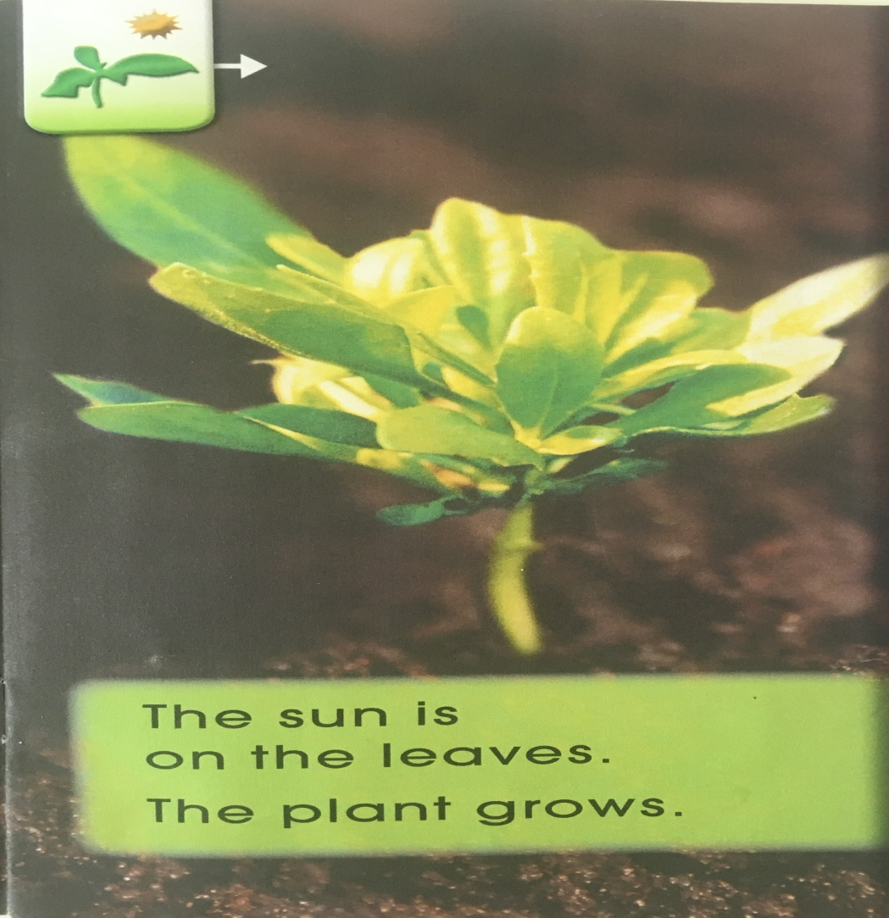
Q: What would happen after a few days?
Q: What can you see on the leaves?
leaves
leaf
leaves
grows

Slide 4
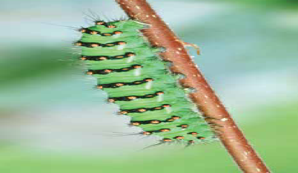
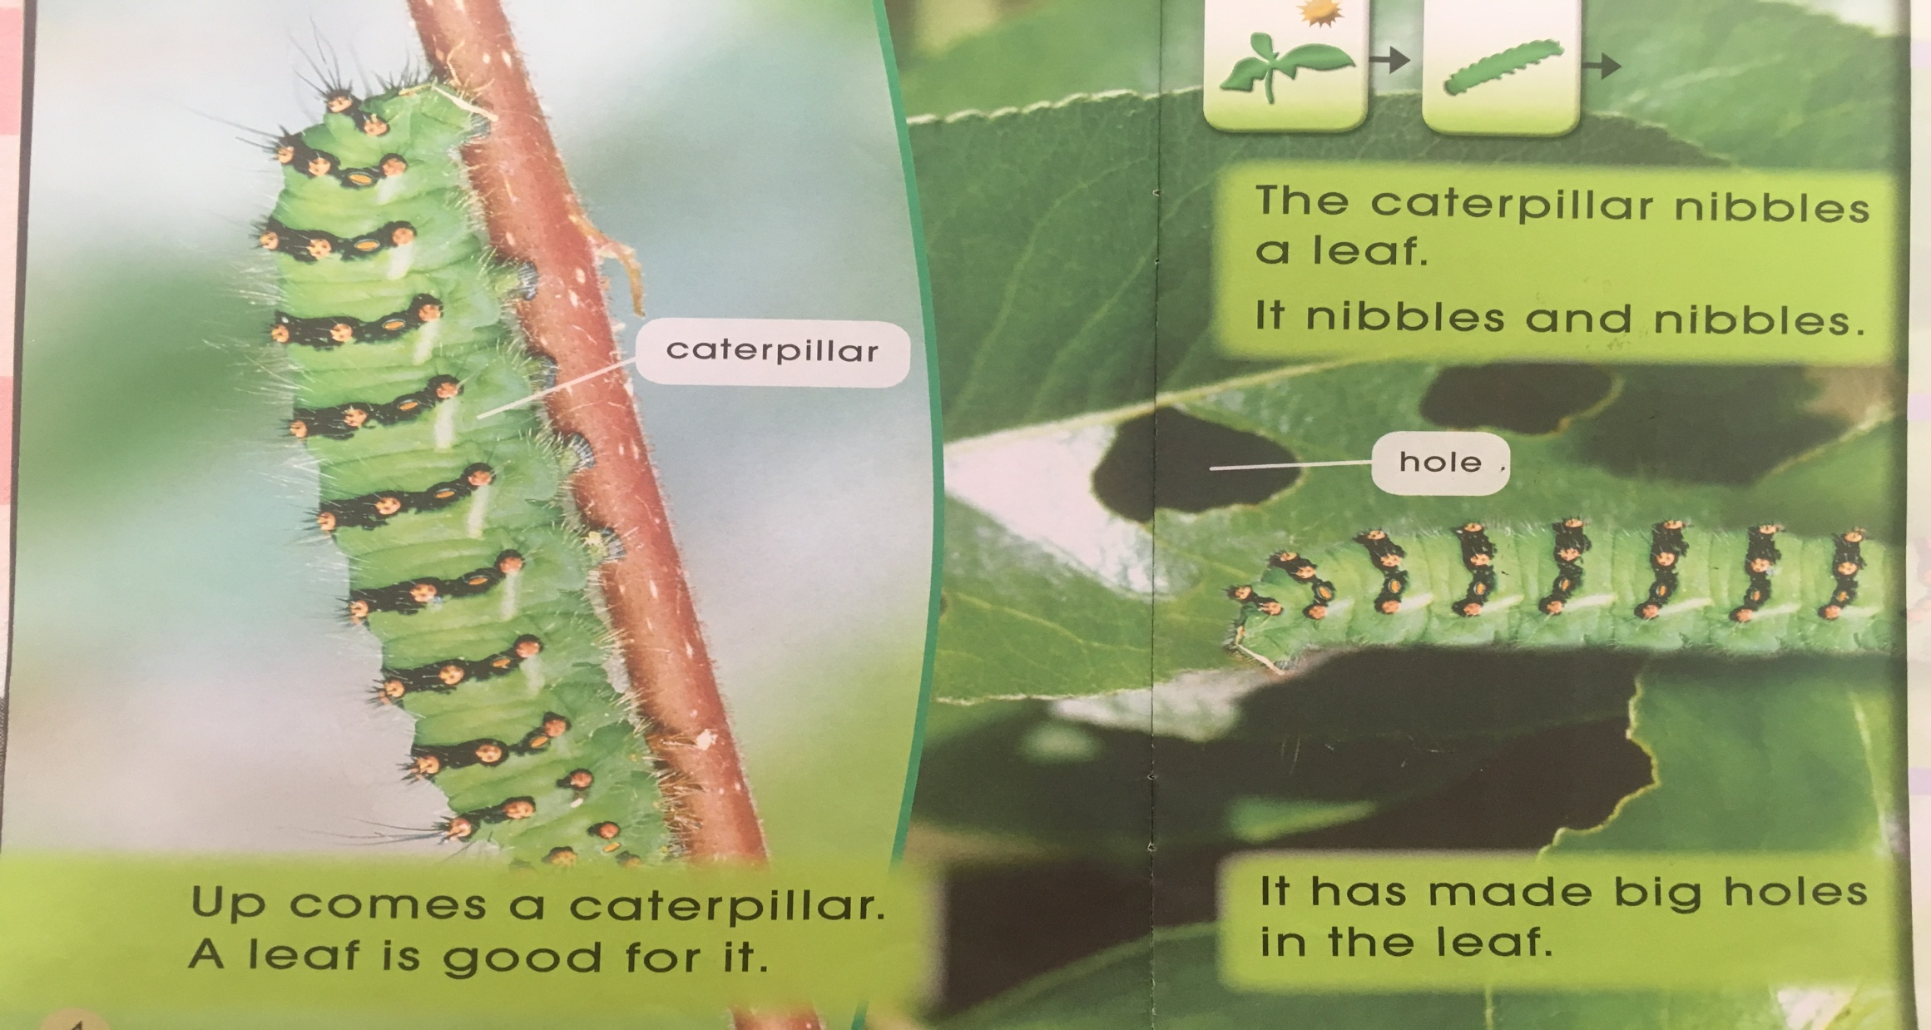
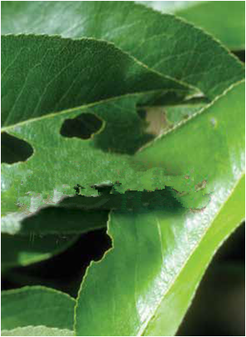
Q: Who makes them?
Q: What can you see in the leaf?
Q: Why does the caterpillar make holes in the leaf?
hole
caterpillar
is good for

Slide 5
nibble

Slide 6
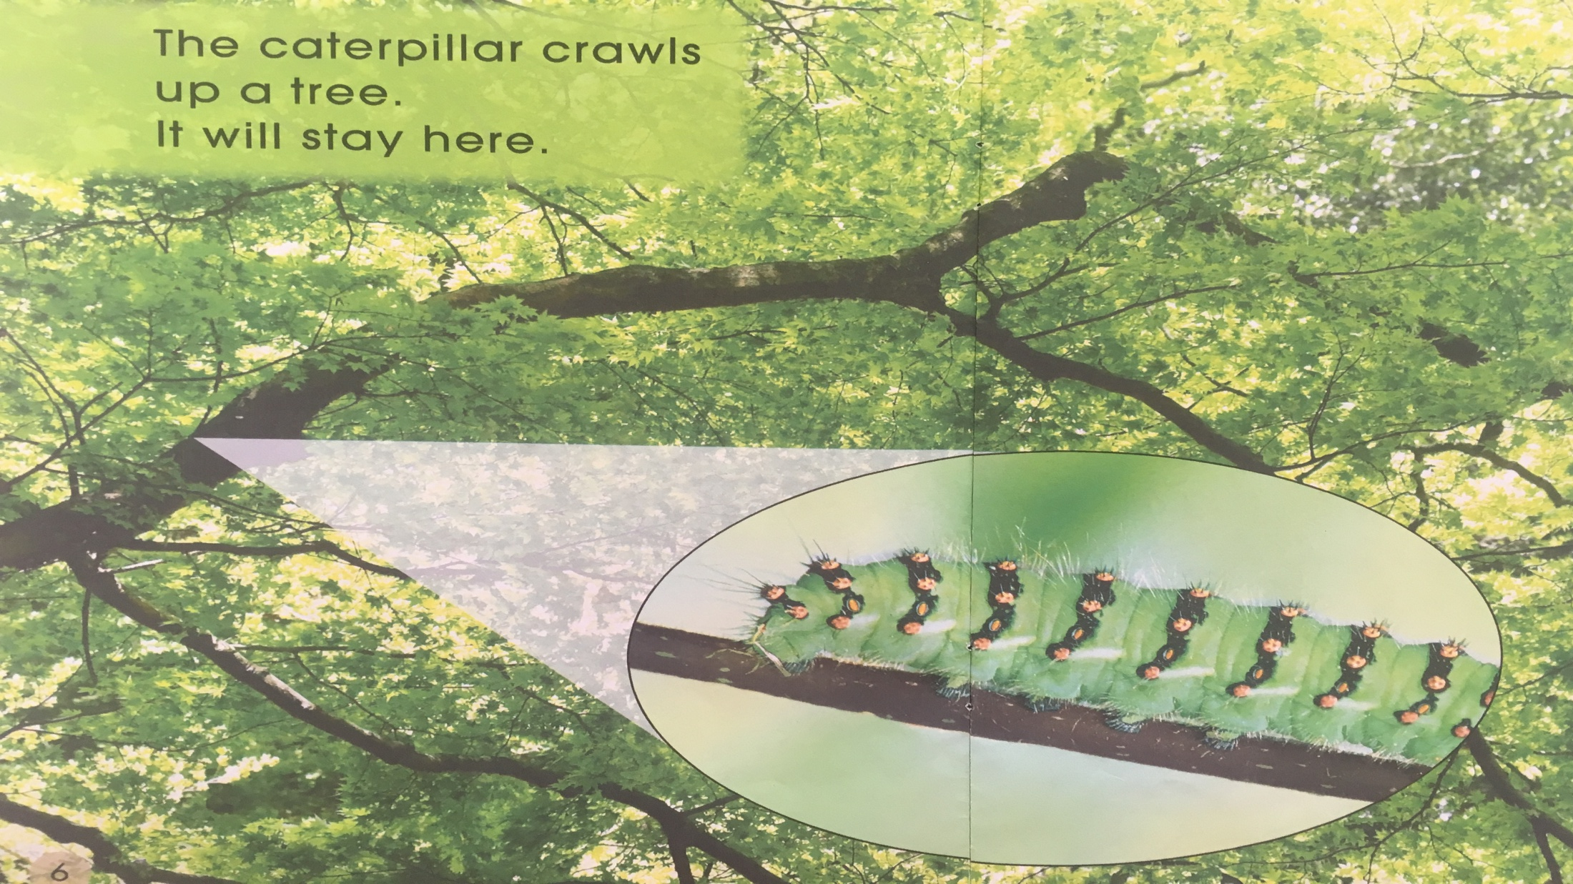
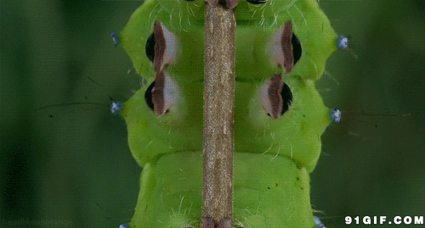
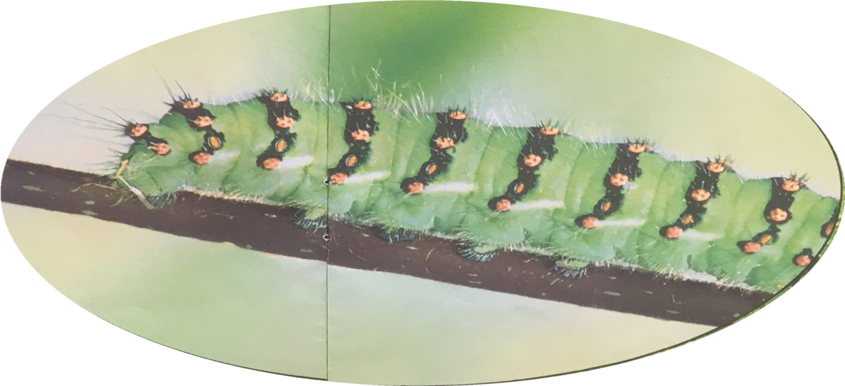
Q: Where is the caterpillar going?
crawls

Slide 7
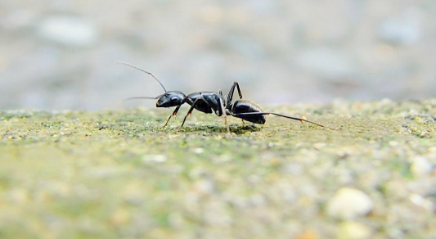
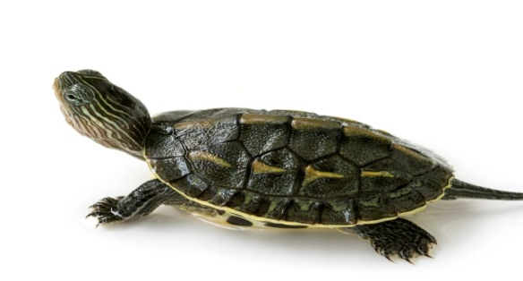
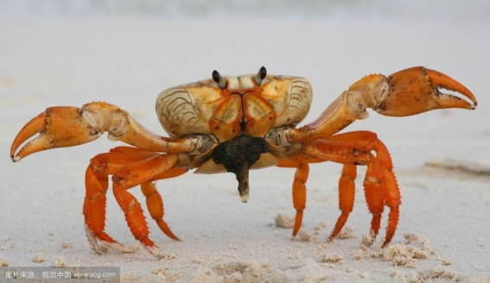
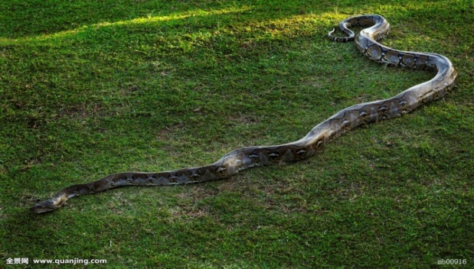
crawl
ant
turtle
…
crab
snake

Slide 8
Q: Do you think it is safe here?

Slide 9
Q: What do you think it might do? Why?
?

Slide 10
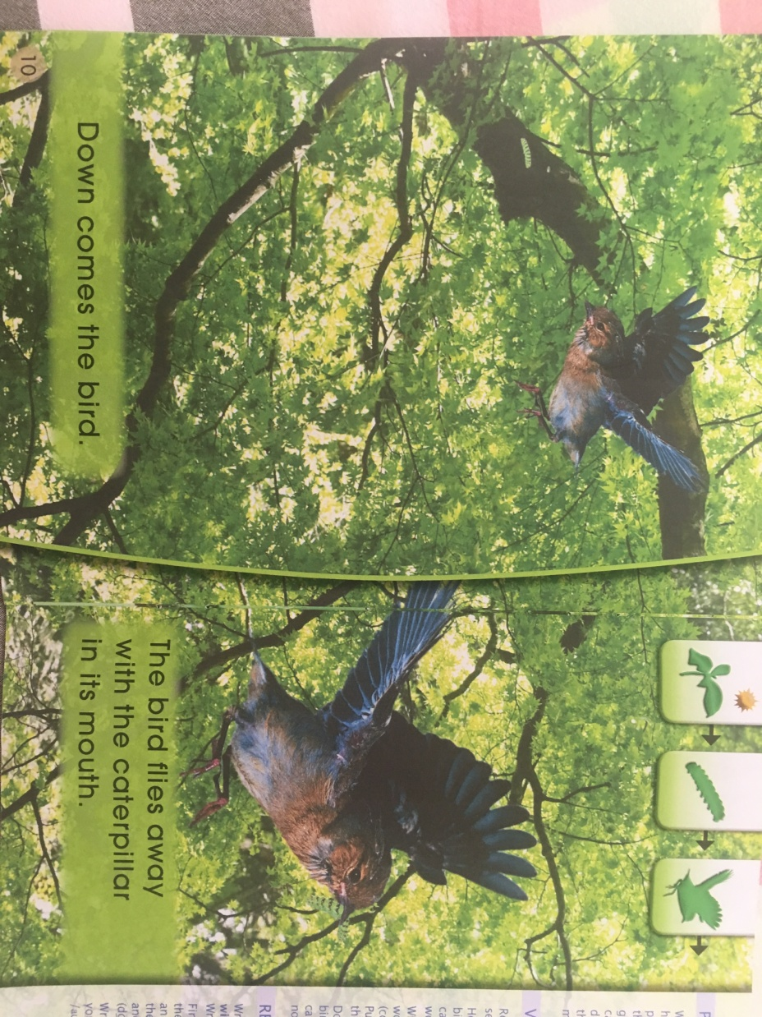
flies away

Slide 11
?
Tips：
1. Self-reading PP 12-14.
2. Keep silent.
Q: What animal is coming?
Useful Sentences:
I think the bird is ___.
Because _________.
Q: Is the bird lucky? Why?

Slide 12
Q: What animal is coming?
A cat

Slide 13
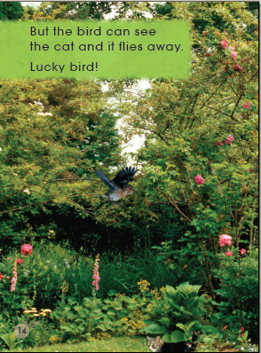
flies away.
Q: Is the bird lucky? Why?
Lucky bird!
Useful Sentences:
I think the bird is ___.
Because _________.
Q: If the bird comes down, could the cat catch it?
Useful Sentences:
I think the cat could/couldn’t ____.
Because _________.

Slide 15
What?
Food Chain
Q: What else do you think “it” means?

Slide 16
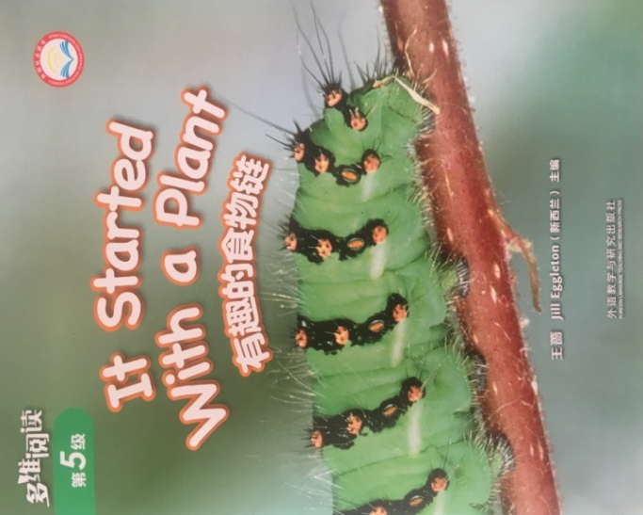
Listen and repeat
Tips:
Listen and repeat.
Point with finger.

Slide 17
Listen and repeat
Tips:
1. Group work.
2. Repeat with key words.
3. Do some actions.
Useful Sentences:
A: The … is on the leaves, and a … grows.
B: The … nibbles a leaf.
C: The … flies away with the caterpillar.
D: The … is waiting for the bird.

Slide 18
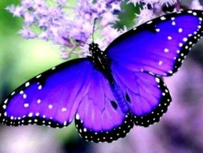
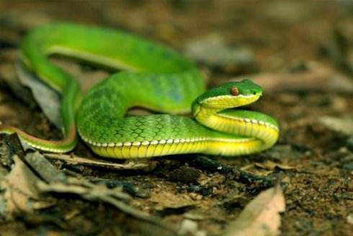
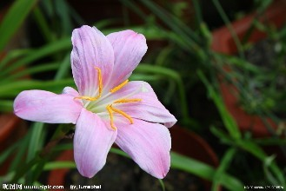
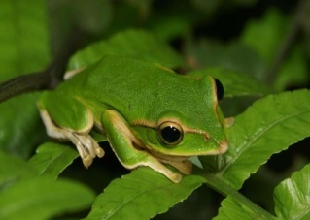
Think and order
① butterfly ② snake ③ flower ④ frog
Useful Sentences：
A: Here is a … .
B: … is good for … to eat.
C: … is good for … to eat.
D: … is good for … to eat.

Slide 19
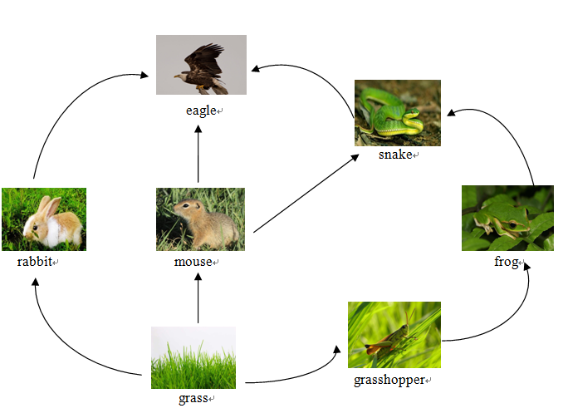
Find and say
Tips:
1. Group work.
2. Count food chains.
3. Choose one and write it on your worksheet.
We find ___ food chains.

Slide 20
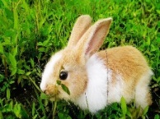
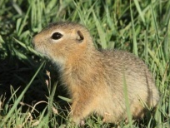
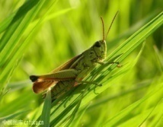
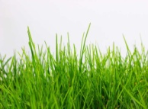
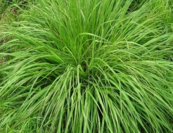
Find and say
eagle
snake
If there is much grass, what would happen?
If there is no grass, what would happen?
balance
rabbit
mouse
frog
grasshopper
grass

Slide 21
Homework
1. Listen and read the book.
2. Think of an item of food and draw the steps to show how you are able to have the food. (Such as the milk, the egg, the fish, …)

