Slide 1
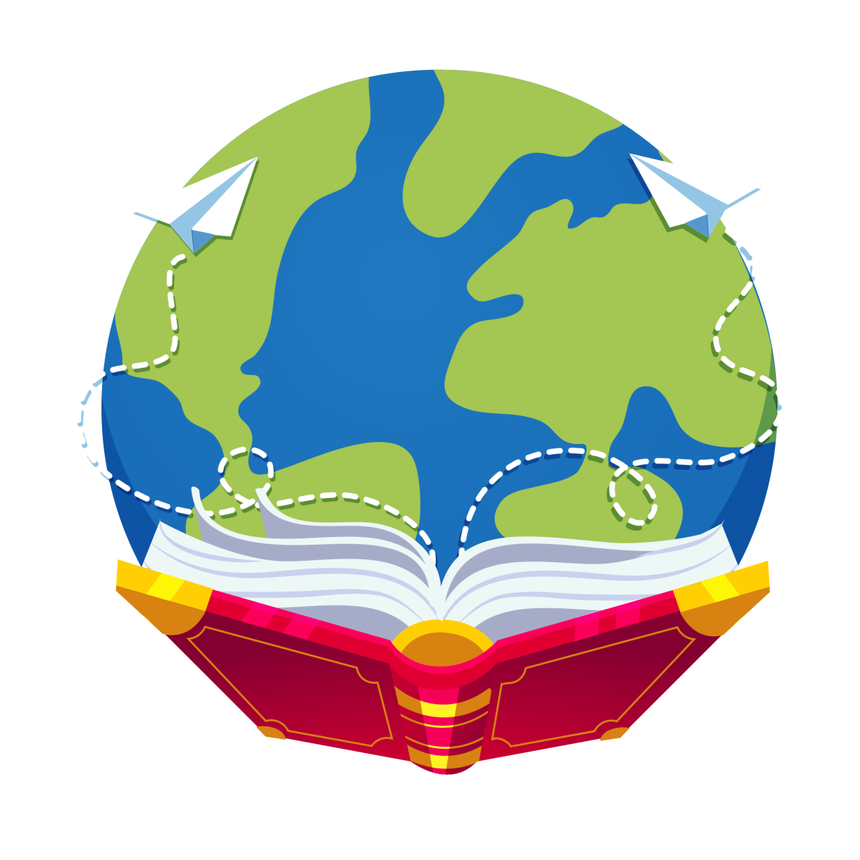
Let’s read
第5级

Slide 2
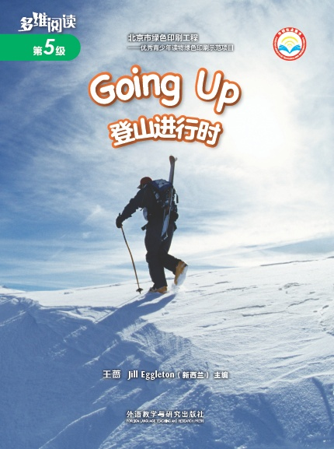
Series
Level
Title
Authors
Publisher

Slide 3
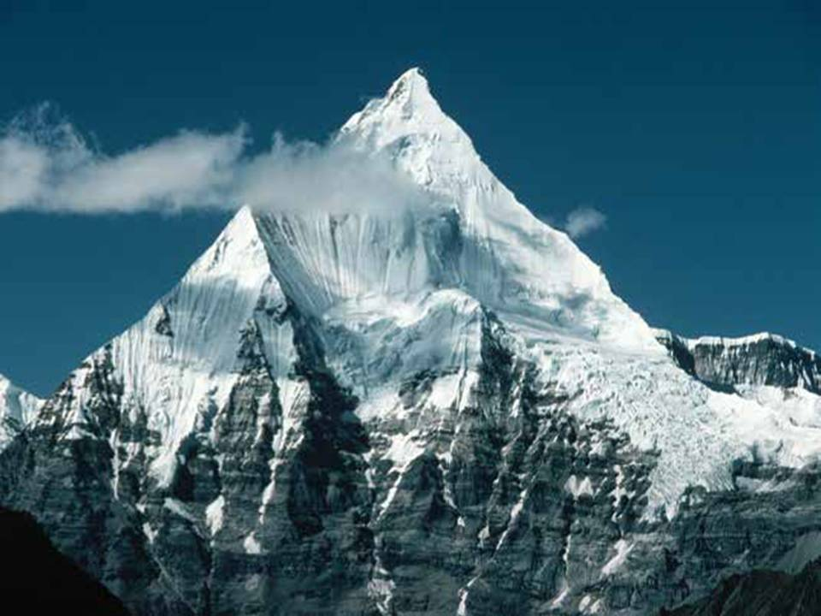
Q1: What can you see in the photograph?
Q2: What do you think of the mountain?

Slide 4
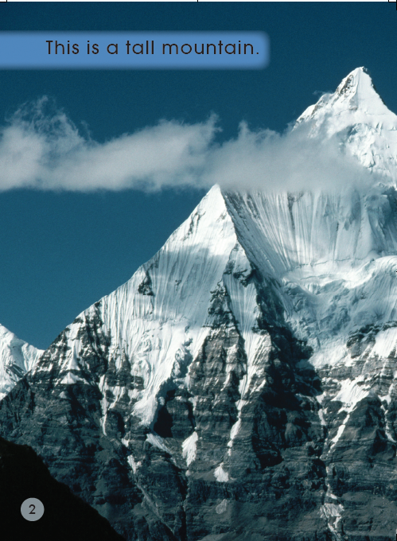
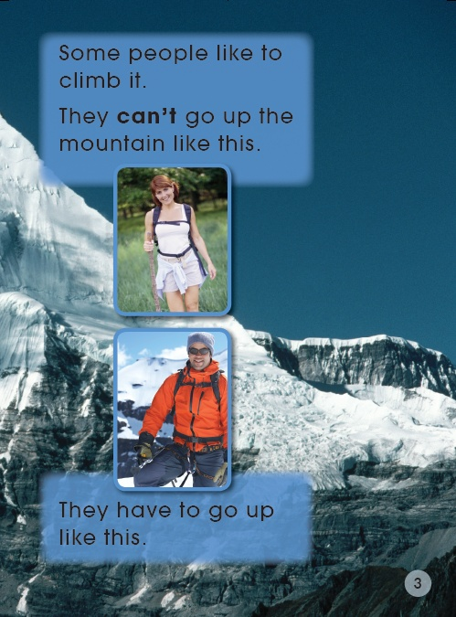

Slide 5
Q: How many parts of a tall mountain can you see?
Tips:
1. Fast reading(PP 4-16).
2. Discuss in group.

Slide 6
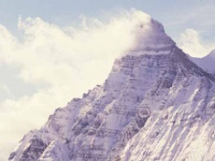
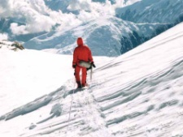
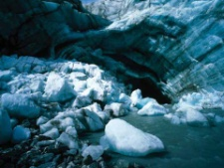
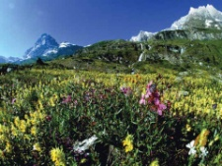
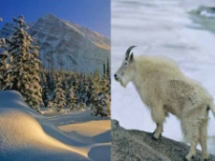
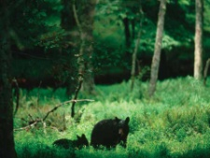
Q: How many parts of a tall mountain can you see?
The top of the tall mountain
Higher Altitudes
Middle Altitudes
Lower Altitudes
（海拔）

Slide 7
Jigsaw reading
Q: What’s it like here?
Tips:
1. Choose one part.
2. Read the pages.
3. Finish the worksheet.

Slide 8
Jigsaw reading
Q: What’s it like here?
Tips:
1. Discuss in expert group.
2. Practice together.

Slide 9
Jigsaw reading
Q: What’s it like here?
Tips:
1. Discuss in home group.
2. Show the work in turns.

Slide 10
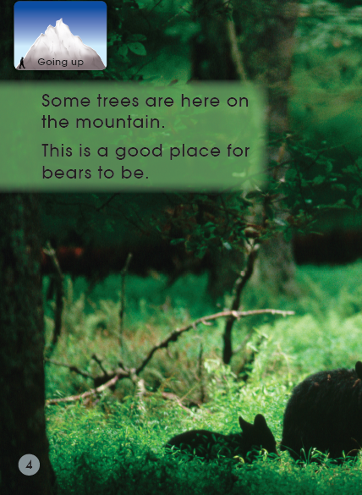
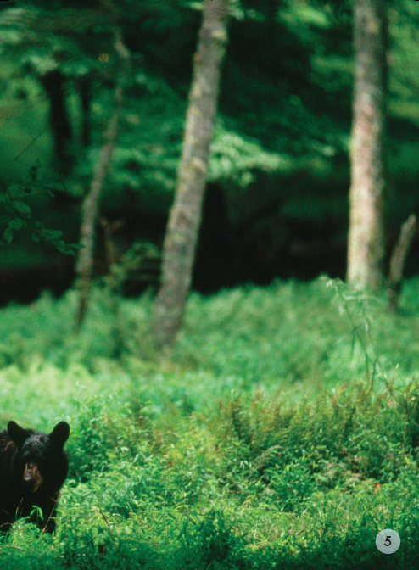
Q: Why do bears live here?

Slide 11
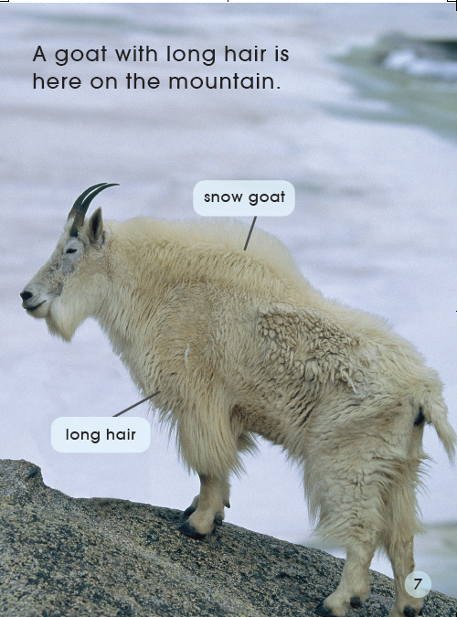
Q: Why are these trees good for this mountain?
Q: Why does the goat have long hair?

Slide 12
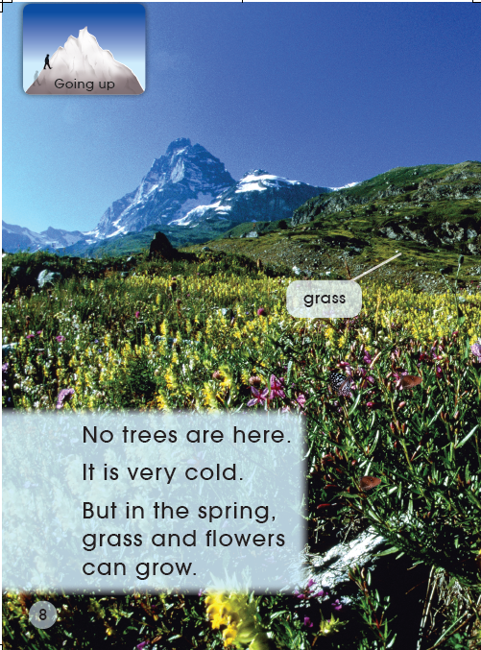
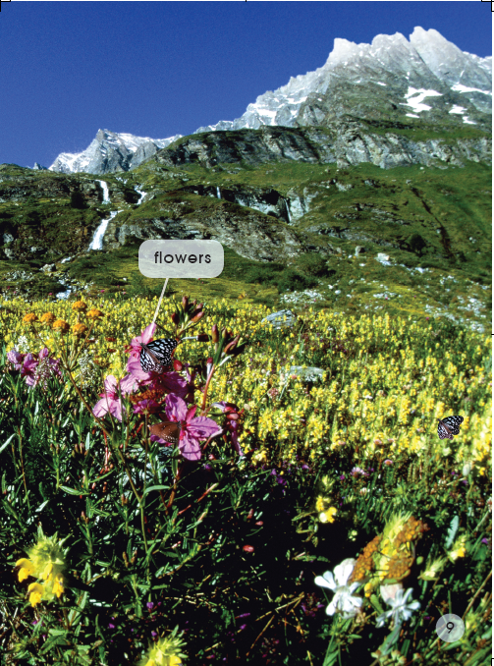
Q: Why are there no trees?
Q: What time of the year was it when this photo was taken?

Slide 13
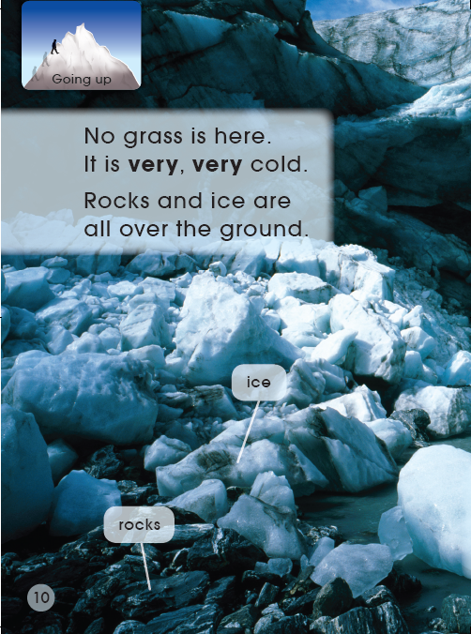
Q: Why is there no grass?
Q: How cold is it?
Q: Why do they go down the mountain?
Q: What animals are here? How do they look like?

Slide 14
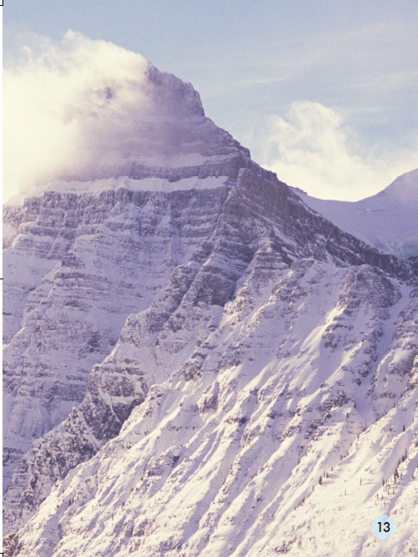
Q: How cold is it?

Slide 15
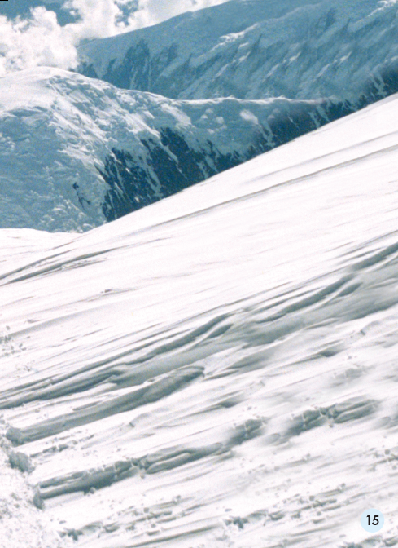
Q: Why can’t people live here?

Slide 16
Q: Why can we see these on the mountain?
Tips:
1. Discuss in group.
2. No Chinese.

Slide 17
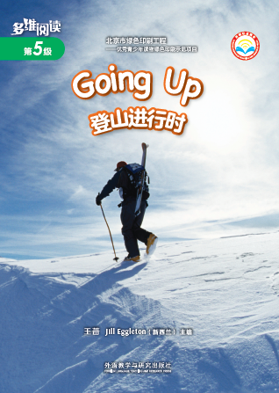
Listen and repeat
Tips:
1. Listen carefully.
2. Follow to read.

Slide 18
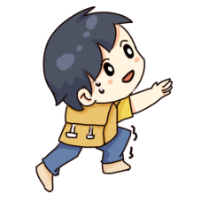
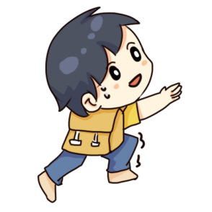
Q1: Which place do you want to go?
Q2: What’s it like there?
Q3: Why do you want to go there?
Tips:
1. Choose one part of the tall mountain.
2. Practice in groups.

Slide 19
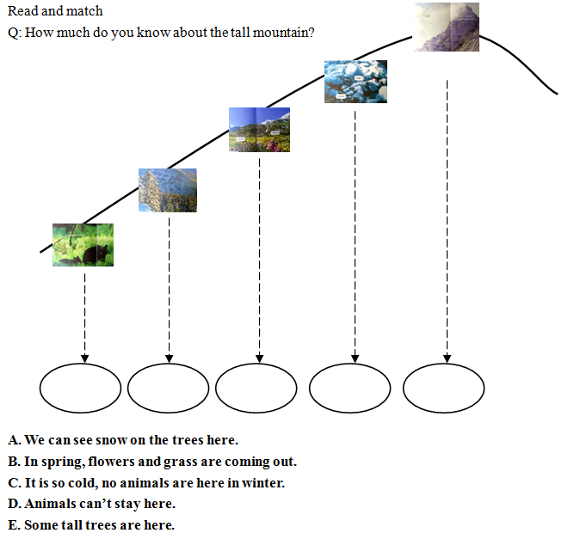
Read and match
Q: How much do you know about the tall mountain?
Tips:
1. Match the pictures with the words.
2. Discuss in group.

Slide 20
E
A
B
C
D

Slide 21
Q1: What do we need to go up a tall mountain? Why?
Q2: Can you give some other tips for going up a tall mountain?
We need…

Slide 22
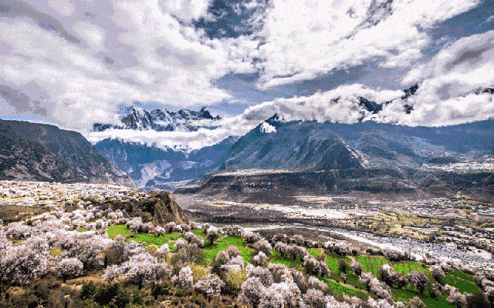
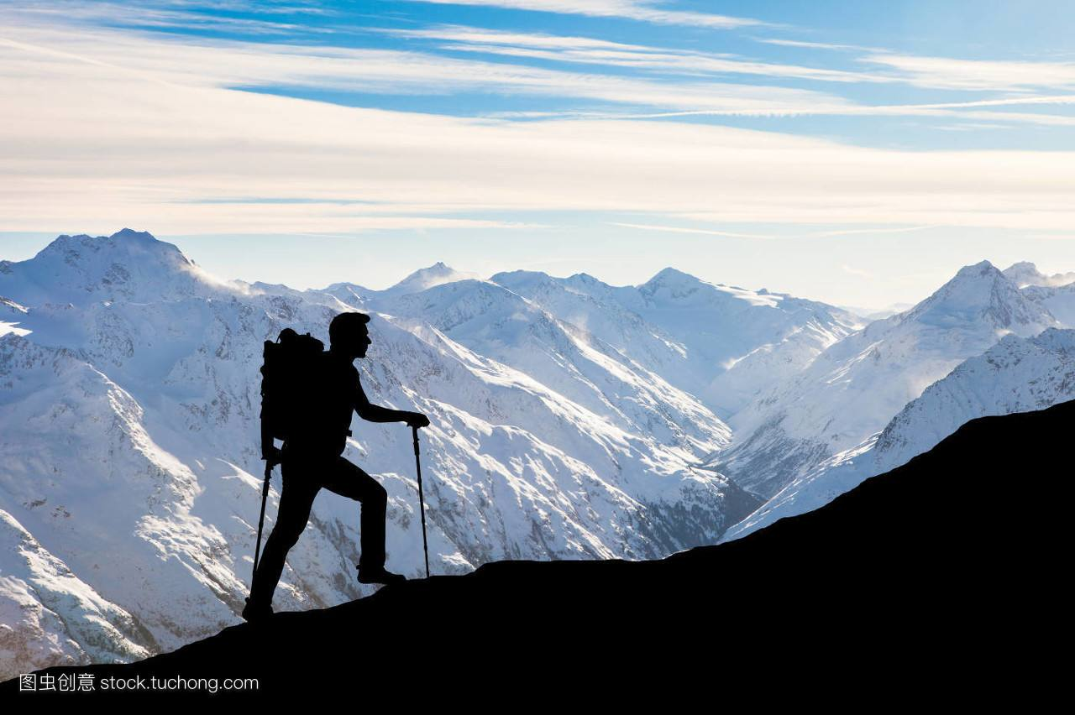
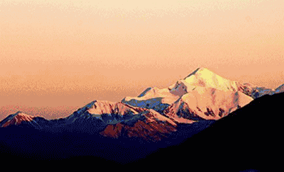
Let’s go up!
Q1: How do you think of a tall mountain?
Q2: Do you want to go up a tall mountain? Why?

Slide 23
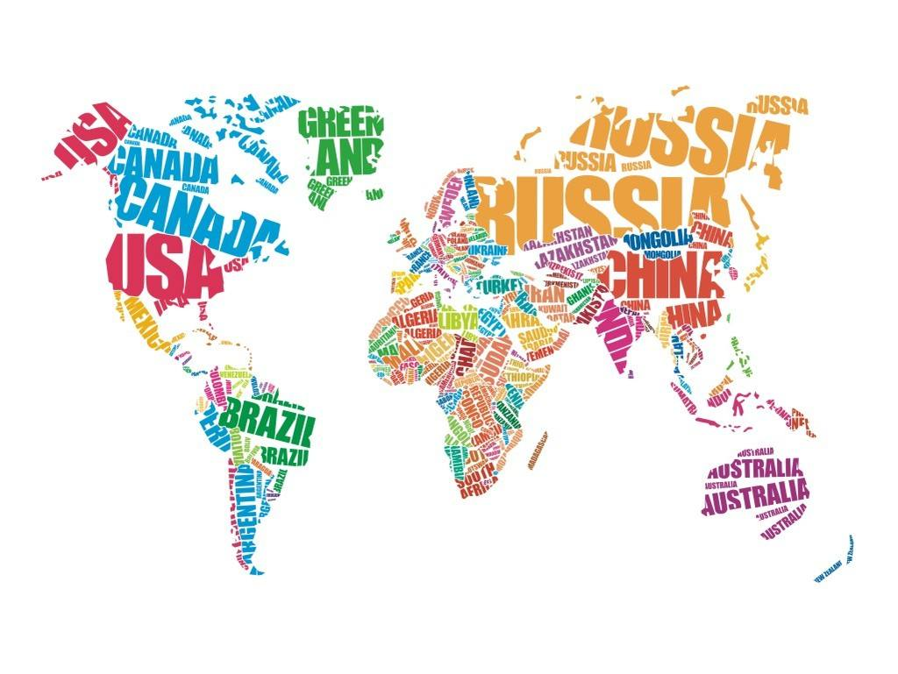
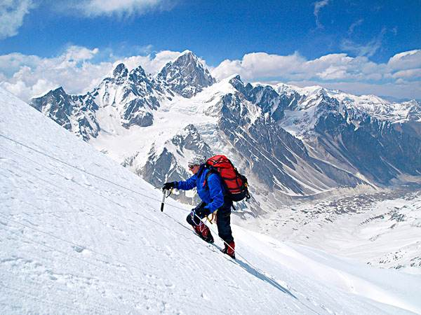
Homework
1. Listen to the audio and read the book.
2. Make a photo map about tall mountains in the world.
Himalaya Mountains

