Slide 1
Let’s read
第5级

Slide 3
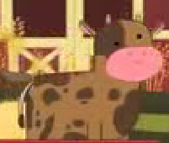
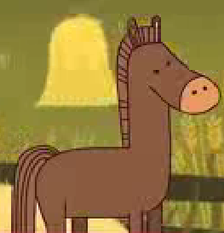
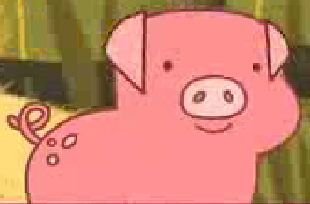
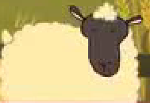
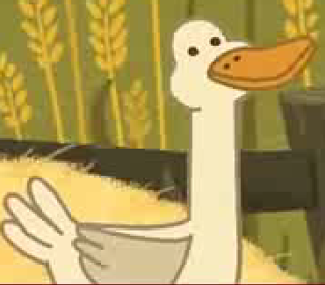
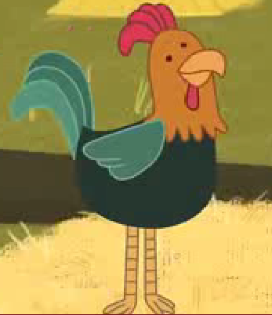
Q: What animals can you hear from this song?
cow
horse
pig
sheep
duck
rooster

Slide 4
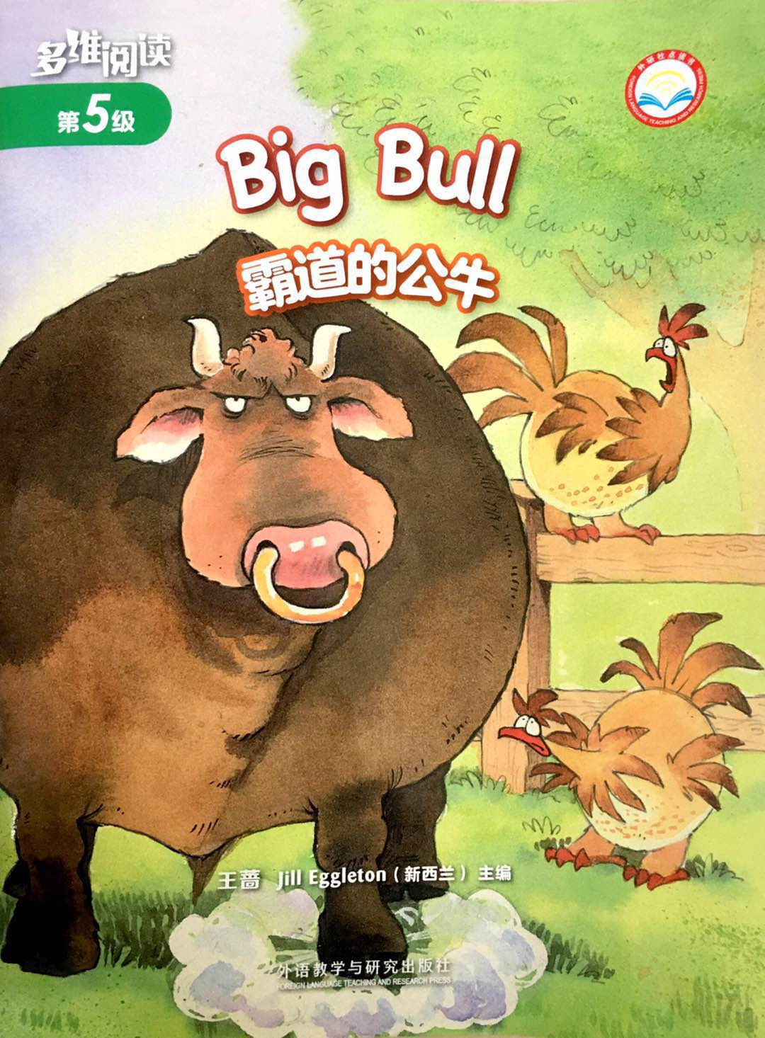
Series
What was Big Bull doing?
Level
Title
How did Rooster feel? Why?
What do you think of Big Bull?
Authors
Publisher

Slide 5
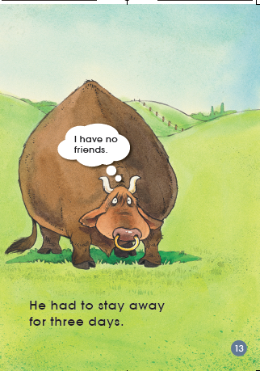
Where was Big Bull?
What was Big Bull thinking?
How did Big Bull feel?

Slide 6
Q: What did Big Bull do?
Tips:
1. Read PP 2-9.
2. Find out the things Big Bull did.
What did Big Bull do to Rooster?
What did Big Bull do to the goats?
What did Big Bull do to the hens?

Slide 7
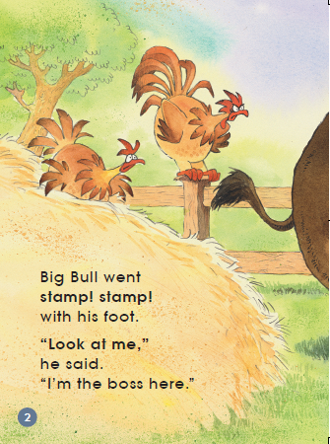
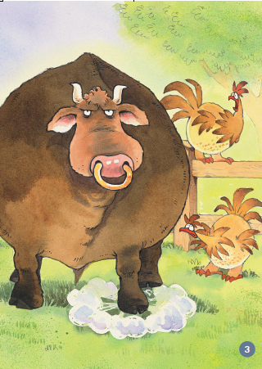
went stamp

Slide 8
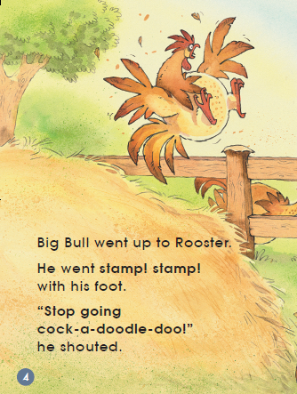
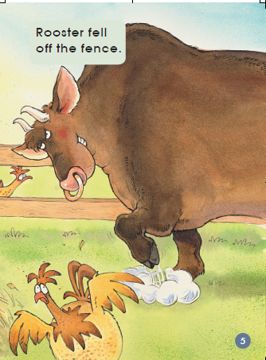
went up to Rooster

Slide 9
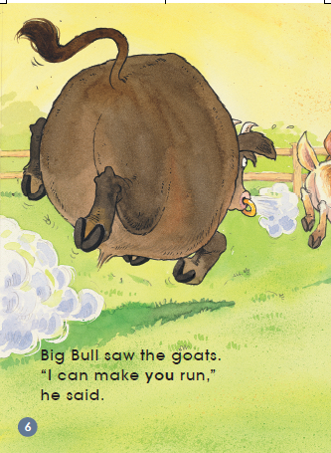
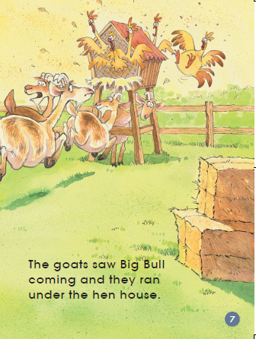
made the goats run

Slide 10
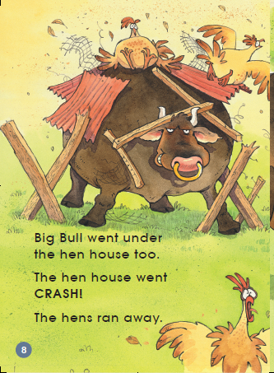
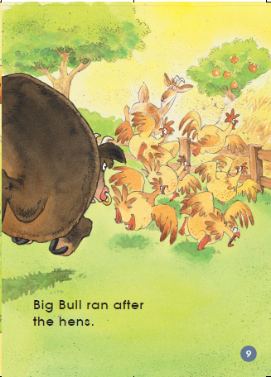
went under the hen house
ran after the hens

Slide 11
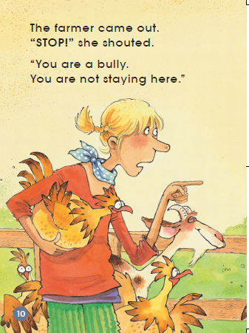
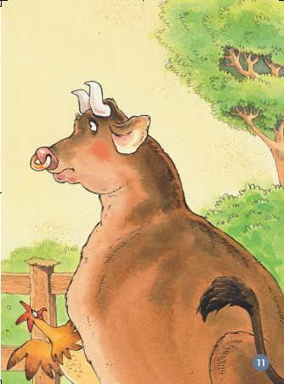
?
?

Slide 12
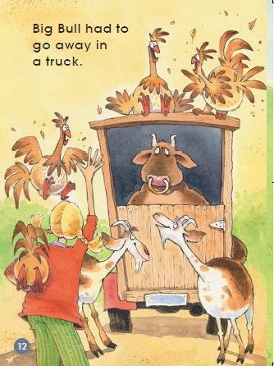
？
Word bank:
happy
sad
angry
worried
I think she is..., because...

Slide 13
?

Slide 14
Three days later...

Slide 15
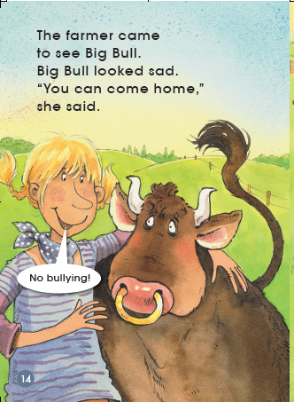

Slide 16
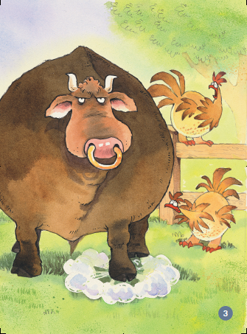
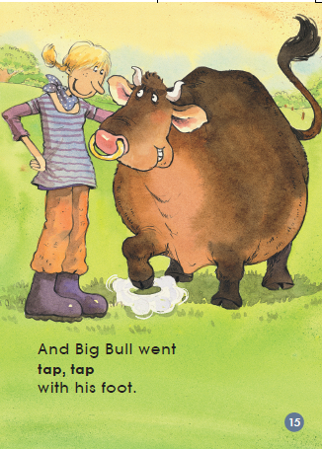
stamp
Why?
tap
What do you think of the farmer?

Slide 17
Listen and repeat
Tips:
1. Listen carefully.
2. Follow to read.
3. Point with finger.

Slide 18
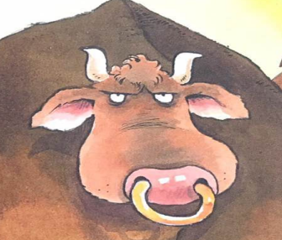
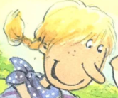
Reading theater
Big Bull
Tips:
1. Read loudly.
2. Read with full emotion.
farmer
narrator

Slide 19
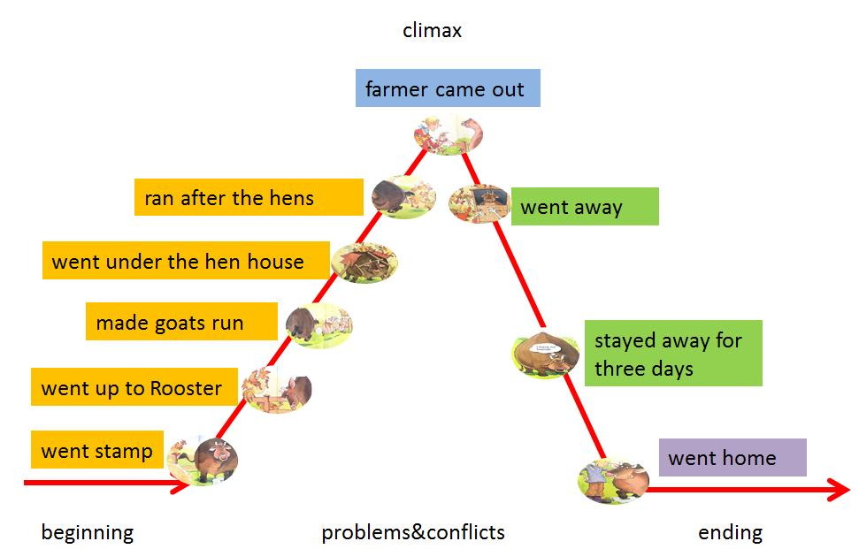
Retell the story
Useful sentences:
In the beginning, ...
Next, ...
Then, ...
In the end, ...

Slide 20
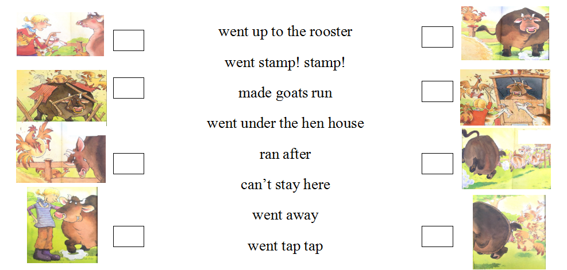
Match and number
6
1
4
7
2
3
8
5

Slide 21
?
?
?
?

Slide 22
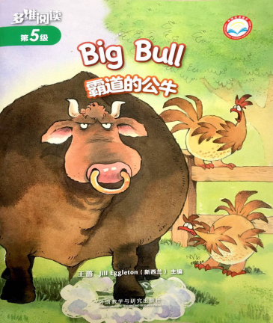
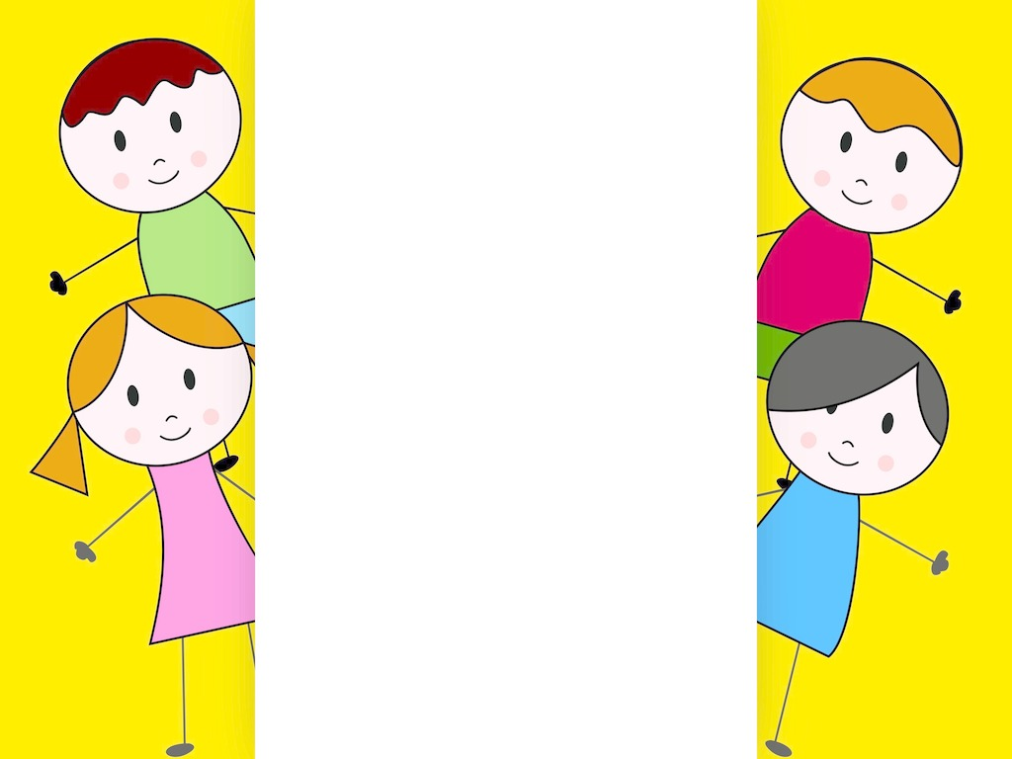
What do you learn from this story?
How do you get along with your friends?

Slide 23
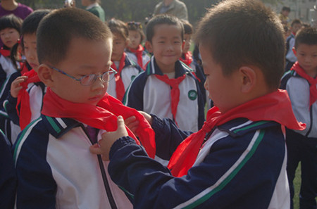
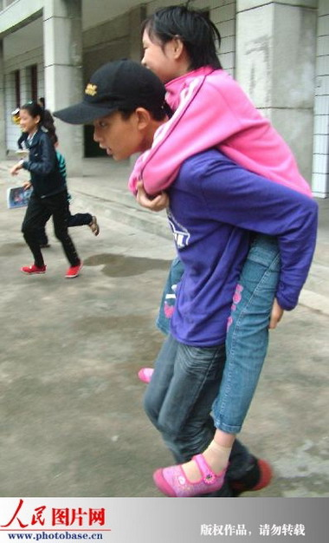
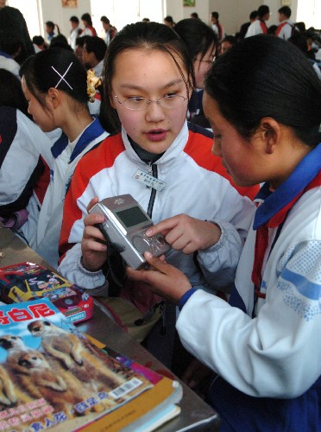
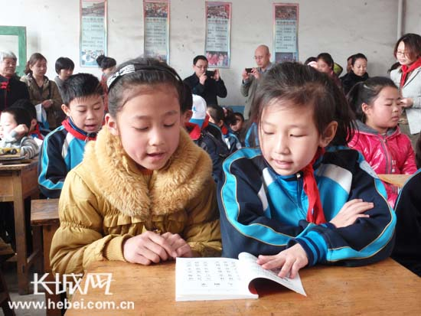
A friend in need is a friend indeed.

Slide 24
Homework
1. Make a story map of this story.
2. Write down the story you made and draw the pictures.

