Slide 1
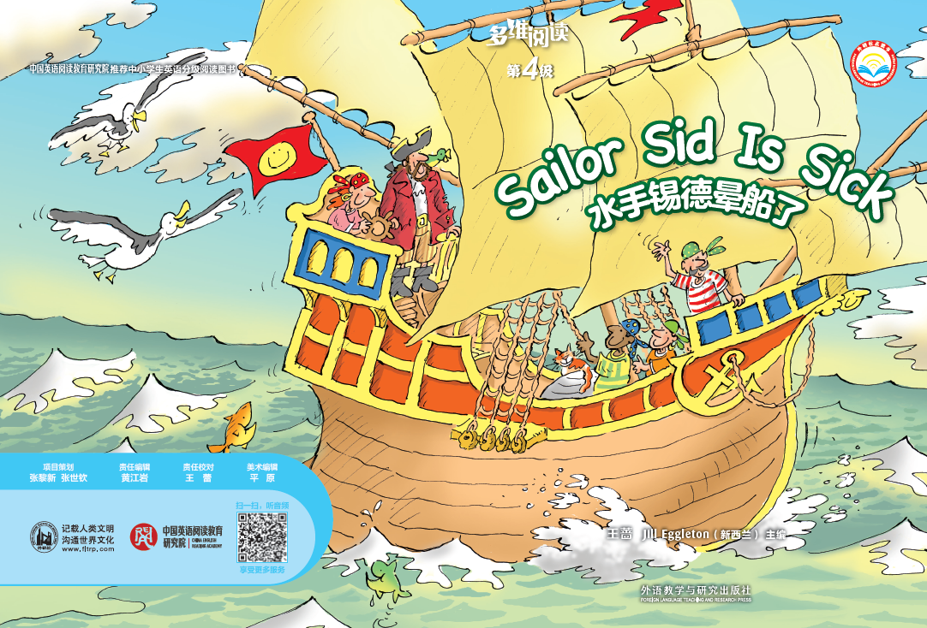
Sailor Sid Is Sick
多维阅读 第4级

Slide 2
What do you see from the cover?

Slide 3
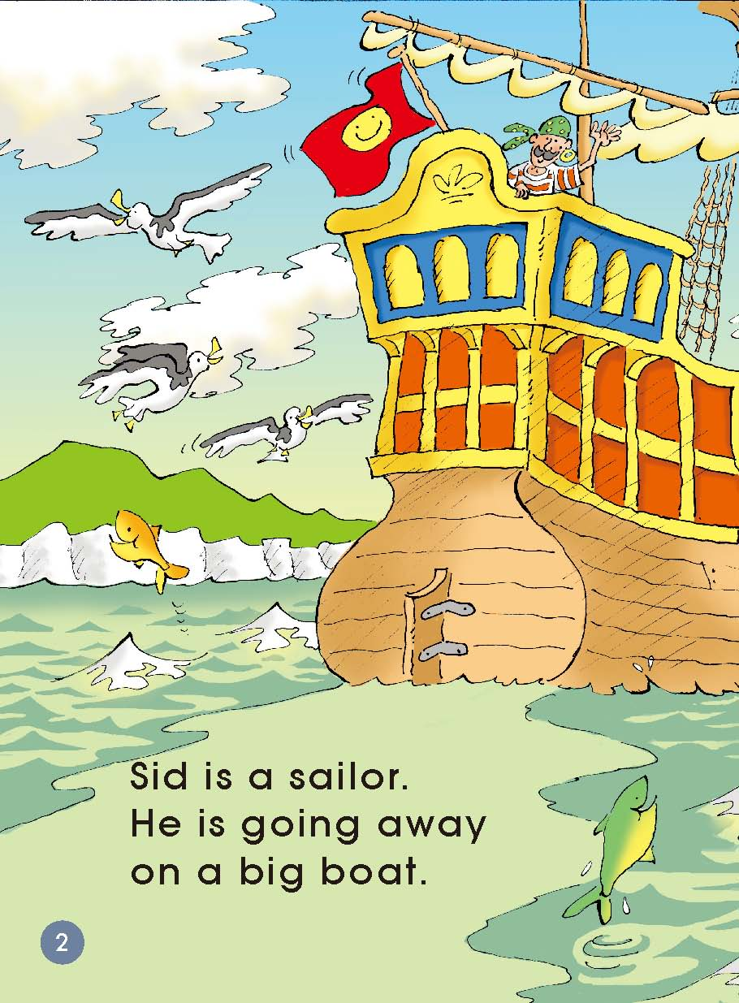
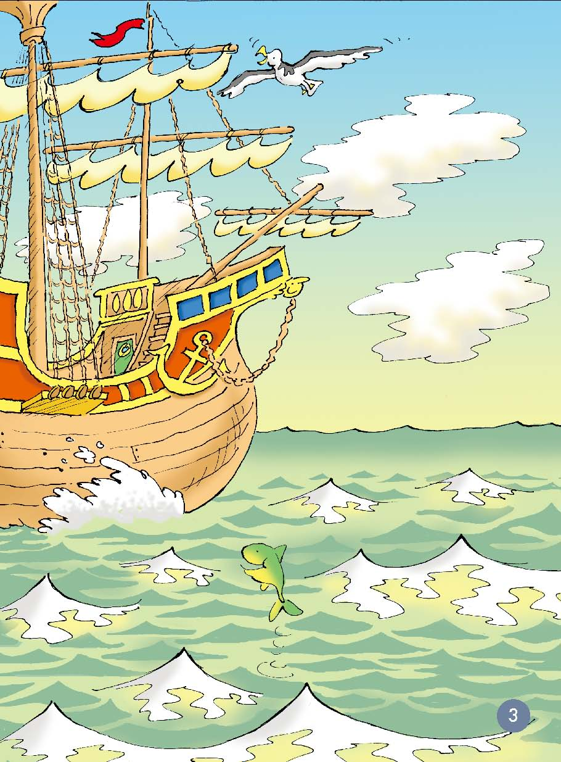
Read and answer.
What is Sid? Where is he?

Slide 4
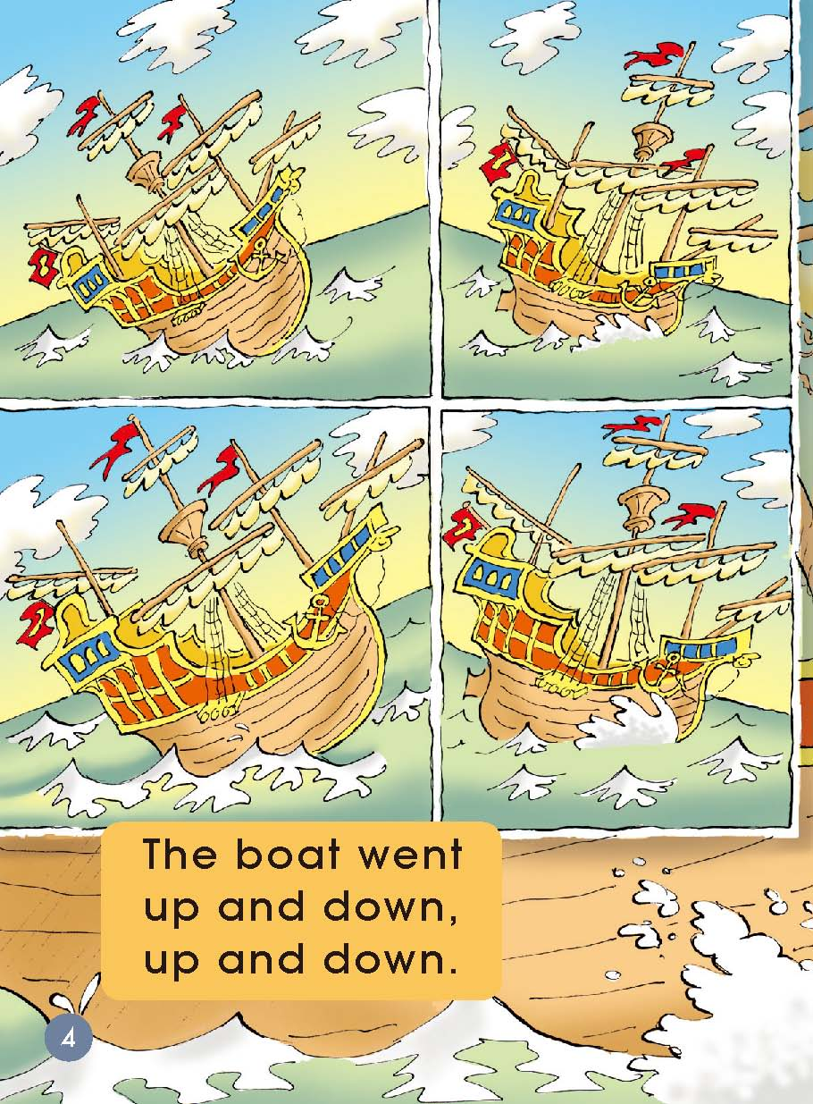
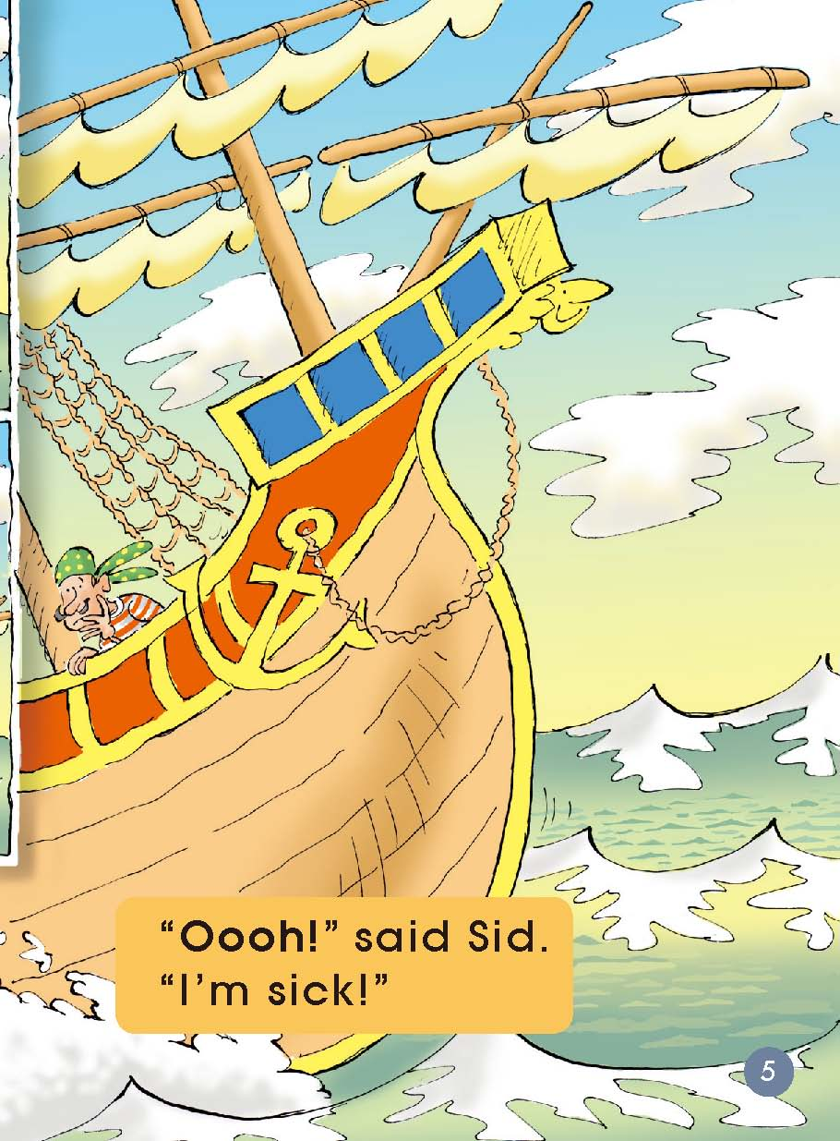
What happened to the boat? How was Sid feeling?

Slide 5
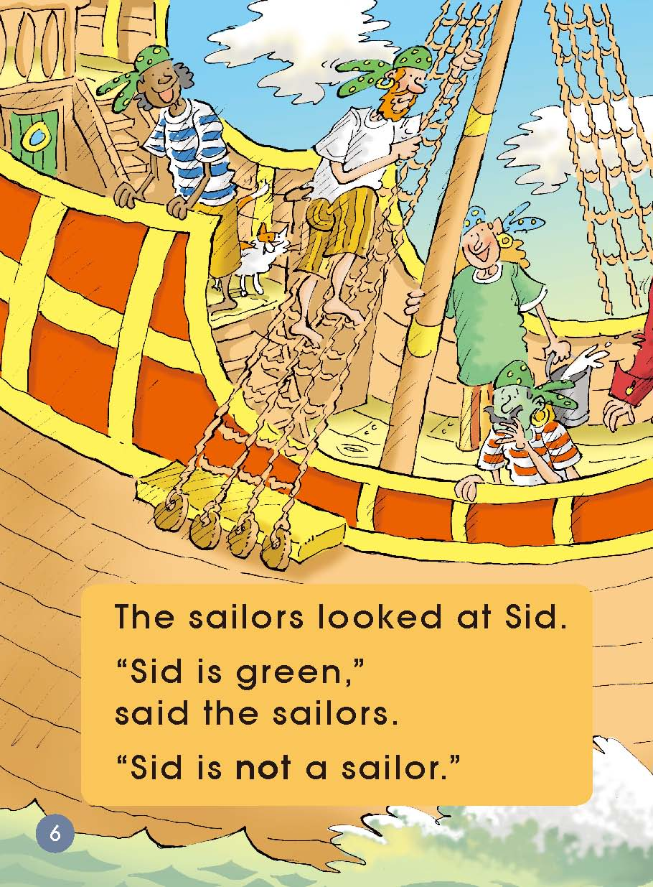
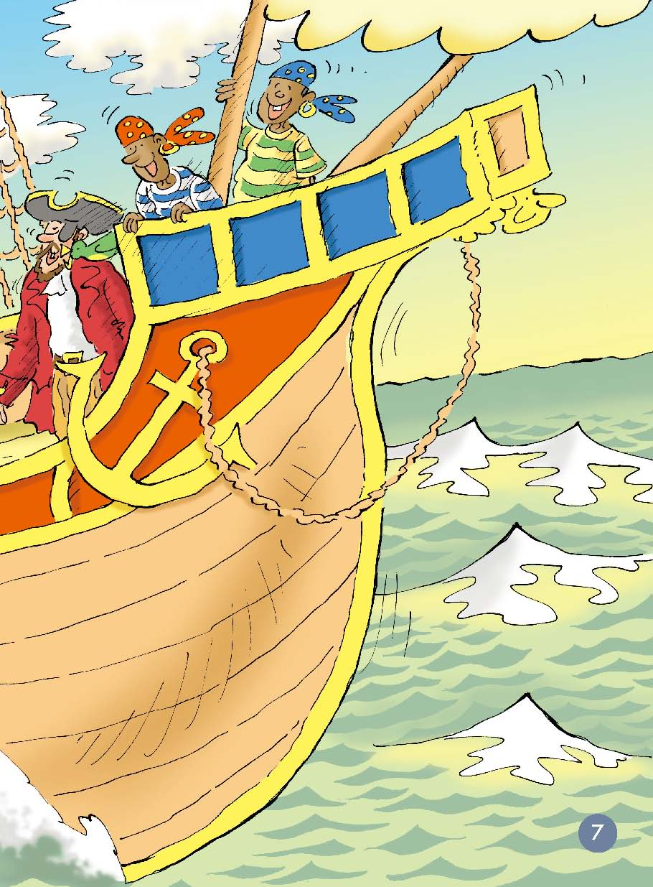
What did the sailors say?

Slide 6
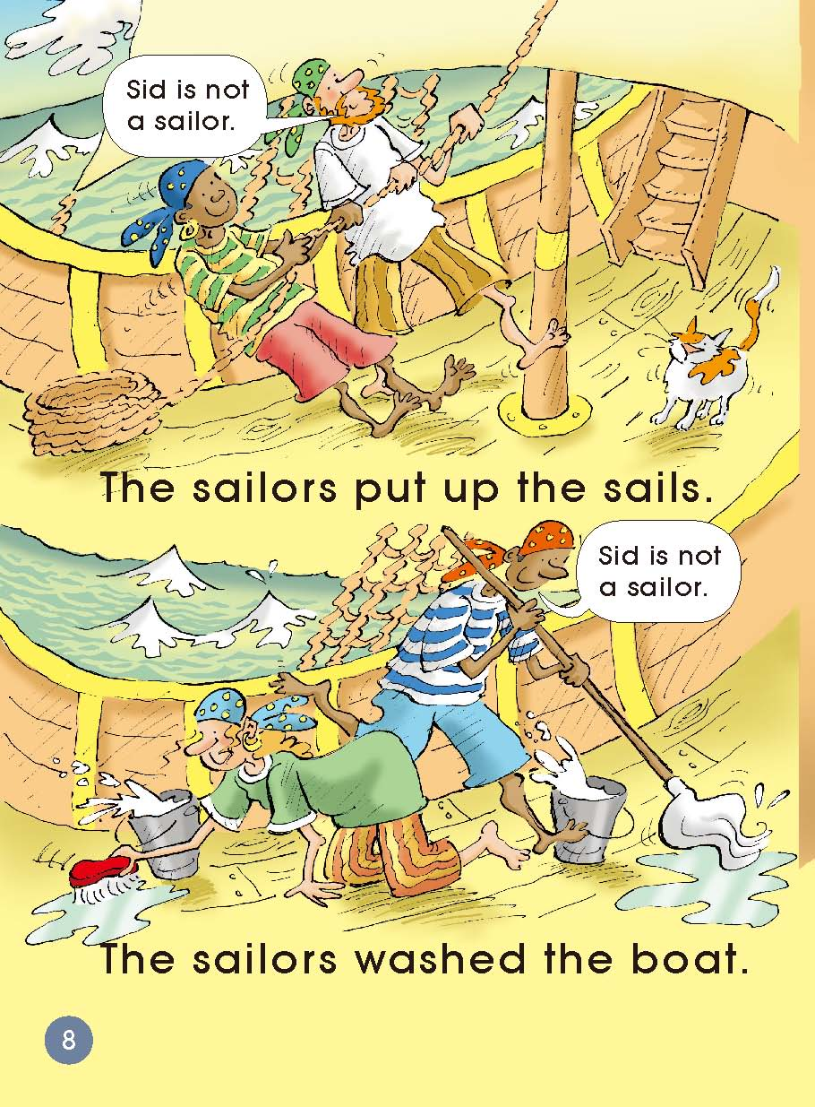
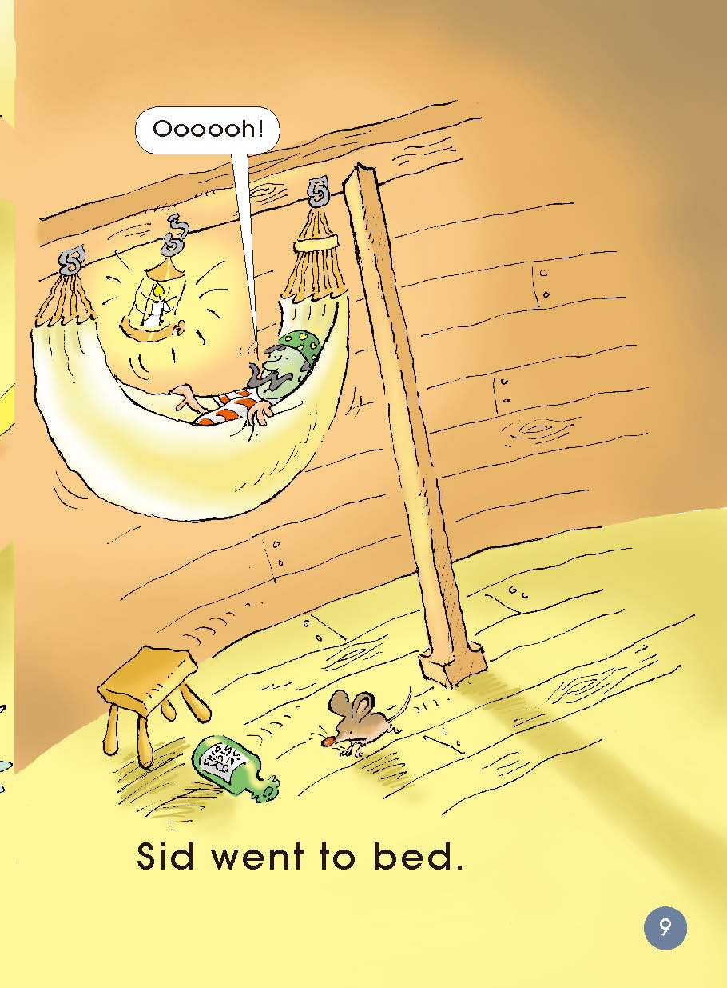
What did the sailors and Sid do?

Slide 7
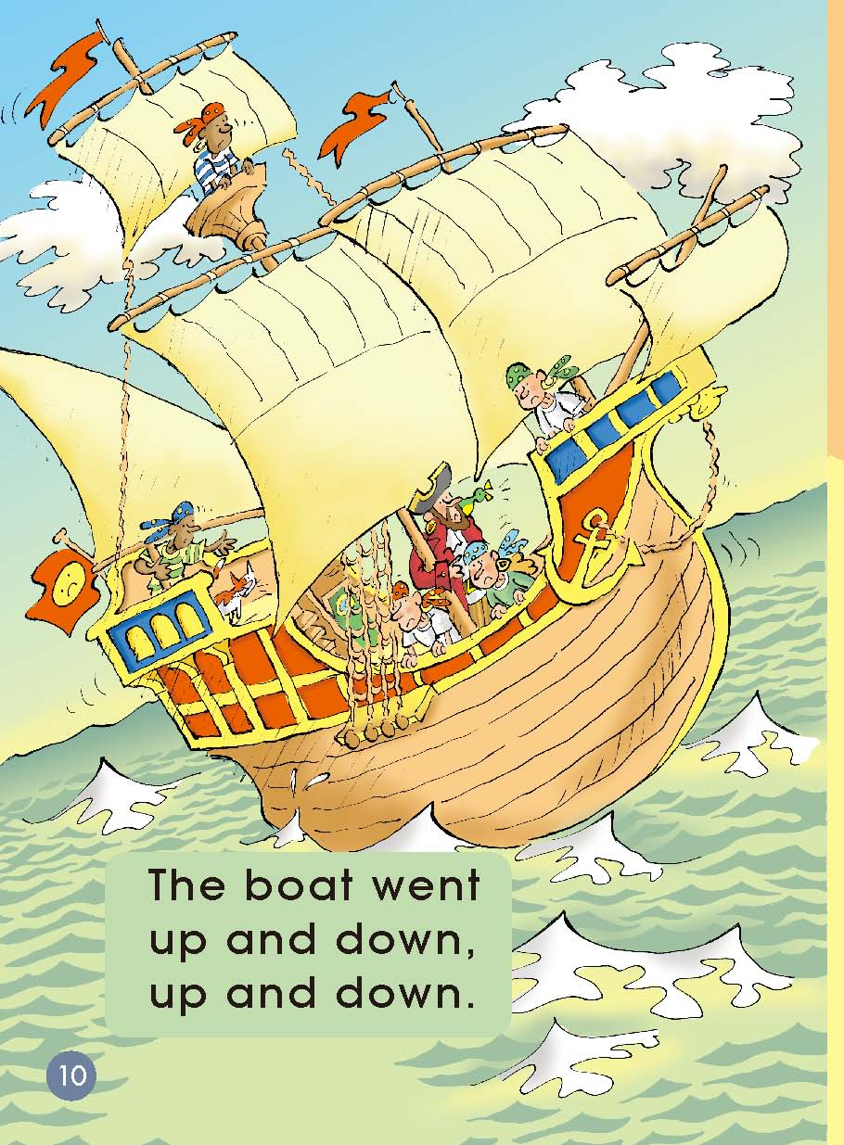
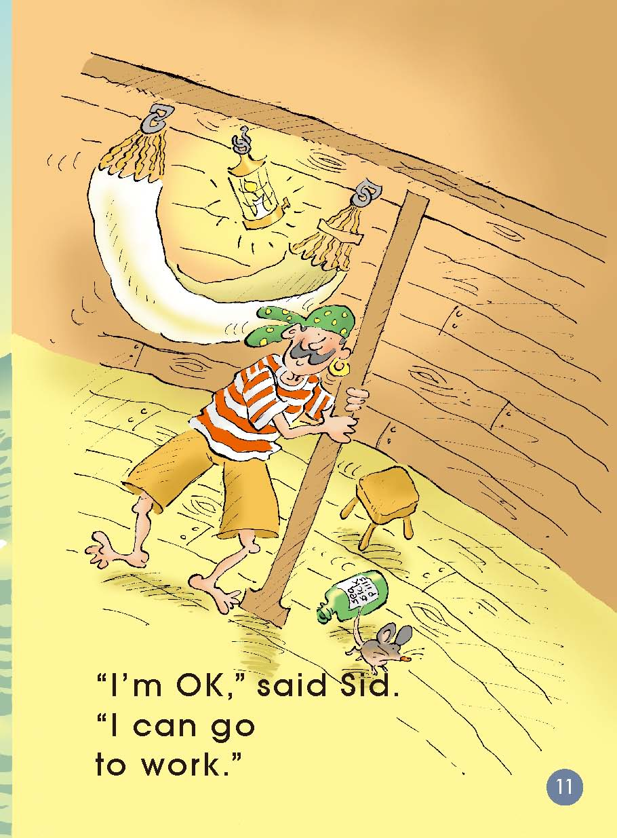
What’s the weather like?
Is Sid OK now?

Slide 8
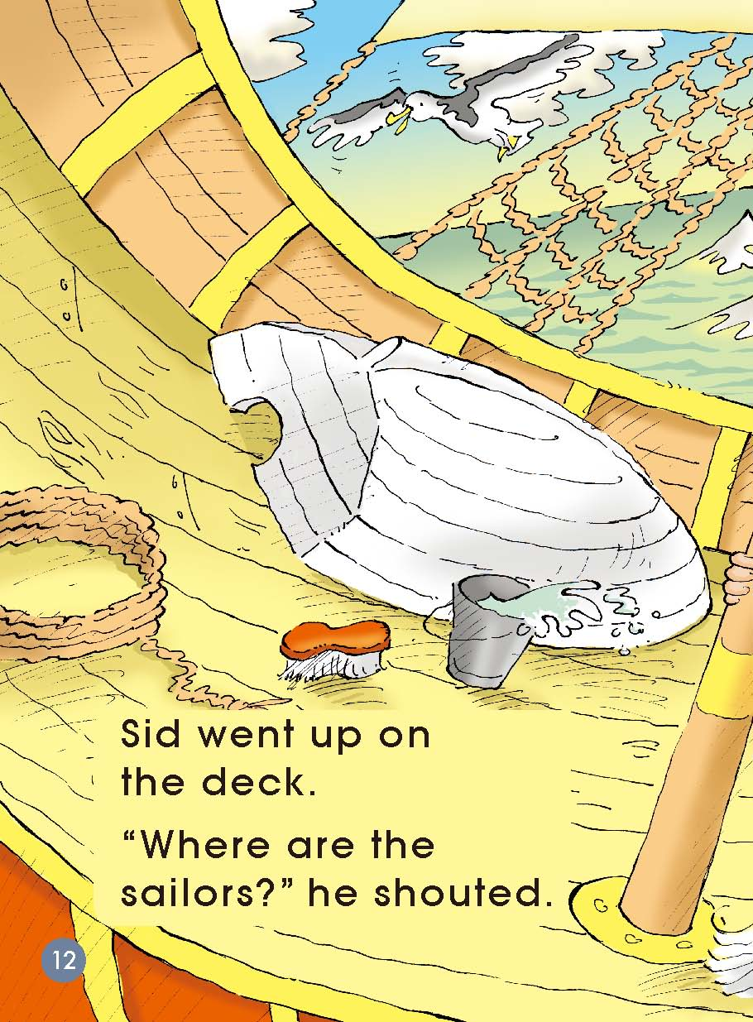
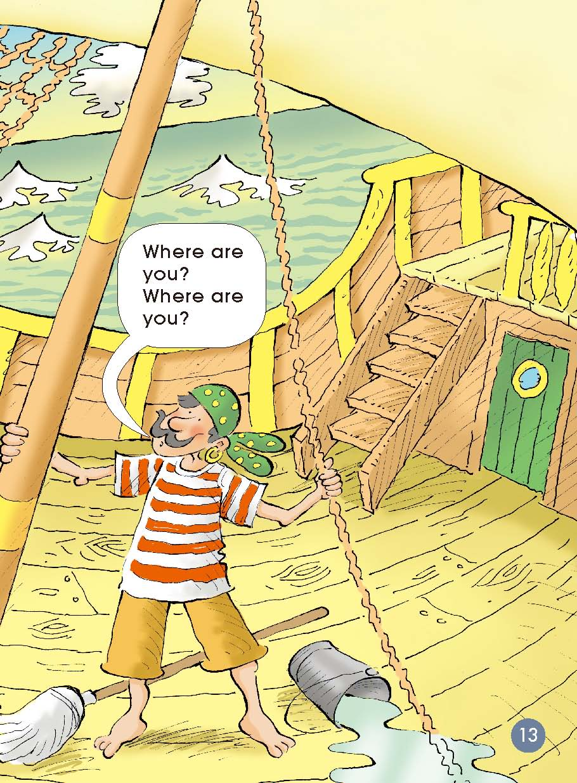
Where were the sailors?

Slide 9
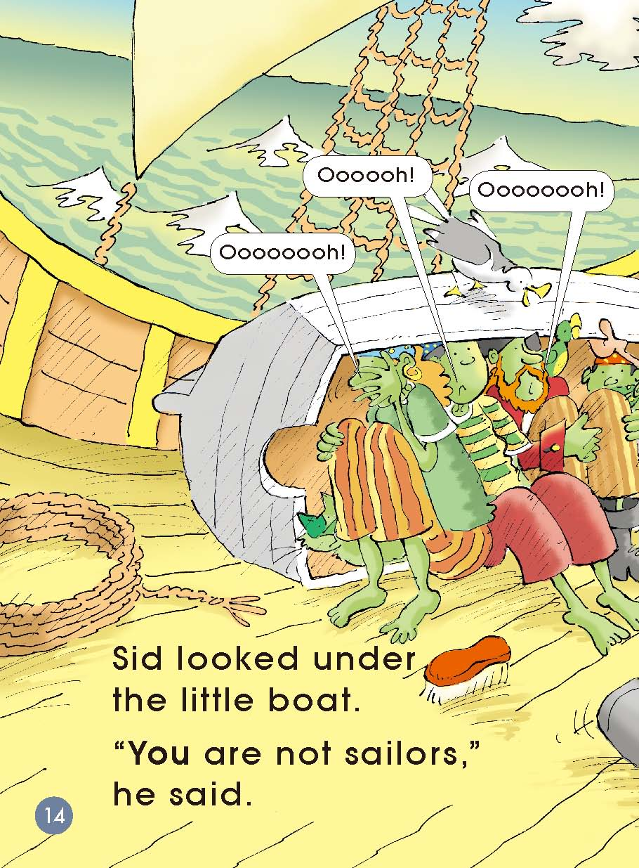
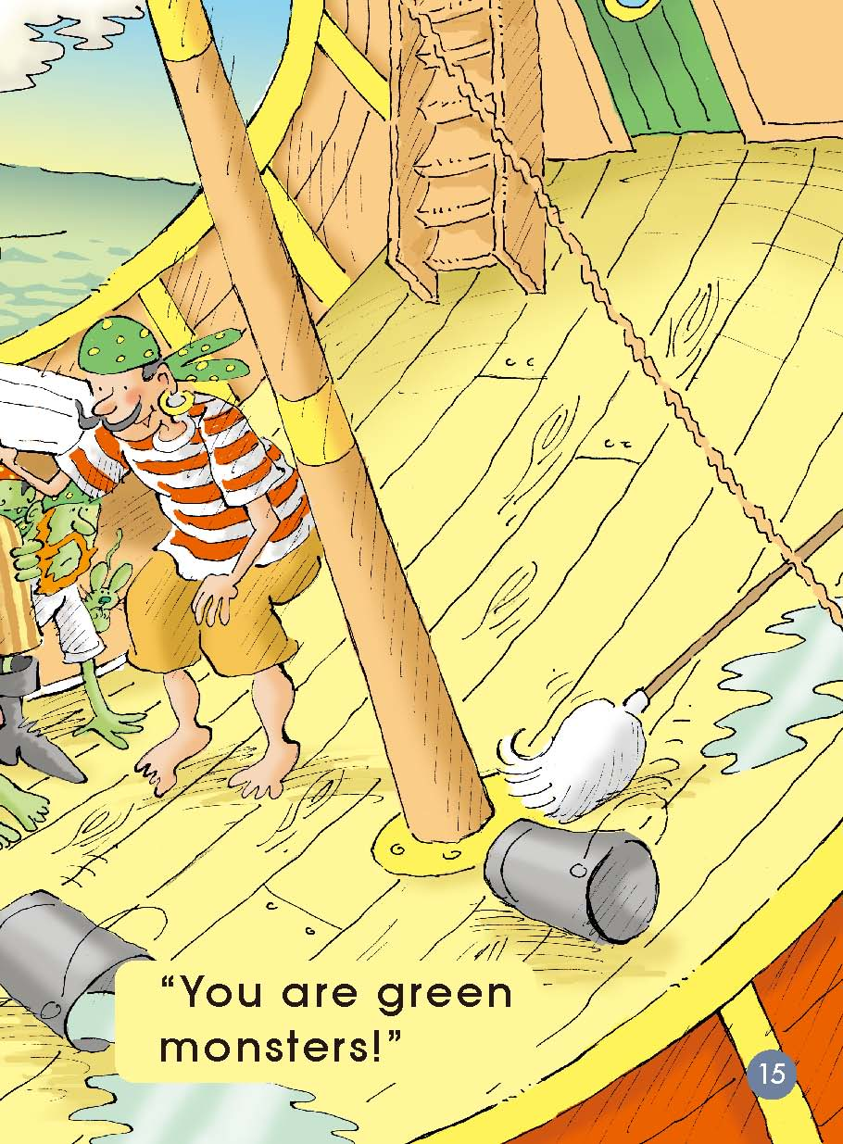
What’s wrong with the sailors?

Slide 10
Listen and read.

Slide 11
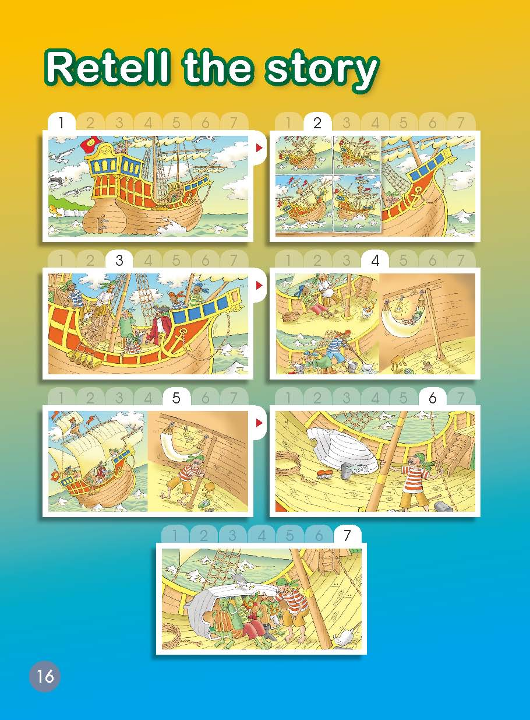
Let’s retell!

Slide 12
Act out!

Slide 13
If your friend were sick, what would you do?
Think and discuss.

Slide 14
Homework
Listen to the audio and read the story.
Tell the story to your parents. Act out the story in your family.

