Slide 1
多维阅读第4级
Where are the bats?

Slide 2
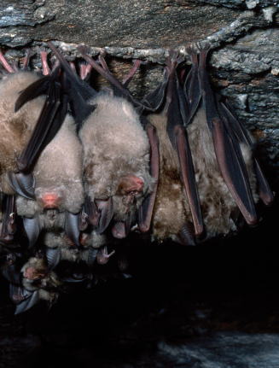
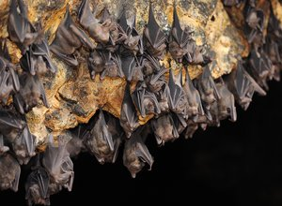
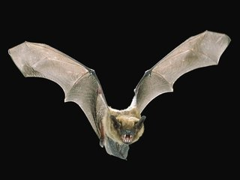
Read and guess.
bats

Slide 3
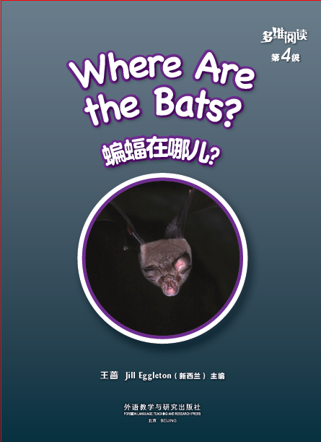
Title
Main Character
Writer

Slide 4
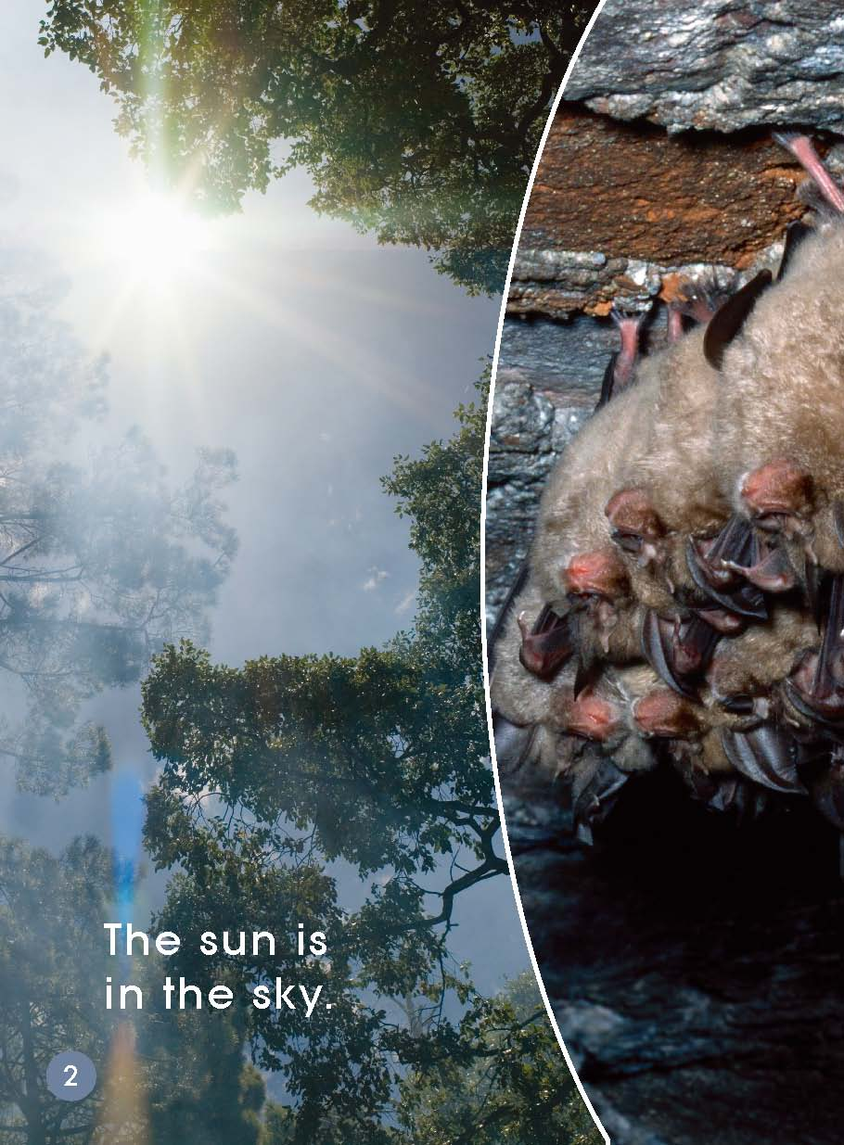
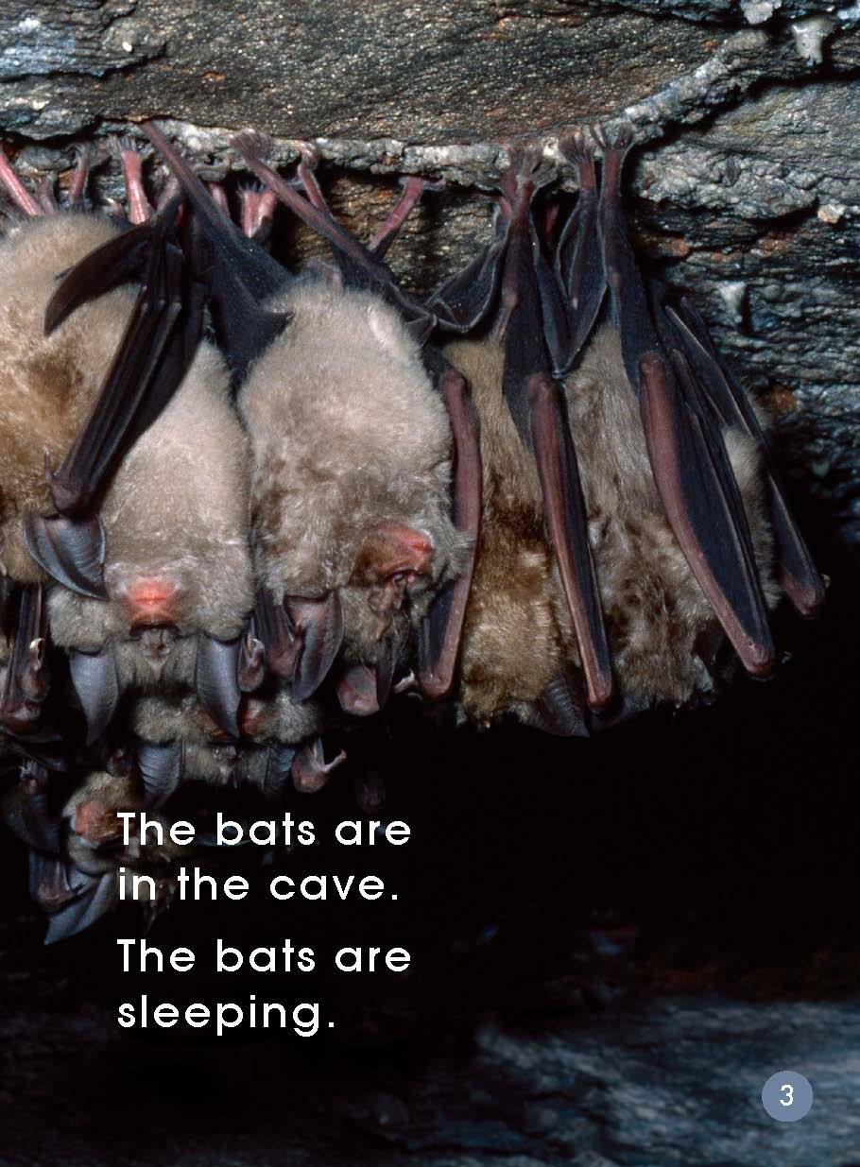
Read and answer.
Where are the bats?
What are they doing?
Is it night or day?
How do you know that?
How do bats sleep?
Can you act it out?

Slide 5
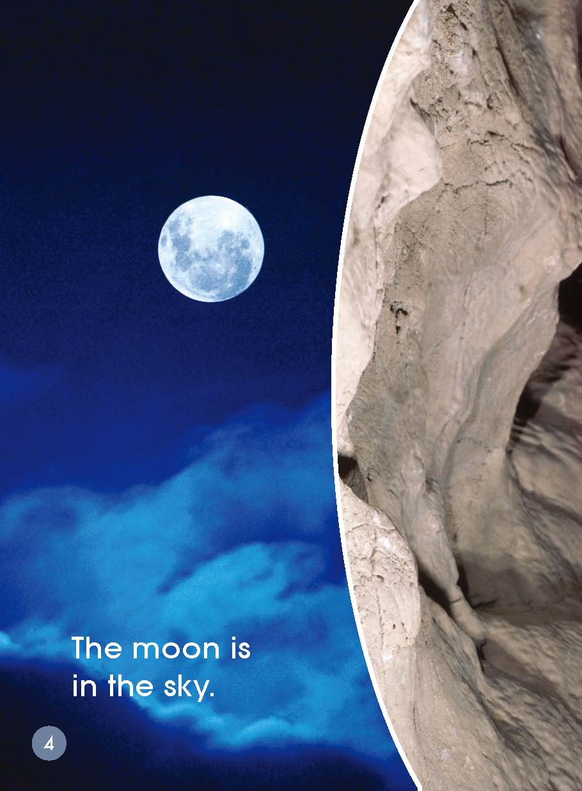
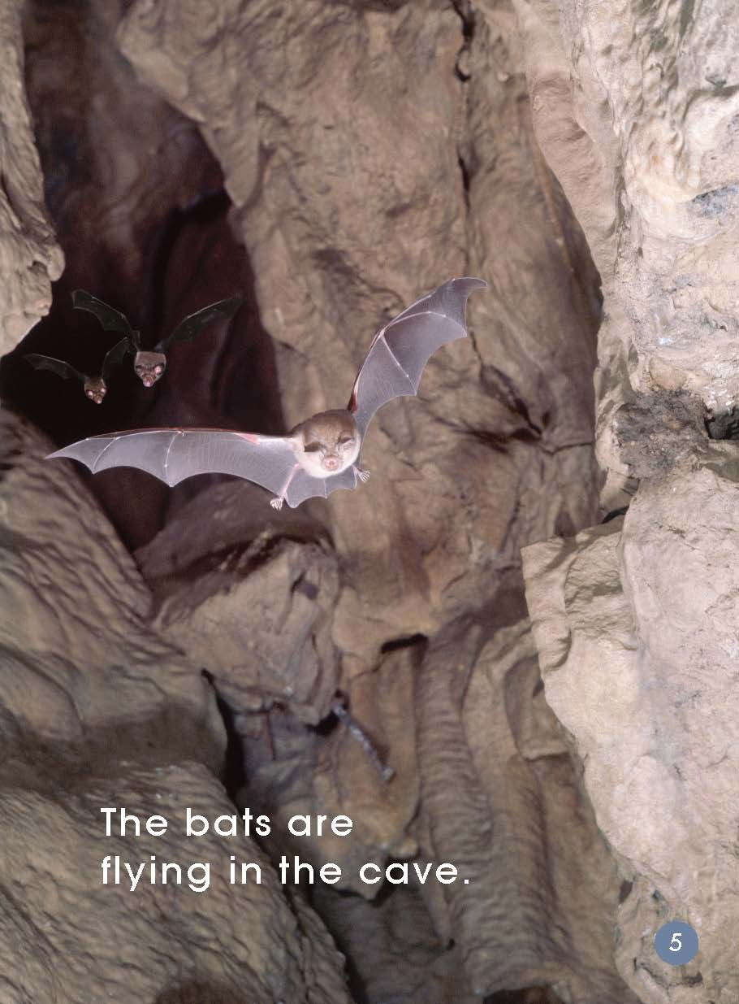
cave
What has changed?
What will the bats do?

Slide 6
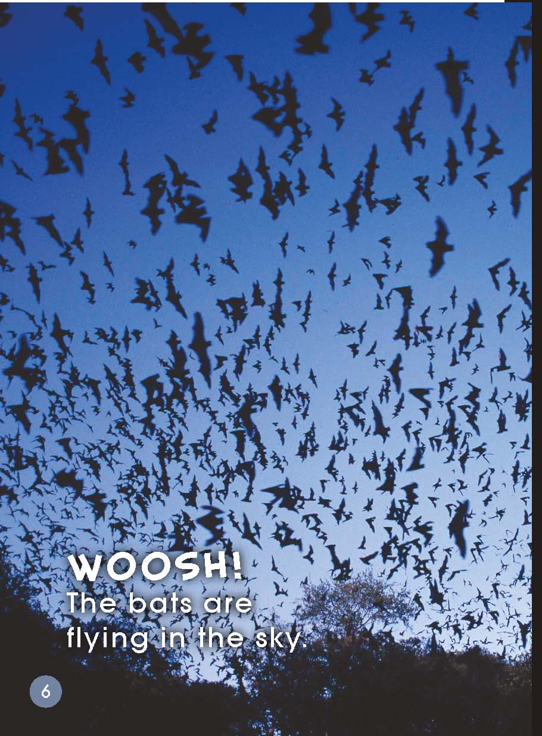
How do bats sound when they are flying?
Can you make a sound like the bat?

Slide 7
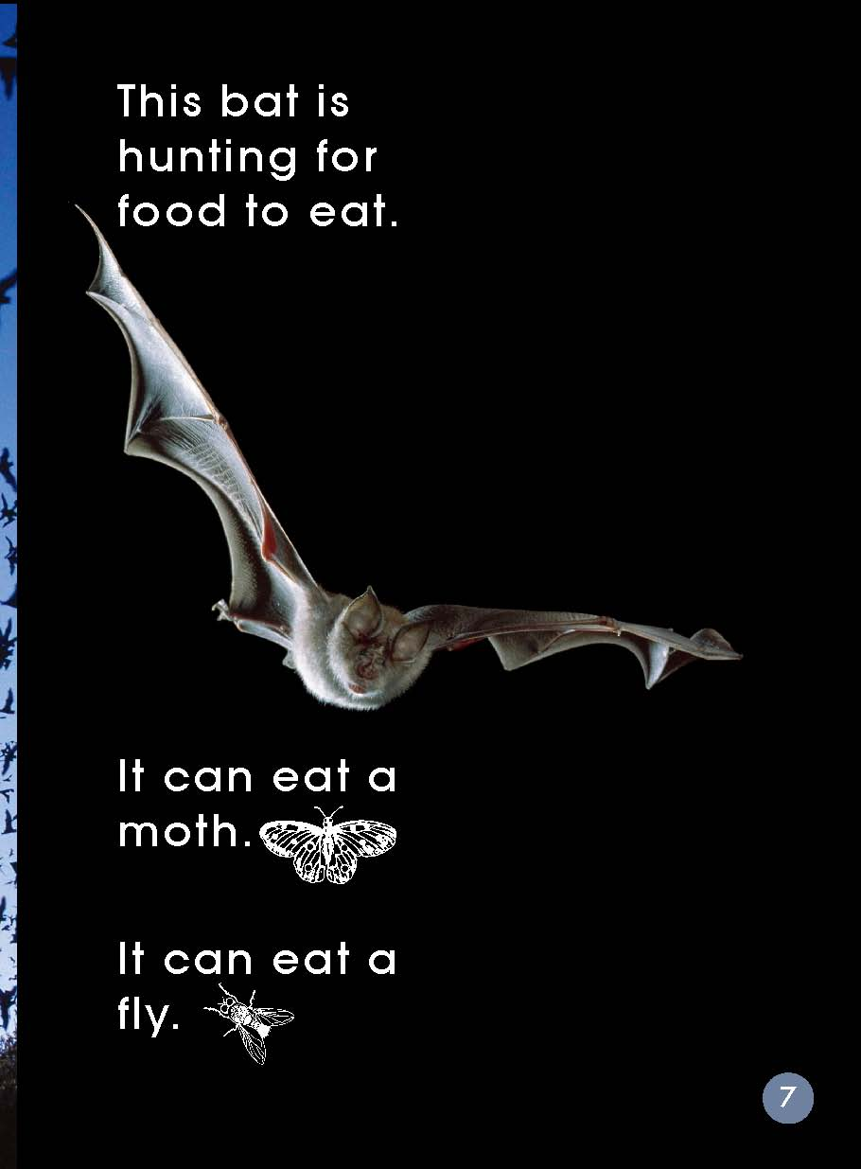
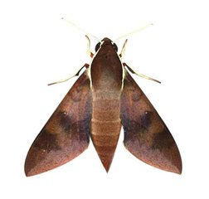
Where are bats now?
What do you think they are going to do?
What can the bats eat?
moth
fly

Slide 8
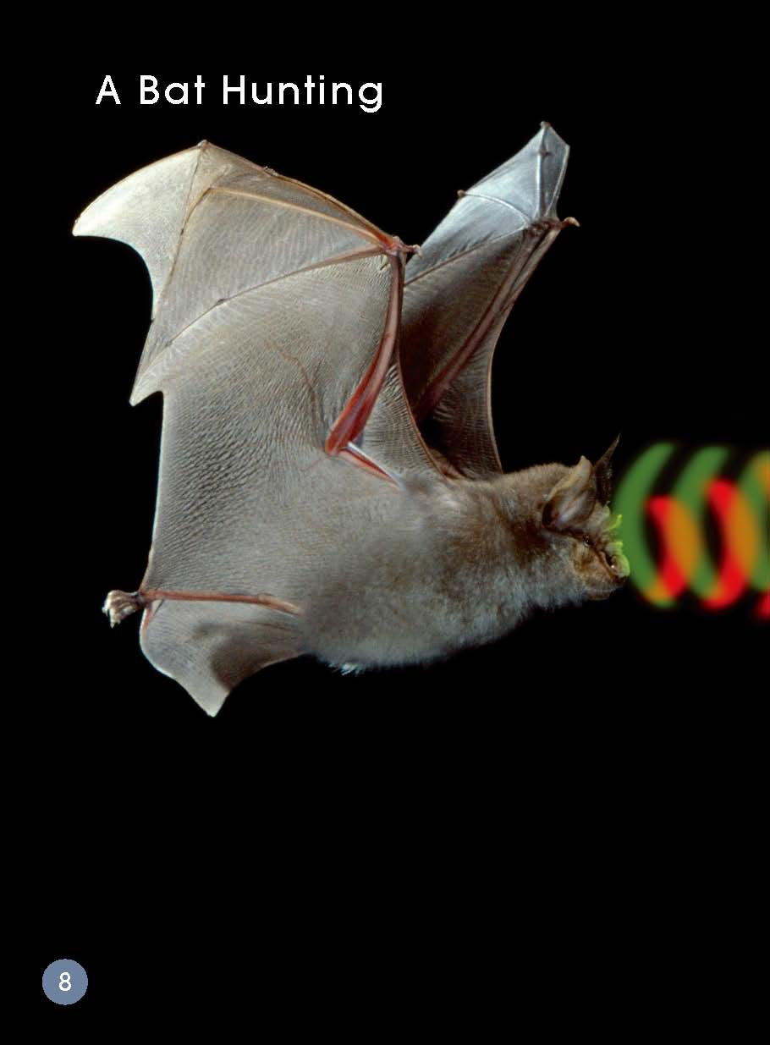
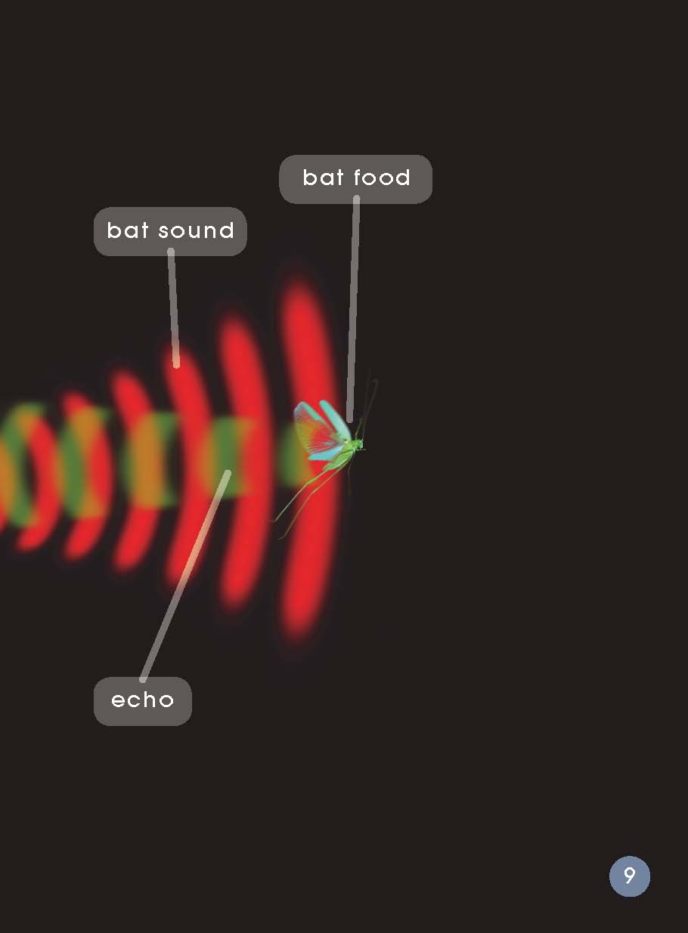
How do bats hunt for food?

Slide 9
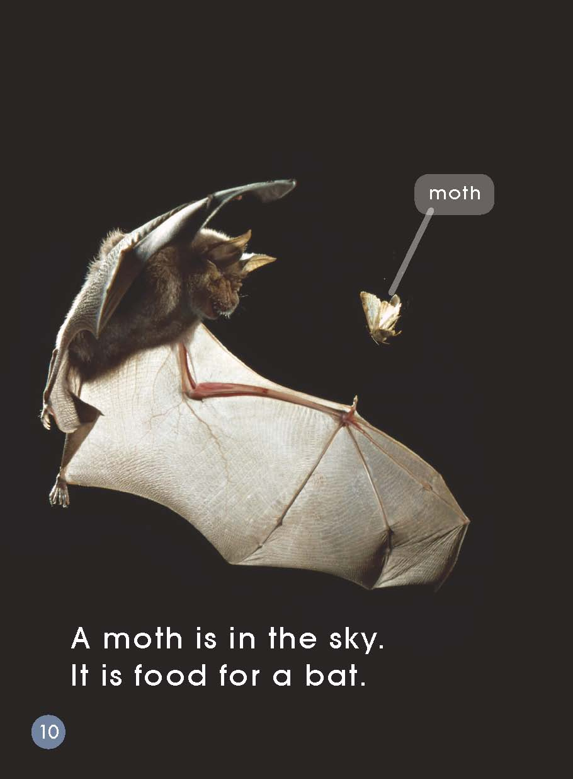
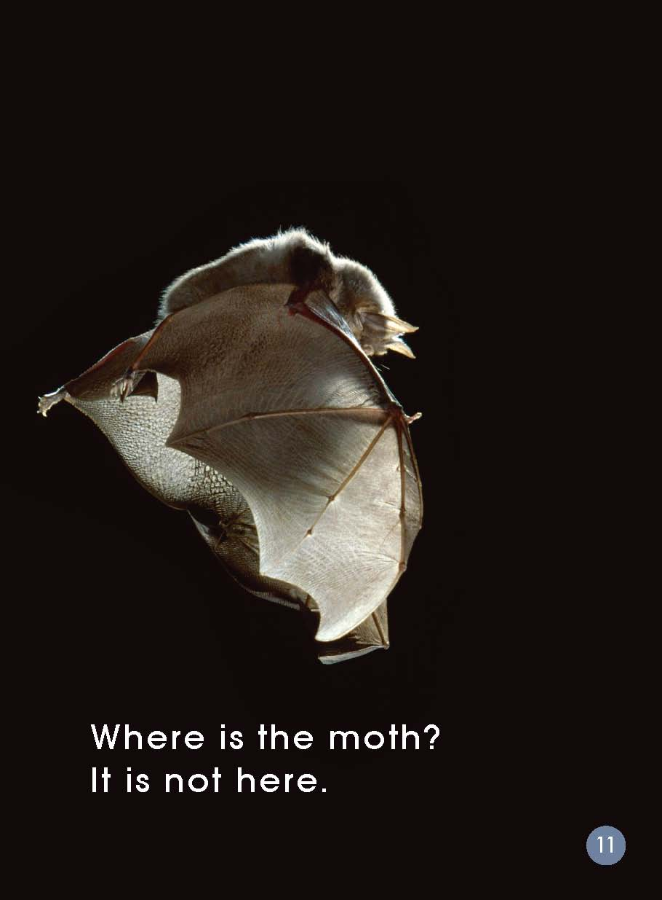
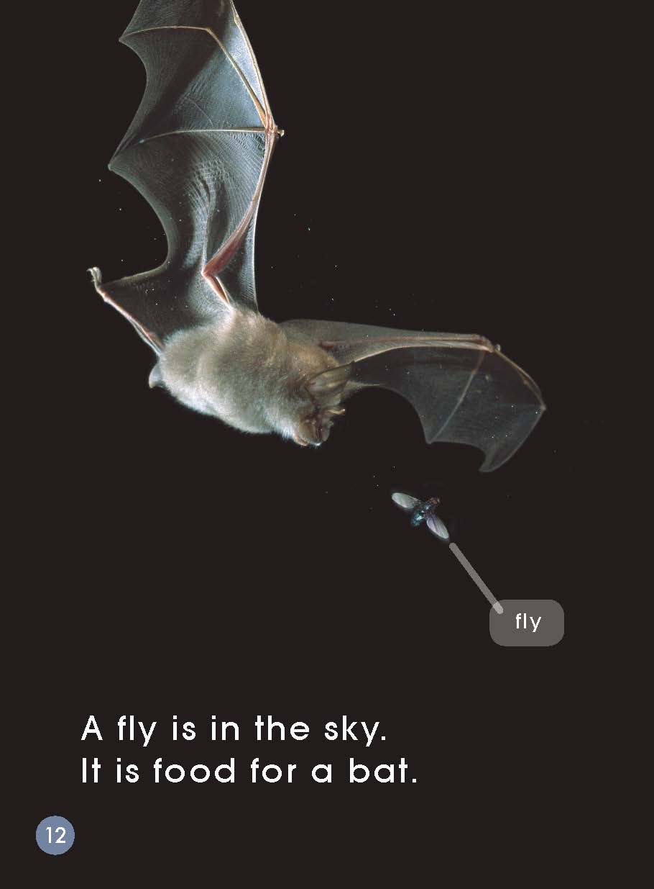
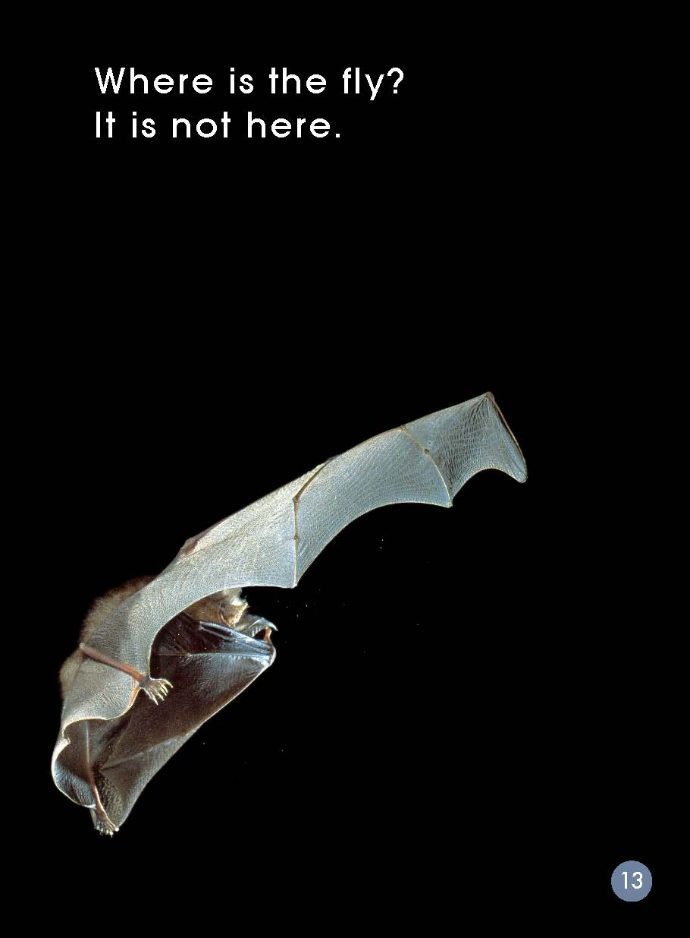
What can you see in the sky?
What do you think has happened to the moth and the fly?

Slide 10
Is it day or night? How do you know?
Where are the bats now?
Why do you think they are back in the cave?

Slide 11
The sun is in the sky.
(Daytime)
The moon is in the sky.
(Night)
flying in the cave
or in the sky
hunting in the sky
sleeping
in the cave

Slide 12
echo

Slide 13
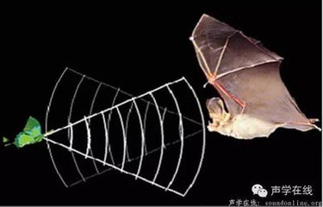
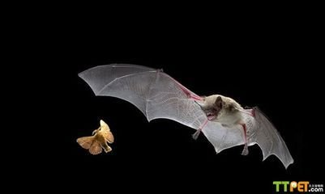
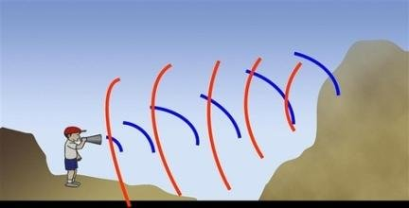
echo

Slide 14
Complete the worksheet.
回顾蝙蝠是如何捕食的，尝试填一填、画一画吧！
（提示：S1：红色的笔画出bat sound, S2：绿色的笔画出echo,
S1：黑色的笔画出一种bat food. S2：黑色的笔画出另外一种bat food.）

Slide 15
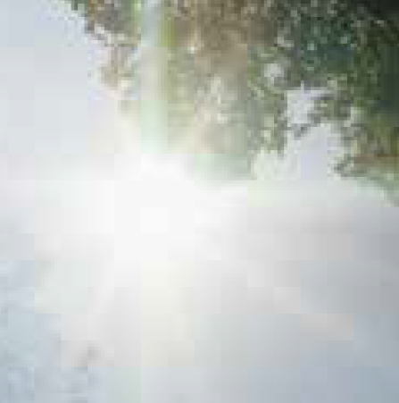
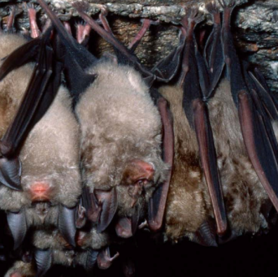
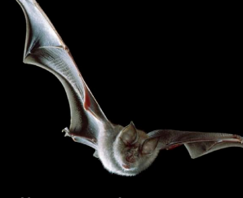
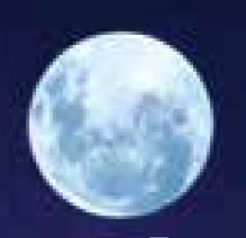
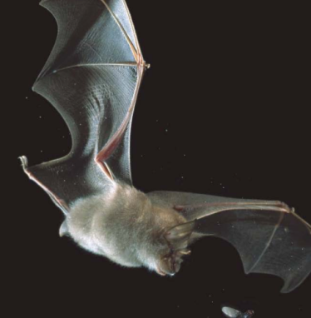
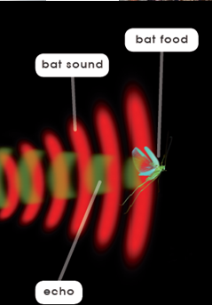
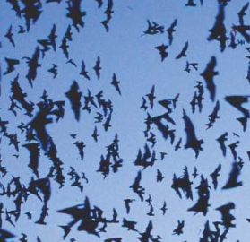
The sun...sky.
sleeping, cave
flying,
cave
Retell the book.
flying,
sky
The moon...sky.
hunting, eat, food, a moth, a fly
A Bat Hunting
The sun...sky.
sleeping, cave

Slide 16
Read again and discuss.
Bats are very interesting. Do you think so?
What do you think of the bats?
What did you learn from this book?
Do you know other animals which like hunting at night?

Slide 17
Homework
（1）朗读绘本，制作一张有关蝙蝠的海报。
（2）小组成员一起利用网络或者图书馆查询资料，继续查找和
探秘其他“夜行动物”，进行分享。

