Slide 1
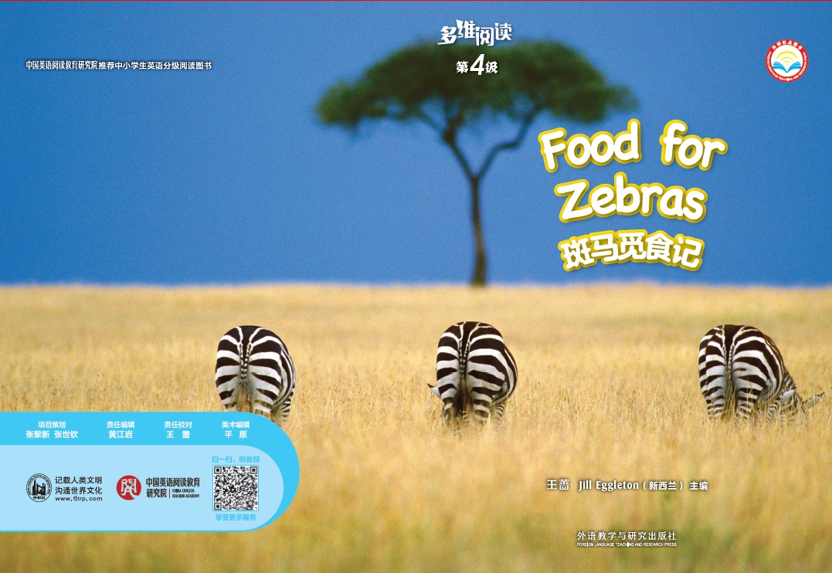
多维阅读第4级
Food for Zebras

Slide 2
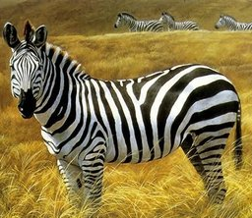
Read and guess.
It is an animal. It is white and black. It can run fast. It looks like a horse. It lives in the grassland.
What is it?

Slide 3
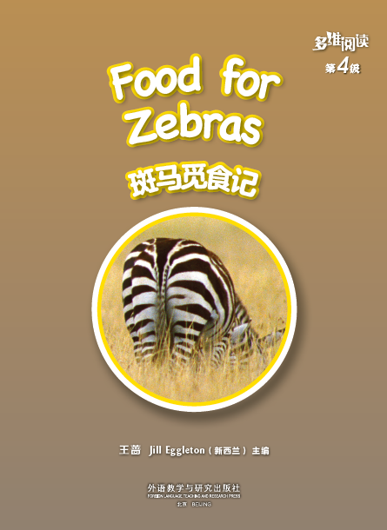
Read and answer.
What can you see from the cover?
Where is the zebra?
What is the zebra doing?
Can the zebra eat food?
Do you have any questions about the picture?

Slide 4
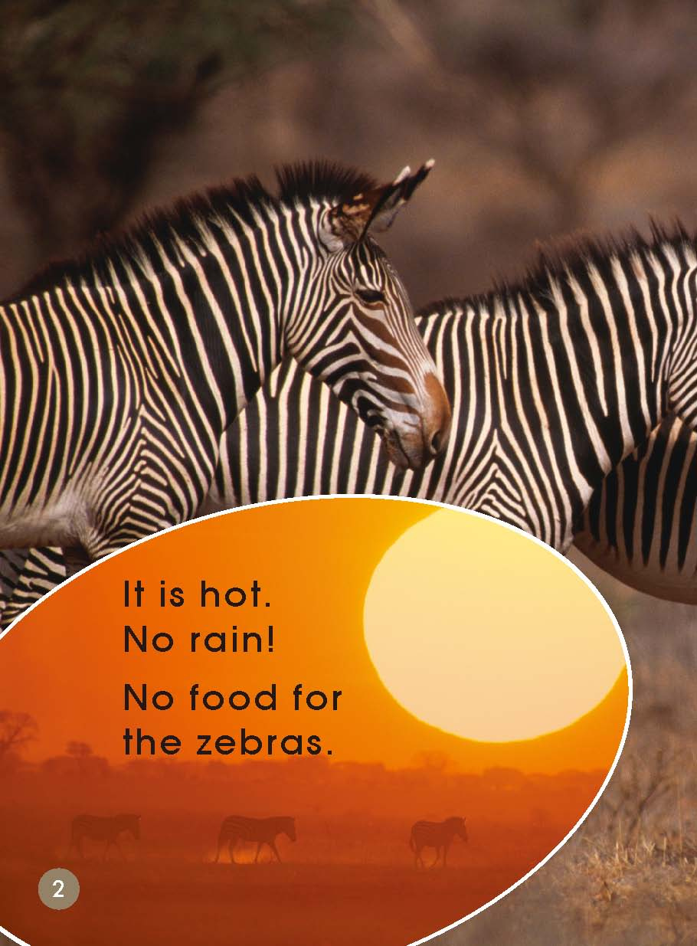
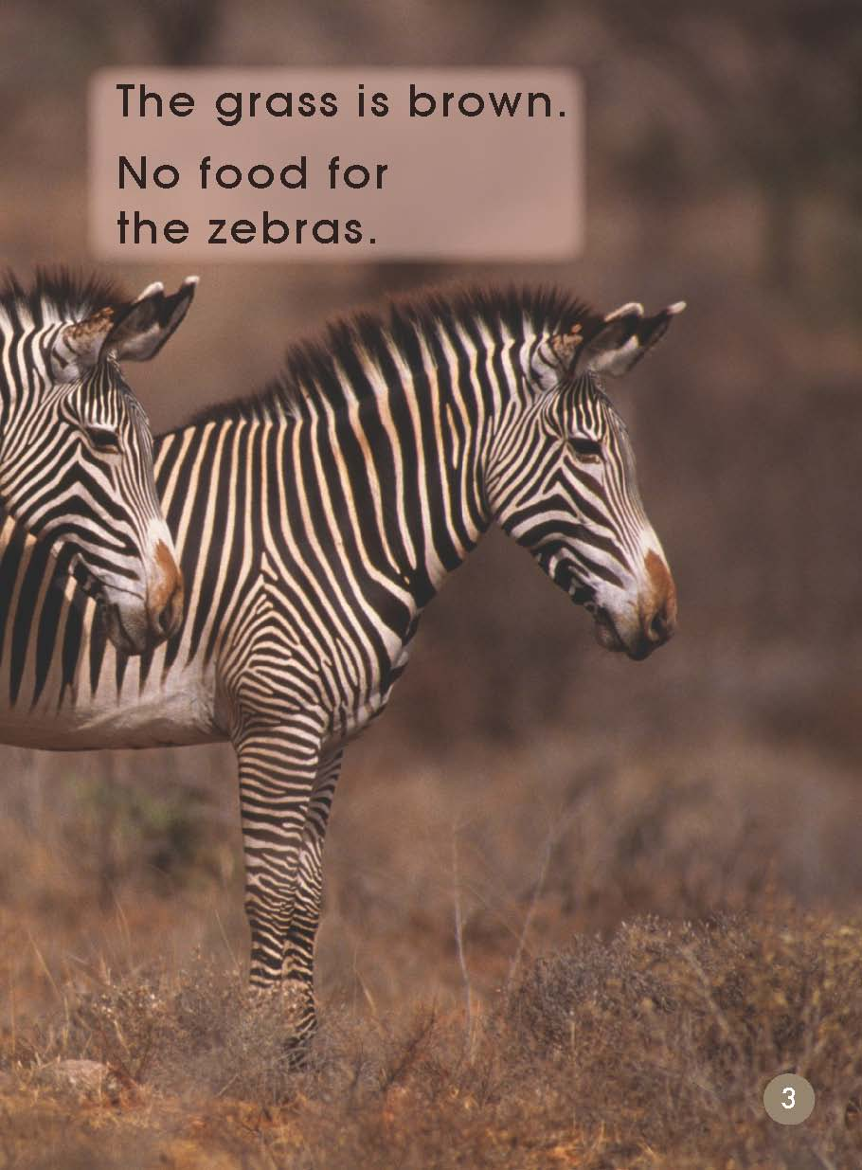
Read and answer.
Look at these zebras, what happens to them?
How do they feel?
Can the zebras find something to eat?
How do you know that? Which words tell you?

Slide 5
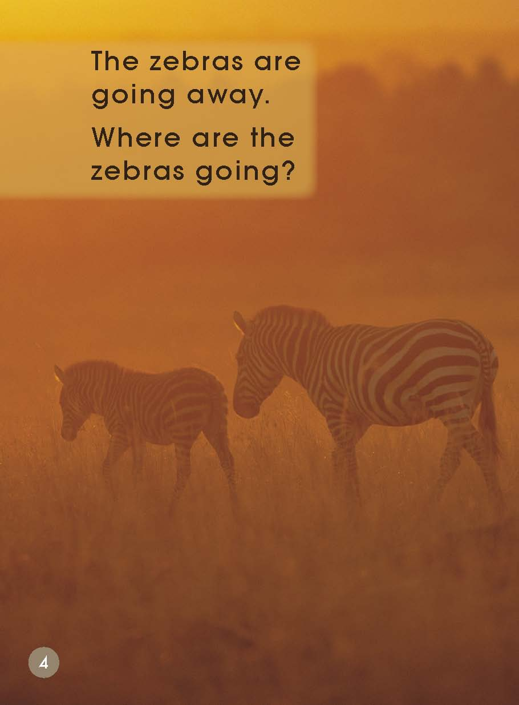
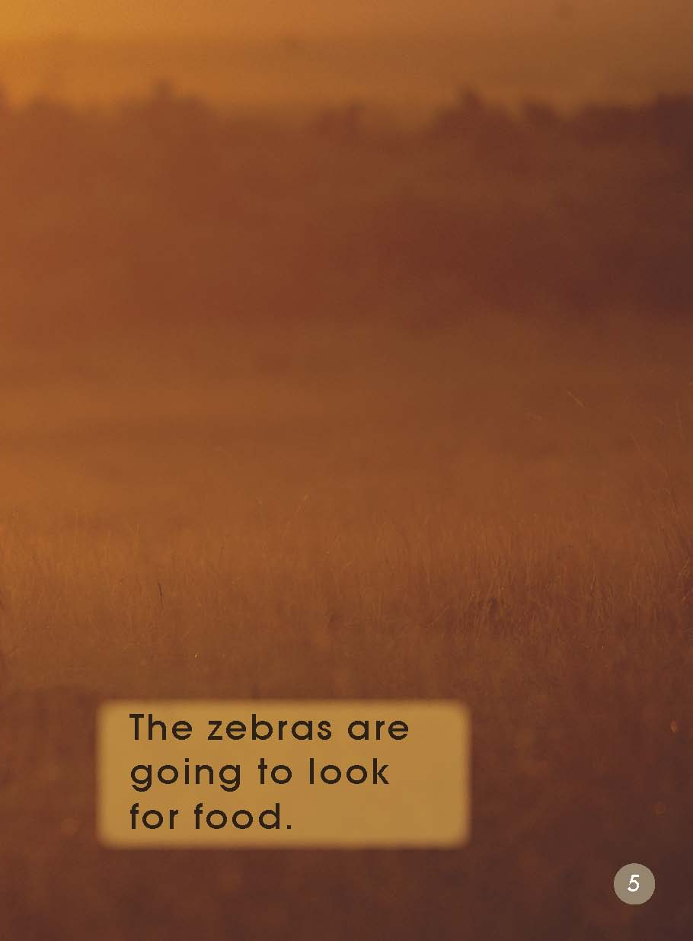
Why do the zebras go away?
Where are the zebras going?
What do you think the zebras might be going to do?

Slide 6
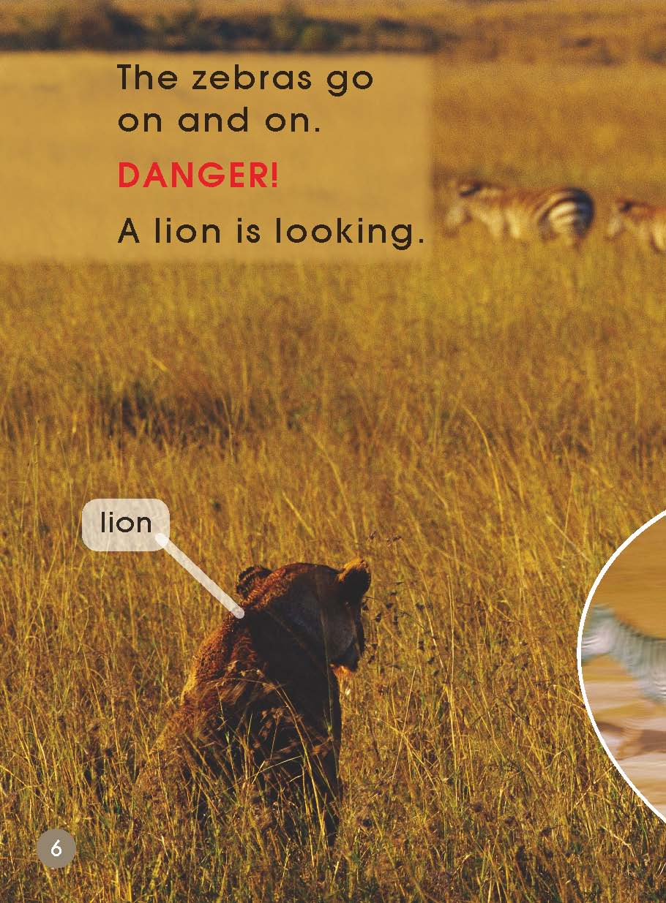
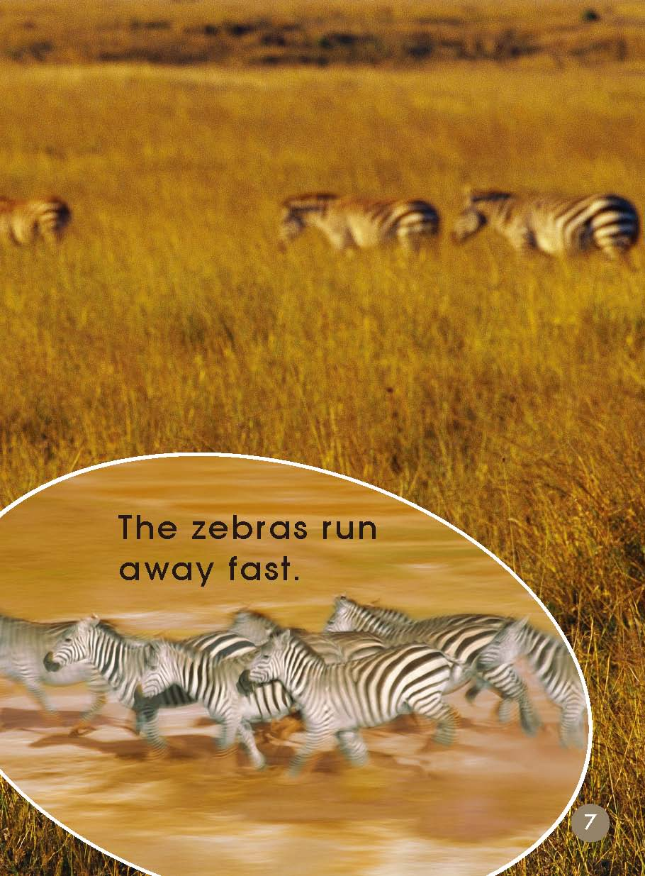
Who is looking at the zebras?
Why do you think the zebras are running?
What is DANGER, why is DANGER red here?

Slide 7
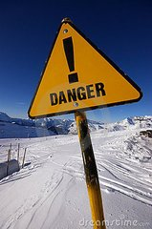
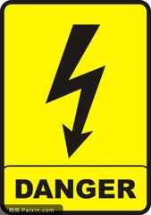
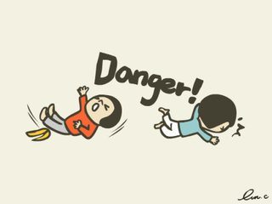
DANGER

Slide 8
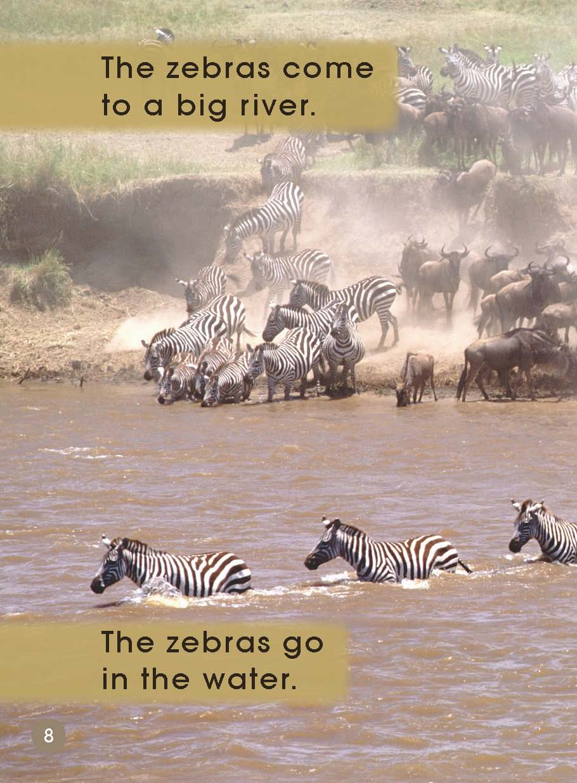
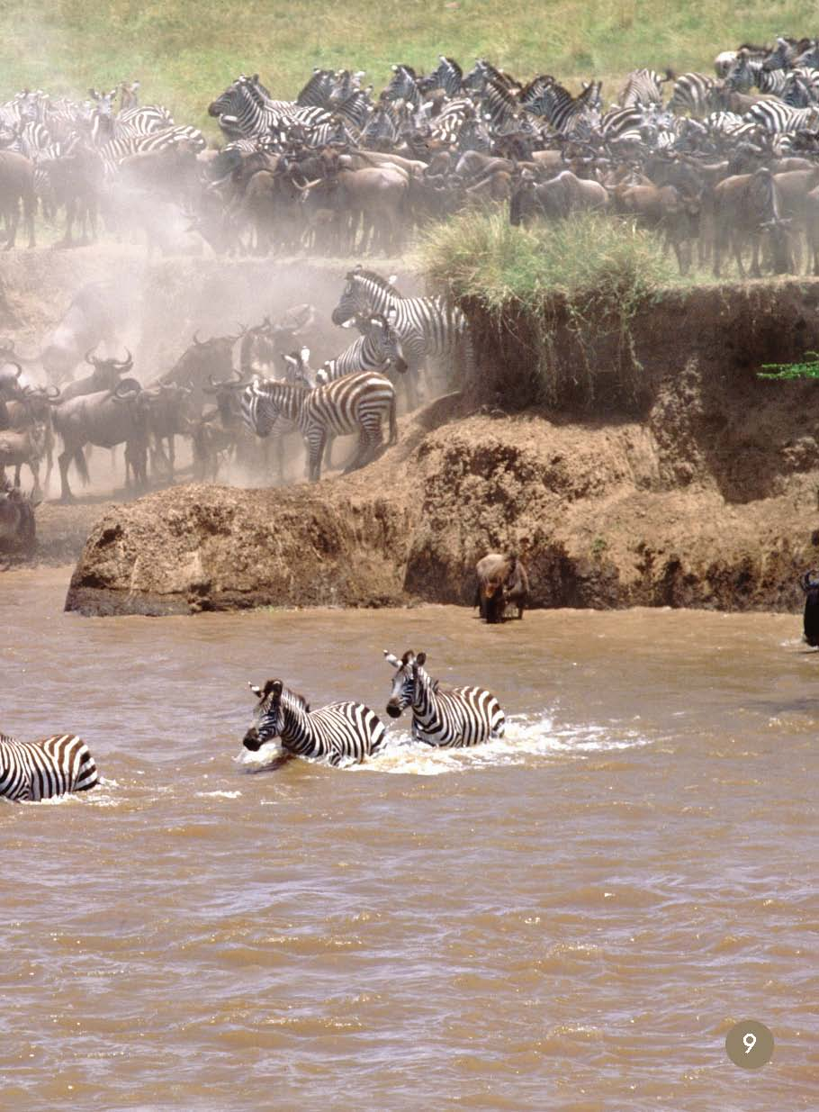
Can zebras look for food in the water?
Are there any DANGERS in the water?

Slide 9
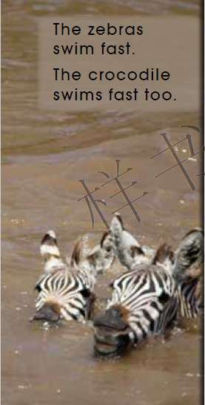
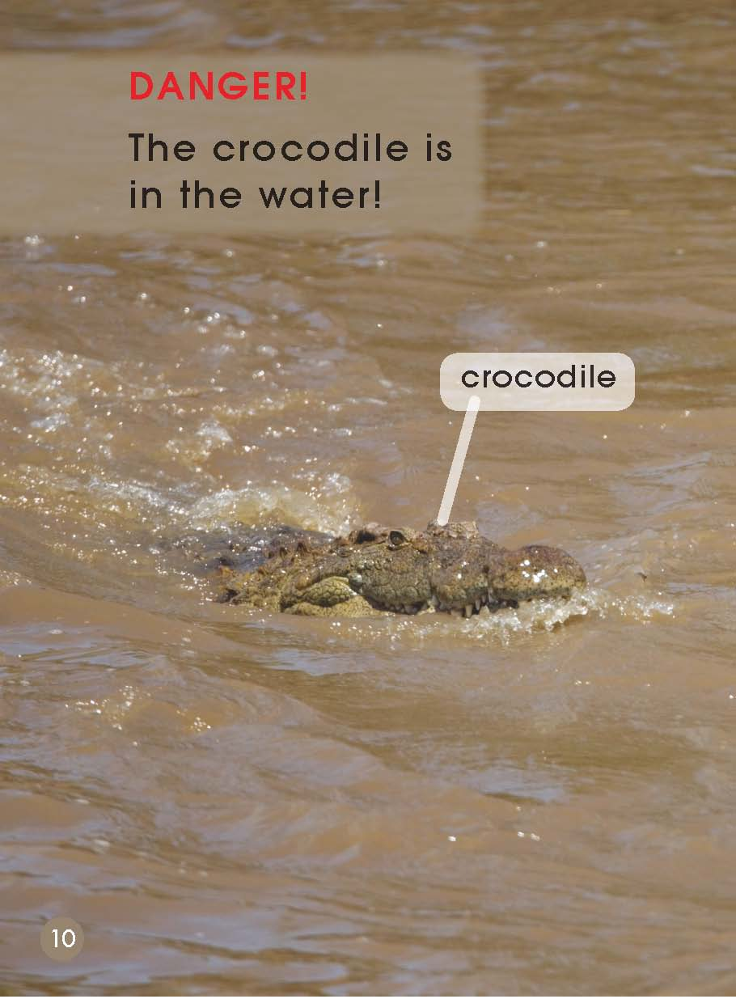
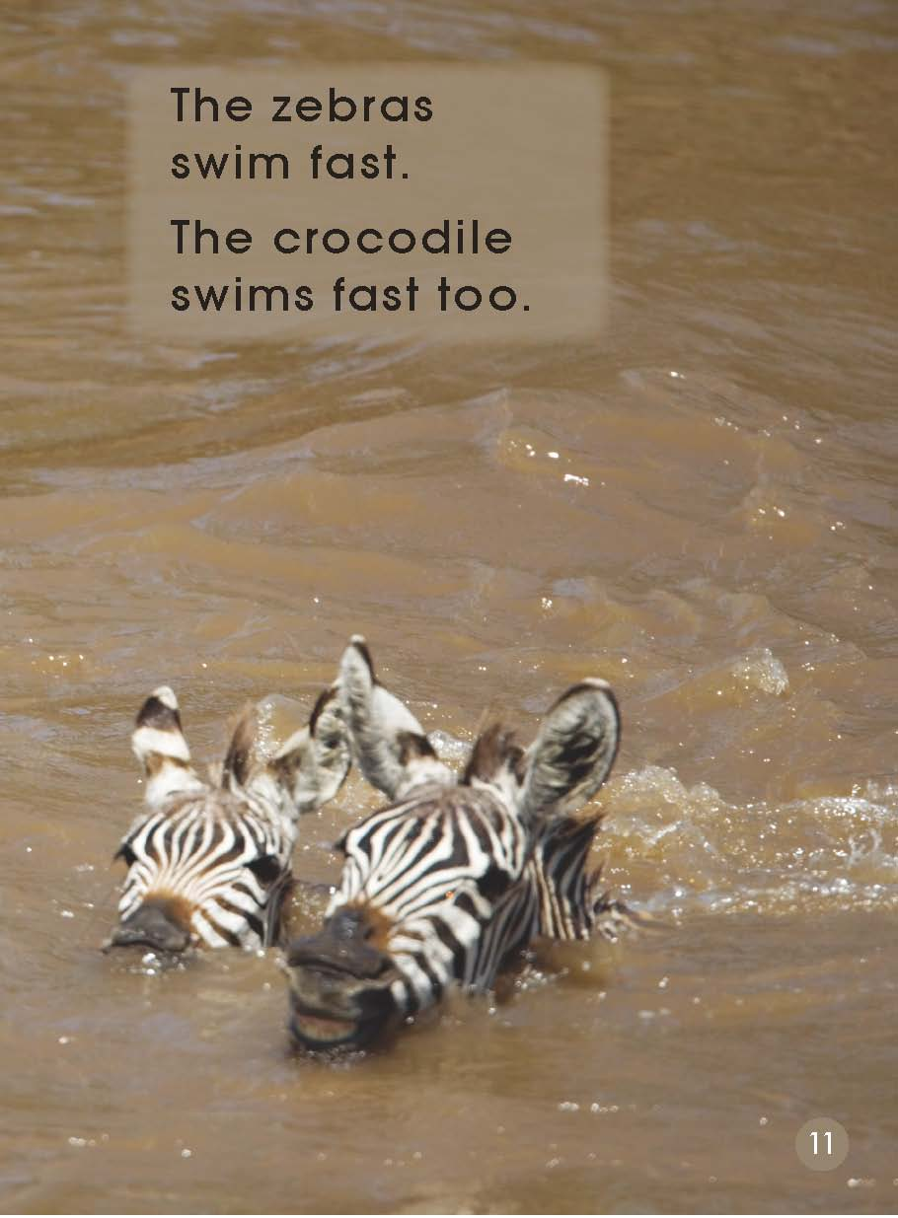
How do you know there is a DANGER here?
What will the zebras have to do?

Slide 10
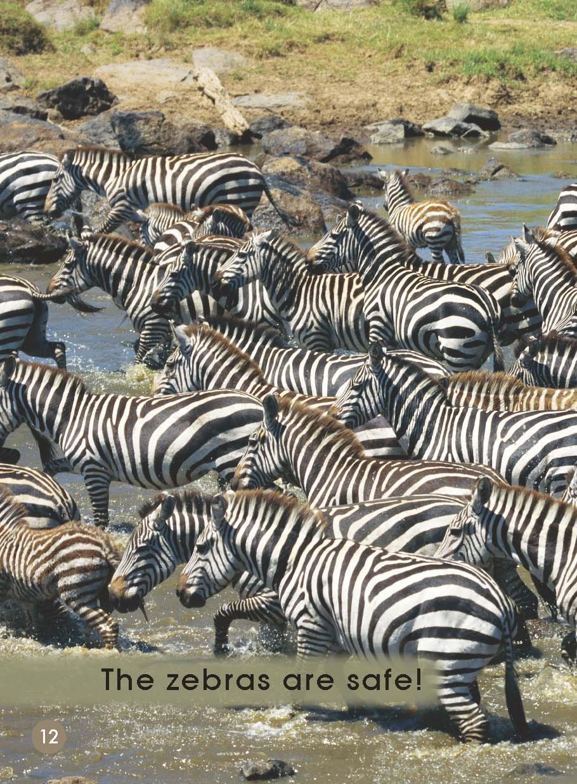
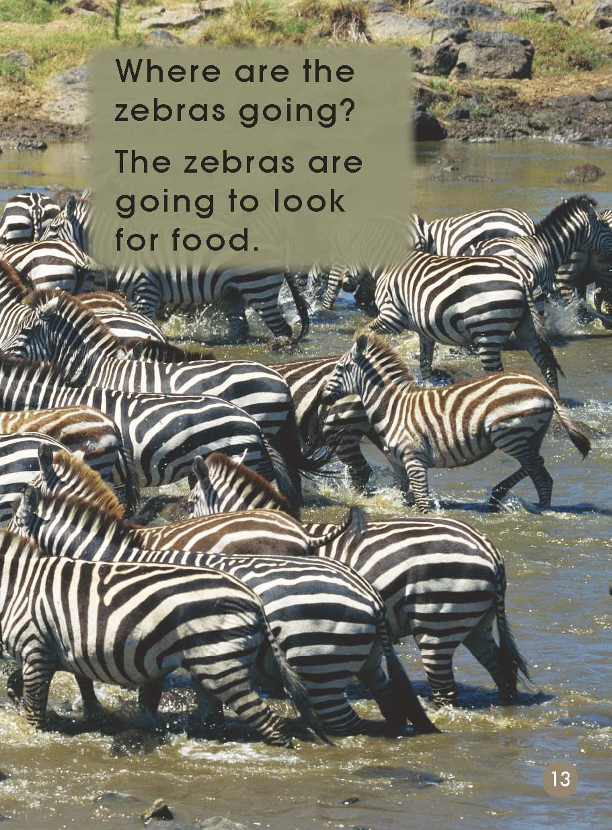
Do you think the zebras are safe?
Do you think the zebras should have crossed the river? Why or why not?

Slide 11
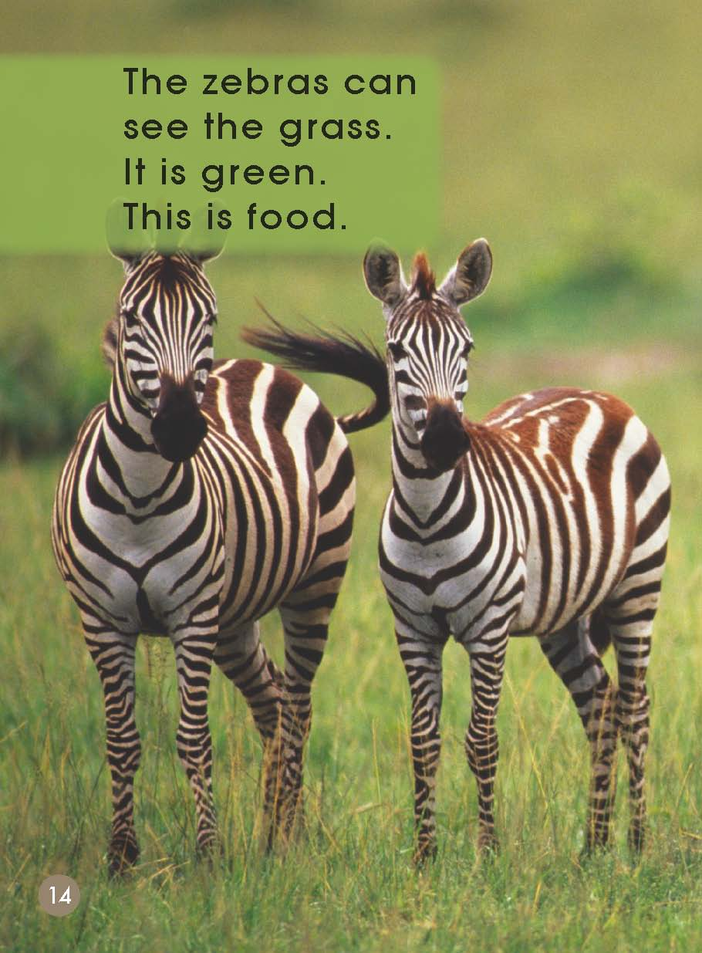
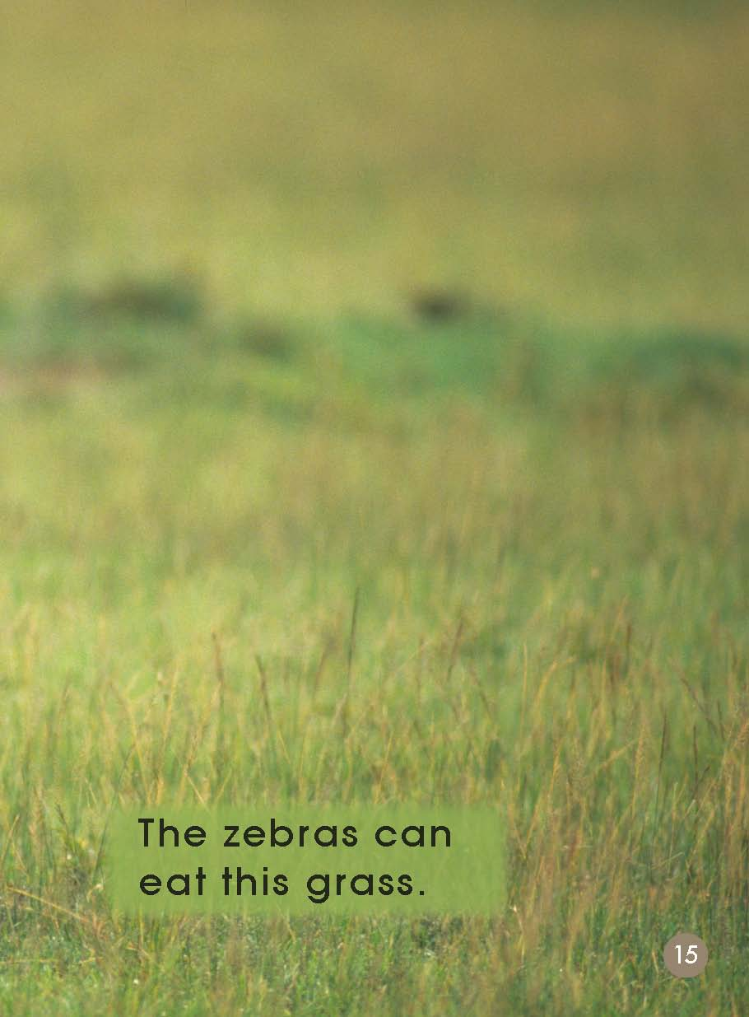
Where are the zebras now?
Do you think the zebras will stay here? Why or why not?

Slide 12
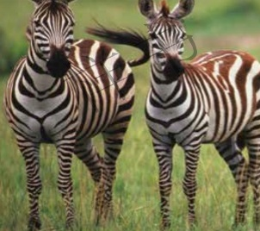
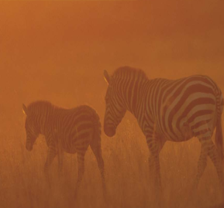
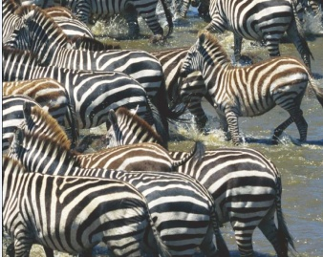
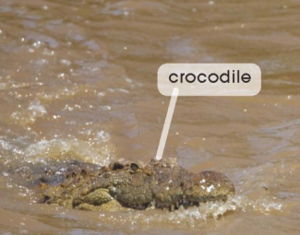
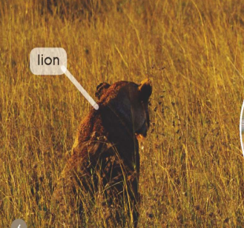
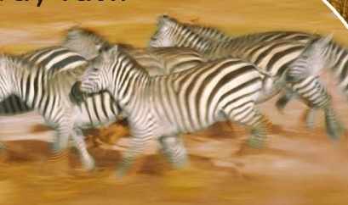
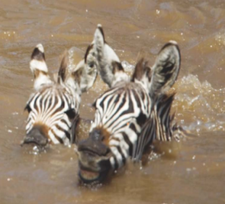
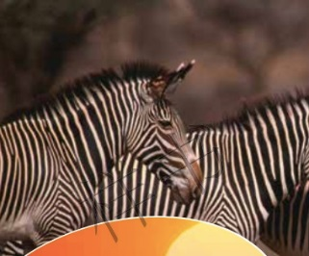
Put these pictures in the right order.

Slide 13
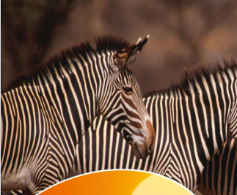
Please check the answers.
go away
DANGER!
no rain, no food
a lion
green grass
run away fast
DANGER!
a crocodile
safe
swim fast

Slide 14
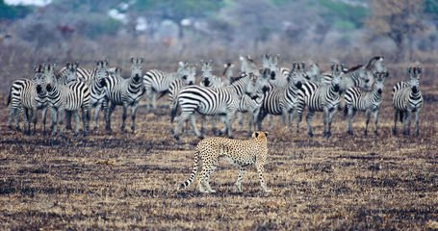
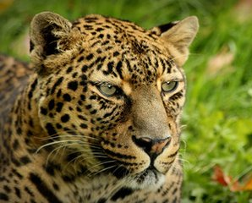
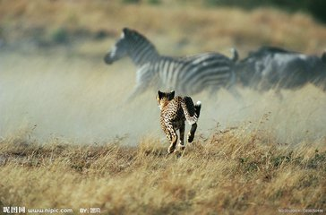
Think and talk.
a leopard

Slide 15
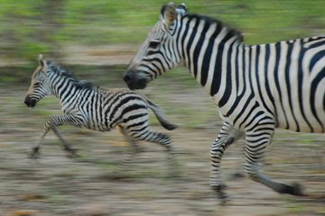
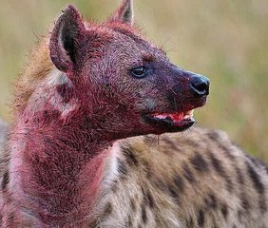
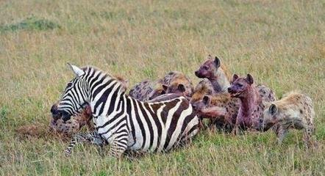
Think and talk.
a pye-dog

Slide 16
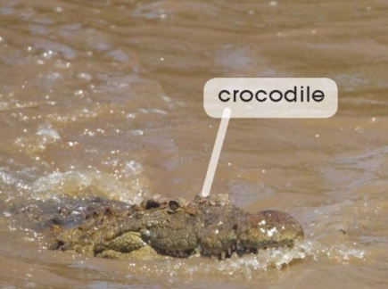
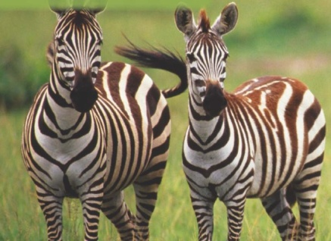
Read again and fill in the blanks.
It is hot.
No___, no___ for zebras.
DANGER! A crocodile is in the _____.
DANGER! A lion is _____.
The zebras are_____.
The zebras _____ away fast.
The zebras can eat green_____.
The zebras are _________.
The zebras _____ fast.

Slide 17
Think and discuss.
When the zebras eat green grass, how do they feel?
Is it easy to eat grass for zebras?
If you were going somewhere to get food, what DANGERS would you expect to meet? Is there anything you should be careful of?
4. Look, the zebras eat grass, the lions and crocodiles eat
zebras…What do you think of this food chain (食物链)?
5. What can we do to protect animals and nature?

Slide 18
Homework
必做项目：
朗读文本，并简单复述文本内容。
任选项目：（二选一完成）
（1）学生独立完成或者与同伴合作，制作一幅“大自然的食物链”
海报，并进行分享。
（2）课后和小组成员一起利用网络或者图书馆查询资料，找寻
“斑马”的信息，全班进行分享。（可以是斑马的特征、斑马
的食物、斑马的旅程、斑马的种类和分布、斑马的趣事等）

