Slide 1
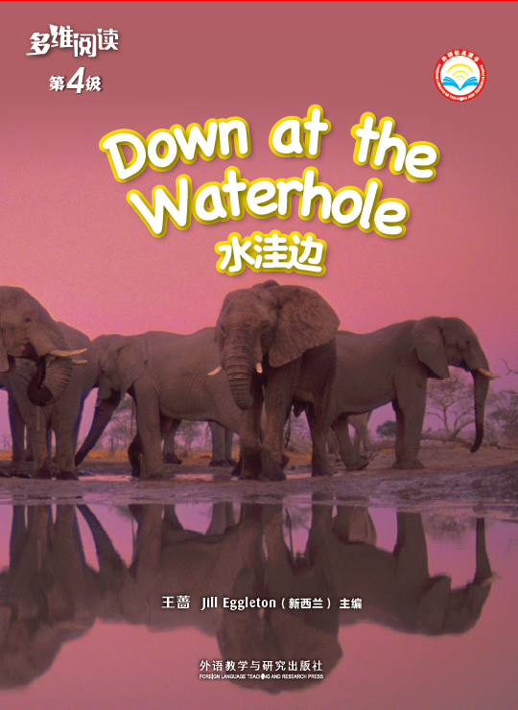
Title
Writer

Slide 2
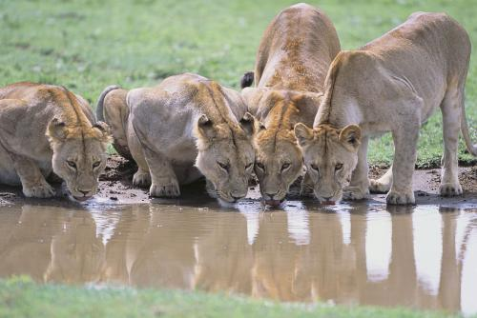
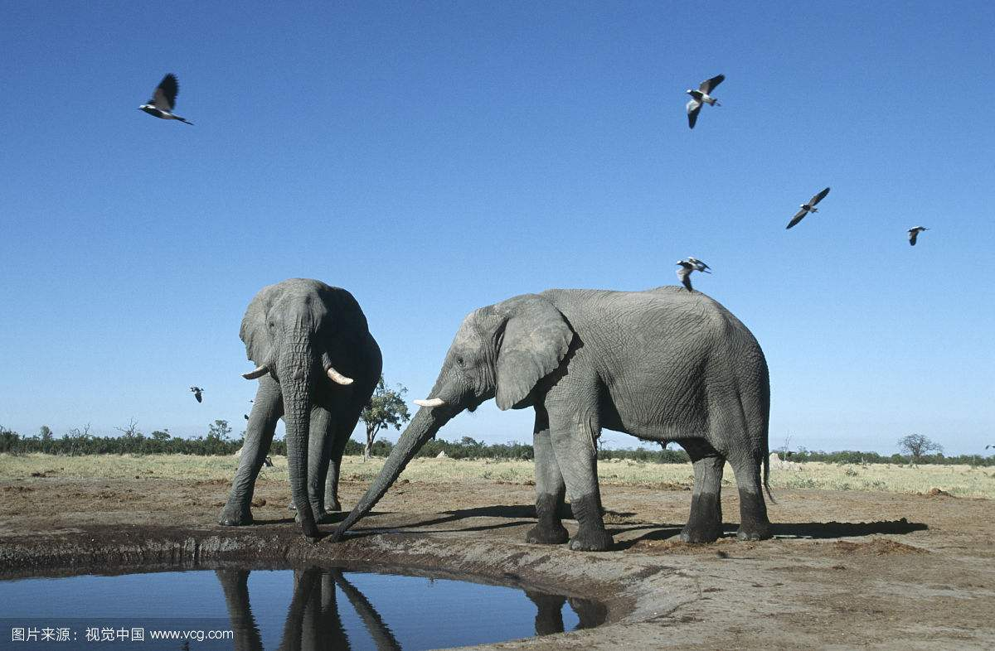
Can you find the waterhole？

Slide 3
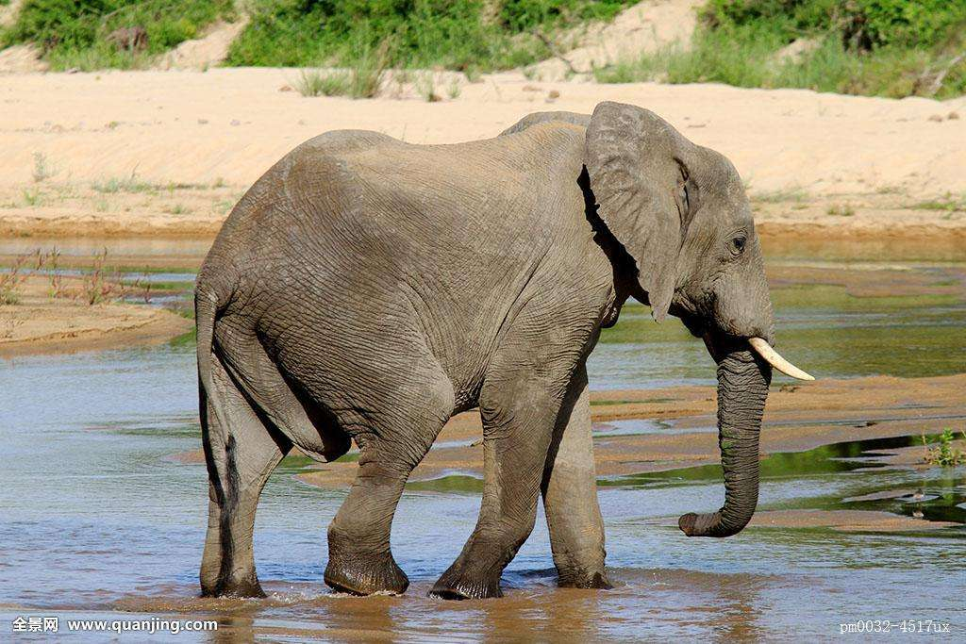
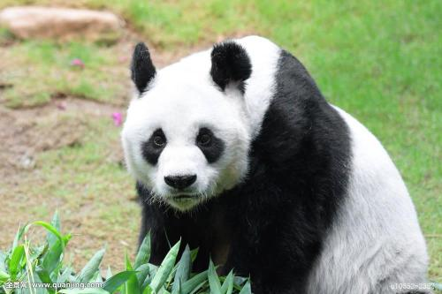
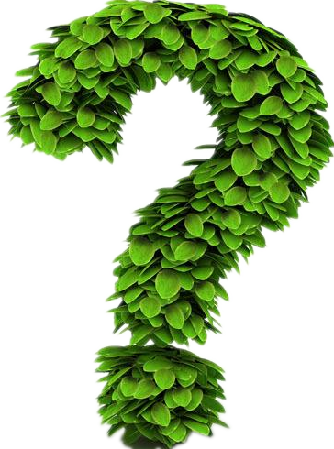
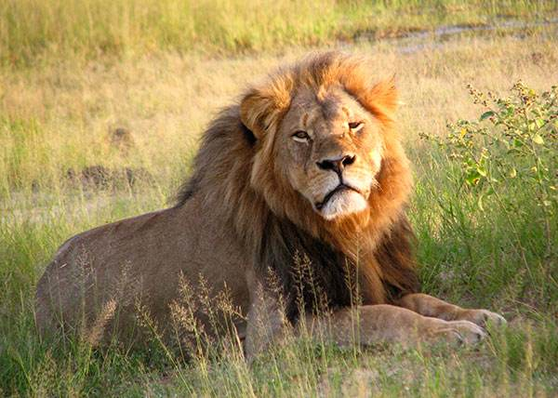
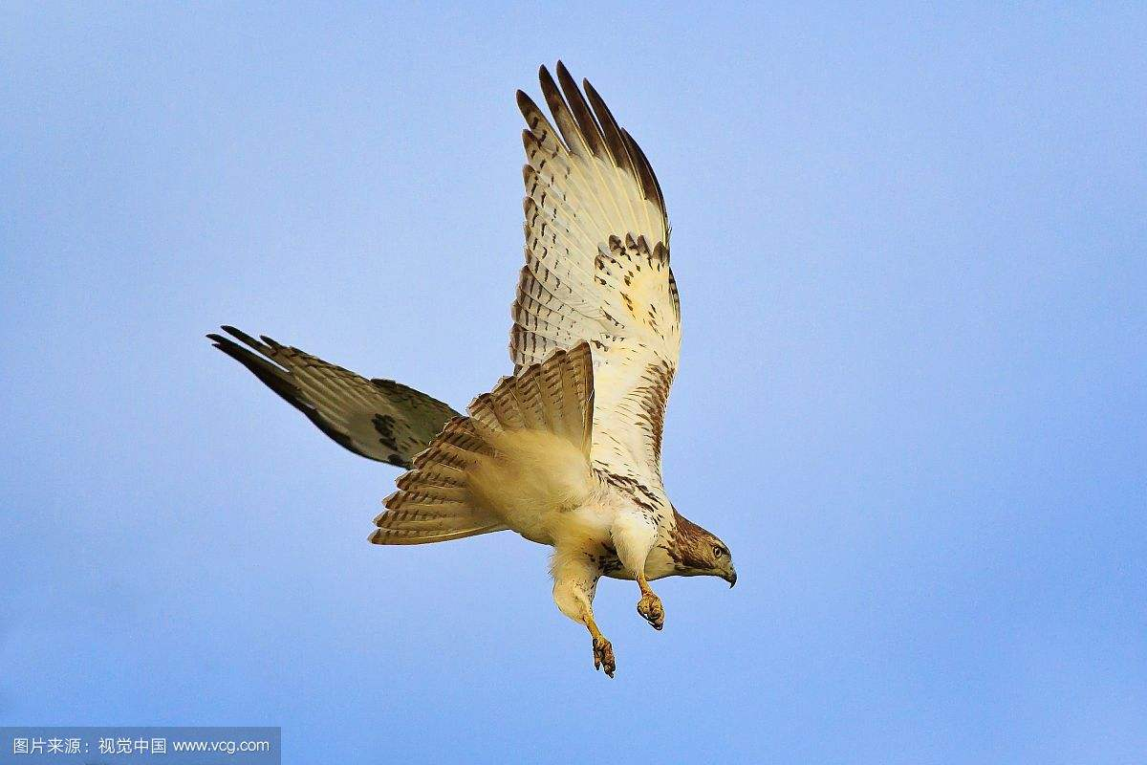
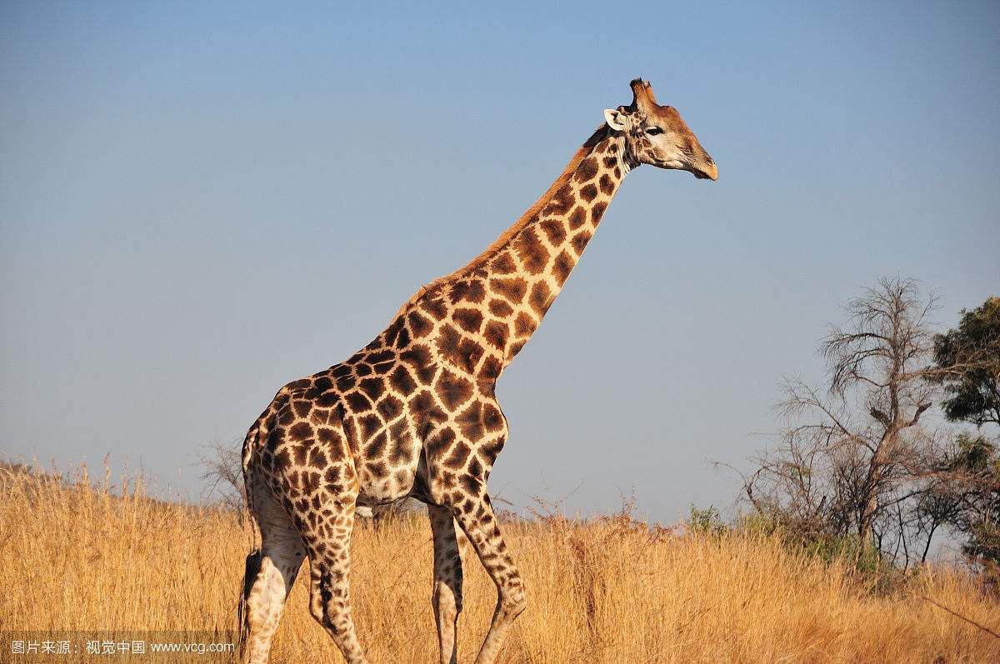
panda
elephant
What animals live near the waterhole?
hawk
giraffe
lion

Slide 4
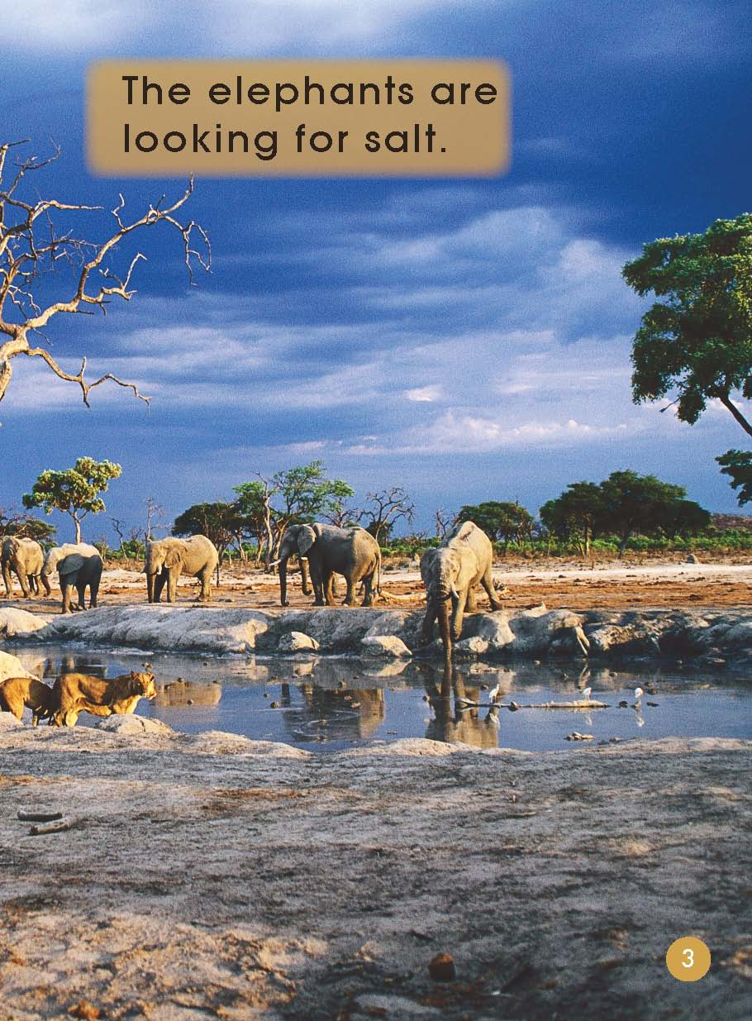
Look and say.
Notes:
Look at the clock.
What number can you see on the clock？
What time is it?
Is it morning or afternoon?
How do you know it is morning?
what elephants do at this time？

Slide 5
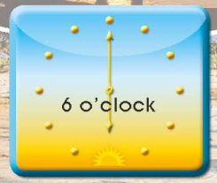
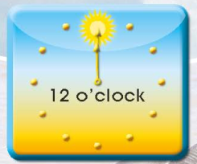
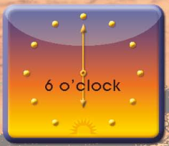
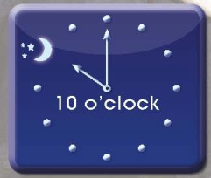
Can you guess what elephants do at these times?

Slide 6
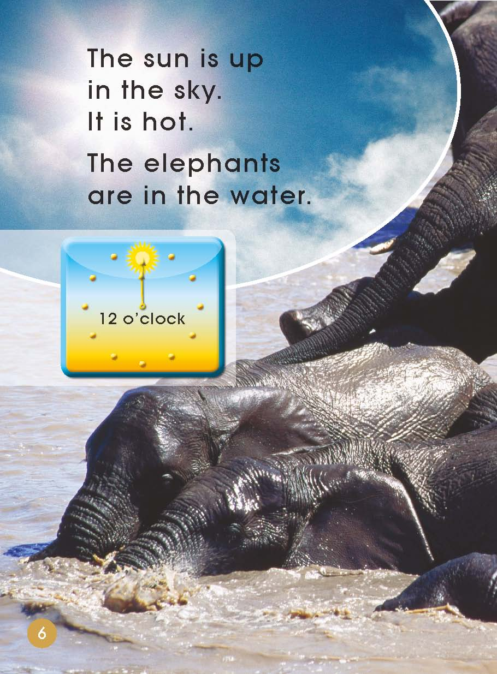
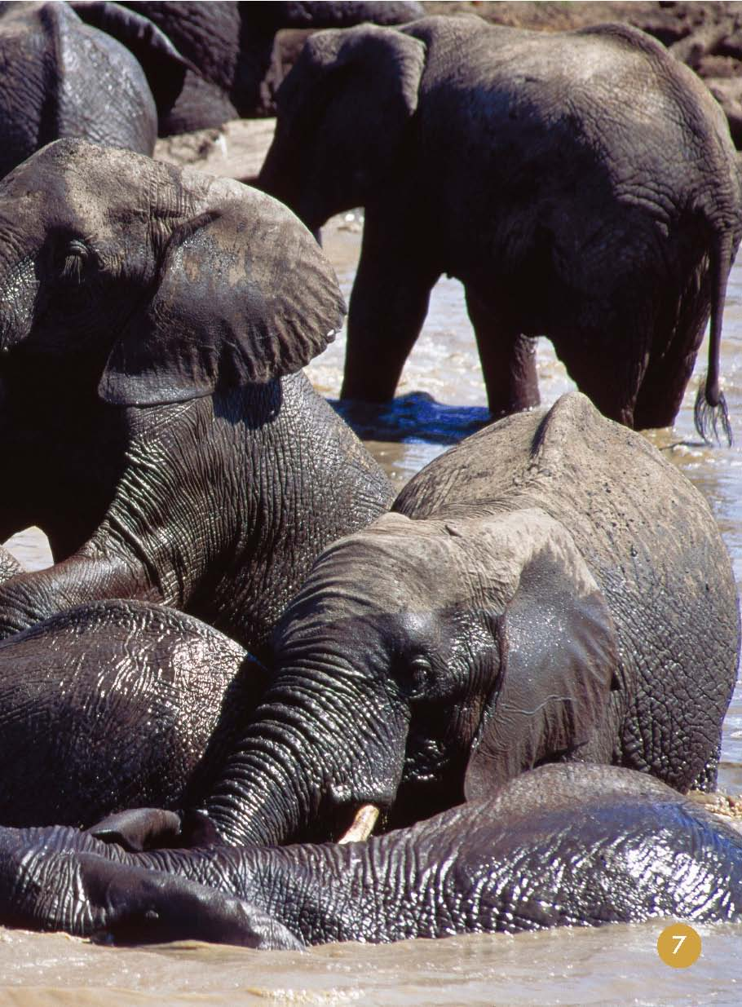

Slide 7
Looking for salt
In the water

Slide 8
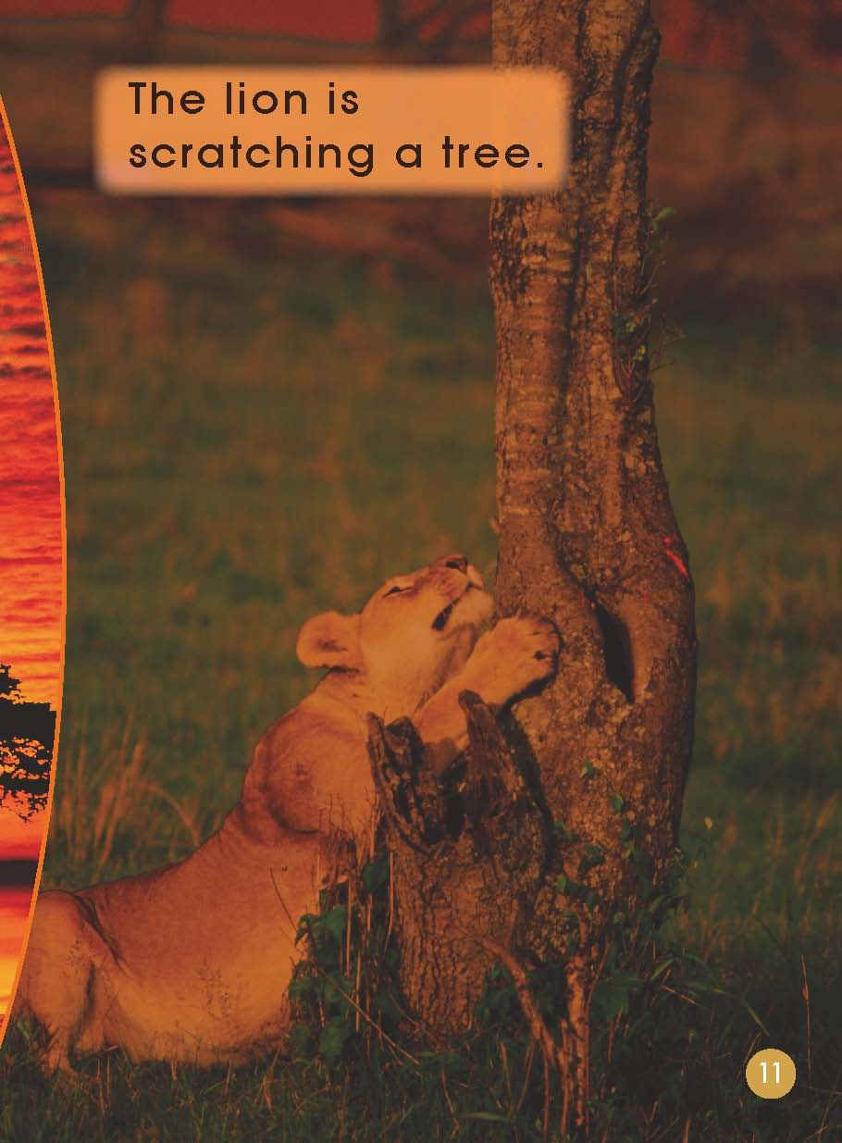

Slide 9
Under the tree
Looking for salt
In the water

Slide 10
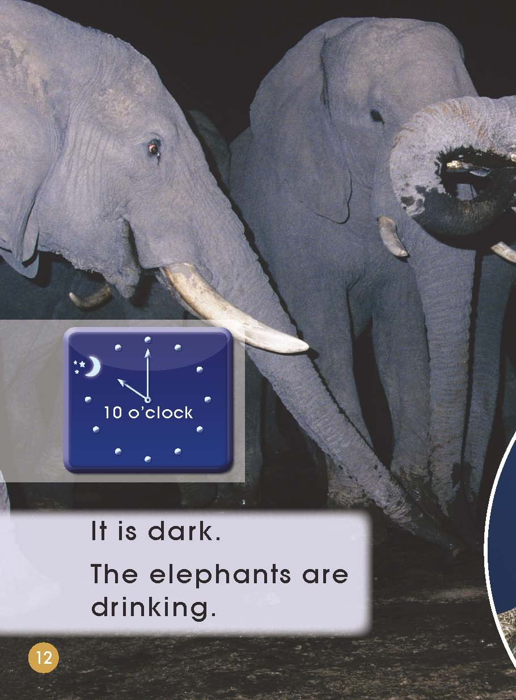
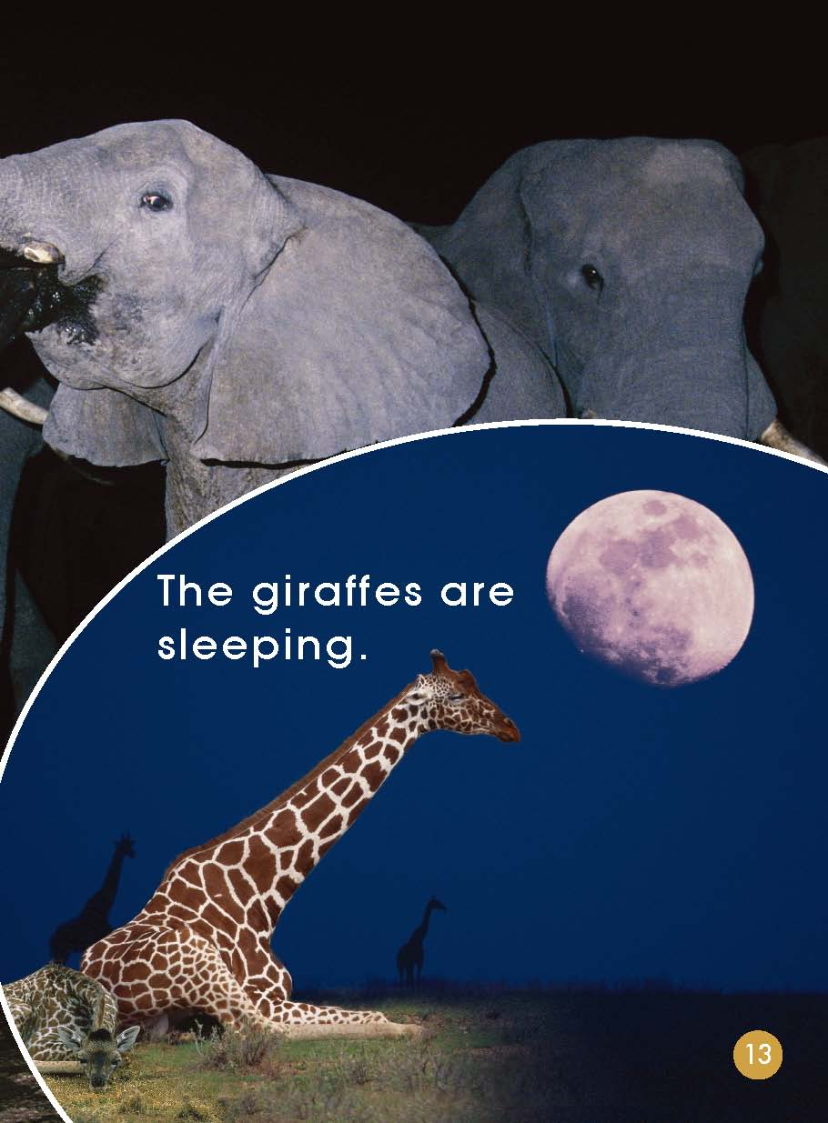

Slide 11
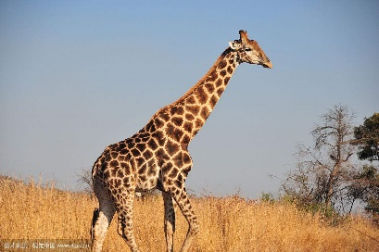
Looking for salt
In the water
Under the tree
Drinking
How about giraffes, hawks and lions?

Slide 12
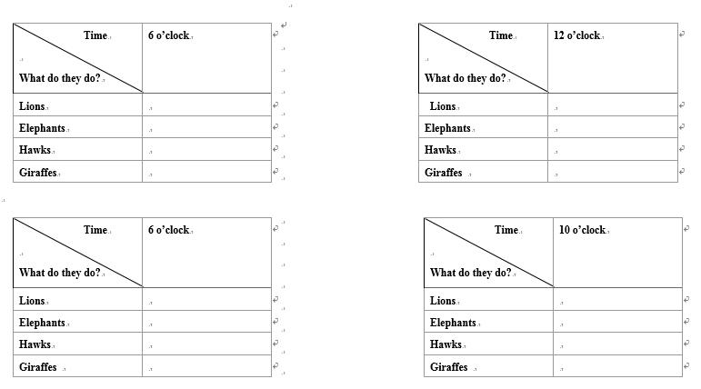
Please read the story in your group and finish the worksheet.

Slide 13
学生分组阅读
1
2
3
4
A
A
B
B
C
C
D
D
A
A
B
B
C
C
D
D
A
A
B
B
C
C
D
D
A
C
D
D
A
B
B
C

Slide 14
学生分组阅读
1
2
3
4
A
B
A
B
A
B
A
B
C
D
C
D
C
D
C
D
A
B
A
B
A
B
A
B
C
D
C
D
C
C
D
D

Slide 15
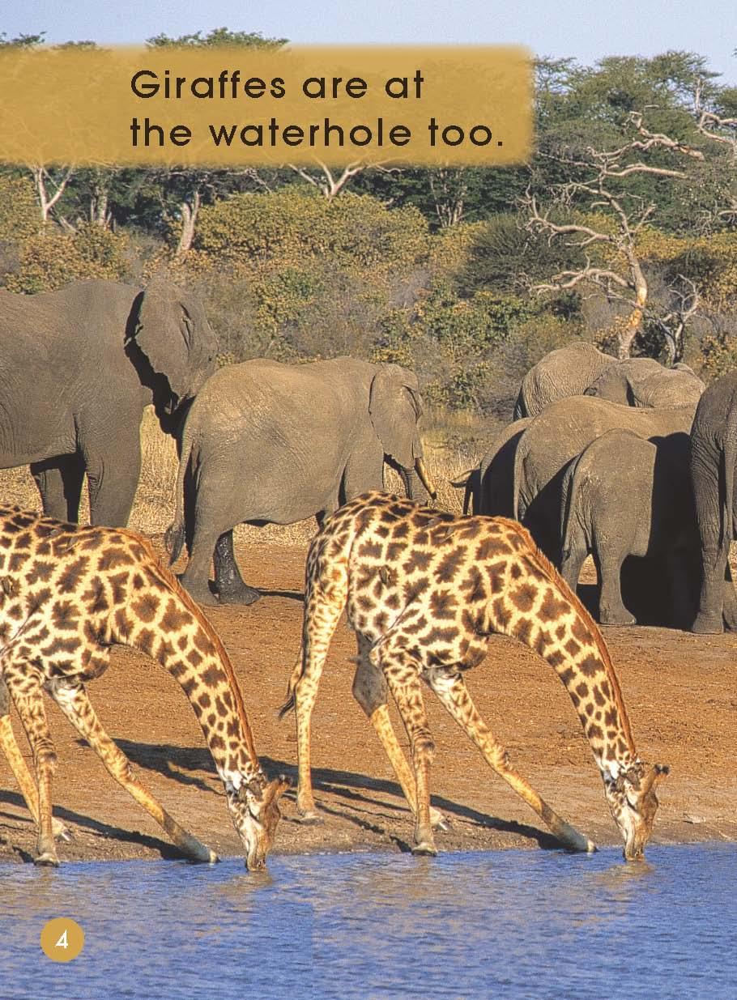

Slide 17
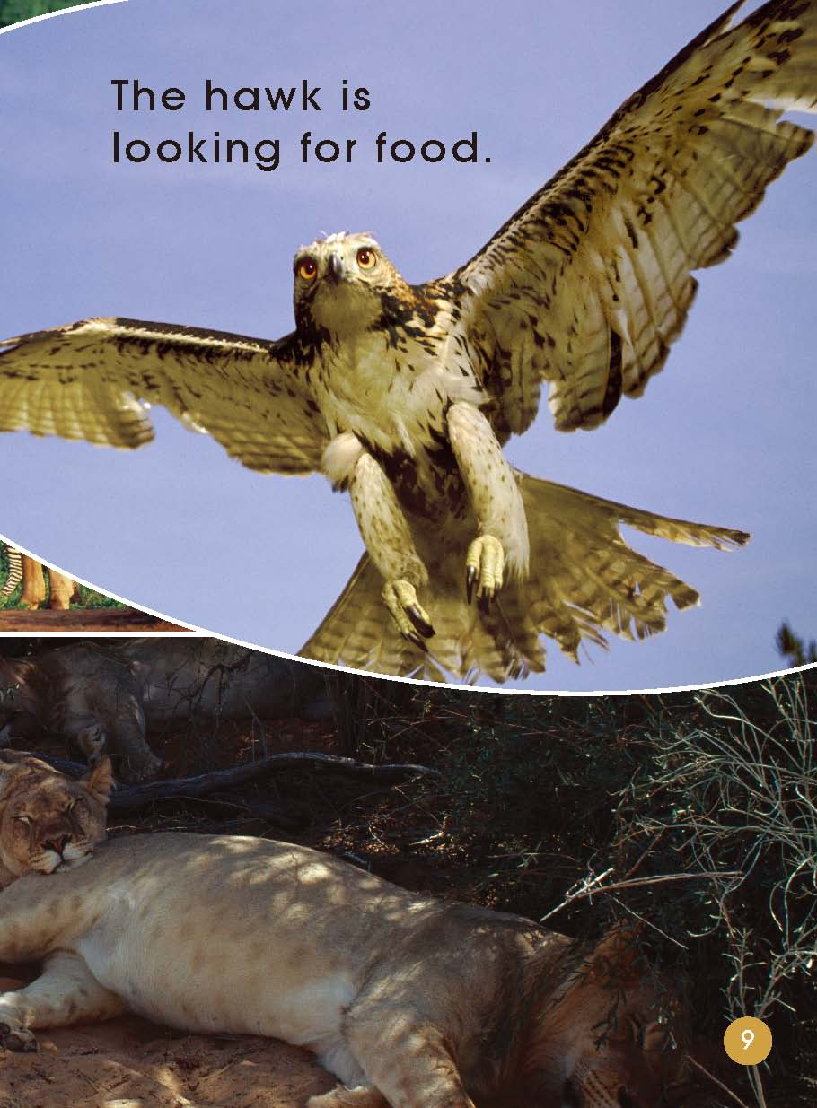

Slide 20
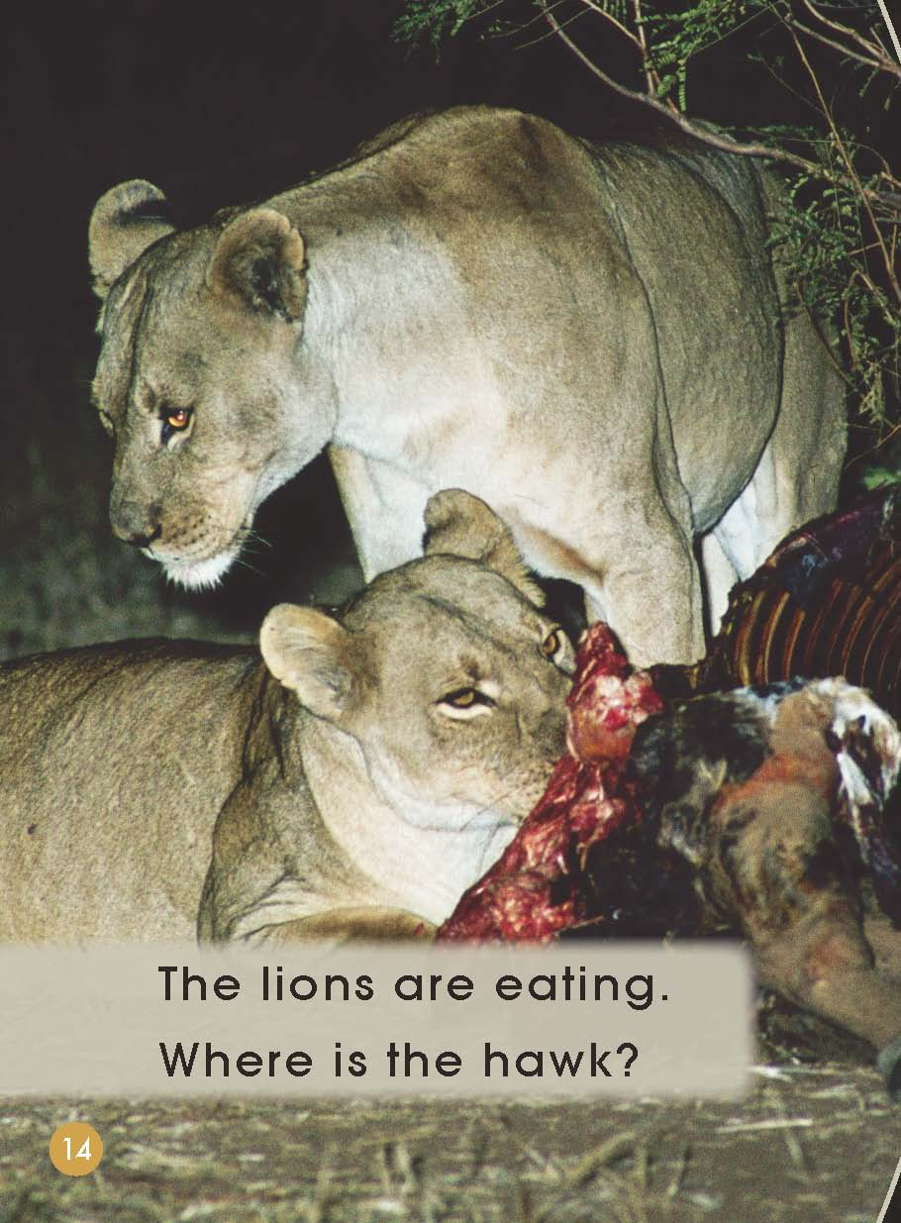

Slide 21
Let’s share!

Slide 22
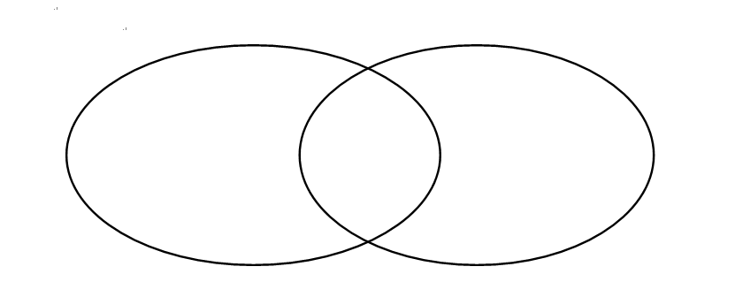
Read the story by yourself.
Try to find similarity and difference.
(动物习性的相同与不同)
Difference
Difference
Similarity

Slide 23
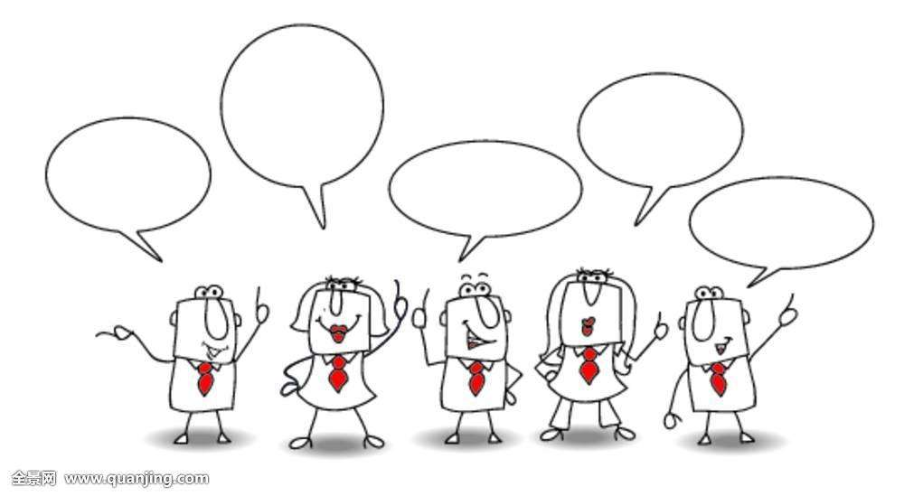
Let’s talk!
Different animals have different lifestyles.
What can we do to protect animals and nature?
If you go to a wild animal zoo, what should you do?

Slide 24
