Slide 1
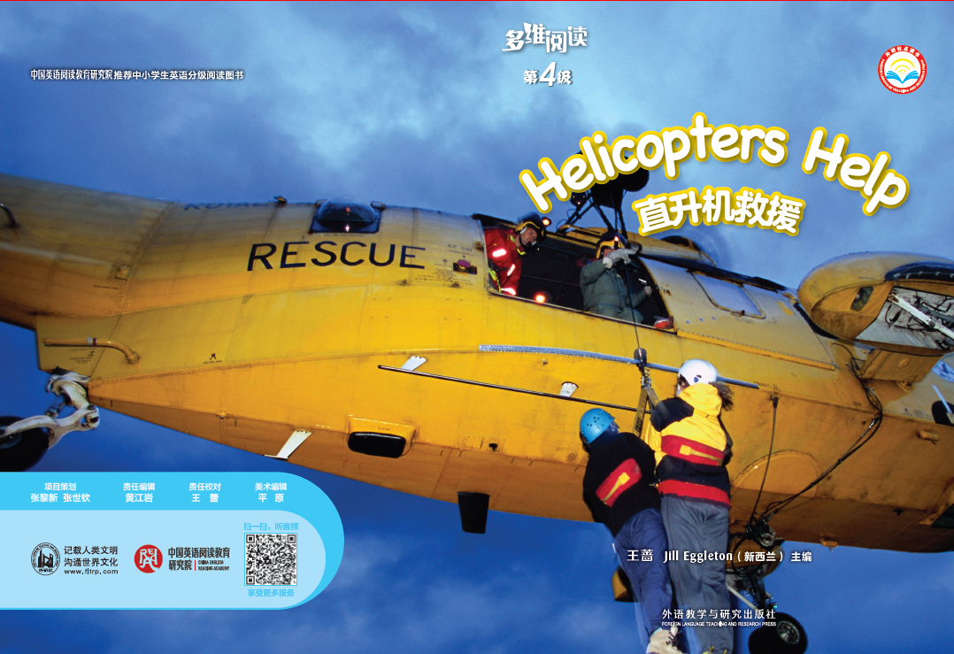
多维阅读第4级
Helicopters Help

Slide 2
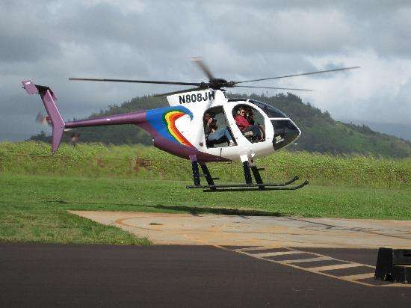
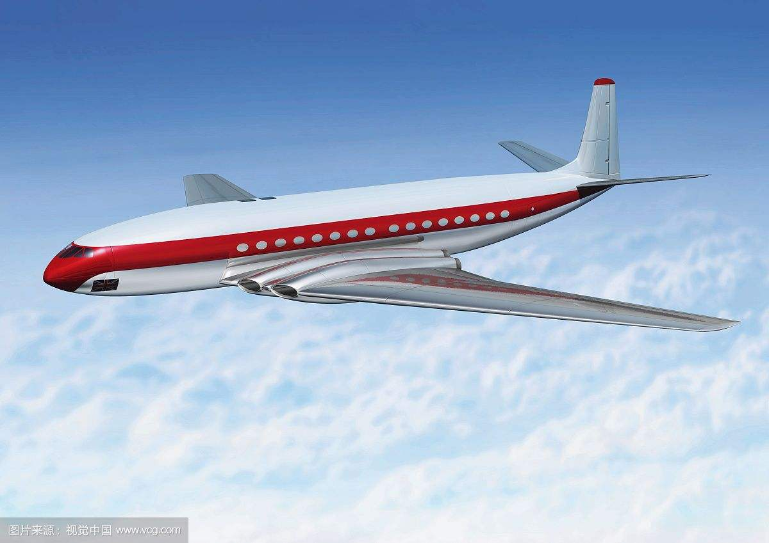
Which one is a helicopter？
A
B

Slide 3

Read the story by yourself.
Why is it called Helicopters Help？

Slide 4
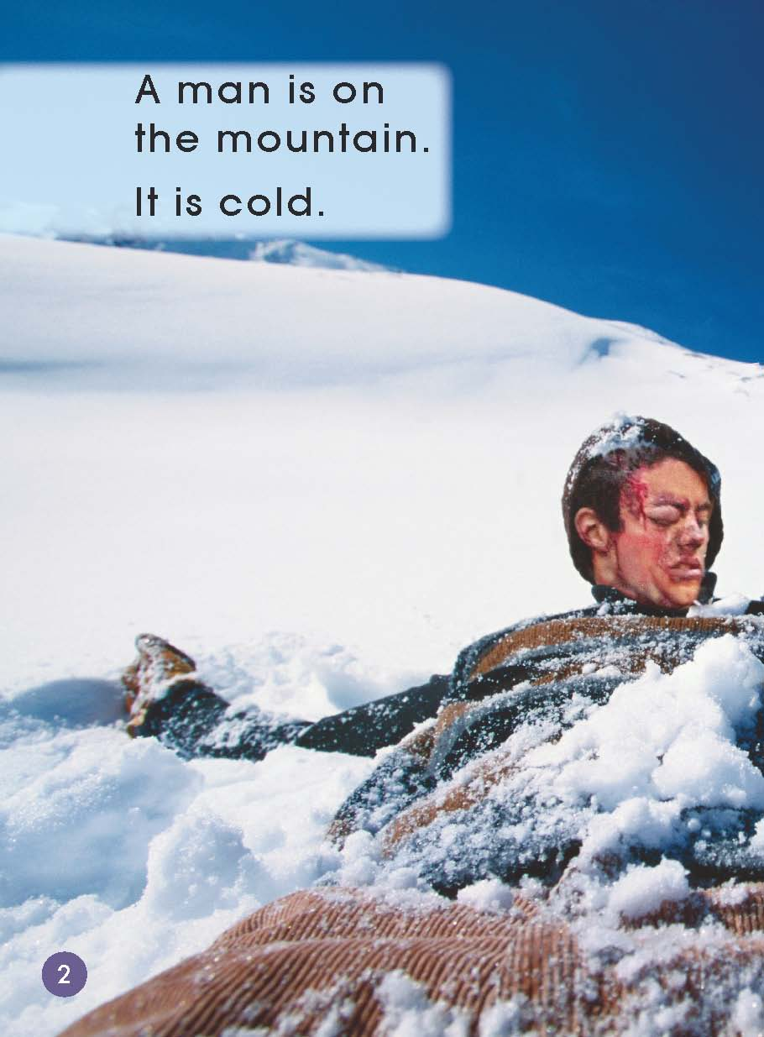
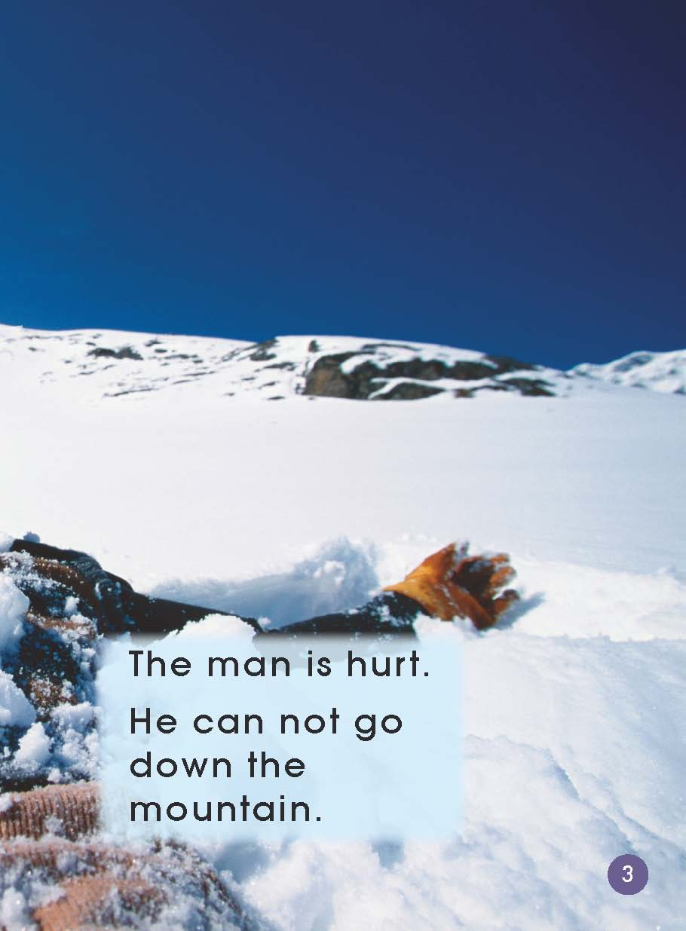
Who can you see?
Where is the man?
What do you think
has happened to
him?
Does the man feel
good?

Slide 5
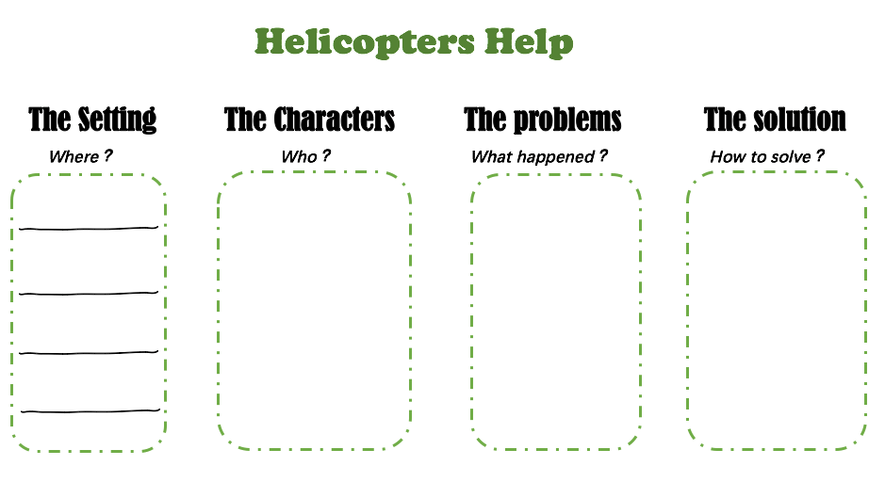
On the mountain
A man
He is hurt.

Slide 6
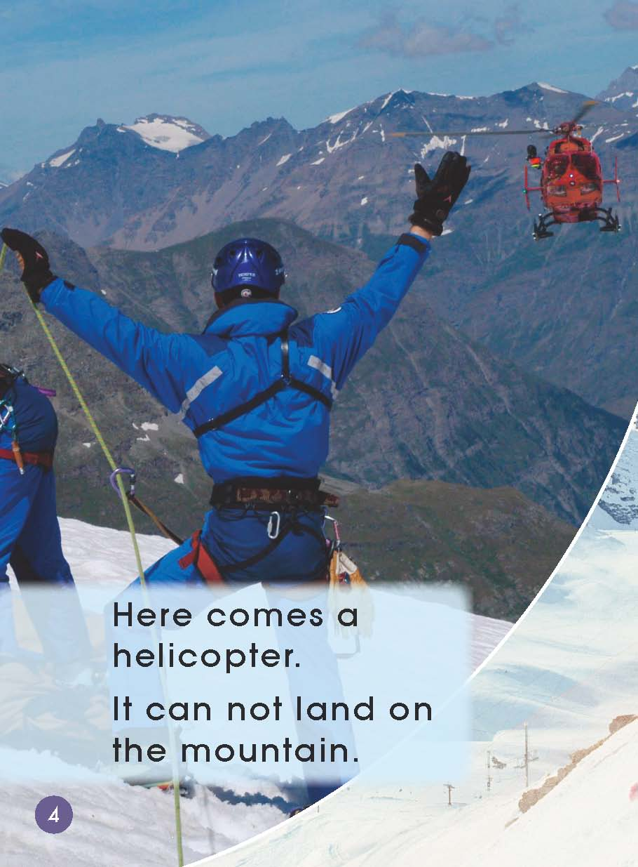
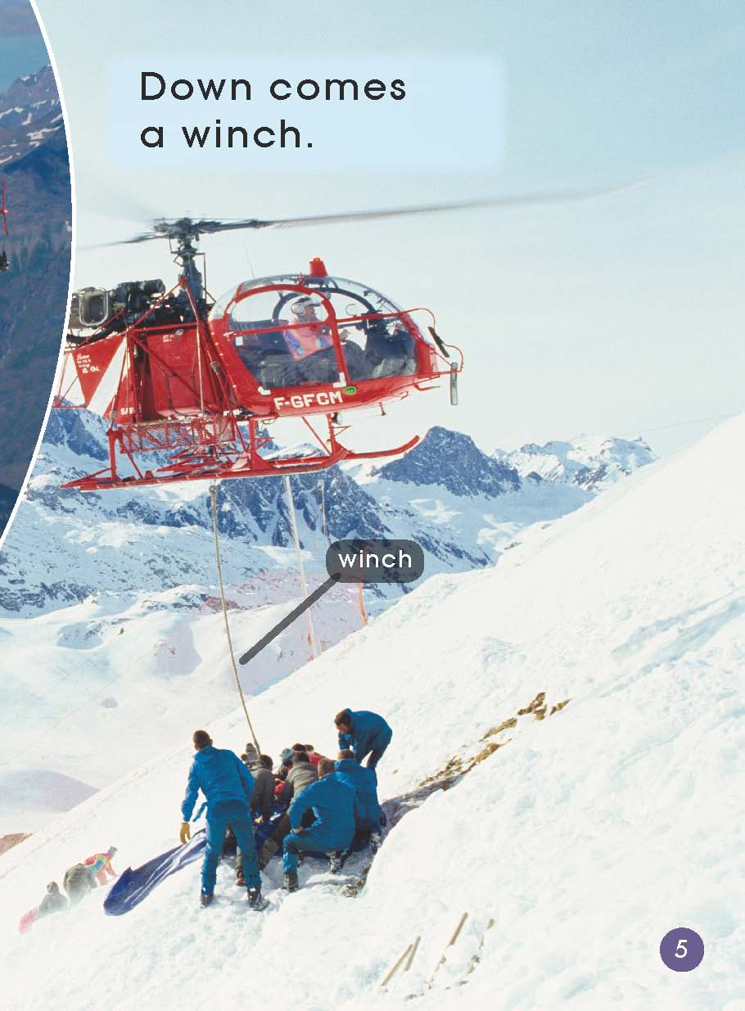
Can a helicopter land on the mountain？
How do you think he might get help?
Can you find the winch of the helicopter？

Slide 7
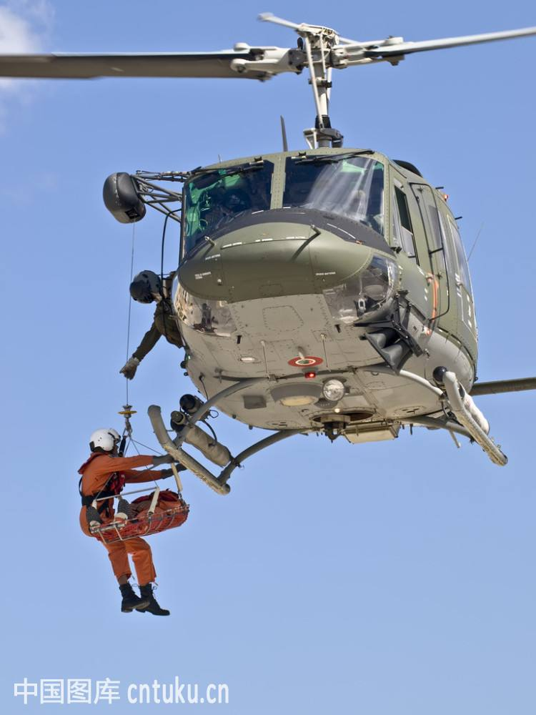
Can you find the winch of the helicopter？

Slide 8
On the mountain
A man
He is hurt.
Helicopter puts down a winch.

Slide 9
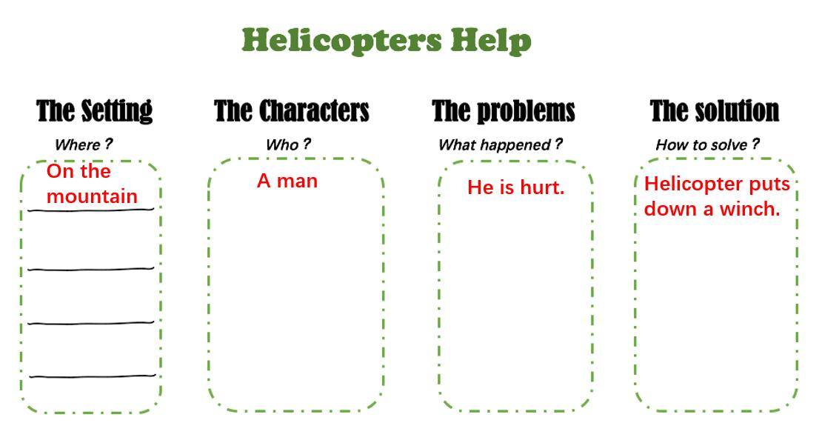

Read PP6-15 by yourself and finish the worksheet in your group.

Slide 10
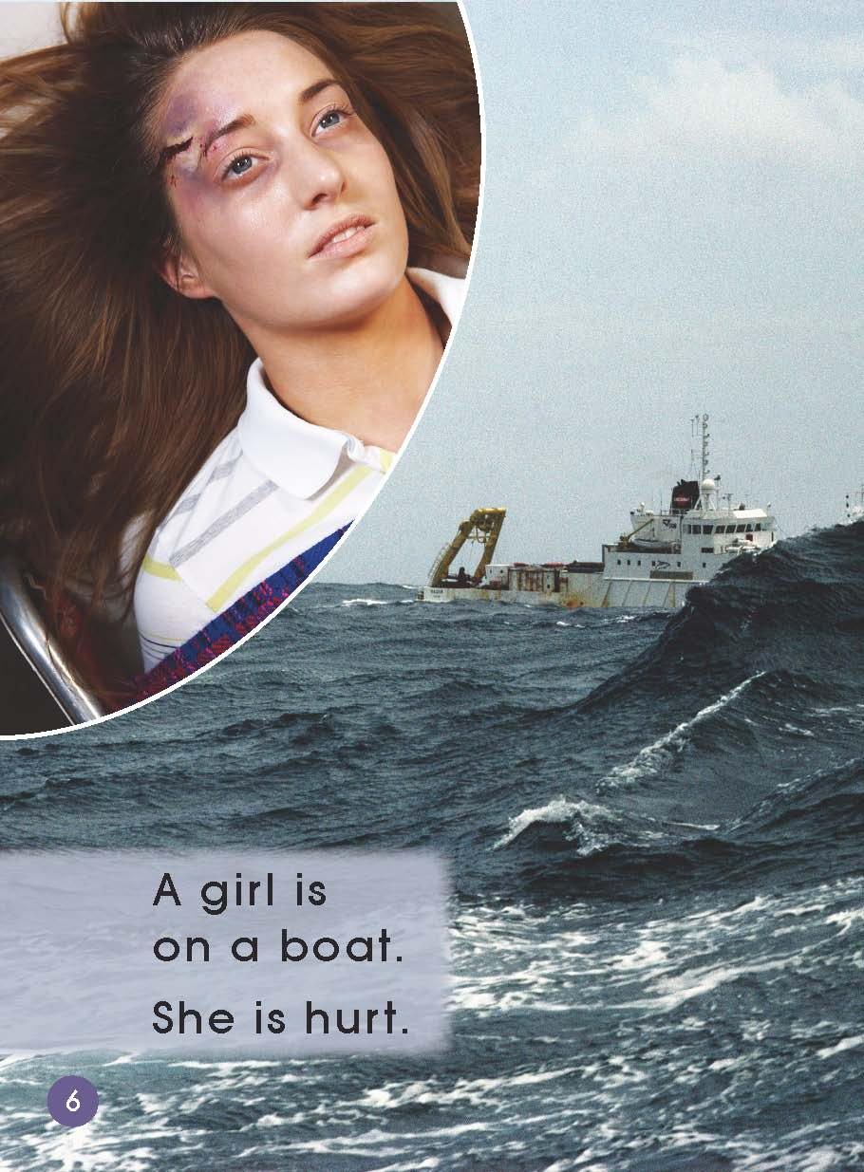
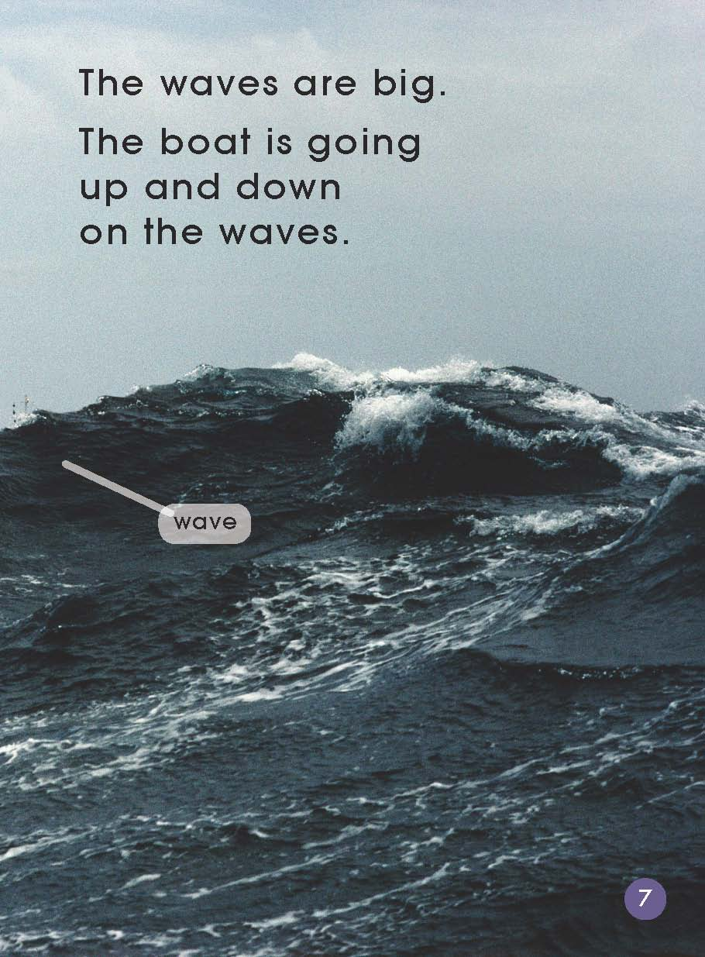
Who can you see?
Where is the girl？
Are the waves big?
How can she get help?
Why do you think a helicopter can’t land?

Slide 11
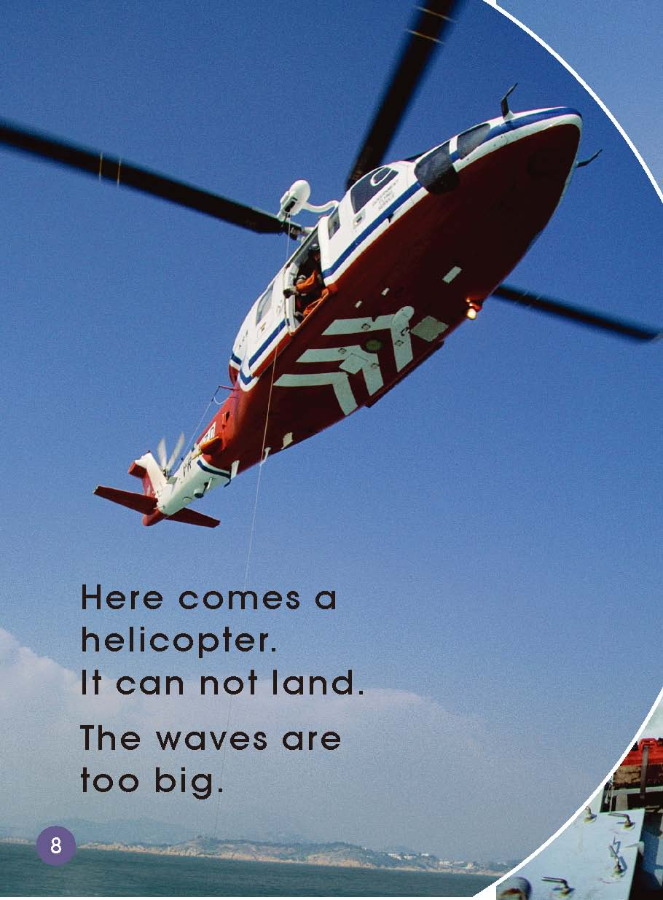
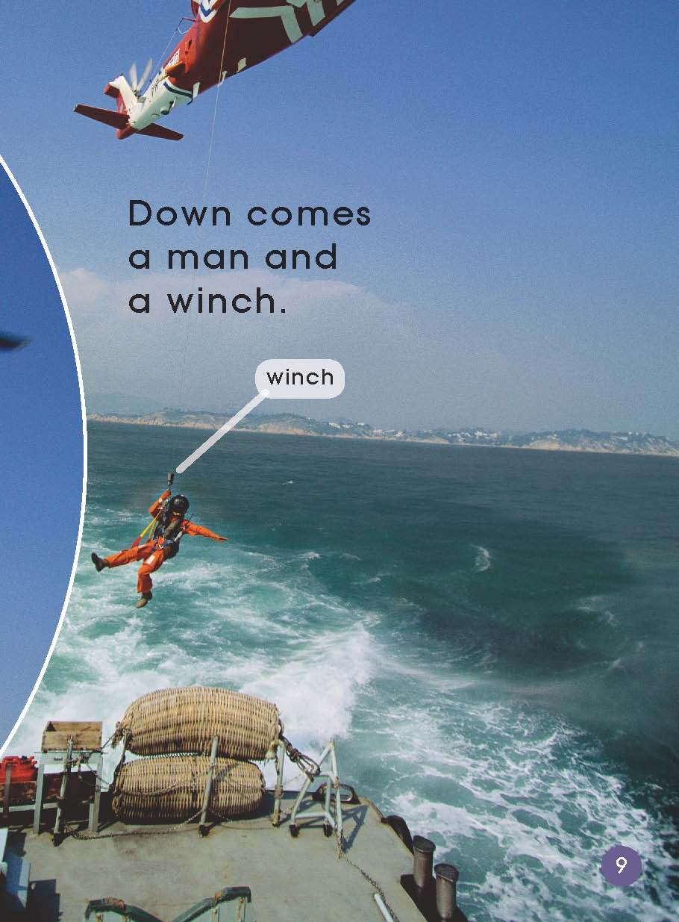
How does she get help?

Slide 12
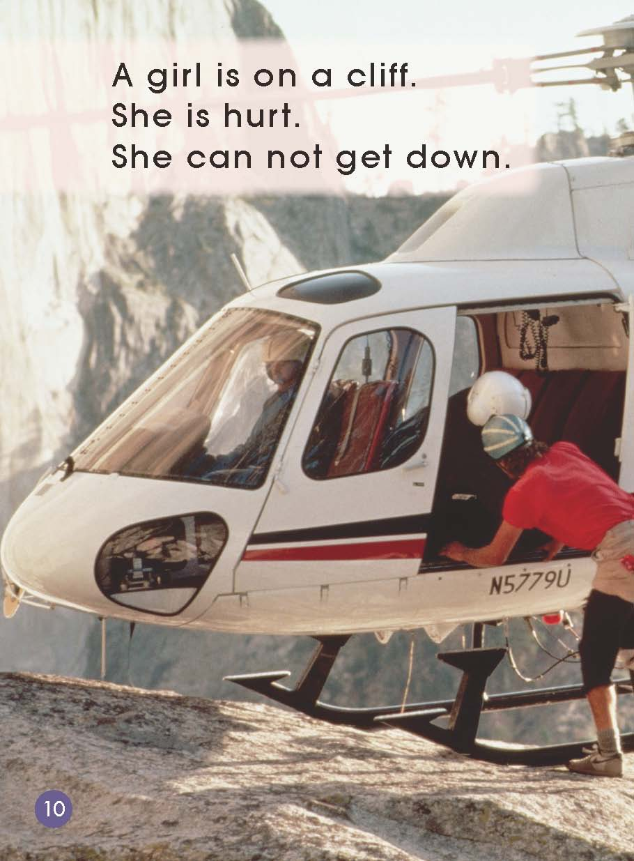
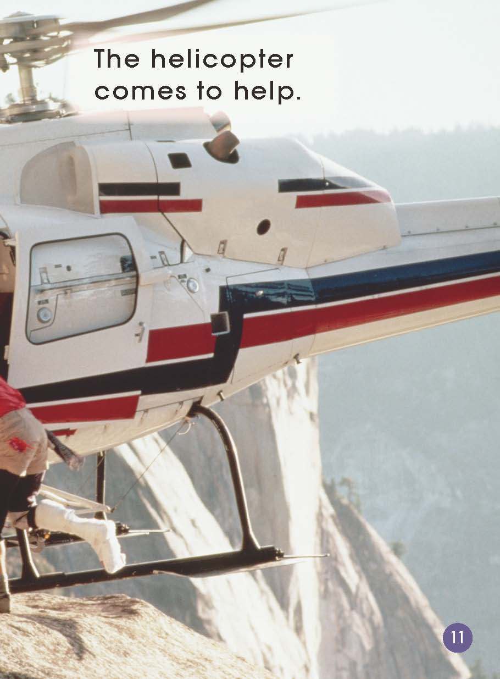
Who is on a cliff?
What happened to the girl?
Do you think cliffs are a safe place? Why?
Can a helicopter land here?

Slide 13
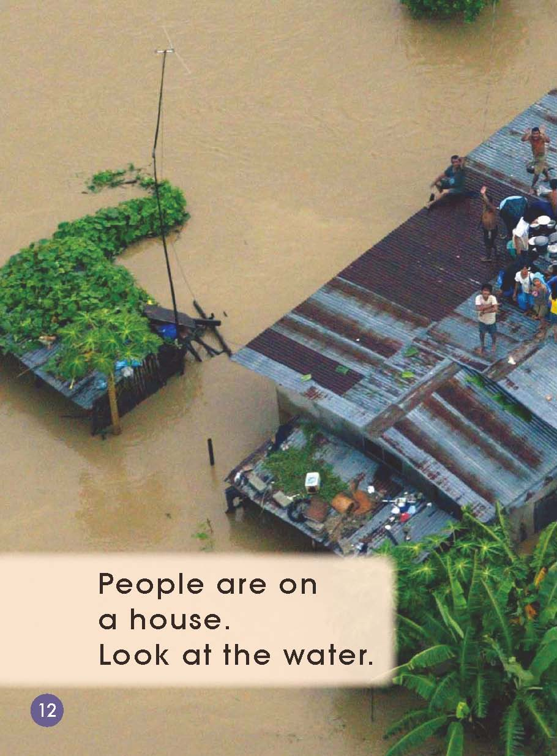
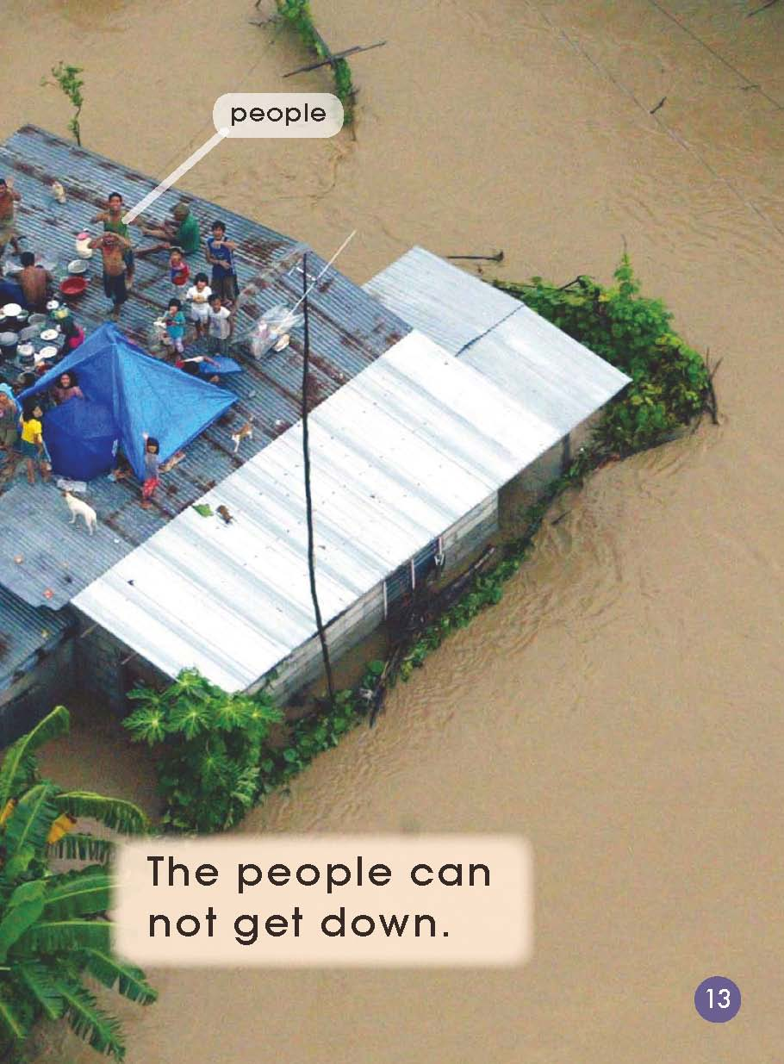
Who can you see?
Where are they?
Why are people on the roof?
How do they feel?
How can they get help？

Slide 14
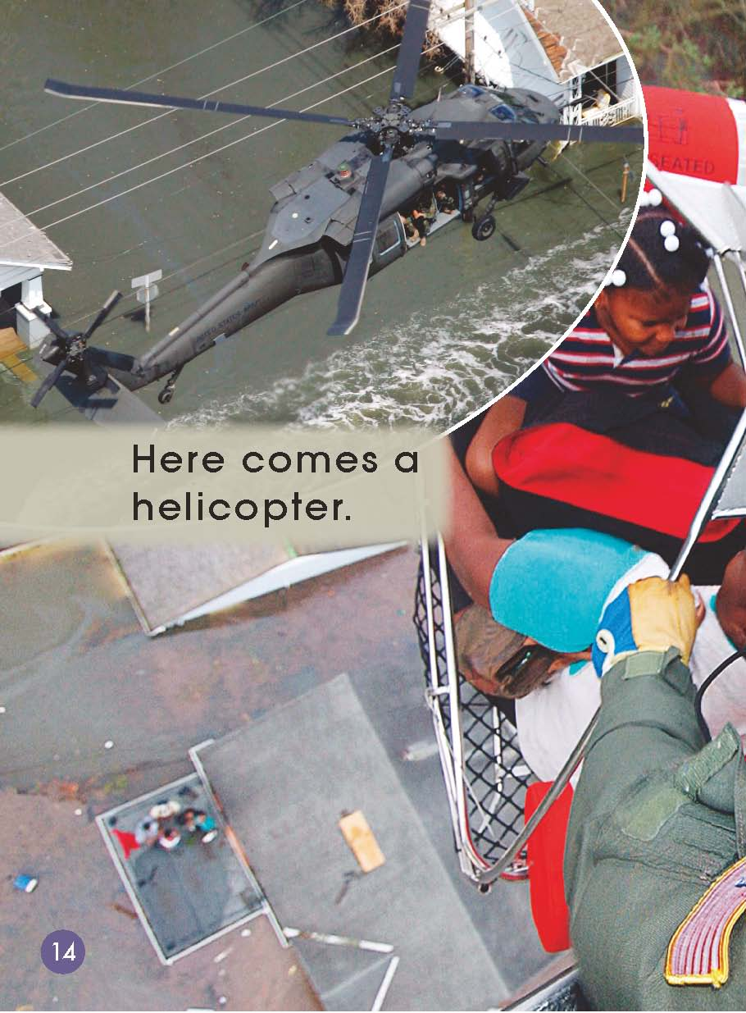
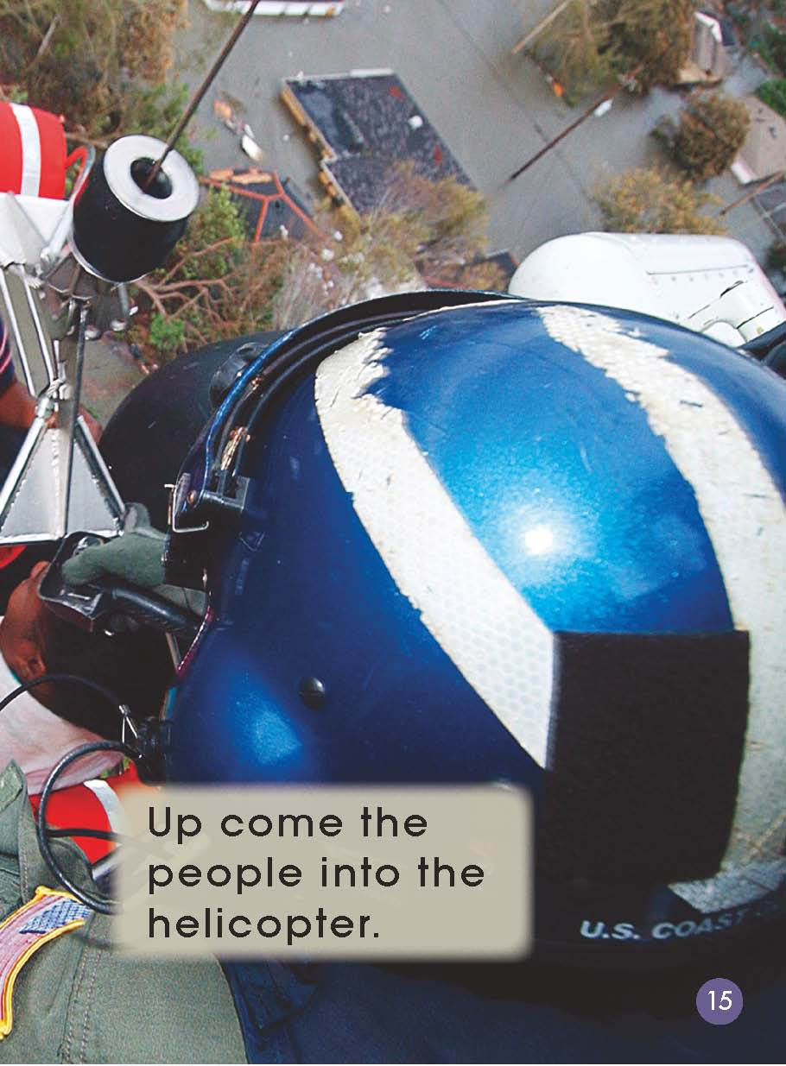
How can they get help？

Slide 15

Retell the story according to your worksheet!

Slide 16

Think and say.
Why does the author write the book?
What can we do to protect ourselves?
If you were the people in the book, what would you do to ask for help?

