Slide 1
多维阅读第4级
Octopus Is a Friend
我们做朋友吧

Slide 2
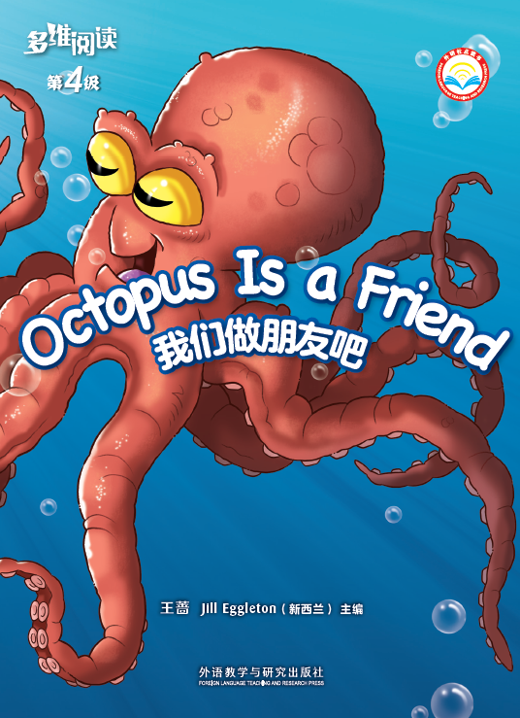
Title
Writer
Publisher
What is octopus?

Slide 3
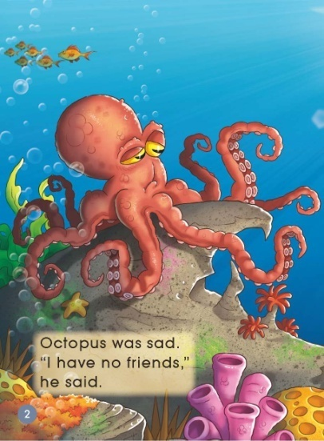
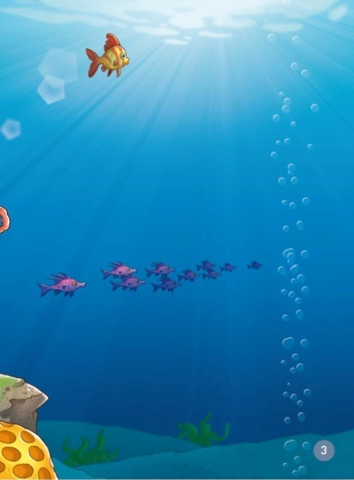
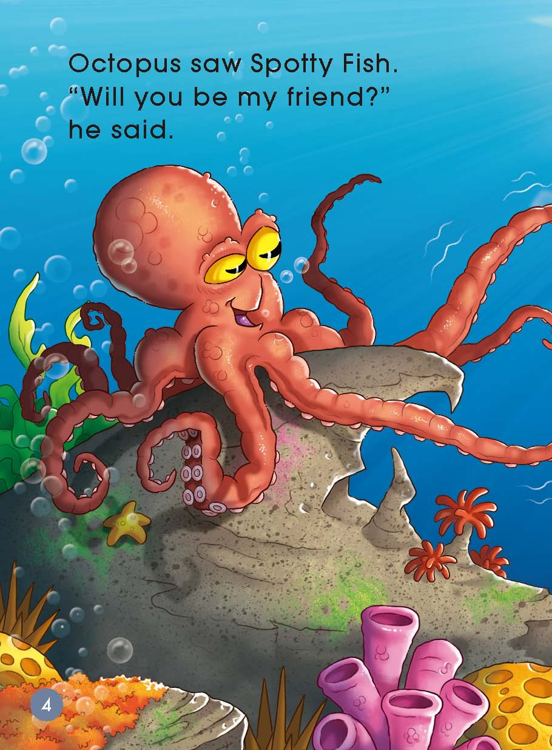
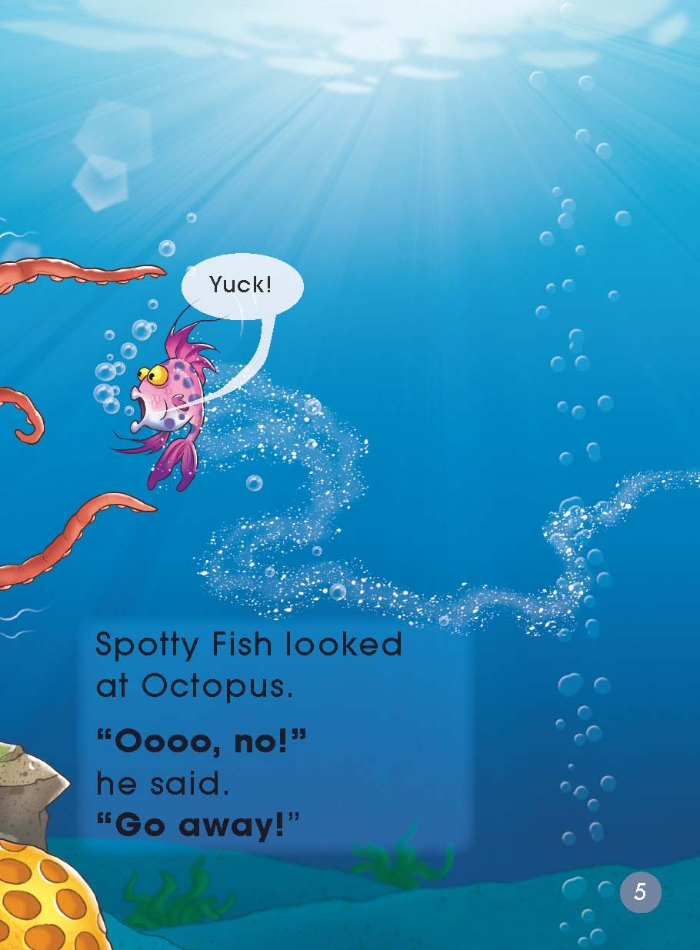
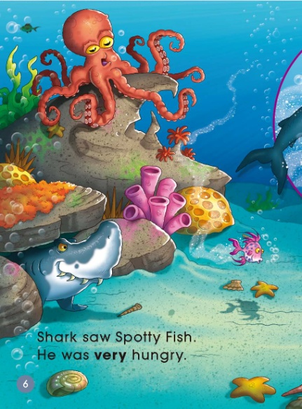
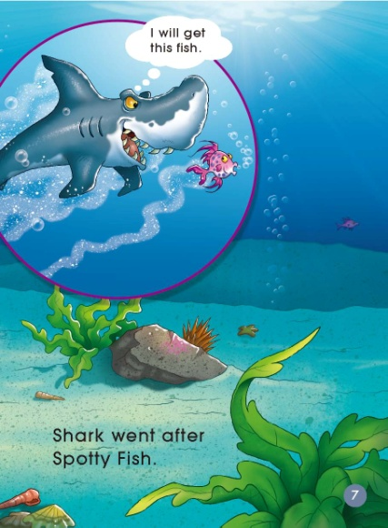
Look & listen

Slide 4
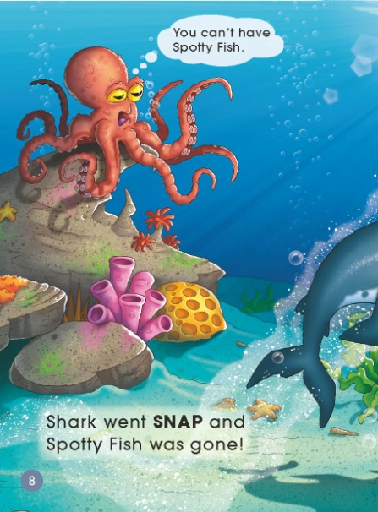
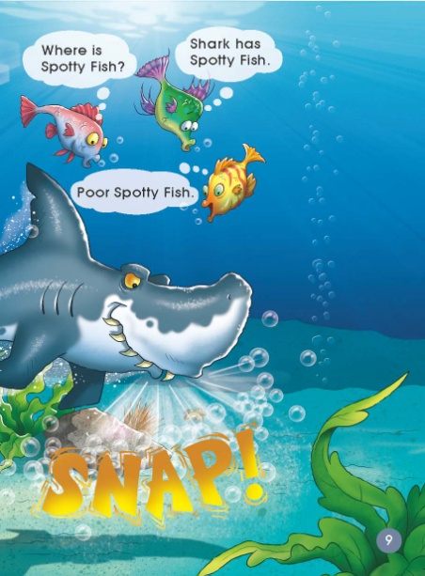
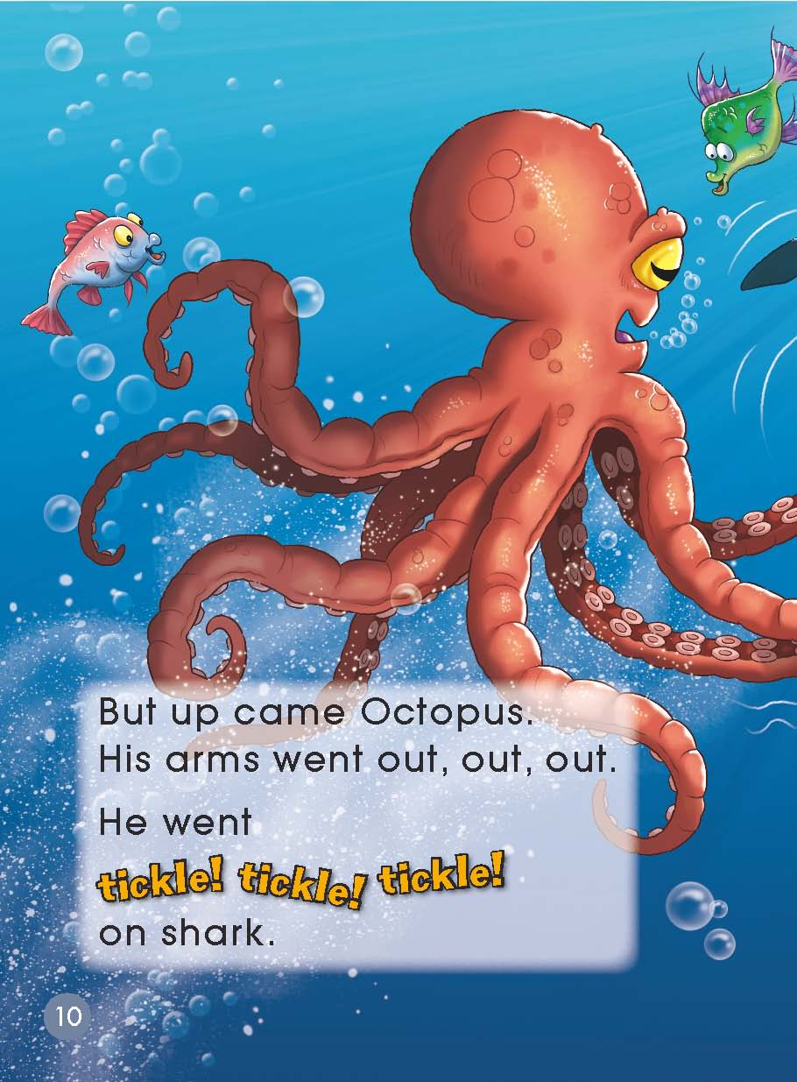
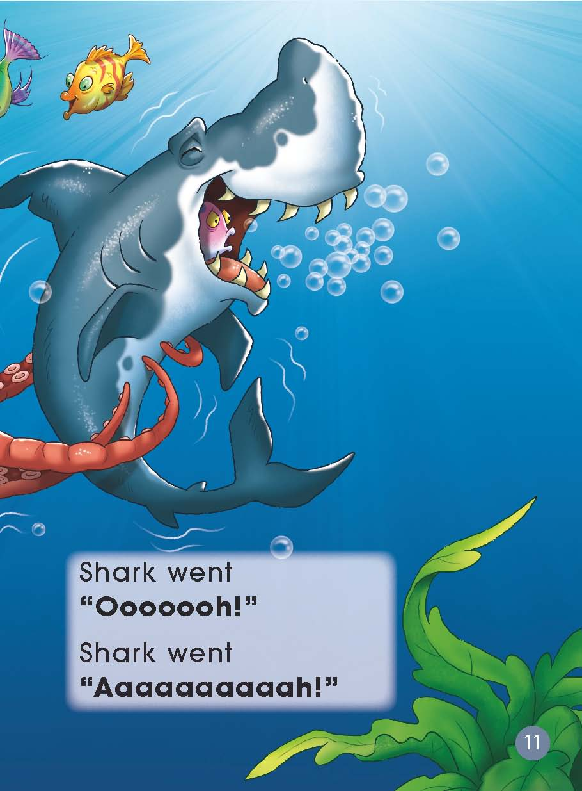
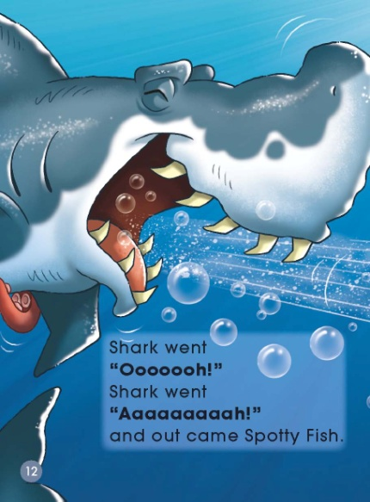
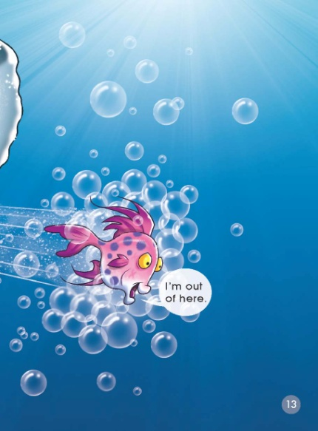
Look & listen

Slide 5
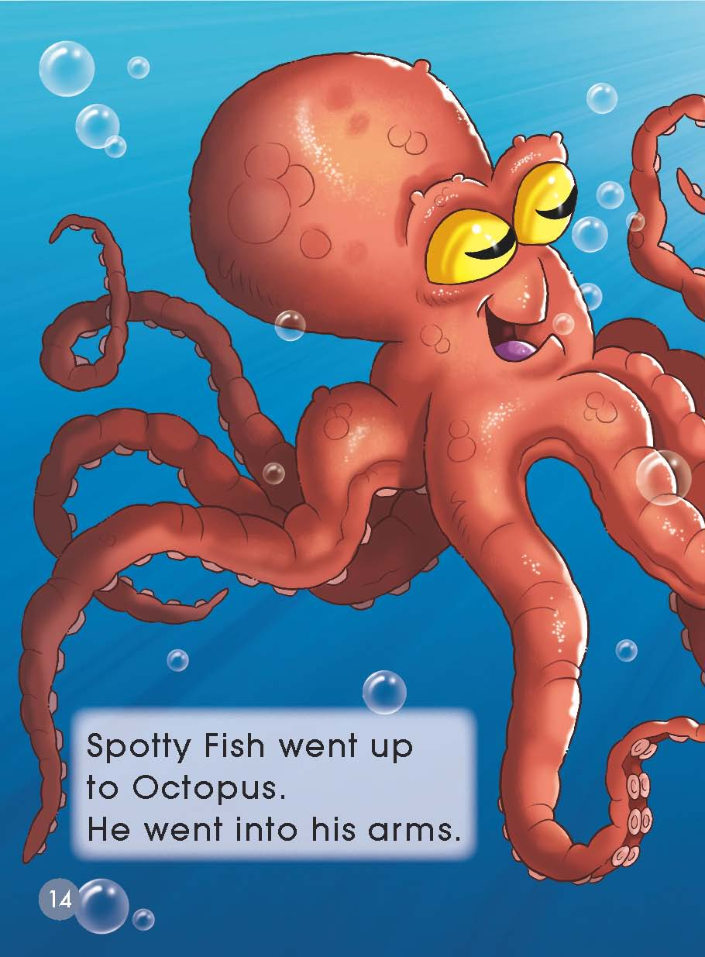
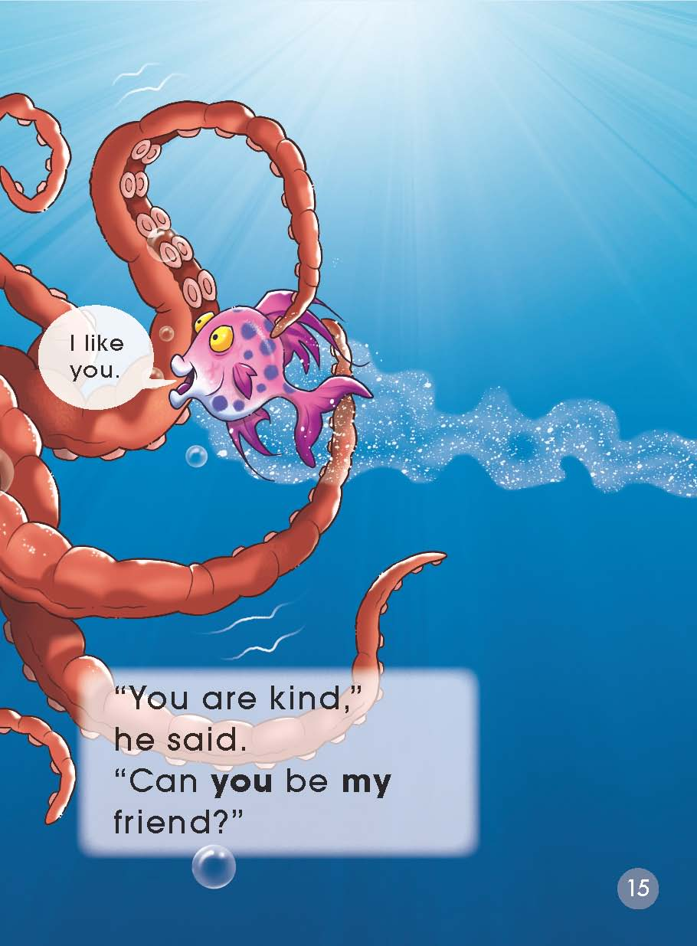
Look & listen

Slide 6
Second reading

Slide 7
Second reading

Slide 8
Second reading

Slide 9
Second reading

Slide 10
Second reading

Slide 11
Second reading

Slide 12
Second reading

Slide 13
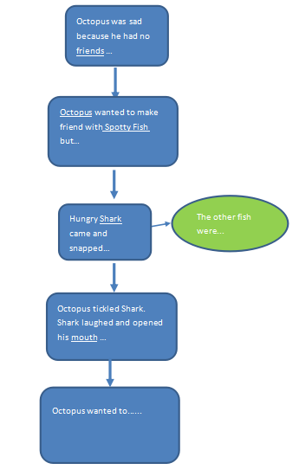
Outline
Finish on your paper

Slide 14
Third reading

Slide 15
Third reading

Slide 16
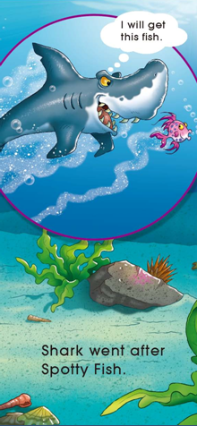
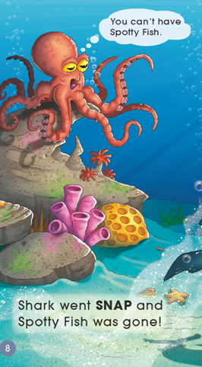
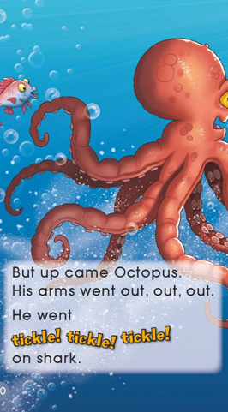
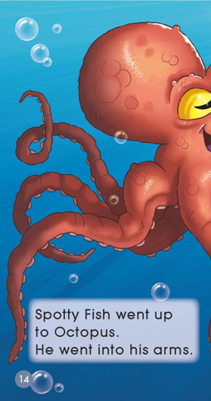
Third reading

Slide 17
Third reading

Slide 18
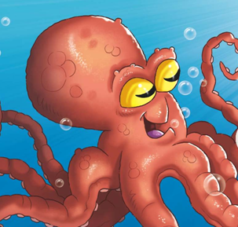
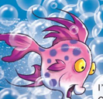
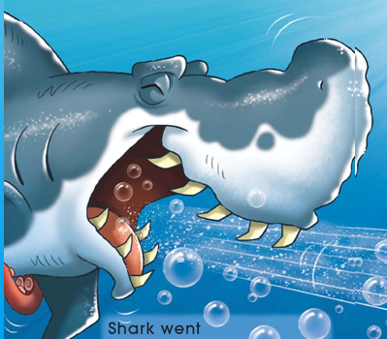
Post-reading
Octopus
Spotty Fish
Shark

Slide 19
Think

Slide 20
Review

Slide 21
Review

Slide 22
Review

Slide 23
Homework
Tell the story Octopus Is a Friend to your parents.
Octopus was kind even though Spotty Fish had
been mean to him. That is very hard. Do you know
someone who has been like that? Share your story
in the class.

