Slide 1
多维阅读第4级
Greedy Rabbit
贪吃的兔子

Slide 2
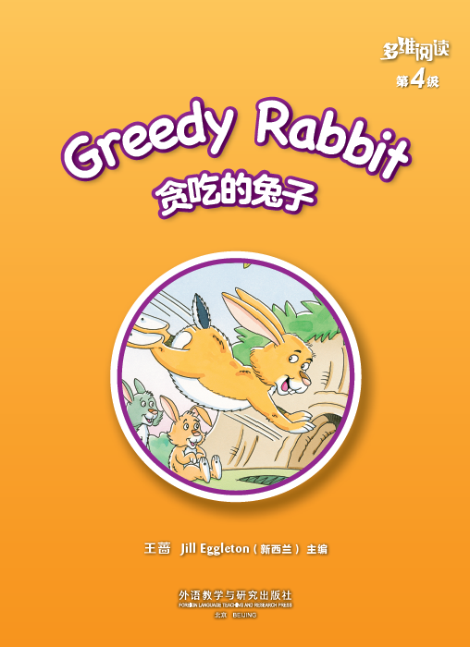
Title
Writer
Publisher
What does “greedy” mean?

Slide 3
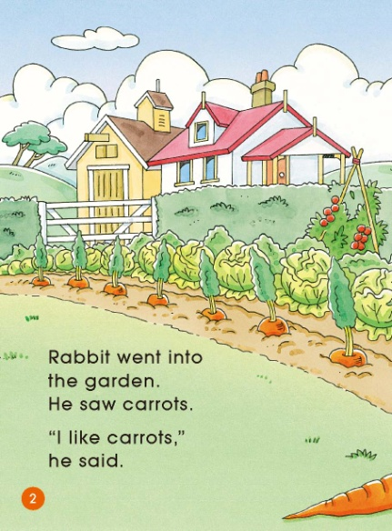
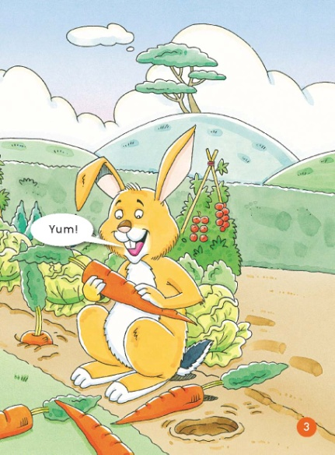
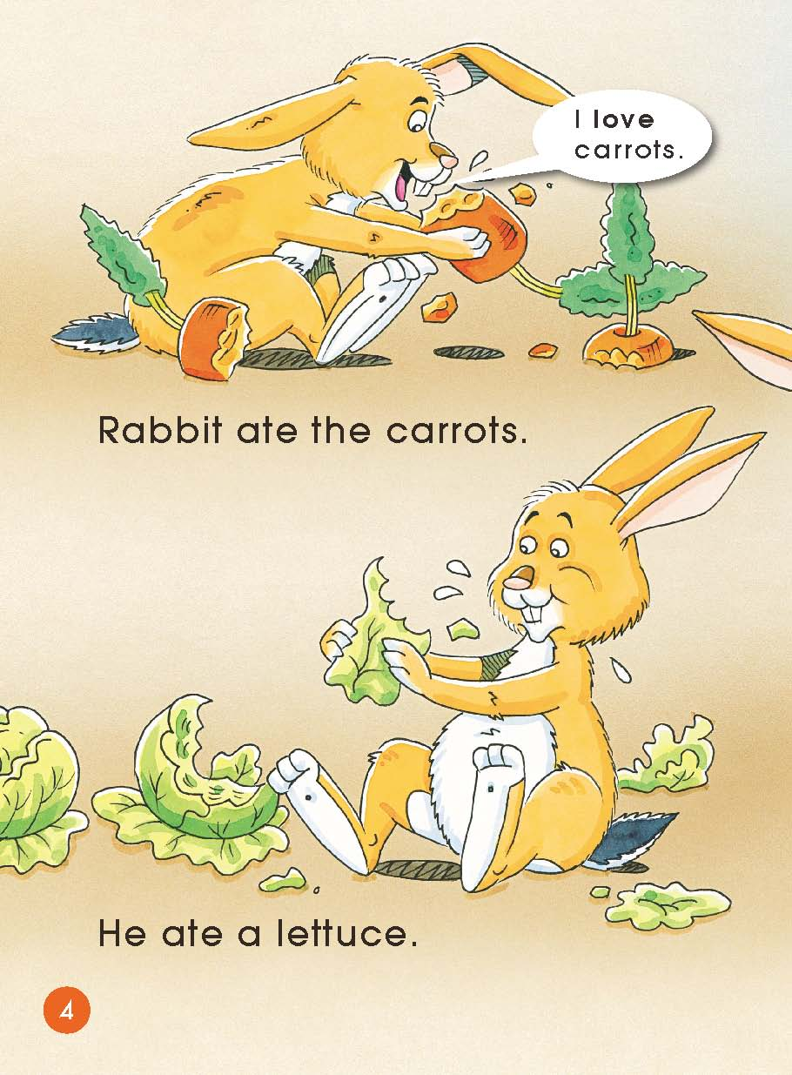
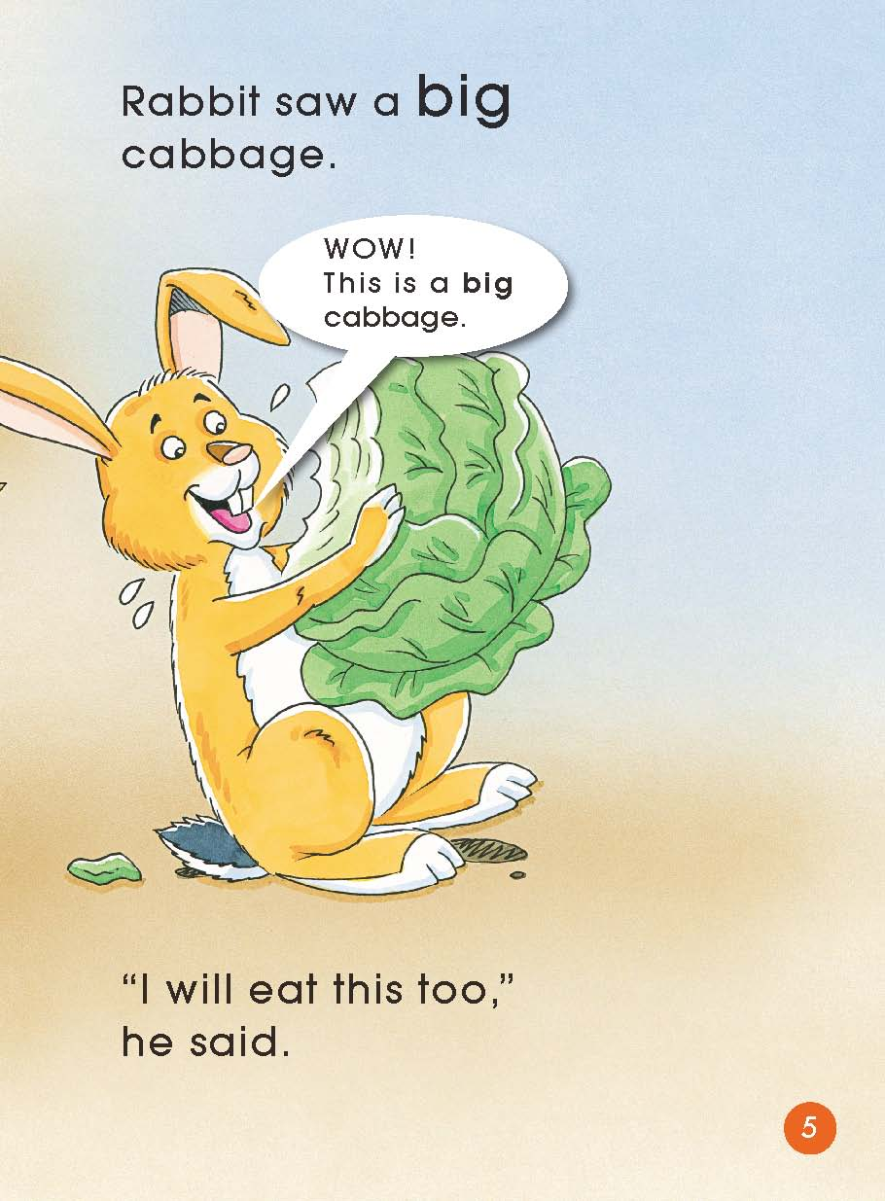
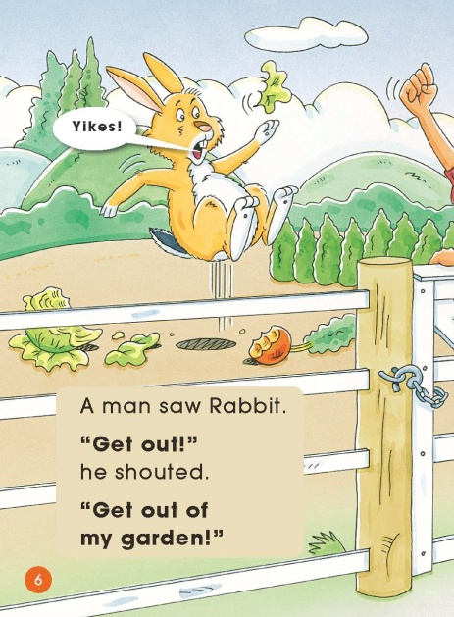
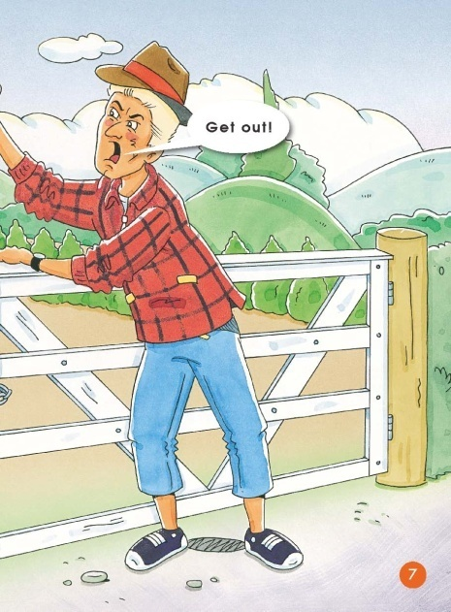
Look & listen

Slide 4
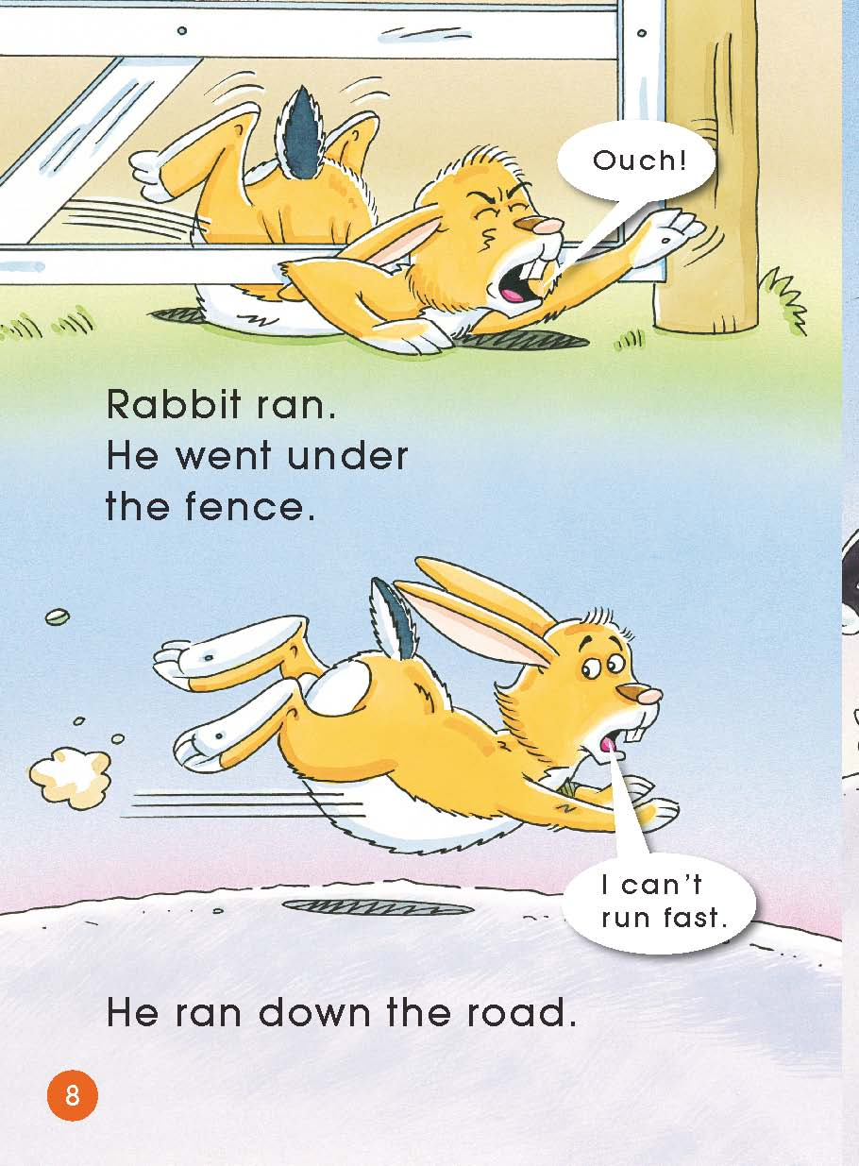
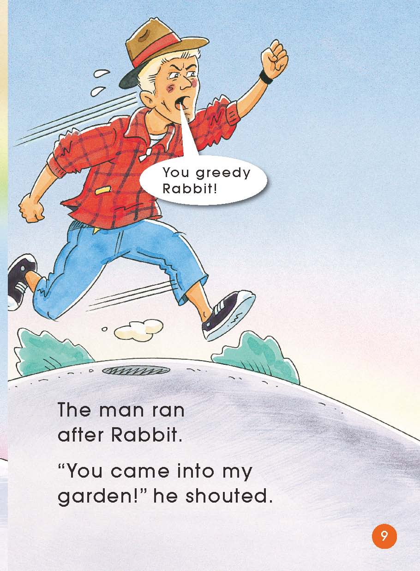
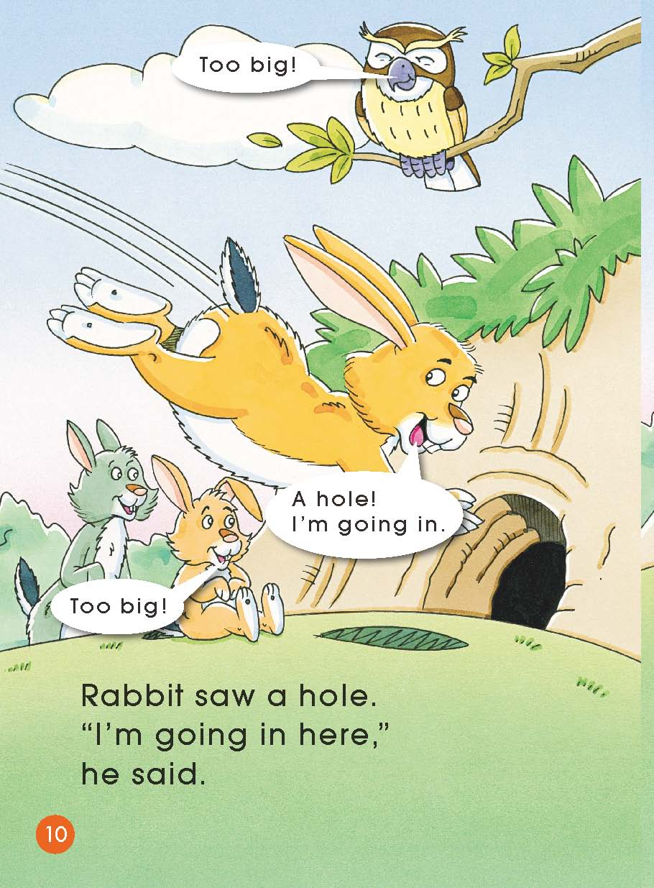
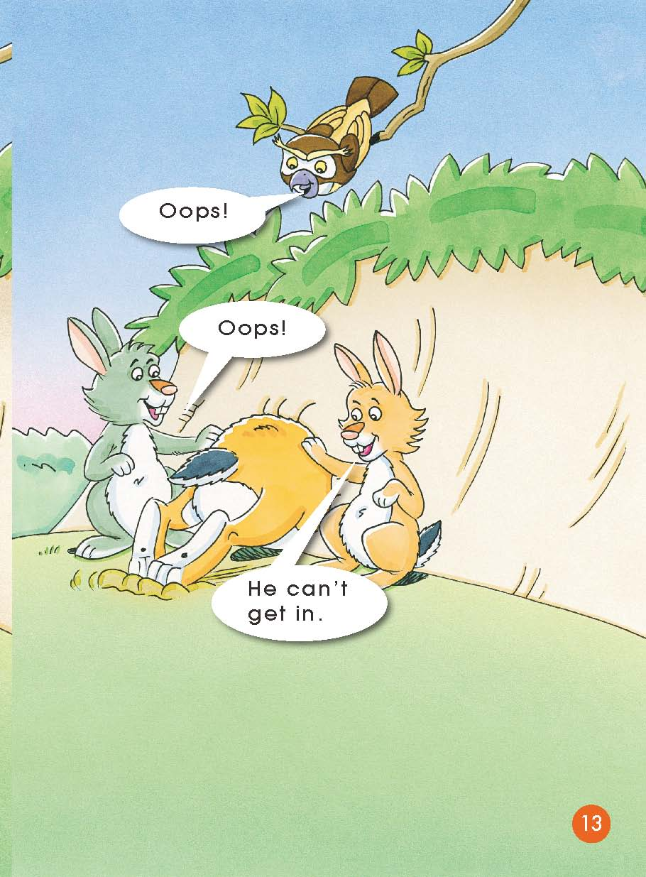
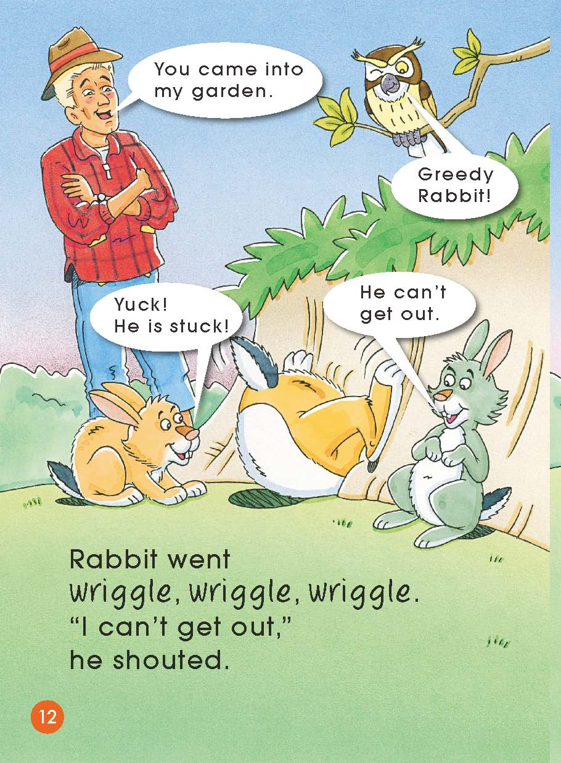
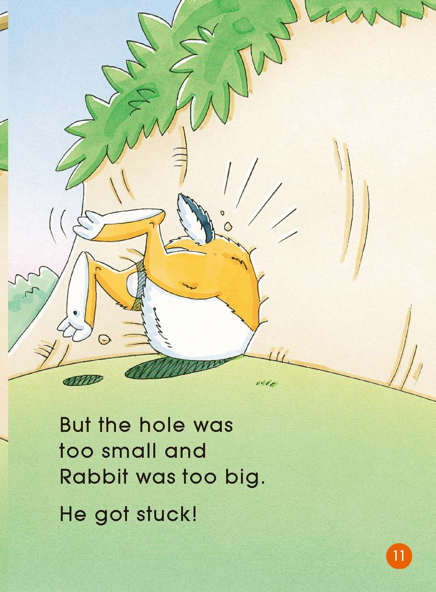
Look & listen

Slide 5
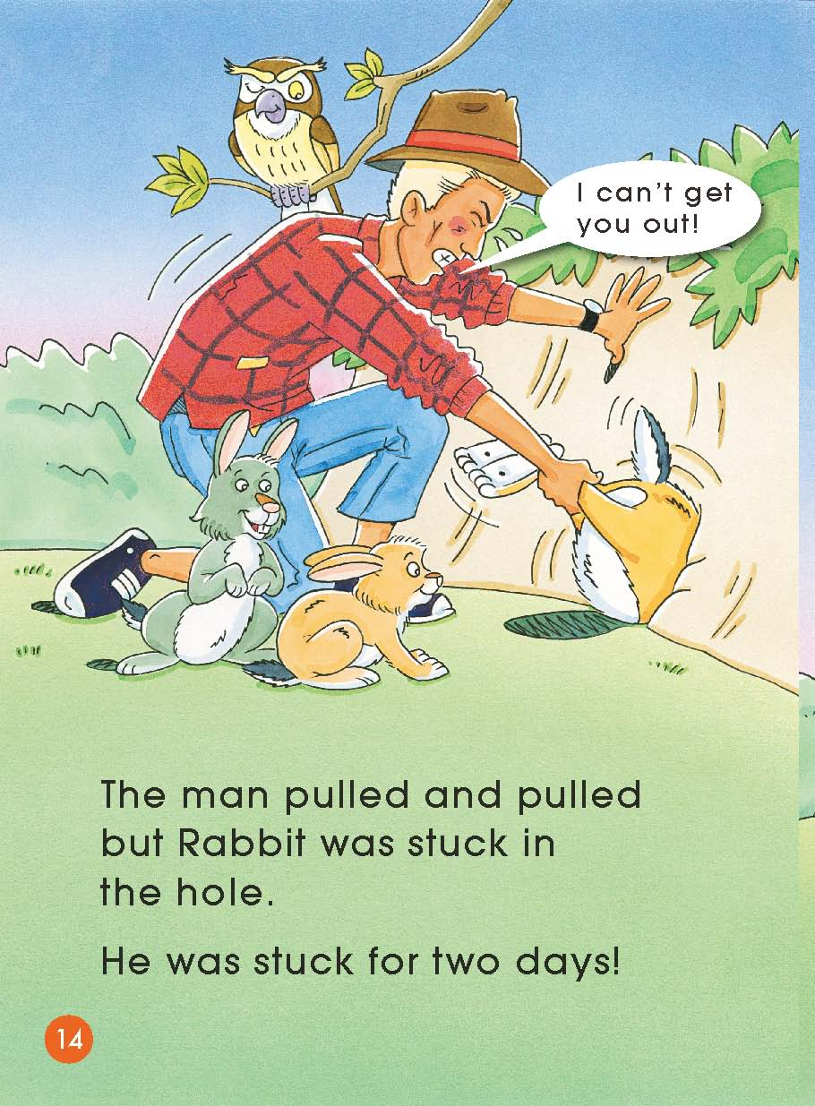
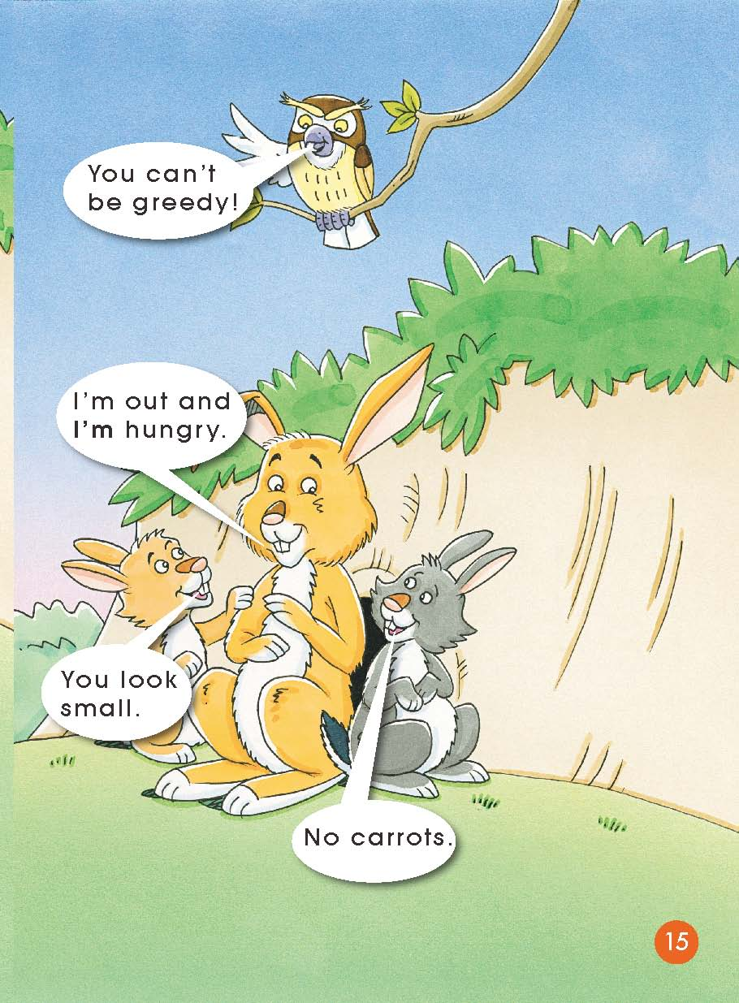
Look & listen

Slide 6
Second reading

Slide 7
Second reading

Slide 8
Second reading

Slide 9
Second reading

Slide 10
Second reading

Slide 11
Second reading

Slide 12
Second reading

Slide 13
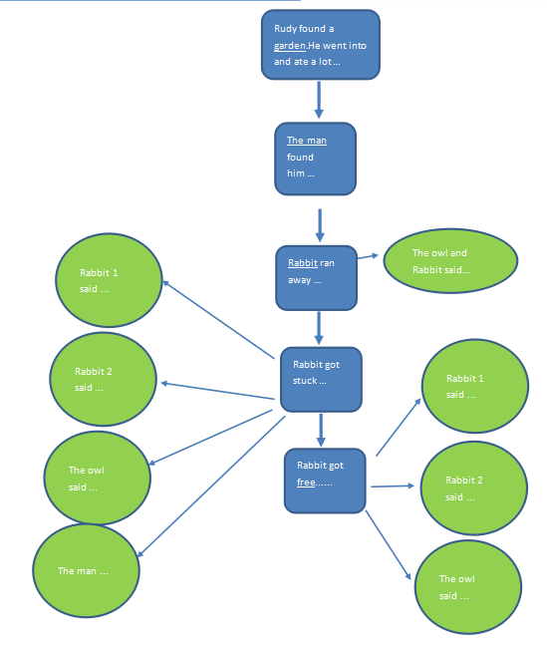
Outline
Finish on your paper

Slide 14
Third reading

Slide 15
Third reading

Slide 16
Third reading

Slide 17
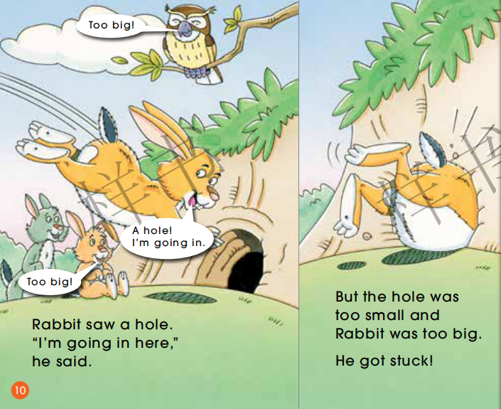
Third reading

Slide 18
Third reading

Slide 19
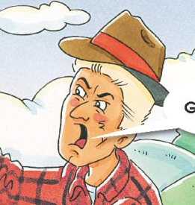
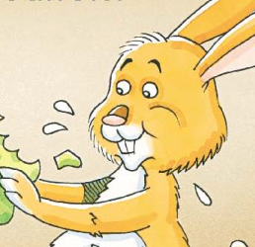
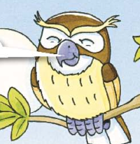
Post reading
Rabbit
Man
Owl

Slide 20
Think

Slide 21
Review

Slide 22
Review

Slide 23
Review

Slide 24
Homework
Tell the story Greedy Rabbit to your parents.
Tell another story about an animal you have read
or heard or composed to your classmates.

