Slide 1

多维阅读第4级
Crazy Cat

Slide 2
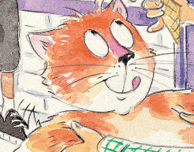
What do you know about the cat?

Slide 3

What can you see from the cover?

Slide 4

What do you think she might do
in this story?
Discuss in pairs.

Slide 5
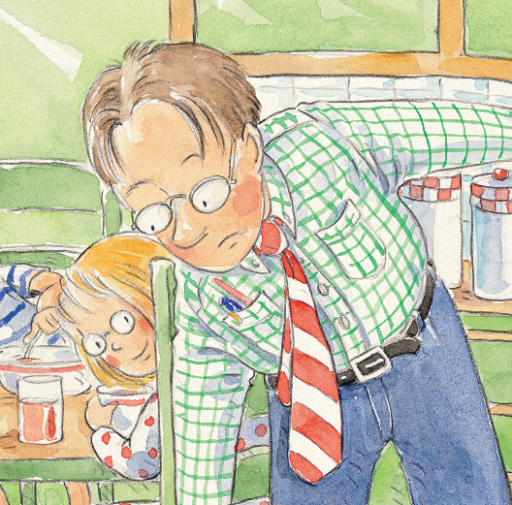
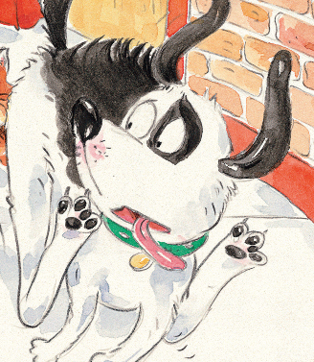
Who are in this story?

Slide 6
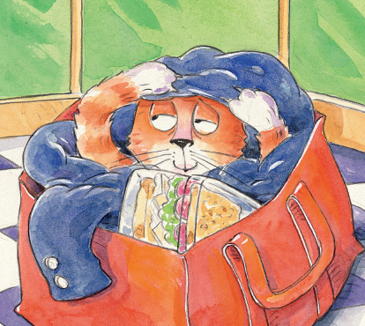
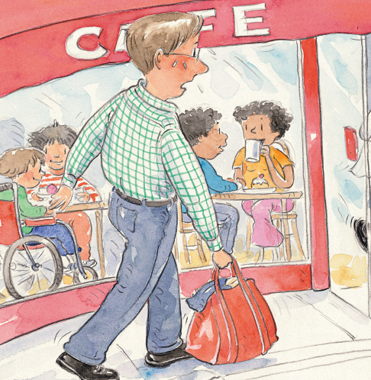
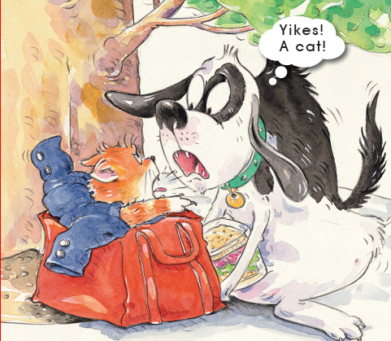
Where did they go?
at home
in a cafe
under a tree

Slide 7
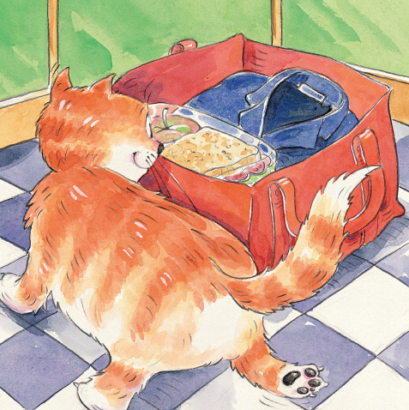
What’s in the bag?
Where did the cat do
when he saw a bag?

Slide 8
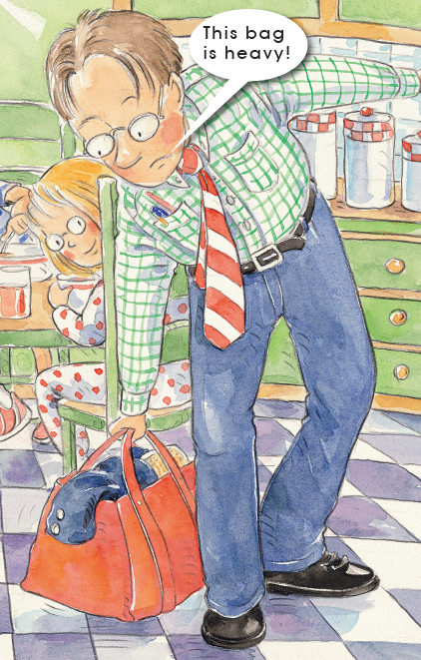
What do you think Dad might be thinking?
Did Dad look in his bag? Why?

Slide 9
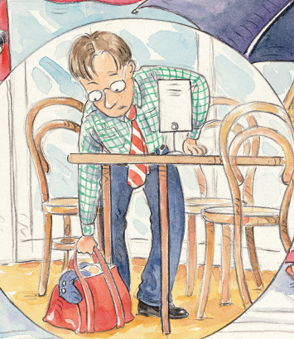
Where did Dad put his bag?

Slide 10
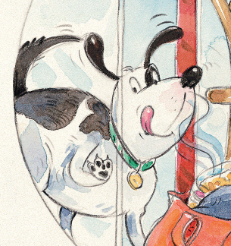
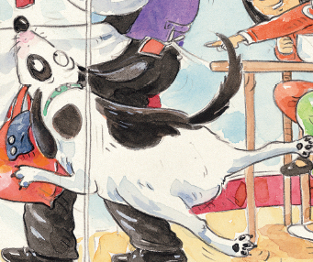
Who saw the bag on the floor?
What did the dog do?

Slide 11
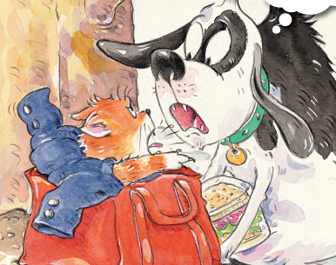
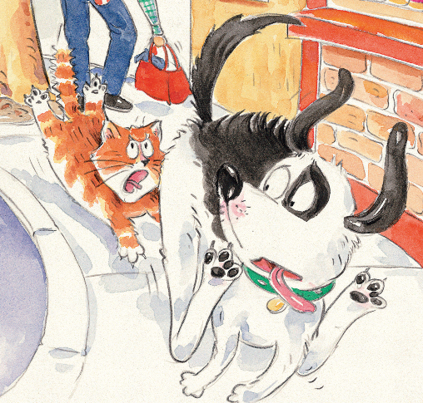
Who came out of the bag?
Why did the dog run away?

Slide 12
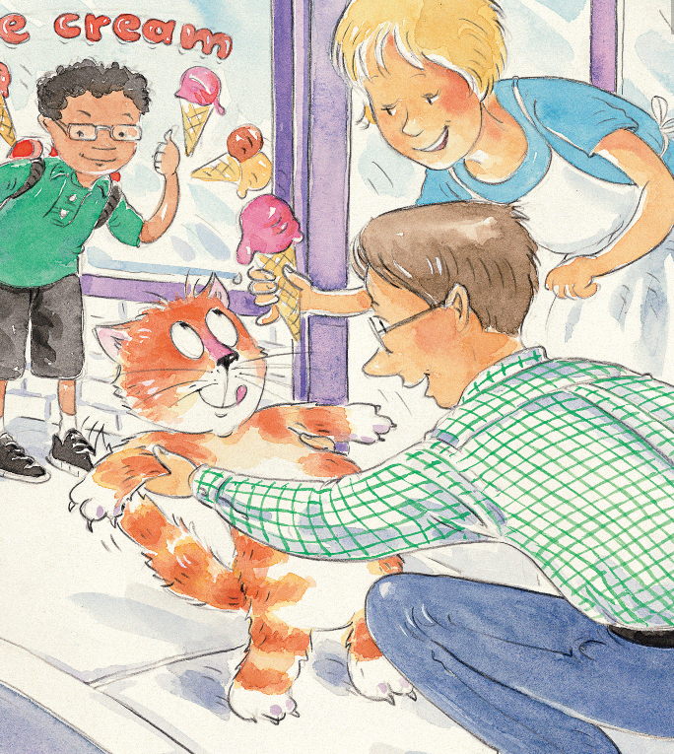
What did the cat get?

Slide 13

Listen and read the story.

Slide 14
What do you think of the cat?
Why?

Slide 15
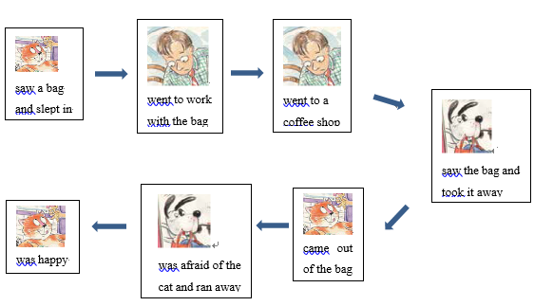
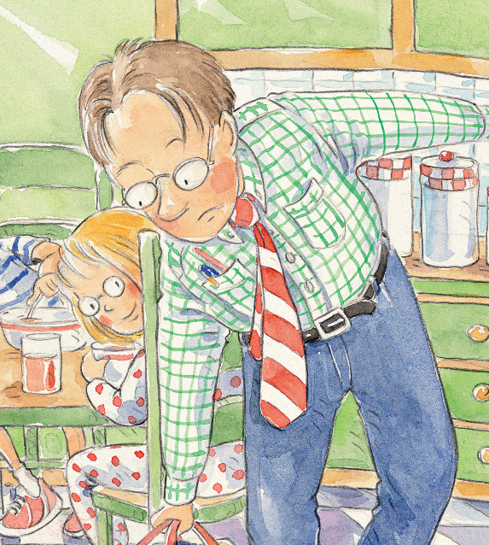
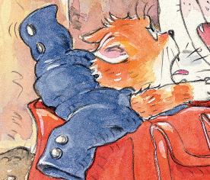
Retell the story.

Slide 16
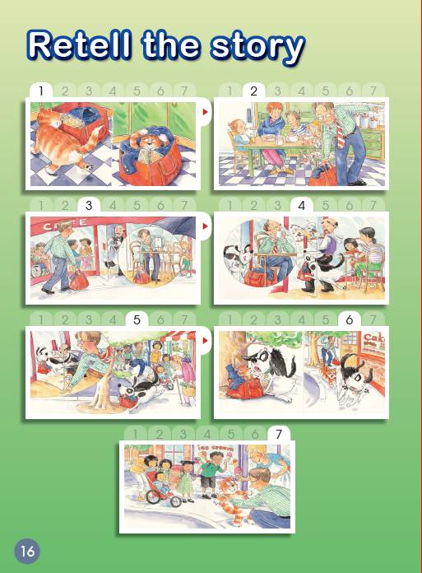
Act out the story.

Slide 17

Think.
If you were Dad, what would you do with the cat?
2. What have you learnt from the
story?

Slide 18
Homework.
1.Tell the story to your parents.
2. Read some stories about
animals and people.

