Slide 1
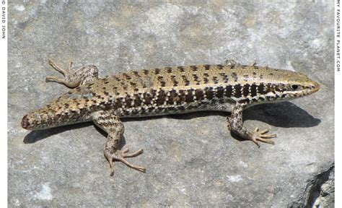
多维阅读 第3级
Look! No Tail

Slide 2
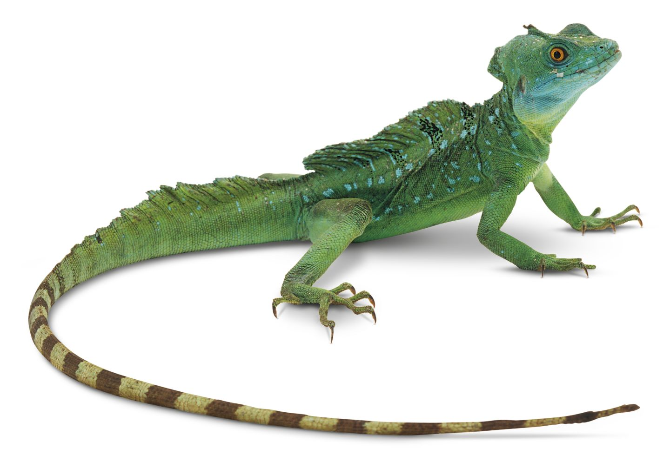
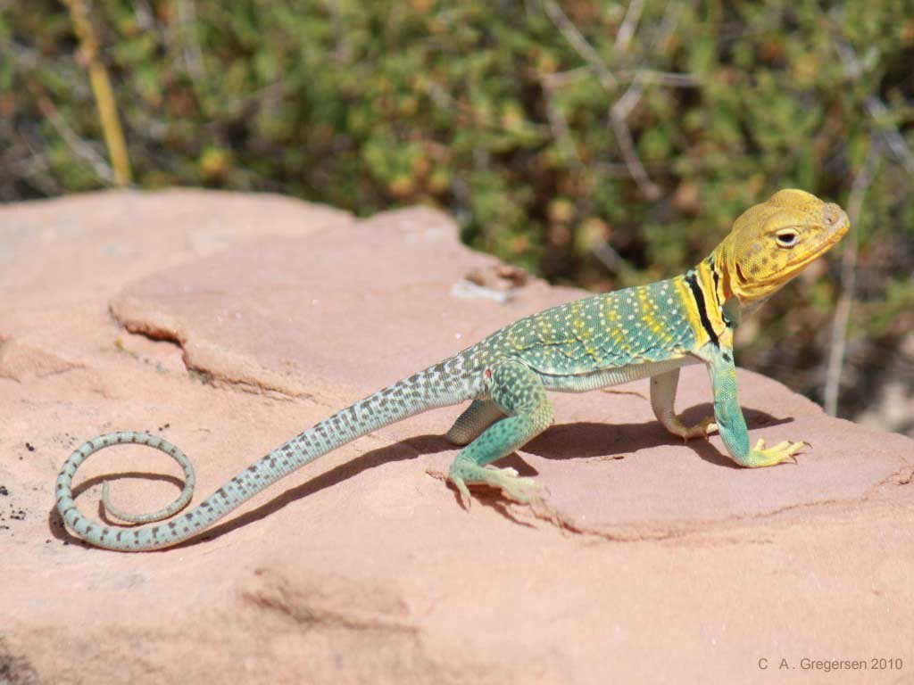
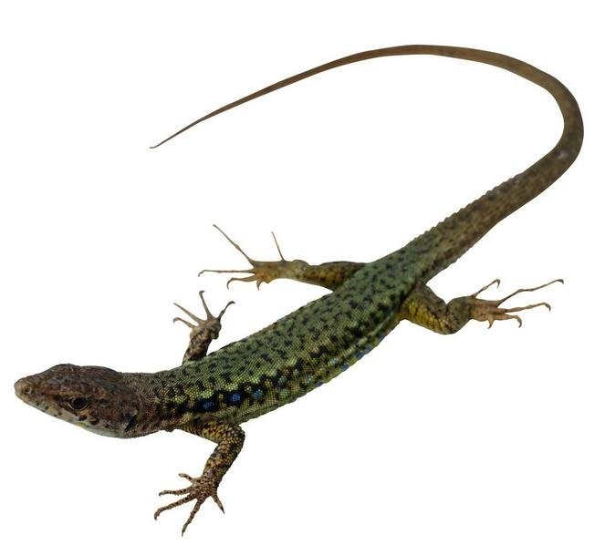
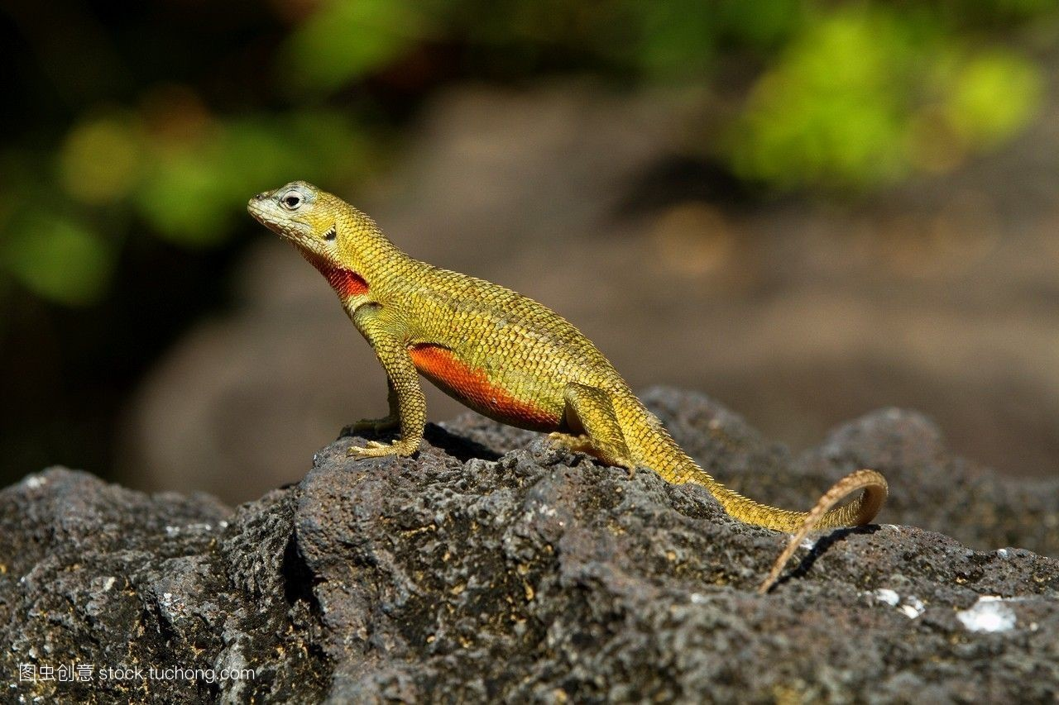
lizard

Slide 3
What do you know about
the
Lizard
?
What does the lizard look like?

Slide 4
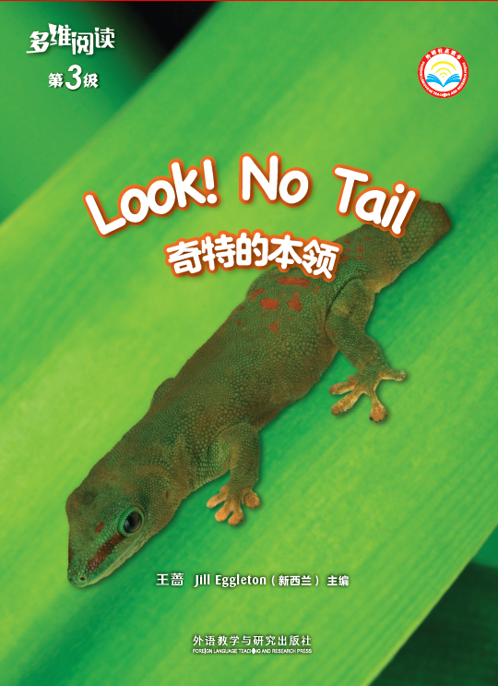
What’s the title?
Who’s the writer?

Slide 5

Pages 2-5
Why does the lizard have no tail?

Slide 6
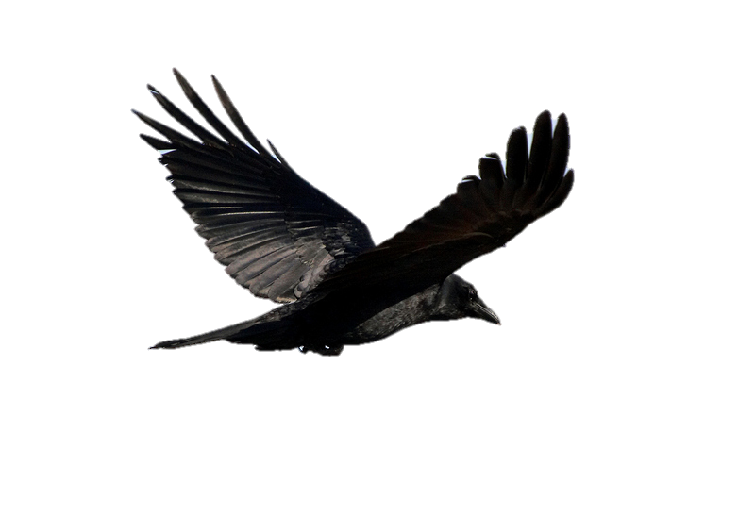
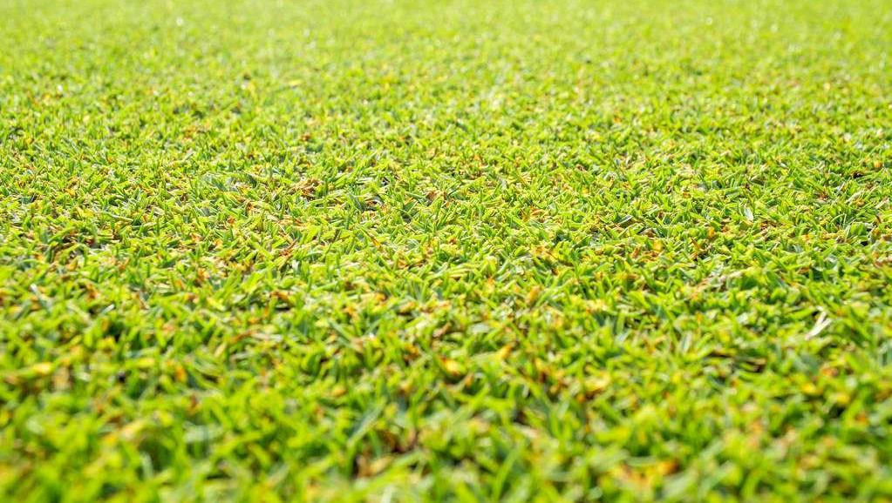
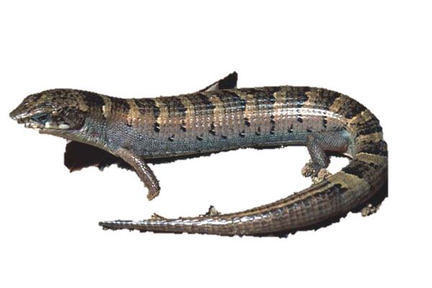
What does the bird want to do?
What can the lizard do?

Slide 7

No tail!
Where is the tail?

Slide 8
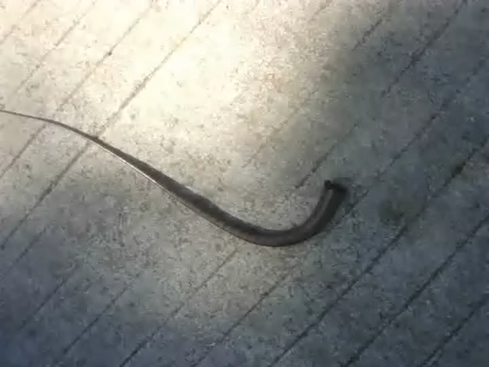
The broken tail can help the
lizard to run away.

Slide 9
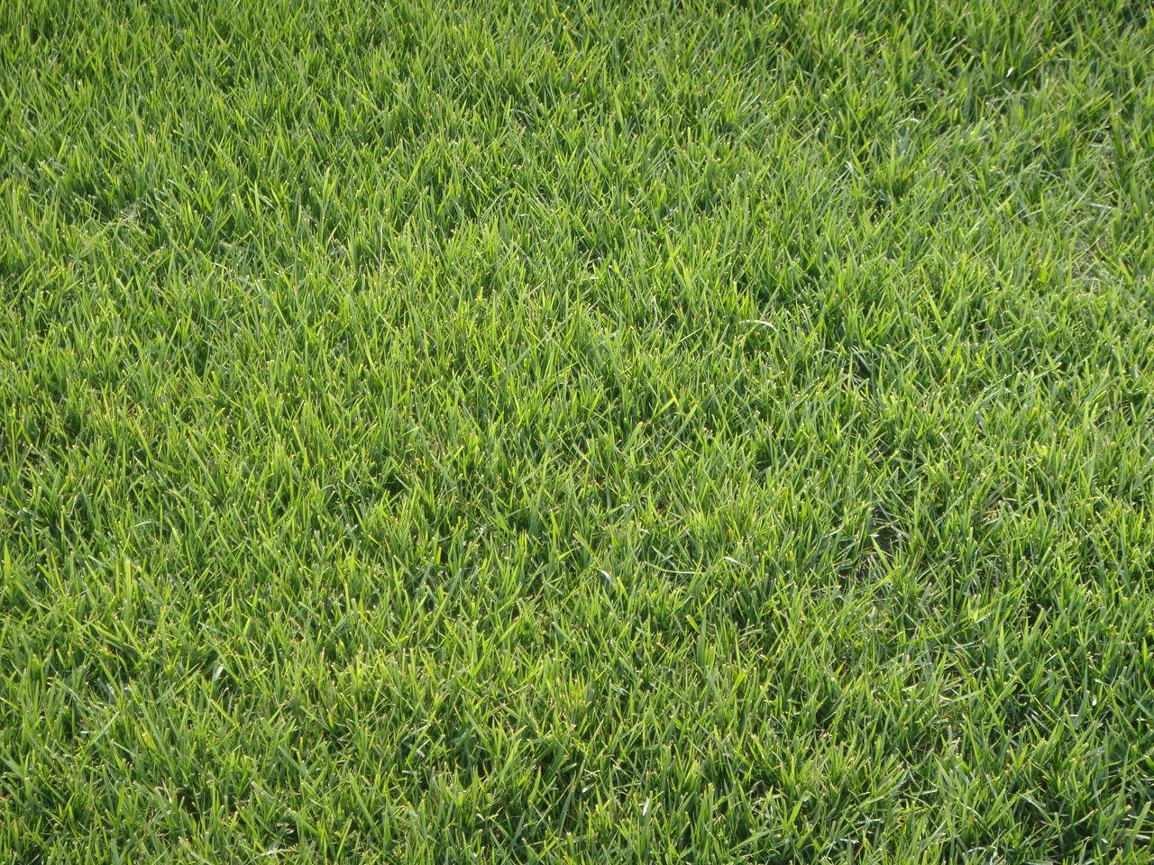
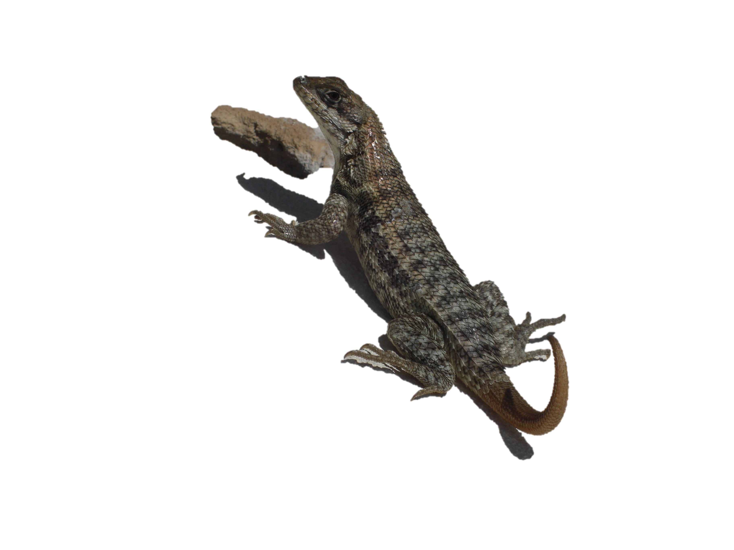
A new tail!

Slide 10
What questions do you want to
ask the lizard?

Slide 11

Read and finish your worksheet.
Read your text. Talk about the
questions on the worksheet with
your group members.
2. Read your text to the student
sitting next to you and ask the
questions.

Slide 12

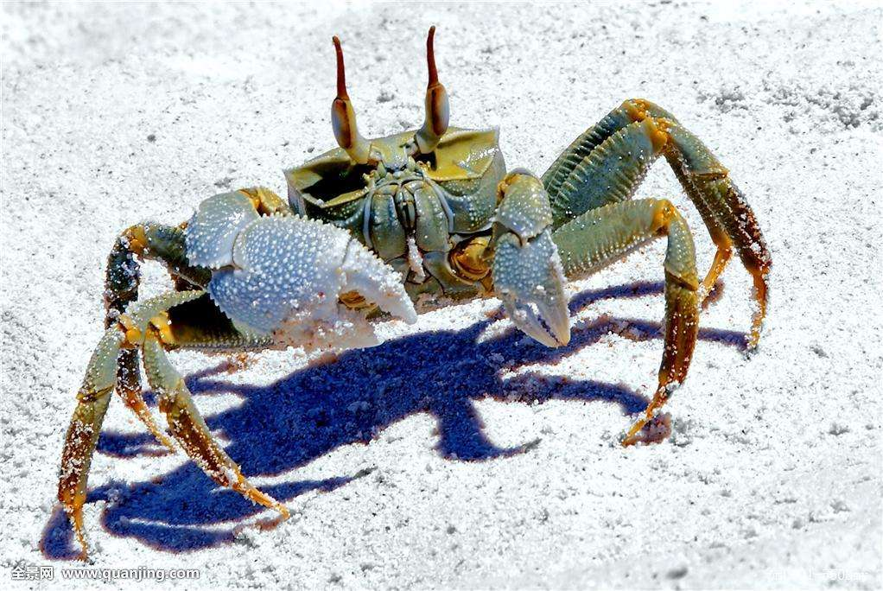
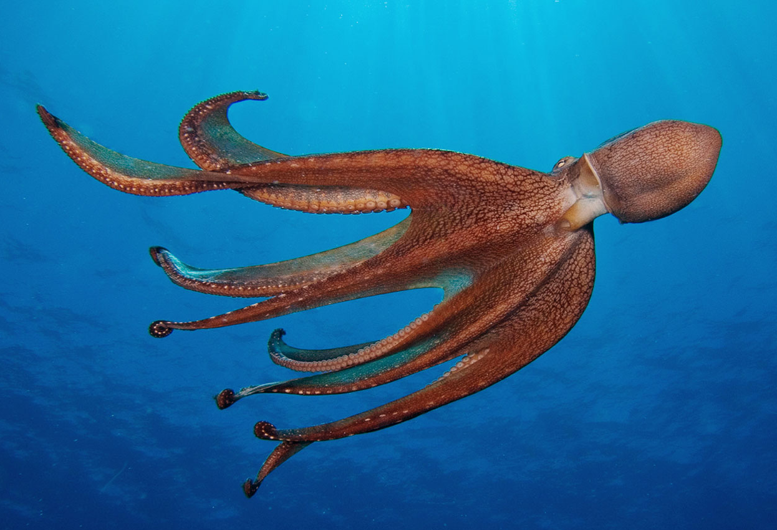
Read the book again!
What is the same about the
and and ?

Slide 13
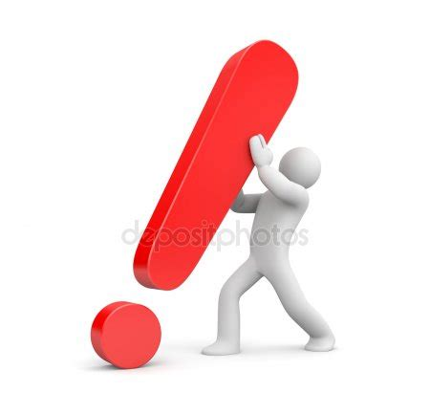
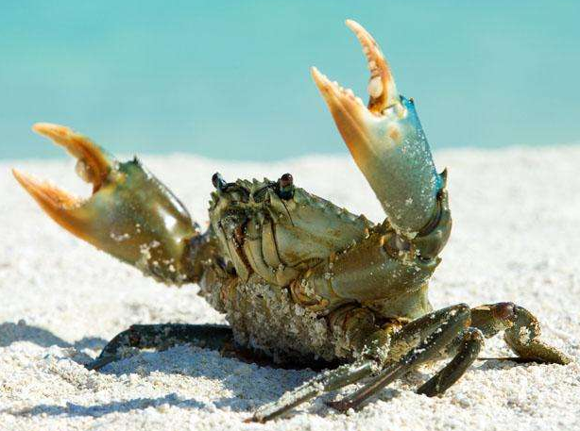
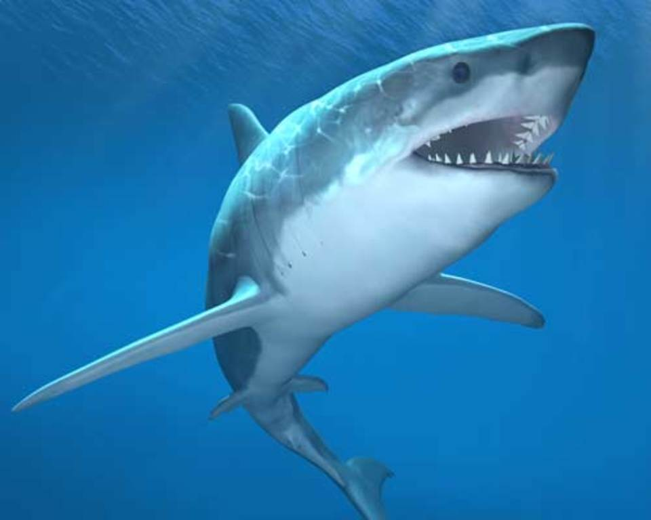
Read, learn and Practice.
go
grass
girl
gas
good
No tail
big crab
shark

Slide 14
Choose your favorite animal
and read the text about it.

Slide 15

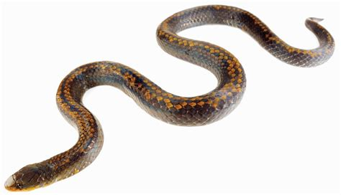
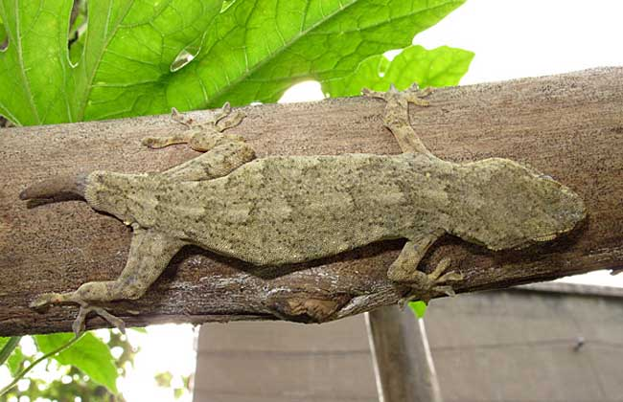
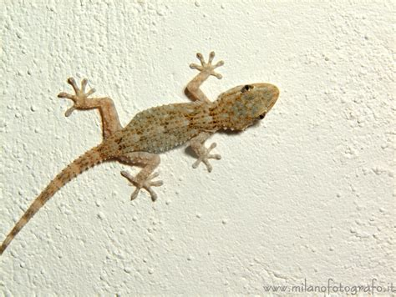
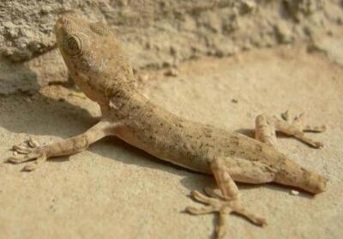
SOS
⚡️
What happens to the gecko (壁虎)？

Slide 16
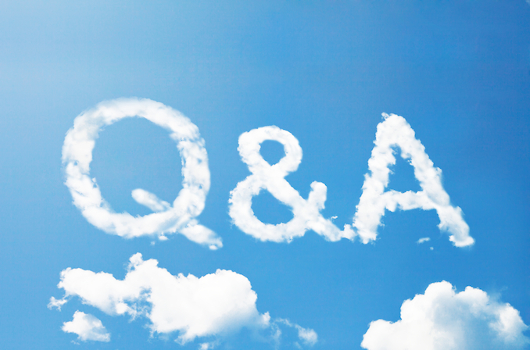
1. When in danger, why do some animals
lose something that can grow again ?
2. What can we lose that will grow again?
3. Can we do things like these animals did
to keep safe? What can we do?

Slide 17

Tell what you learnt about the lizard,
crab and octopus to your parents or
friends.
2. Try to find more animals who have the
same ability.

