Slide 1
多维阅读 第 3级
No Kings in the Kitchen

Slide 2
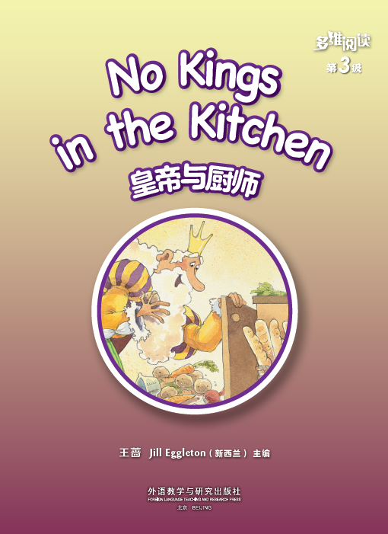
What’s the title?
Who’s the writer?
What will happen
to the King in the
book?

Slide 3
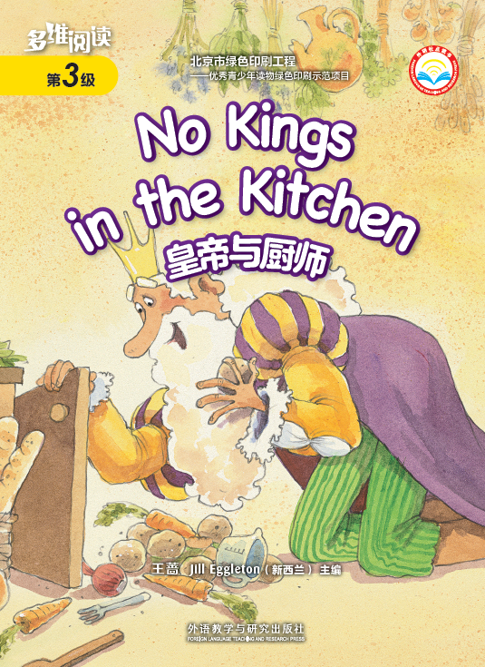
Who can you see from the front cover?
Where do you think the king might be?
What do you think the story is going to be about?

Slide 4
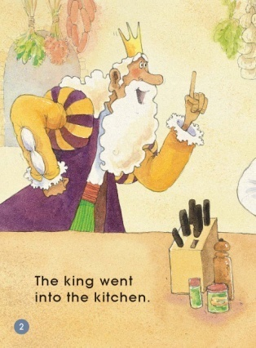
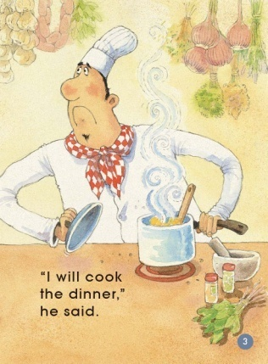
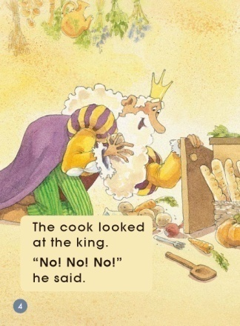
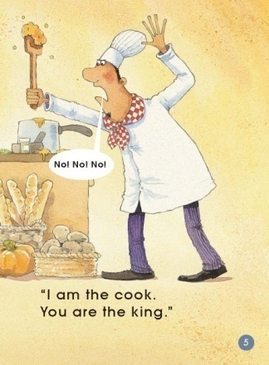
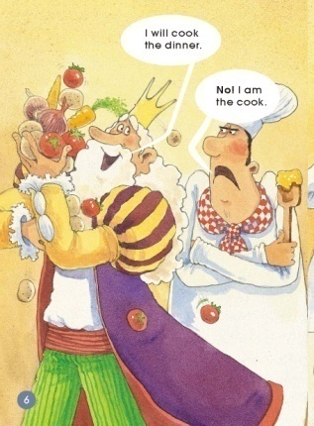
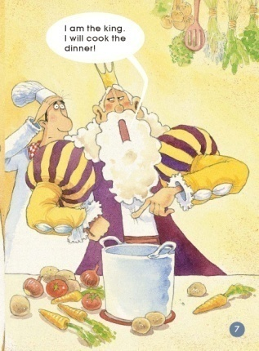
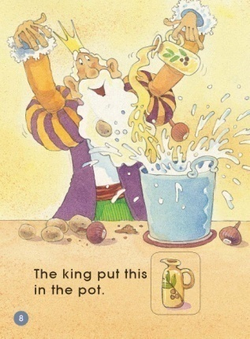
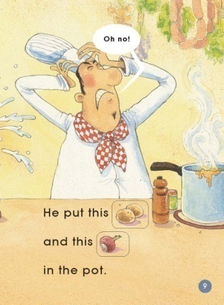
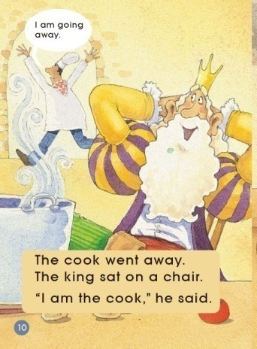
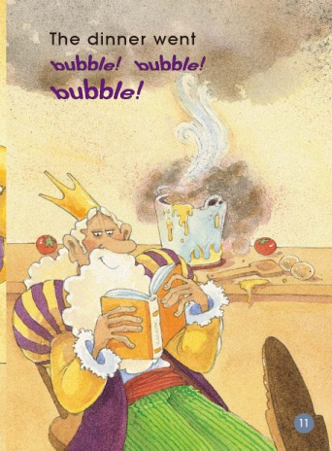
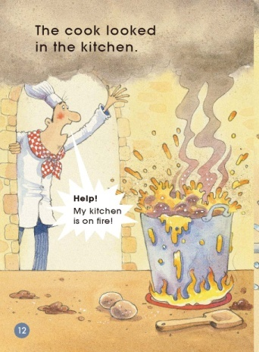
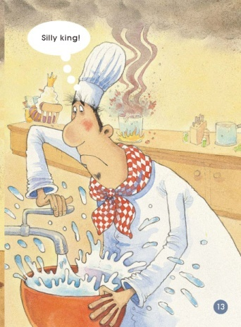
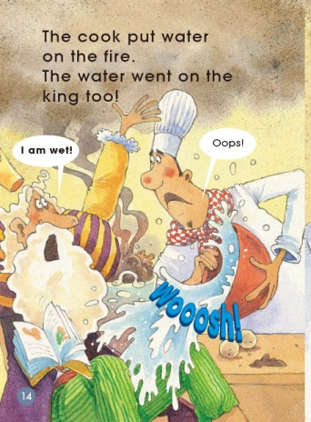
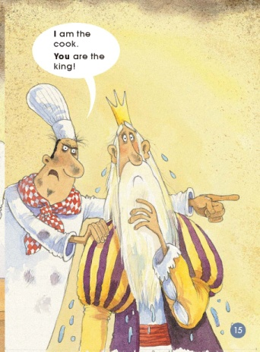
Read and listen.

Slide 5
Read again and answer questions.

Slide 6
Where did the king go?

Slide 7
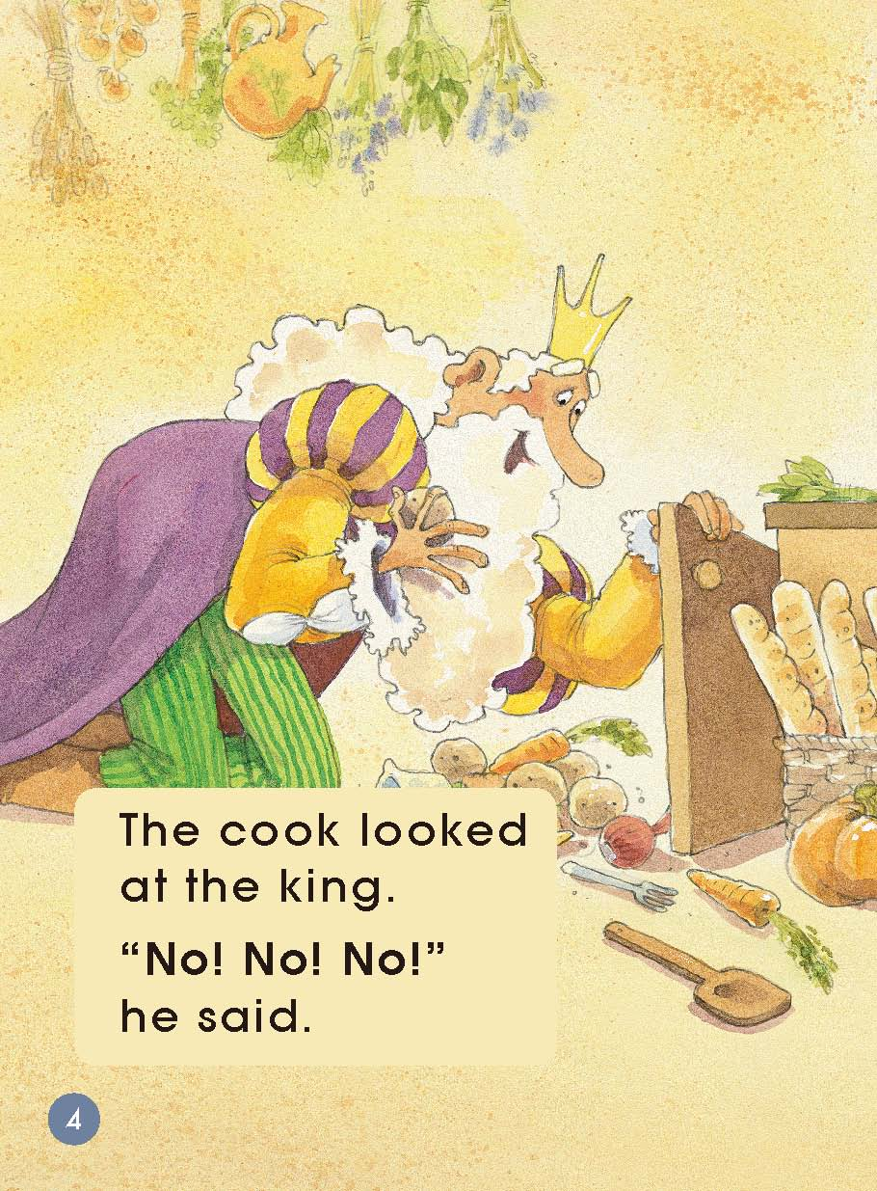
What do you think the king is looking for in the cupboard?

Slide 8
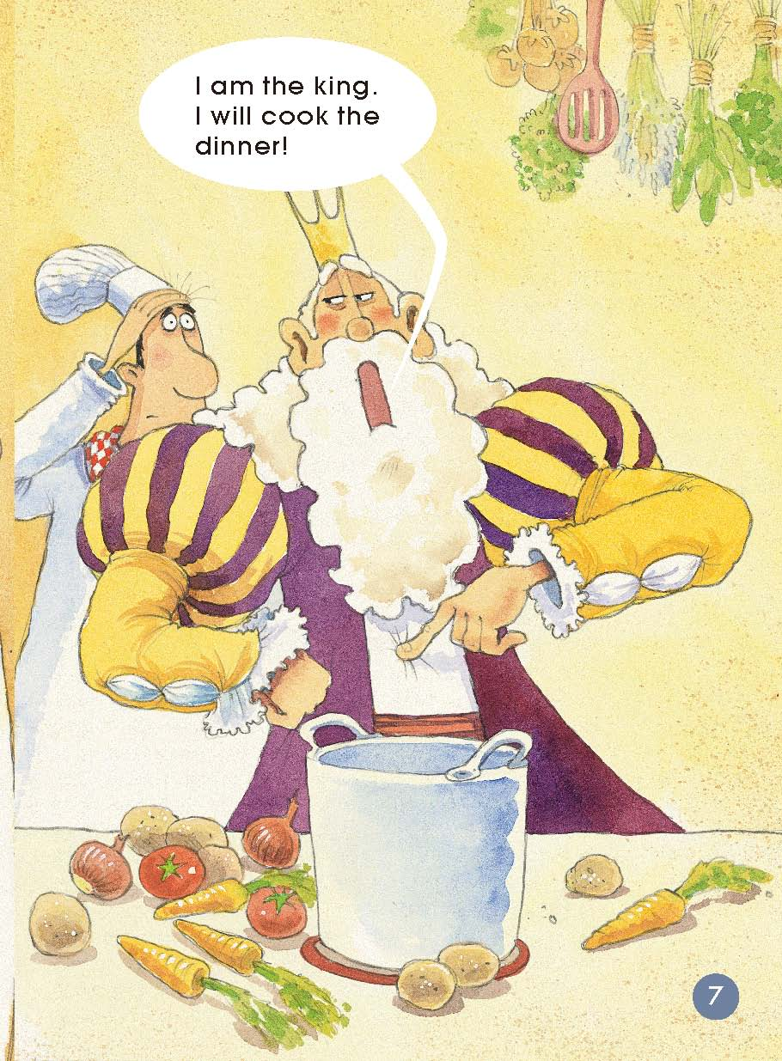
What do you think the king might be going to do
with that big pile of vegetables?

Slide 9
How did the cook feel when the king was cooking?

Slide 10
What is happening when the king puts the things in the pot?

Slide 11
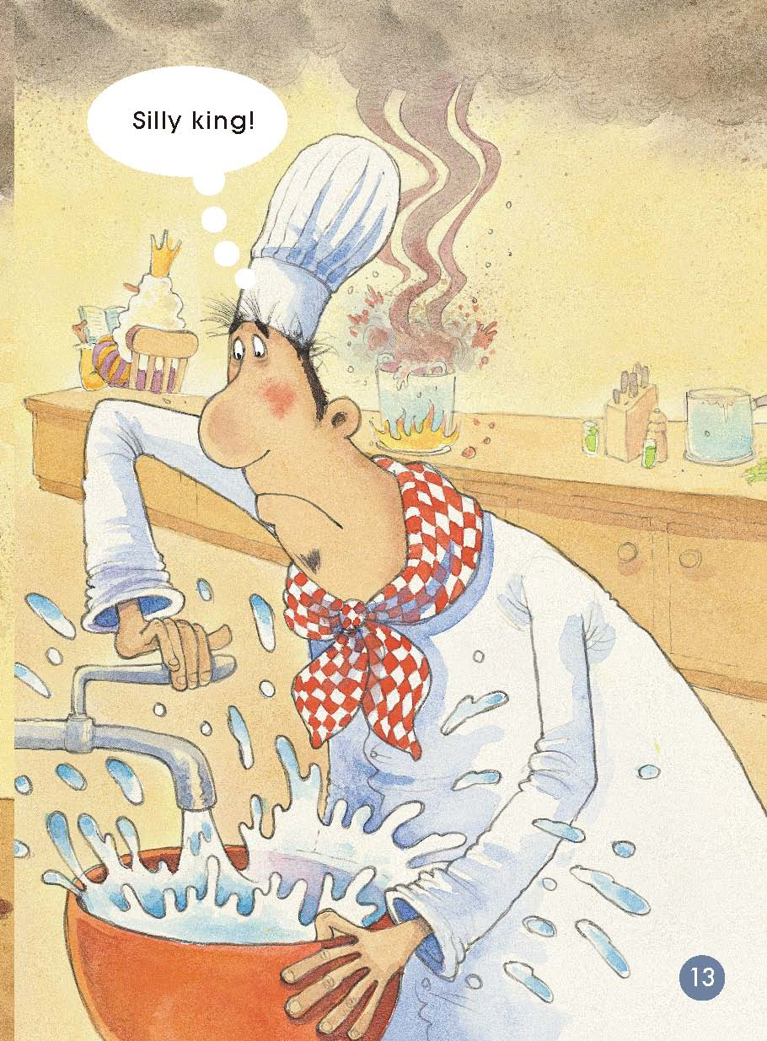
Now there is another problem. What do you think it is?

Slide 12
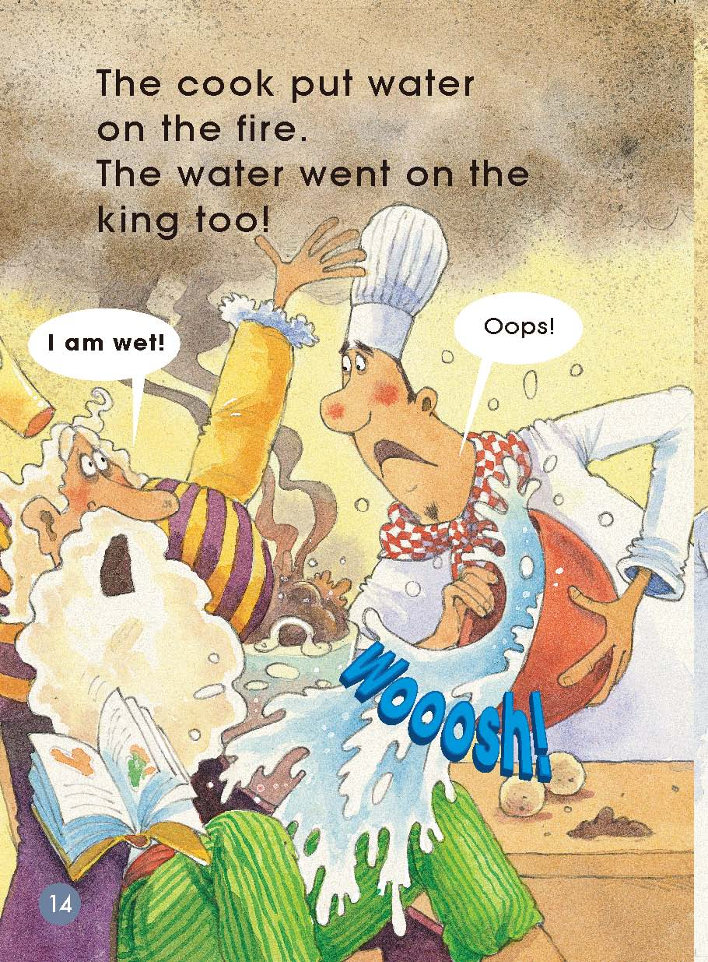
What is the cook doing？

Slide 13
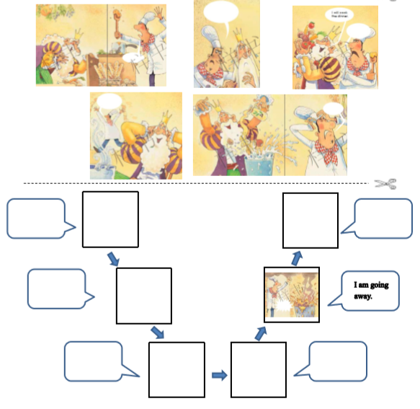
Read and complete the story map.

Slide 14
Explain the cook’s feelings to your partner.

Slide 15
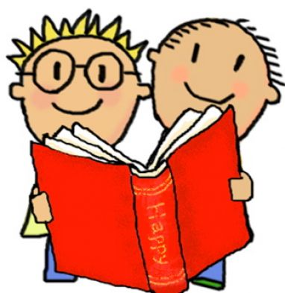
Listen and repeat.

Slide 16
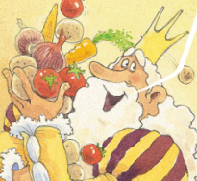
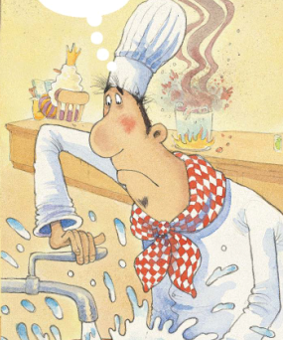
Act it out.

Slide 17
Find a better
If you were the king and you wanted to cook, what would you do?
If you were the cook and you didn’t want the king to ruin your kitchen, what would you do?

Slide 18
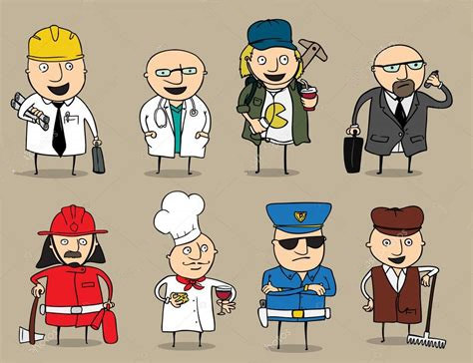
Each performs one's own functions.

Slide 19
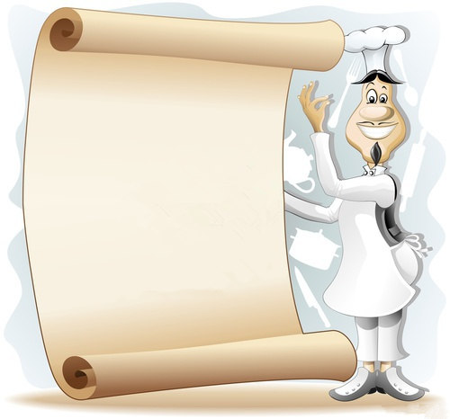
Homework
（1）Tell the story to your parents.
（2）Tell another story about you or your friend who could have caused a big problem before.

