Slide 1
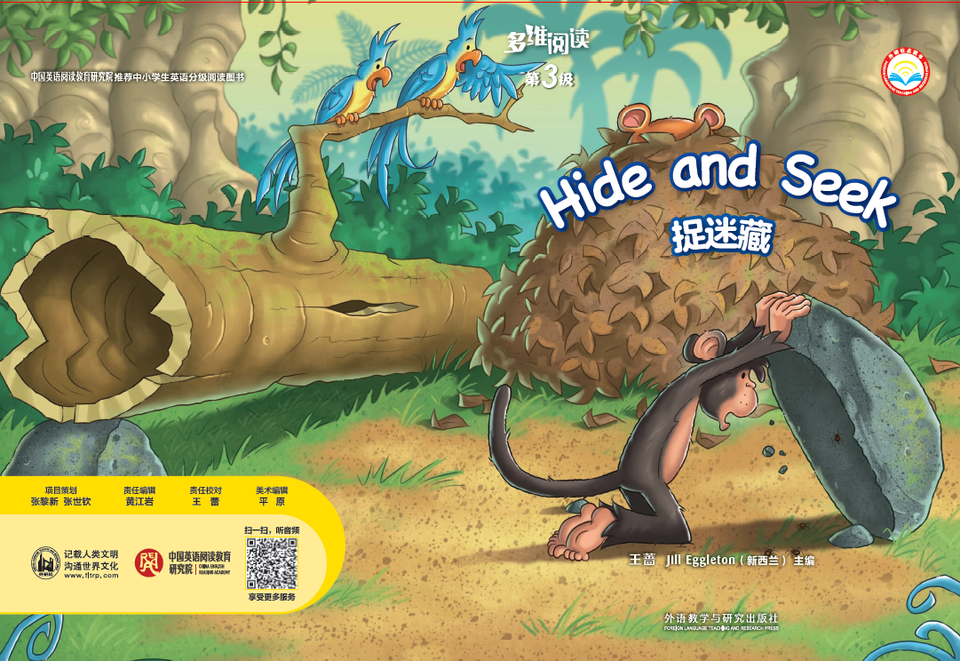
多维阅读 第3级
Hide and Seek
邓玉娇

Slide 2
Title （书名）
Writer （作者）

Slide 3
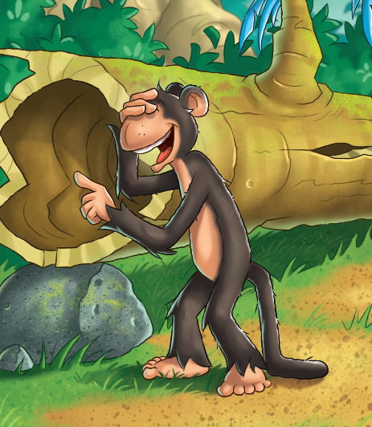
Who can you see from the front cover?
What is the Monkey doing?
What do you think the story is going to be about?

Slide 4
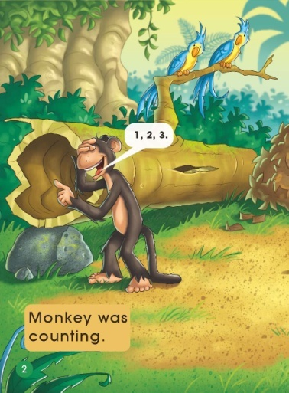
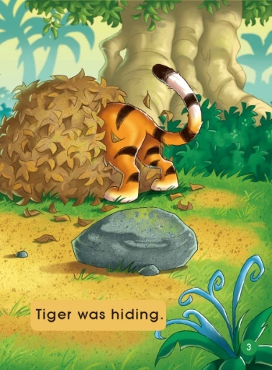
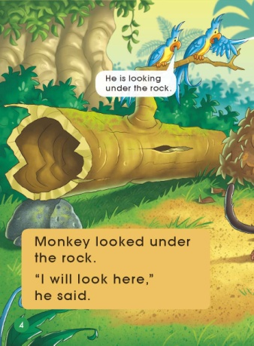
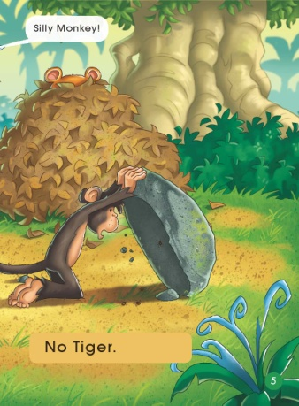
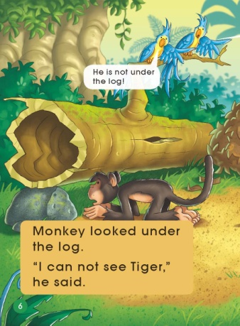
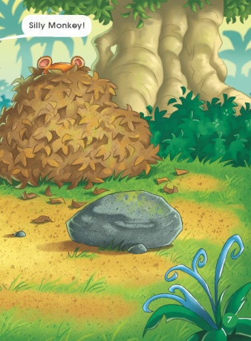
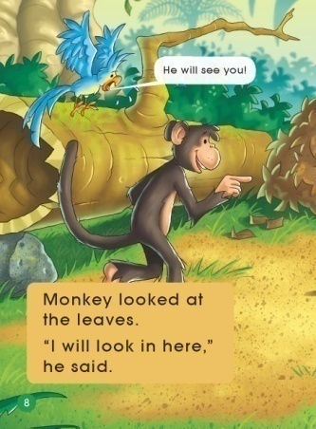
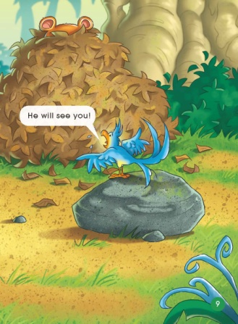
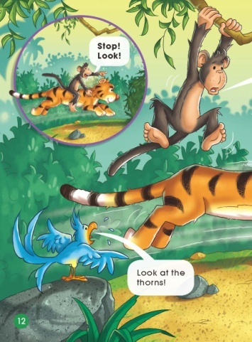
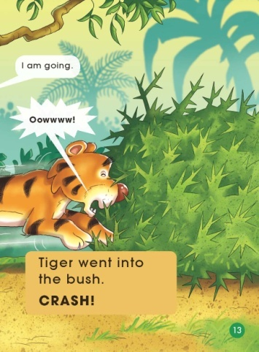
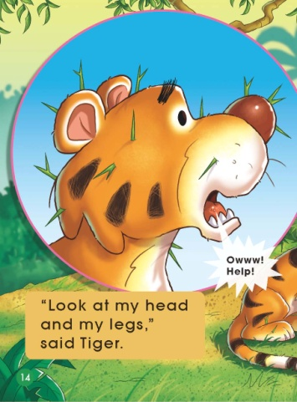
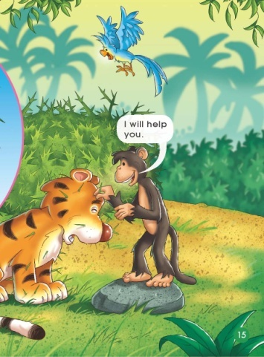
Read and listen.

Slide 5
Read again and answer questions.

Slide 6
What is Monkey doing?
Why is he counting?

Slide 7
c
What is Tiger doing?
Where is Monkey looking for Tiger?

Slide 8
Would you look under the log for Tiger? Why? Why not?

Slide 9
What do you think might happen next?

Slide 10
How is Monkey feeling? How do you know?

Slide 11
What do you think is going to happen to Tiger?

Slide 12
How do you know Monkey really is kind?

Slide 13
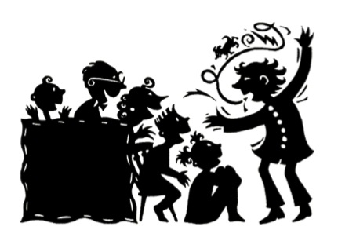
Tell the story.

Slide 14
Listen and repeat.

Slide 15
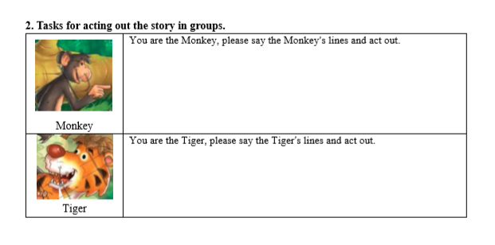
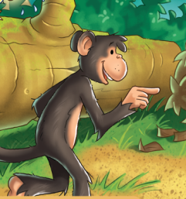
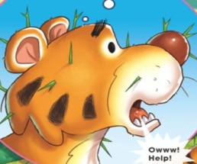
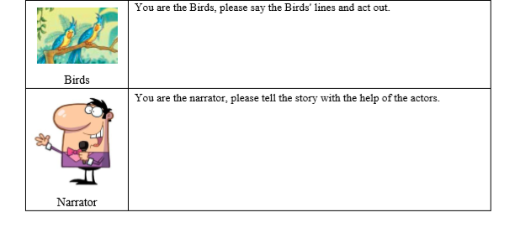
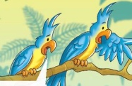
Act it out.

Slide 16
What do you think of the Monkey?
Have you had a good time with your friend?

Slide 17
Homework
（1）Tell the story to your parents.
（2）Draw a picture about you and your friend’s happy time.

