Slide 1
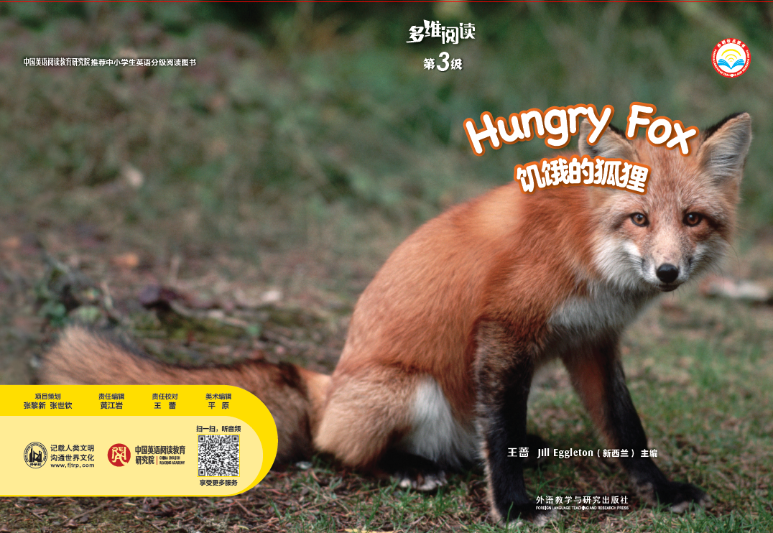
多维阅读 第3级
Hungry Fox

Slide 2
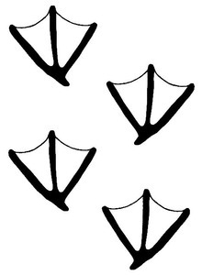

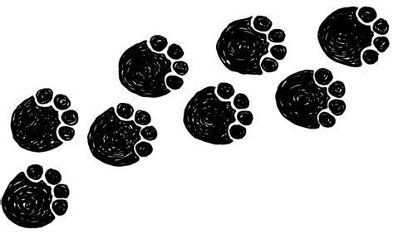
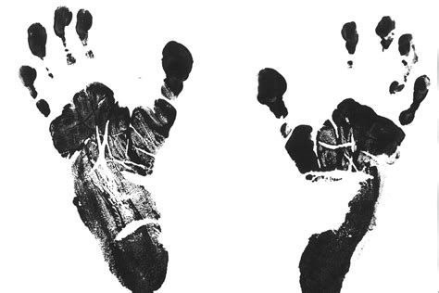
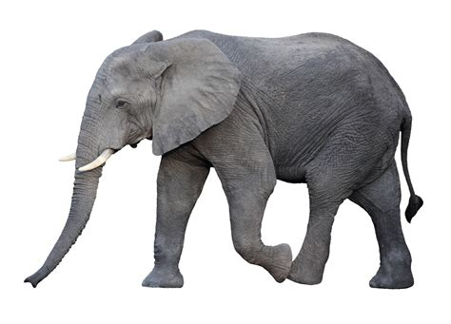
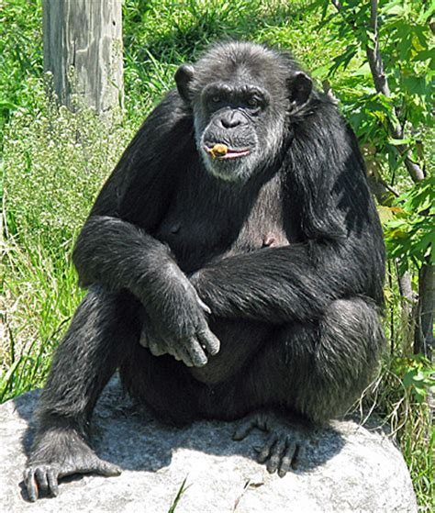
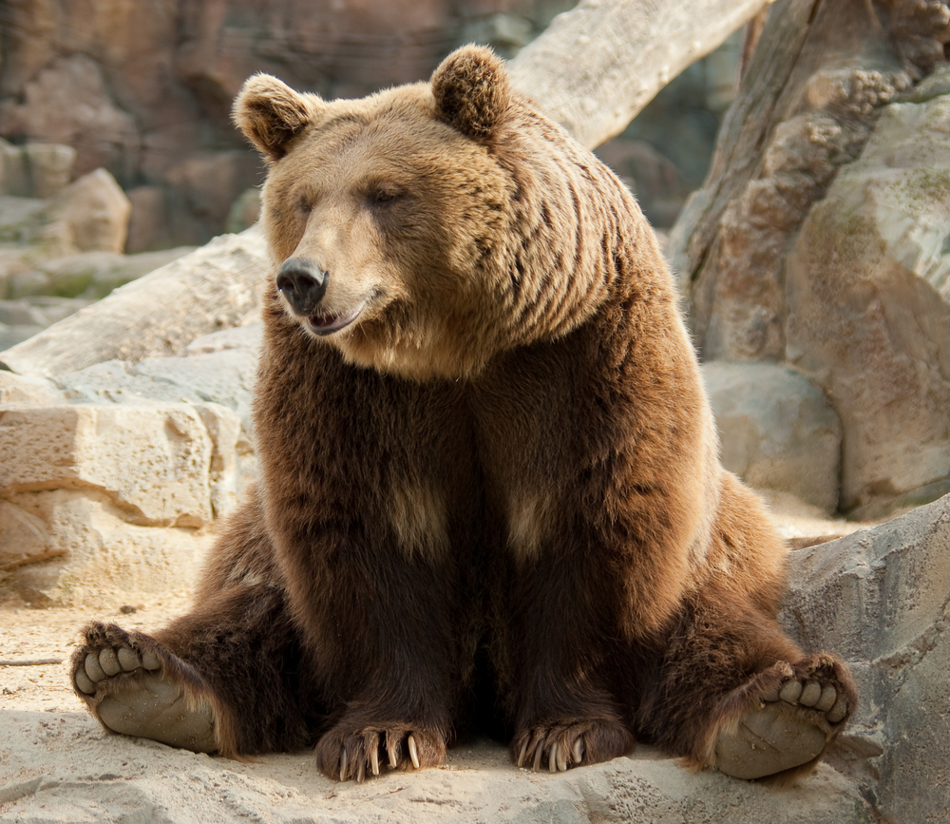
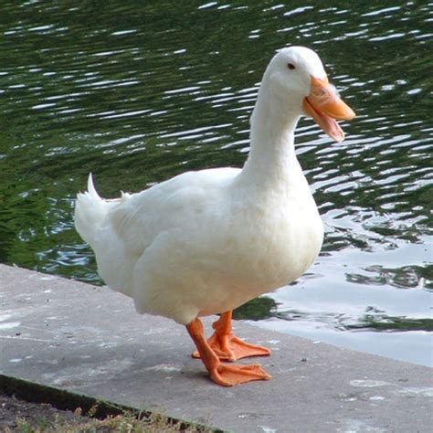
Match the tracks and the animals

Slide 3

Which animal has these tracks?

Slide 4
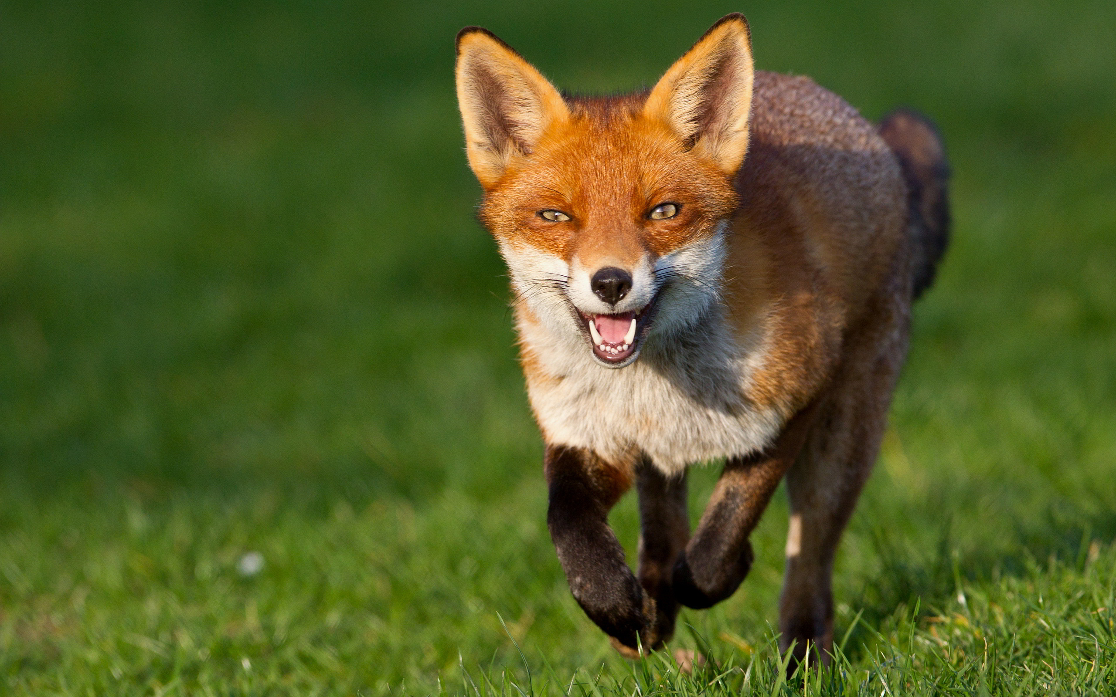
What do you know about the fox?
fox

Slide 5
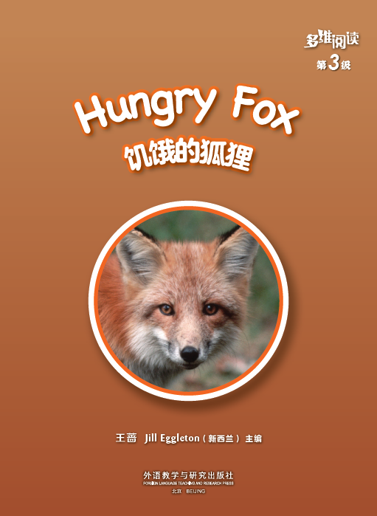
What’s the title?
Who’s the writer?
What will happen
to the hungry fox
in the book?

Slide 6

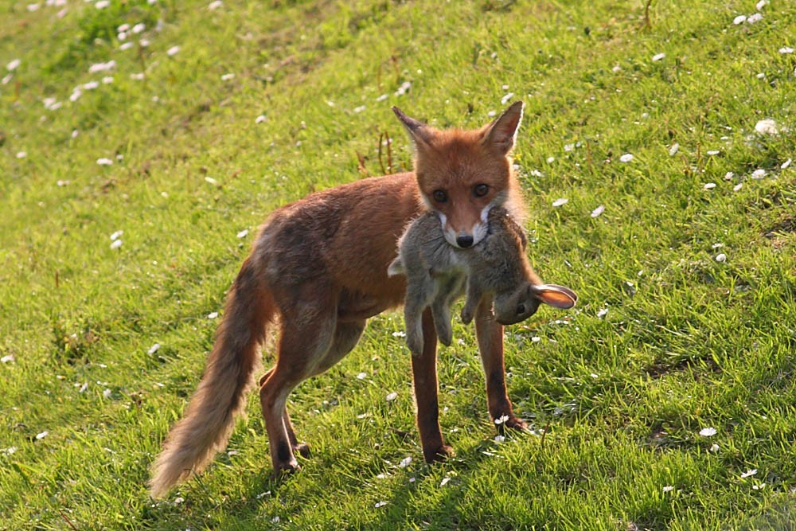
What can the fox find to eat?

Slide 7


Read pages 2-5.
When does the fox comes out for food?
Day: sleep underground in the den
Night: look for food

Slide 8
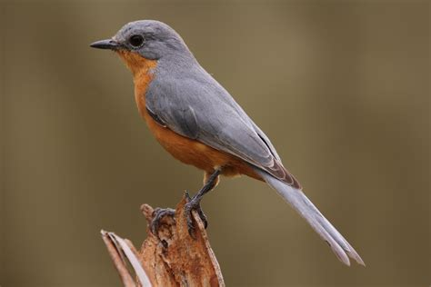
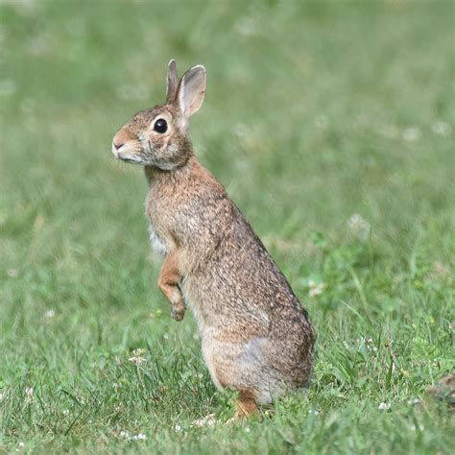
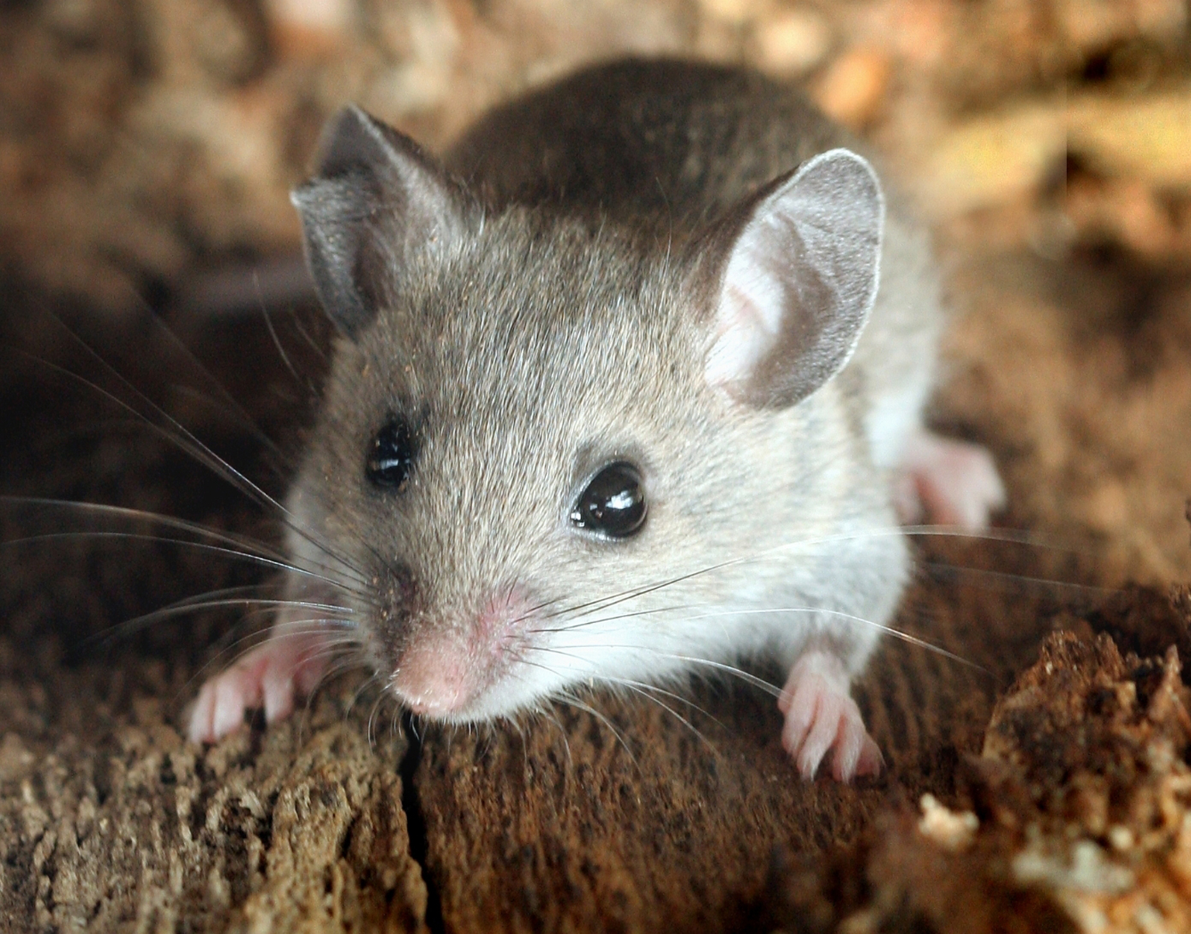
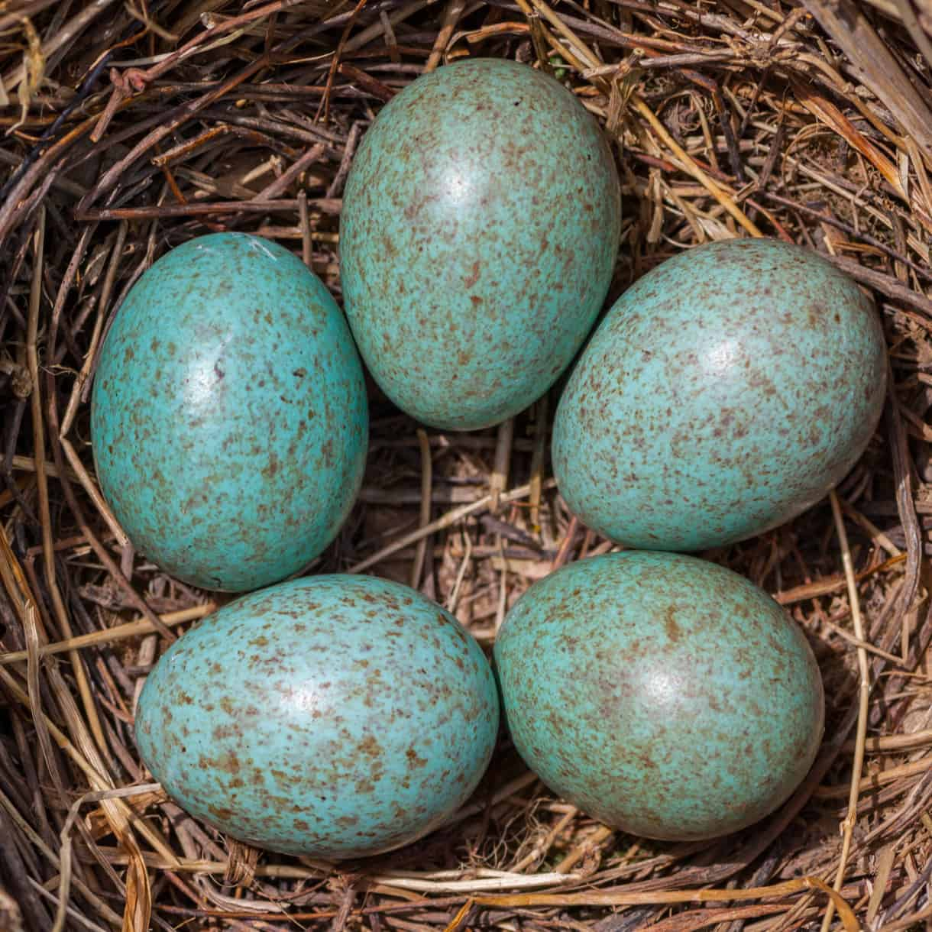

Read pages 6-7.
What does the fox eat?

Slide 9
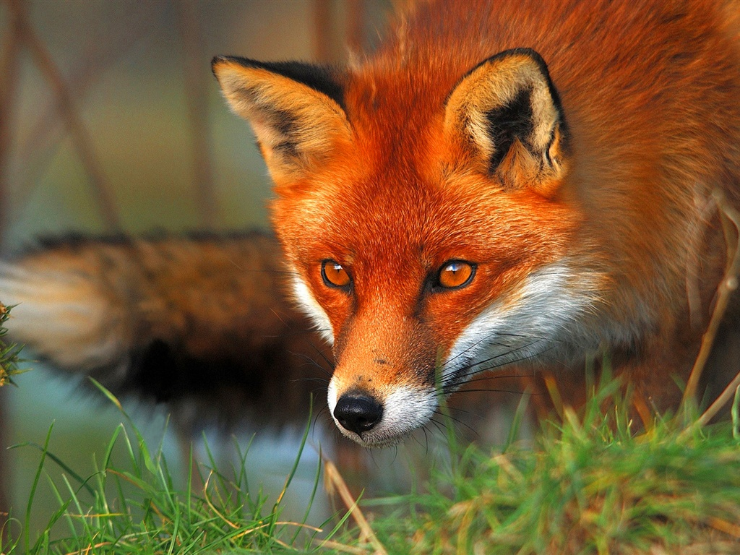
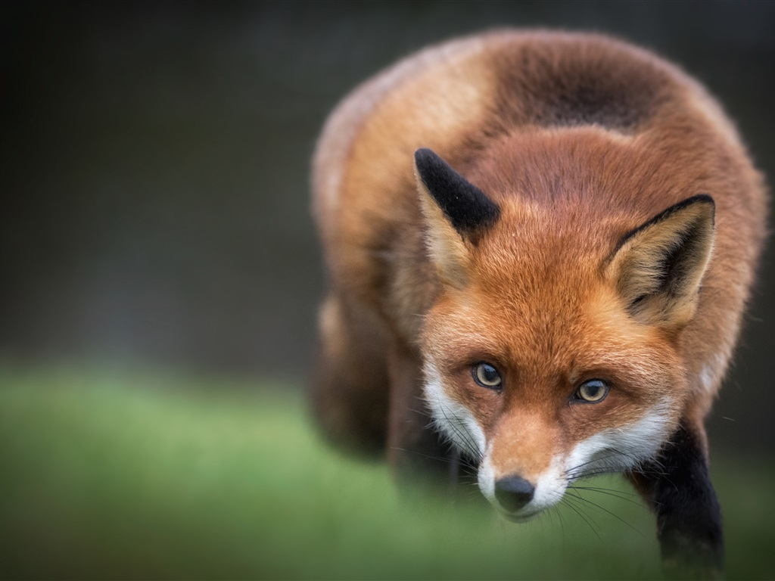
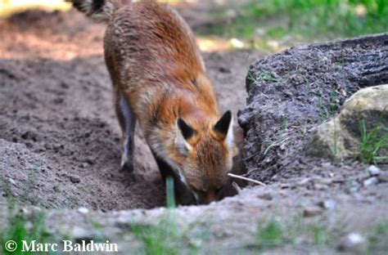
Read pages 8-15.
How does the fox find the rabbit?
big ears
…is going
…is looking for
…is digging
…is listening

Slide 10
Put the words on the blackboard
into different groups.
time
food
hunting

Slide 11
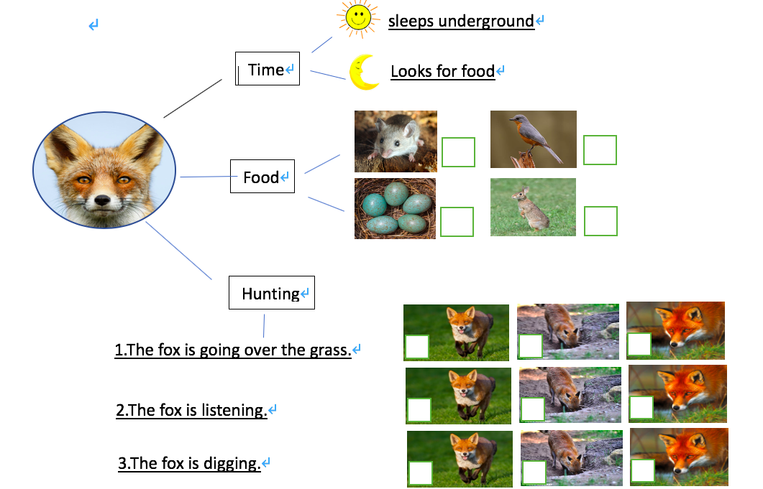
Read again, finish the worksheet.
Tick the right pictures.

Slide 12
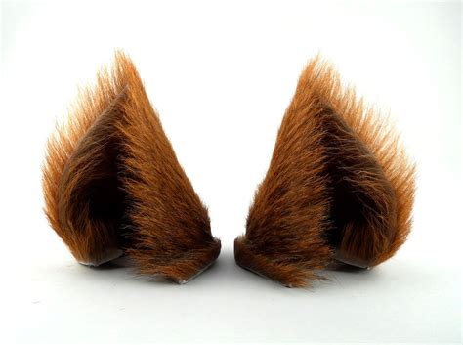
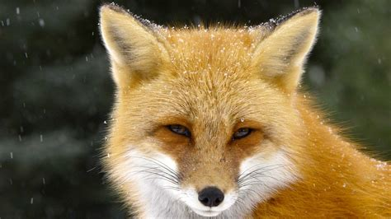

Read, learn and practice.
tracks
ears
comes
looking
she

Slide 13

Read and share.
Hunting
Time
Food

Slide 14

What questions will you ask about the fox? You can use How, When, Where, What, Who or Why.
Have a discussion.

Slide 15

Tell what you have learnt about the fox to your parents or friends.
Look for more things you want to know about the fox on the Internet.

