Slide 1
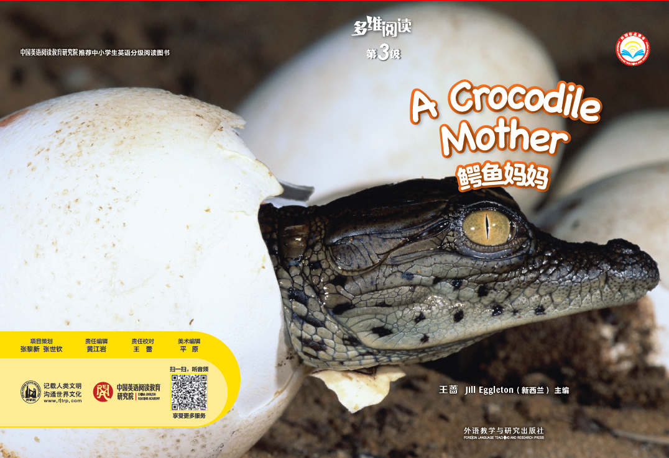
A Crocodile Mother
多维阅读第3级

Slide 2
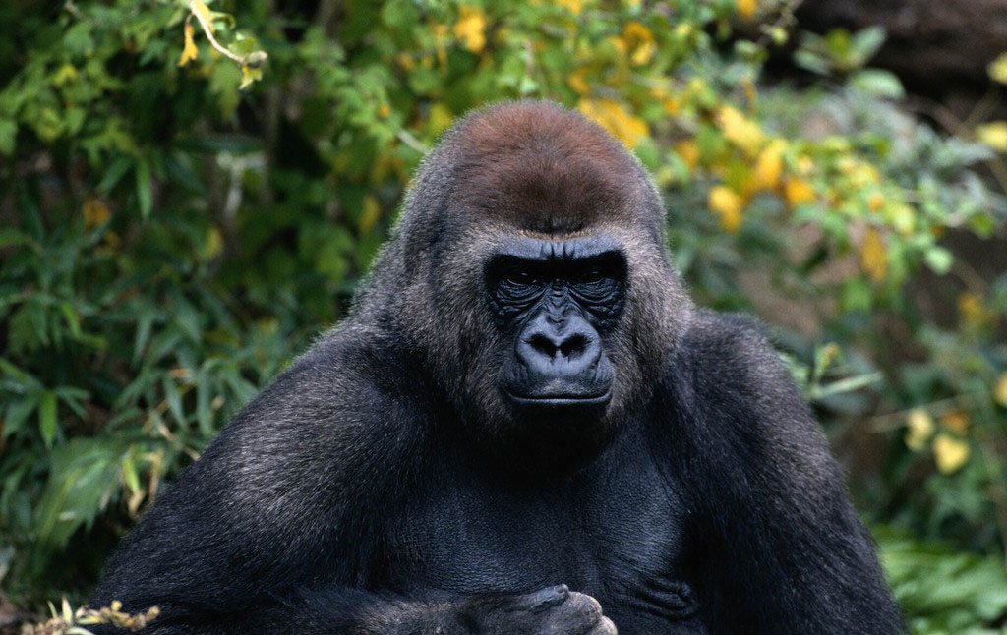
What’s the animal?

Slide 3
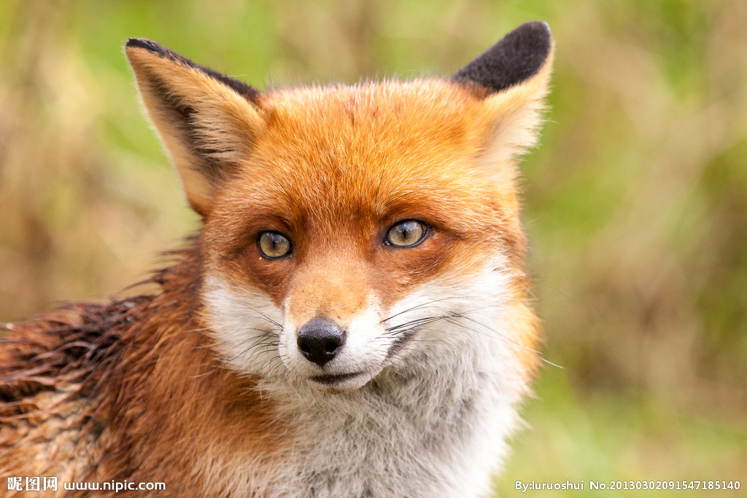
What’s the animal?

Slide 4
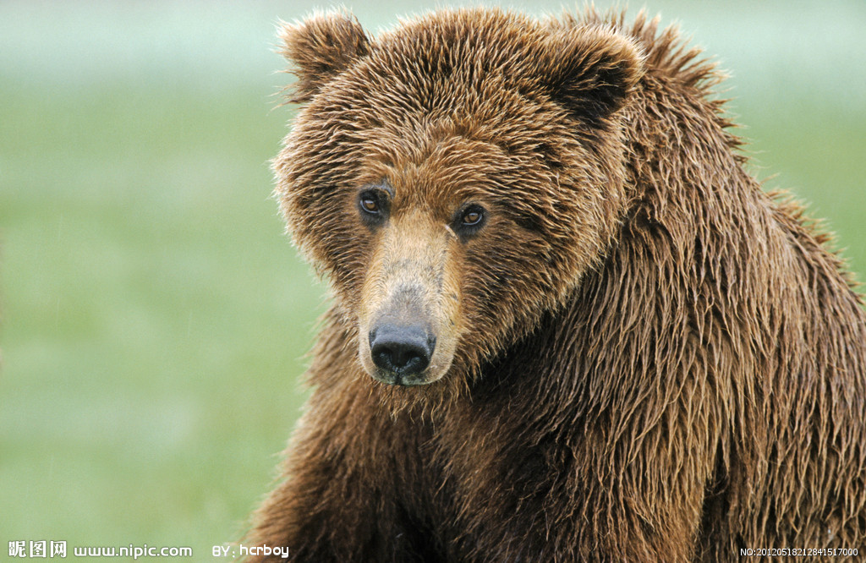
What’s the animal?

Slide 5
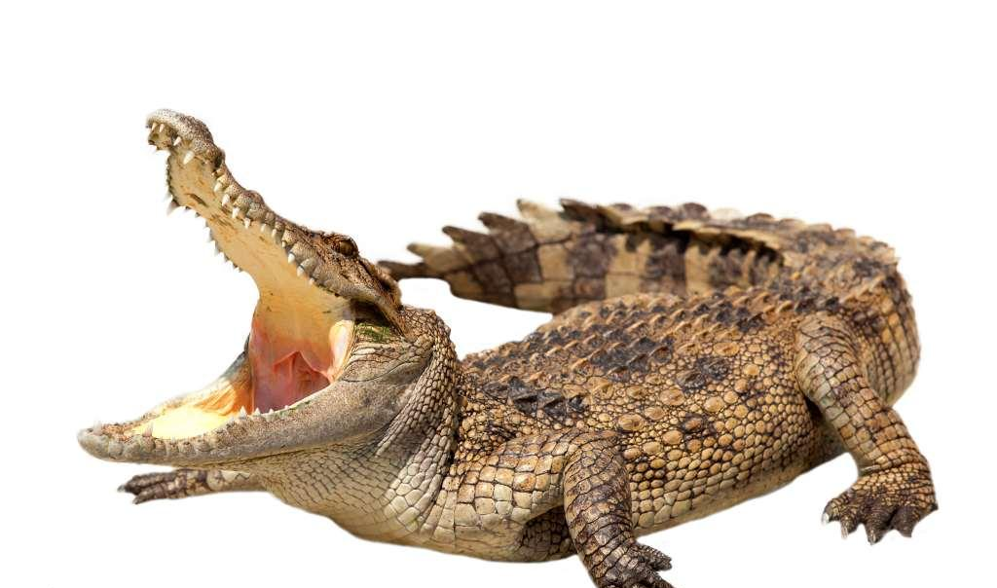
What’s the animal?

Slide 7
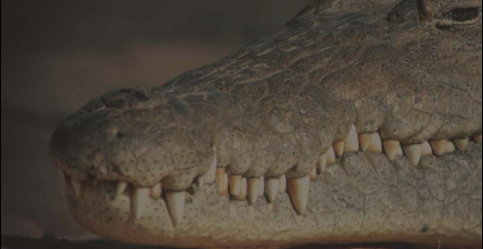
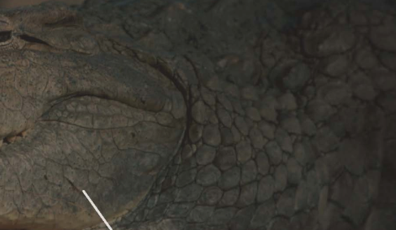
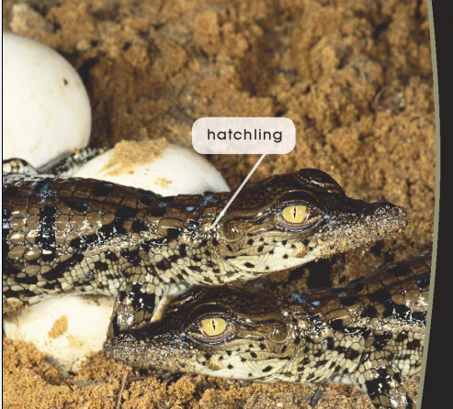
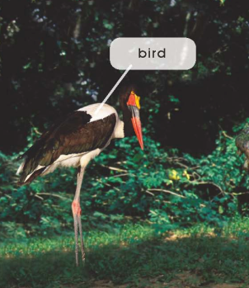
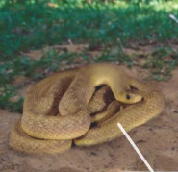
First Reading

Slide 8
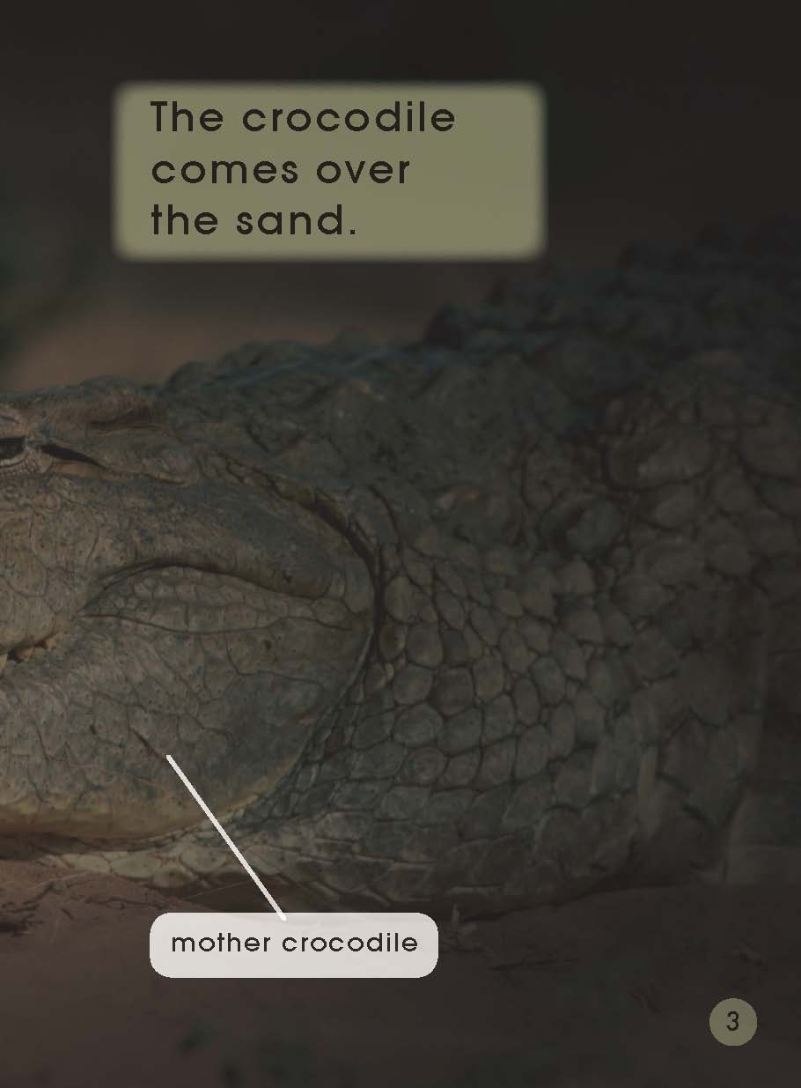
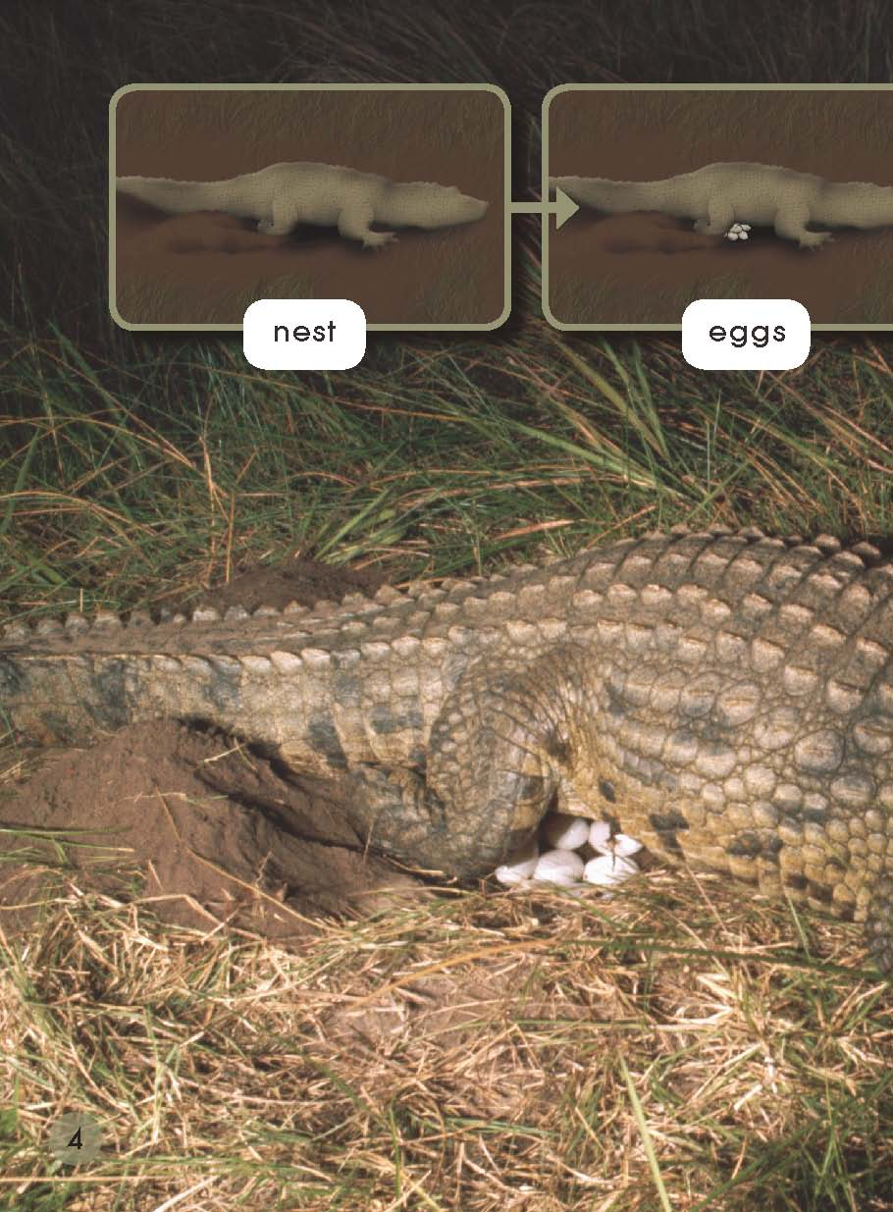
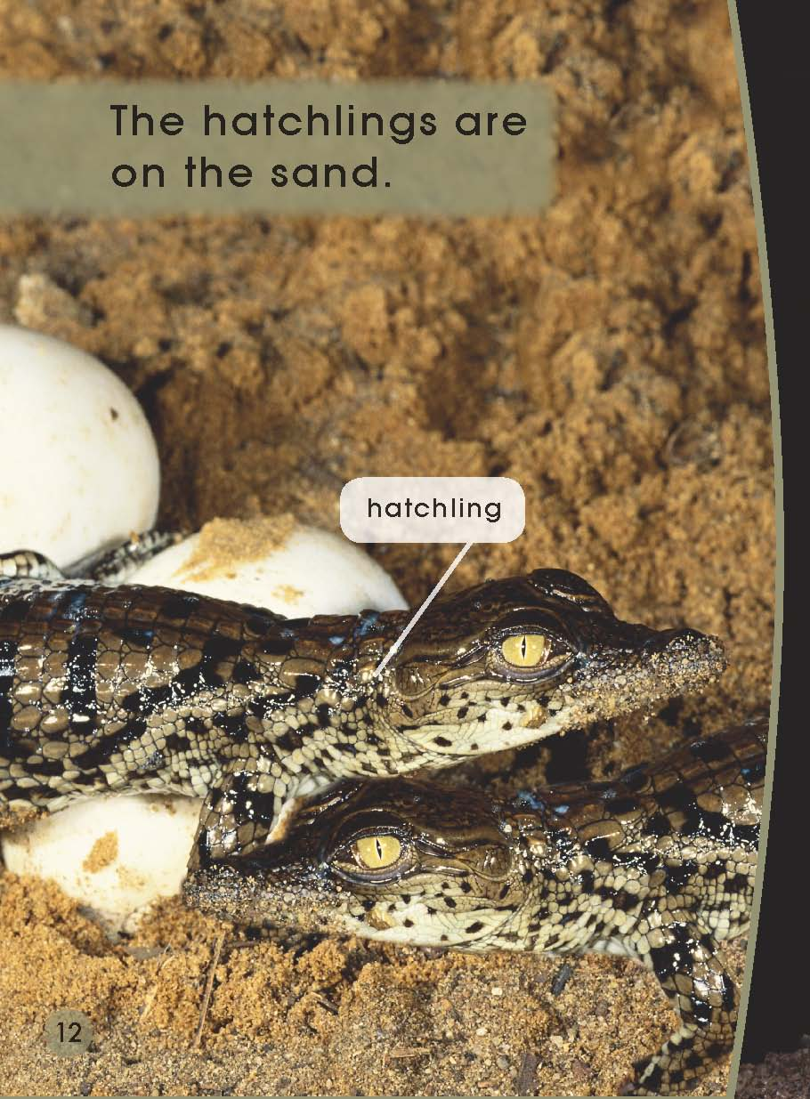

Slide 9
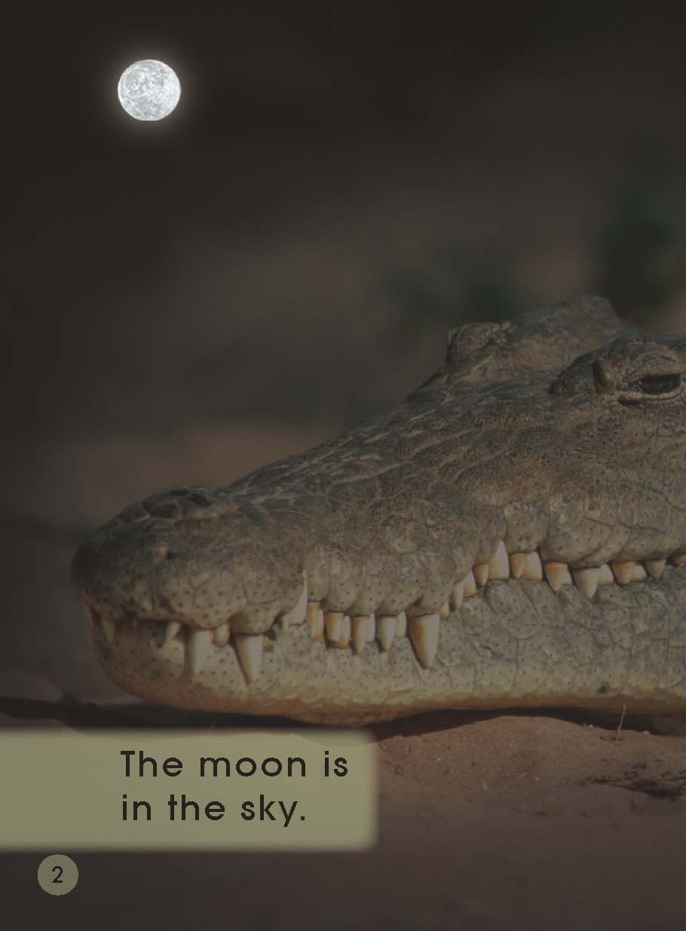
Second Reading
Pages 2-3

Slide 10
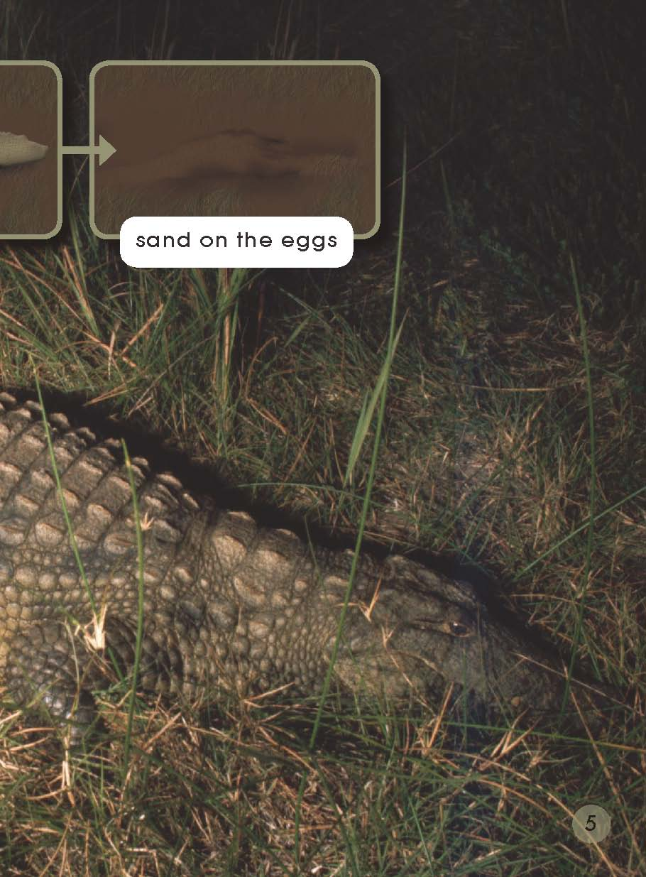
Second Reading
Pages 4-5

Slide 11
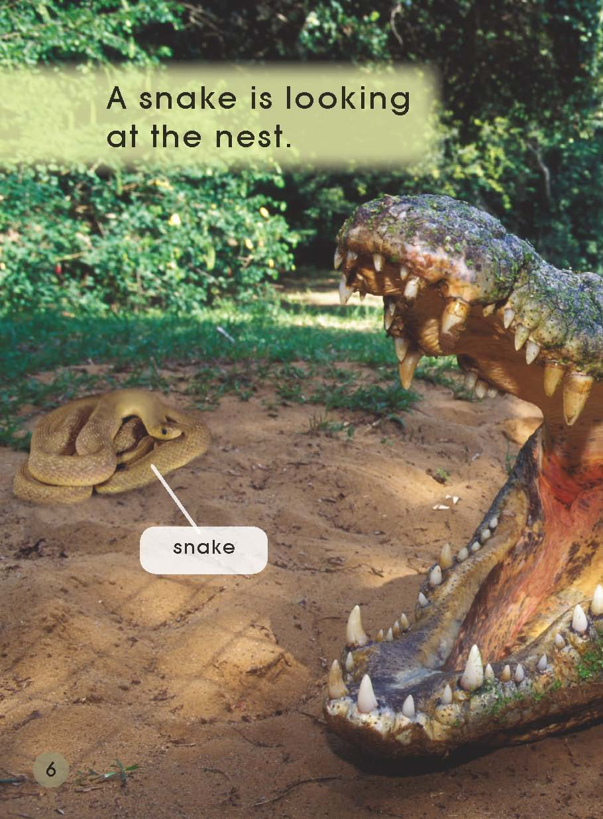
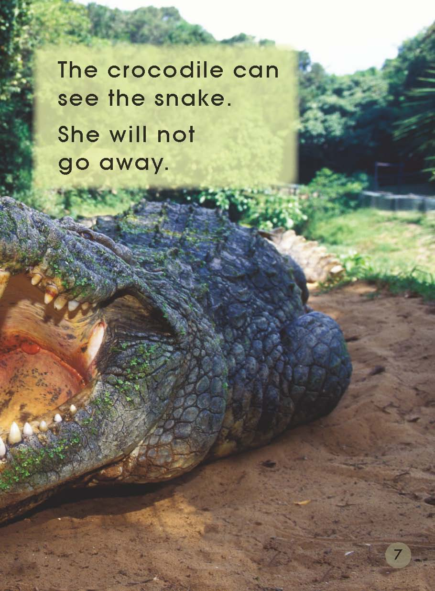
Second Reading
Pages 6-7

Slide 12
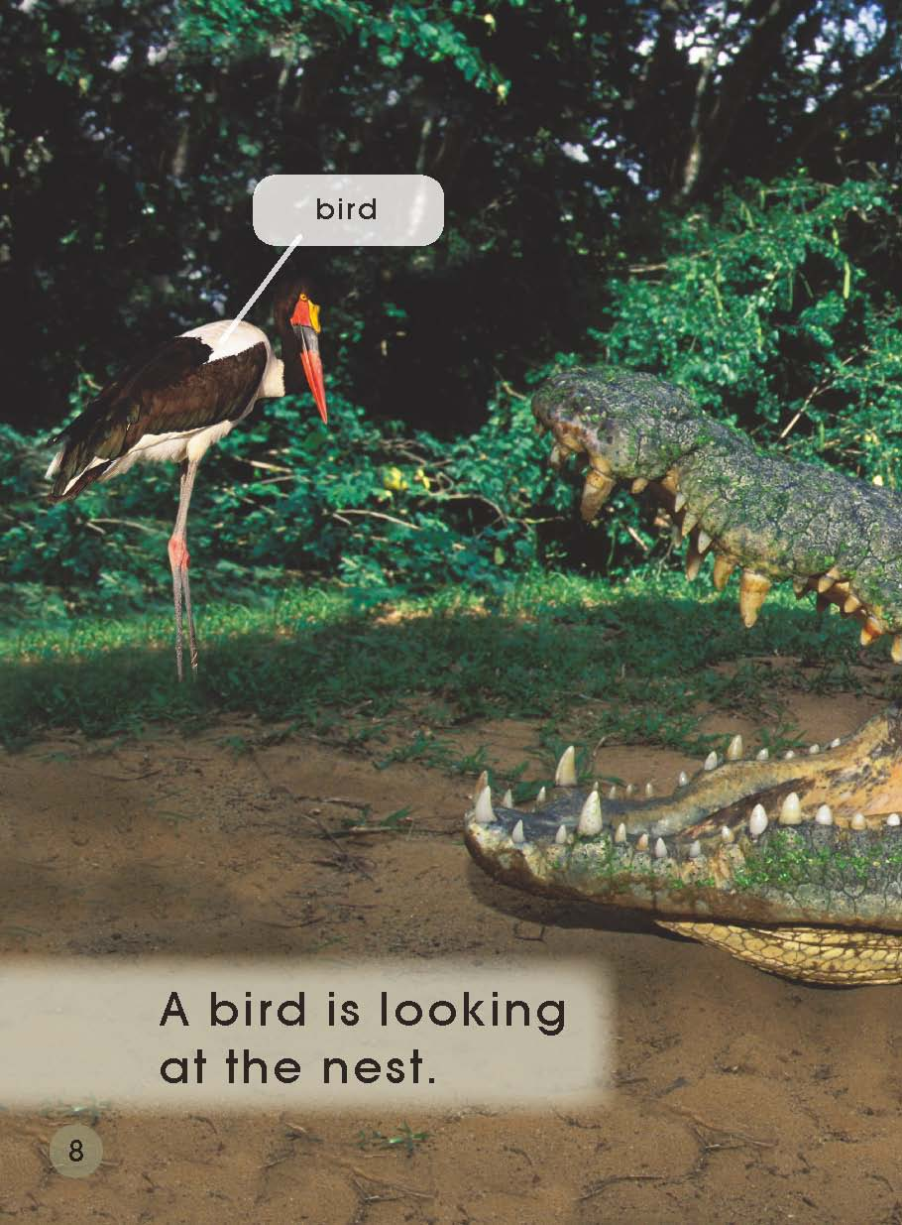
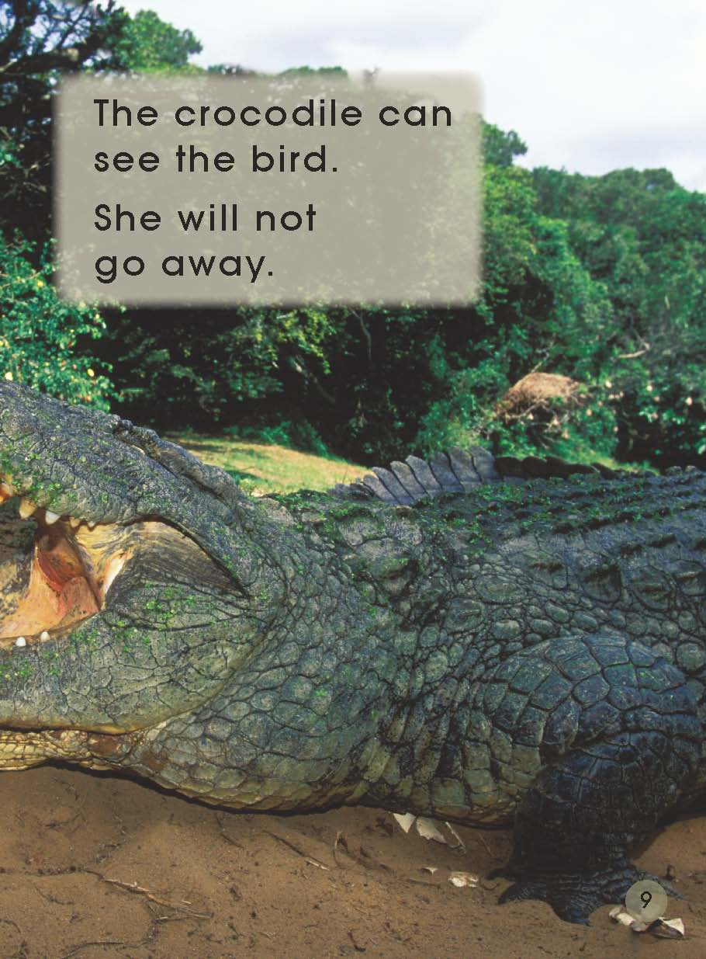
Second Reading
Pages 8-9

Slide 13
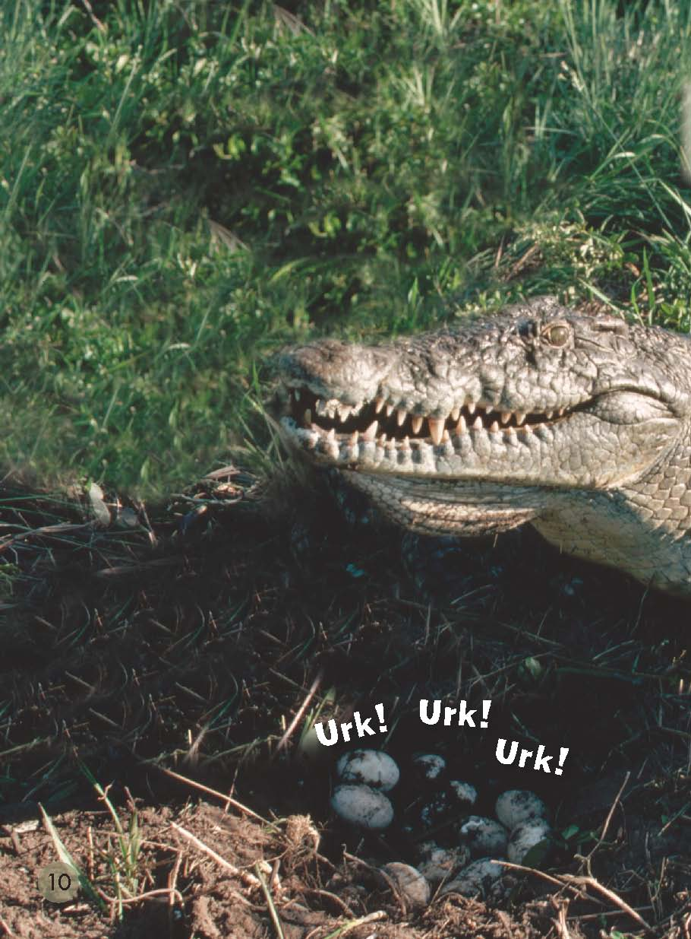
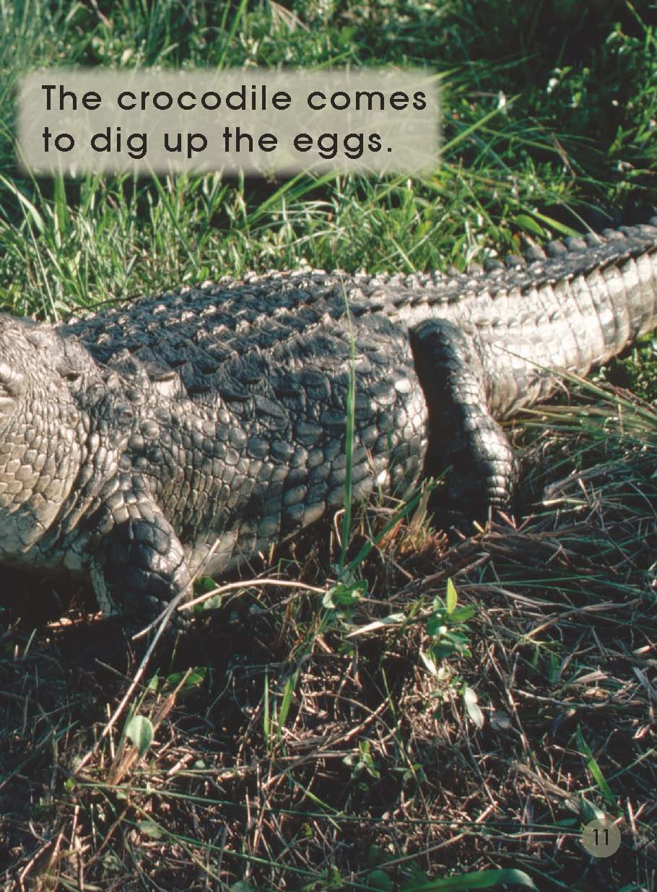
Second Reading
Pages 10-11

Slide 14
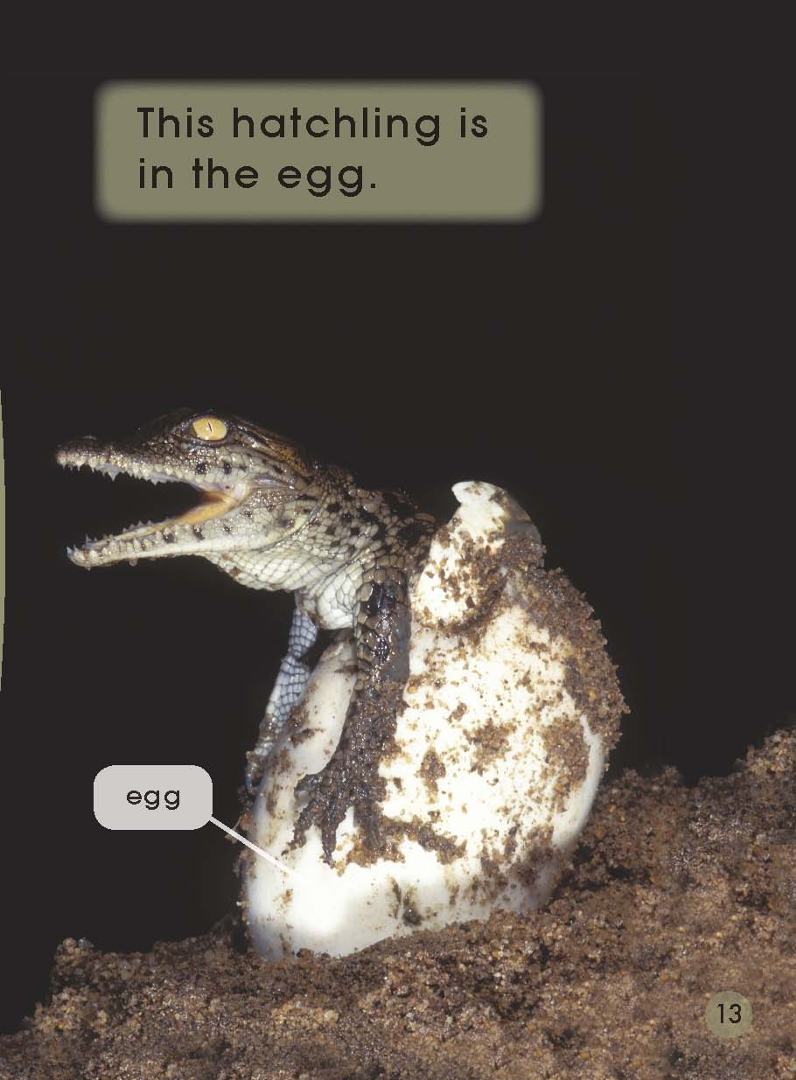
Second Reading
Pages 12-13

Slide 15
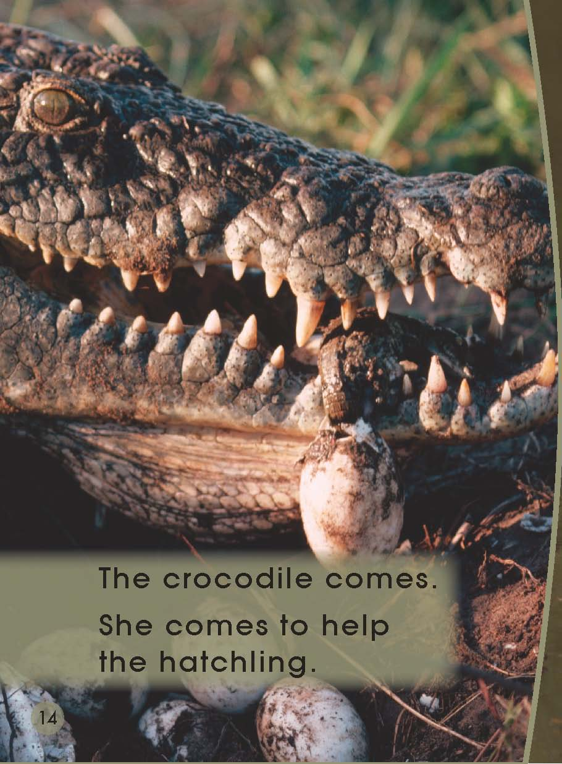
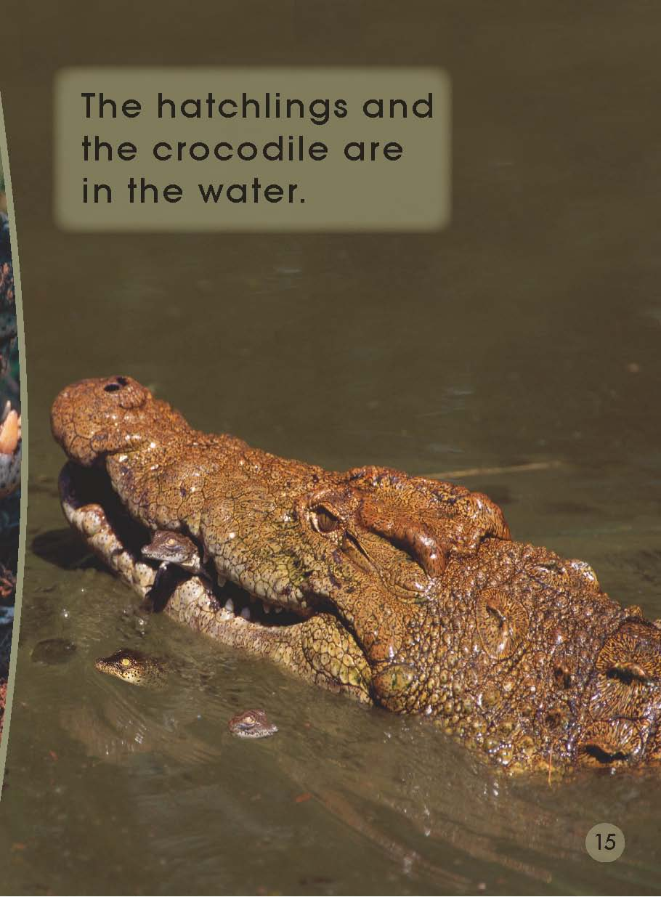
Second Reading
Pages 14-15

Slide 16
Please draw a four-frame comic strip.
① | ②
③ | ④

Slide 17
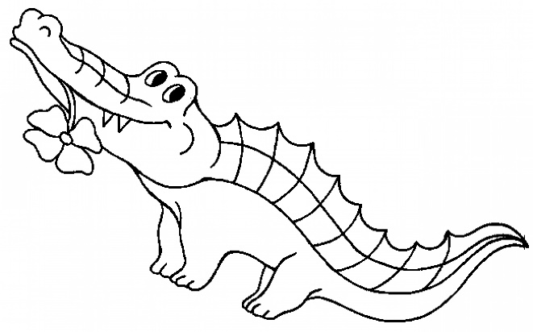
Meet the crocodile. Listen and put the words in the blanks.
live in ______________. ( rivers, seas ) get ____________ teeth. ( six, sixty ) Crocodiles eat ______________. ( fish, dish ) are ____________________. ( not dangerous, very dangerous ) are very __________ parents. ( good, bad )

Slide 18
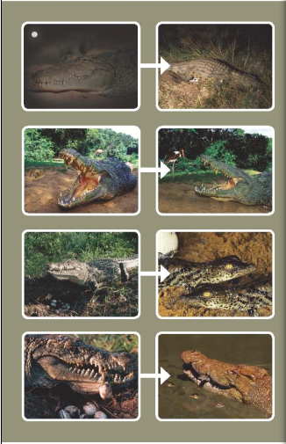
Talk again.

Slide 19
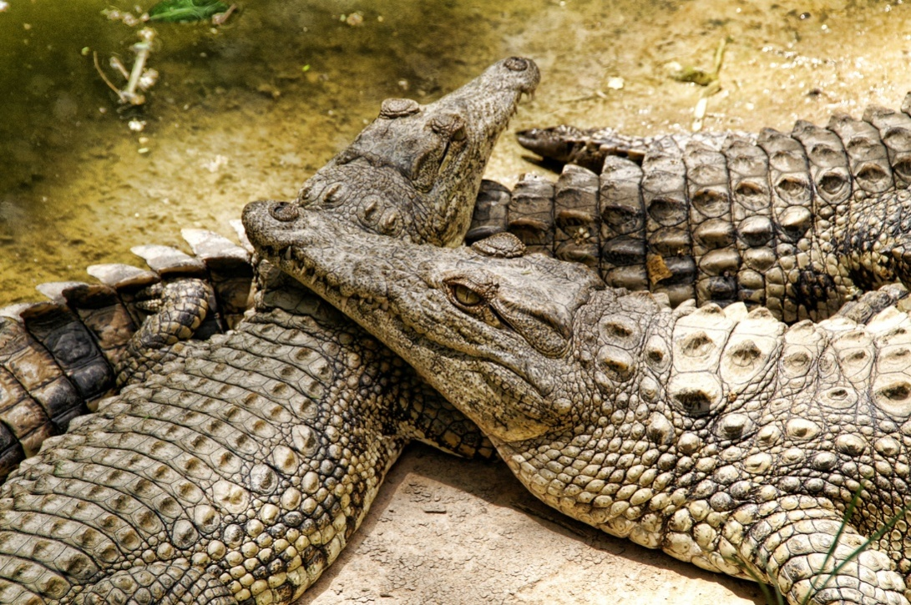
Homework
（1）Share the story of the baby crocodile with your
friends.
（2）Try to get more information about crocodiles.

