Slide 1
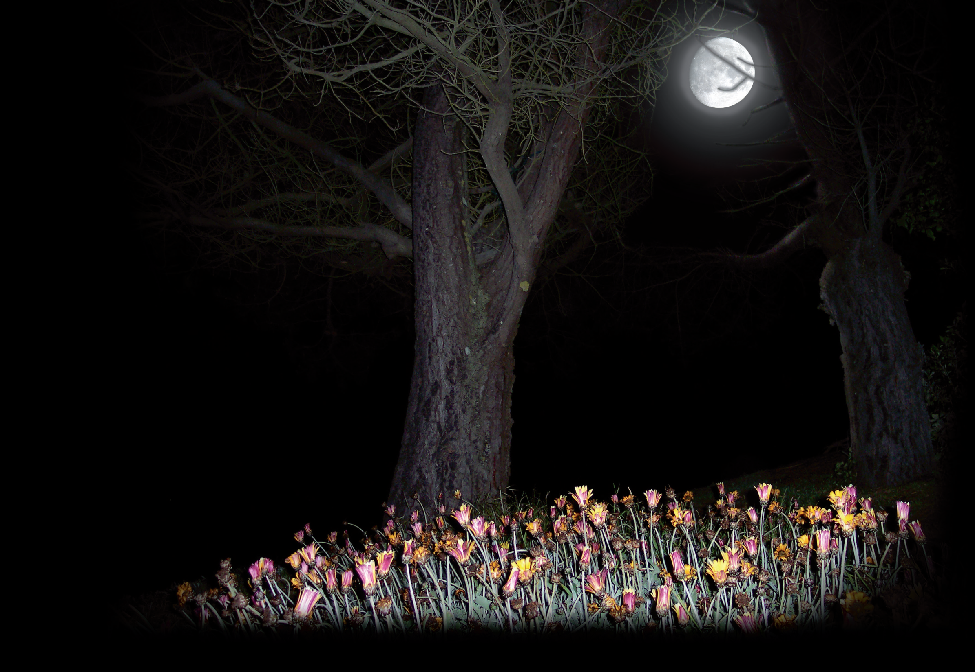
Night in the Garden
花园的夜晚
选自《多维阅读第2级》

Slide 2
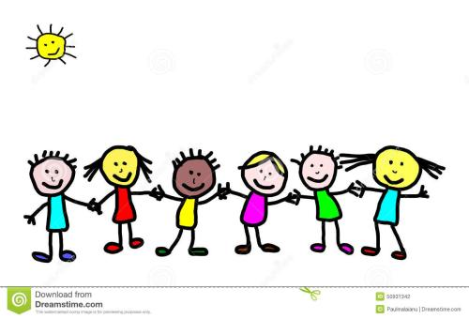
Guessing game
It’s a beautiful place. There are many trees, flowers and grass in it. There are some animals in it, too.
Where is it?
Notes:
Guessing game(猜谜）
学生根据老师的描述与提示，猜出故事发生的地点Garden.

Slide 3
Look and say
What can you see from the cover?
What is the title?
Garden

Slide 4
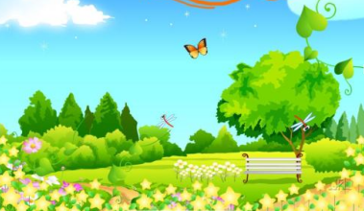
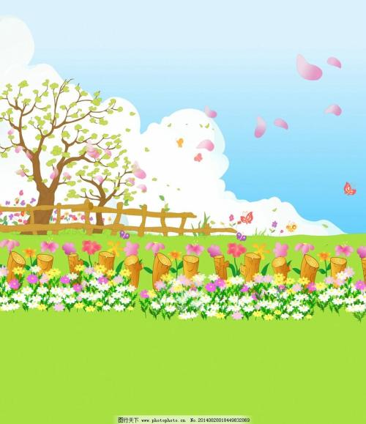
Garden

Slide 5
Look and say
Where is it?
When is it? Day? Night?
Night

Slide 6
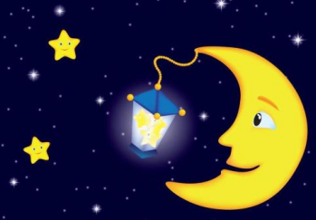
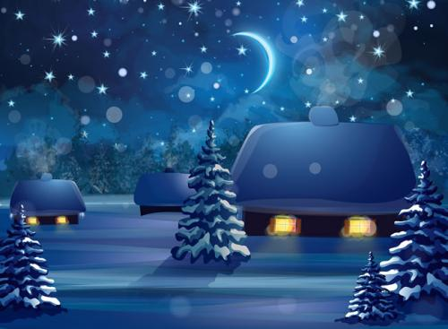
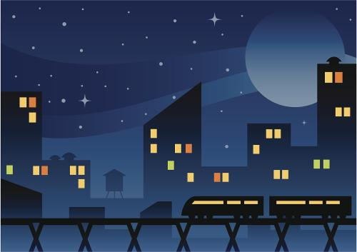
Night

Slide 7
Look and say
What will come out at night in the garden?

Slide 8
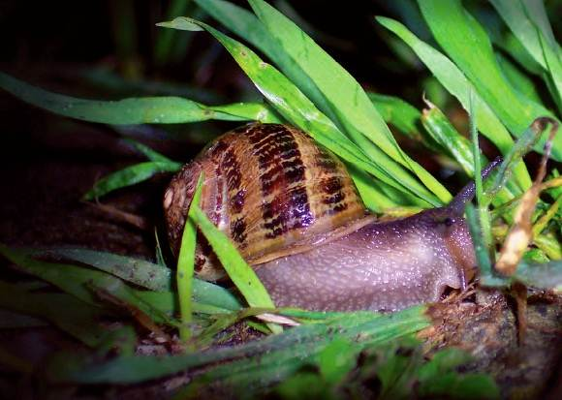
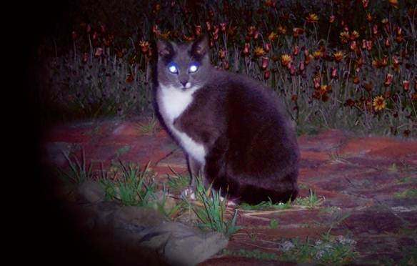
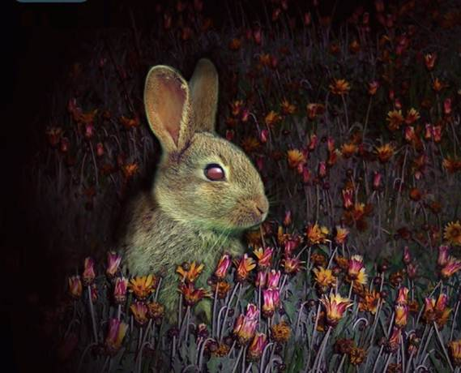
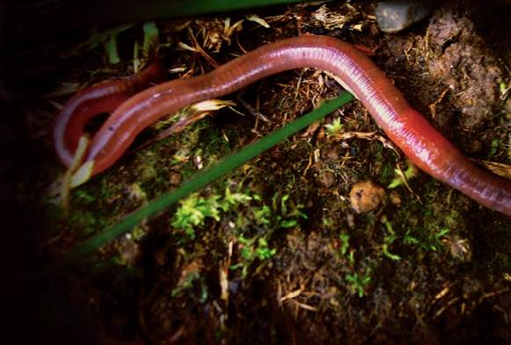
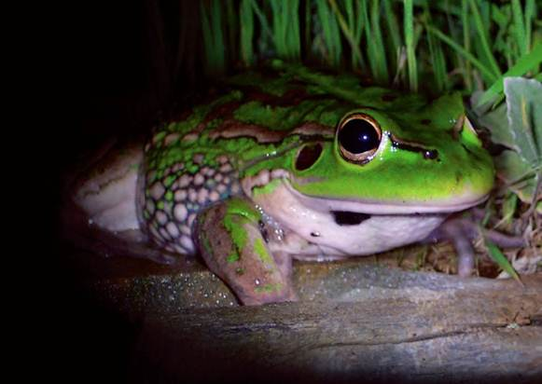
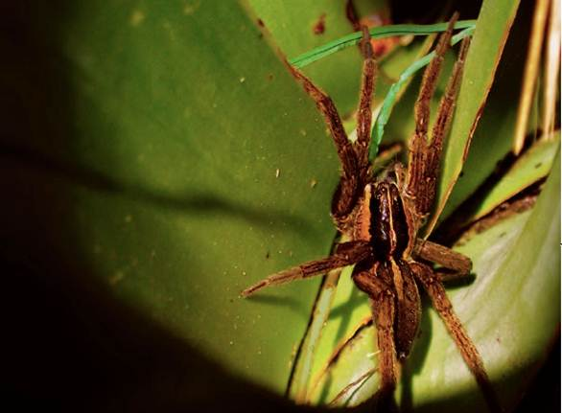
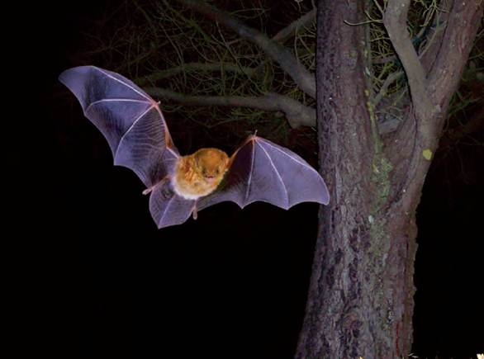
Read & predict
What will come out at night in the garden?
Why do they come out at night in the garden?
What animals can you see?

Slide 9
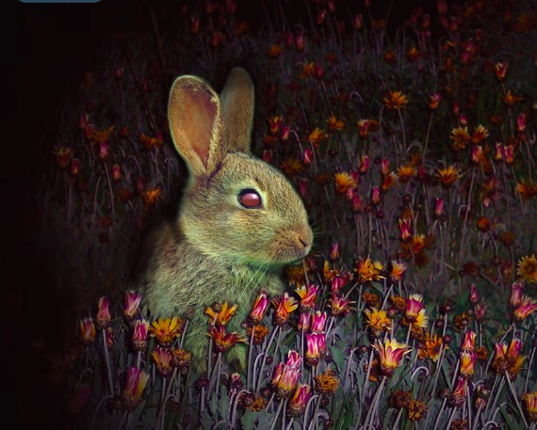
Picture walk
Where do you think the rabbit is?
What do you think it could be doing?
Why do you think rabbits come out at night?

Slide 10
Picture walk
Who has a cat at home?
What does your cat do at night?
Look at the cat’s eyes.
What do you notice?

Slide 11
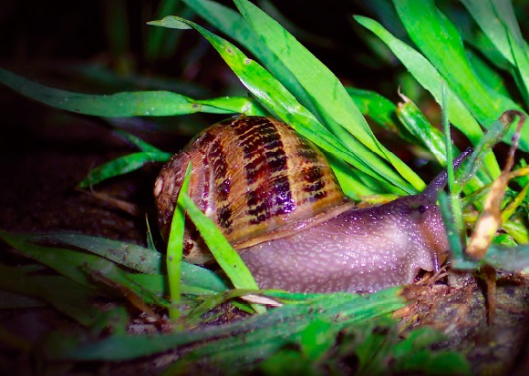
Picture walk
What do you think is in the garden?
What do you know about snails?
What do they do in the garden at night?

Slide 12
Picture walk
Have you ever seen a worm? Where did you find it?
What do you know about worms?
What do you think a worm is doing in a garden at night?

Slide 13
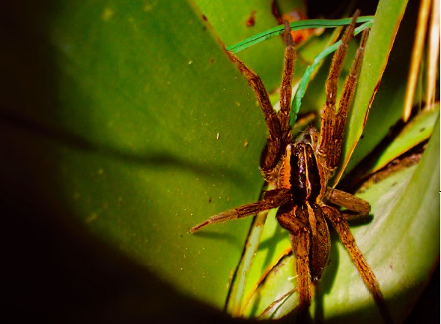
Picture walk
What do you know about spiders?
What do you think a spider is doing in a garden at night?

Slide 14
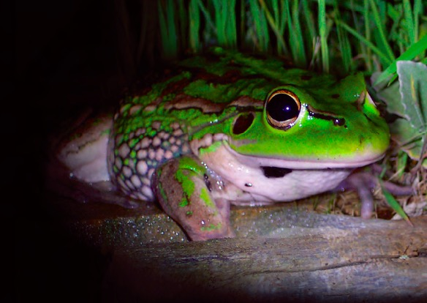
Picture walk
What do you know about frogs?
Why do you think frogs might come out at night?

Slide 15
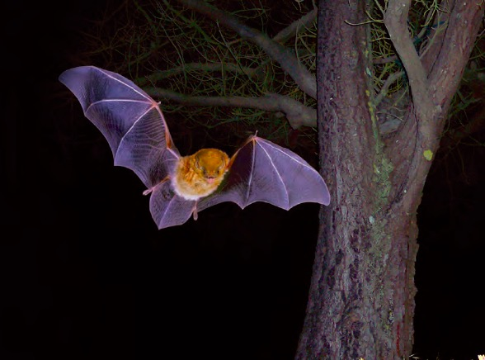
Picture walk
What do you think the bat is looking for?
What animals in the garden might hide from a bat? Why?

Slide 16
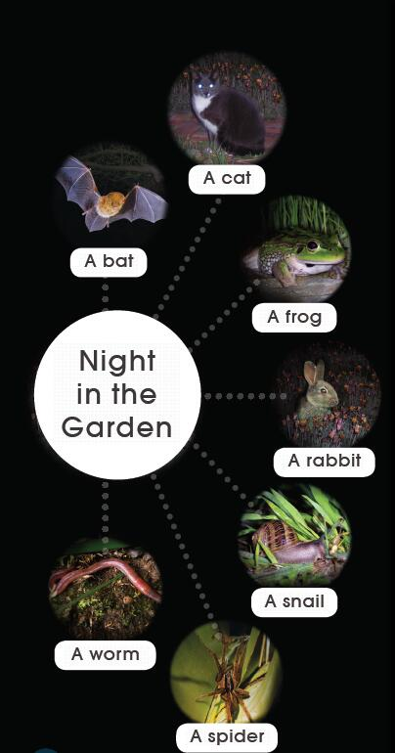
Try to say
Bat
Cat
Frog
Rabbit
Snail
Spider
Worm

Slide 17
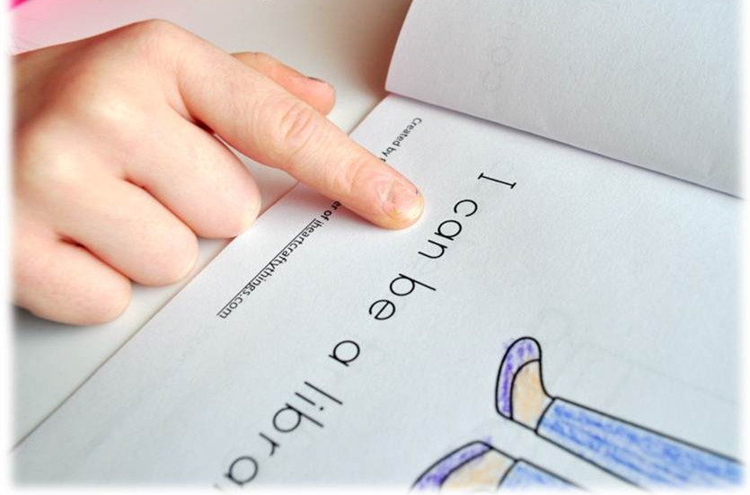
Read and find
Tips:
Point and read

Slide 18
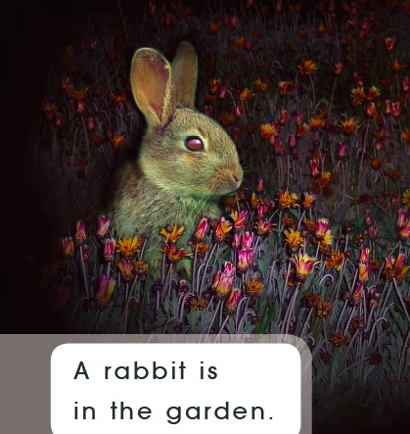
Which word says rabbit?
How do you know?
Read the sentence.

Slide 19
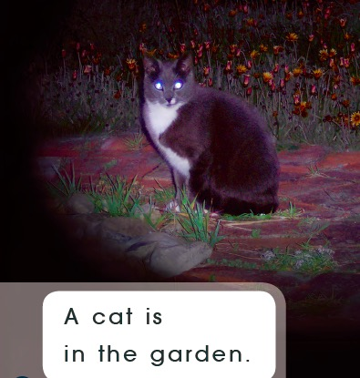
Make a circle with your finger around the word that says cat.
What sound can you hear at the beginning of the word cat?
What word would we make if we swapped the /k/ in cat for /m/?
What word would we make if we swapped the /m/ in mat for /b/?
What other words could we say that rhyme with cat?

Slide 20
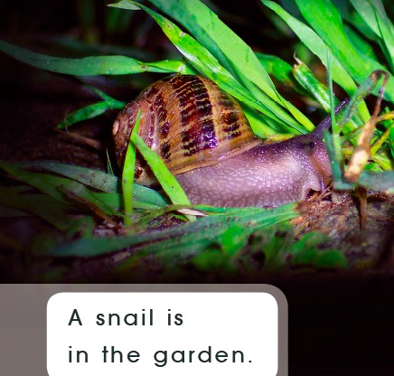
1. Which word says garden?
How do you know?
2. Make a circle with your finger around the word garden. What sound does it start with?

Slide 21
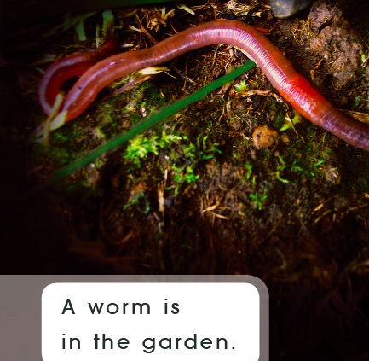
What does it tell you about the worm?

Slide 22
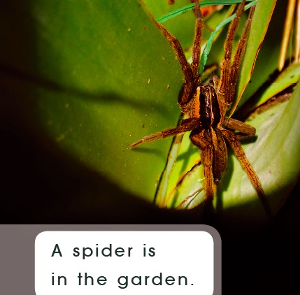
1. Which word in the sentence says spider?
2. How do you know?

Slide 23
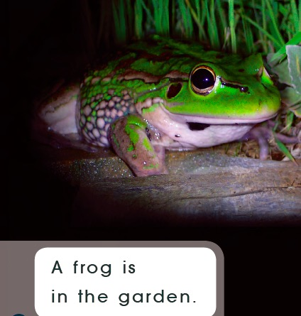
Which word says frog? How do you know?
Which word says garden?
3. How do you know?

Slide 24
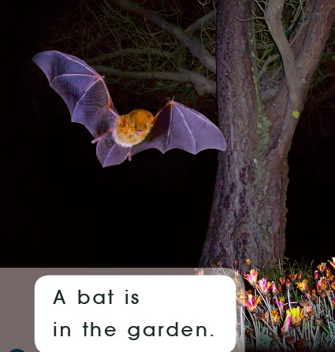
Read the sentence to a partner.

Slide 25
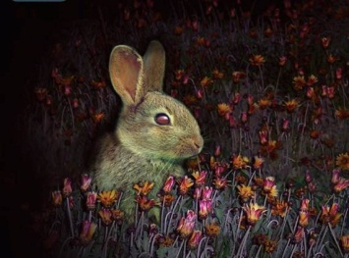
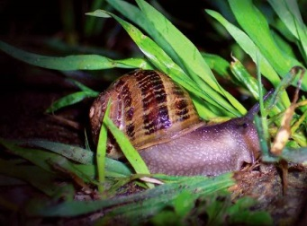
Think & match

Slide 26
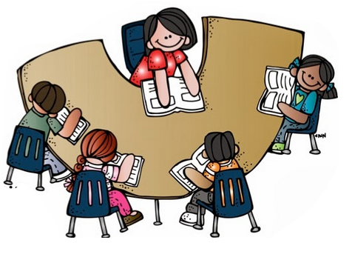
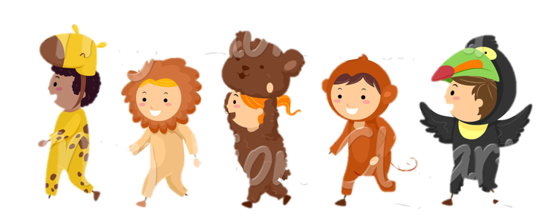
Let's read
·Read by yourself
·Read in groups
·Readers theater

Slide 27
Let's try
·What other night animals do you know?
Night
Animals

Slide 28
