Slide 1
Go, Mouse
老鼠快跑
选自《多维阅读第2级》

Slide 2
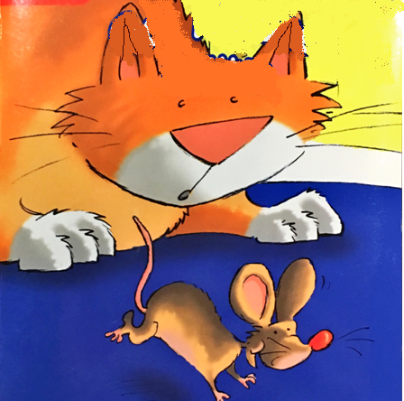
Look and say.
What is the title?
A. The mouse and
the cat
B. Go, mouse
C. No, cat.

Slide 3
View and answer.
What does the title mean ?
2. What happens ?
Act it out.

Slide 4
View and say.
chair
The mouse is under the chair.

Slide 5
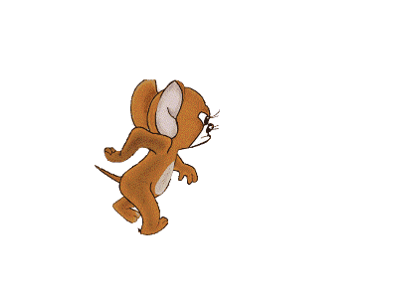
View and say.
mouse

Slide 6
View and say.
under

Slide 7
View and say.
the

Slide 8
View and say.
table
The mouse is under the table.

Slide 9
View and say.
basket
The mouse is under the basket.

Slide 10
View and say.
pillow
The mouse is under the pillow.

Slide 11
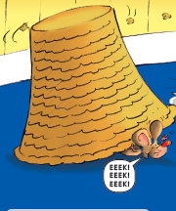
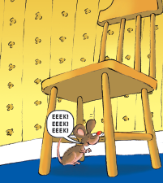
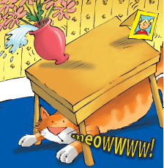
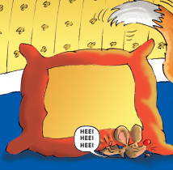
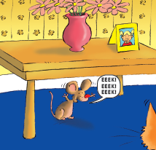
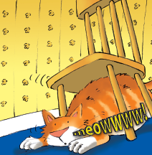
View and number.
( )
( )
( )
( )
5
1
4
6
( )
( )
( )
7
3
2

Slide 12
Guess and choose.
1. Where is the mouse going ?
House.
B. In the cafe.
C. In the playground.

Slide 13
Think and say.
2. Where is the cat ?
3. Why do you order it like this ?

Slide 14
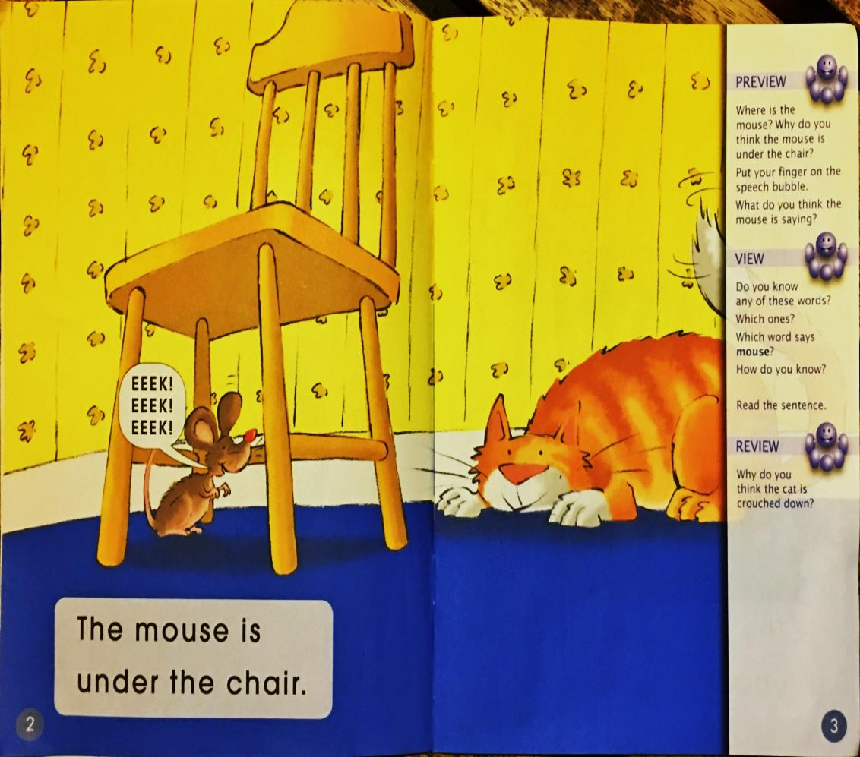
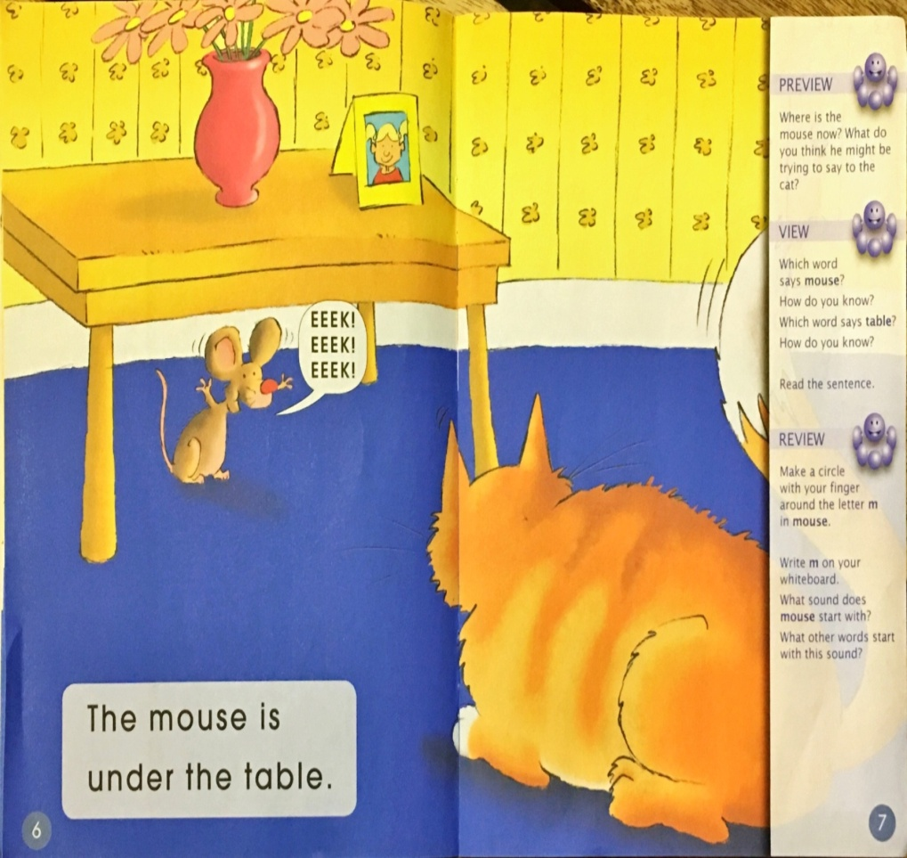
View and say.
Where is the mouse?

Slide 15
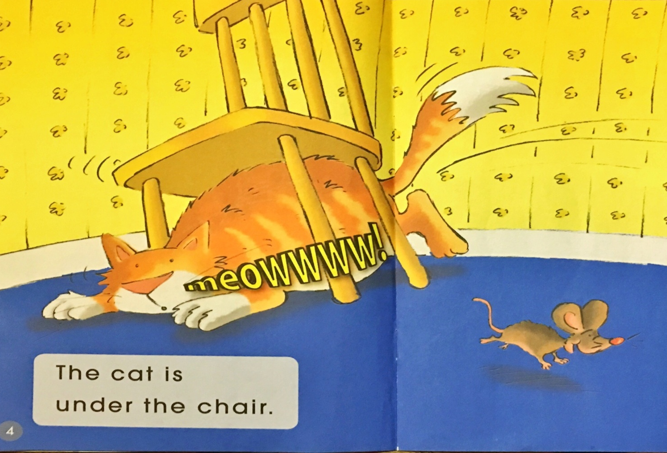
View and say.
Where is the cat doing? Why ?

Slide 16
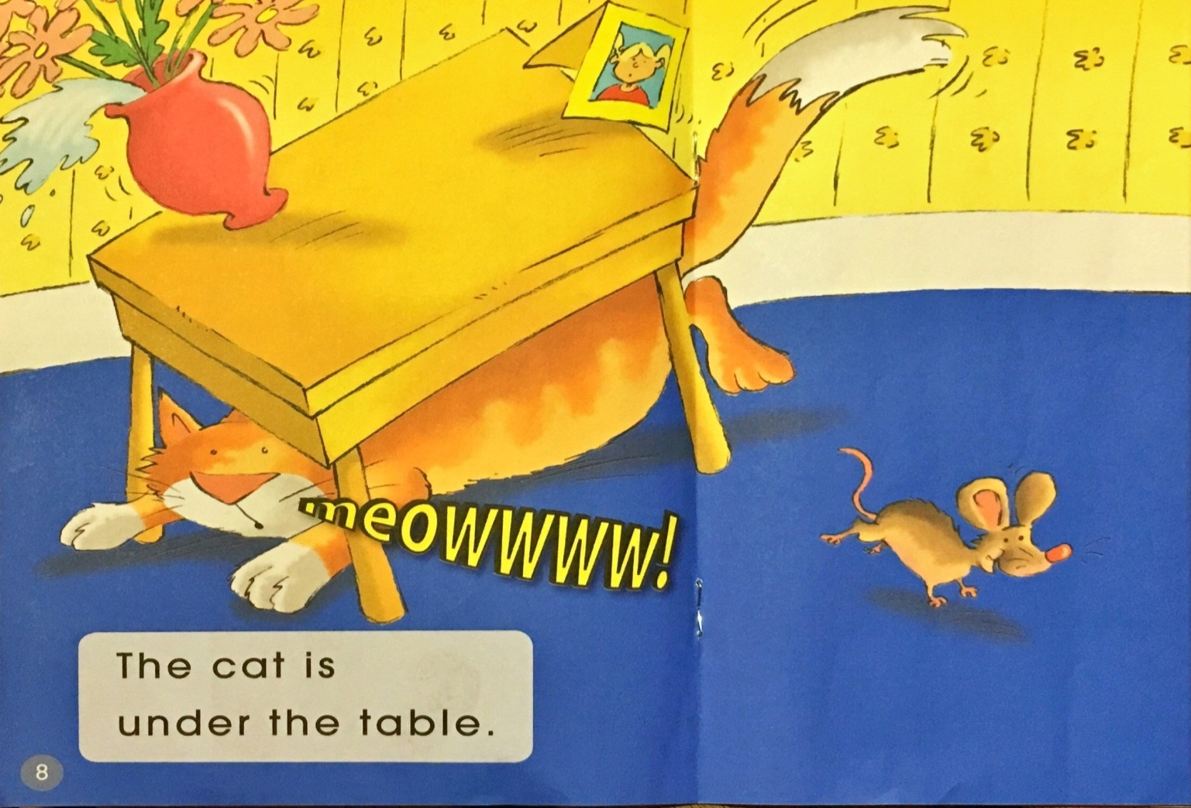
View and say.
What is the cat saying ?

Slide 17
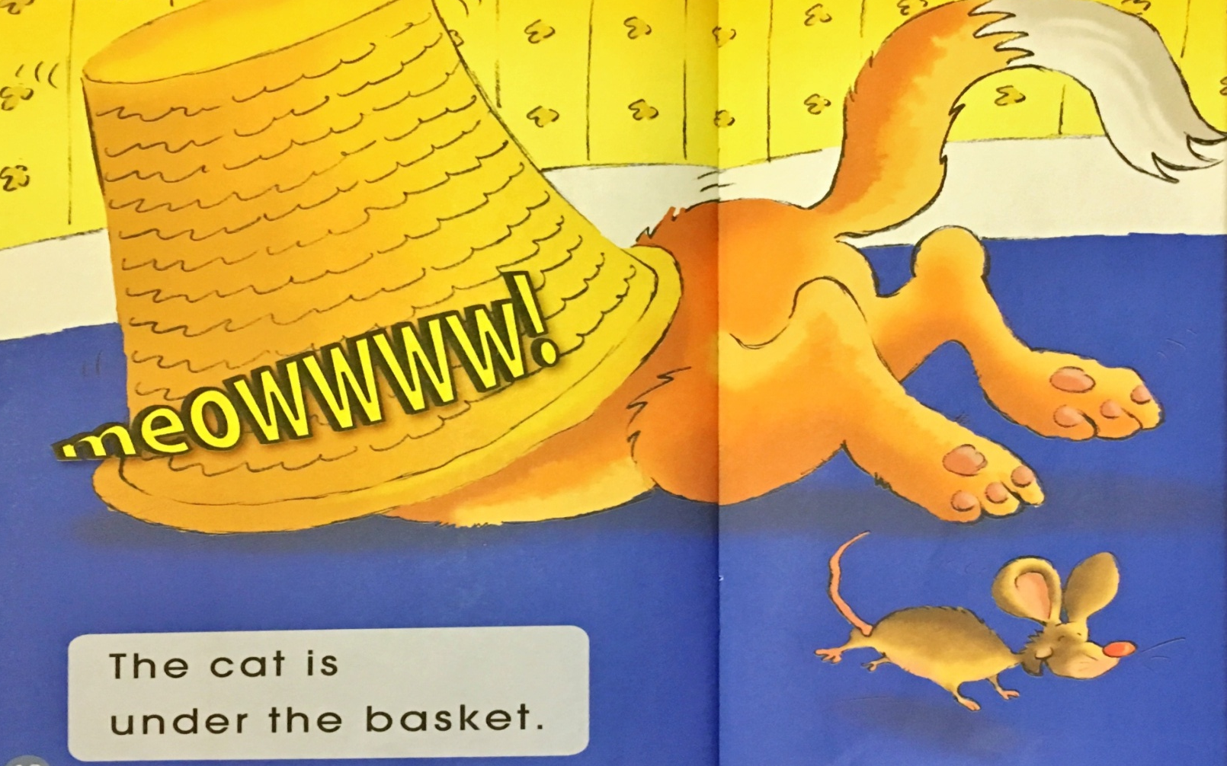
View and think.
Who is under the basket now?
What do you think is going to happen next ?

Slide 18
Read and think.
Why is the cat meowing?
Is the mouse afraid of the cat ?

Slide 19
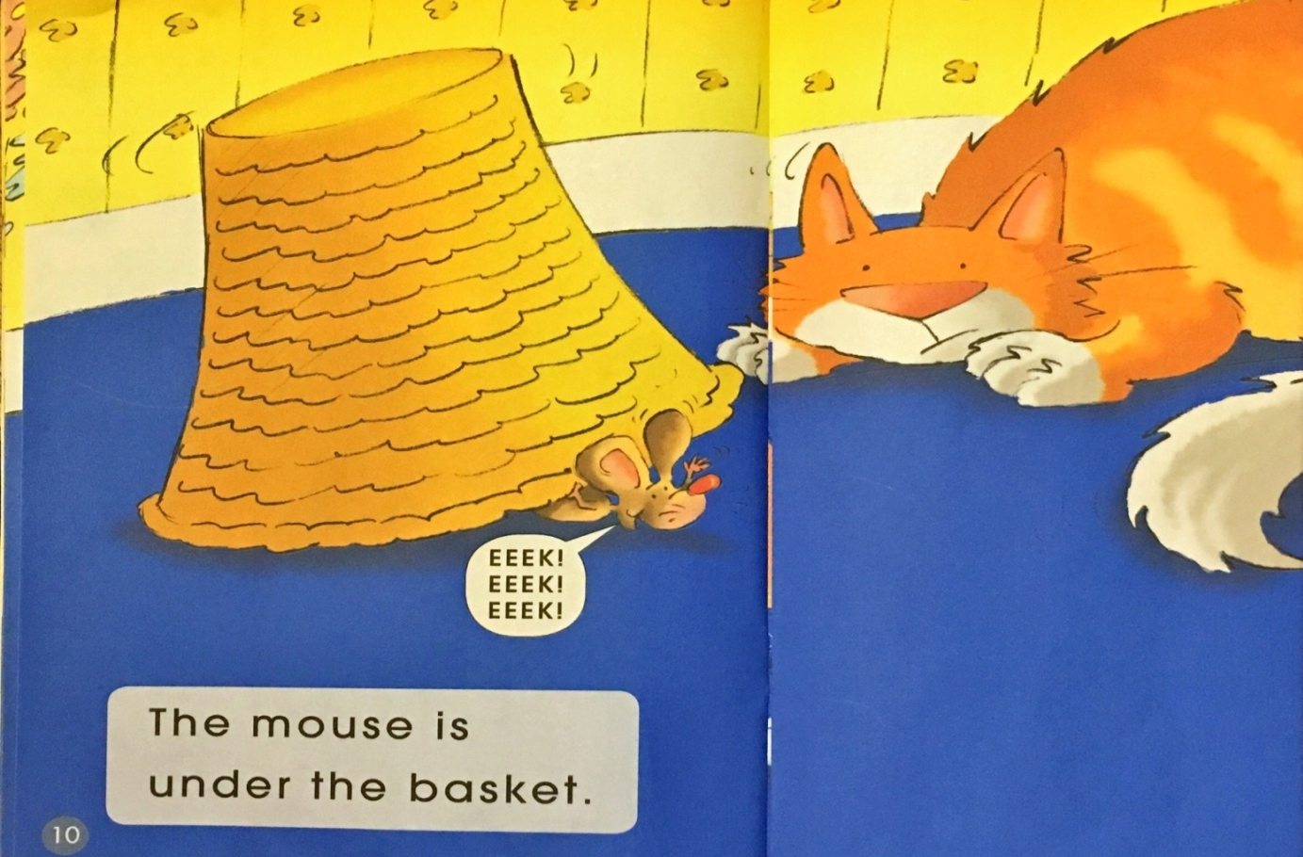
View and think.
What is the mouse doing ?
What do you think the cat might be thinking?

Slide 20
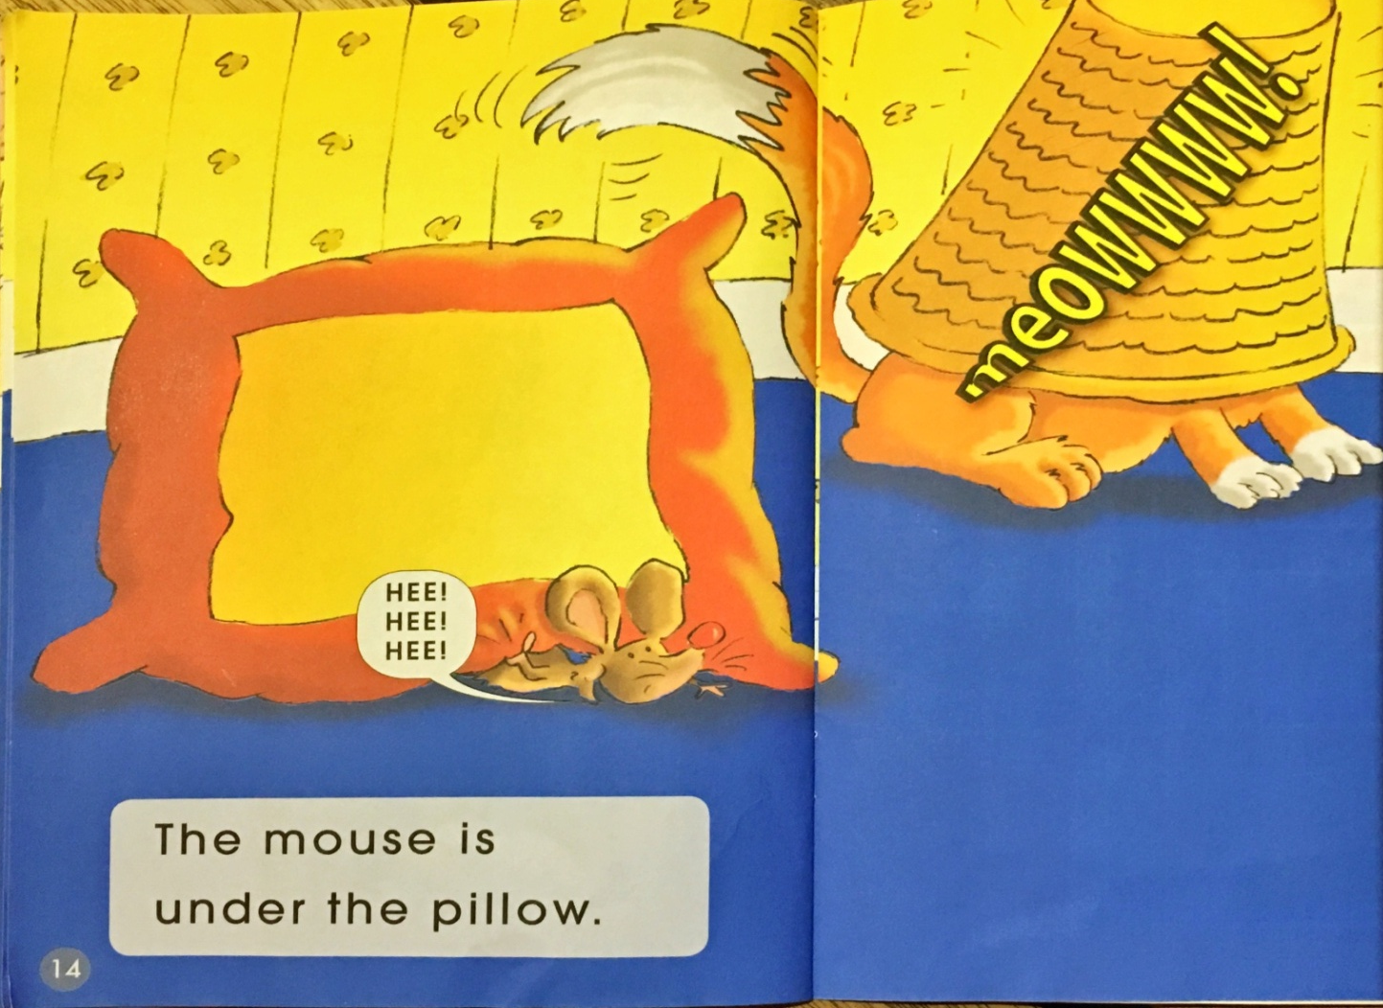
View and think.
How is the cat feeling now? Why?

Slide 21
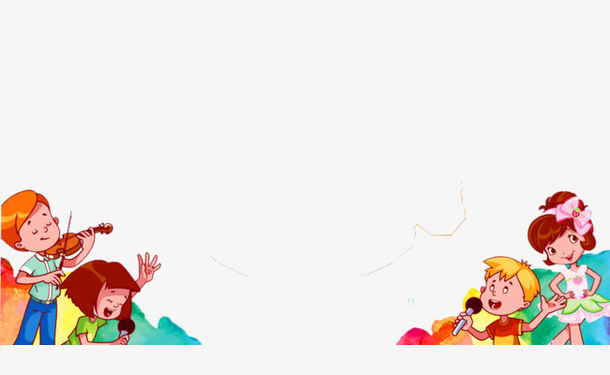
1. Read aloud the story.
2. Act out the story.

Slide 22
Look and retell the story.
1 2 3 4
5 6 7

Slide 23
Play and say.
玩戏剧游戏：
用不同的情感和语气说出同一
个句子，看谁说得更加生动、有趣。

Slide 24
Act and say.
同桌合作表演故事。
1. 声音洪亮
2. 发音标准
3. 动作到位

Slide 25
Think and discuss.
What problems does the cat meet at the end of the story？Do you think how to solve them？
B. How do you think of the mouse?
Why ?
C. Have you ever had a problem? How
was it solved? How did you feel?

Slide 26
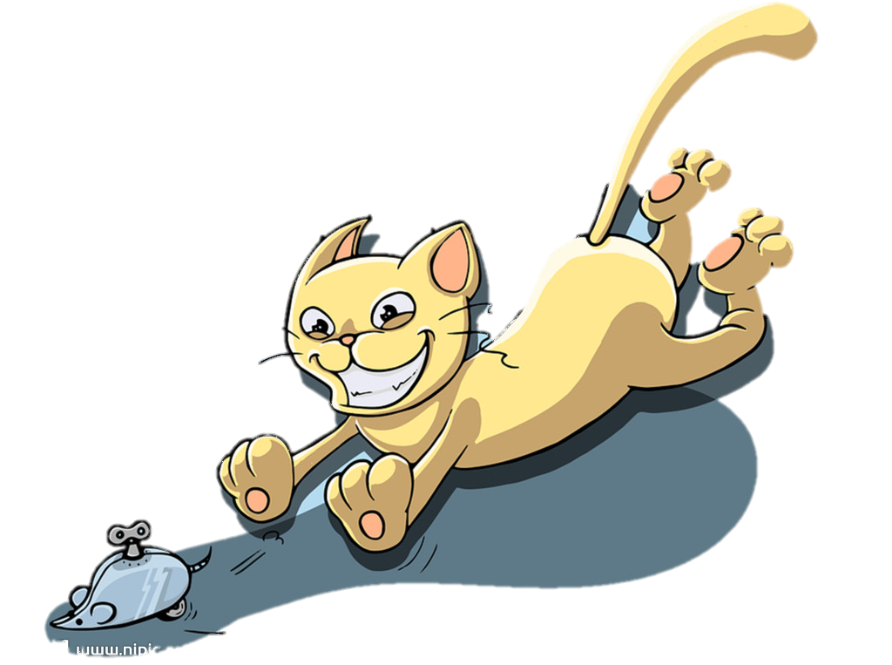
Think and make a new ending.

Slide 27
Homework.
Read or act out the story to your family.

Slide 28
Thank you!

