Slide 1
Tricky Tiger
老虎的小聪明
选自《多维阅读第2级》

Slide 2
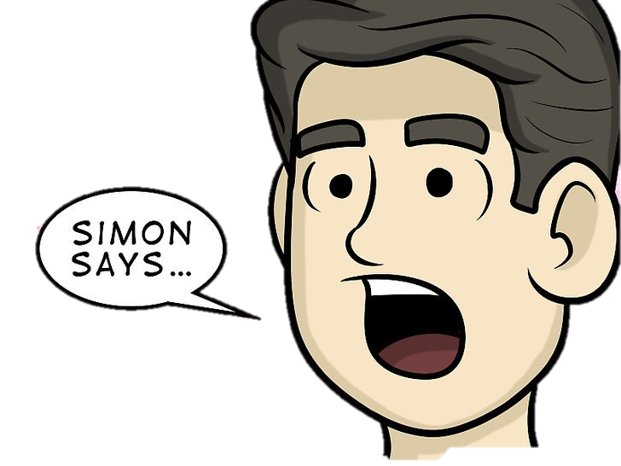

Slide 3
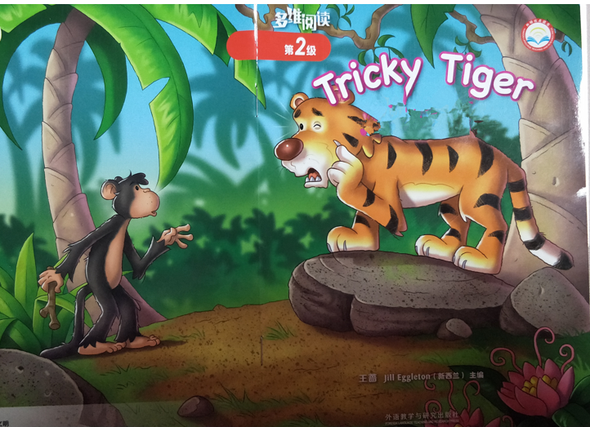
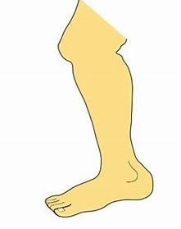
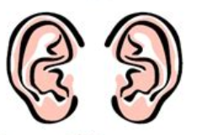

Slide 4
Look and Say
What can you see from the cover page?
What is the title?
Why is the tiger tricky?
tricky

Slide 5
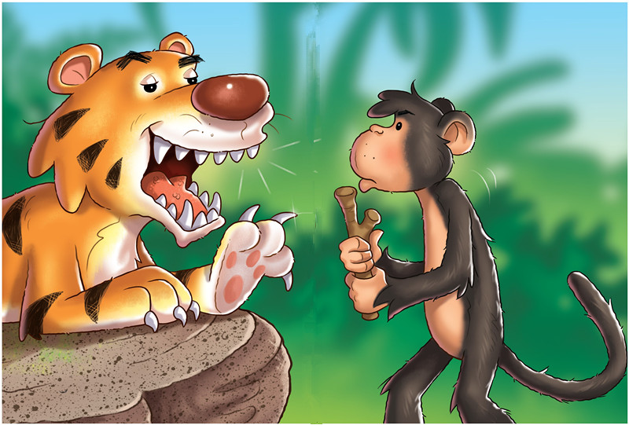
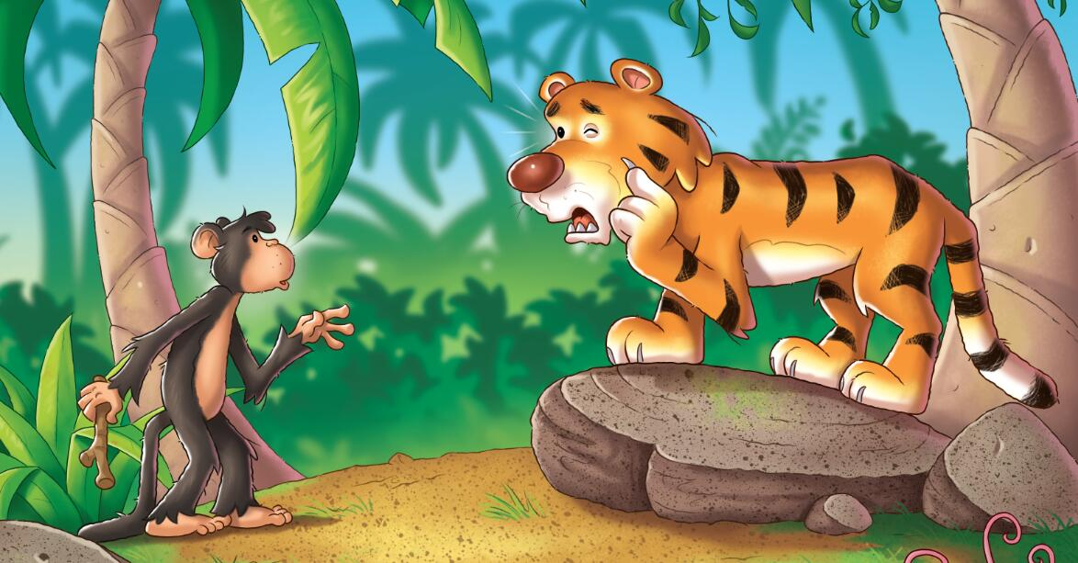
Look and Predict
Did Tiger trick Monkey successfully at last?
How do you know?

Slide 6
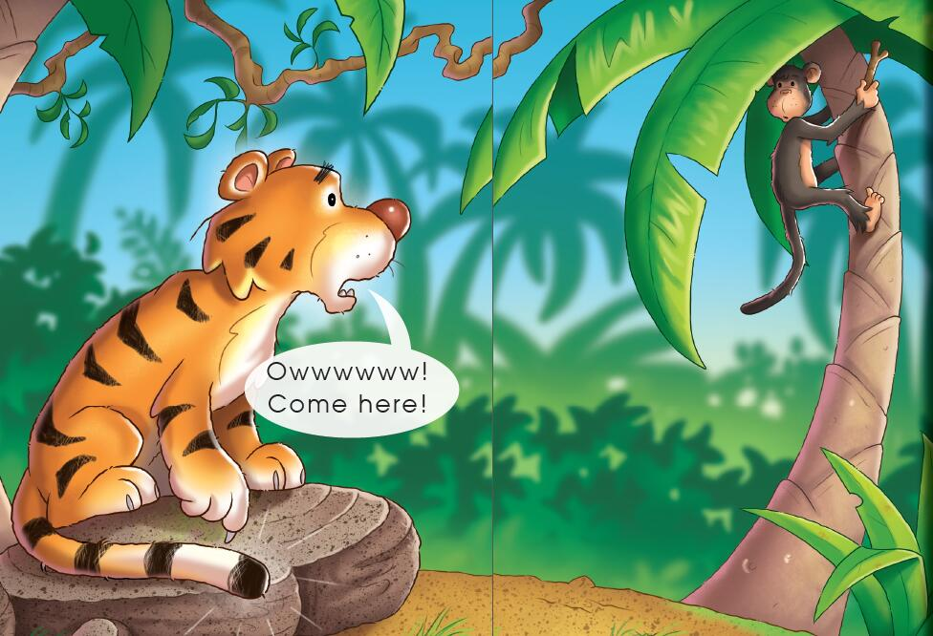
Picture Walk
What’s wrong with Tiger? How do you know?
Where is Monkey?
What’s in Monkey’s hand?

Slide 7
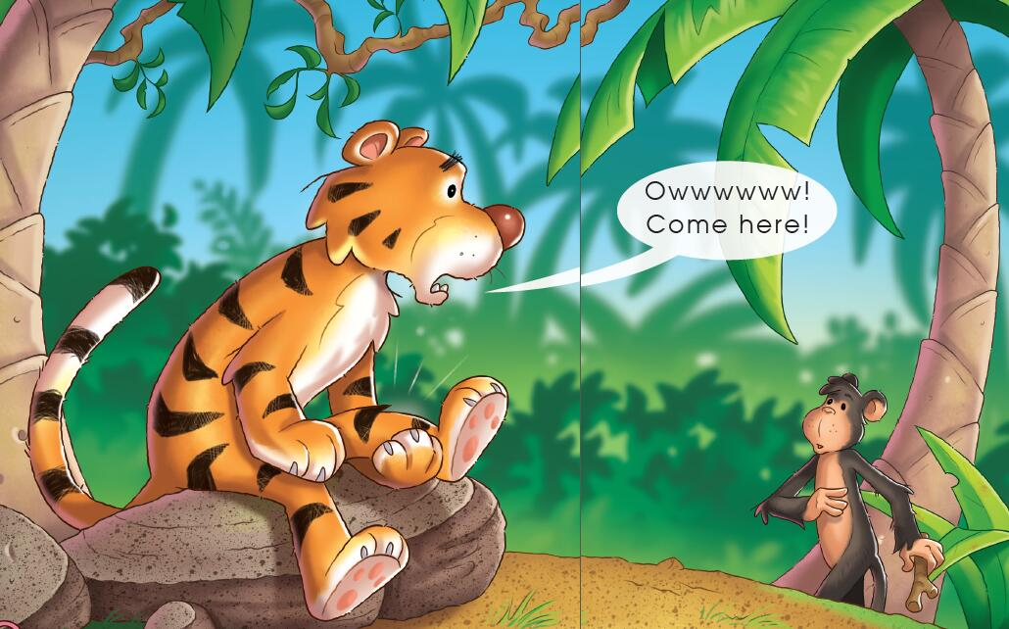
Picture Walk
What’s wrong with Tiger now?
Where is Monkey now?

Slide 8
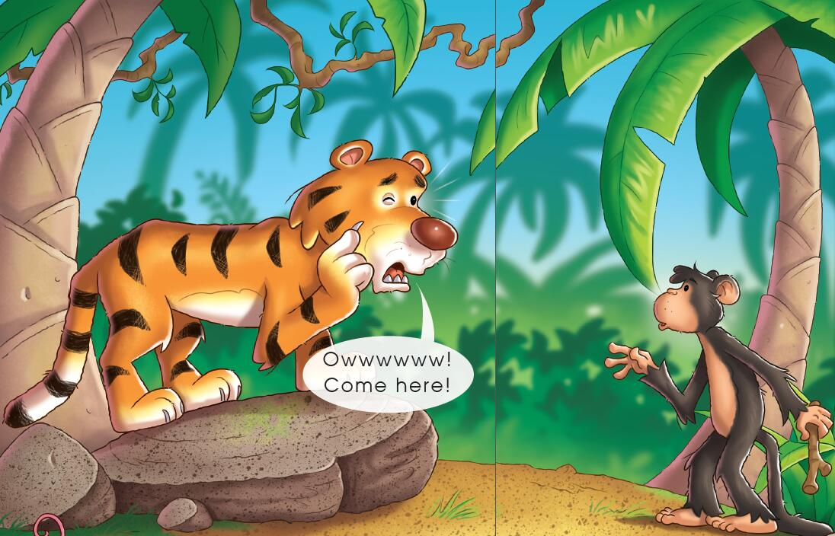
Picture Walk
Do you think Tiger really has a sore eye?
Is Monkey afraid of Tiger? How do you know?

Slide 9
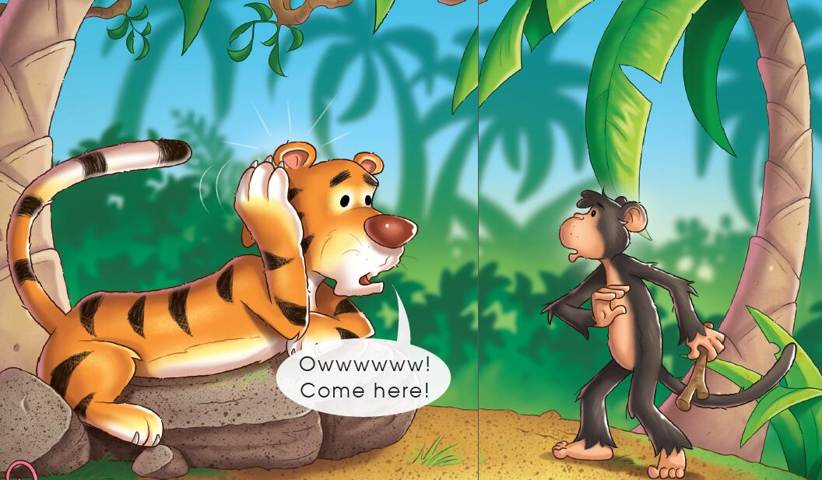
Picture Walk
What does Tiger say is sore now? How do you know?
Is Monkey coming closer again?

Slide 10
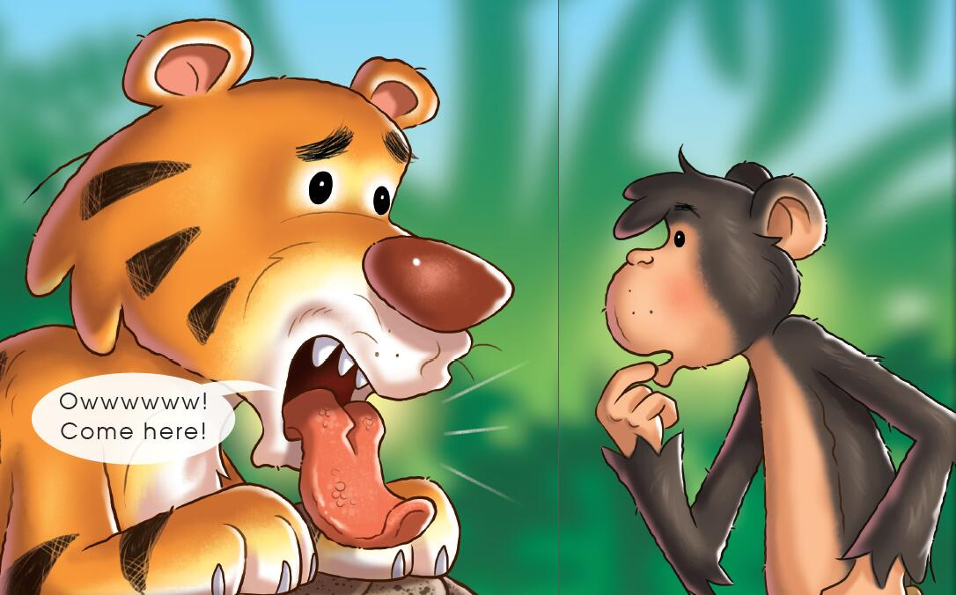
Picture Walk
What do you think Tiger is saying to Monkey now?
What is Monkey thinking about?

Slide 11
Picture Walk
Look at Tiger’s face. Is he happy or sad now? Why?
What do you think Monkey will do next?

Slide 12
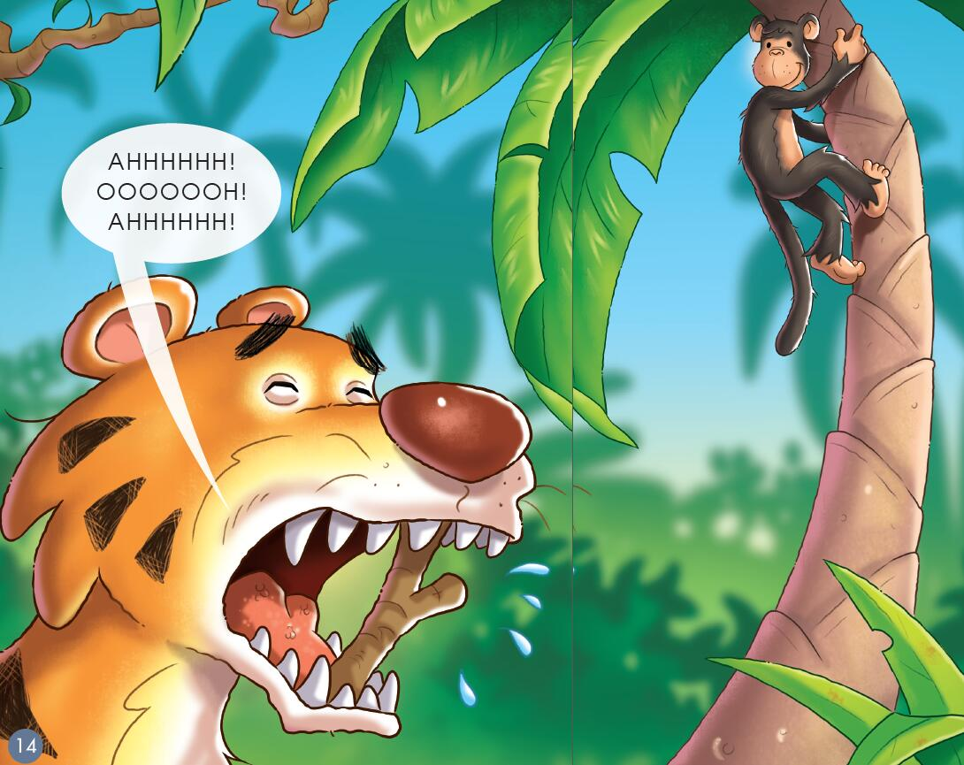
Picture Walk
What does Monkey do with Tiger?
How do they feel? How do you know?

Slide 13
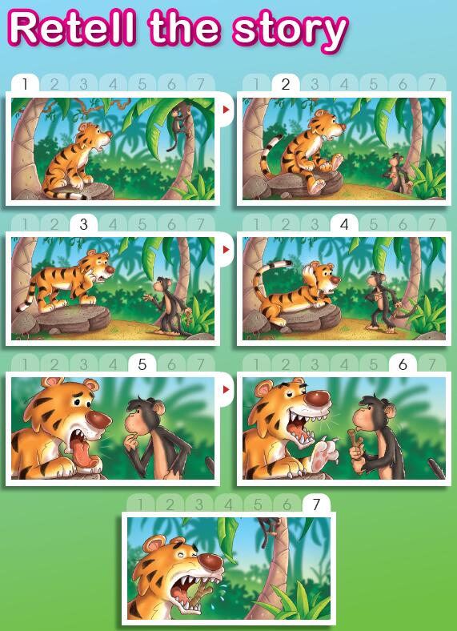
Did Tiger trick Monkey successfully at last?

Slide 14
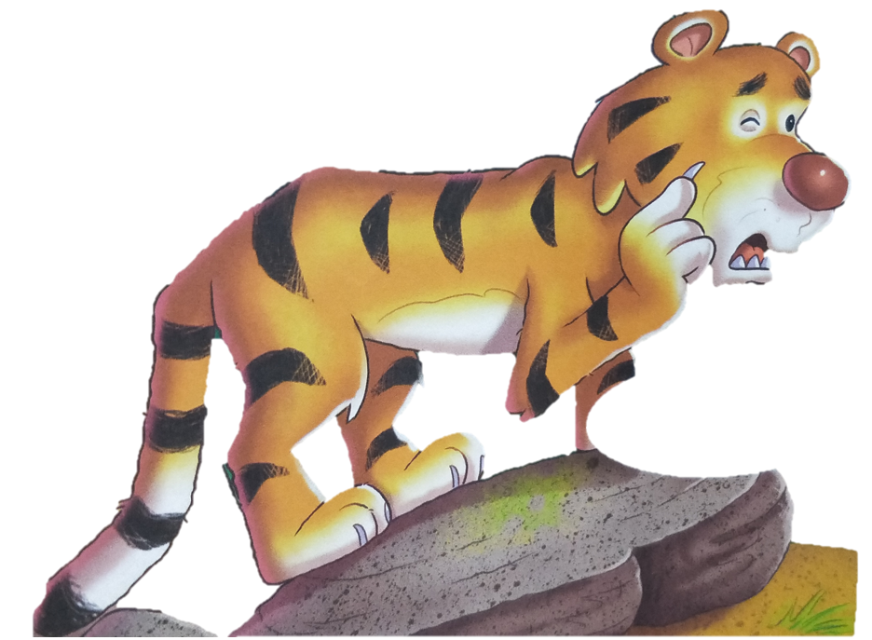
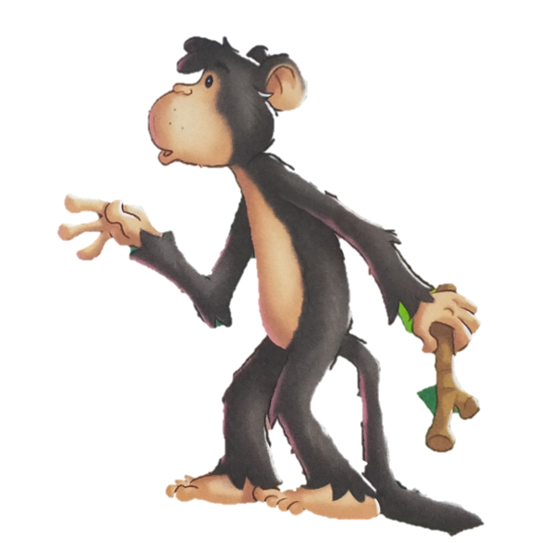
Think and Number
4
3
6
5
2
1

Slide 15
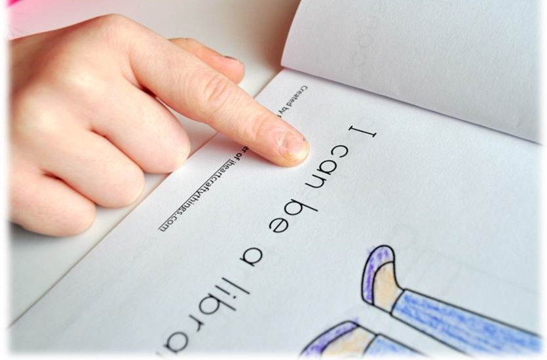
Read and Find
Tips:
1. Point and read.
2. Read the speech bubble as if you were the tiger.

Slide 16
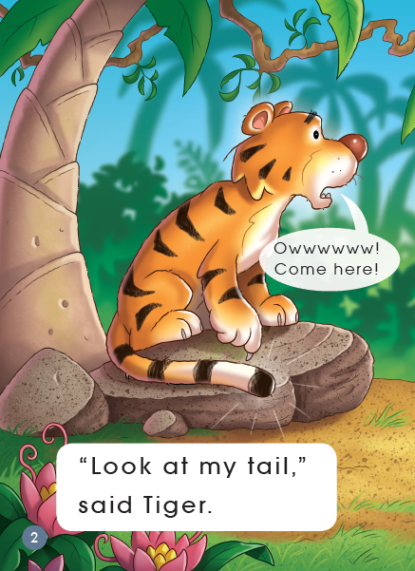
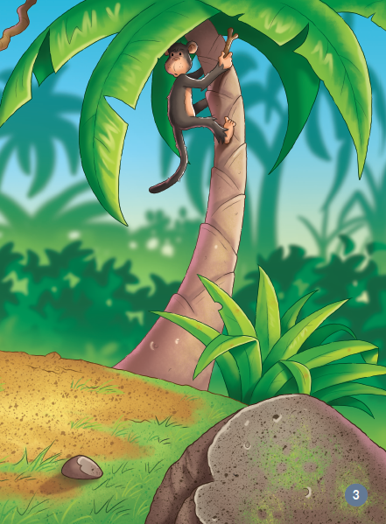
Which word says “Tiger”?
What sound does “Tiger” start with?
What other words start the same?

Slide 17
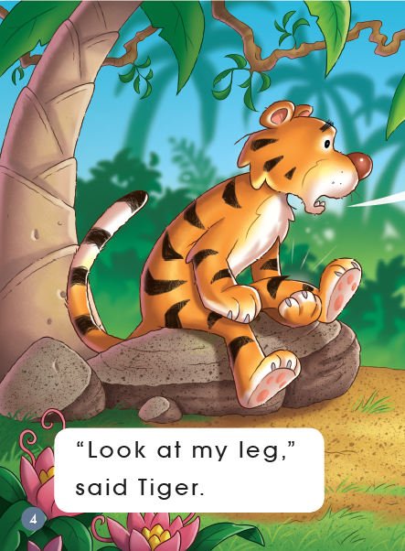
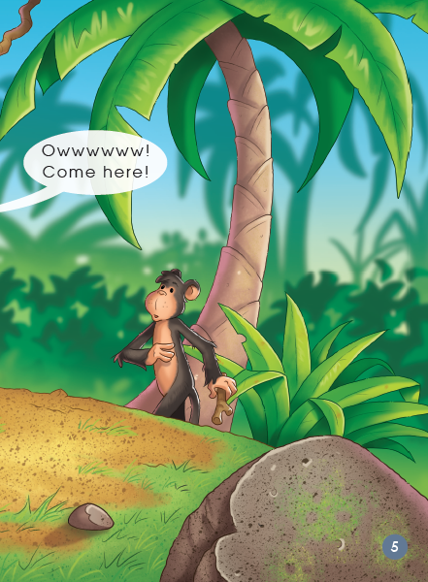
1. How do you know the tiger is talking?
2. Make a circle with your finger around the speech marks.
3. Change your voice between the speech marks to sound like the tiger.

Slide 18
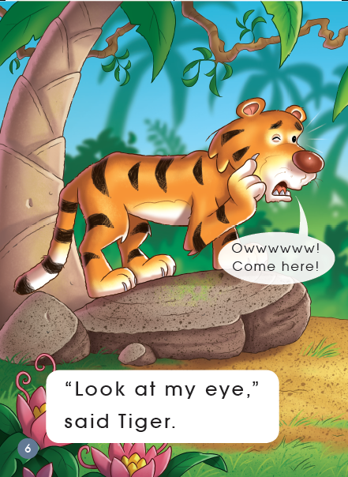
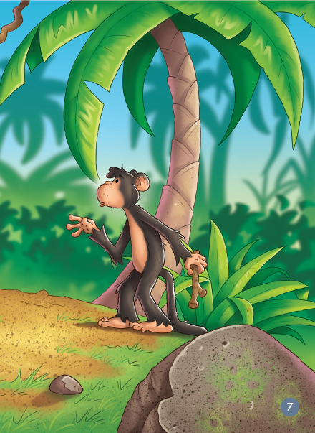
1. Make a circle with your finger around the word “Look”.
2. If you change “l” to “b”“t” “sh”, what would the words be? Can you read them?

Slide 19
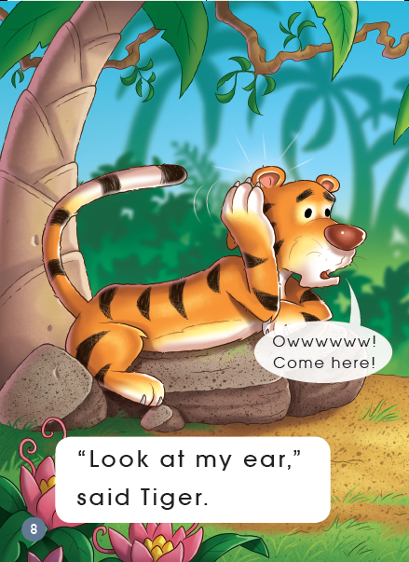
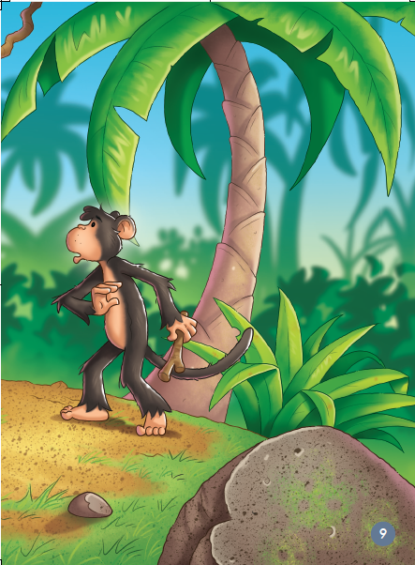
1. Put your finger on the word that says where the tiger is sore. What does this word say?
2. How do you know that?

Slide 20
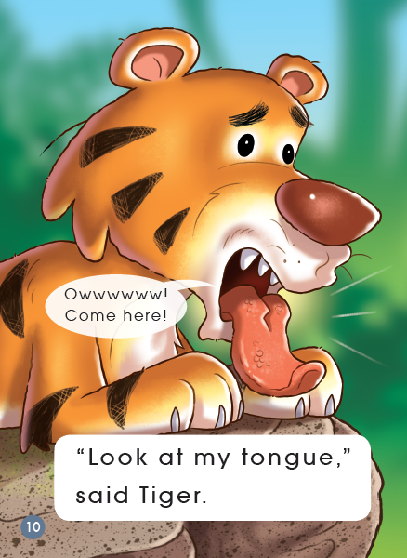
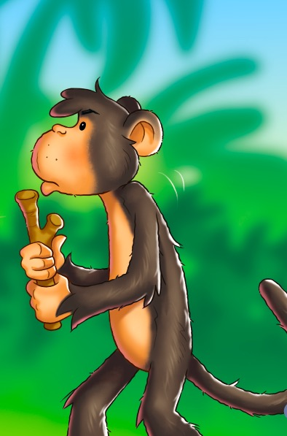
1. Put your finger on the word that says where the tiger is sore. What does this word say?
2. Make a circle with your finger around the letter t in Tiger and tongue. Are they the same?

Slide 21
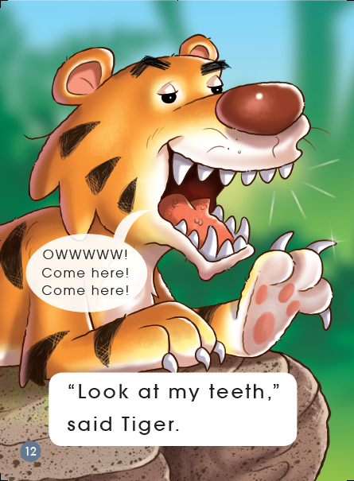
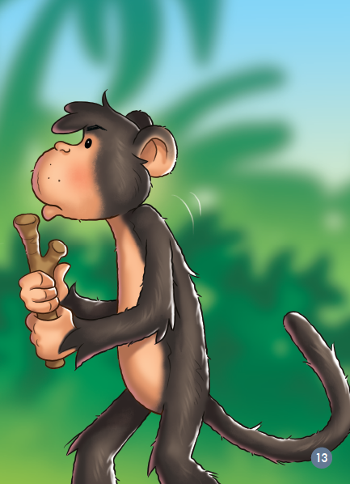
1. Put your finger around the word that means .
2. What sound does “teeth” start with?
3. Is OWWWWW! in the speech bubble the same as other pages? Why are they different?

Slide 22
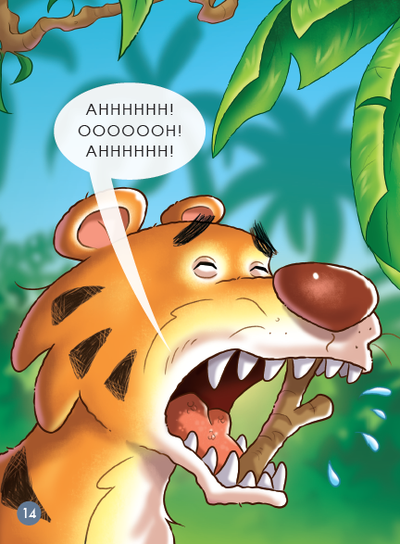
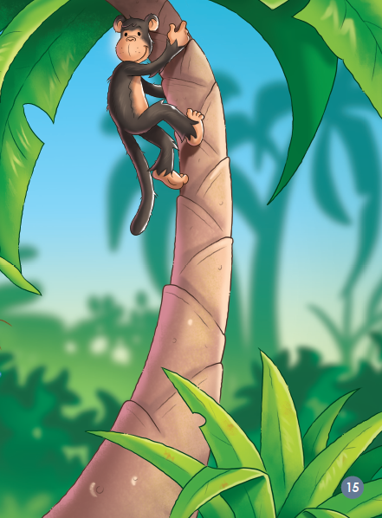
1. Read the speech bubble and make your voice sound like Tiger may have said it.
2. Why are “AHHHHHHH” “OOOOOOH” all in big letters?

Slide 23
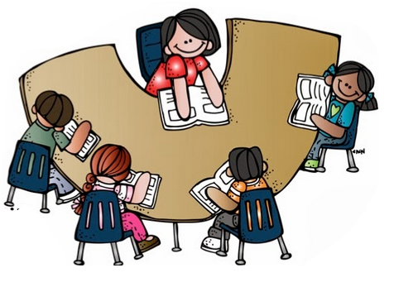
Read in Groups

Slide 24
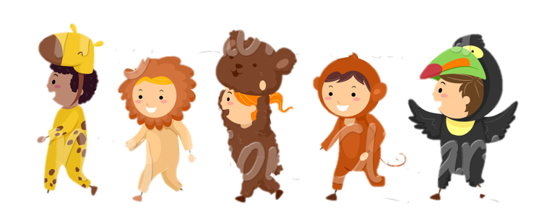
Role Play

Slide 25
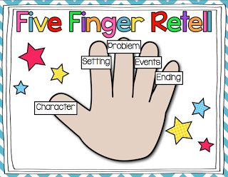
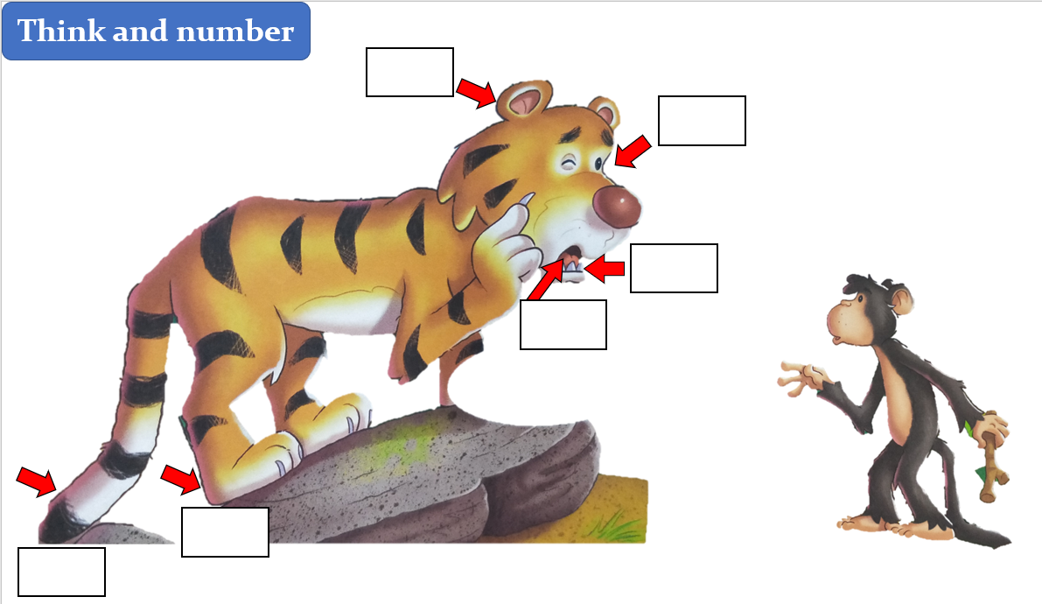
Retell in Groups

Slide 26
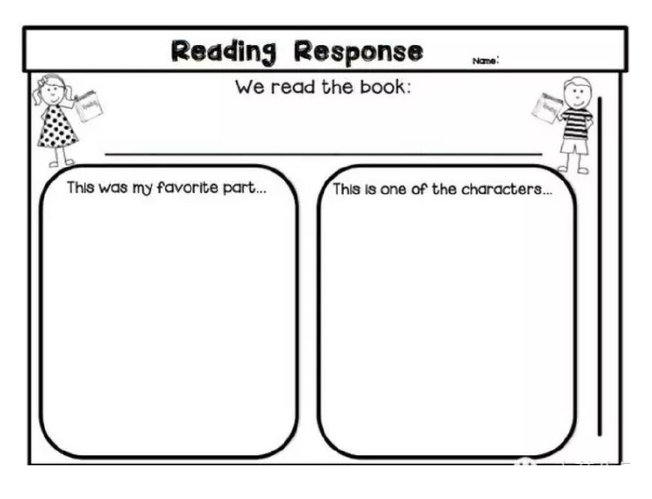
Think and Draw

Slide 27
