Slide 1
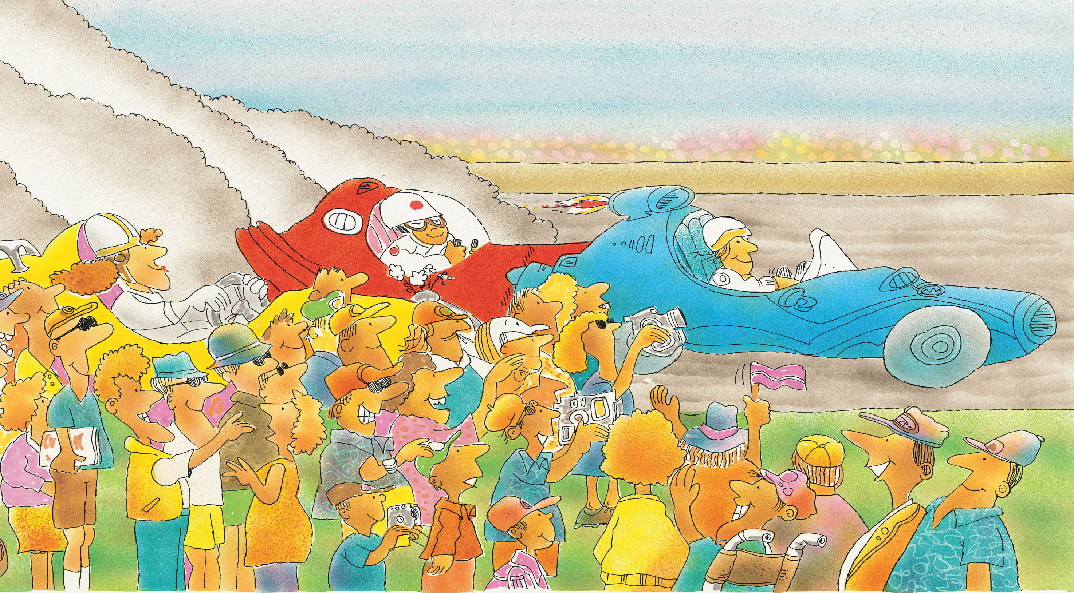
Racing Cars
谁是冠军？
选自《多维阅读第2级》

Slide 2
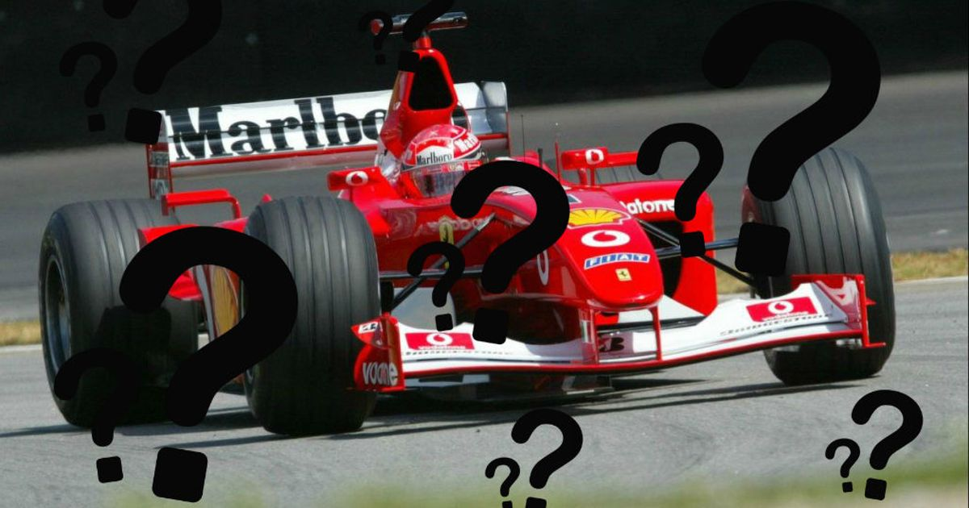
How much do you know about racing cars?

Slide 3
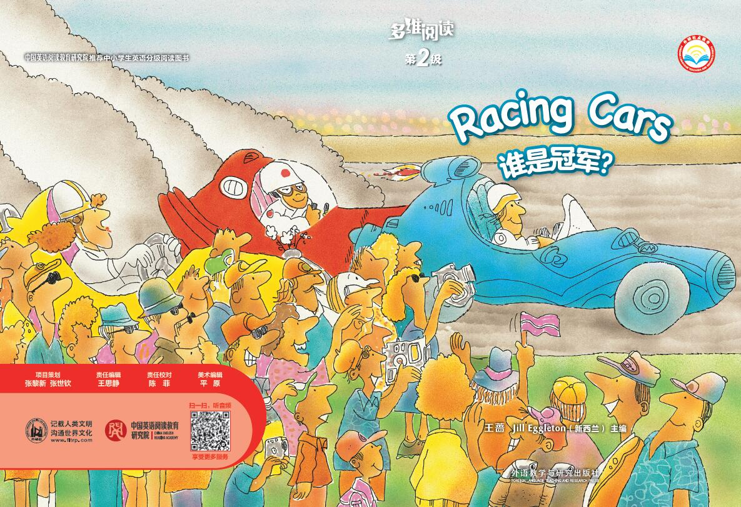
What is the title of the book?
What can you see from the cover page?

Slide 4
Look and say
1. Where are the people?
2. What are they doing?
3. How many racing cars can you see?
4. What colours are they?

Slide 5
Look and predict
Who is the winner of the race?
Why？

Slide 6
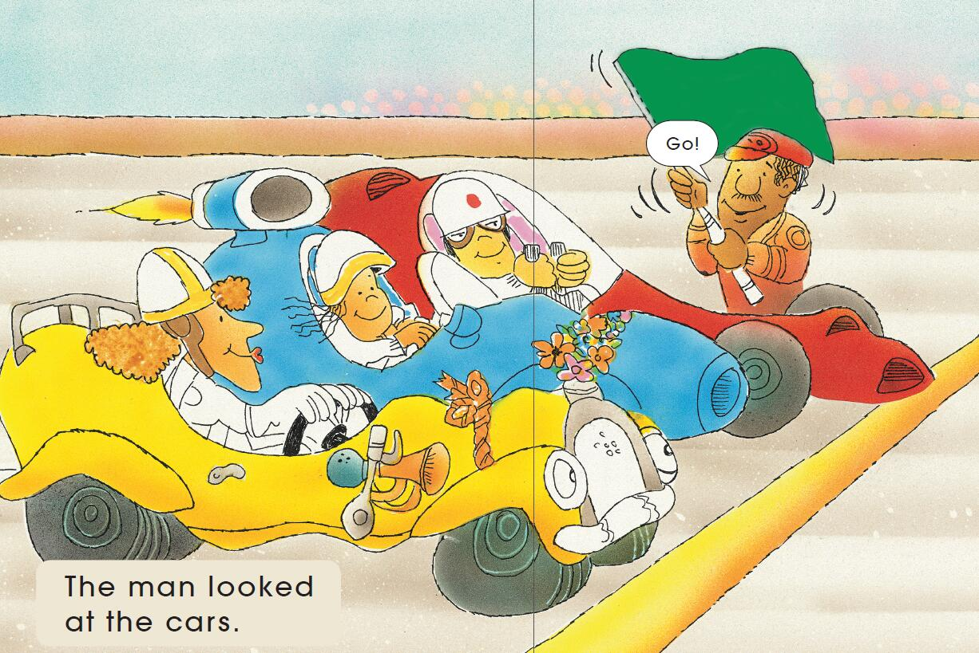
Picture walk
Who is the man with the green flag?
What are these cars going to do?

Slide 7
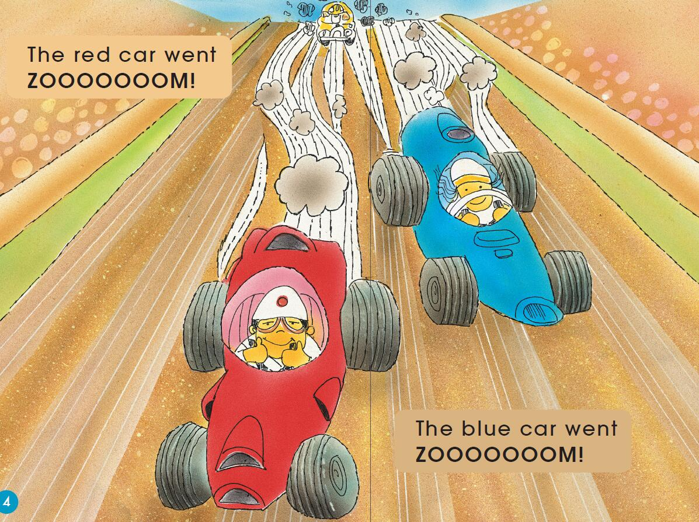
Picture walk
Who is the first now?
Who is the second?

Slide 8
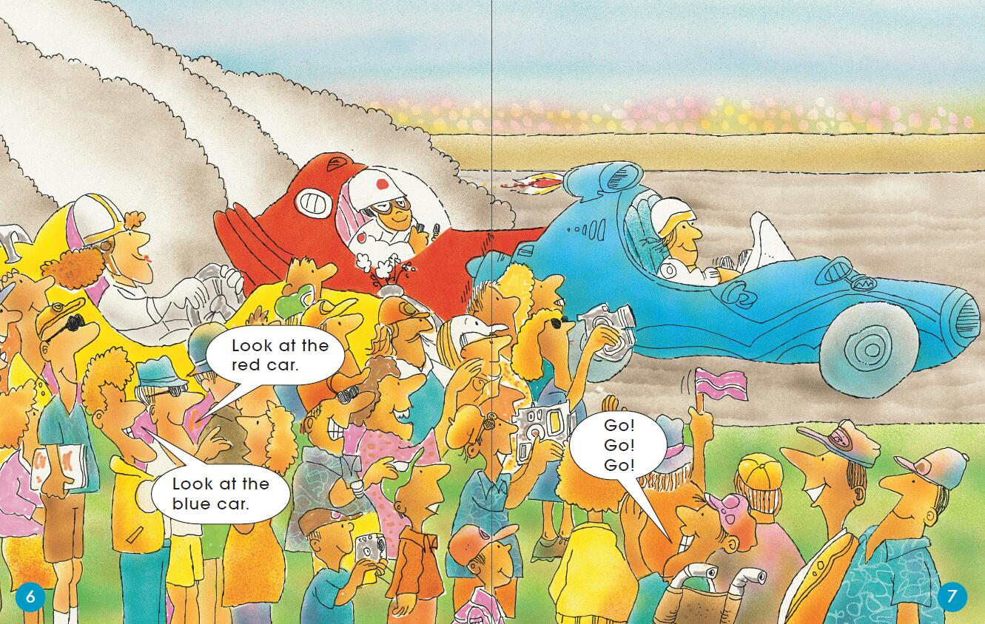
Picture walk
Who is winning the game now?
What are the audience doing? How are they feeling?
How are the drivers feeling?

Slide 9
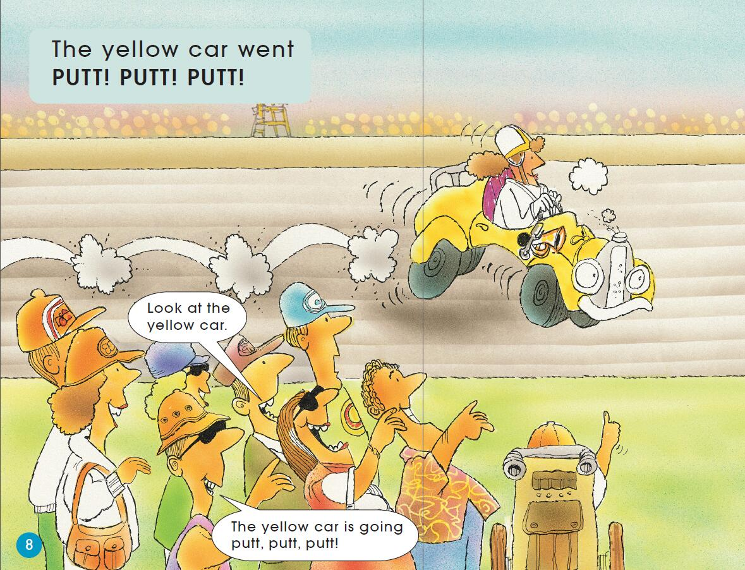
Picture walk
Who are the people laughing at?
Why are they laughing?

Slide 10
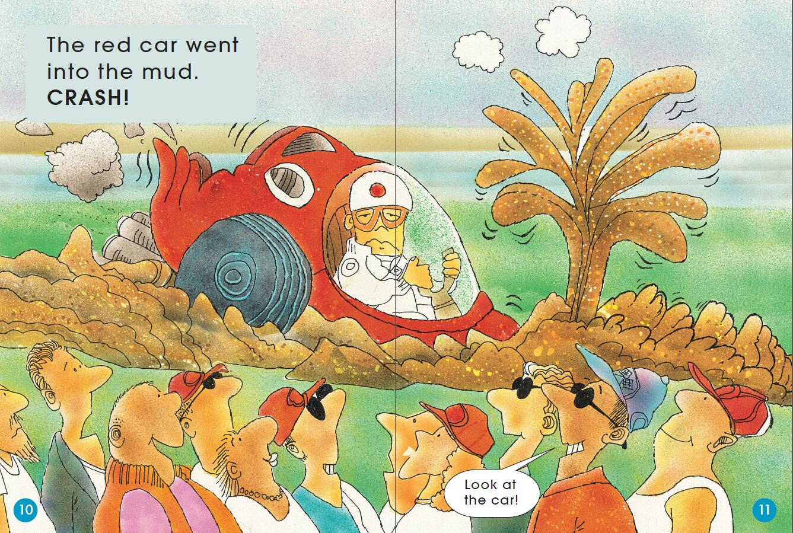
Picture walk
What happened to the red car?
How is the driver feeling now? How do you know?
How are the audience feeling now?

Slide 11
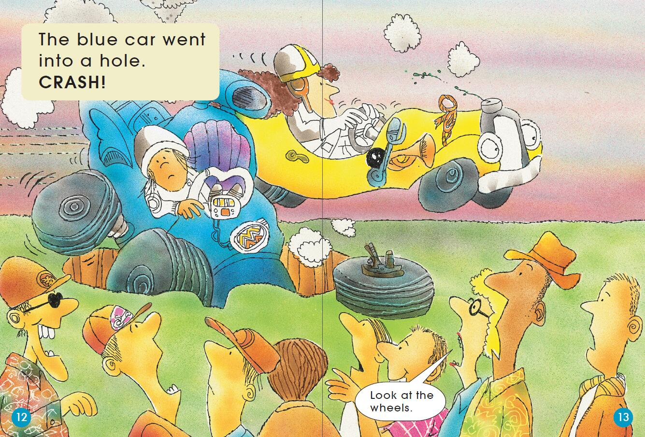
Picture walk
What happened to the blue car?
How are the audience feeling now?
What do you think might happen next?

Slide 12
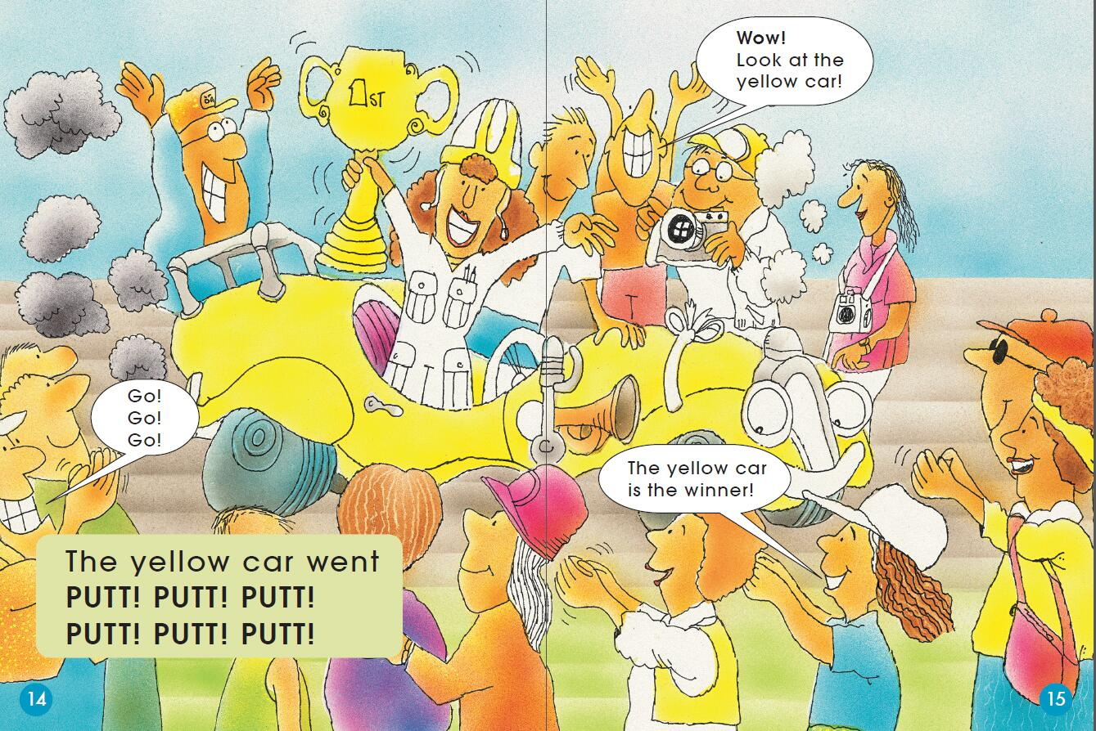
Picture walk
Who is the winner? How do you know?
Look at the “face” of the yellow car. Is it the same as the first picture? Why?

Slide 13



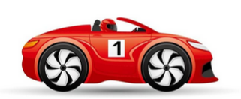
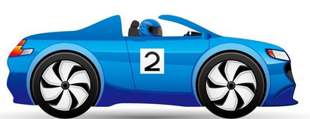
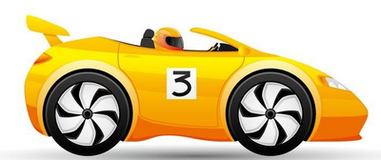
Think and order
Ranking Time
Beginning
Middle
Ending

Slide 14
Read and find out
Tips:
Point and read.
Read as if you are one of the audience.

Slide 15
1.Which word says look?
2.How do you change look to looked?
3.What does the ed suffix sound like in looked?
This suffix tells us this has already happened.

Slide 16
1. Which word says ZOOOOOOOM? How do you know that?
2. Why is it bold?
3. Put your finger on the exclamation mark. What does it tell you?
4. Read the pages and change your voice when you read ZOOOOOOOM to sound like the word.

Slide 17
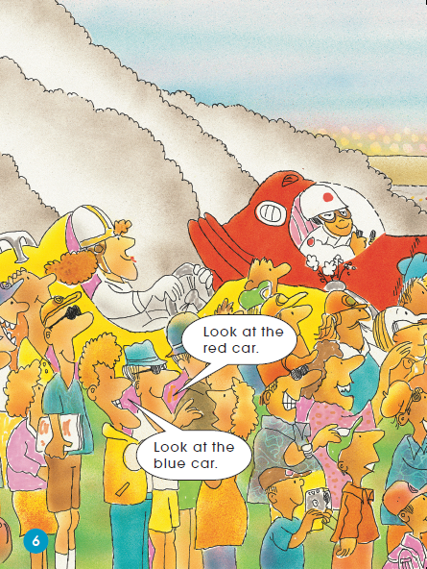
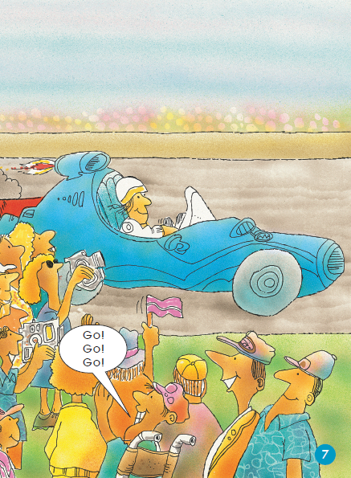
1. Which word says red? Which word says blue? How do you know that?
2. What words rhyme with car?
3. Read the speech bubbles and make your voice sound like the people talking.
4. Which person wants the cars to go fast? How do you know that?

Slide 18
1. Put your finger on the word that says PUTT. How do you know? What does it mean?
2. Read the pages and change your voice when you read PUTT to sound like the word.
3. Read the speech bubbles and make your voice sound like the people talking.

Slide 19
1. How do you say into? How do you know that? What does it mean?
2. Which word says crash? How do you know?
3. Find the words that tell you what happened to the red car.
4. Read the pages and change your voice when you read CRASH to sound like the word.

Slide 20
1. Where did the blue car go? Find out the words that tell you.
2. Find out the two words on the pages that start with /w/.
3. What does wheels mean? Point it in the picture. How do you know that?
4. Read the pages and think about where and how you will change your voice.

Slide 21
1. Who is the winner? How do you know?
2. Read the pages and think about when and how you will change your voice.

Slide 22

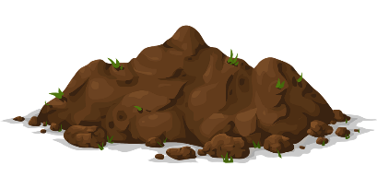

Think and match

Slide 23
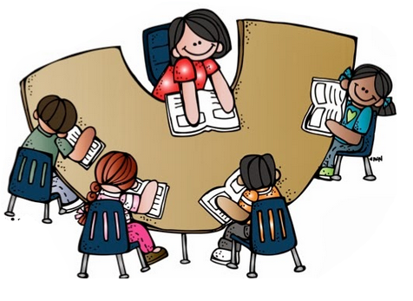
Read in groups

Slide 24
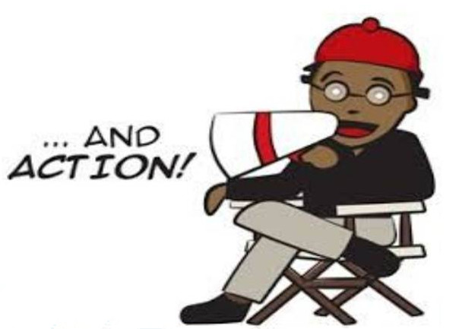
Role play

Slide 25
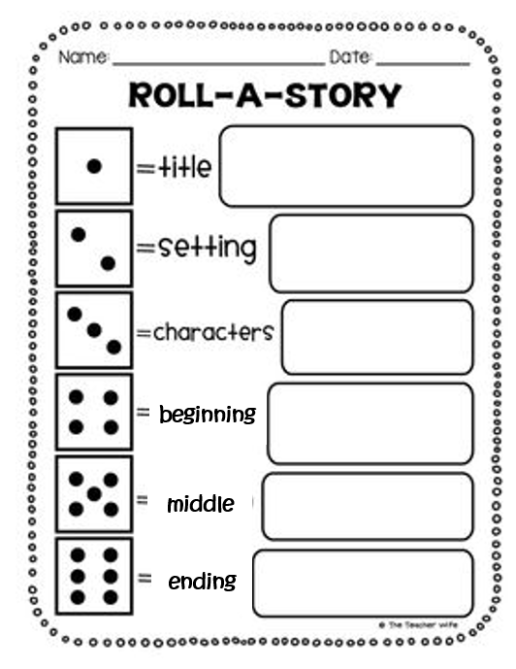
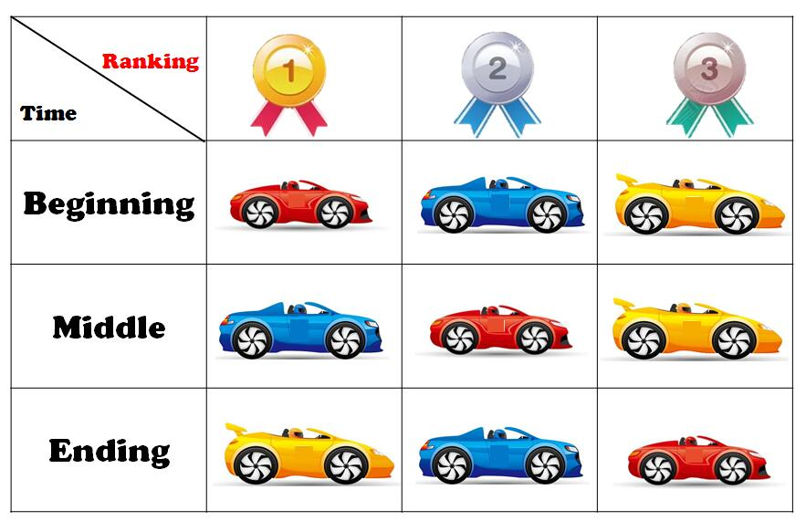
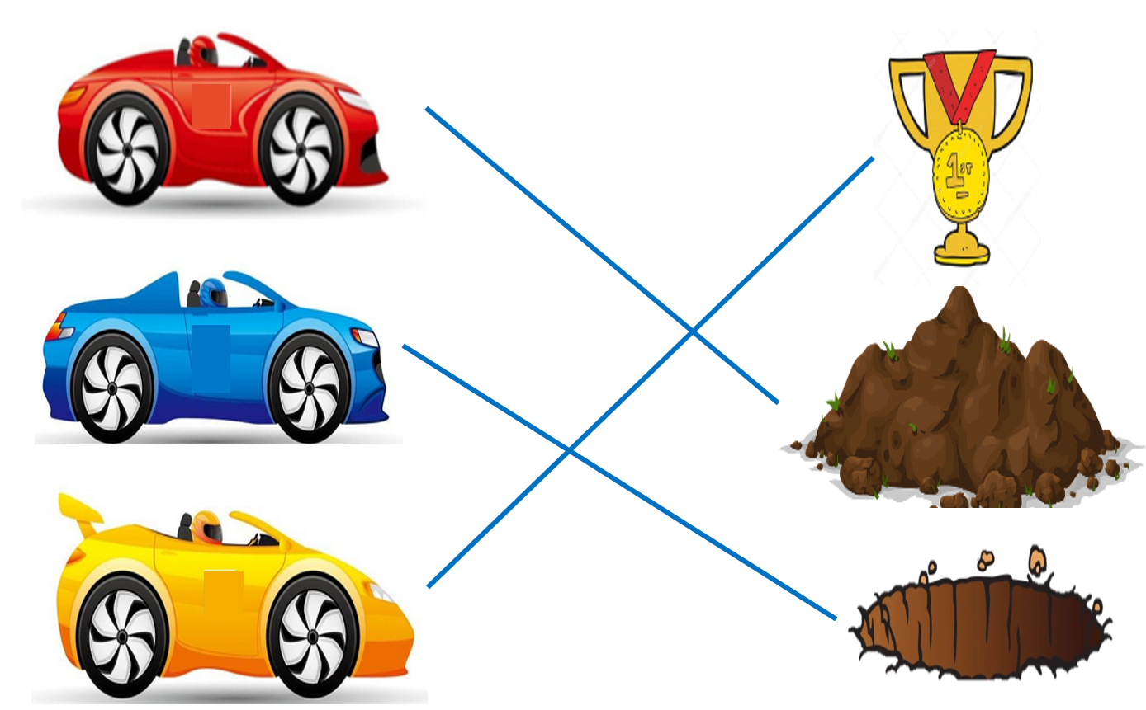
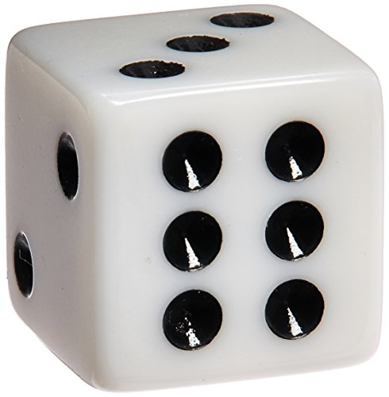
Retell in group

Slide 26
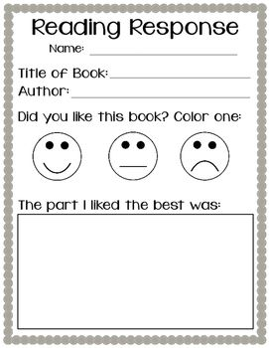
Think and draw

Slide 27



