Slide 1
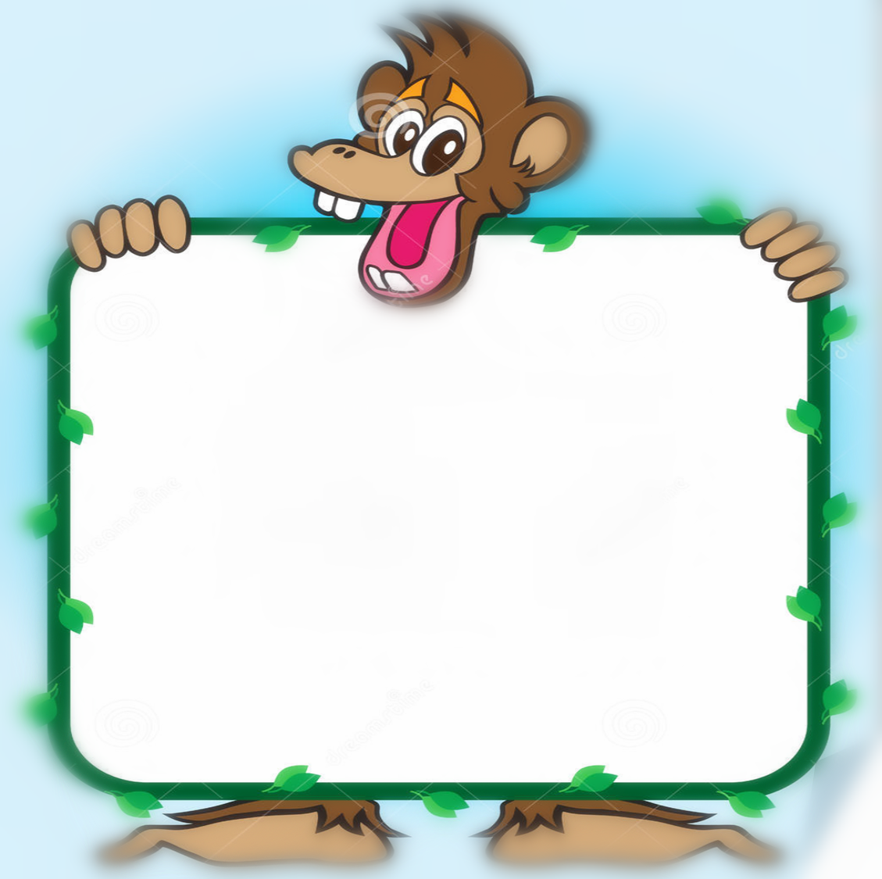
Monkey Fun
爱逞能的猴子
选自《多维阅读第1级》

Slide 2
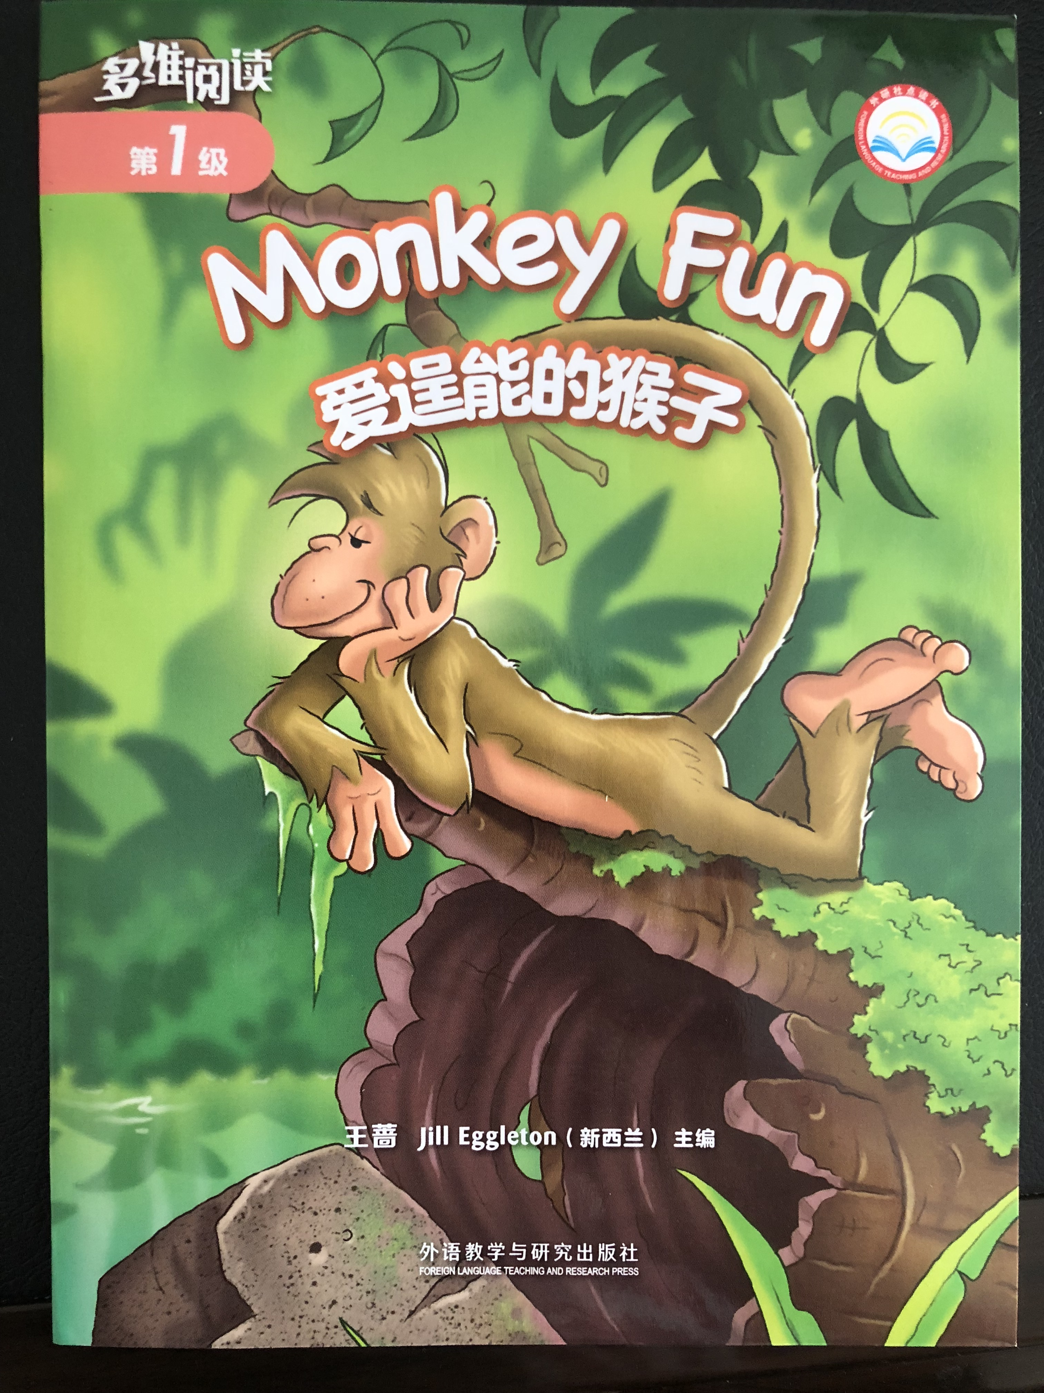
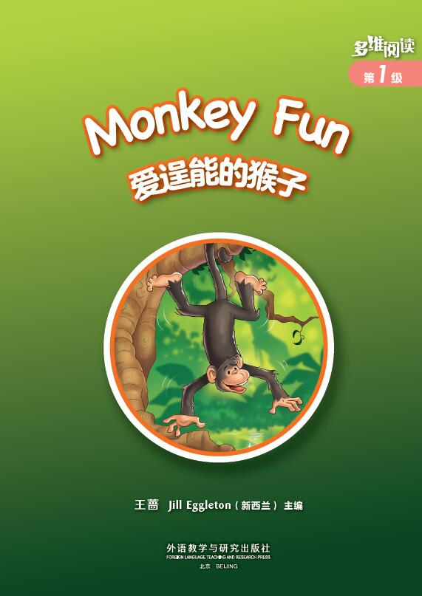
Prediction 预测
How many monkeys do you see?
What are they doing?
What can you see on the front cover?
What's the title?

Slide 3
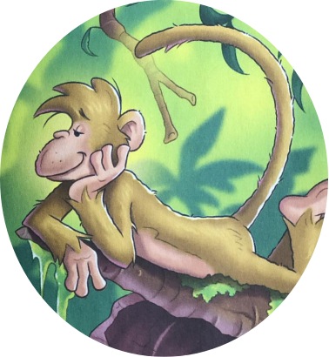
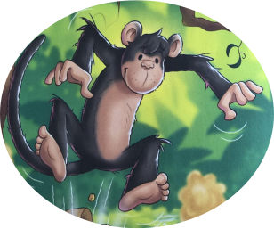
Introduce the monkeys’ names
Jojo
Dodo

Slide 4
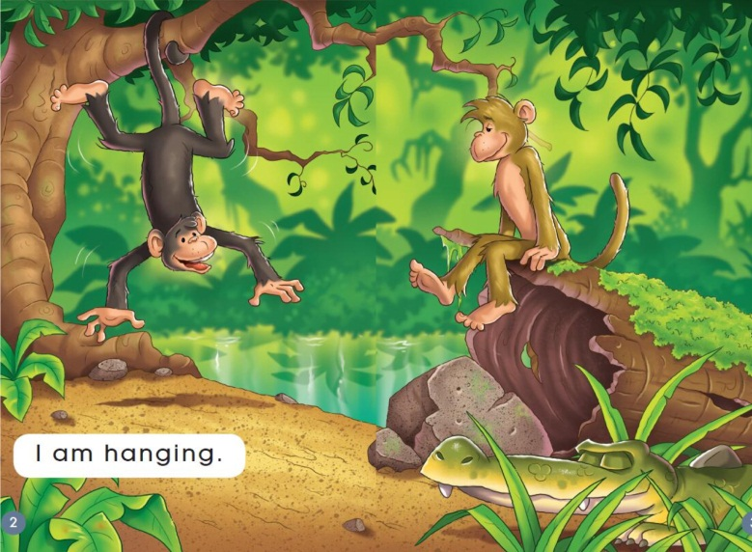
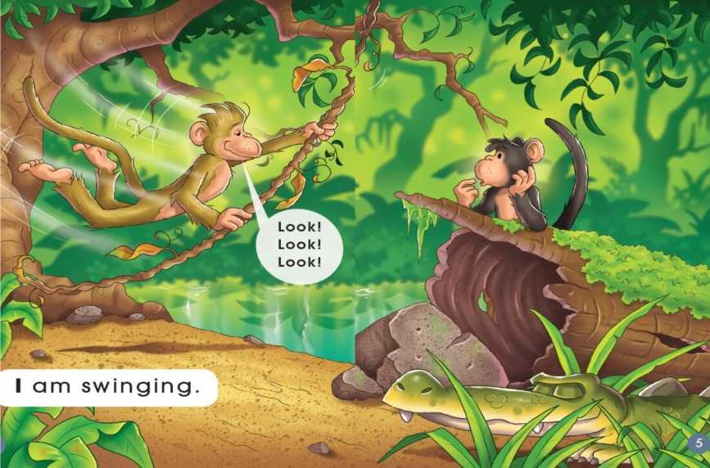
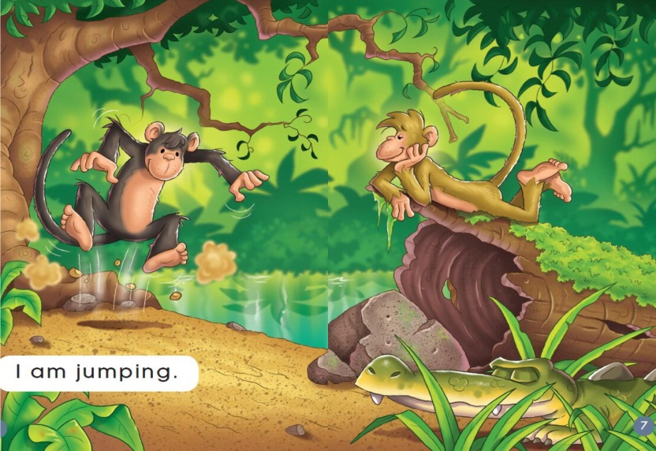
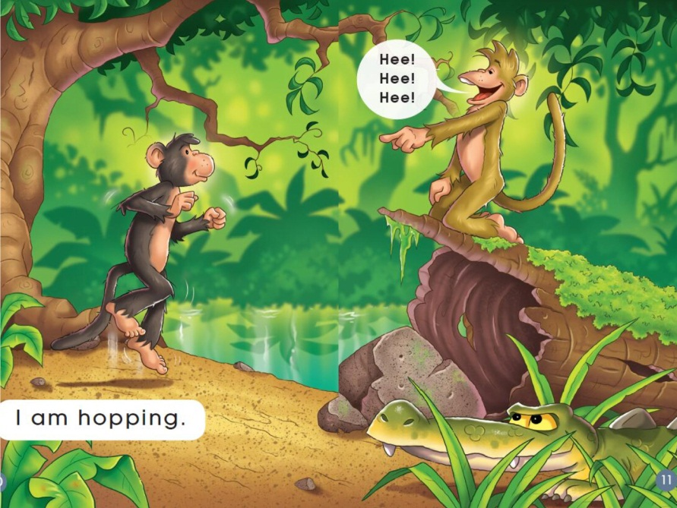
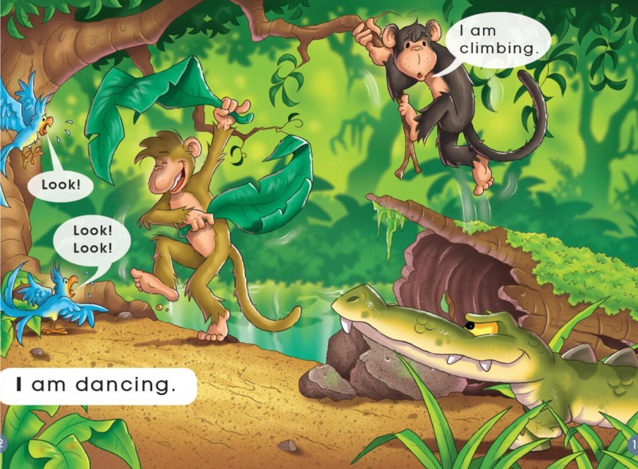
First reading: view & answer 看图回答（PP2-13）
1. What are the monkeys doing?
2. Are they happy or not?
Notes:
学生自主阅读P2-13

Slide 5
Second reading
What are they doing?

Slide 6
What are the monkeys doing now?
Why do you think he is saying “Look! Look! Look!”?

Slide 7
What are they doing?

Slide 8
Look at the monkey on the log. He is saying “Wow!” Why do you think he is saying this?

Slide 9
What is the monkey on the log doing? Why do you think he might be doing that?
Look at the crocodile. What do you think he may be thinking?

Slide 10
What do you think is going to happen next?
What is Dodo doing?

Slide 11
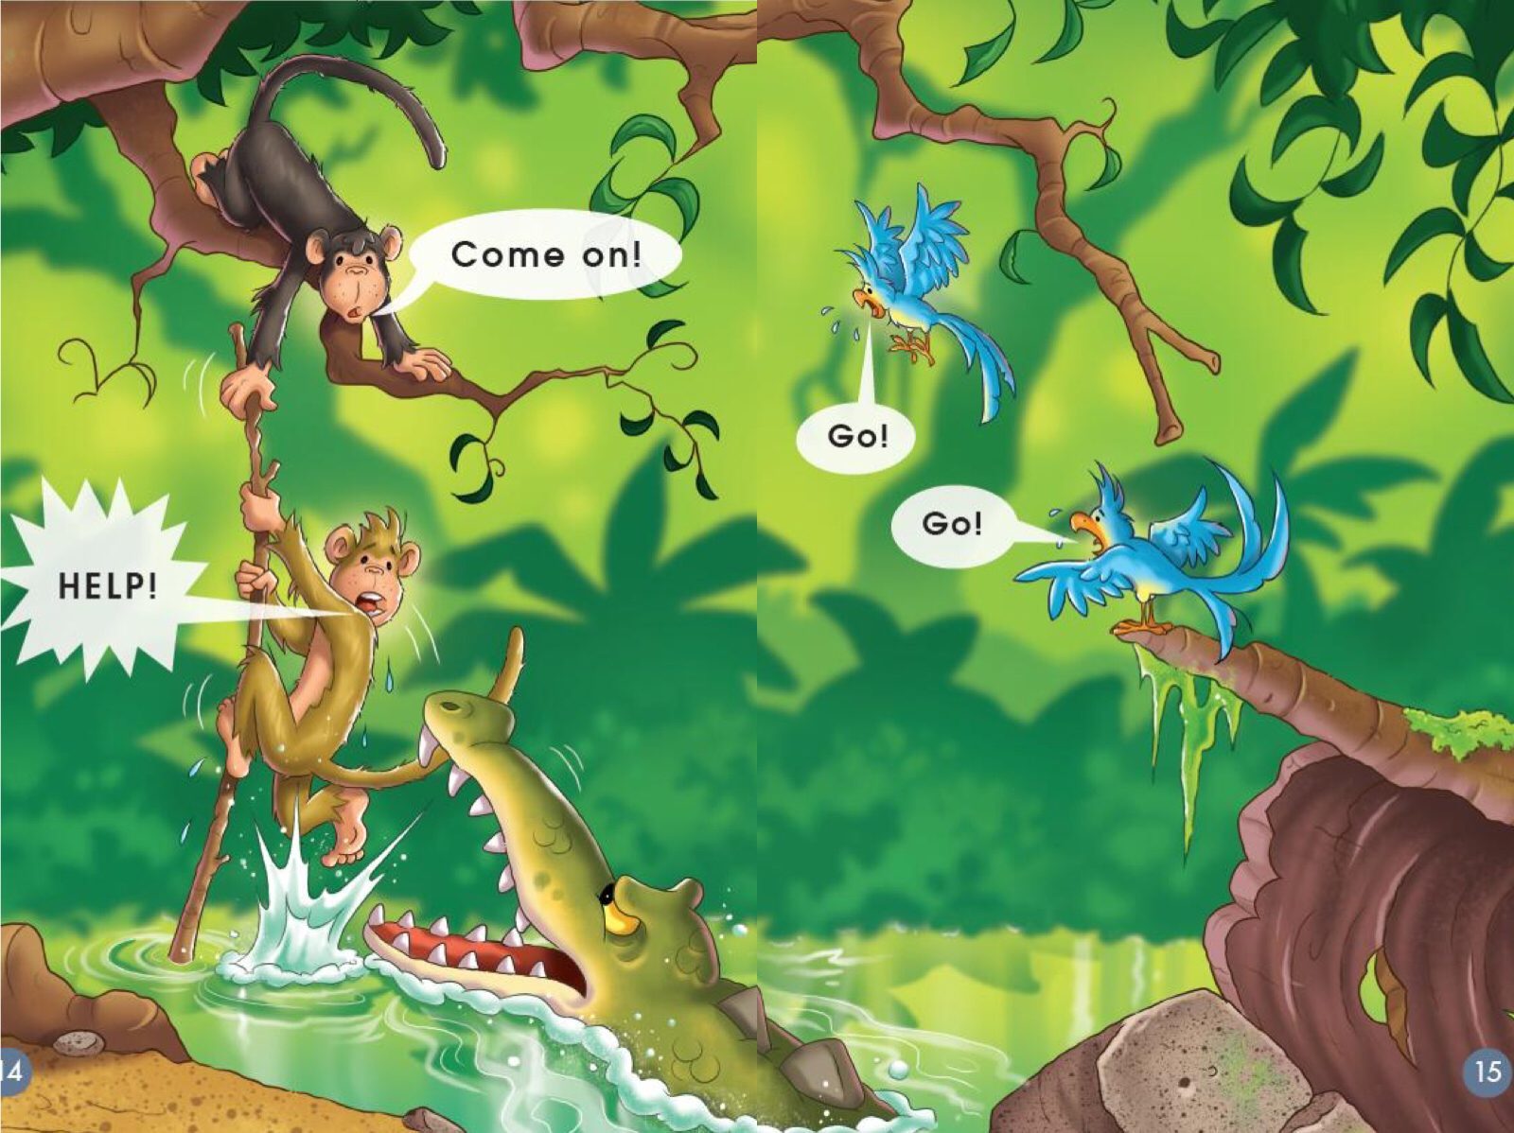
Predict，read and check 预测与验证
What is happening now?

Slide 12
Read and number the pictures 给下列图片排序
( )
2
( )
1
( )
7
( )
( )
3
4
( )
6
( )
5

Slide 13
Retell the story
( )
2
( )
1
( )
7
( )
( )
3
4
( )
6
( )
5

Slide 14
Third reading
Which word says hanging?
What sound does hanging start with?
hanging
h
Notes:
教师过渡语：Let's review the story together.Look at the picture.

Slide 15
Read the speech bubble.
Make your voice sound like the monkey is shouting.

Slide 16
Look at the word jumping.
What sound does jumping start with?
jumping
j

Slide 17
Look at the speech bubbles. Read them in the way you think the monkeys would say them.

Slide 18
Look at the bubble.
The monkey is laughing.
How will you read it?
Read the speech bubble.

Slide 19
Look at the speech bubbles. Read them and make your voice sound like the animals may have said them.

Slide 20
Look at the speech bubbles.
Read them and make your voice sound like how the animals might talk.
Notes:
本环节问题解决之后，带领学生有感情地指读或朗读绘本故事。

Slide 21
Act out the story

Slide 22
Discuss and share
What could Jojo say to the monkey swinging?

Slide 23
What do you think Dodo might be thinking?

Slide 24
Imagine, discuss and say
Jojo helped Dodo. What might have happened if the monkey hadn't helped his friend?

Slide 25
Talk about your friend
Has a friend ever helped you?
How?

Slide 26
作业布置，请从两项作业中任选一项并完成。
1. Have you ever helped your friends? How? Talk about it to your parents or classmates.
2. Draw a friend who has helped you.
作业2范例

