Slide 1

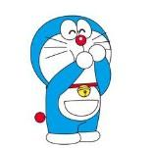
I Am a Robot
我才是机器人
选自《多维阅读第1级》

Slide 2

Warm-up 热身: Listen and sing the song.
Head shoulders knees and toes

Slide 3
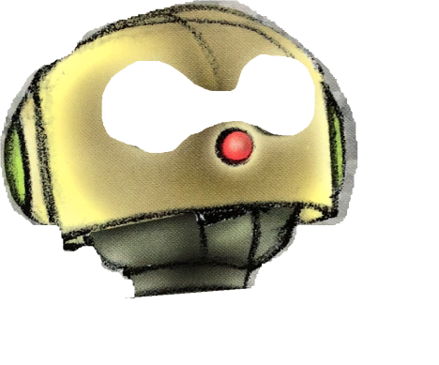
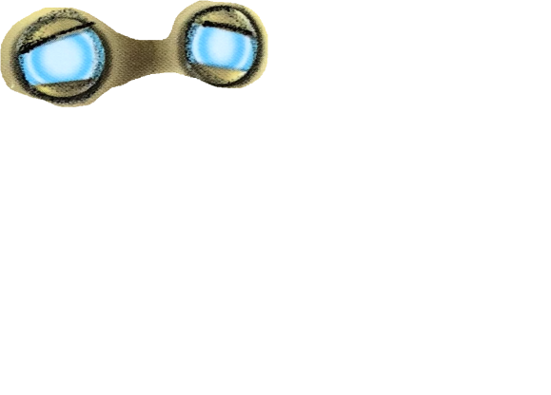
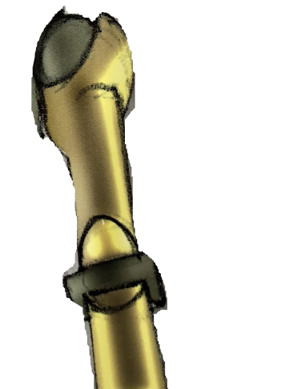
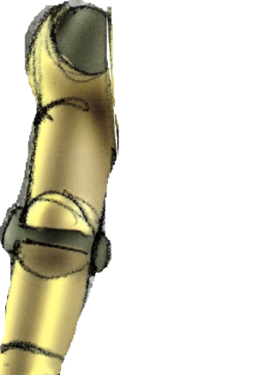

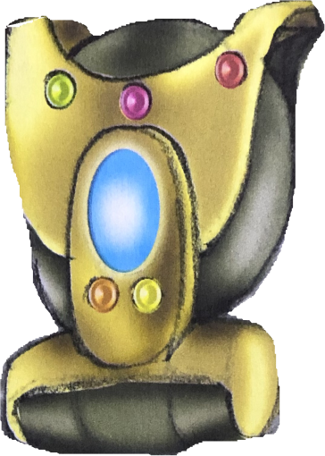
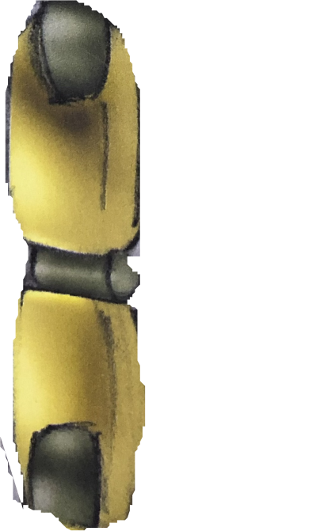

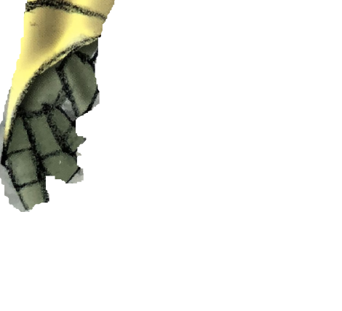
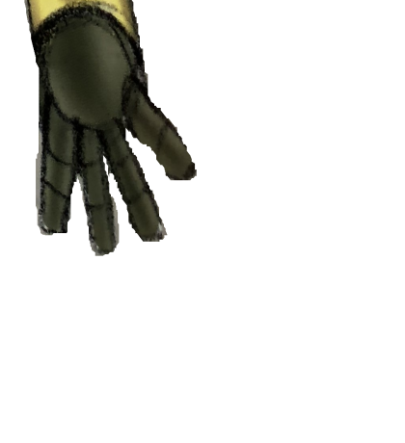






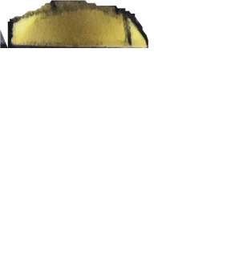



Let’s play and guess 拼一拼，猜一猜
What’s this?

Slide 4
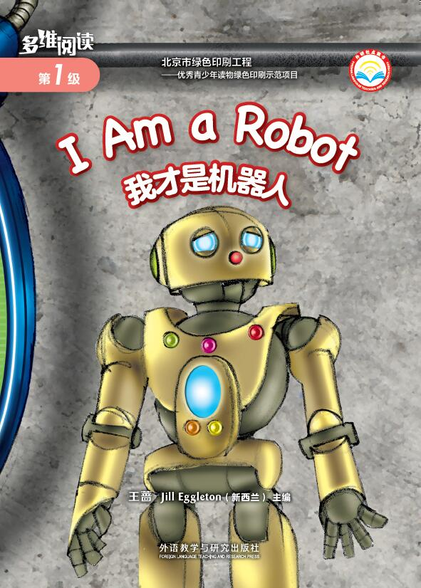
Prediction 预测
What is the book about?
Animals
B. Robots

Slide 5
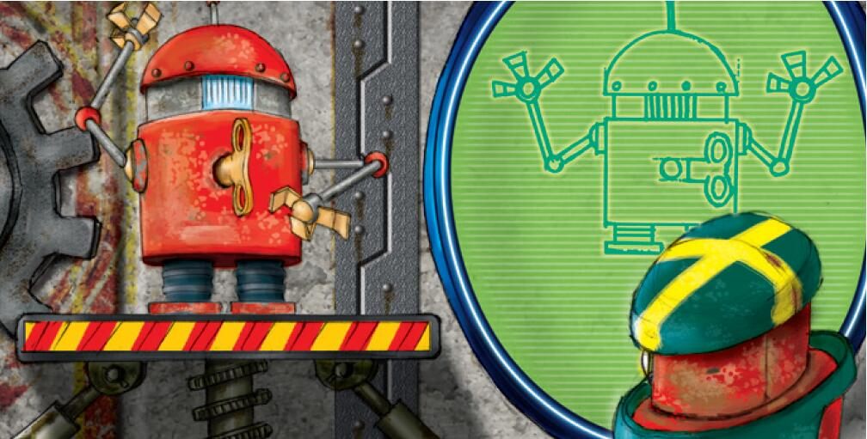
First-reading: View & say 看一看，说一说
arm

Slide 6
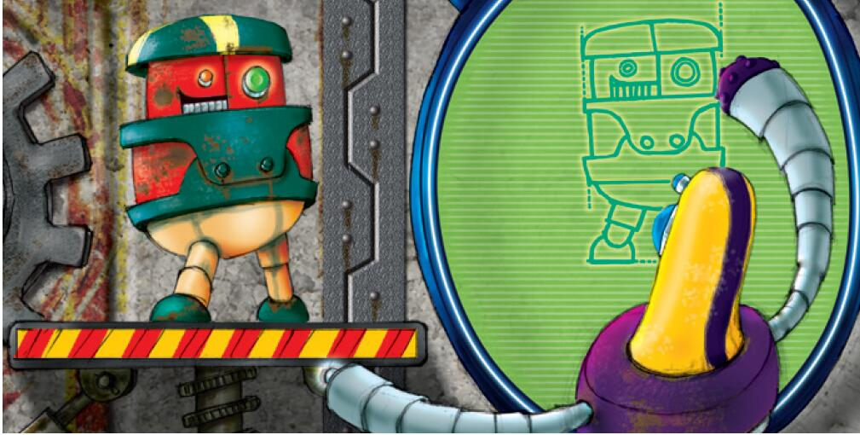
eye

Slide 7
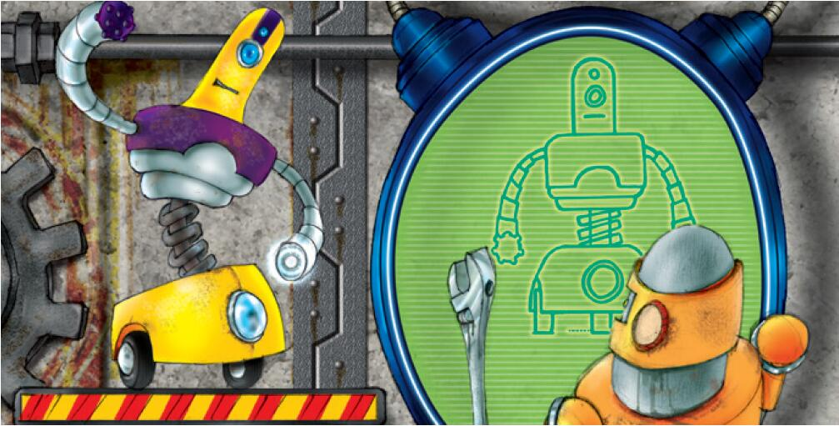
head

Slide 8
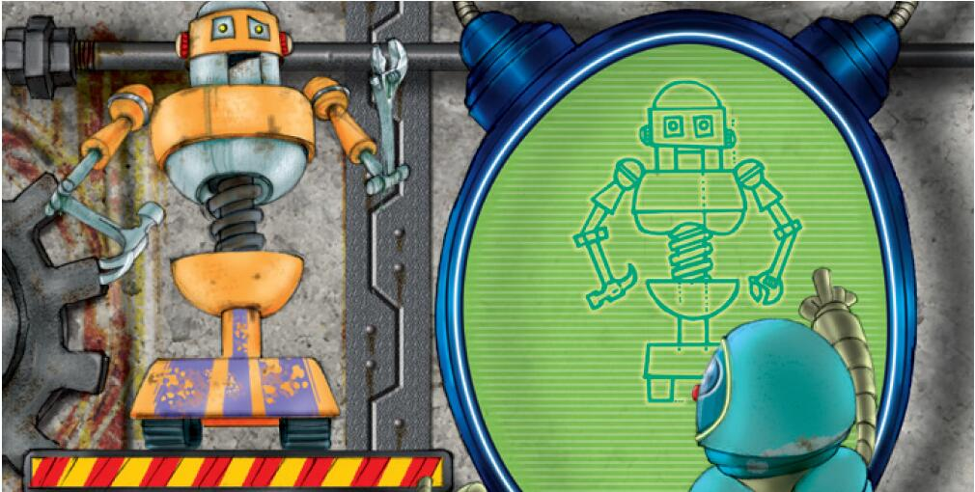
hand

Slide 9
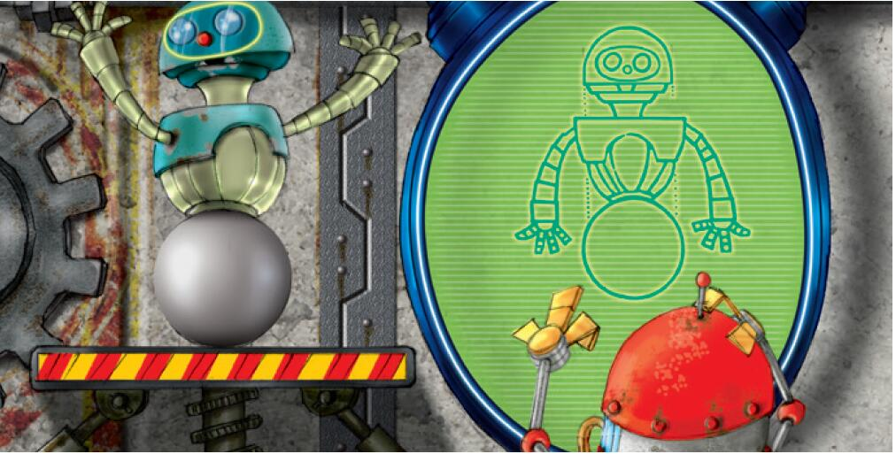
fingers

Slide 10
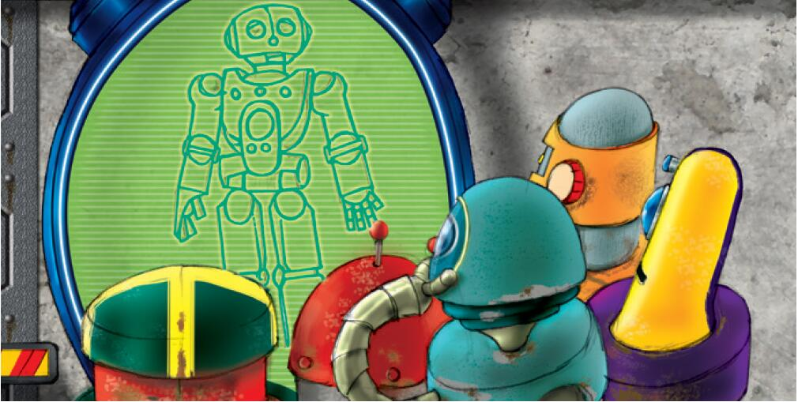
legs

Slide 11
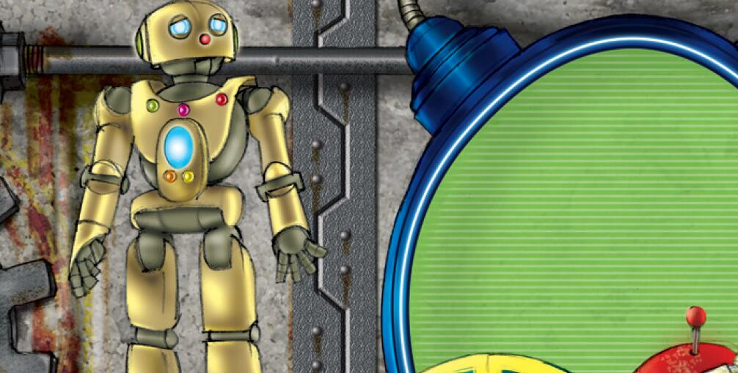
eyes
Point to the body parts of the robot.
head
arm
buttons
fingers
hand
leg

Slide 12
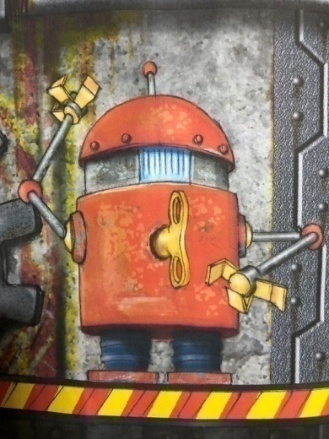
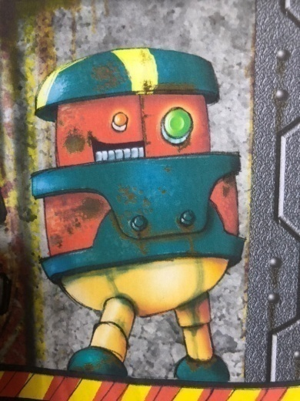
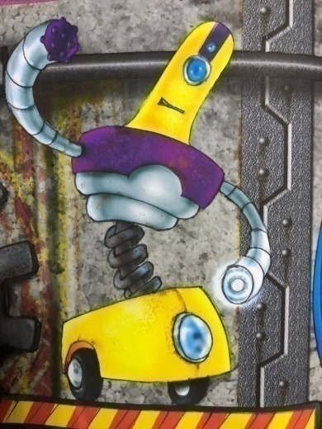
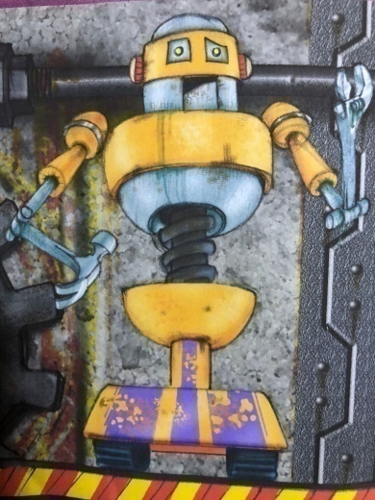
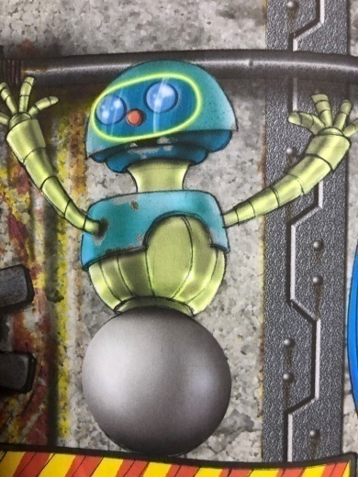
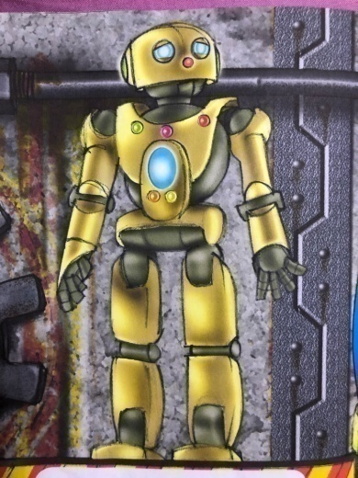
View and answer 看图回答
How many robots can you see?
Six robots.

Slide 13

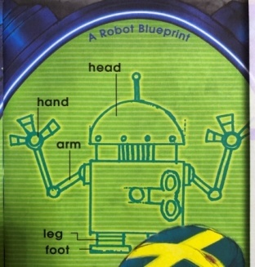
What is a robot blueprint?
设计图

Slide 14
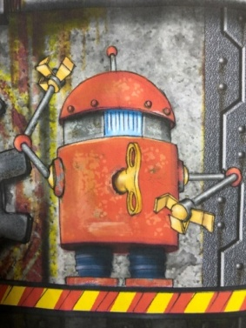



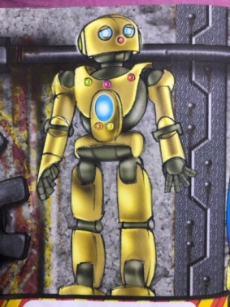
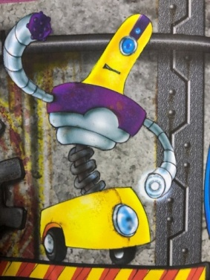
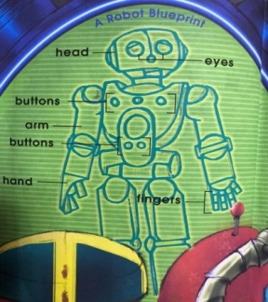
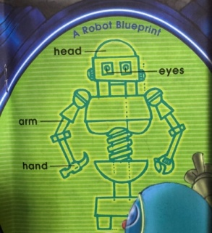
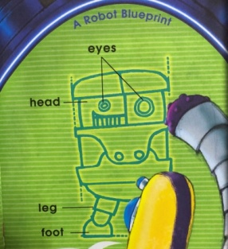
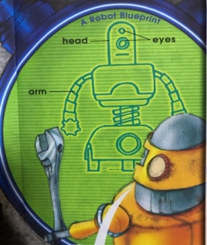
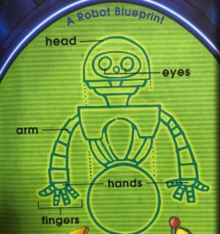
Second-reading: Matching Game 配对游戏
1.Can you match the blueprint with robots?
2. Are all the robots the same?
A
B
C
D
E
F

Slide 15
Third-reading : Let’s read and find out
找出与众不同之处
What’s missing on the robot?
No eyes.
What can the robot do with the eyes?

Slide 16
What’s missing on the robot?
No arms.
What can the robot do with the arms?

Slide 17
What’s missing on the robot?
No hands.
What can the robot do with the hands?

Slide 18
What’s missing on the robot?
No fingers.
What can the robot do with the fingers?

Slide 19
What’s missing on the robot?
No feet.
What can the robot do with the feet?

Slide 20
What’s missing on the robot?
No fingers.
What can the robot do with the fingers?

Slide 21
What’s missing on the robot?
Buttons.
What can the robot do with the buttons?

Slide 22
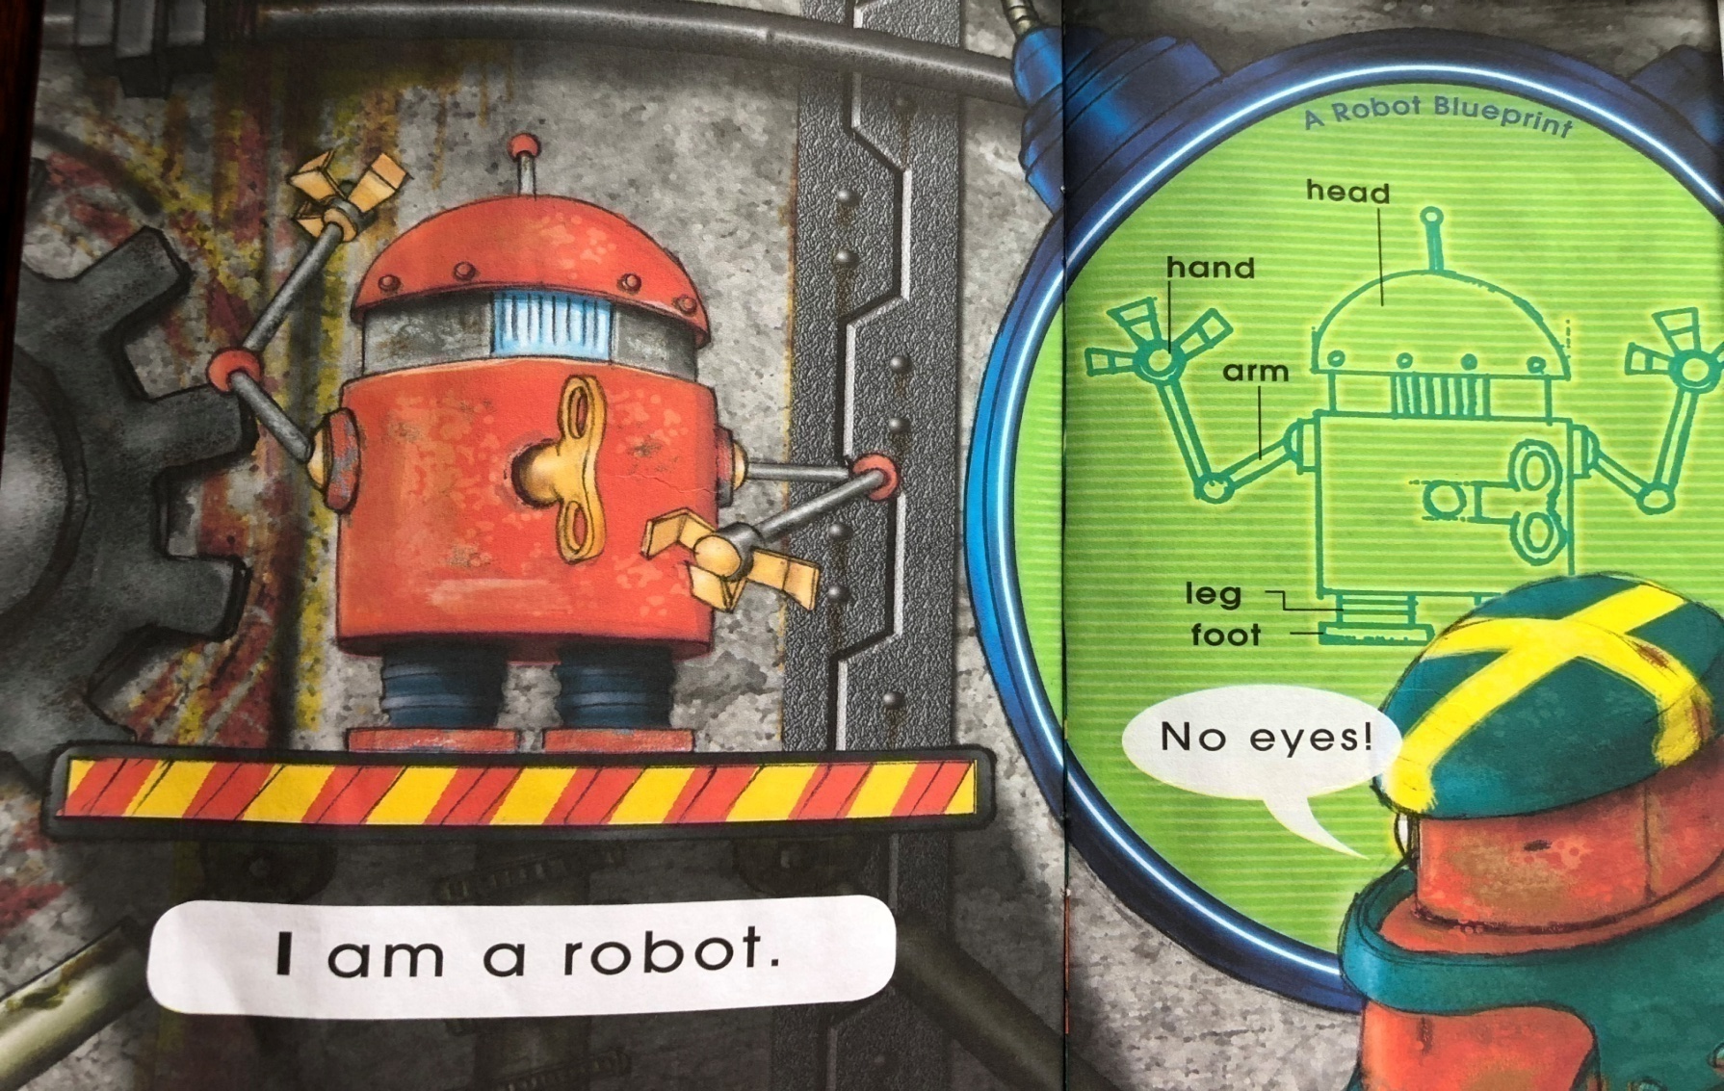


Let’s point and read 指一指，读一读
1. Read the sentence “I am a robot.”
2. Put your fingers on the labels and read the words.
3. Put your finger on the speech bubble and read it.
4. Make your voice like a robot.

Slide 23
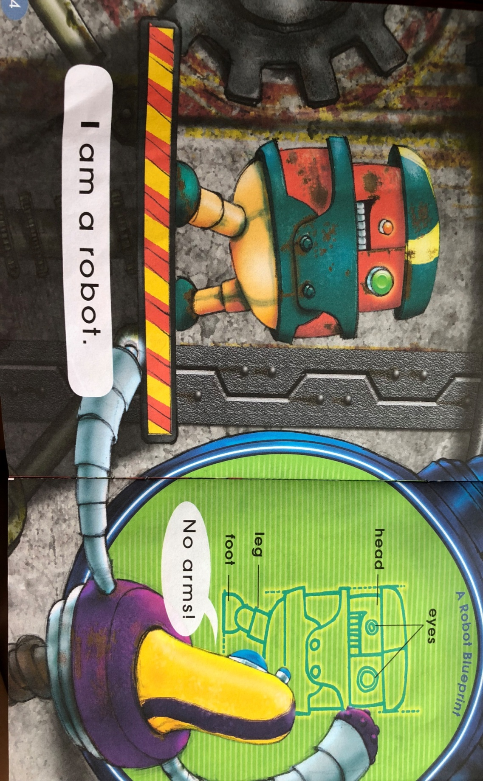
3. How to read "I"?
2. Look at the first word in the sentence, what do you notice?
1. Read the sentence “I am a robot.”

Slide 24
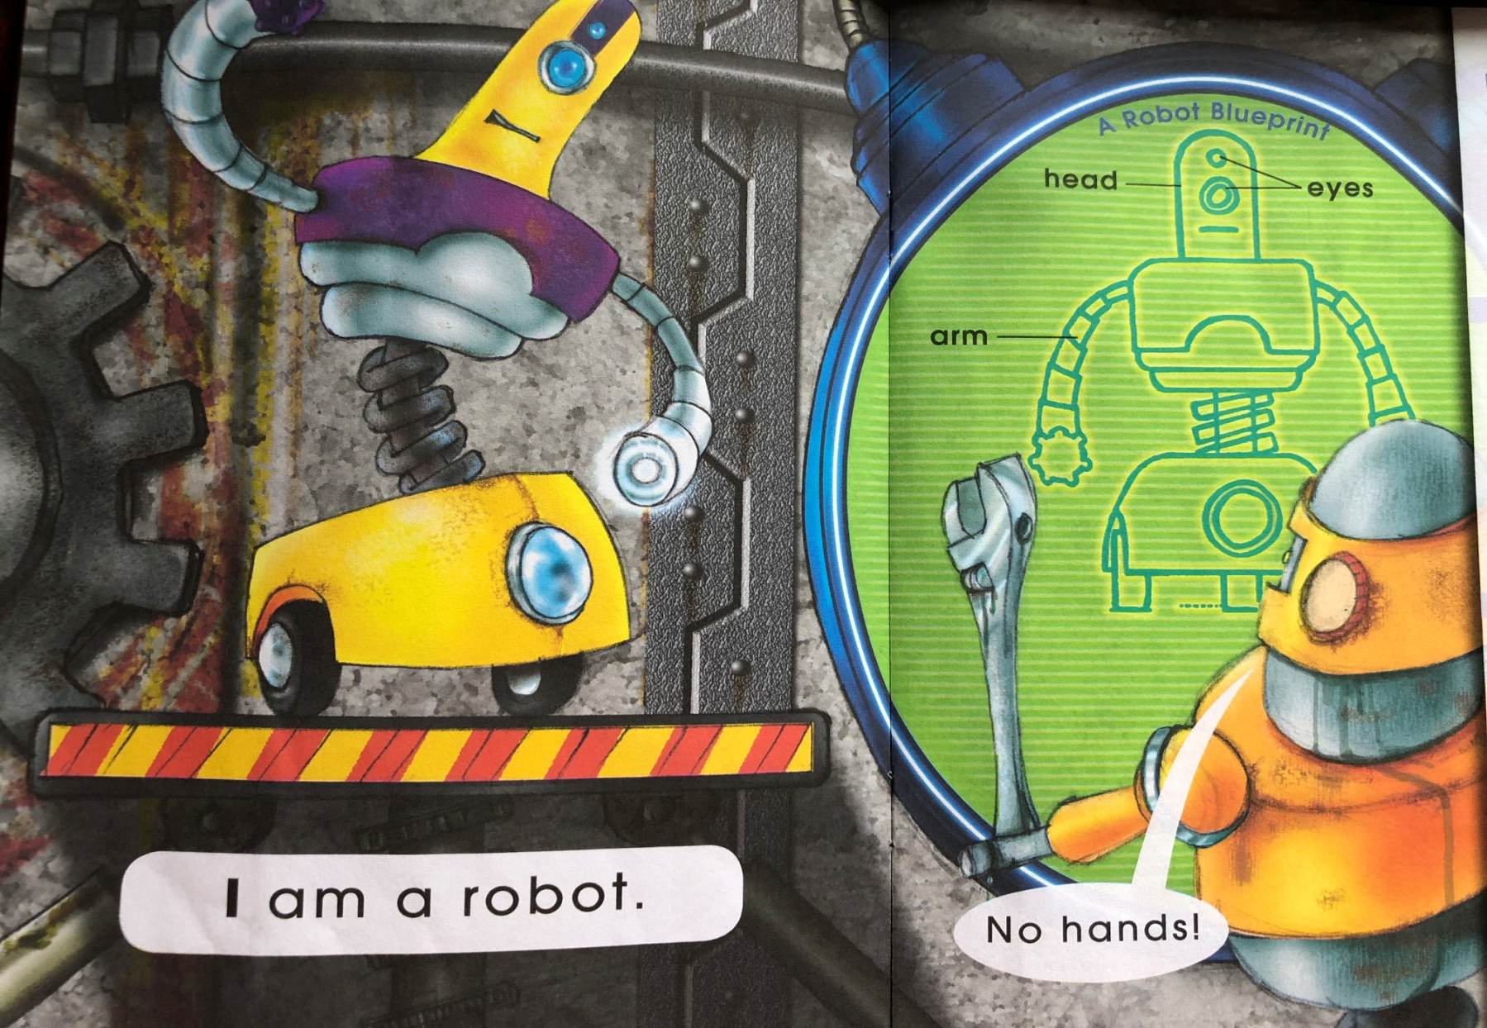
red
4. What other words start with r?
rabbit
3. What sound does robot start with?
2. Write r on your exercise book.
请在练习本上写下r。
1. Make a circle with your finger around the letter r in robot.

Slide 25
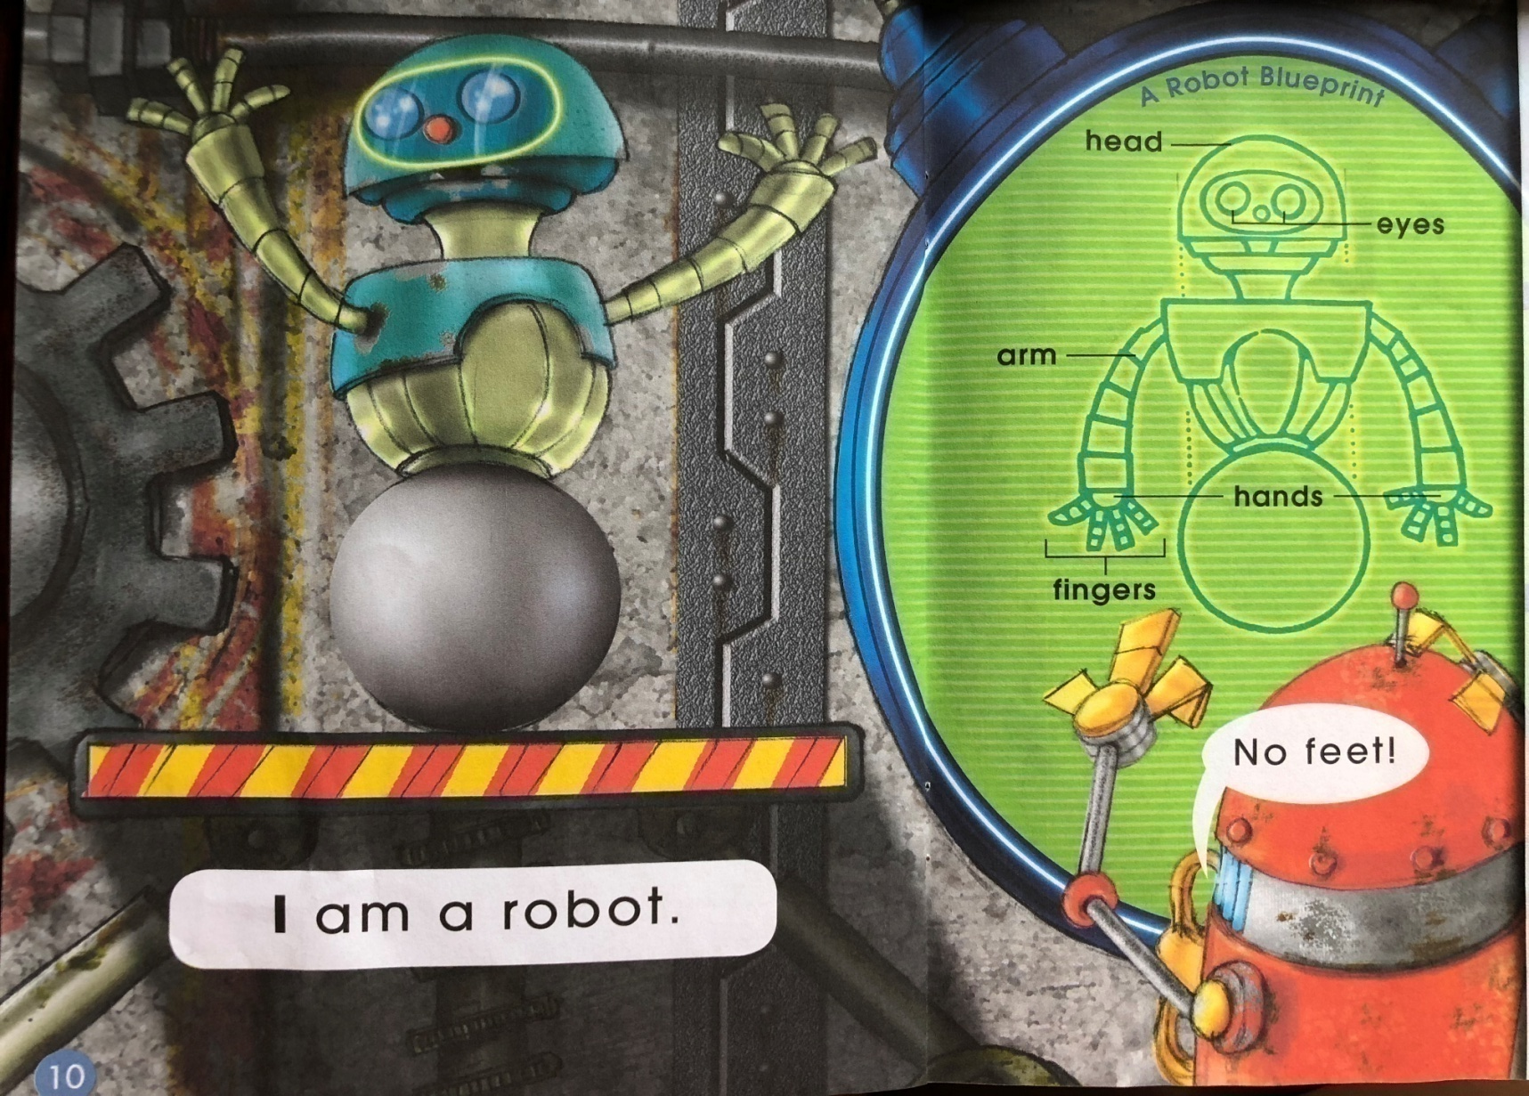
f
1. What sound does feet start with?
2. Write am on your exercise book.
请在练习本上写下am。

Slide 26
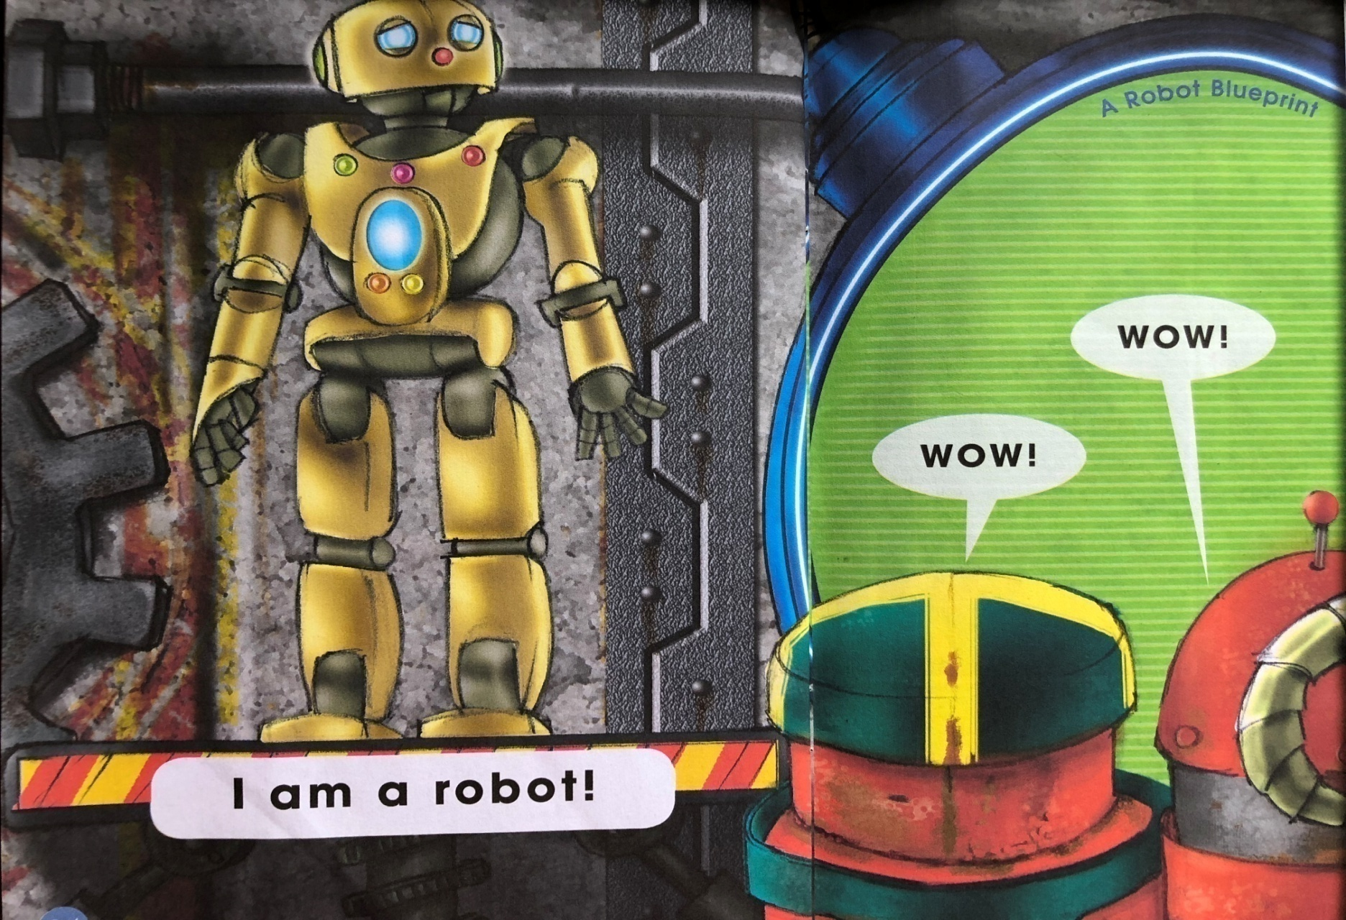
2. Think and try to read the sentence and bubbles emotionally.
请思考并有感情地朗读句子。
1. Look at the words that are bold font, what do you notice?

Slide 27
Let’s act out 小组表演
Act out in a group of six
六人小组，合作完成角色表演
Level 1
每位组员选择并扮演一种robot进行表演。
Level 2
每位组员选择并扮演一种robot进行表演，
加入更多的语言No ears/legs/buttons…

Slide 28
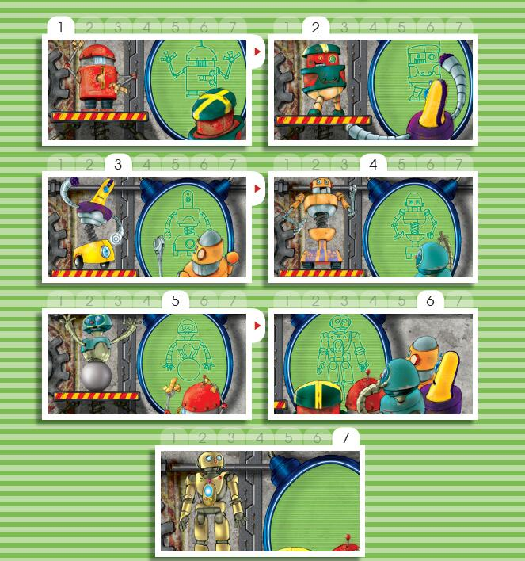
Try to retell 复述文本内容

Slide 29
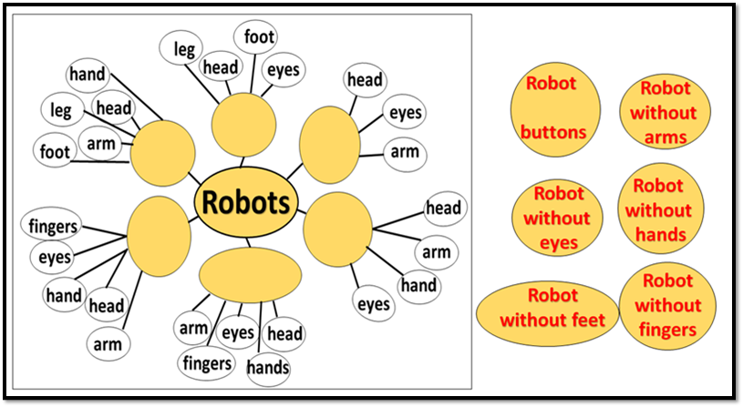
Finish the mind map 完成思维导图

Slide 30
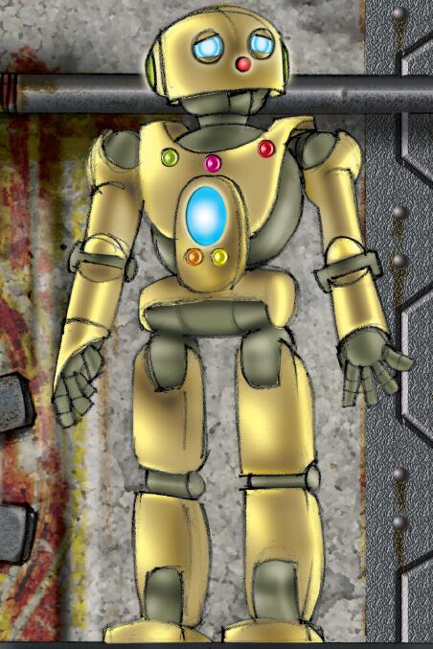
More discussion 小组讨论
Do you think the robot needs eyes/ hands/fingers...?
你认为机器人都需要眼睛/
手/手指……吗?

Slide 31
Watch and think 观看微课并思考
What makes the robots special?
是什么使得每个机器人与众不同?

Slide 32
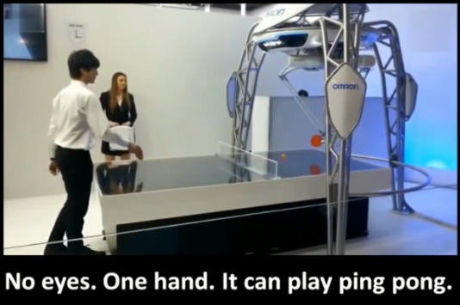
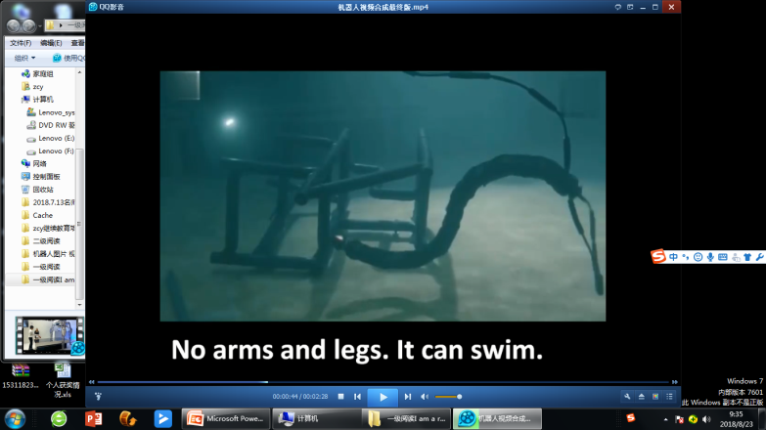
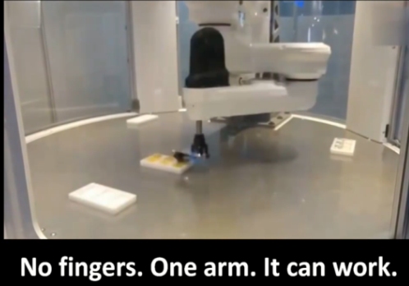
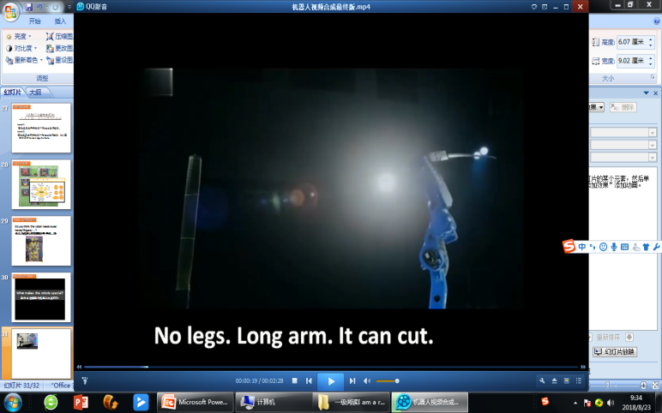
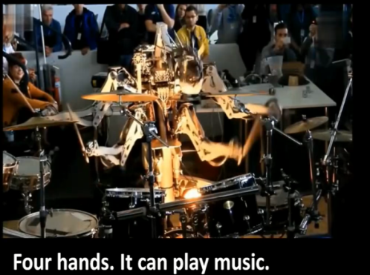
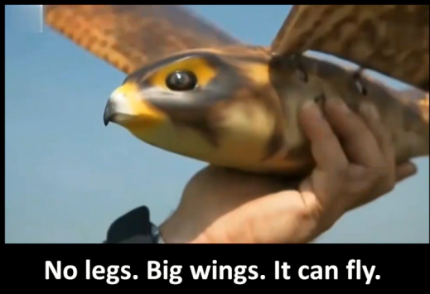
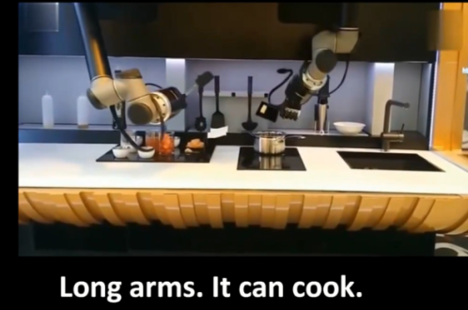
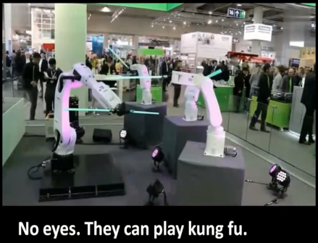
Discuss and share 讨论与分享
Which robot do you like？
Why?

Slide 33
They are all special.
They can do special things.

Slide 34

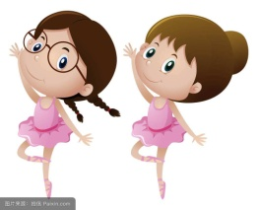


Discuss and share 讨论与分享
Who is special in your eyes? Why?
What makes you special?
Ling Ling. She can sing.(唱歌)
Dong Dong. He can cook.(煮饭)
Me. I like writing.(写话)

Slide 35

Everyone is special.
We can learn from each other.

Slide 36
Homework
1. Listen to the audio and read the book.
2. Share the story with your parents.
3. Design a special robot and introduce it.

Slide 37



