Slide 1

What Next?
成长三部曲
选自《多维阅读第1级》

Slide 2

Warm-up: Guessing game (猜一猜)
What is in the bag？
What is in the egg？

Slide 3
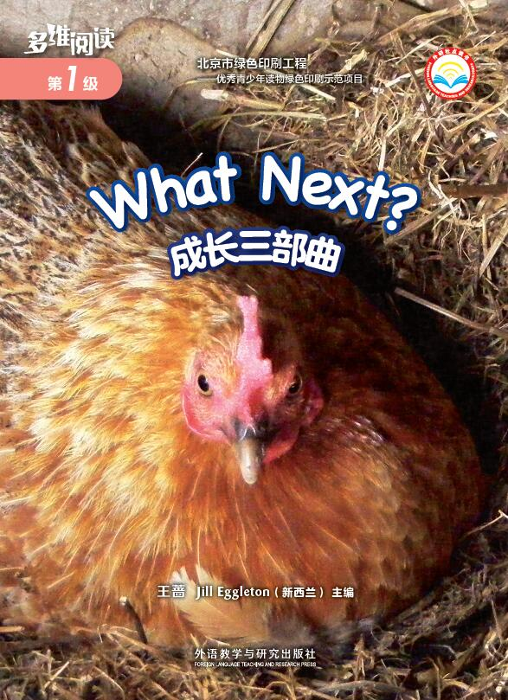
Prediction 预测
1. What can you see on the cover?
2. What is the title?

Slide 4
First-reading: View & Answer (看图回答)
View the pictures in the book:
1. How many animals can you see?
2. Where are they from?

Slide 5
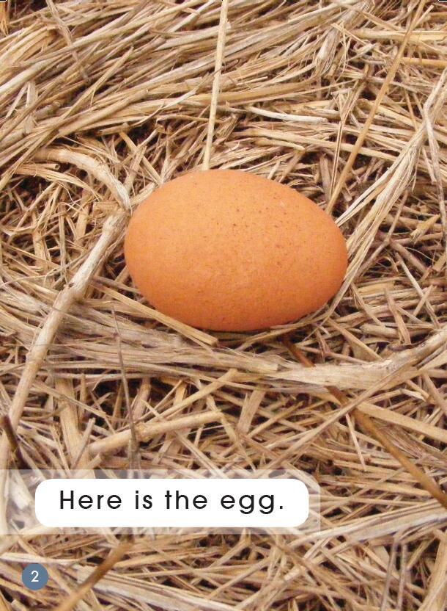
Second-reading

Slide 6
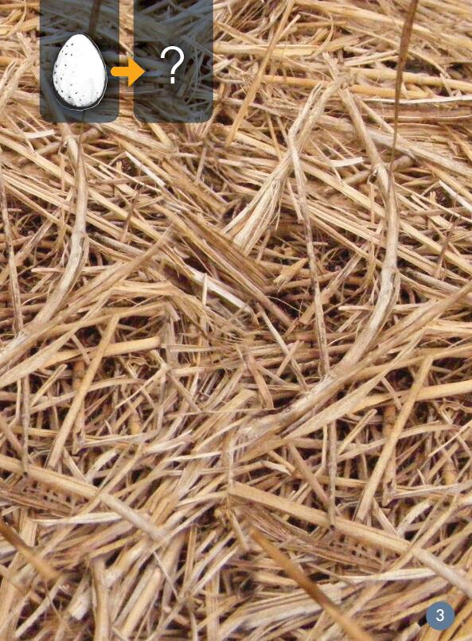
What next?

Slide 7
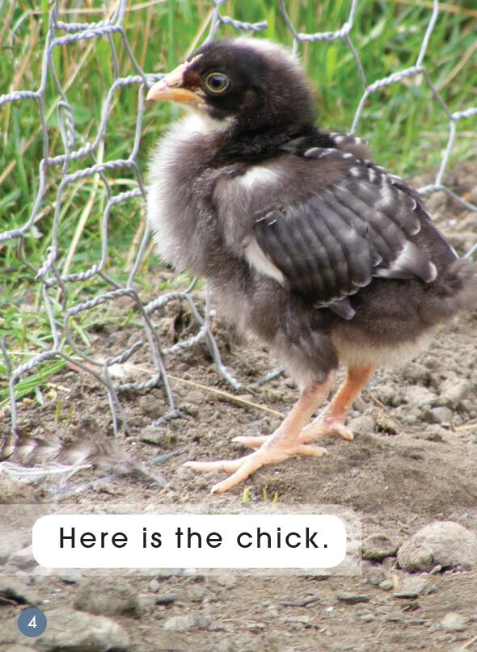

Slide 8
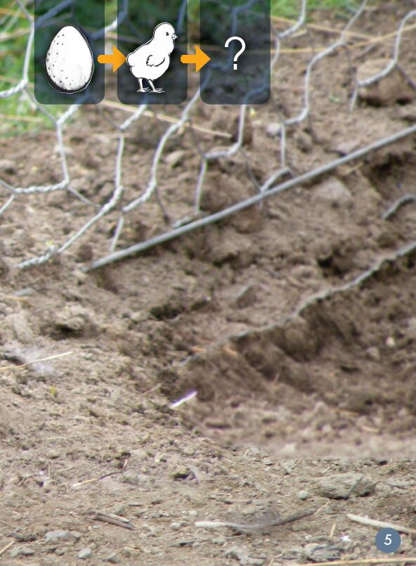
What next?

Slide 9
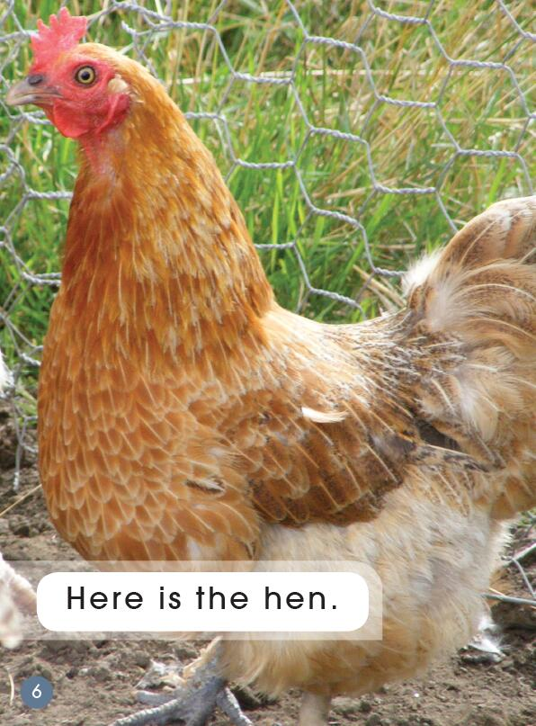

Slide 10
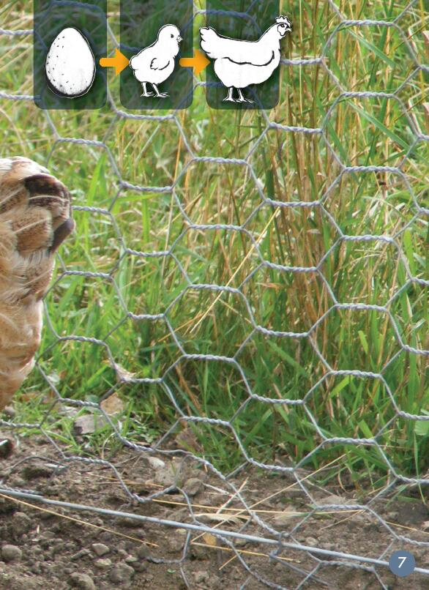
What next?

Slide 11
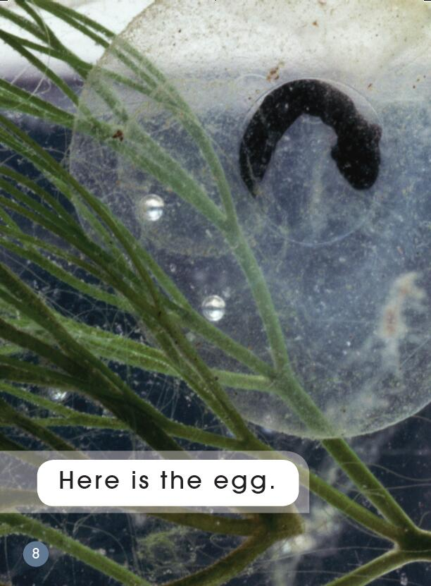

Slide 12
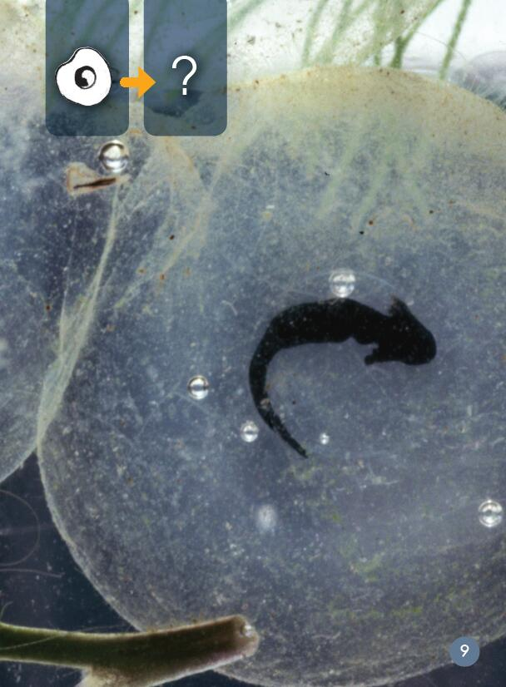
What next?

Slide 13
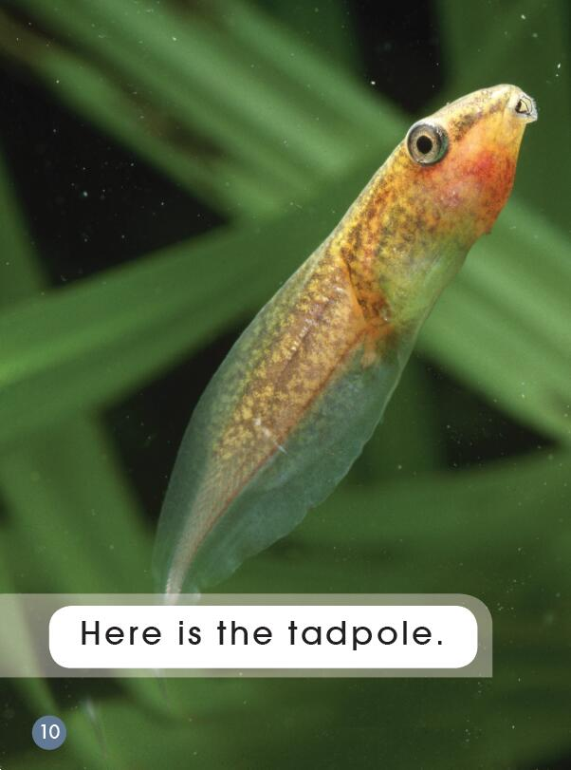

Slide 14
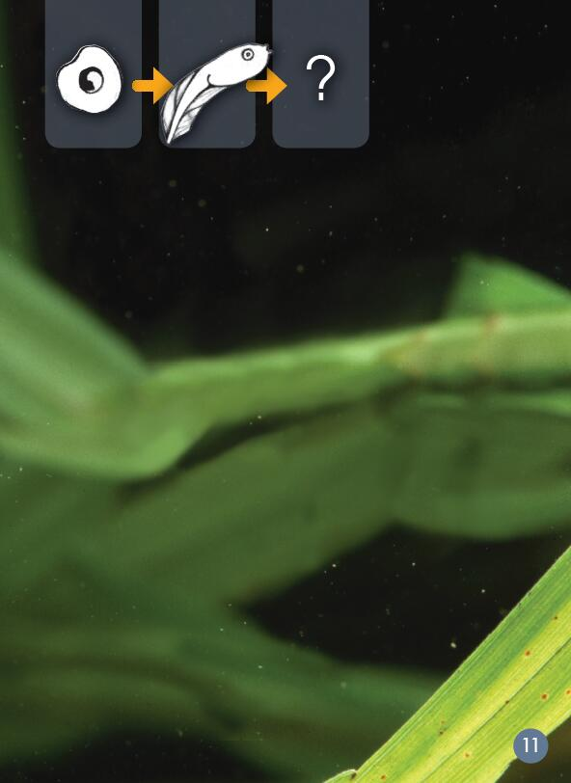
What next?

Slide 15
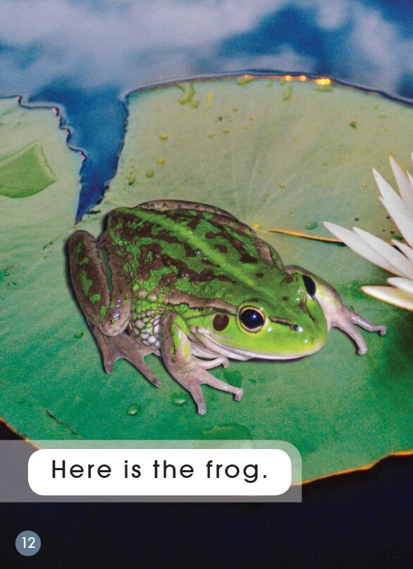

Slide 16
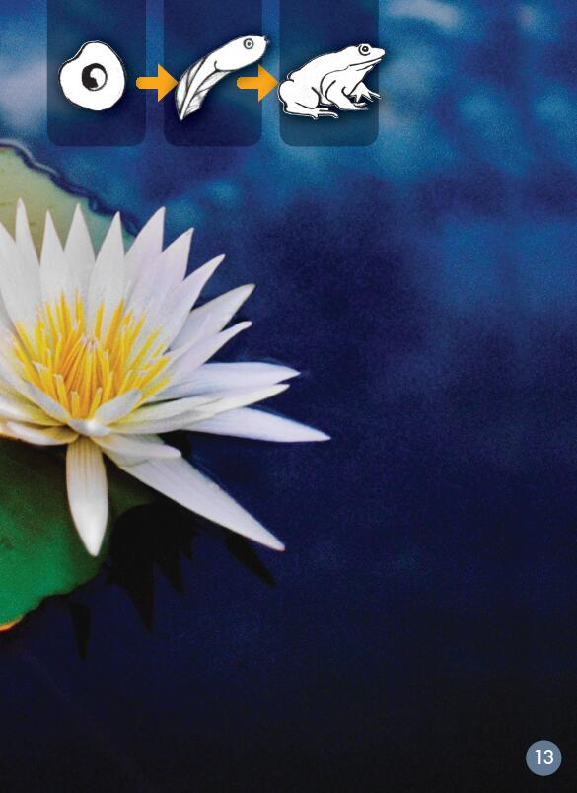
What next?

Slide 17
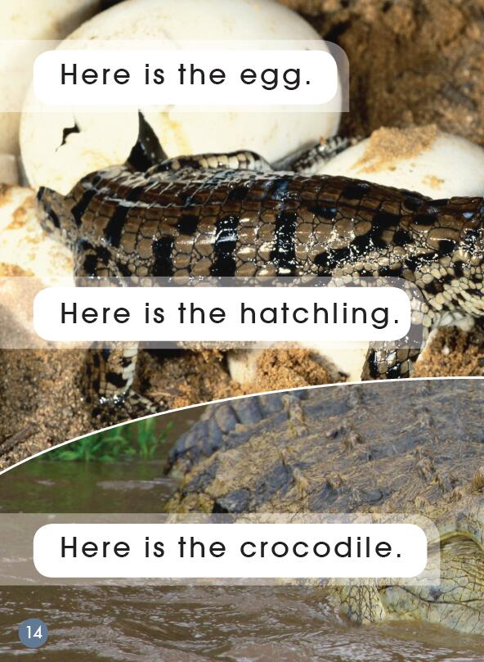

Slide 18
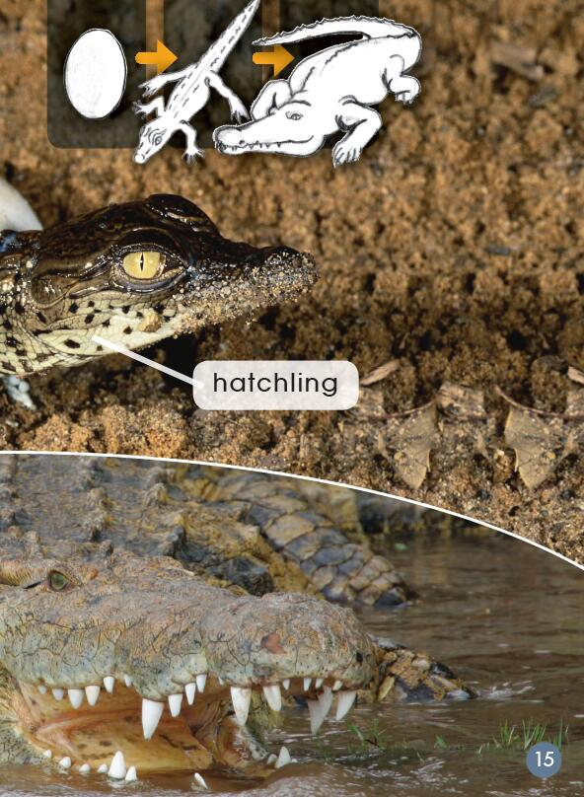
What next?

Slide 19
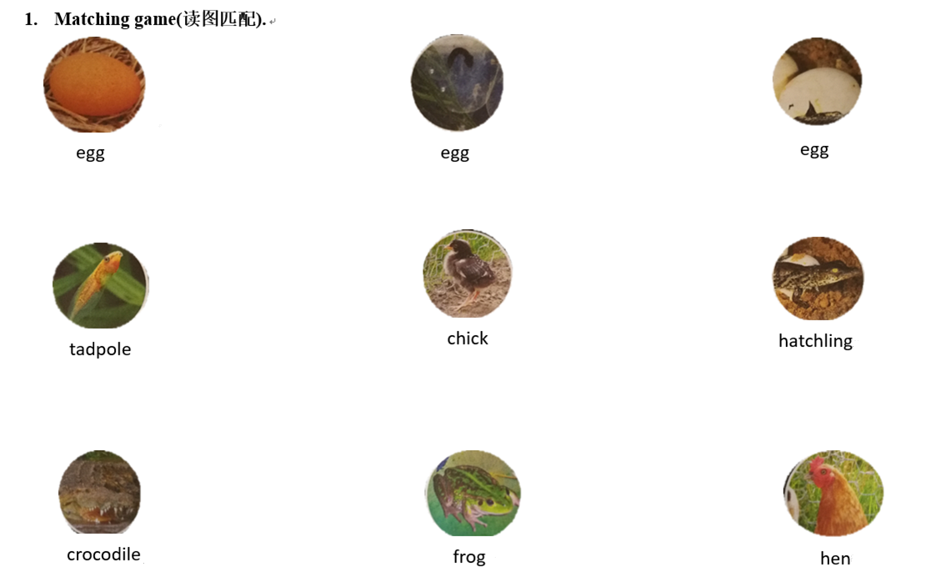
Matching Game 读图匹配
What does this chart tell us?

Slide 20
Third-reading
Which word says egg?
How do you know?

Slide 21
Which word says chick?
How do you know?

Slide 22
Which word says hen?
How do you know?

Slide 23
Put your fingers on the high-frequency words “here” “is” “the”.

Slide 24
Which word says tadpole?
How do you know?
tadpole

Slide 25
Which word says frog?
How do you know?

Slide 26
Which word says hatchling/crocodile?
How do you know?

Slide 27
Game: 听音起立
教师指定一个音，如“h”，学生听到首字母发音是“h”的单词时要起立，反之则不动。
c
f
h
e
t
ch

Slide 28
Group work: 小组表演
Level 1: each student tells a sentence and acts with sounds and actions
Level 2: each student tells an animal and acts with sounds and actions

Slide 29
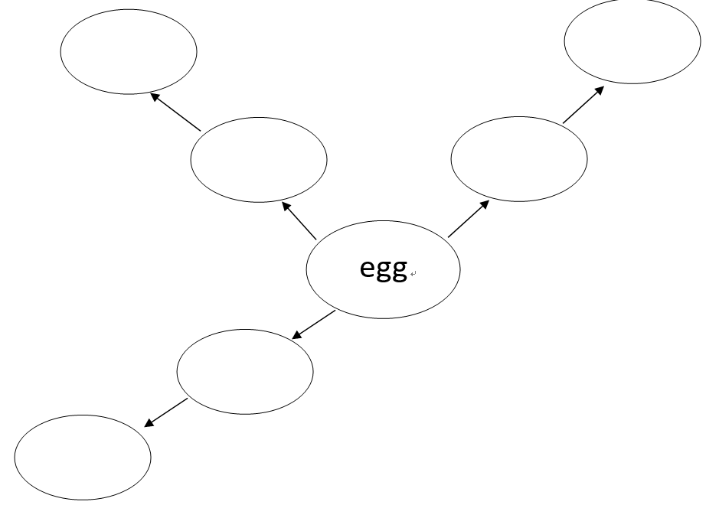
Finish the thinking map. 完成思维导图
hen
frog
chick
tadpole
hatchling
crocodile

Slide 30
More discussion. 拓展延伸
hen
frog
chick
tadpole
hatchling
duckling
crocodile
Do you know any other animals ?
What are they?
What is the process of duck’s growth？
duck

Slide 31
More discussion. 拓展延伸
What about you?
2. What’s the process of your growth?

Slide 32
Homework
Listen to the audio and read the story.
Tell the story to your parents.
Make a new book about other animals, such as duck…

