Slide 1
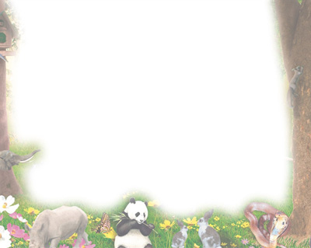
Sleeping Animals
动物睡着了
选自《多维阅读第1级》

Slide 2
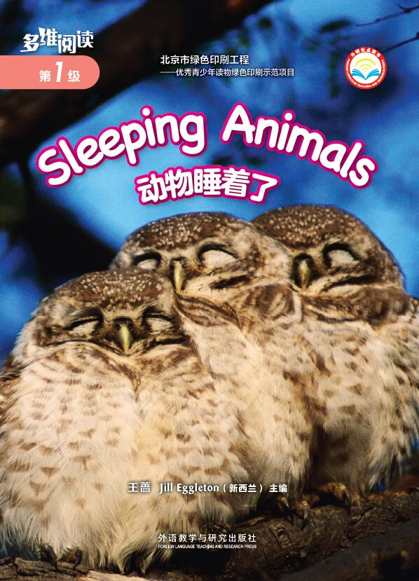
1. What animal do you see in the picture?
2. What are the owls doing?
A. They’re playing. B. They’re sleeping.
3. What is the book about?

Slide 3
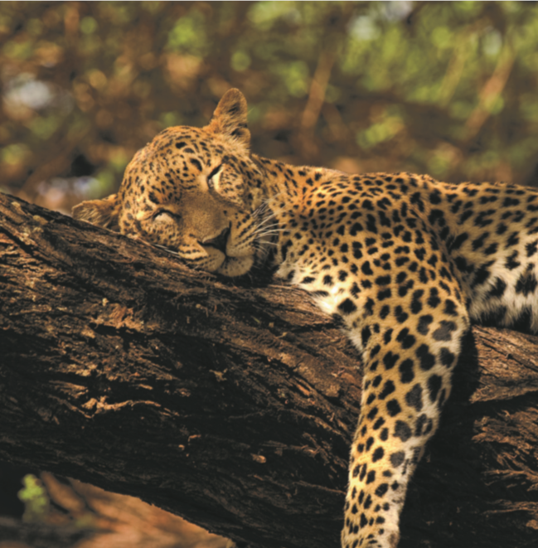
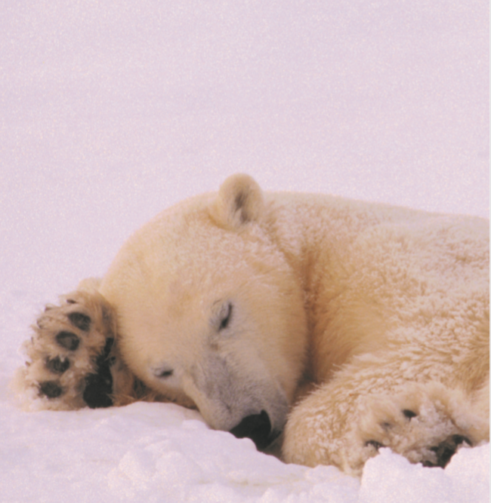
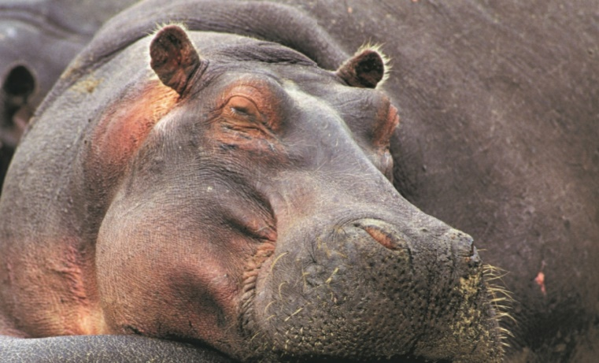
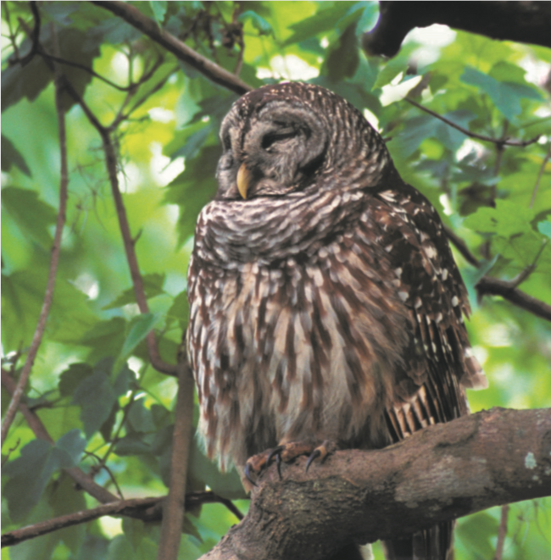
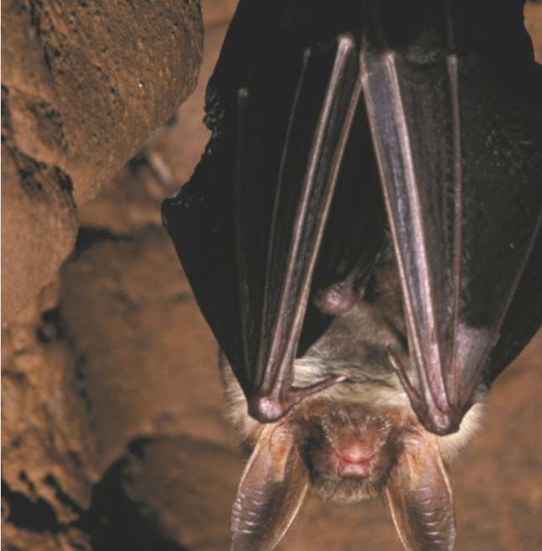
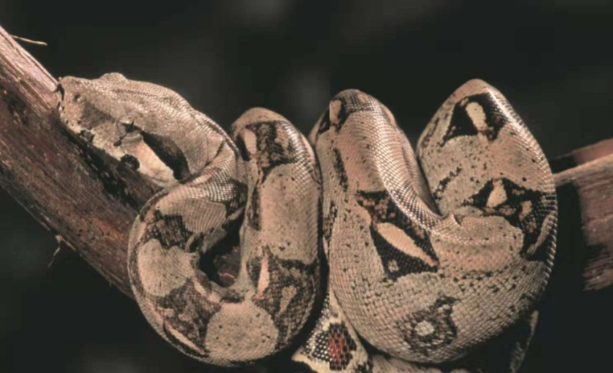
First reading: view & answer
看图回答
1
2
3
4
5
6
How many animals can you see?
What animals are they?
What are they doing?

Slide 4
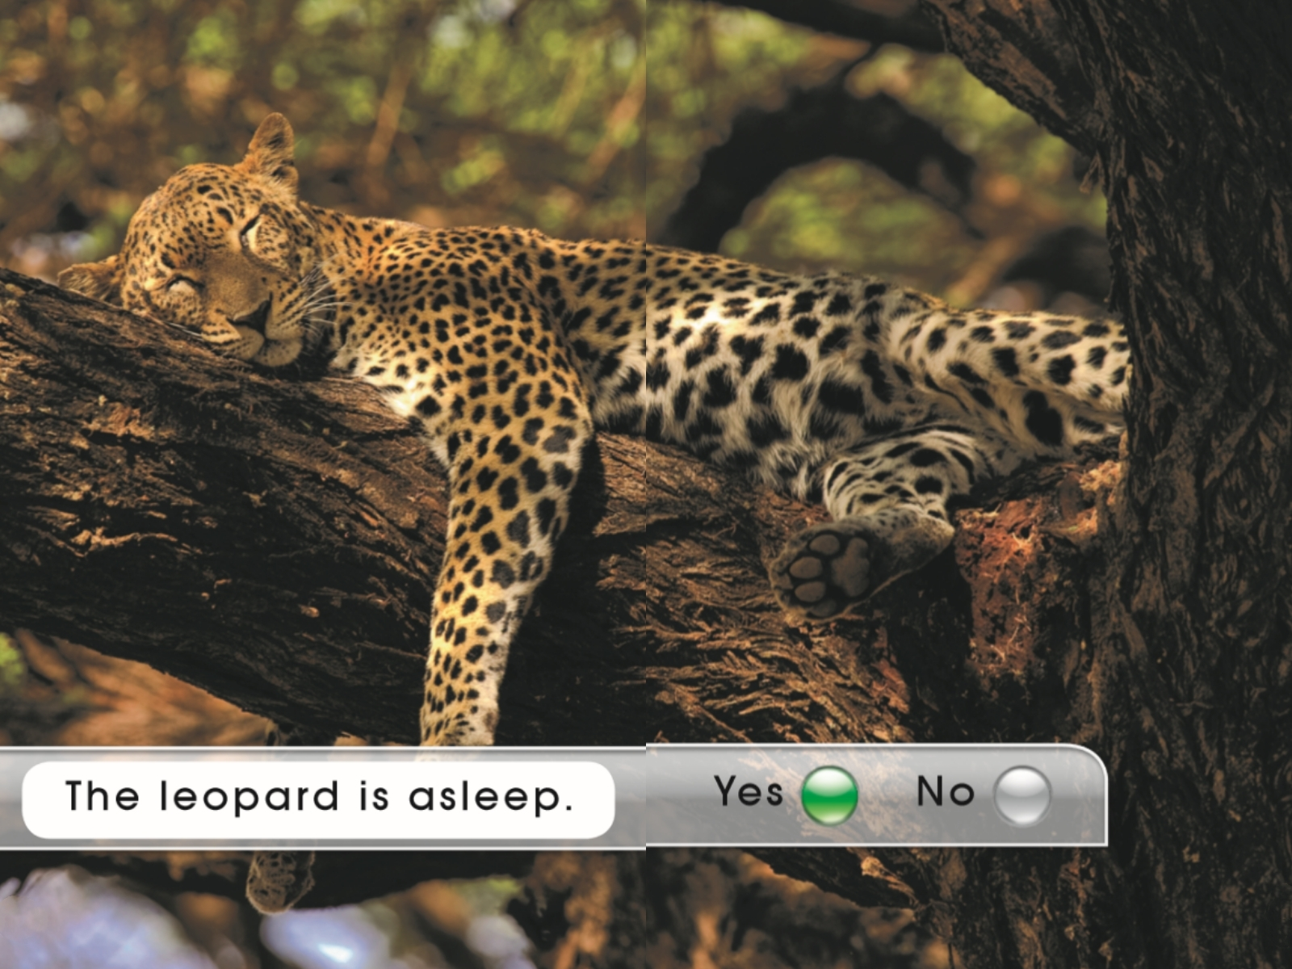
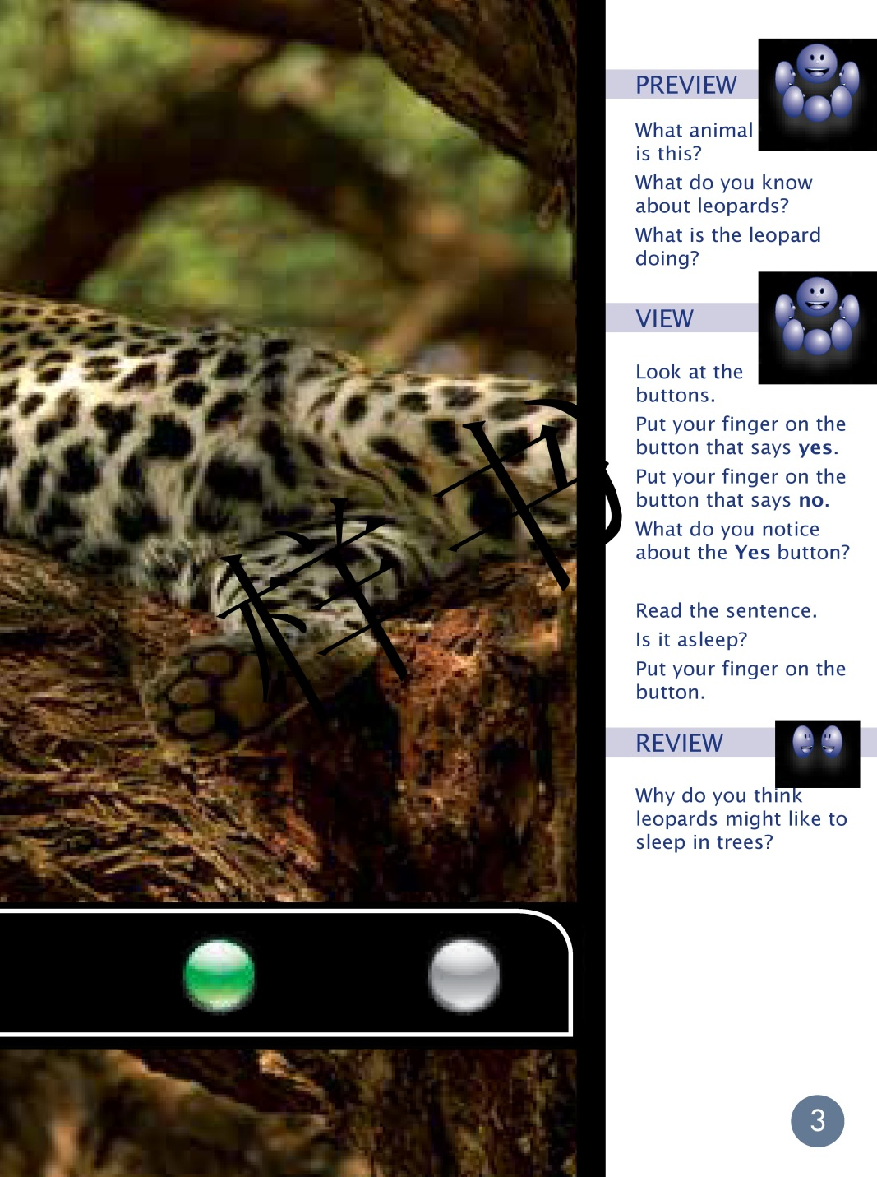


Second reading
What animal is this?
What do you know about leopards?
What is the leopard doing?

Slide 5
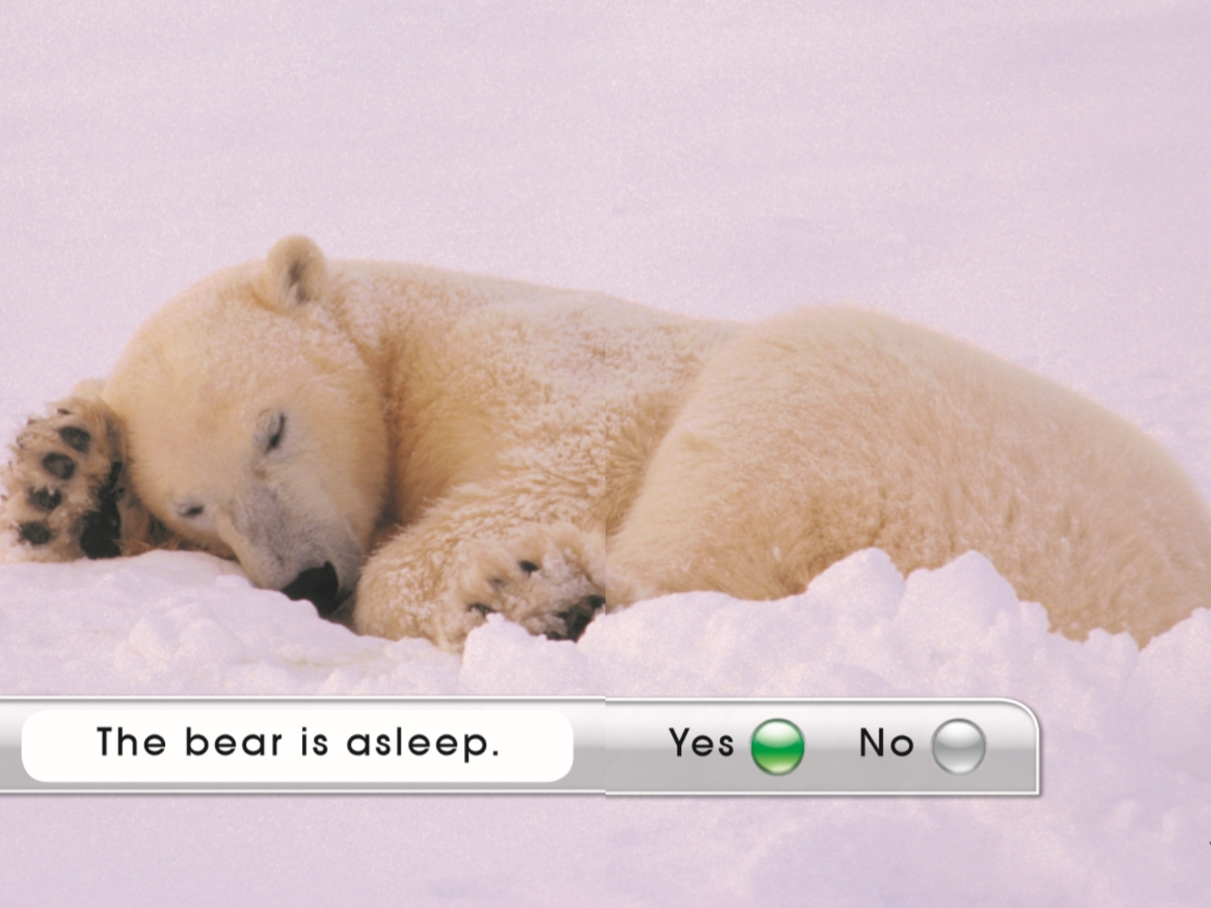
What animal is this?
What do you know about bears?
What is the bear doing?

Slide 6
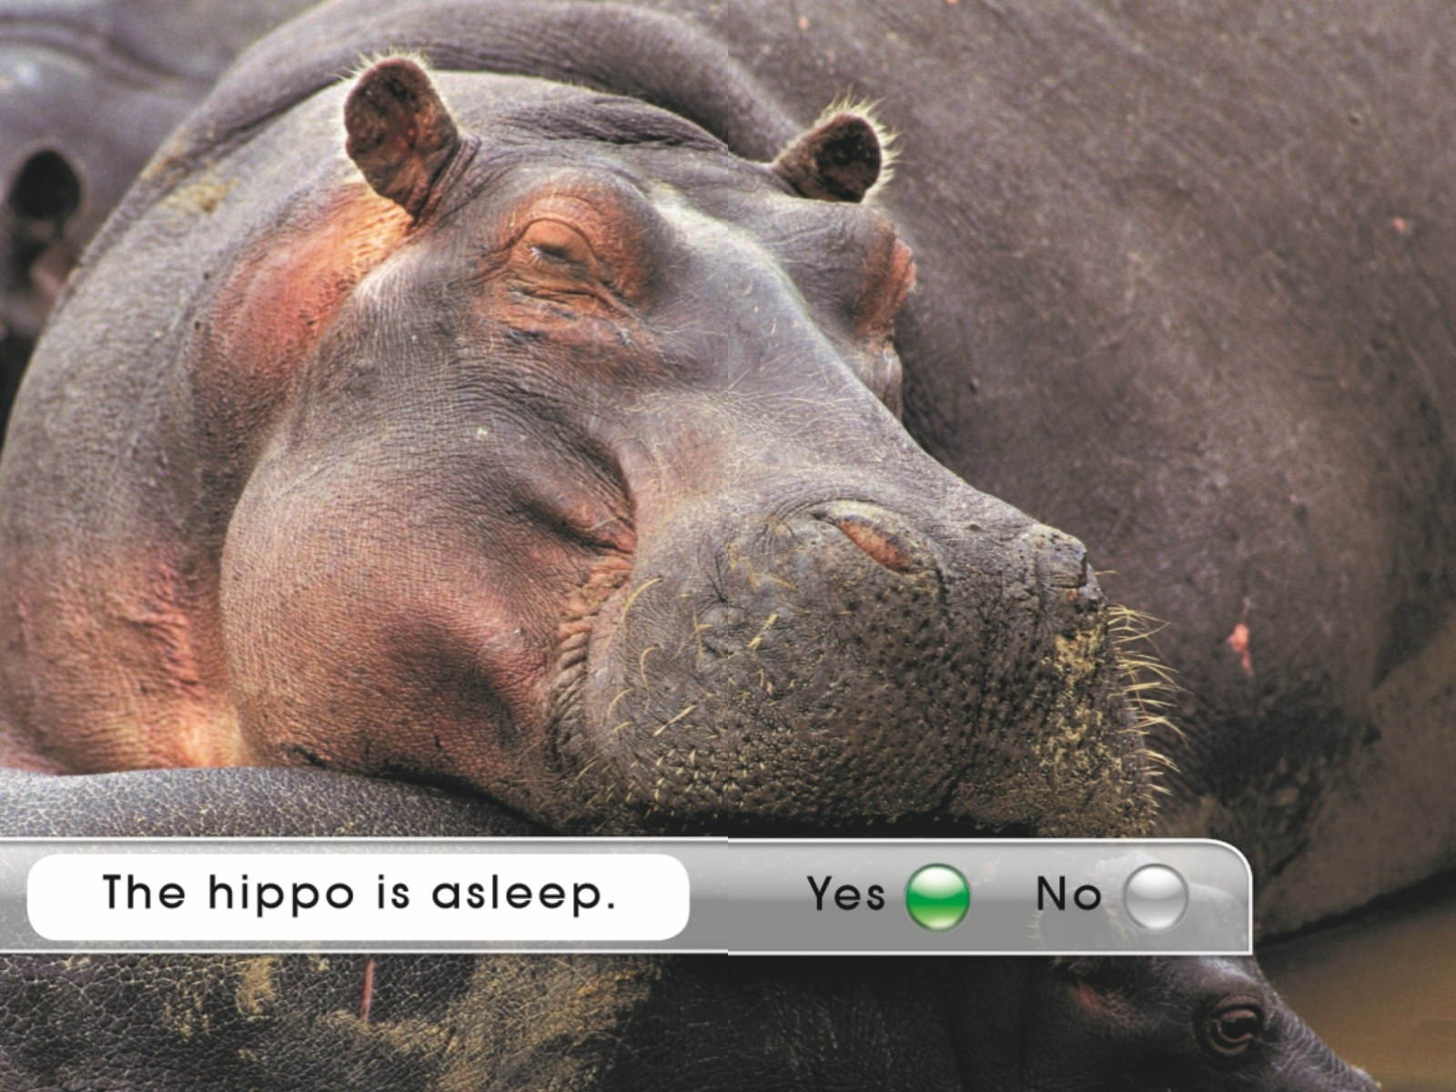
What animal is this?
What do you know about hippos?
What is the hippo doing?

Slide 7
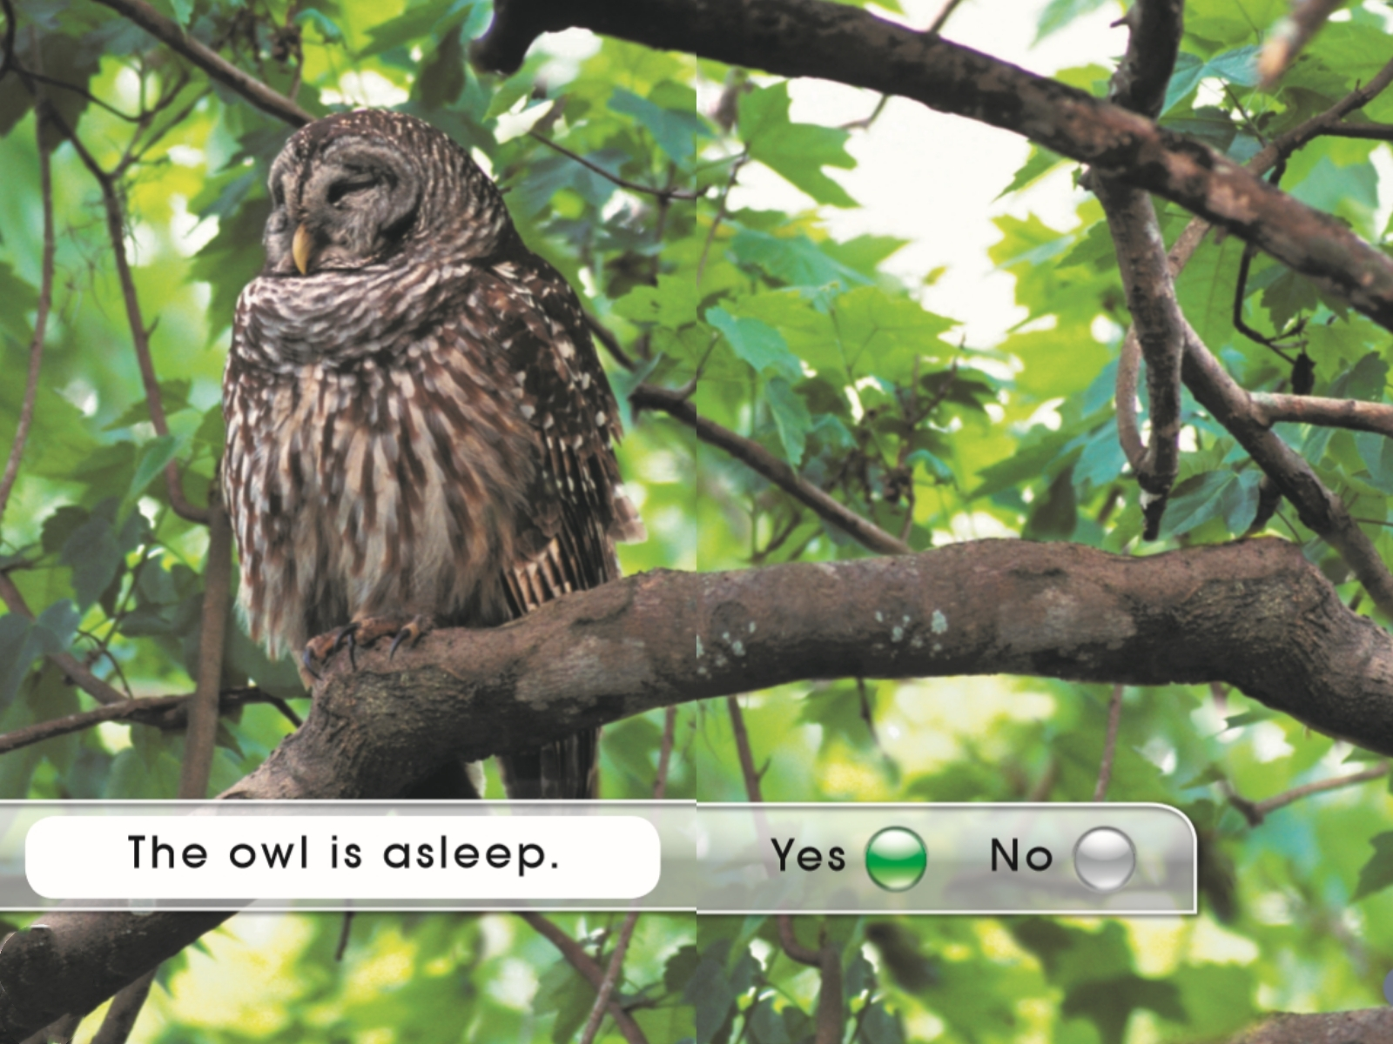
What animal is this?
What do you know about owls?
What is the owl doing?

Slide 8
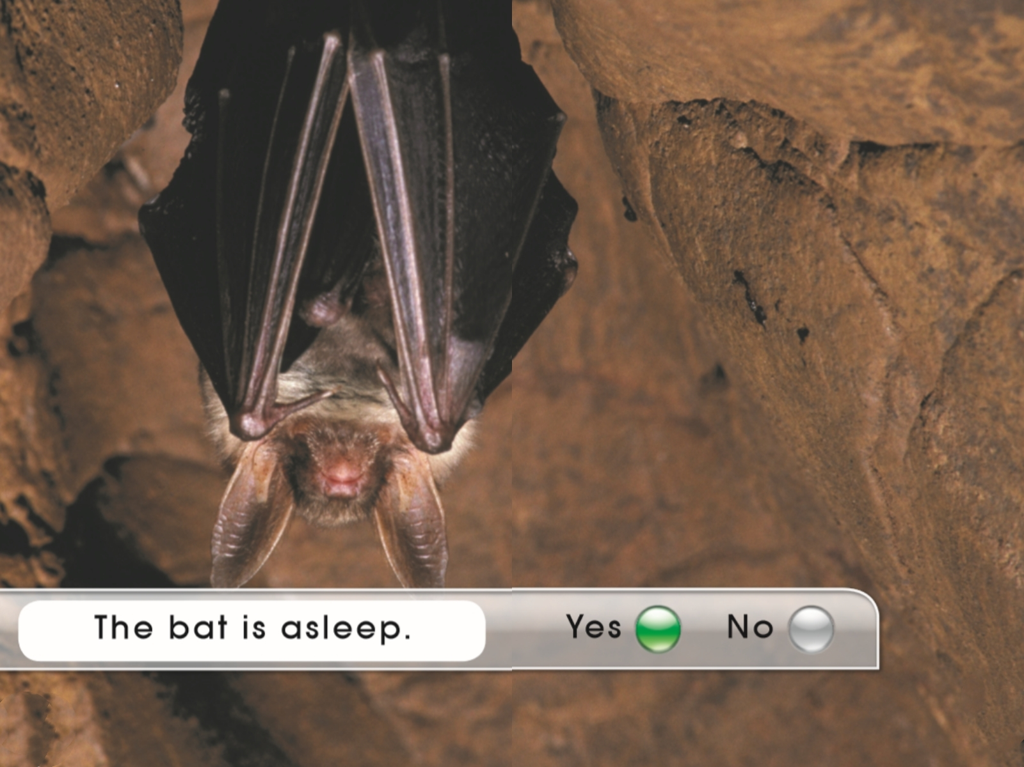
What animal is this?
What do you know about bats?
What is the bat doing?

Slide 9
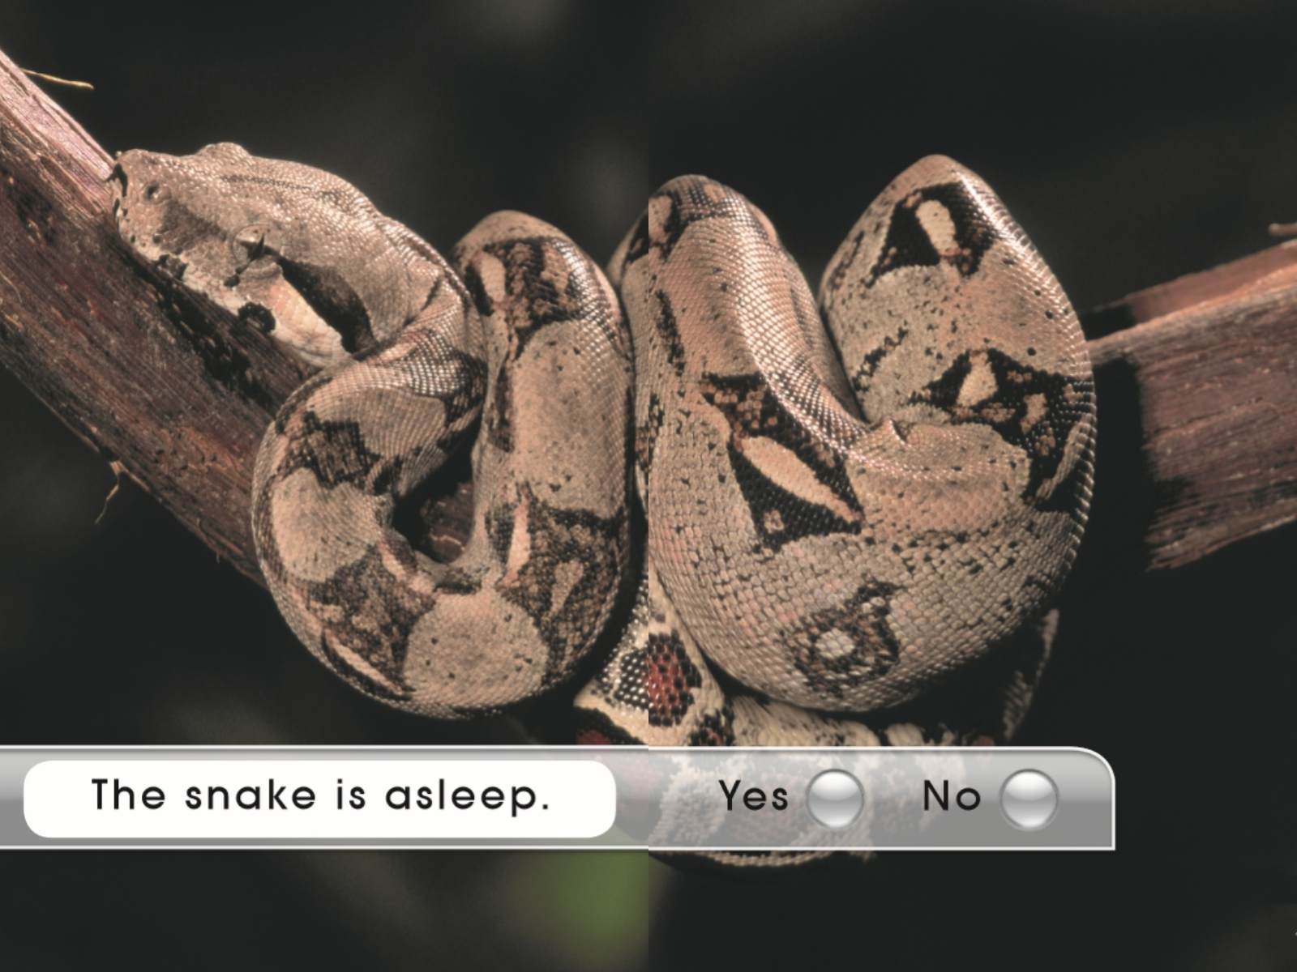
What animal is this?
Is the snake sleeping?

Slide 10
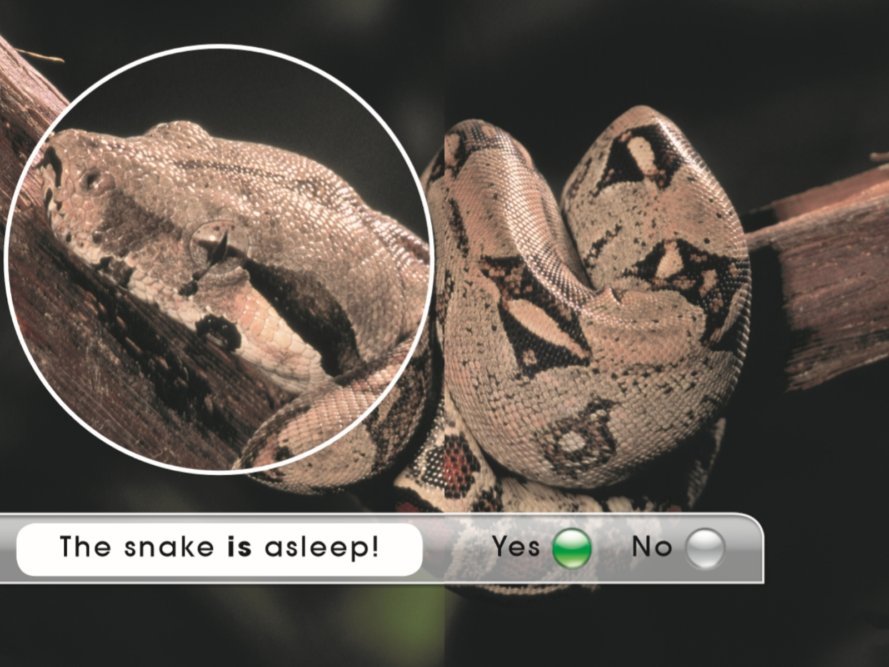

Slide 11
Third reading
leopard
asleep

Slide 12
bear

Slide 13
hippo

Slide 14
owl

Slide 15
bat

Slide 16
snake

Slide 17






Flashcard game 卡片游戏
Basic level
The … is asleep.
1
2
3
4
5
6

Slide 18
Flashcard game 卡片游戏
Medium level
The … is asleep.
leopard
bear
hippo
owl
bat
snake

Slide 19
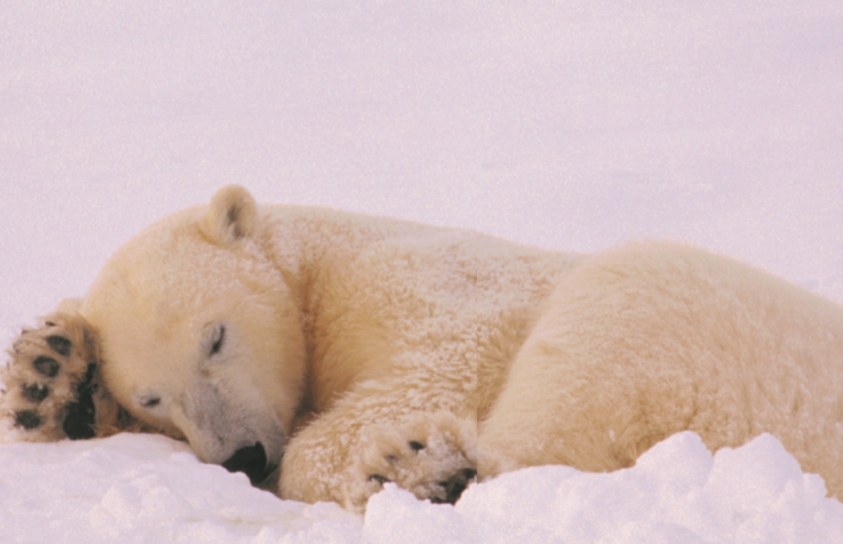
Flashcard game 卡片游戏
High level

Slide 20
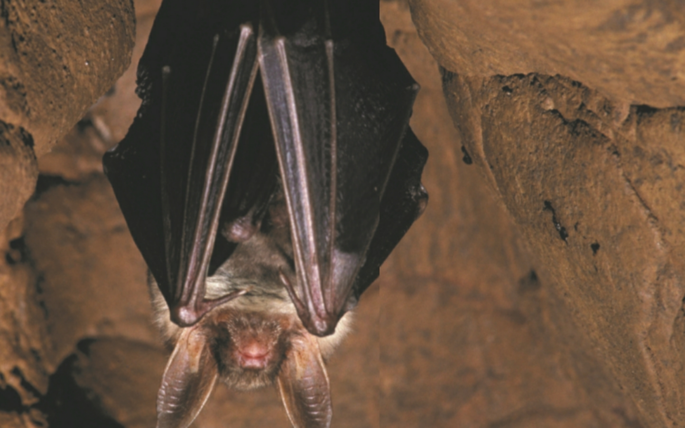
Flashcard game 卡片游戏
High level

Slide 21
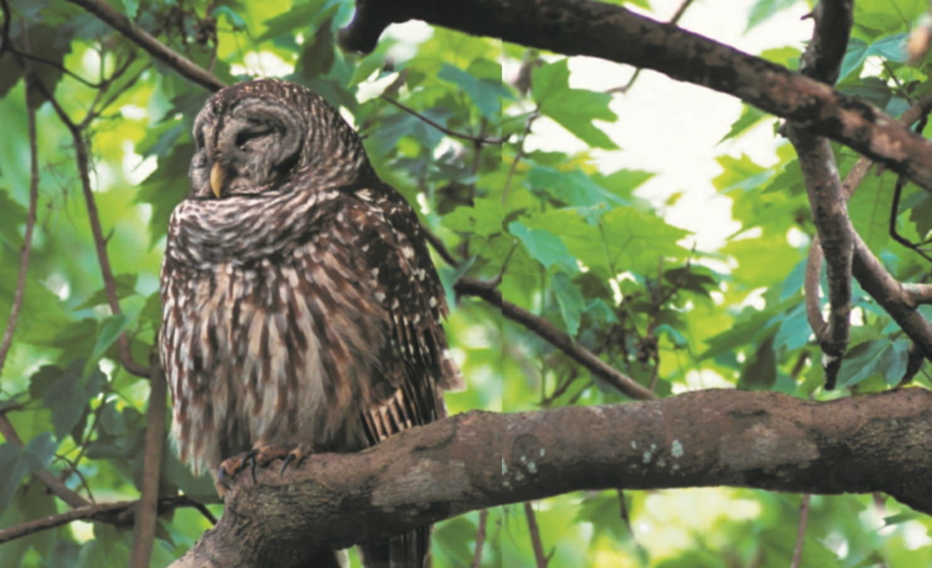
Flashcard game 卡片游戏
High level

Slide 22
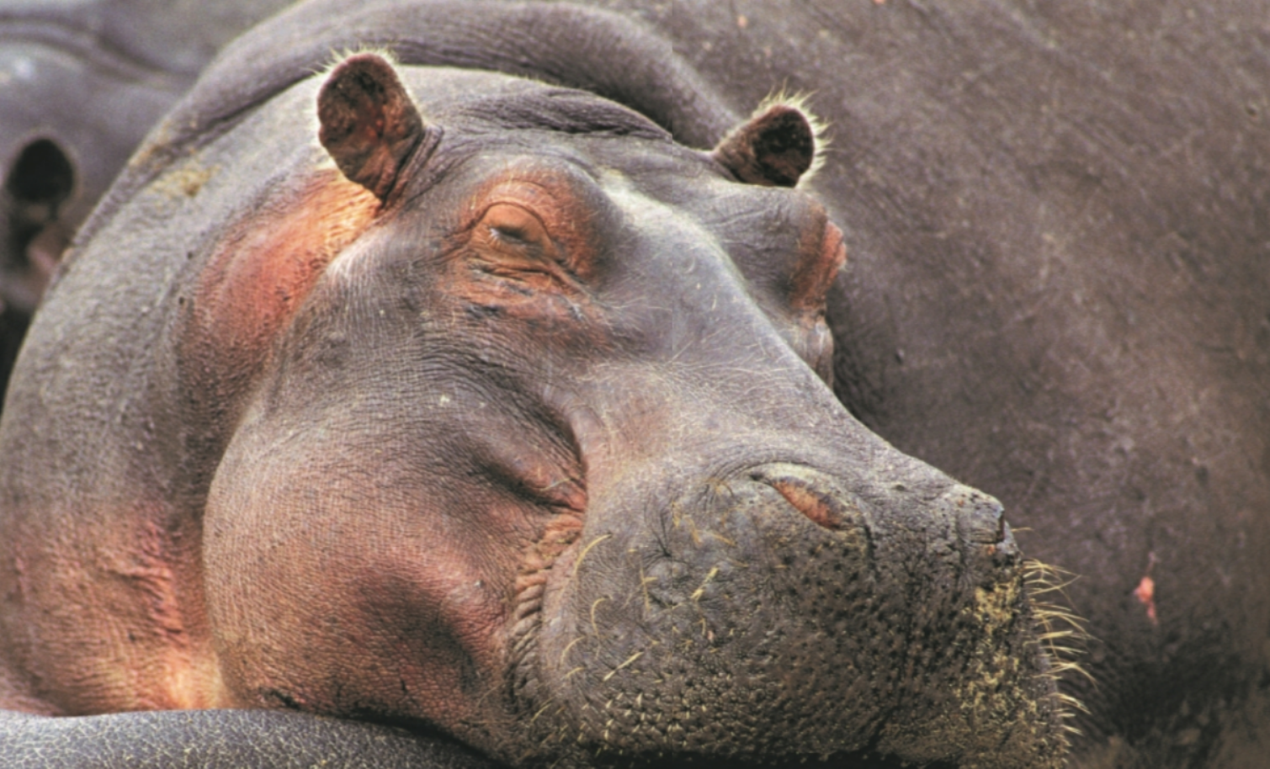
Flashcard game 卡片游戏
High level

Slide 23

Flashcard game 卡片游戏
High level

Slide 24
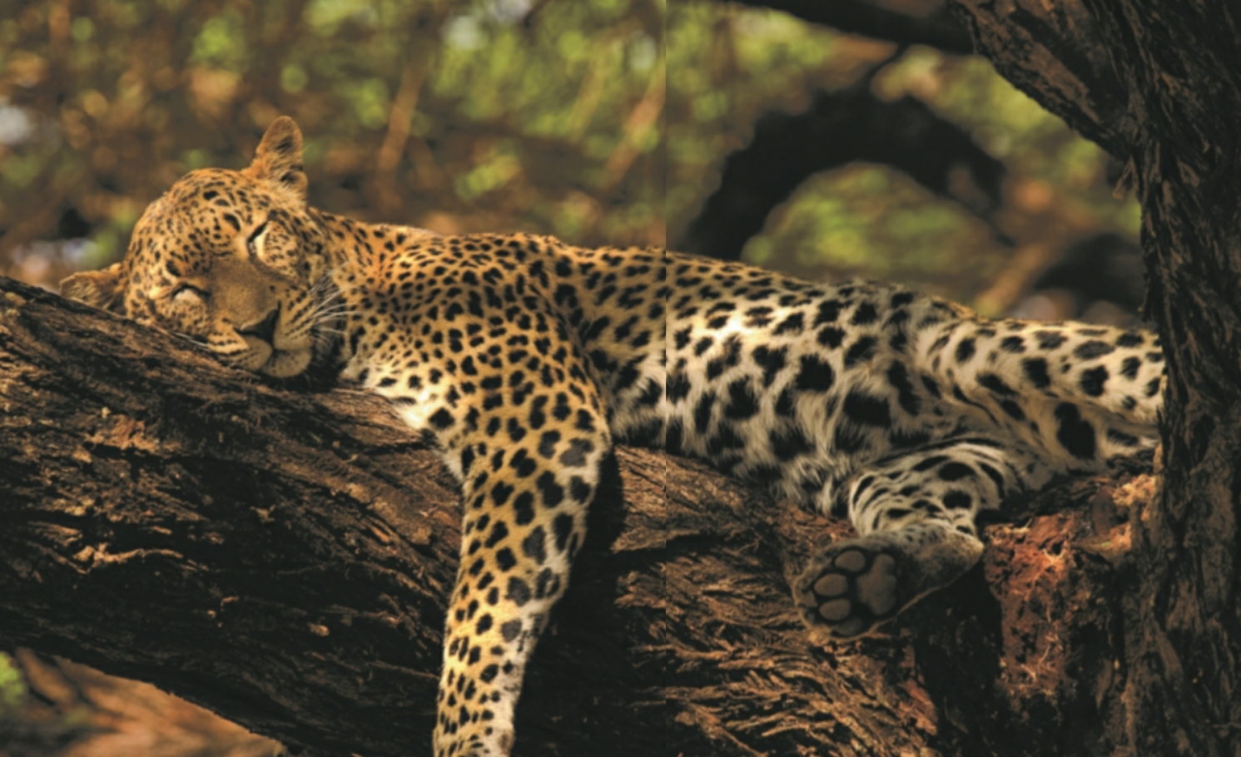
Flashcard game 卡片游戏
High level

Slide 25
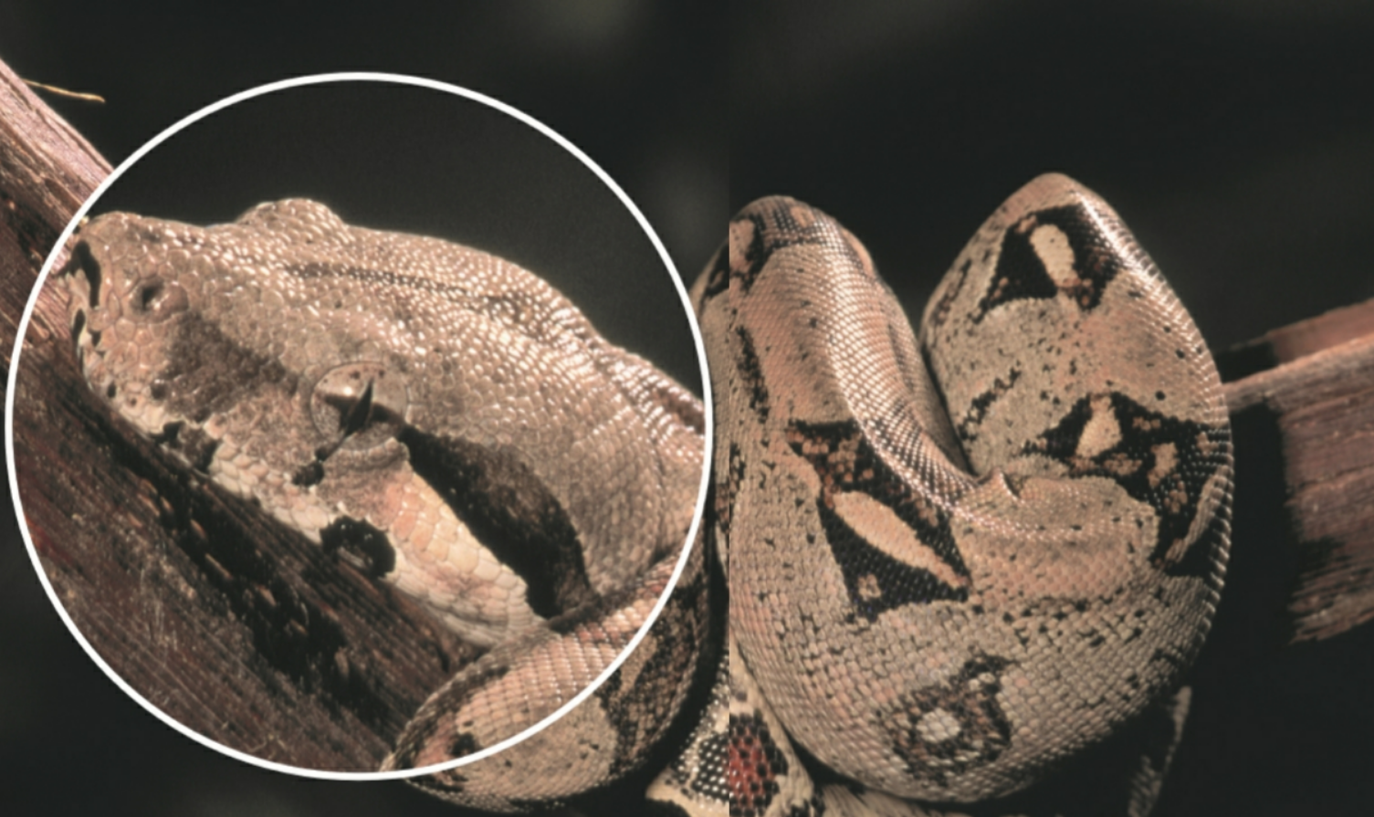
Flashcard game 卡片游戏
High level

Slide 26









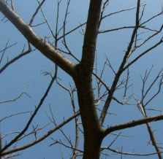
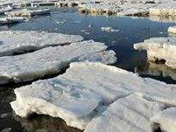
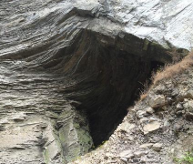
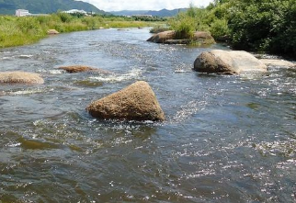
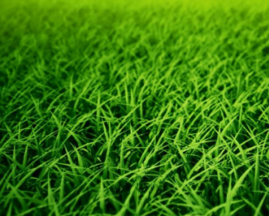
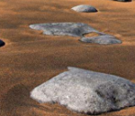
Group work 小组活动
The … is asleep.
1
2
3
4
5
6
A. Yes, yes, yes. The … is asleep.
B. No, no, no. The … is not asleep in the tree/ on the ice. The … is asleep …..

Slide 27
Read again.
Group(分组) the animals in your opinion.
1
2
3
4
5
6

Slide 28
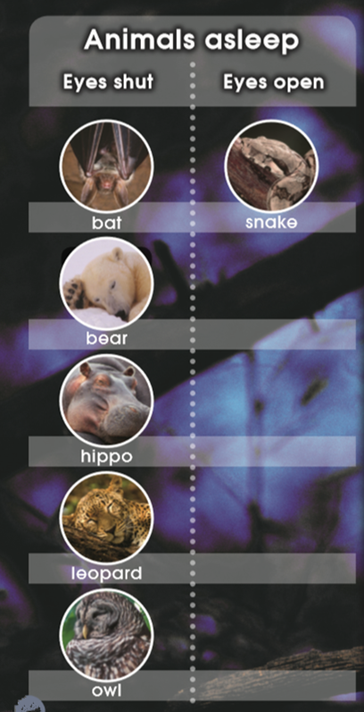

Slide 29
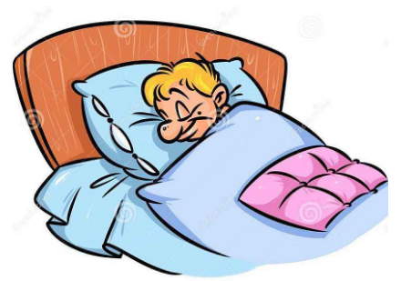
How do people sleep? (When/Where/How/Why…)

Slide 30
What other animals do you know that are asleep with eyes open/shut?

Slide 31
Homework
Listen to the audio and read the story.
Tell the story to your parents.
Make a new book about sleeping animals and sleeping you.

