Slide 1
Racing
大家来比赛
选自《多维阅读第1级》

Slide 2
Prediction
What is the book talking about?
A. Cars
B. Animals

Slide 3
Read the cover
1. What are these in the photo?
2. What are they doing?
3. What’s the title?

Slide 4
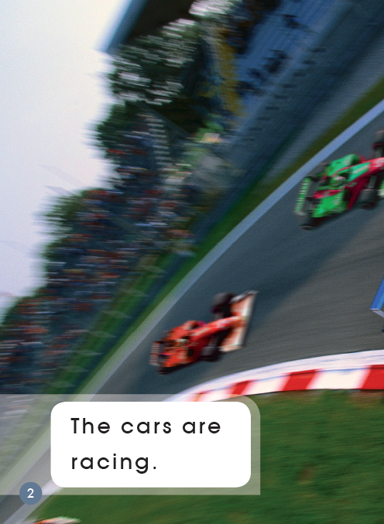
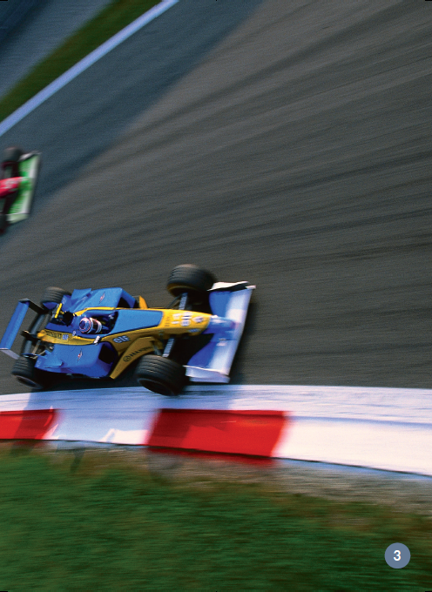
Read and answer
2
1
3
1. How many cars can you see?
2. Which car is coming first?
3. Which car is coming last?

Slide 5
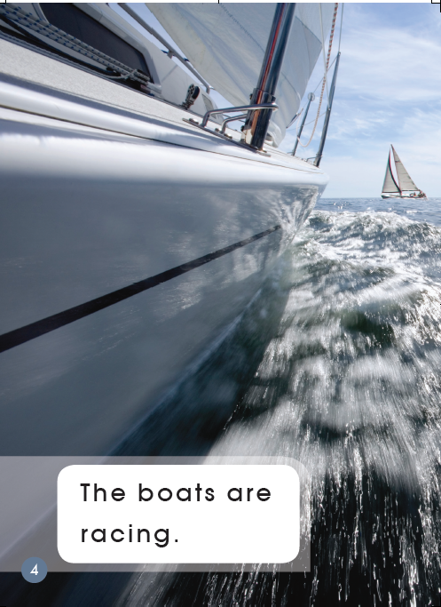
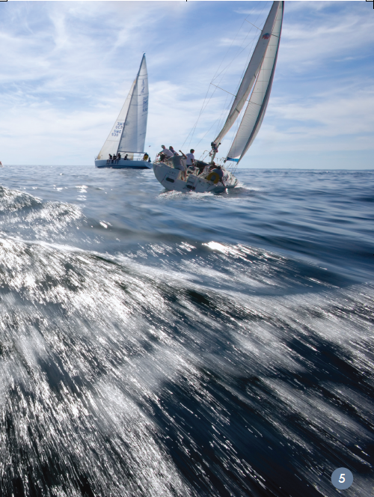
Read and answer
1.What do you see in the photo?
2.Where are the boats?
3.How many boats can you see?

Slide 6
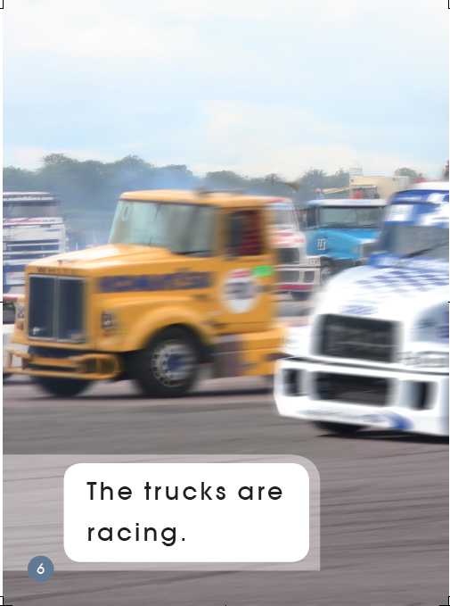
Read and answer
1. What are these in the photo?
2. What are they doing?
3. How many trucks can you see?

Slide 7
Read and find
1. Can you read the sentence?
2. Which word says racing?
3. Make a circle with your finger around the word racing.

Slide 8
Read and find
1. Which word says the?
2. Which word says are?
3. Can you read the sentence?

Slide 9
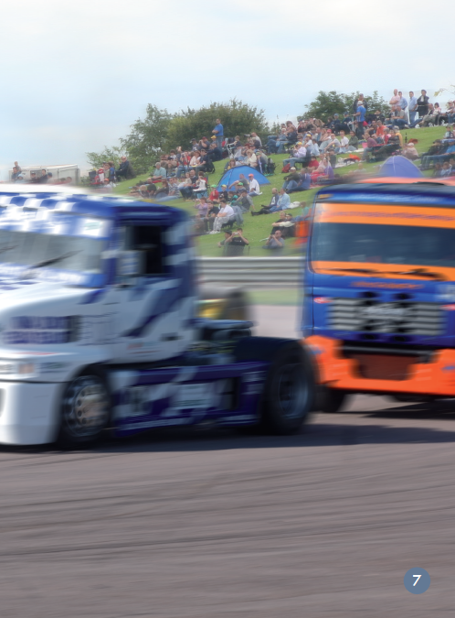
Read and find
Make circles with your fingers around the words the, are.
Can you read the sentence?

Slide 10
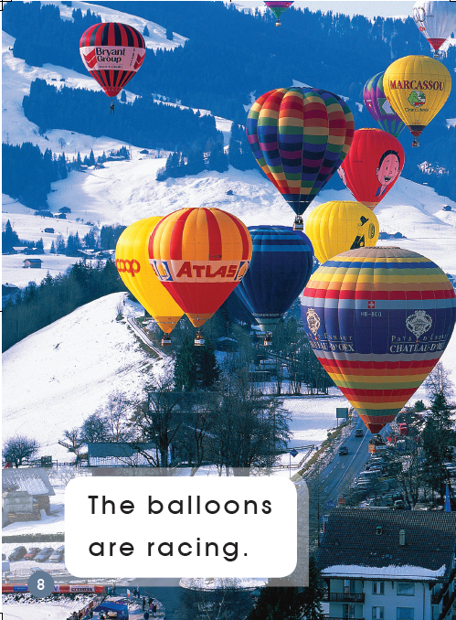
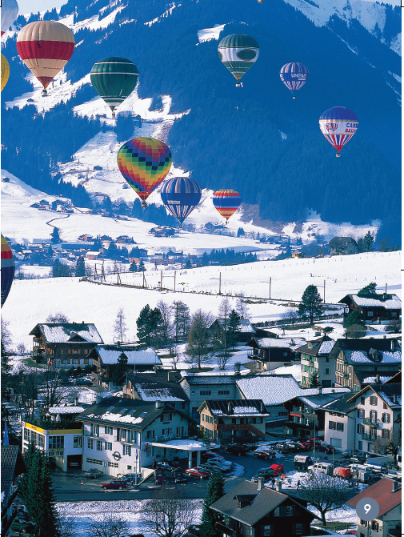
Read and find
1. Make a circle with your finger around the word balloons.
2. Can you read the sentence?

Slide 11
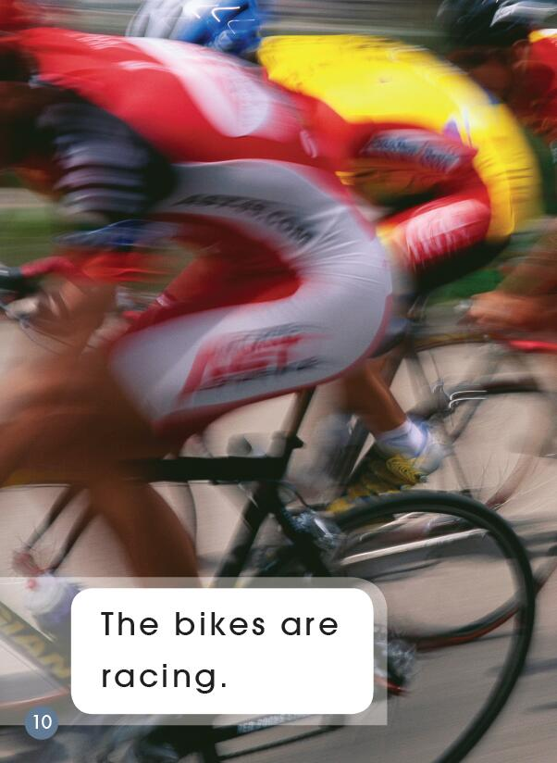
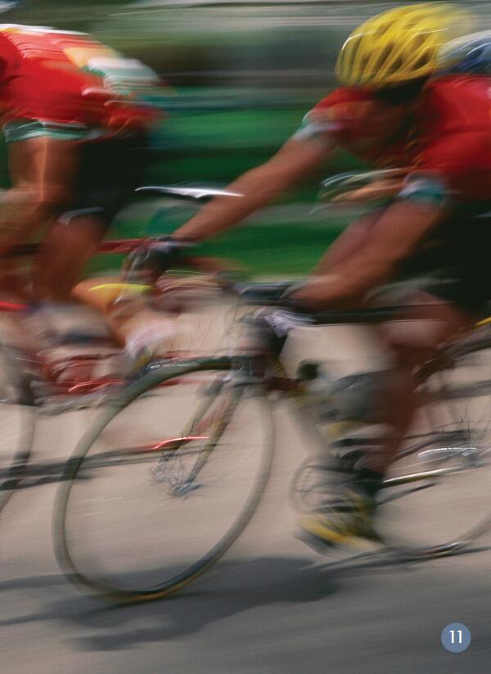
Read and find
1. Can you read the sentence?
2. Make a circle with your finger around the word bikes.

Slide 12
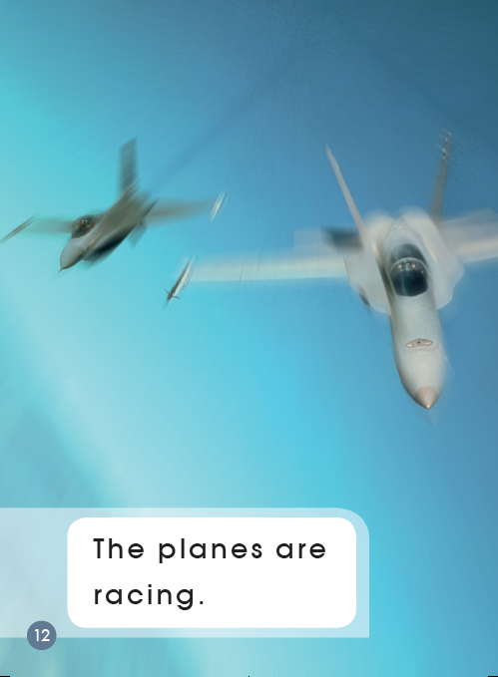
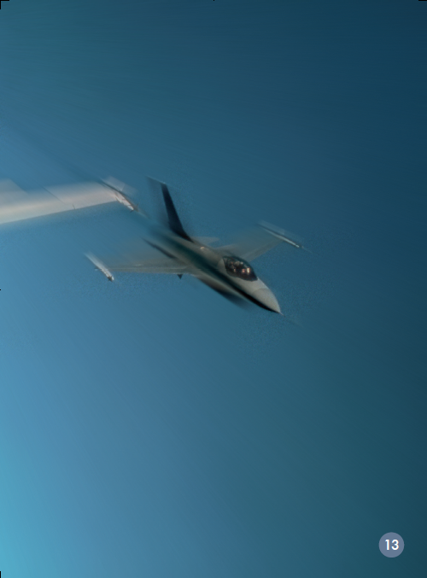
Read and find
1. Can you read the sentence?
2. Make a circle with your finger around the word planes.

Slide 13
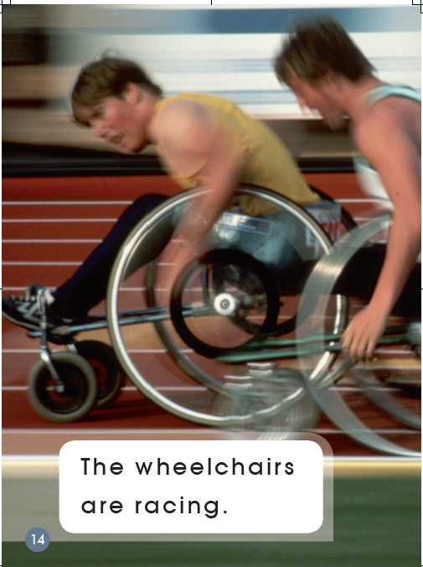
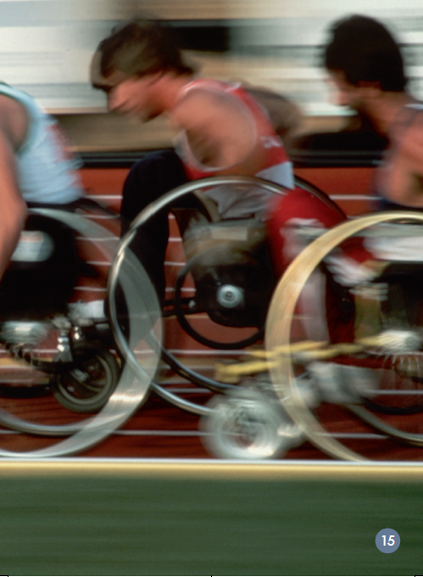
Read and find
wheelchairs
1. Look at the word wheelchairs.
What two words can you find?
2. Can you read the sentence?

Slide 14
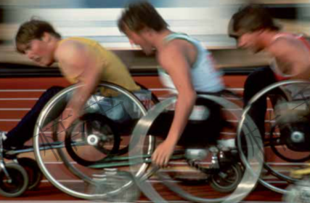
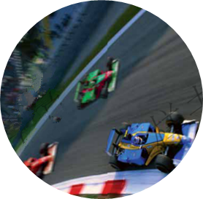
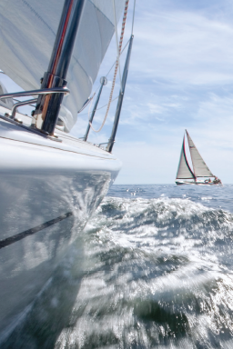
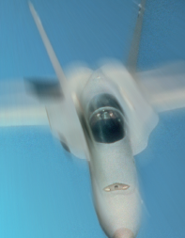
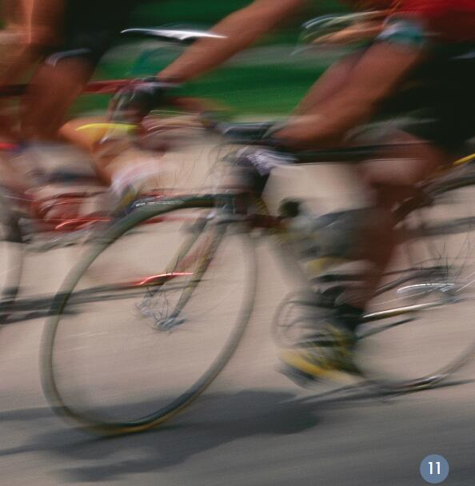
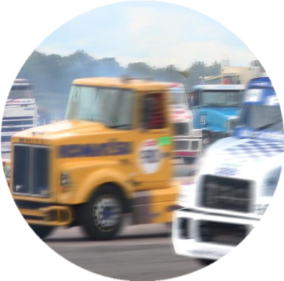
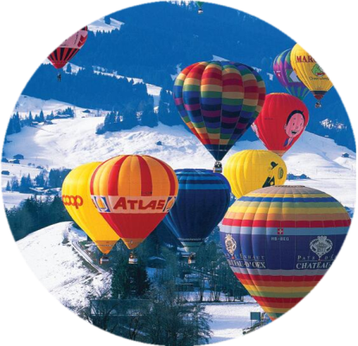
Read and choose
7
racing
1.The cars are racing.
2
1
2.The boats are racing.
3.The trucks are racing.
5
4.The balloons are racing.
6
5.The bikes are racing.
6.The planes are racing.
7.The wheelchairs are racing.
3
4

Slide 15
Read and blend
1. Which word says boats/balloons/bikes?
2.What is the first letter in boats?
3.What does this letter sound like in boats?
4.What is the same about boats/balloons/
bikes?
1. The cars are racing.
b
2. The boats are racing.
boats
3. The trucks are racing.
b
balloons
4. The balloons are racing.
bikes
b
5. The bikes are racing.
6. The planes are racing.
7. The wheelchairs are racing.

Slide 16
Read and blend
b
baby
...
bear
5. Can you find another word begins with /b/?
6. Can you read the words on the right?
bus
bag
bed
ball
bee
bell
bat
bug

Slide 17
Listen to the audio and imitate
1. The cars are racing.
5. The bikes are racing.
2. The boats are racing.
6. The planes are racing.
3. The trucks are racing.
7. The wheelchairs are racing.
4. The balloons are racing.

Slide 18
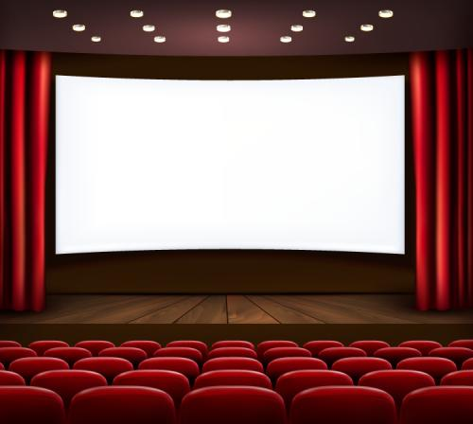
Show time

Slide 19
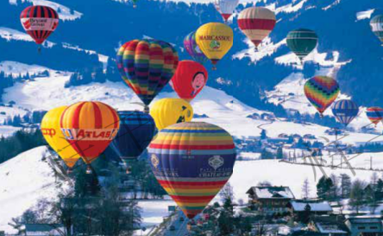
Think and discuss
racing
1. Do you know any other racing?
2. What are they?
3. Do you like racing?
4. What do you think
would help the...go fast?

Slide 20
Homework
1. Listen to the audio and read the story.
2. Tell the story to your parents.
3. Make a new book about racing cars/dogs/
bikes/boats...

