Slide 1

What Is Long?
动物的“长处”
选自《多维阅读第1级》

Slide 2
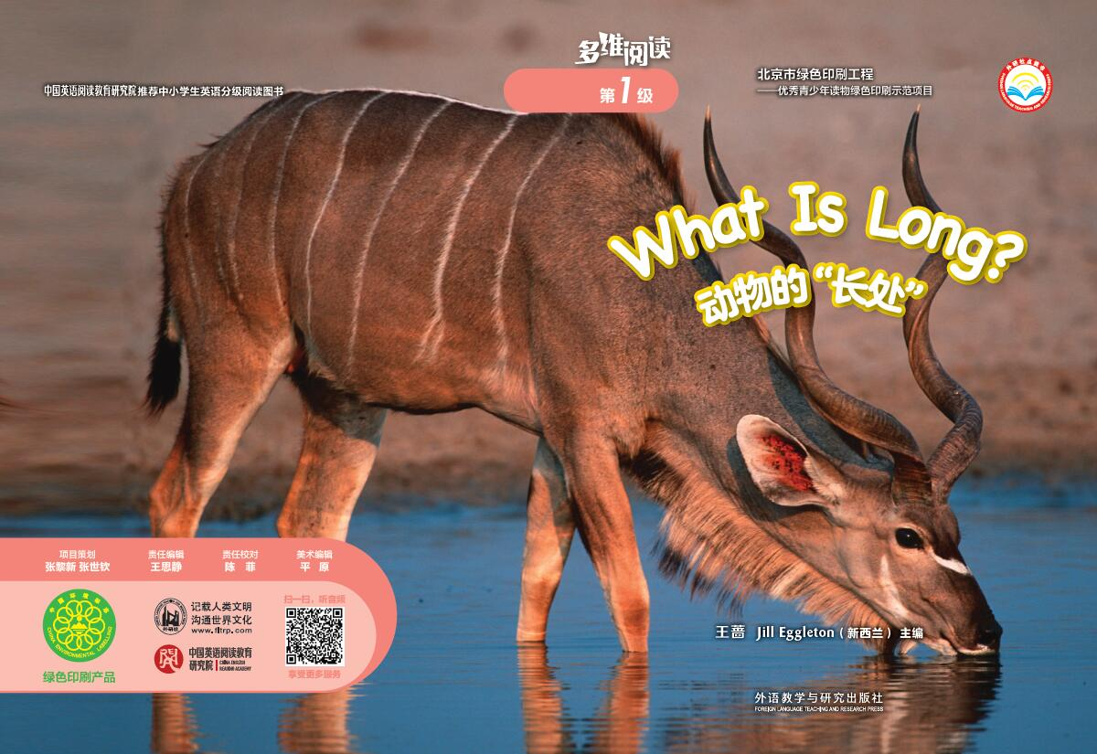
Prediction 预测
What can you see on the front cover?
What is long?

Slide 3
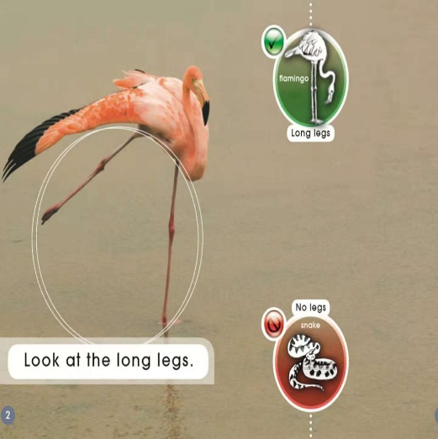
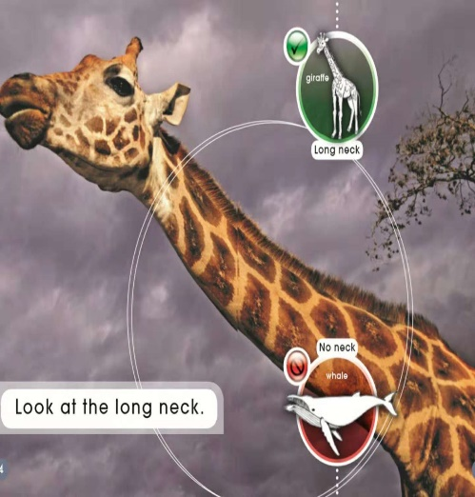
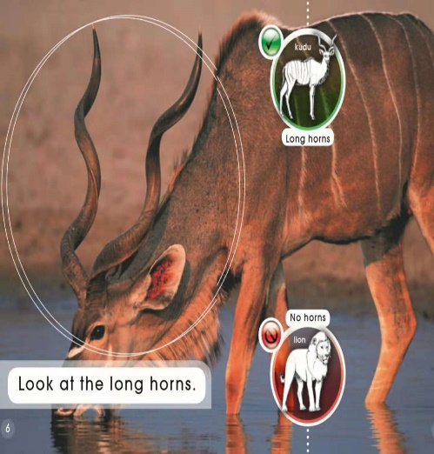
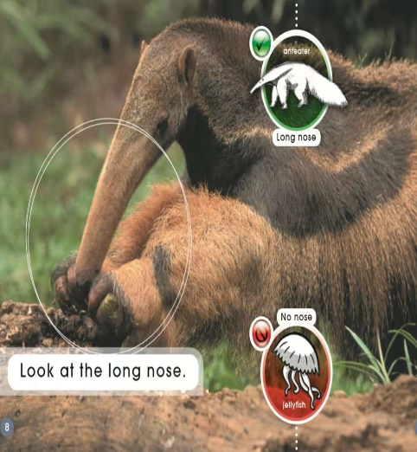
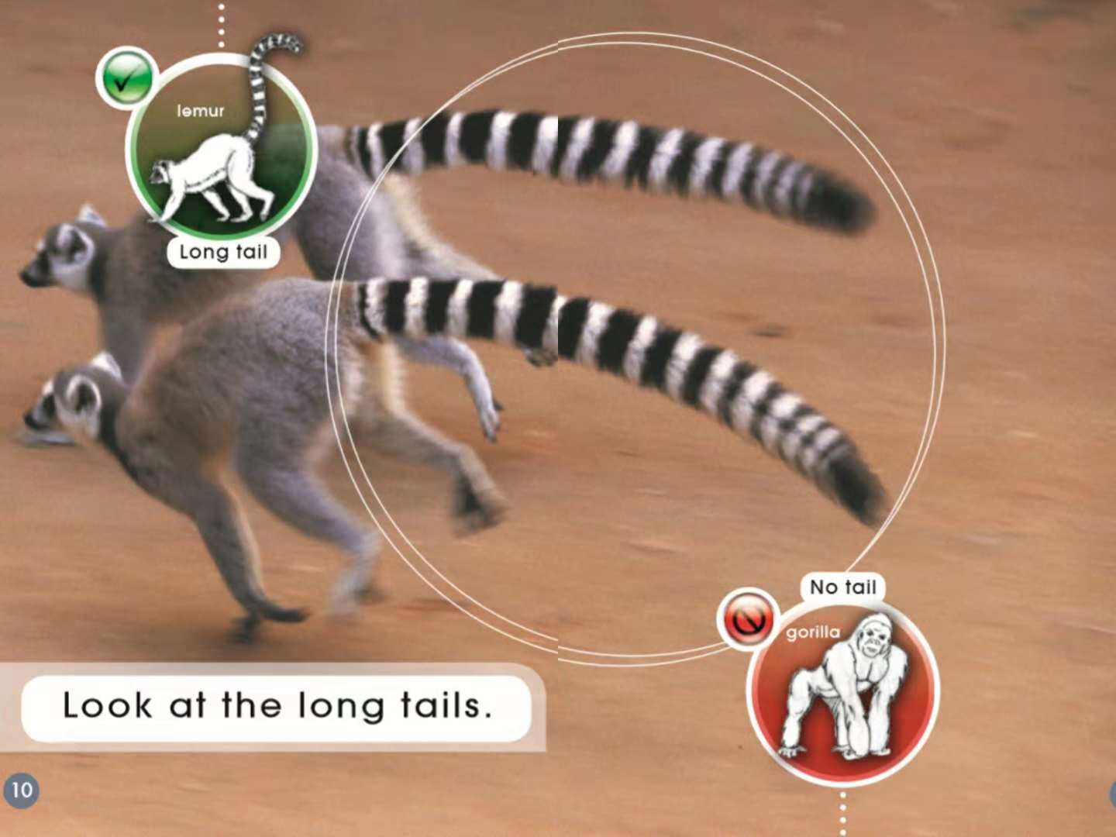
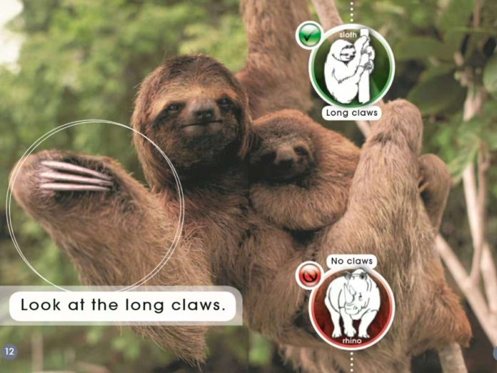
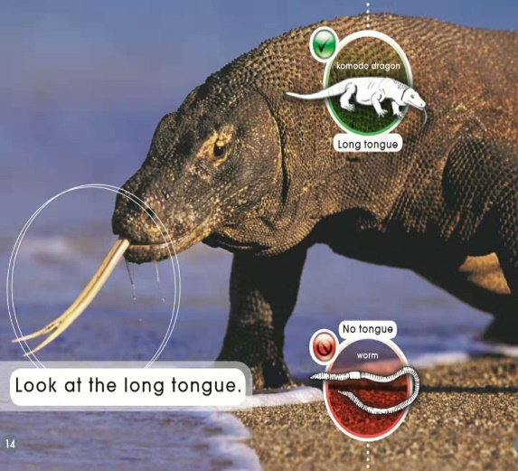
First reading: view & answer (看图回答)
1. How many animals can you see?
2. What do you notice about the animals?
3. What is long?

Slide 4
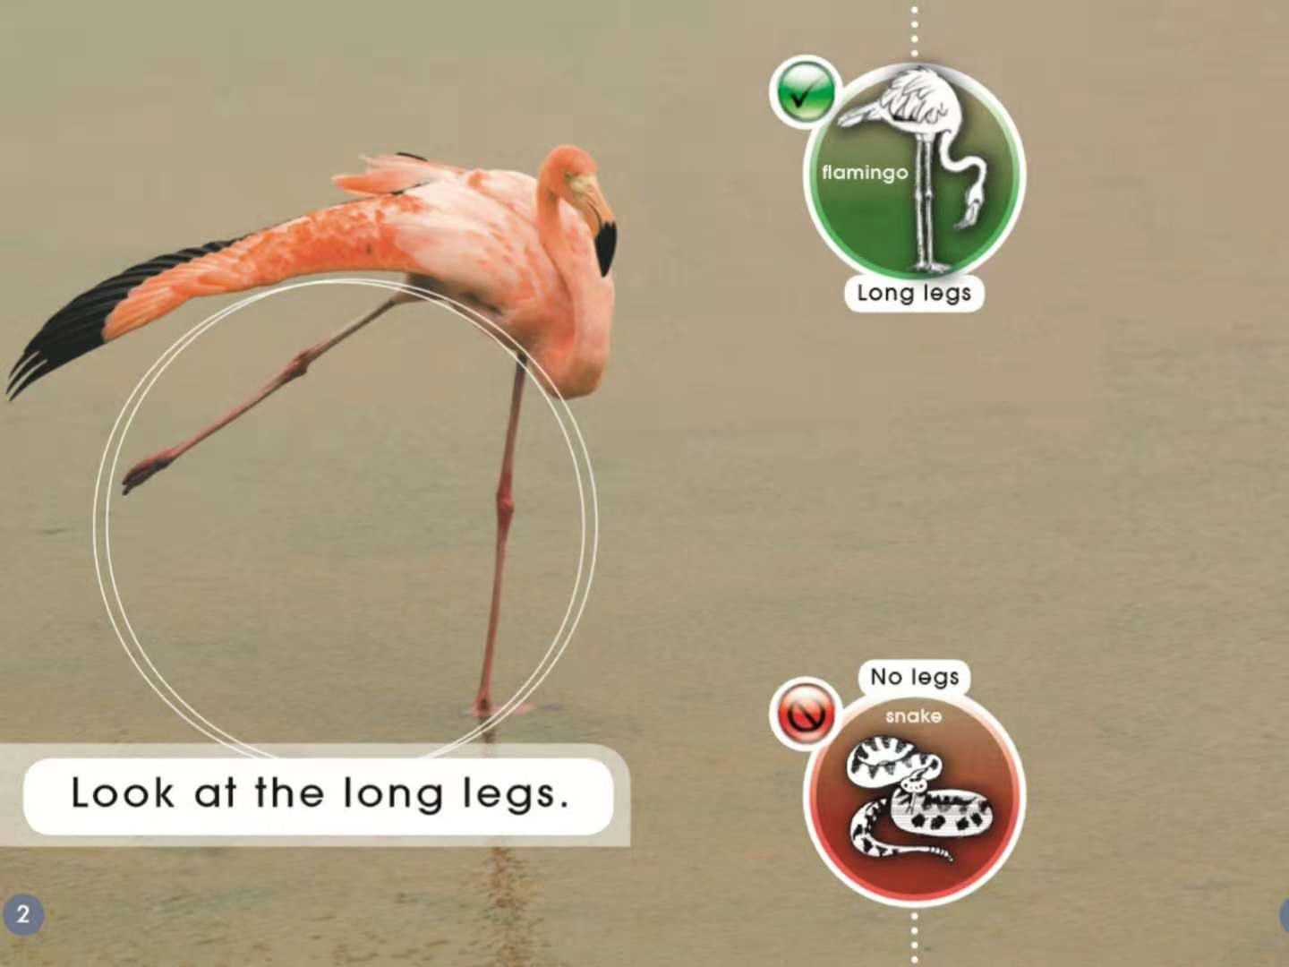
Second reading

Slide 5


Slide 6


Slide 7


Slide 9


Slide 10
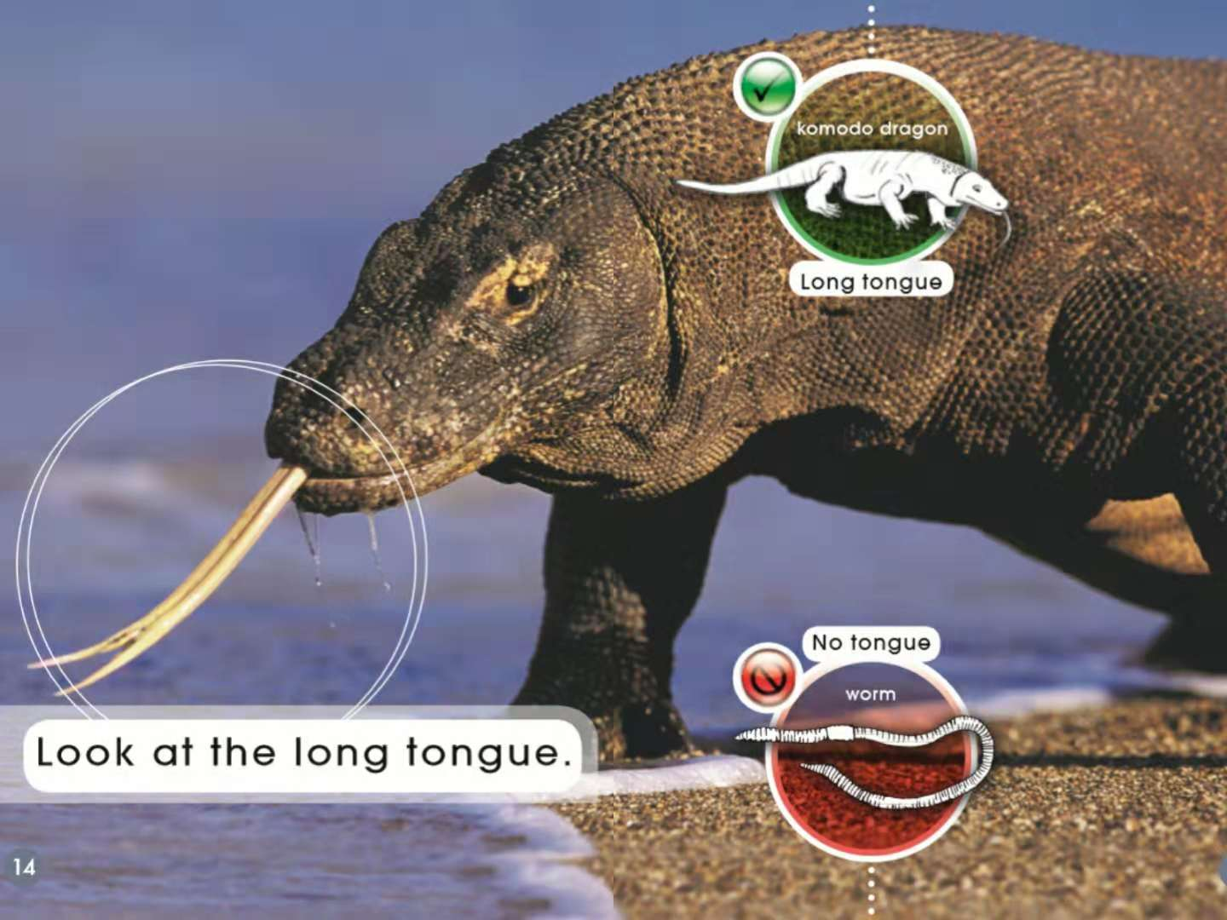

Slide 11
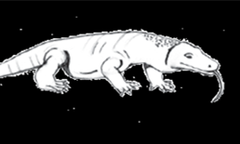
Circle and match 画圈并连线
Circle the long part and match the words.
Long nose
Long claws
Long tongue
Long horns
Long tail
Long neck
Long legs

Slide 12
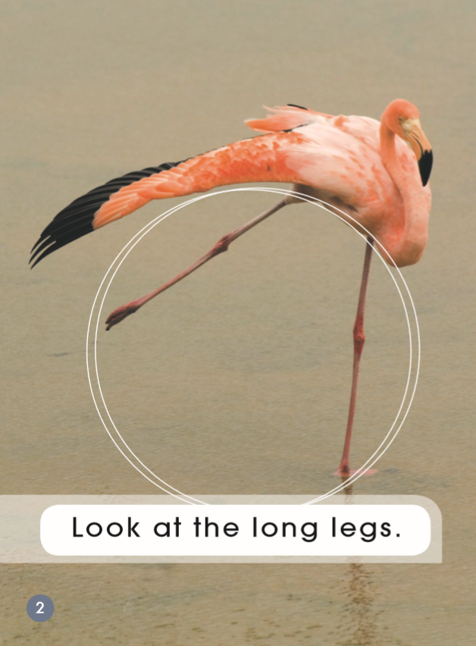
Third-reading
Which word says legs?
How do you know?
a leg

Slide 13
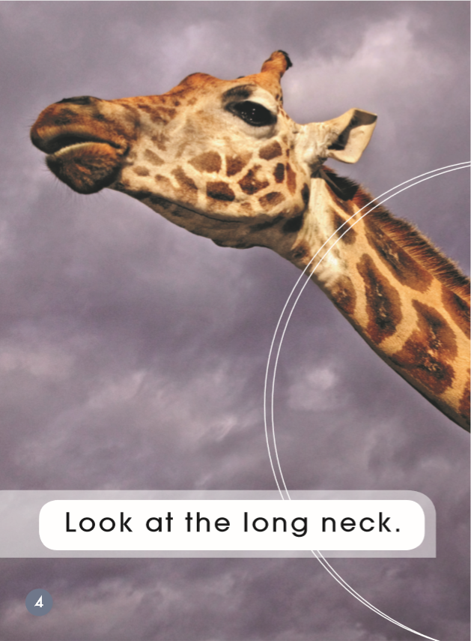
Which word says neck?
How do you know?

Slide 14
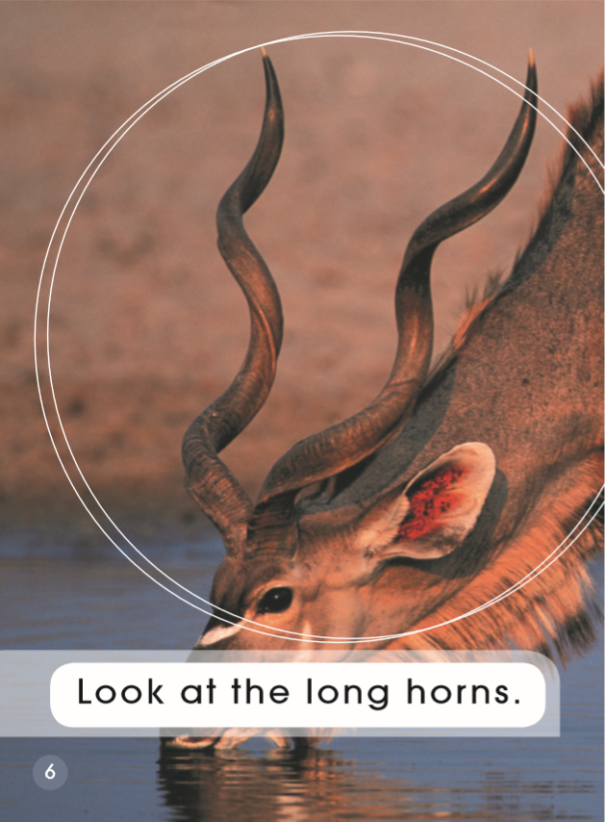
Which word says horns?
How do you know?
a horn

Slide 15
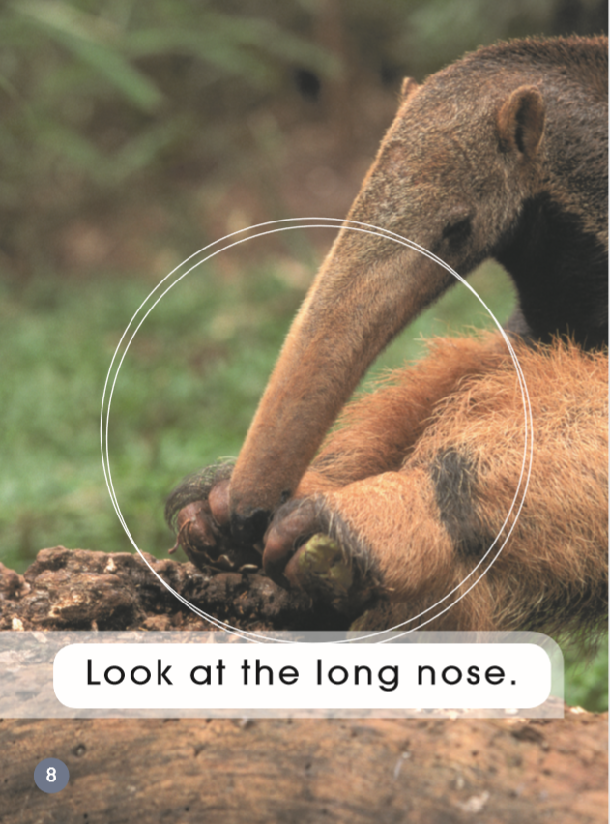
Which word says nose?
How do you know?

Slide 16

a tail
Which word says tails?
How do you know?

Slide 17
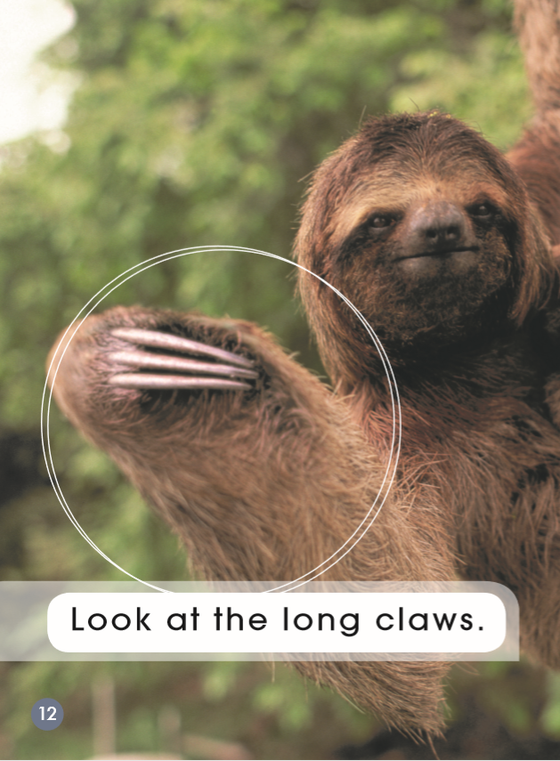
Which word says claws?
How do you know?
a claw

Slide 18
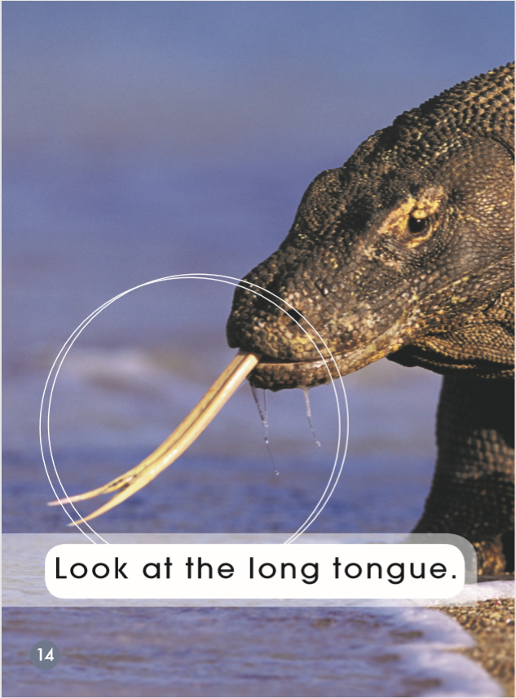
Which word says tongue?
How do you know?

Slide 19

Put your fingers on the words look, at, the.

Slide 20
Game: 拍卡片
听单词，找到正确的单词拍一拍，抢先拍对卡片者胜。
leg
neck
tail
nose
horn
claw
tongue

Slide 21



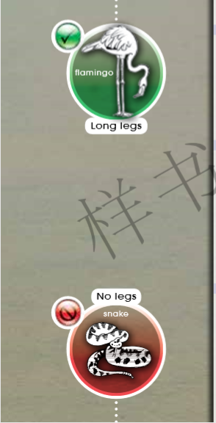
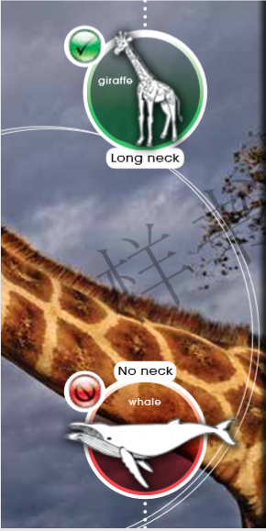
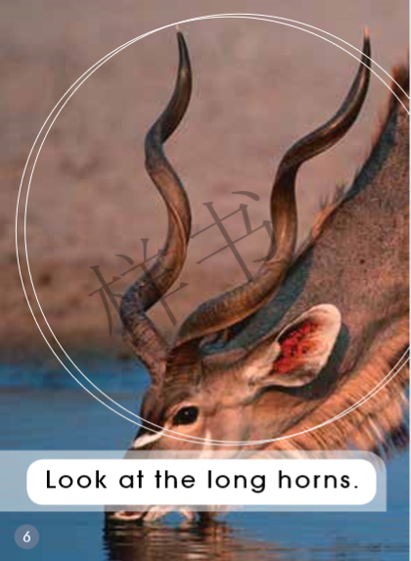


跟读录音

Slide 22





Group work: 小组表演

Slide 23
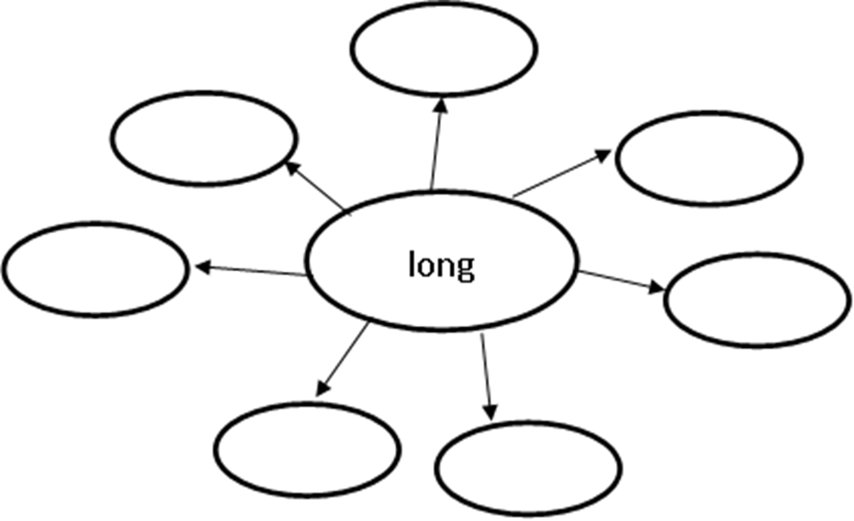
Finish the mind map. 完成思维导图
leg
tongue
neck
claw
horn
tail
nose

Slide 24
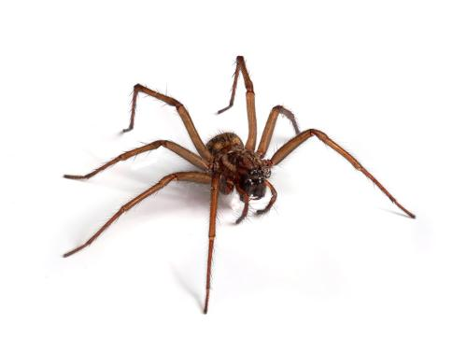
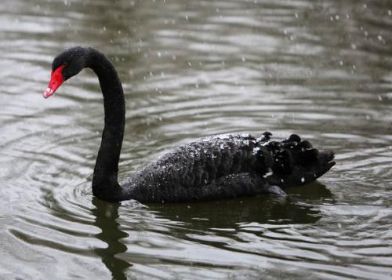
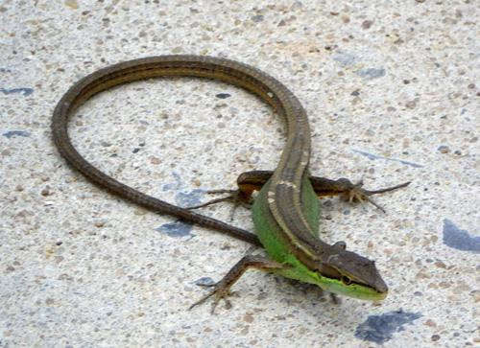
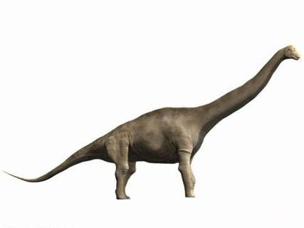
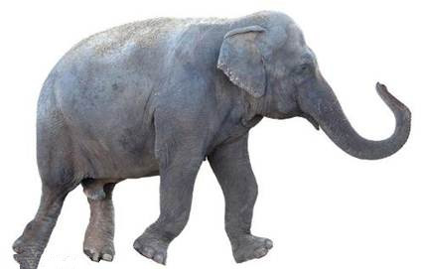
More discussion. 拓展延伸
1. What other animals have the long tail/nose…?
2. What might it use its long… for?

Slide 25


More discussion. 拓展延伸
Do you have a long or short nose?
What do you use your nose for ?
What part of your body is the longest?
How does this help you?

Slide 26
Homework
Listen to the audio and read the story.
Tell the story to your parents.
Make a new book about the long part of the other animals, such as the elephant’s nose.

