Slide 1

Whiskers
动物的胡子
选自《多维阅读第1级》

Slide 2
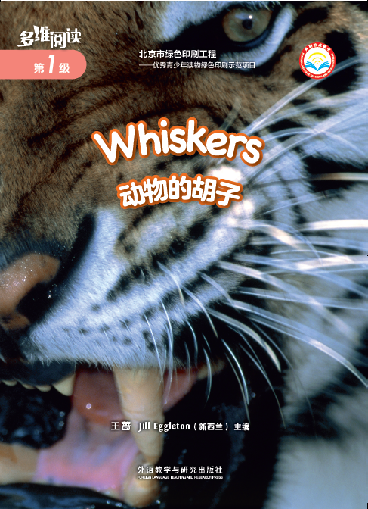
Prediction 预测
What is this book talking about?
A. Animals
B. People

Slide 3
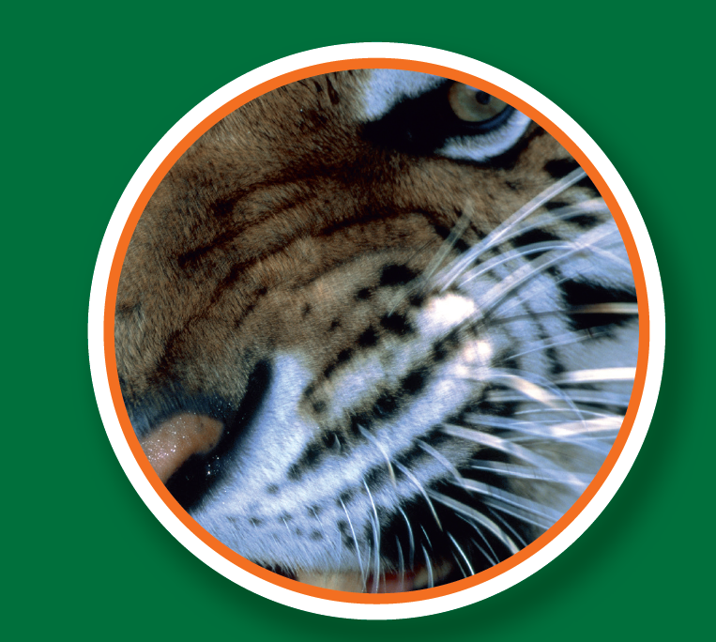
What animal can you see?
What is “Whiskers”?

Slide 4
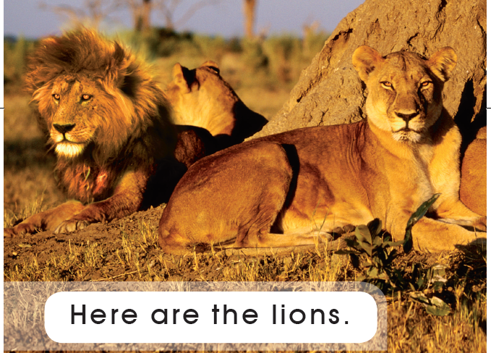
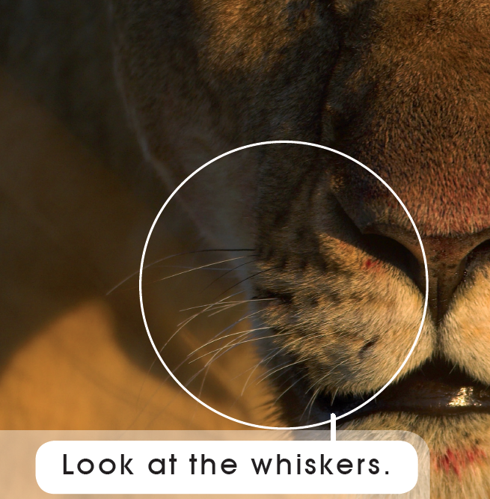
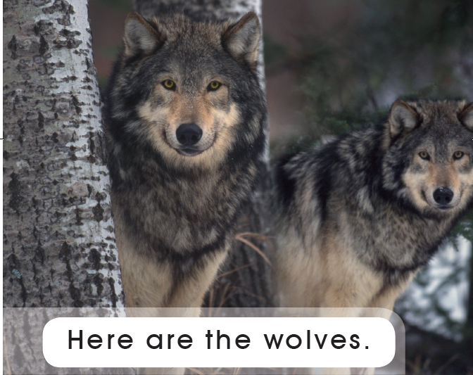
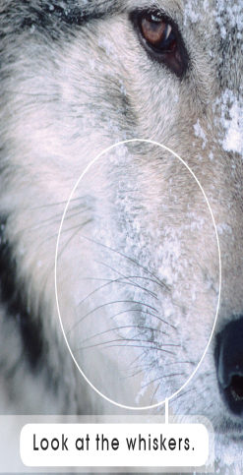
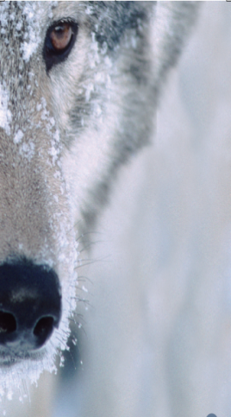
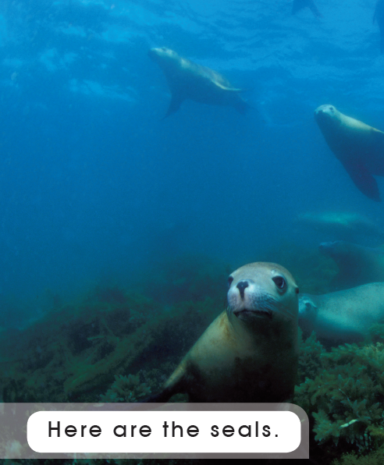
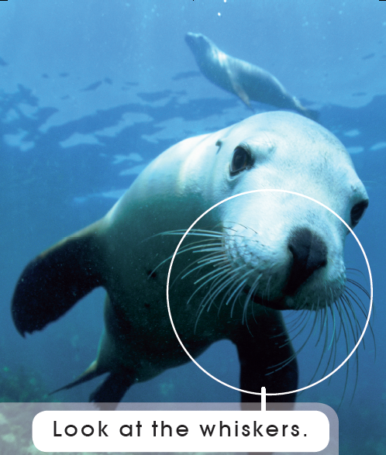
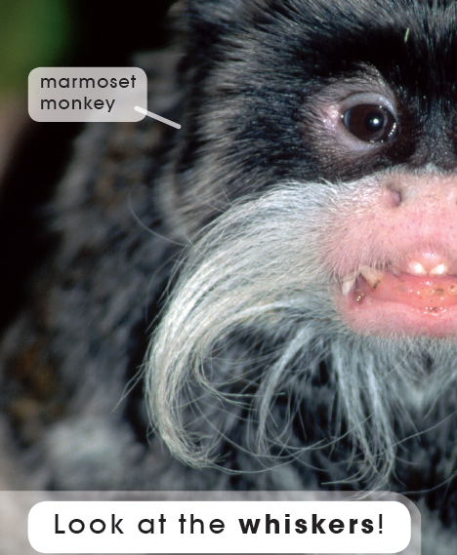
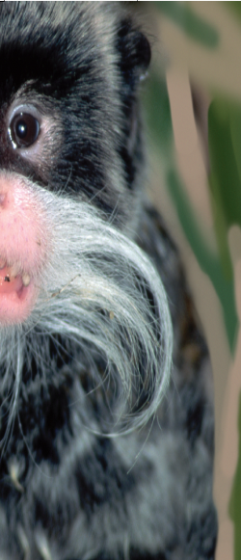
First reading: view & answer
看图回答
1
2
3
4
1.How many animals can you see?
2.What animals are they?
5
6
7

Slide 5
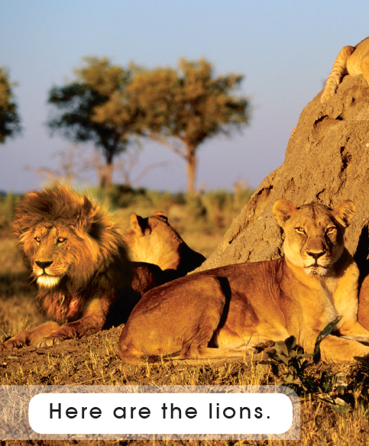
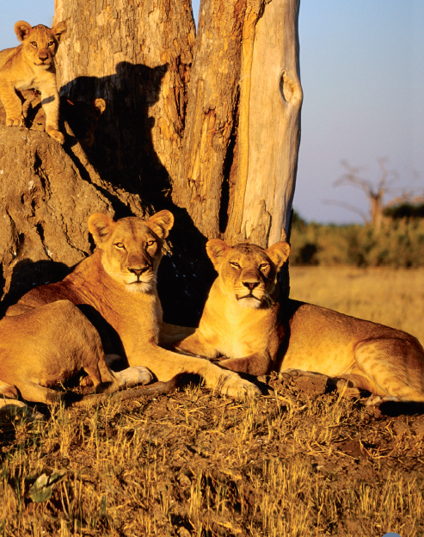
Second reading

Slide 6
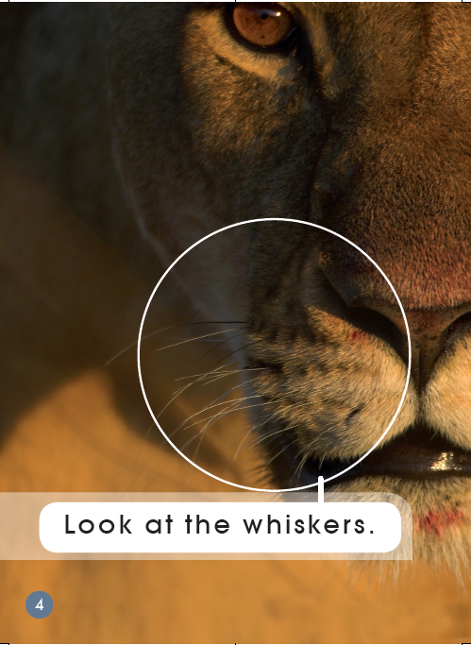
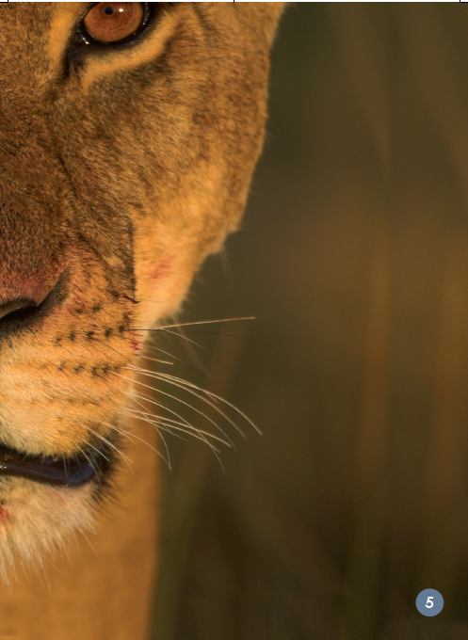

Slide 7
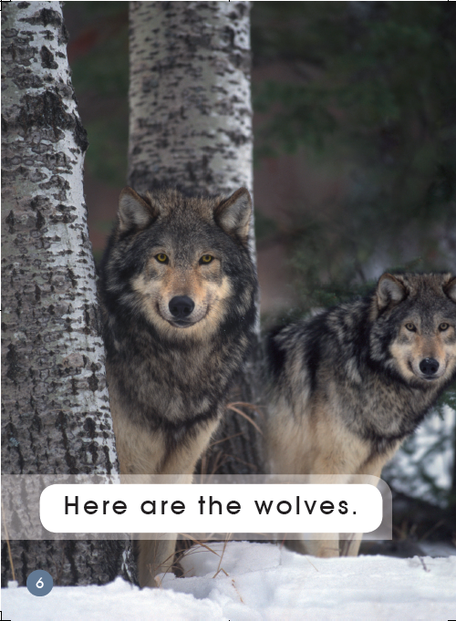
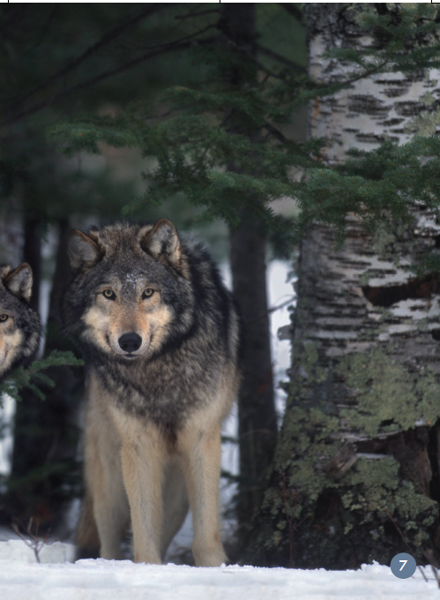

Slide 8
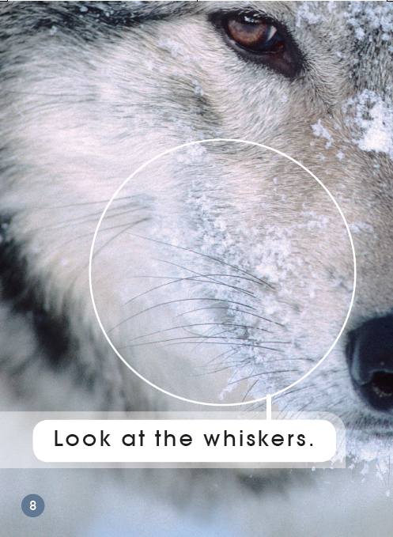
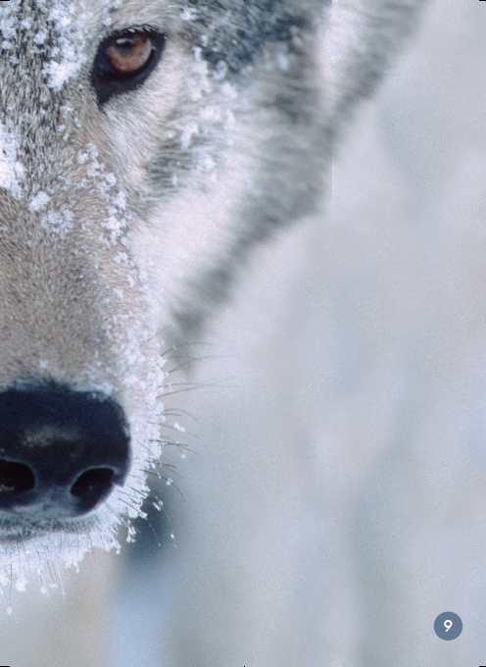

Slide 9
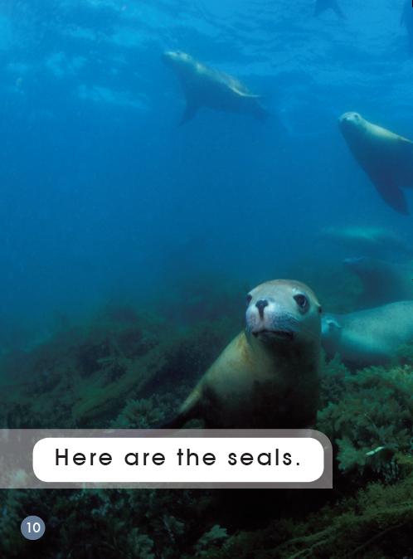
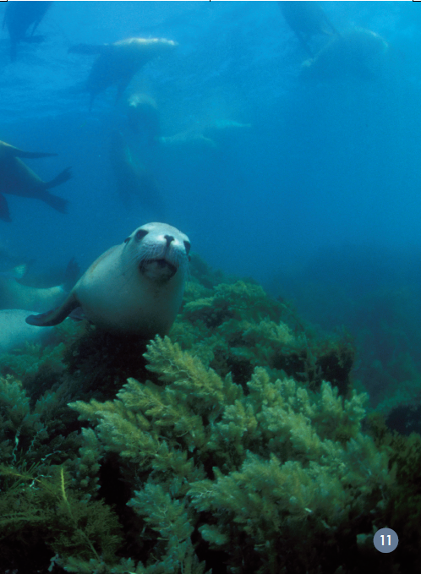

Slide 10
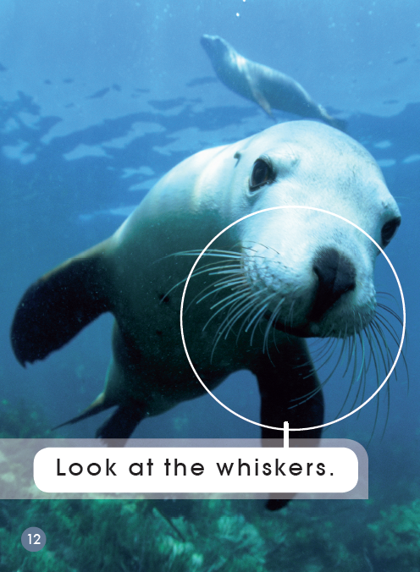
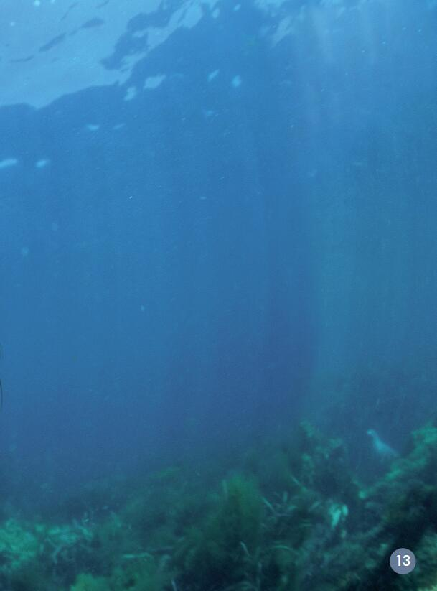

Slide 11
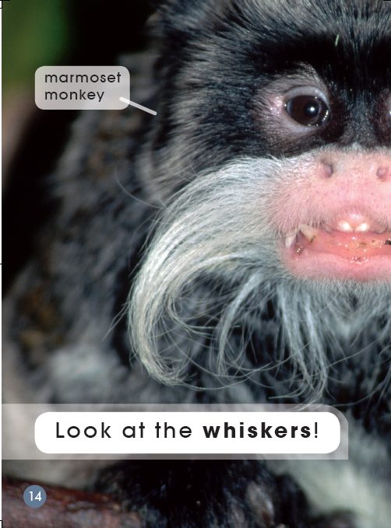
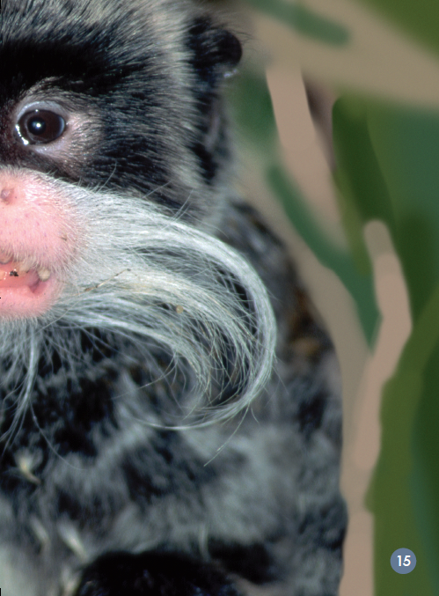

Slide 12
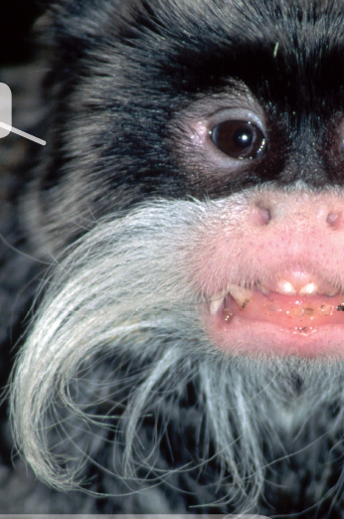
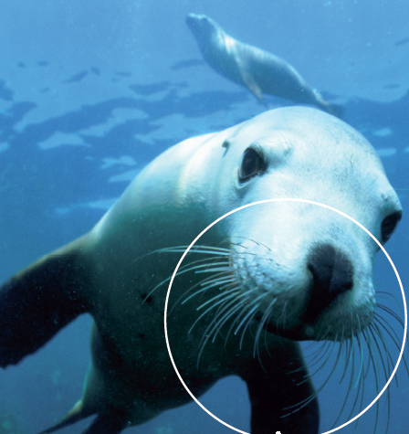
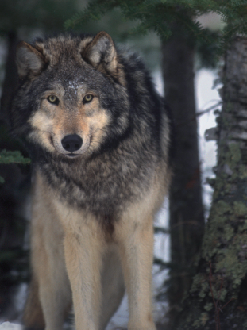

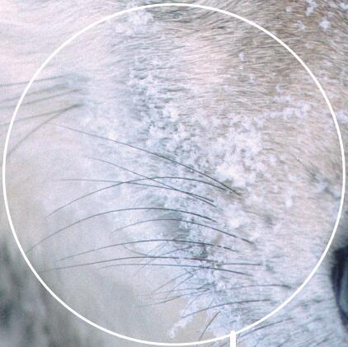
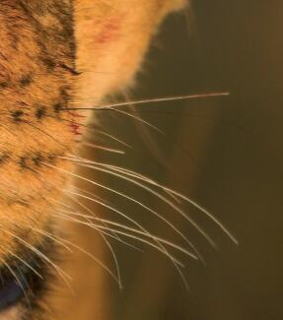
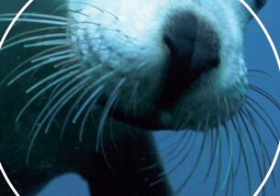
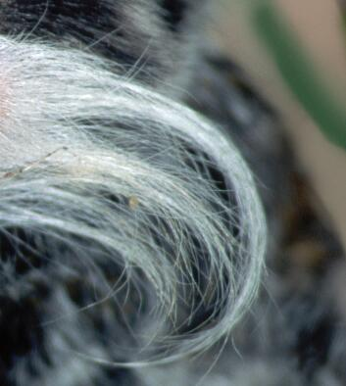
Matching game 配对游戏
monkey
seal
wolf
lion
A
B
C
D
1. What animals are they?
2. Can you match animals with their whiskers?
3. Are their whiskers the same?

Slide 13
Third reading
Which word says lions?
How do you know?
l i o n
Notes:
Which word says lions/whiskers/wolves/seals? How do you know?

Slide 14
Which word says whiskers?
How do you know?
whisker
whiskers

Slide 15
Which word says wolves?
How do you know?
wolf
wolves

Slide 16
Make circles with your fingers around the words “look” “at” “the”.
Look
at
the

Slide 17
Which word says seals?
How do you know?
seal

Slide 18
Make circles with your fingers around the words “here” “are” “the”.
Here
are
the

Slide 21

Flashcard game 卡片游戏
wh
i
s
k
er
s
w
o
l
v
es

Slide 22
Pair work 双簧活动
1
One student tells the sentences.
One student acts with sounds and actions.
2
3
4
5
6
7

Slide 23
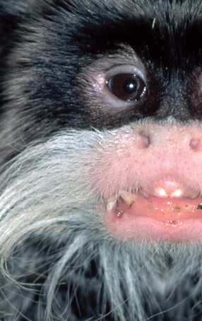
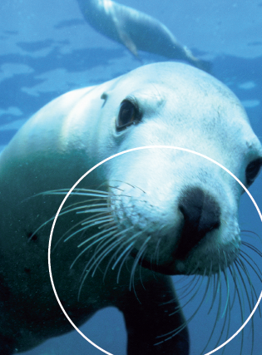
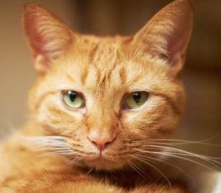
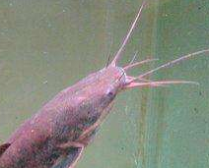
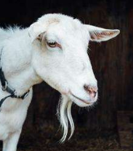
More discussion. 拓展延伸
1. Do you know other animals with whiskers?
2. What are they?
3. Why do they need whiskers?
4. How do their whiskers help them?

Slide 24
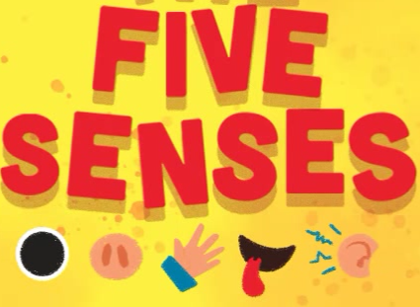
What do you have to help you smell and feel things?
What’s the function of five senses?

Slide 25
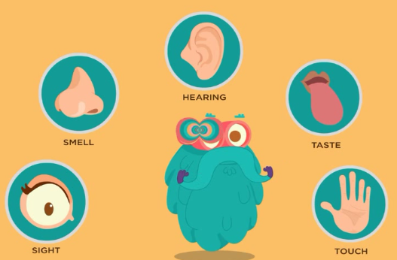
Enjoy the video about five senses.

Slide 26
Homework
Listen to the audio and read the story.
Tell the story to your parents.
Make a new book about five senses, such as tails, eyes, noses, ears …

