Slide 1
Where Can They Live?
他们住在哪儿？
选自《多维阅读第1级》

Slide 2
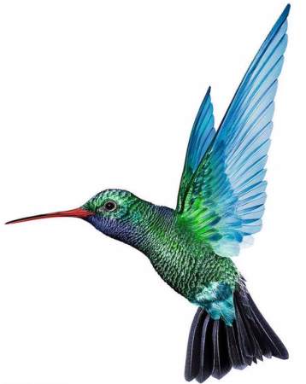
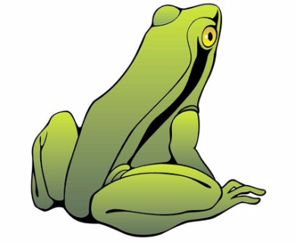
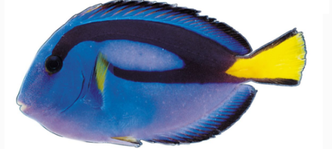
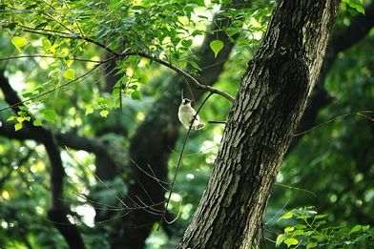
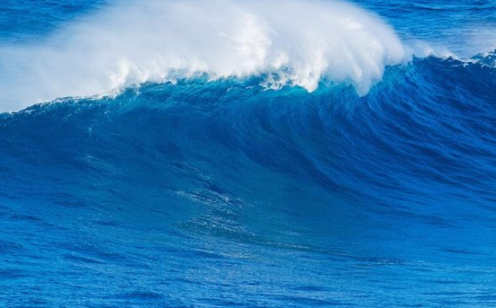
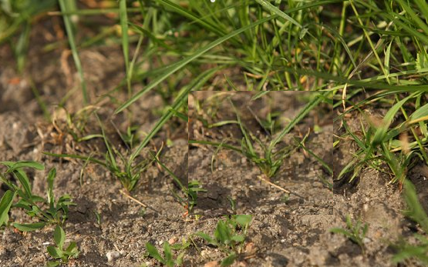
Guess and match：Where can the animals live？
A
B
C

Slide 3
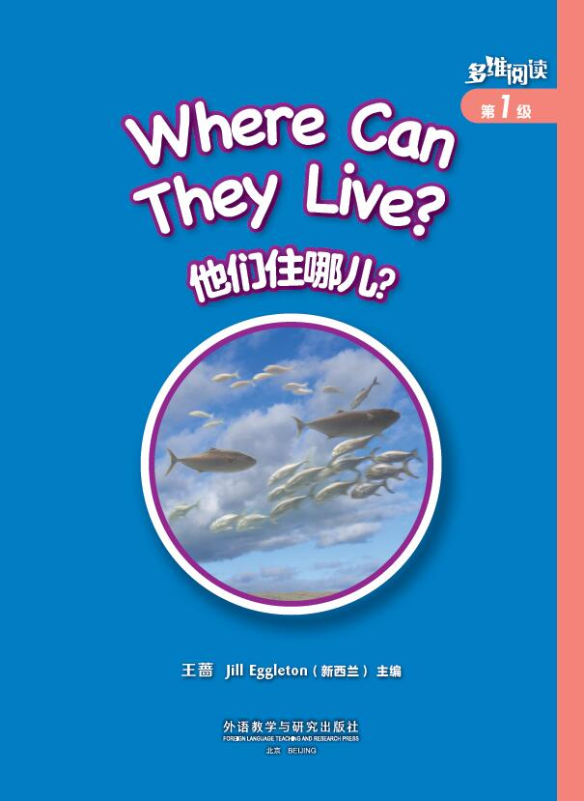
1. Prediction
What is this book talking about?( )
B
A. People B. Animals

Slide 4
2. View & Think
What animal can you see?
Where do they live?

Slide 5
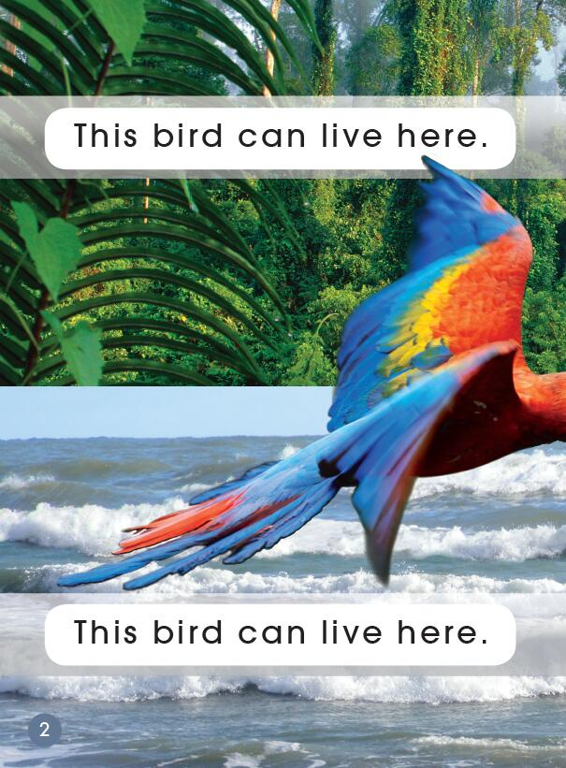
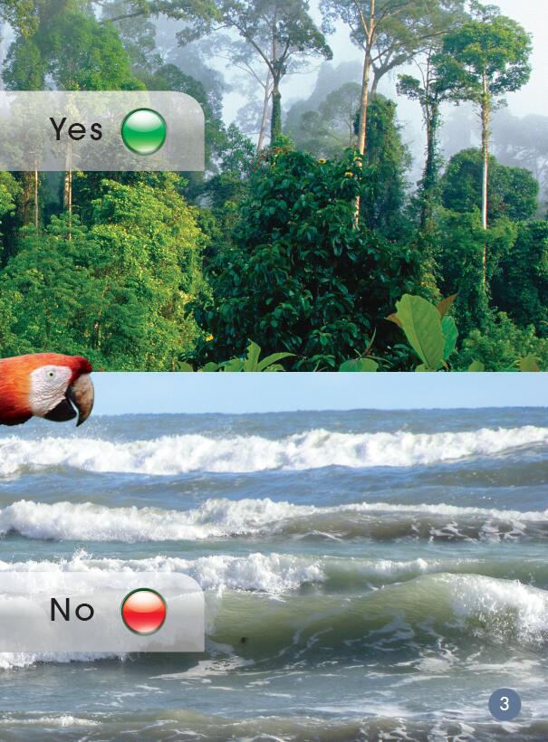
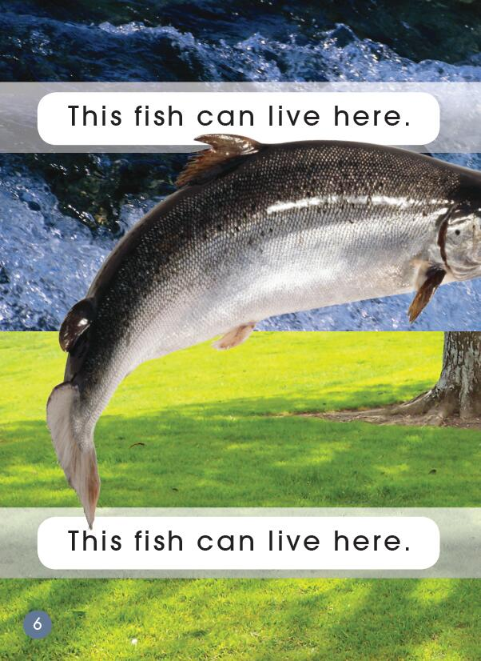
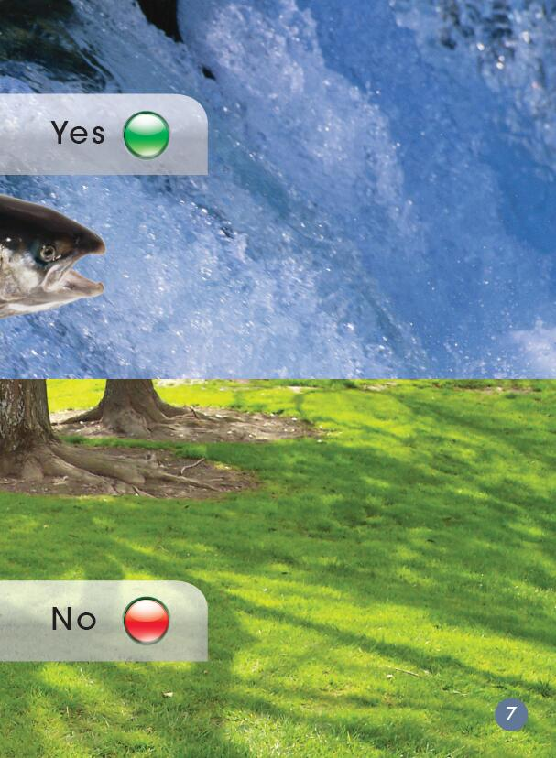
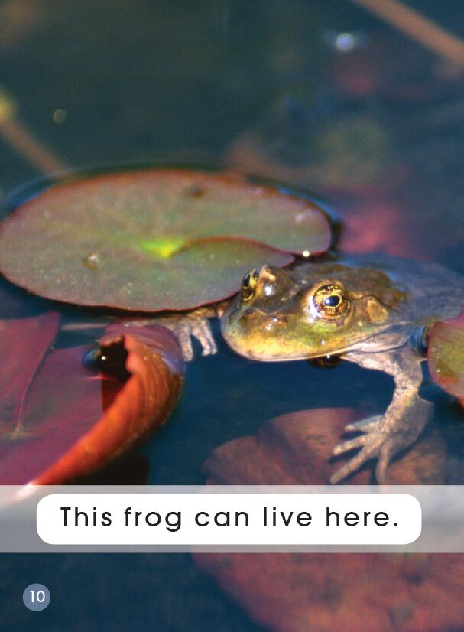
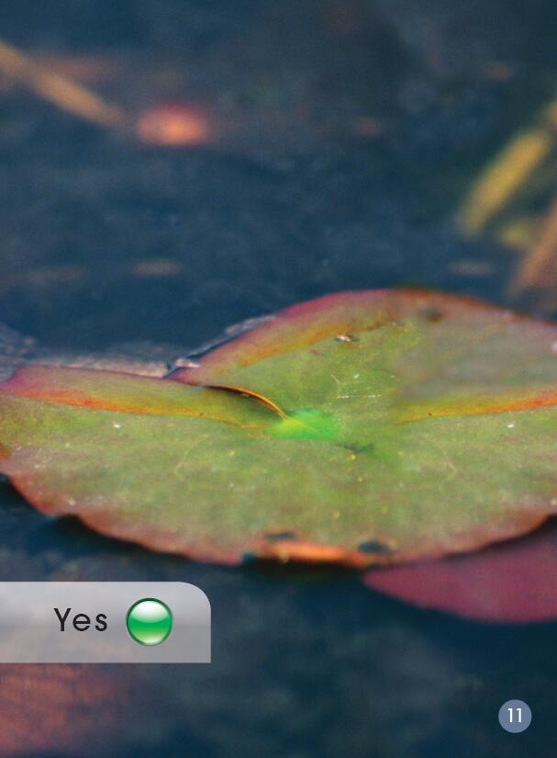
3. Skim & Answer
How many animals can you see?
What animals are they?

Slide 6
What animal is it?
It’s a bird.

Slide 7
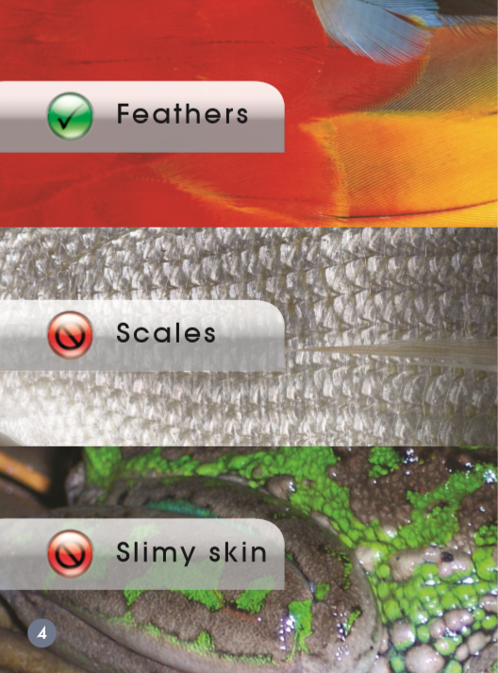
A
√
Which covering does a bird have?
B
It has feathers.
C

Slide 8
What animal is it?
It’s a fish.

Slide 9
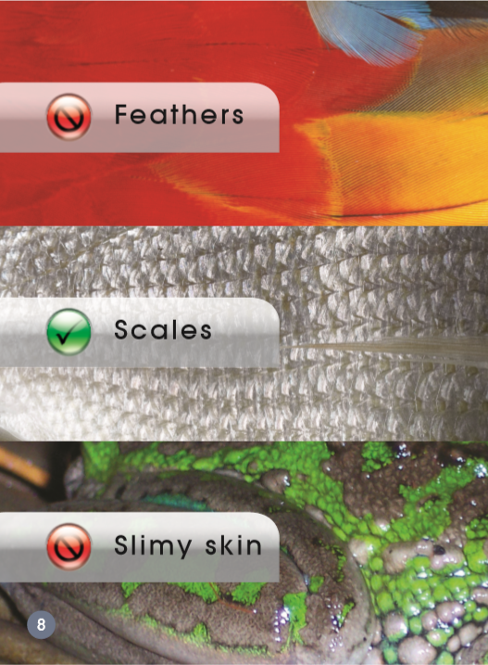
A
Which covering does a fish have?
B
√
It has scales.
C

Slide 10
What animal is it?
It’s a frog.

Slide 11
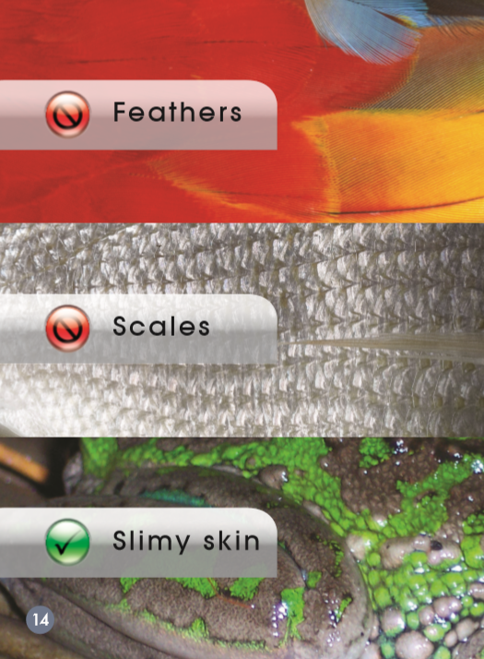
A
Which covering does a frog have?
B
It has slimy skin.
√
C

Slide 12
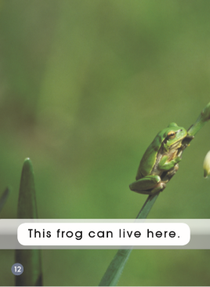
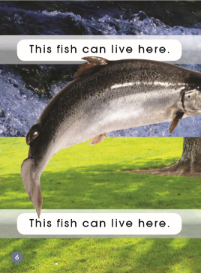
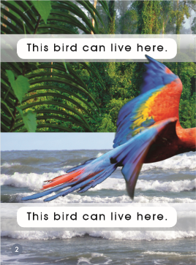
4. Match & Say
A
We can see a bird. It has feathers.
We can see…
It has…
B
C

Slide 13
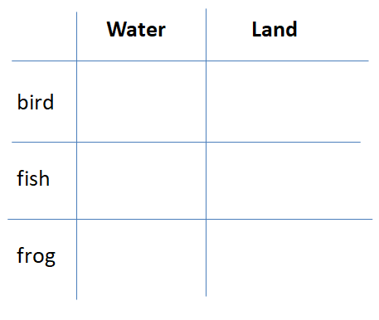
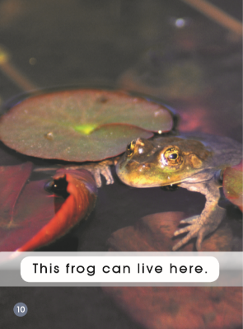
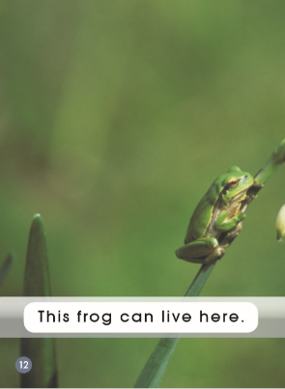
5. Tick & Say
√
Where does a bird live?
√
It lives on the land.
√
√

Slide 14
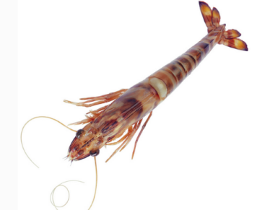
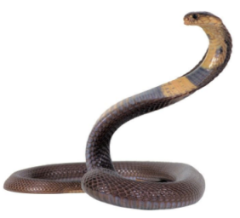
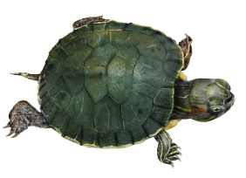
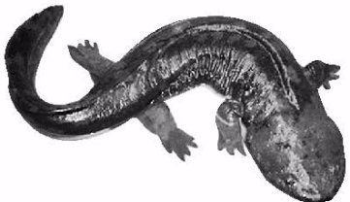
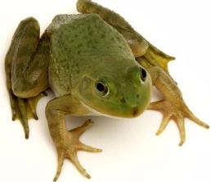
6. Sort & Discuss
water
land
tortoise
shrimp
giant salamander
frog
snake

Slide 15
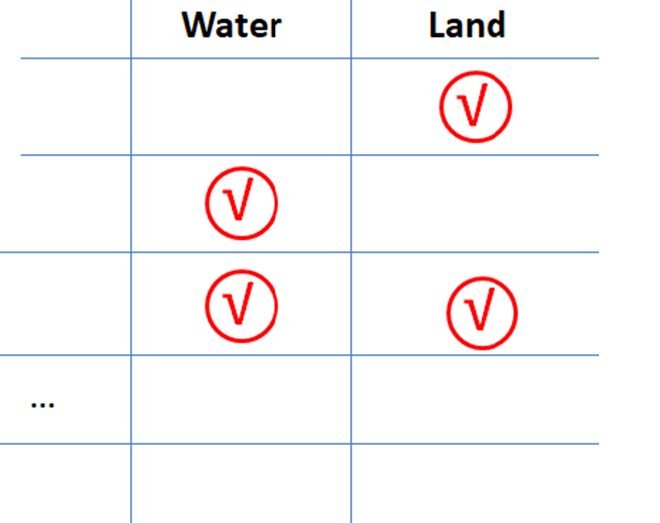
7. Know more animals
snake
shrimp
giant
salamander

Slide 16
8. Homework
Listen to the story and repeat it for two times.
Tell the story to your friends.
Make a mini book about some new animals and their living places.

